Slide 1


Using Windows Azure Access Control Service 2.0 with Your Cloud Application
SIM324
Vittorio Bertocci
Principal Technical Evangelist
Microsoft

Slide 2
ACS Makes it Easier to
Connect Users to Applications

Slide 3























Connecting Users to Applications

Slide 4
Windows Azure AppFabric Access Control Service
Part of the Windows Azure PaaS offering
In a nutshell:
  1. We host for you an authentication service in the cloud
  2. You configure your app to delegate authentication to it
  3. Profit!

Slide 5
ACS: the Ropes
Demo

Slide 6
Access Control Service (Visible) Parts
Authentication endpoints
Management portal
Management APIs
Integration helpers

Slide 7


Namespaces and Endpoints
/v2/mgmt/service
/v2/metadata/IdentityProviders.js
/v2/FederationMetadata/2007-06/FederationMetadata.xml
/v2/mgmt/web
https://
YOURNAMESPACE
.accesscontrol.windows.net
/v2/wsfederation
/WRAPv0.9
/v2/OAuth2-13/
/v2/wstrust

Slide 8
Web Sign In Flow
Browser
Relying Party (site)
Access Control Service
Identity
Provider
GET
Google, Yahoo!, LiveID, OpenID, Facebook, AD FS v2
Return HTML + Script
GET feed of configured IdPs
Return JSON array of configured IdPs
Render IdPs (HRD)
GET selected IdP
Return IdP Token
Login
Issue ACS Token
Return ACS Token
SAML 1.1, 2.0, and SWT
Return Resource +
Session Cookie
Validate ACS Token

Slide 9
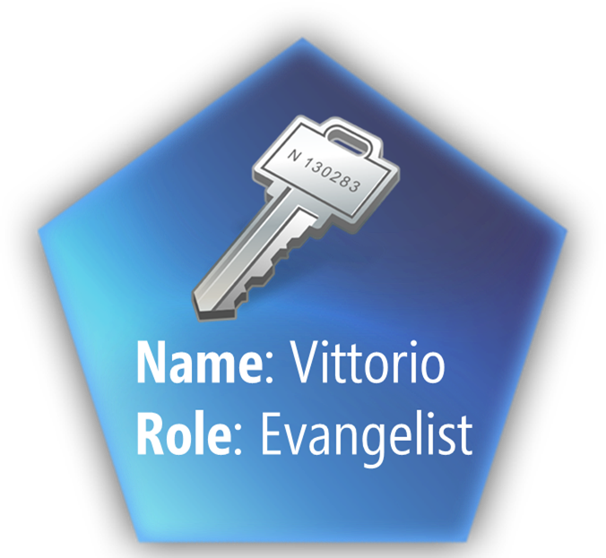
How Does It Work?

Slide 10
Claims and Rules
Demo

Slide 11
Rules and Groups
Claims Issuer
Claim Type
Claim Value
Claim Type
Claim Value
Rules Group

Slide 12
Management APIs
OData + OAuth WRAP
Everything the portal can do, and more
  E. OpenID Providers

Slide 13
Management API
Demo

Slide 14
ACS Management cmdlets
(SAMPLE)
Announcing

Slide 15













Identity Providers/Credentials
ACS
Your Application
Protocol
Protocol
Trust
Trust
Claims
Transf.
Web Site
SAML
SWT
Used with Browser-based apps
WS-Federation
WS-Federation
SOAP Web Service
OpenID
Used With
Rich Clients
SAML
SWT
WS-Trust
WS-Trust
Used with Server 2 Server
SWT
REST Web Service
SWT
Service Identities
OAuth WRAP/2.0

Slide 16
Frequently Asked Features
More Protocols
  SAML, updated OAuth
More Token Formats
  JSON Web Tokens (with Asymmetric signatures)
Richer Authorization
  For your applications as well as the Portal & Management API
HRD improvements
Management Tooling

Slide 17
ACS Makes it Easier to
Connect Users to Applications

Slide 18





Resources
  Connect. Share. Discuss.
http://northamerica.msteched.com
Learning
  Sessions On-Demand & Community
  Microsoft Certification & Training Resources
www.microsoft.com/teched
www.microsoft.com/learning
  Resources for IT Professionals
  Resources for Developers
http://microsoft.com/technet
http://microsoft.com/msdn

Slide 19












Required Slide
Complete an evaluation on CommNet and
enter to win!

Slide 20
MS Tag Placeholder Slide
Required Slide
Your MS Tag will be inserted here during the final scrub.

Slide 21

© 2011 Microsoft Corporation. All rights reserved. Microsoft, Windows, Windows Vista and other product names are or may be registered trademarks and/or trademarks in the U.S. and/or other countries.
The information herein is for informational purposes only and represents the current view of Microsoft Corporation as of the date of this presentation. Because Microsoft must respond to changing market conditions, it should not be interpreted to be a commitment
on the part of Microsoft, and Microsoft cannot guarantee the accuracy of any information provided after the date of this presentation. MICROSOFT MAKES NO WARRANTIES, EXPRESS, IMPLIED OR STATUTORY, AS TO THE INFORMATION IN THIS PRESENTATION.

