Slide 1

Active Directory Rights Management Services Updates
SIM318
Tejas Patel
Program Manager
Microsoft

Slide 2
Agenda
RMS Value Proposition and Strategy
Recent RMS Features/ Workload Integration
RMS Feature Direction
Q&A

Slide 3








Our Information Protection Strategy
Protect Sensitive Information
Reduce risk associated with information leaks
Improve regulatory compliance
Centrally manage information protection policies
Provide Secure Messaging and Collaboration
Protection of email and documents between internal users
Secure collaboration with external partners and customers
Automated protection for email and collaboration applications
Integrated Throughout The Enterprise
Built into core components of Microsoft infrastructure
Extensible platform to support third-party applications, document formats, and devices through the entire information lifecycle

Slide 4

Expanding the AD RMS Ecosystem
Move to the cloud
  Accelerate MSFT cloud adoption
  Increase RMS adoption and market reach
Continue RMS investments with Microsoft applications/platforms
  On-premises and online
  Support secure collaboration across organizations
Build a great Information Protection platform
  Support key formats/devices through ISVs/Partners
  Simplify developer experience

Slide 5
Recent RMS Features and Workload Integration
Online Federation Gateway Integration
RMS Integration in Exchange Online
Mac Office 2011 Integration

Slide 6
AD RMS Integration with through Online Federation Gateway
Online Federation Gateway
  Identity service that runs in the cloud (over the Internet and beyond your corporate network domain)
  Allow users from one federated organization to be trusted by another federated organization.
Scenarios:
  Extends AD RMS usage to External Parties for Exchange 2010 Sp1 IRM features
    No AD RMS is required in the external party
    Enables IRM in OWA, Transport Decryption, Journal Decryption for B2B Scenarios
Requires AD RMS Windows Server 2008 R2 Sp1

Slide 7

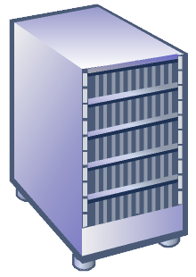






AD RMS Integration with Online Federation Gateway
Scenario
5
Contoso
Fabrikam
Author sends protected mail to recipient at Fabrikam
Exchange (Fabrikam) receives message and performs service discovery against Contoso’s RMS Server
Exchange (Fabrikam) requests a token from the OFG
OFG validates the claims and returns the token to Exchange (Fabrikam)
Exchange (Fabrikam) creates a bootstrapping request including the token to the RMS server.
RMS Server validates the token and then returns a RAC for Exchange(Fabrikam)
Exchange (Fabrikam ) then requests a token on behalf of the recipient from the OFG
Repeat Steps 4-6 for a licensing request
The message is delivered and the recipient can consume the content via OWA
MFG
3
4
7
5
6
2
Exchange
RMS
1
9
UL
Notes:
7
7

Slide 8
Online Federation Gateway Integration
demo

Slide 9
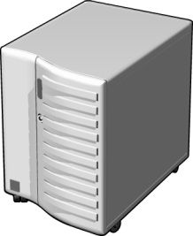





RMS Integration in Exchange Online (Cross- Premise
Exchange Online tenants get Exchange IRM Capabilities
After setup, all RMS transactions in Datacenter executed within Datacenter
Clients continue to call on-premises AD RMS web services
Exchange Online
Contoso Premise
Import TPD
Contoso
Tenant
AD RMS

Slide 10
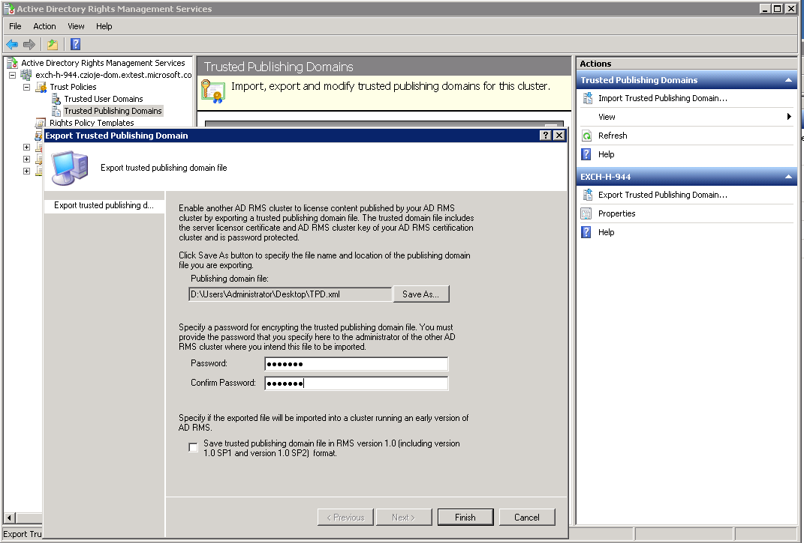
RMS Integration in Exchange Online
Deployment
RMS Admin exports private key and SLC via AD RMS Administrative Console. Make sure NOT to save in version 1.0

Slide 11
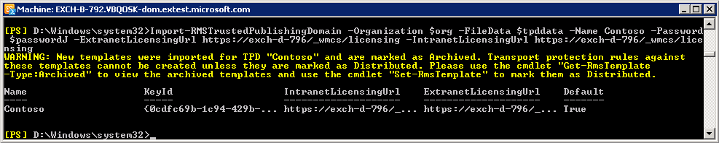
RMS Integration in Exchange Online
Trusted Publishing Domain (TPD):
Allows an RMS cluster to issue Use Licenses against
Publishing Licenses issued by another RMS cluster.
Tenant must import Trusted Publishing Certificate of their AD RMS cluster into Exchange Online.

Slide 12
RMS Integration in Exchange Online
Exchange Configuration
Import-RMSTrustedPublishingDomain allows:
  Import of both software and hardware keys
  Import of multiple TPDs for Cross Forest RMS environments
  Refreshing of RMS templates stored in Exchange Online
Get/Set/Remove-RMSTrustedPublishingDomain tasks also provided.
Keys stored securely via Distributed Key Management (DKM) within Datacenter and only accessible to Exchange Service

Slide 13
RMS Integration in Exchange Online
demo

Slide 14
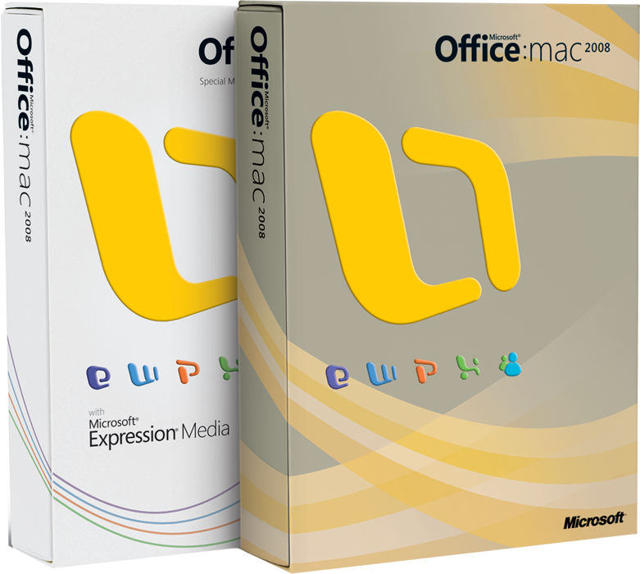
Mac Office
Ability to open RMS-protected messages and attachments
Ability to apply RMS protection to documents and email

Slide 15
RMS Direction
RMS Client SDK
Updated AD RMS Cryptographic Mode
Generic File Protection
Mobile Device Updates

Slide 16
New RMS Client SDK
Accelerate the integration by making the development of RMS-aware applications easier
    Delight developers with a simplified API to address pain points from current SDK
    Provide competitive differentiation for your product, making it easier for customers to collaborate with it safely.
Make RMS applications better by improving the user experience, performance, and topology support
    Simplified discoverability for complex environments
    New SDK simplifies the most common RMS functions, some scenarios no requires no code.

Slide 17
New RMS Client SDK
Improved cryptographic support and enabling continuing innovation
No loss of functionality from current SDK
  Publishing, consuming, and collaborating scenarios all continue to work
  Compatible with down-level ADRMS servers

Slide 18
MSDRM (User Activation)
pdasi = new DRM_ACTSERV_INFO;
if ( pdasi == NULL )
{
wprintf( L"\nMemory allocation failed for DRM_ACTSERV_INFO.\n" );
hr = E_OUTOFMEMORY;
goto e_Exit;
}
pdasi->wszURL = NULL;
if ( NULL != wszActivationSvr ) {
pdasi->wszURL = wszActivationSvr;
wszActivationSvr = NULL;
}
else {
hr = DRMGetServiceLocation( hClient,
DRM_SERVICE_TYPE_CERTIFICATION,
DRM_SERVICE_LOCATION_ENTERPRISE,
NULL,
&uiStrLen,
NULL
);
if ( SUCCEEDED( hr ) ) {
pdasi->wszURL = new WCHAR[ uiStrLen ];
if ( NULL == pdasi->wszURL ) {
wprintf( L"\nMemory allocation failed for activation URL string.\n" );
hr = E_OUTOFMEMORY;
goto e_Exit;
}
hr = DRMGetServiceLocation( hClient,
DRM_SERVICE_TYPE_CERTIFICATION,
DRM_SERVICE_LOCATION_ENTERPRISE,
NULL,
&uiStrLen,
pdasi->wszURL
);
if ( FAILED( hr ) ) {
wprintf( L"\nDRMGetServiceLocation (ENTERPRISE) failed. "\
L"hr = 0x%x\n", hr );
goto e_Exit;
}
wprintf( L"\nDRMGetServiceLocation (ENTERPRISE) "\
L"succeeded.\n\nUser Activation server "\
L"URL:\n%s\n", pdasi->wszURL );
}
else
{
wprintf( L"\nDRMGetServiceLocation failed. hr = 0x%x.\n"\
L"Passing NULL server info to DRMActivate.\n", hr );
}
}
}
hr = DRMCreateClientSession( &StatusCallback,
0,
DRM_DEFAULTGROUPIDTYPE_WINDOWSAUTH,
wszUserId,
&hClient
);
if ( FAILED( hr ) )
{
wprintf( L"\nDRMCreateClientSession failed. hr = 0x%x\n", hr );
goto e_Exit;
}
hr = DRMIsActivated( hClient,
DRM_ACTIVATE_MACHINE,
NULL
);
if ( E_DRM_NEEDS_MACHINE_ACTIVATION == hr )
{
//
// 3. Call DoMachineActivation to activate the machine if
// it's not activated
//
hr = DoMachineActivation( hClient, wszActivationSvr );
if ( FAILED( hr ) )
{
goto e_Exit;
}
}
else if ( hr == S_OK )
{
wprintf( L"The machine is already activated.\n" );
}
else
{
goto e_Exit;
}
hr = DRMIsActivated( hClient,
DRM_ACTIVATE_GROUPIDENTITY,
NULL
);
if ( SUCCEEDED( hr ) )
{
wprintf( L"The user is already activated.\n" );
goto e_Exit;
}
else if ( E_DRM_NEEDS_GROUPIDENTITY_ACTIVATION != hr )
{
goto e_Exit;
}
else
{
if ( NULL == ( context.hEvent = CreateEvent( NULL, FALSE, FALSE, NULL ) ) )
{
wprintf( L"\ncontext.hEvent was NULL after the CreateEvent call." );
goto e_Exit;
}

Slide 19
MSIPC (User Activation)

Slide 20
Updated ADRMS Cryptographic Support
ADRMS – “Crypto Mode 2”
  Remove blocker for some segments
    Public Sector
    Keep FIPS compliance status, increased key length
  Updates Planned
    Moving to 2048-bit key support for RSA
    Moving from SHA1 to SHA2
  Support for current and new SDK

Slide 21
Updated ADRMS Cryptographic Support –Early Deployment Considerations
  AD RMS Client
    Clients should be updated first with Crypto Mode 2 update
    Client is interoperable with both ADRMS Cryptographic Modes
  AD RMS Server
    Server can be deployed or upgraded to Crypto Mode -2
    Requires all servers to be running in the same Cryptographic mode within an organization
    Access to content protected using Crypto Mode 1 is preserved
  Application Compatibility
    QFE’s required for Office, SharePoint, and Exchange
    ISV applications, must check with vendor.

Slide 22
Generic File Protection
Container based generic file protection
  Create a fall back solution for any file type (*.jpg, *.pdf, *.anything)
    User experience similar to .zip packages
    Support all file types (no application integration required)
  Encrypted containers
    RMS evaluates if a user has access to the container and that it has not expired
    Once user has been granted access, the user will be able to extract files from the container
    Users can now access files without any app usage restrictions

Slide 23
Generic File Protection
  Generic File Protection is not a complete replacement for native application integration
    Native application integration is the most secure and best user experience
    New RMS client SDK will simplify development for ISV’s
  Supported Platforms
    Vista, Windows 7, Windows Server 2008, Windows Server 2008 R2
    Requires .NET 4.0

Slide 24
Generic File Protection
demo

Slide 25
IRM for Windows Phone 7
Untethered bootstrapping
    6.5 required initialization via tethering
Supports Outlook
    Uses Exchange Active Sync for IRM protected email messages
    Can compose and read IRM protected email
Supports Office Mobile Applications
    Excel, Word, PPT
    Can consume IRM protected files
Will support updated ADRMS Crypto Mode

Slide 26
Updated ADRMS SCOM Pack
  Updated rules and alerts
  Compatible with SCOM 2007
  Supports ADRMS on Windows Server 2008 and 2008 R2

Slide 27
Summary
Today
Future
Applications
Office 2003-2010
MAC Office 2011
FCI (WS08 R2)
Windows Mobile 6.5
Secure email / messaging
  Exchange 2007-2010
Secure collaboration
  SharePoint 2007-2010
  UAG 2010 SP1
RMS Platform
Windows Client (XP – Win7 )
Windows Server (2003-2008 R2)
Support for Cloud
Cross premise support for RMS on-premises and Exchange Online
RMS Platform
Crypto: 2048-bit key support
Container level Generic file protection
New RMS Client SDK
IRM support on Windows Phone 7
Updated ADRMS SCOM Pack
Subject to Change
Notes:
© 2009 Microsoft Corporation. All rights reserved. Microsoft, Windows, Windows Vista and other product names are or may be registered trademarks and/or trademarks in the U.S. and/or other countries.
The information herein is for informational purposes only and represents the current view of Microsoft Corporation as of the date of this presentation. Because Microsoft must respond to changing market conditions, it should not be interpreted to be a commitment on the part of Microsoft, and Microsoft cannot guarantee the accuracy of any information provided after the date of this presentation.
MICROSOFT MAKES NO WARRANTIES, EXPRESS, IMPLIED OR STATUTORY, AS TO THE INFORMATION IN THIS PRESENTATION.

Slide 28
Q & A

Slide 29
Track Resources
Don’t forget to visit the Cloud Power area within the TLC (Blue Section) to see product demos and speak with experts about the Server & Cloud Platform solutions that help drive your business forward.
You can also find the latest information about our products at the following links:
Cloud Power - http://www.microsoft.com/cloud/
Private Cloud - http://www.microsoft.com/privatecloud/
Windows Server - http://www.microsoft.com/windowsserver/
Windows Azure - http://www.microsoft.com/windowsazure/
Microsoft System Center - http://www.microsoft.com/systemcenter/
Microsoft Forefront - http://www.microsoft.com/forefront/

Slide 30





Resources
  Connect. Share. Discuss.
http://northamerica.msteched.com
Learning
  Sessions On-Demand & Community
  Microsoft Certification & Training Resources
www.microsoft.com/teched
www.microsoft.com/learning
  Resources for IT Professionals
  Resources for Developers
http://microsoft.com/technet
http://microsoft.com/msdn

Slide 31












Complete an evaluation on CommNet and
enter to win!

Slide 32


Slide 33

© 2011 Microsoft Corporation. All rights reserved. Microsoft, Windows, Windows Vista and other product names are or may be registered trademarks and/or trademarks in the U.S. and/or other countries.
The information herein is for informational purposes only and represents the current view of Microsoft Corporation as of the date of this presentation. Because Microsoft must respond to changing market conditions, it should not be interpreted to be a commitment
on the part of Microsoft, and Microsoft cannot guarantee the accuracy of any information provided after the date of this presentation. MICROSOFT MAKES NO WARRANTIES, EXPRESS, IMPLIED OR STATUTORY, AS TO THE INFORMATION IN THIS PRESENTATION.

