Slide 2

Planning and Deploying Microsoft Forefront
Endpoint Protection 2010 with Microsoft System
Center Configuration Manager
SIM317
Adwait Joshi
Sr. Program Manager
Microsoft
Chris Norman
Sr. Escalation Engineer
Microsoft

Slide 3
Session Objectives and Takeaways
Session Objective(s):
  Overview of Forefront Endpoint Protection (FEP)
  Understand the server and client deployment scenarios using System Center Configuration Manager
  Provide a high level understanding of the underlying deployment architecture
Takeaways
  Unifying infrastructures for desktop management and security is easy with FEP and ConfigMgr
  FEP deployment is simple and scalable

Slide 4
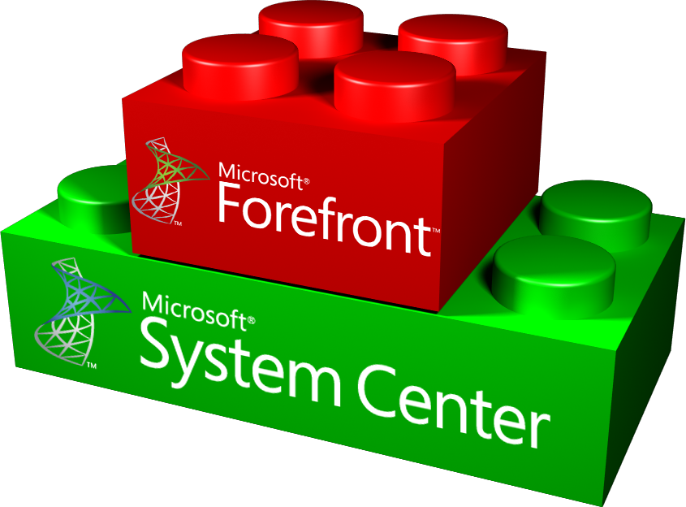




Forefront Endpoint Protection 2010
One infrastructure for desktop management and protection
        Ease of Deployment
        Enhanced Protection
        Simplified Desktop Management
        Built on top of Microsoft® System Center Configuration Manager
        Supports all System Center Configuration Manager topologies and scale
        Facilitates easy migration
        Deploy across various operating systems Windows® client and Server
        Protection against all type of malware
        Proactive security against zero day threats
        Productivity-oriented default configuration
        Integrated management of host firewall
        Backed by Microsoft Malware Protection Center
        Unified management interface for desktop administrators
        Effective alerts
        Simple, operation-oriented policy administration
        Historical reporting for security administrators
Notes:
Forefront Endpoint Protection is the next generation of Forefront Client Security. It builds on the protection technologies included in the previous versions and provides a completely new management experience.
Since FEP is built on Configuration Manager, it offers easy installation of FEP server and easier deployment of clients using the existing infrastructure. FEP is also able to support enterprise wide scalability up to 100s of thousands of clients across various Windows operating systems.
FEP provides highly accurate detection of known and unknown threats using many new and improved technologies in its antimalware engine as well as through host firewall management. While providing comprehensive protection, FEP keeps employees productive with low performance impact scanning an productivity oriented default policies.
And finally, with FEP Administrators have a central location for creating and applying all endpoint-related policies. With a shared view of endpoint protection and configuration, administrators can more easily identify and remediate vulnerable computers.
In the following sections, we will look at these benefits in more details.

Slide 5



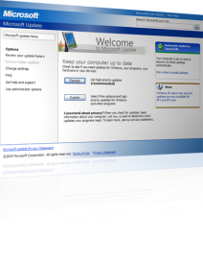











Config. /
Dashboard
FEP Architecture
Reports
SpyNet
DATA
SQL
Reporting
Services
ConfigMgr Site
Server & DB
ConfigMgr
Software
Distribution
(or File Share)
ConfigMgr
Desired
Configuration
Management
EVENTS
TELEMETRY
Desktops, Laptops, and Servers
running ConfigMgr Client & FEP 2010

Slide 6
Under the hood – FEP & ConfigMgr 2007 Integration
ConfigMgr Console
FEP UI
ConfigMgr Server
ConfigMgr Software Distribution
ConfigMgr Agent
Event log
Forefront
Endpoint Protection 2010
Registry
ConfigMgr Reporting
FEP Extensions
DCM
WMI
FEP Reports
Managed Computer
ConfigMgr
DB
FEP
Warehouse
ConfigMgr
Forefront Endpoint Protection 2010
Notes:
FEP uses DCM in 2 different ways:
As a channel to relay information to ConfigMgr
Baselines automatically triggered by FEP client
Reports malware status and details, definition updates etc.
Must not be modified
To measure settings on a client, compare to defined Baselines, and enable compliance reporting
Comes with 4 default Baselines
Can be copied and customized
Assign to desired ConfigMgr Collections
As already alluded to, the FEP client uses WMI to trigger DCM baselines whenever it would like to report information back to SCCM. It does this to report malware infections, definition updates, etc.
Once the DCM baseline is triggered, it Collects data and returns the results to the Management Point for storage in the SCCM DB. If offline, the results are cached until it comes back to the network.
Once in the SCCM DB, the data is used in evaluating SCCM Collection membership, and is transferred (every 15 mins) to the FEP Reporting DB to enable Reporting
The second type is the conventional use of DCM Baselines. A Baseline is configured and assigned to a SCCM Collection. Computers in that Collection evaluate the baseline (on the defined schedule) and return results to SCCM. These results are used in Reports to demonstrate compliance (or otherwise) with the settings in the Baseline.

Slide 7
FEP Management Models
Centralized
  Management and Reporting
Decentralized
  Management and Reporting
Decentralized with Centralized Reporting
Notes:
When you plan to integrate FEP into a multi-site SCCM hierarchy, there are 3 modes to choose from:
Centralized
Management and Reporting is all done from the Central Primary site
Decentralized
Management and Reporting is done from individual Primary sites
Decentralized with Centralized Reporting
Management is done from individual Primary sites, but Reports can be run across the entire hierarchy

Slide 8
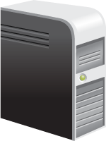

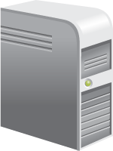
Centralized Management
  Centralized policies, monitoring, and reporting capabilities
FEP Server Extensions
FEP Reports
FEP Console Extension
CENTRAL SITE
Primary Site
Primary Site
Primary Site
FEP Console Extensions
FEP Console Extensions
Secondary Site
Secondary Site
Secondary Site

Slide 9
Centralized Management Features
Task | Central Primary Site | Child Primary Site(s)
Monitor Forefront Endpoint Protection client deployment progress | Yes | Yes
Create or modify Forefront Endpoint Protection policies | Yes | No
Assign Forefront Endpoint Protection policies to collections | Yes | Yes
Monitor Forefront Endpoint Protection via the Forefront Endpoint Protection dashboard | Yes | No
Forefront Endpoint Protection Reporting | Yes | No
Configure Forefront Endpoint Protection alerts | Yes | No
Notes:
This table shows what can be done from the various tiers in the hierarchy.
There is a bug that prevents the Dashboard from displaying data in the Child Primary sites. This may be fixed at RTM

Slide 10
Decentralized Management
  Separate security management and operations to child sites
CENTRAL SITE
Primary Site
Primary Site
Primary Site
FEP Server Extensions
FEP Server Extensions
FEP Server Extensions
FEP Reports
FEP Reports
FEP Reports
FEP Console Extensions
FEP Console Extensions
FEP Console Extensions
Secondary Site
Secondary Site
Secondary Site

Slide 11
Decentralized Management
Task | Central Primary Site | Child Primary Site(s)
Monitor Forefront Endpoint Protection client deployment progress | No | Yes
Create or modify Forefront Endpoint Protection policies | No | Yes
Assign Forefront Endpoint Protection policies to collections | No | Yes
Monitor Forefront Endpoint Protection via the Forefront Endpoint Protection dashboard | No | Yes
Forefront Endpoint Protection Reporting | No | Yes
Configure Forefront Endpoint Protection alerts | No | Yes
Notes:
Here you see all of the tasks are done from the child Primary sites

Slide 12
Decentralized Management +
Centralized Reporting
Task | Central Primary Site | Child Primary Site(s)
Monitor Forefront Endpoint Protection client deployment progress | No | Yes
Create or modify Forefront Endpoint Protection policies | No | Yes
Assign Forefront Endpoint Protection policies to collections | No | Yes
Monitor Forefront Endpoint Protection via the Forefront Endpoint Protection dashboard | No | Yes
Forefront Endpoint Protection Reporting | Yes | Yes
Configure Forefront Endpoint Protection alerts | No | Yes
Notes:
The only difference is reports can be run across the entire hierarchy

Slide 13
Basic Installation –
FEP On Existing ConfigMgr Server Roles
FEP Server Extensions
FEP Reports
FEP supports the existing ConfigMgr topologies
FEP discovers and installs its server roles on the ConfigMgr server roles
FEP Console Extension
Central Site
FEP Console Extension
FEP Console Extension
Primary Site
Primary Site
Primary Site
      One less infrastructure to deploy, secure & maintain;
      No additional HW required;
      Simple - Auto discovery & installation of FEP on top of ConfigMgr roles

Slide 14
Advanced Installation options -
Basic with Remote Reporting Database Setup
FEP Server Extensions
FEP Reports
Offload FEP reporting role and database to a different machine
Consider it when there’s no spare capacity in the existing ConfigMgr deployment
FEP Console Extension
Central Site
FEP Console Extension
FEP Console Extension
Primary Site
Primary Site
Primary Site

Slide 15
Centralized Management
Advanced Installation options – hierarchy
FEP Server Extensions
FEP Reports
Distributed Management
Customers Environment
Separate security management and
operations to child sites
Central policies, monitoring and
reporting capabilities.
FEP Console Extensions
Consolidated reporting
Central Site
FEP Server Extensions
FEP Reports
FEP Server Extensions
FEP Reports
FEP Server Extensions
FEP Reports
FEP Console Extensions
Primary Site
FEP Console Extensions
Primary Site
FEP Console Extensions
Primary Site
Secondary Site
Secondary Site
Primary Site

Slide 16
FEP Capacity Planning
Criteria | Recommended Resource availability based on CM HW recommendation | FEP 2010 300K topology internal test results
SQL server CPU impact by FEP (delta) | 20% | <5%
SCCM Server CPU impact by FEP (delta) | 10% | <2%
Memory footprint | 500MB | <100MB
Expected disk capacity after 1-year | 500GB | <400GB
* Actual capacity planning depends on organization load profile, retention policy and specific hardware deployment
*http://blogs.technet.com/b/clientsecurity/archive/2011/01/19/fep-capacity-planning-worksheet.aspx

Slide 17
Installing Server Components
Server Topology Options
Forefront Endpoint Protection Components installed on ConfigMgr
Introduction to FEP Dashboard
demo
Notes:
Forefront Endpoint Protection Server Install
Highlight different Install modes
Explore Forefront Endpoint Protection Console in CM
Forefront Endpoint Protection Nodes
Packages
Report
Policy
Collections

Slide 18
Troubleshooting Server Install
4 Setup logs are created
  %ProgramData%\Microsoft Forefront\Support\Server
  ServerSetup_YYYYMMDD_HHMMSS.log
  FEPExt_YYYYMMDD_HHMMSS.log
  FepReport_YYYYMMDD_HHMMSS.log
  FepUX_YYYYMMDD_HHMMSS.log
Notes:
Disjointed Name Space
Duplicate SPN
Names instances with static Ports
SQL Aliases using CName Records
Missing Hotfix KB2271736

Slide 19
Planning Signature Deployment

Slide 20
Signature Update Distribution
UPDATE SOURCES
  Multiple update sources
  Configurable priority for sources
  Uses existing infrastructure of Microsoft Windows Server Update Services
  Improved size of signature downloads reduces bandwidth use
  Up to date clients have smaller downloads
    Binary Delta Delta (BDD) (~100 KB - ~1 MB)
Corporate
network
(UNC share)
Corporate network
(WSUS)
Internet
(MU/WU)
Network Service
Local system
Antimalware Service (FEP Client)
Event Log
Notes:
Forefront Endpoint Protection 2010 provides multiple options to receive signature and engine updates. Organizations can use their existing Windows Server Update Services (WSUS) infrastructure to get FEP updates. Administrators can also configure a client to connect to Microsoft Update or use a file share to download the latest definition updates. These sources can be prioritized from the policy management console. So the client will check for the signature updates with the sources based on the priority defined in the policy- For e.g when the client is connected to the corporate network it can receive updates from the WSUS infrastructure. If the client is in a remote location not connected to the enterprise then the client can still continue to get updates through the internet using Microsoft Updates.
Microsoft uses package chaining feature to reduce the size of signature updates. This feature reduces the total bandwidth a WSUS server has to use to download updates from MU to stay up to date. This reduces the total cost of ownership for definition updates for WSUS.
Generally, the size ranges of the delta updates are from 50-2048 KB and the entire delta files are from 1-15 MB, depending on several factors. These factors include the duration since the last rebase and include the number of changes since the last rebase.

Slide 21
Delta Update Example
1
2
3
4
Signature Version:
1.42.2000.0
Engine Version: 1.4000.0
First Install
Signature Version:
1.41.2000.0
Engine Version: 1.3000.0
Signature Version:
1.42.1500.0
Engine Version: 1.4000.0
Signature Version:
1.42.1700.0
Engine version : 1.4000.0
Forefront Endpoint Protection
Definition Update Scenarios
Full Package
BDE Package
Delta Package
BDD Package
Current Definition Updates available on MU
First Install or >2 engine releases behind - Full
Old engine (& signatures) – Binary Delta Engine
Current engine:
  Signature > 36hours old – Delta
  Signature < 36hours old – Binary Delta Delta
Notes:
Here is a working example that should make it easier to explain

Slide 22
Troubleshooting
  Update Attempts are logged to the System Event log
    Event ID 2000 Success
    Event ID 2001 Failure
    One signature update success/failure event per update source, not an aggregate event per update cycle
  Also look in the windowsupdate.log file
    ClientID = Microsoft Antimalware
    CategoryIDs
      a38c835c-2950-4e87-86cc-6911a52c34a3 (FEP 2010)
      e0789628-ce08-4437-be74-2495b842f43b (Signatures)

Slide 23
Client Deployment

Slide 24
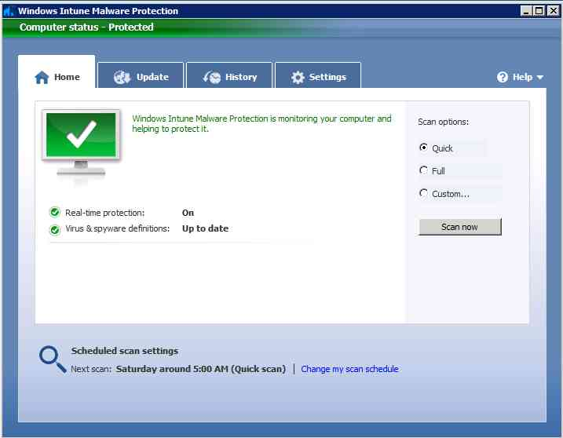
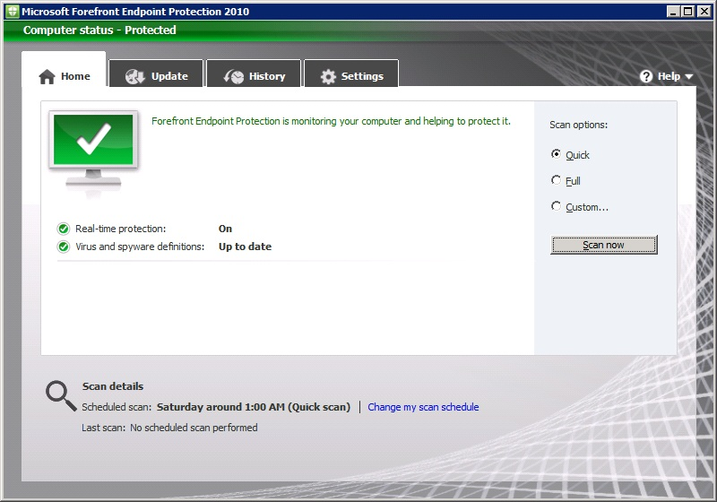
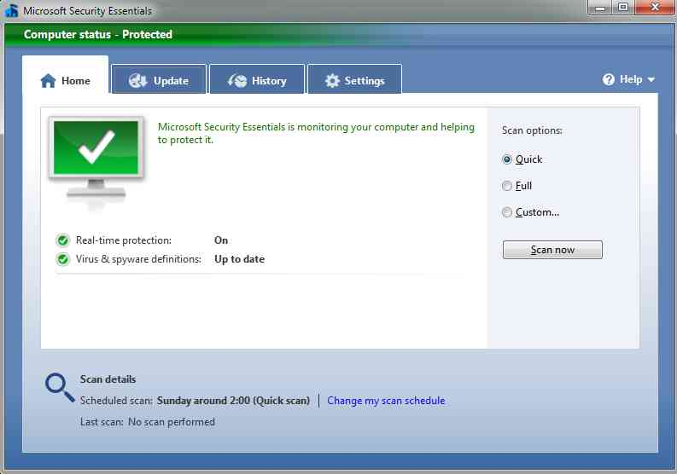
Common Client
Built on Microsoft Security Essentials proven success
Common client across Microsoft security products – MSE, FEP, Intune
Notes:
Design Philosophy
Simple to use
Minimal user involvement required to stay protected
Simple and clean graphical user interface
Clear actions to follow with a single click
Lightweight, high performance
Designed to optimize end user productivity
High performance on full spectrum of PC configurations including Netbooks
World class protection
Based on the same award winning Anti-malware engine as Security Essentials
Leverage Security Essentials malware samples collection channel
Common client across all 3 of these products – only difference is the way we hook it into management and monitoring systems
Microsoft Security Essentials
The free, consumer version downloadable from Microsoft.
Only allows configuration via the local UI, and doesn’t provide centralized monitoring.
Uses Microsoft Update to receive definition updates
Windows Intune
Windows Intune simplifies how businesses manage and secure PCs using Windows cloud services —so your computers and users can operate at peak performance, from virtually anywhere.
Windows Intune is a comprehensive solution that includes PC management, malware protection, Windows upgrades, and more.
The current version is aimed at small businesses of up to 500 PCs
Use the Windows Intune cloud service to:
Manage updates
Protect PCs from malware
Proactively monitor PCs
Provide remote assistance
Track hardware & software inventory
Set security policies

Slide 25
FEP Supported Clients
Client SKUs:
  Windows XP SP3 (x86) SP2 (x64)
    No Network Inspection System (Vulnerability Shielding) support
  Windows Vista (x86 and x64)
    SP1 required for NIS support
  Windows 7 (x86 and x64)
  Windows 7 XP Mode
Server SKUs:
  Windows Server 2003 SP2 (x86 and x64) + R2
  Windows Server 2008 (x86 and x64) + R2
Notes:
At RC there is an open bug regarding Windows XP SP3 (x64). This may or may not be supported at RTM
Mac and Linux clients may be available after RTM or in the next release

Slide 26
Other Software Requirements
Windows Filtering Platform (WFP) Hotfix Rollup
  Required on Vista SP1 and SP2, Windows 7 and Windows Server 2008 (or R2)
  Will ship in next Service Pack
  http://support.microsoft.com/kb/981889
  Requires Reboot for NIS to work
.Net Framework 2.0 or later
  Required to run DCM Baselines
  Required on Windows XP SP3 and
  Windows Server 2003 SP2
  Recommend latest version
Notes:
WFP hotfix is required for NIS to function. Operating systems (or service pack versions) not listed don’t need it as they do not implement NIS
The hotfix will be included in any subsequent service packs – including the upcoming Windows 7 and 2008 service packs
You don’t need to reboot immediately for the rest of the protection technologies to work – only NIS module will not load. The computer will however be in the “reboot pending” state and wont download any other updates and will keep prompting the user to reboot.
NOTE: As of RC, the reboot is still required, but the PG are working on a fix for this. Remove the above line if this requirement is removed
Recommend .Net Framework 3.5 SP1 on XP and 2003 machines
Note that these updates can be deployed using SCCM prior to FEP deployment. This gets the client reboot out of the way.

Slide 27
FEPInstall.exe
Client Distribution Flow
Self-contained install package
  Includes WFP Hotfix
2 Deployment Methods:
  ConfigMgr Software Distribution
  Running the .exe with parameters
    Manual install
    Scripted install
    Third-party software installation tool
    Group Policy software installation
    Preinstalled in OS image
    Etc.
Third-party detection
Silent removal of third-party products
FEP client installation
Policy configuration
Signature update
Notes:
SCCM is the simplest delivery method as it is already packaged – simply assign to the Collections you want it deployed to
Customers that don’t use SCCM can use any method to run the .exe and pass the required parameters

Slide 28
Deployment in OSD
Create new Program
  Must start with Install for default collections to work
  Command line is FEPInstall.exe /s /q
Update the Distribution Points
All documented in this TechNet Wiki article
http://social.technet.microsoft.com/wiki/contents/articles/how-to-deploy-the-fep-2010-client-via-osd-and-test-deployment.aspx
Notes:
In the tree pane, expand Site Database, expand Computer Management, expand Software Distribution, expand Packages, expand Microsoft Corporation FEP-Deployment 1.0, and highlight Programs.
From the Actions menu, click New Program.
In the Name field, type a name for the program (for example, InstallFEPviaOSD).
Note: To ensure that the default FEP collection works, the program name must start with "Install".
In the Command line, type: "FEPInstall.exe /s /q "
Change Run to Hidden.
Click Next.
In Requirements, in the Estimated disk space field, type "200" and select MB from the drop down list.
In Maximum allowed run time (minutes), type "60".
Click Next.
In Environment, for Program can run, change it to Whether or not user is logged.
Click Next.
In Advanced, check Suppress program notifications and Allow this program to be installed from the Install Software task sequence without being advertised
Click Next.
Click Next.
Click Finish.
Click Next at the Summary page.
On the Wizard Completed page, Click Close.
Go back to the Microsoft Corporation FEP-Deployment 1.0 pane, and right-click Update Distribution Points.
Click Yes when asked "Are you sure you want to update all distribution points?"
In the tree pane, expand Site Database, expand Computer Management, expand Operating System Deployment and expand Task Sequences.
Select your task.
In the Task Sequence Editor, click Add -> General -> Install Software.
Select Install a single application.
In Package, click Browse… and select Microsoft Corporation FEP-Deployment 1.0.
In Program, select the InstallFEPviaOSD program that was created in previous steps.
Click OK to save and close the window.

Slide 29
Deployment as part of an Image
Run regedit as system by using psexec –s –i regedit
Delete these Keys
  HKEY_LOCAL_MACHINE\SOFTWARE\Microsoft\Microsoft Antimalware\InstallTime
  HKEY_LOCAL_MACHINE\SOFTWARE\Microsoft\Microsoft Antimalware\Scan\LastScanRun
  HKEY_LOCAL_MACHINE\SOFTWARE\Microsoft\Microsoft Antimalware\Scan\LastScanType
  HKEY_LOCAL_MACHINE\SOFTWARE\Microsoft\Microsoft Antimalware\Scan\LastQuickScanID
  HKEY_LOCAL_MACHINE\SOFTWARE\Microsoft\Microsoft Antimalware\Scan\LastFullScanID
  HKEY_LOCAL_MACHINE\SOFTWARE\Microsoft\RemovalTools\MRT\GUID
remove psexec
Run sysprep
Power down the machine
If the machine gets restarted you will need to redo these steps as they will be recreated when the system starts
Notes:
Not deleting the client may create some issues to our statistics (all clients will report back as one client) and may also put clients in the wrong SCCM collections (due to “not real “last update time” / “Last scan time” etc…)

Slide 30
Deploying FEP Client using ConfigMgr
Simplest method
  ConfigMgr Package created during FEP server install, and replicated to all child Sites
  Recommended for all ConfigMgr-managed computers
Simple wizard:
  Assign to one or more Collections
  Specify Distribution Points for it to replicate to
  Specify when to install, maintenance windows etc.

Slide 31
Client Deployment Using ConfigMgr
Deployment using the software distribution process
demo
Notes:
Forefront Endpoint Protection packages
Assign to collection
Package Status
Show competitive Uninstall (highlight Forefront Client Security running on one of the clients

Slide 32
Migrating the existing client install base
Migration challenges
    Different products, managed by different systems
    Vulnerability window during replacement
    Complex, error prone to automate
Simplified migration in FEP 2010
    Not a standalone tool, fully integrated
    Encapsulates switching complexities
    Reduces the overall deployment costs

Slide 33
Migration to FEP made simple
Automatically removal of existing AV products:
  Symantec Endpoint Protection version 11
  Symantec Endpoint Protection Small Business Edition version 12
  Symantec Corporate Edition version 10
  McAfee VirusScan Enterprise version 8.5 and version 8.7
  TrendMicro OfficeScan version 8.0 and version 10.0
  Forefront Client Security v1
    Definition files will be left in place (to prevent the need for a full download), and locally-defined settings will be migrated to FEP. The MOM 2005 agent that FCS used will also be removed
Suppress using /noreplace
Notes:
One of the biggest challenges in changing protection product is how to remove the existing and install the new one reliably and efficiently. You also need to minimize the time between removal and installation, or the computer is at risk from malware.
This greatly simplifies that task, and minimizes the vulnerability window.
You can prevent removal of existing products using command line switch, but FEP does not support running with any other protection product simultaneously
How do you stop FCS from trying to reinstall (if you are doing it via WSUS)? – delete the package from WSUS or remove the FCS policy from the client

Slide 34
Migration to FEP Client
Automated uninstall of existing AV
demo
Notes:
Competitive uninstall of Forefront Client Security
Follow up on earlier Demo of deploying client
Verify Forefront Client Security componets have been uninstalled

Slide 35
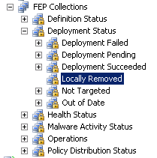
Enforcing Client Deployment
Making Sure FEP client is always installed
Use ConfigMgr processes to mitigate client uninstall by local administrator
Create an advertisement that automates FEP deployment to “Locally Removed” FEP collection
FEP Client will be re-installed, minimizing
the risk of vulnerable computer

Slide 36
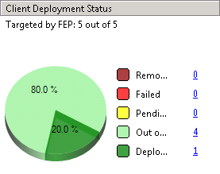
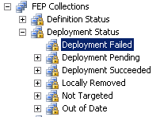
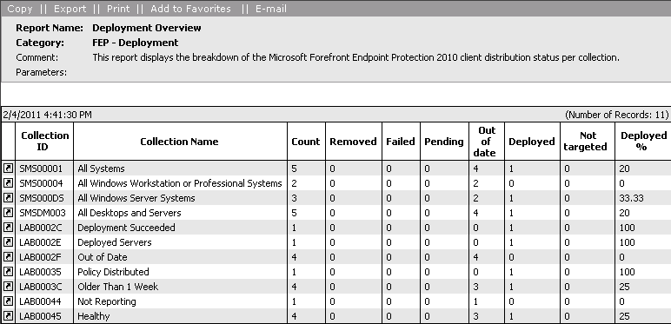
Troubleshooting FEP Deployment
Review dashboard
Failed collection
Deployment Overview report
Things to check
  ConfigMgr agent
  Deployment package replicated to all DP?
  FEP Package advertised?
  Advertisement on clients?
Notes:
After advertising the deployment package to a collection(s), you can review the dashboard.
You can also review the state of the Advertisement, to know how many systems received the advertisement, failed, started
Using the links you can navigate to the according FEP collection to see what systems are in that state

Slide 37
Troubleshooting FEP deployment
FEP client setup information
  XP, 2003: C:\Documents and Settings\All Users\Application Data\Microsoft\Microsoft Security Client\Support
  Win7, 2008: C:\ProgramData\Microsoft\Microsoft Security Client\Support
    EppSetupResult.ini: end result of FEP client setup
    EppSetup.log: general setup log
    MSSecurityClient_Setup_FEP_Install.log: Client setup log
    MSSecurityClient_Setup_mp_ambits_Install.log: AM install log
  ConfigMgr deployment
    C:\Windows\temp\FEP-ApplyPolicy.log:
ConfigMgr log files
  32bit: C:\Windows\System32\CCM\logs
  64bit: C:\Windows\SysWOW64\CCM\Logs
    CAS.log: Package download information
    ExecMgr.log: Advertisements executed on the client
    DCMAgent.log: Baseline evaluations
    ClientLocation.log: Client connectivity info
    DataTransferService.log: Downloads from DP

Slide 38
Troubleshooting Information Collecting Tools
ConfigMgr Toolkit v2
http://www.microsoft.com/downloads/en/details.aspx?FamilyID=5A47B972-95D2-46B1-AB14-5D0CBCE54EB8
MscSupport Tool
http://www.microsoft.com/downloads/en/details.aspx?FamilyID=04f7d456-24a2-4061-a2ed-82fe93a03fd5
Usage:
http://blogs.technet.com/b/clientsecurity/archive/2011/02/01/using-the-mscsupport-tool-to-collect-data-for-troubleshooting.aspx
FEP Best Practice Analyzer Tool
  http://www.microsoft.com/downloads/details.aspx?FamilyID=04F7D456-24A2-4061-A2ED-82FE93A03FD5&amp;displaylang=ja&displaylang=en

Slide 39
Forefront Endpoint Protection 2012
What’s Next

Slide 40
Forefront Endpoint Protection 2012 Beta
Convergence of Management and Security
  Built on System Center Configuration Manager 2012
  Advanced protection with lower impact on productivity
New Enhancements
  Simplified hierarchy model
  Role Based Access Control
  Definition Updates and automatic approval rules through ConfigMgr
  Improved alert timings
Evaluation Options
  FEP 2012 Beta available now: http://www.microsoft.com/fep
  Join Community Evaluation Program (included in ConfigMgr CEP) https://connect.microsoft.com/site1211

Slide 41


FEP 2012: Simplified Deployment & Migration
  Simplified installation using existing infrastructure
  No new servers
  Run setup once on the Central Administration Site (CAS), objects are replicated to the entire hierarchy
  Full FEP functionality in all sites
  Reporting component in the CAS monitors the entire organization
FEP
CENTRAL ADMINISTRATION SITE
FEP Reporting
FEP objects replicated to sites
Client data up
  Simplified Migration
  FEP2012 installs on top of Configuration Manager 2012
  No need to re-install FEP client agents
PRIMARY SITES

Slide 42
FEP 2012: Role Based Access Control
  Custom roles to separate security and operation roles
  User views and manages clients only within its related scope:
    Dashboard includes data only from in-scope collections
    Remediation tasks run on machines within user scope
  Policy can be managed from multiple sites
Create new policies
Modify default policies
Modify custom policies
Modify Precedence
Assign policy to collection
Security Administrator
Policy Deployment Manager
Notes:
FEP Policy Author (Kevin)
Tasks:
Create new policies
Modify default policies
Modify custom policies
Modify Precedence
Permission
Package - Read, Modify
FEP Policy Deployment Manager (Meg)
Task:
Assign policy to collection
Permissions
Package - Deploy
Collection - Read, Deploy

Slide 44
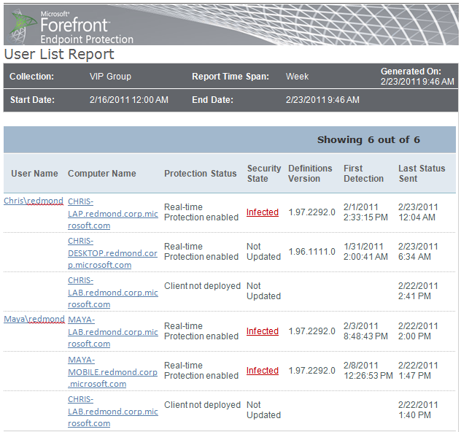
FEP 2012: User Centric support
  Utilizes a new Configuration Manager feature called “User Device Affinity” (UDA)
  Deploy client to users’ collections
  Assign policy to users’ collections
  User centric reports (post beta)

Slide 45

FEP 2012: Signature update via Configuration Manager
  Definition delivery fully automated in CM12.
  Definitions downloaded, distributed, and delivered to clients on an Admin-defined schedule.
  Definition content delivered natively through ConfigMgr via distribution points to minimize network impact.
  Fallback source still supported (WSUS, UNC, Microsoft Update).
Sync Catalog
Refresh Package with Sigs
FEP
Primary Site
Software Distribution Point
Distribution Point
Update rules
Download FEP Sigs
Management Point
Check update Rules
Notes:
Forefront Endpoint Protection uses Configuration Manager 2007 to centralize deployment of security software and policies to multiple endpoints.
There is no need for an additional FEP management server, You can deploy FEP Server on an existing Configuration Manager standalone (single) site or to a hierarchical site environment.
Once FEP server is installed, admins get an integrated console for FEP management within the System Center console.
The Forefront Endpoint Protection server installation process automatically installs the required components to the correct servers based upon the Configuration Manager deployment. Many operational components like distribution packages and desired configuration baselines are automatically created for the administrators during this installation.

Slide 46
Forefront Endpoint Protection 2012
First look
Demo
Notes:
Demonstrate changes in Forefront Endpoint Protection 2012
RBAC
New locations

Slide 47
Summary
Convergence of Forefront Endpoint Protection with System Center Configuration Manager:
  Lowers ownership costs
  Delivers simplified management and ease of deployment
  Enables improved visibility for identifying and safeguarding potentially vulnerable endpoints

Slide 48
Related Content
Required Slide
Speakers, please list the Breakout Sessions, Interactive Discussions, Labs, Demo Stations and Certification Exam that relate to your session. Also indicate when they can find you staffing in the TLC.
SIM311 Microsoft Forefront Endpoint Protection 2010 and Microsoft System Center Deep Dive into Management and Reporting Monday, May 16 4:45 PM - 6:00 PM
SIM310 Advanced Threat Detection and Remediation Using Microsoft Forefront Endpoint Protection Tuesday, May 17 10:15 AM - 11:30 AM
SIM330 Client Management and Protection at Microsoft: Real-World Deployment Case Study of Microsoft Forefront Endpoint Protection Thursday, May 19 1:00 PM - 2:15 PM
SIM390-HOL | Microsoft Forefront Endpoint Protection (FEP) 2012 Beta Overview
SIM394-HOL | Microsoft Forefront Endpoint Protection 2010 Overview
Find Me Later At the Forefront Endpoint Protection Booth in the Server and Cloud Technical Learning Center

Slide 49
Track Resources
Don’t forget to visit the Cloud Power area within the TLC (Blue Section) to see product demos and speak with experts about the Server & Cloud Platform solutions that help drive your business forward.
You can also find the latest information about our products at the following links:
Cloud Power - http://www.microsoft.com/cloud/
Private Cloud - http://www.microsoft.com/privatecloud/
Windows Server - http://www.microsoft.com/windowsserver/
Windows Azure - http://www.microsoft.com/windowsazure/
Microsoft System Center - http://www.microsoft.com/systemcenter/
Microsoft Forefront - http://www.microsoft.com/forefront/

Slide 50





Resources
  Connect. Share. Discuss.
http://northamerica.msteched.com
Learning
  Sessions On-Demand & Community
  Microsoft Certification & Training Resources
www.microsoft.com/teched
www.microsoft.com/learning
  Resources for IT Professionals
  Resources for Developers
http://microsoft.com/technet
http://microsoft.com/msdn

Slide 51












Complete an evaluation on CommNet and
enter to win!

Slide 52

Notes:
New for TechEd 2011, we will be working with Microsoft Tag (http://tag.microsoft.com/overview.aspx) to create unique Tags for every session at the event. Your session Tag will appear on both the room signage and at the end of your presentation. With your session Tag, attendees will be able to scan as they enter the room to retrieve session details, view speaker bios, and engage in discussions; or scan at the end of the presentation to evaluate your session and download materials. We’re excited to integrate Microsoft Tag across the My TechEd mobile experience this year.

Slide 53

© 2011 Microsoft Corporation. All rights reserved. Microsoft, Windows, Windows Vista and other product names are or may be registered trademarks and/or trademarks in the U.S. and/or other countries.
The information herein is for informational purposes only and represents the current view of Microsoft Corporation as of the date of this presentation. Because Microsoft must respond to changing market conditions, it should not be interpreted to be a commitment
on the part of Microsoft, and Microsoft cannot guarantee the accuracy of any information provided after the date of this presentation. MICROSOFT MAKES NO WARRANTIES, EXPRESS, IMPLIED OR STATUTORY, AS TO THE INFORMATION IN THIS PRESENTATION.

