Slide 2

Network Layers (in) Security
SIM314
Paula Januszkiewicz
IT Security Auditor, MVP, MCT
CQURE
paula@cqure.pl
Marcus Murray
Security Team Manager, MVP, MCT
TrueSec
Marcus.Murray@truesec.se
Notes:
Binary patching over http.
Ipv6 router announcement denial of service.
.

Slide 3
Agenda
Introduction
Physical Layer
Data-Link Layer
Network Layer
Transport Layer
Session Layer
Presentation Layer
Application Layer
Summary

Slide 4
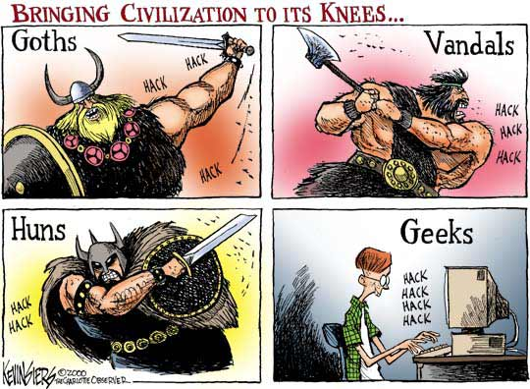
Notes:
Paula
Marcus - comments

Slide 5
The Issue
No matter how well we secure our hosts we are always “vulnerable” on some layers of the infrastructure
Security is a prime concern for networking
  While access to the network is enough to break its integrity
  Still tiny malicious actions can do a lot of damage
Usability stands in front of the security
  Interoperability is based on protocols created more then 30 years ago!
So what is this “Network Security” about?
Notes:
Georgia story
10
The Internet isn’t insecure. It may be unsecure.
Insecurity is mental state. The users of
the Internet may be insecure, and perhaps
rightfully so……Simson Garfinkel
Limit data disclosure to intended set
Monitor communications to catch terrorists
Keep data from being corrupted
Destroy computers with pirated content
Track down bad guys
Communicate anonymously

Slide 6
Physical Layer
Issues
  Loss of power or environmental control
  Disconnection, damage or theft of physical resources
  Unauthorized access: wired or wireless
  Key loggers or other data interception method
Countermeasures
  Use appropriate physical access control f.e. electronic locks or retina scanning
  Record video and audio in the company premises
  Employee training
  Physical network isolation
Physical Layer
Data-Link Layer
Network Layer
Transport Layer
Session Layer
Presentation Layer
Application Layer

Slide 7
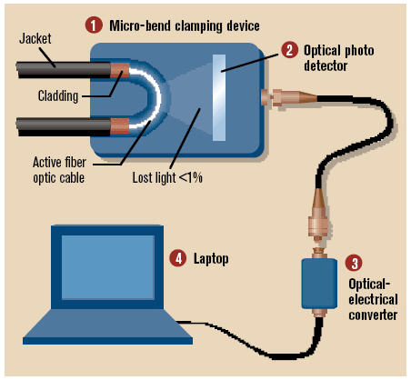
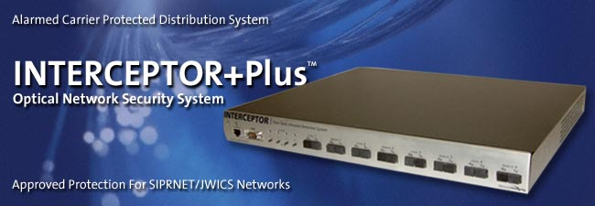
Sniff fiber

Slide 8
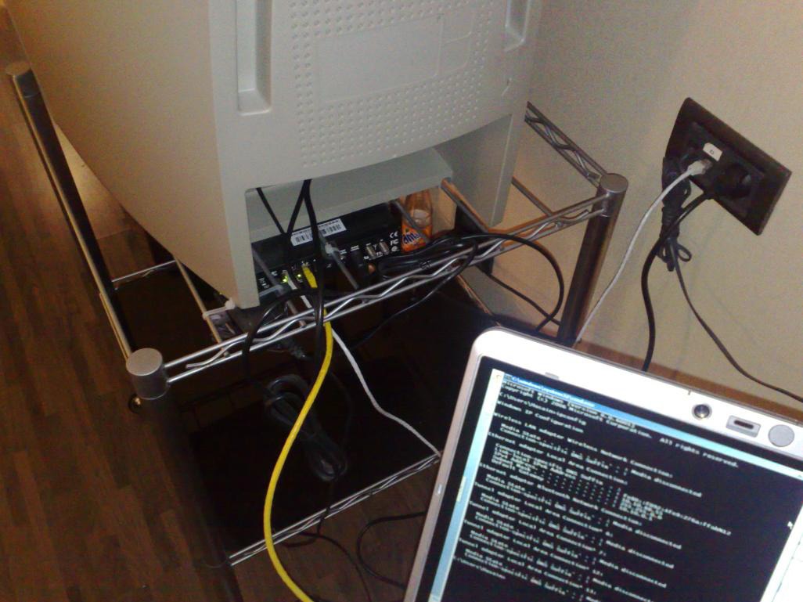
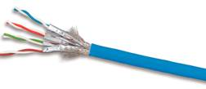
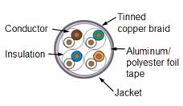
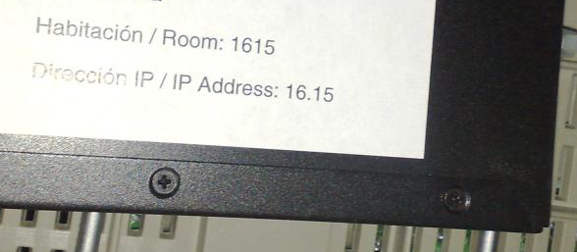
TP-Cables

Slide 9
Wireless Attack Basics
The scenario of physical access
demo
Notes:
Paula – 10 m
Hub – jak działa?

Slide 10
Data-Link Layer
Issues
  MAC address spoofing
  Wireless accessibility
  Spanning tree malfunctions
  Traffic flooding on the switch level
Countermeasures
  Segmentation (VLANs)
  Use corporate-level wireless solutions
  Disable all unnecessary switch ports
Physical Layer
Data-Link Layer
Network Layer
Transport Layer
Session Layer
Presentation Layer
Application Layer
Notes:
ARP
layer 3 technically superior
Rogue packet problem
TCP doesn’t participate in crypto, so attacker can inject bogus packet, no way for TCP to recover
easier to do outboard hardware processing (since each packet independently encrypted)
layer 4 easier to deploy
And unless API changes, layer 3 can’t pass up authenticated identity

Slide 11
802.1x (IN)Security
Shadow Host Scenario
demo
Notes:
Marcus - 7

Slide 12
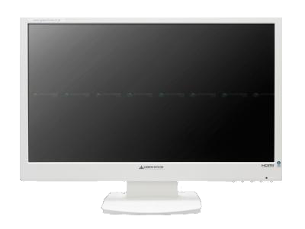
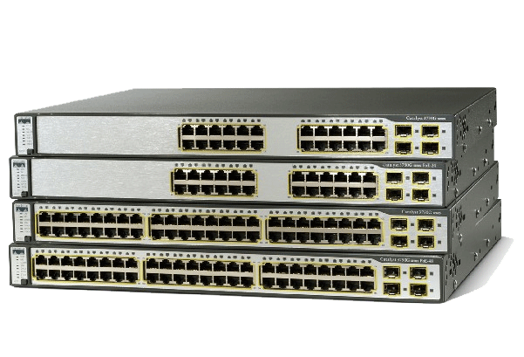
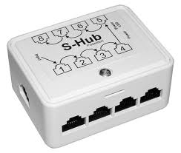


Domain
Controller
Radius
Server
CA
Server
Hacker
Computer
Evil Hacker
Untrusted
Computer
Client
demo

Slide 13
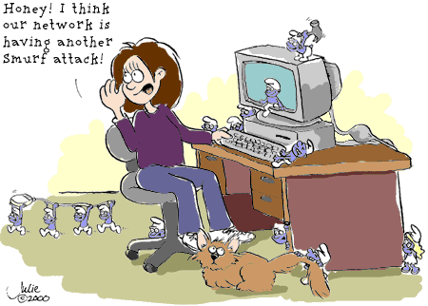
Network Layer
Issues
  Spoofing
  IP Addressing
  Routing protocols
  Tunneling protocols
Countermeasures
  IPSec
  Use firewalls between different network segments
  Use route filtering on the edge
  Perform broadcast and multicast monitoring
  Managed IP Addressing
Physical Layer
Data-Link Layer
Network Layer
Transport Layer
Session Layer
Presentation Layer
Application Layer
Notes:
layer 3 technically superior
Rogue packet problem
TCP doesn’t participate in crypto, so attacker can inject bogus packet, no way for TCP to recover
easier to do outboard hardware processing (since each packet independently encrypted)
layer 4 easier to deploy
And unless API changes, layer 3 can’t pass up authenticated identity

Slide 14
Packet Modification
demo
Playing with protocols
Notes:
TCPView
ICMP –
ARP Poisoing
NTSecurity.NU – walący arpami przykład – nie ma kontroli.
Smurf – demo.
Marcus:

Slide 15

Domain
Controller
File
Server
Web
Server
Hacker
Computer
NEW IPv6 ROUTER ADVERTICEMENTS
Untrusted
Computer
Untrusted
Computer
Untrusted
Computer
Untrusted
Computer
Client
Client
Client
Client
Evil Hacker
Denial of Service
demo
IPv6 vulnerabilities and others
Notes:
TCPView
ICMP –
ARP Poisoing
NTSecurity.NU – walący arpami przykład – nie ma kontroli.
Smurf – demo.
Marcus:

Slide 16
Transport Layer
Issues
  Connectionless nature of UDP
  Weak TCP implementations
    Predictable sequence numbers
  May be disturbed by crafted packets
  Performance may impact traffic qualification and filtering
Countermeasures
  Host and network based firewalls
  IPS/IDS
  Strong session handling
Physical Layer
Data-Link Layer
Network Layer
Transport Layer
Session Layer
Presentation Layer
Application Layer
Notes:
Illegal flags
Malicious packets
Intensive traffic
layer 3 technically superior
Rogue packet problem
TCP doesn’t participate in crypto, so attacker can inject bogus packet, no way for TCP to recover
easier to do outboard hardware processing (since each packet independently encrypted)
layer 4 easier to deploy
And unless API changes, layer 3 can’t pass up authenticated identity

Slide 17
Common TCP/UDP Attacks
demo
Network Trace Scenario
Notes:
To set up
Blocking spoofed packages – various nmap techniques
UDP – spoof
TCP/IP split handsh.
TCPView
ICMP – transport, wprawdzie nie jest, ale można dać.
Coś jeszcze?
10

Slide 18
Session Layer
Issues
  Weak or even lack of authentication
  Unlimited number of failed authentication attempts
  Session data may be spoofed and hijacked
  Exposure of identification tokens
Countermeasures
  Rely on strong authentication
    Keys
    Methods
  Use account and session expiration time
  Use timing to limit failed authentication attempts
Physical Layer
Data-Link Layer
Network Layer
Transport Layer
Session Layer
Presentation Layer
Application Layer
Notes:
Authentication protocols
Illegal flags
Malicious packets
Intensive traffic
layer 3 technically superior
Rogue packet problem
TCP doesn’t participate in crypto, so attacker can inject bogus packet, no way for TCP to recover
easier to do outboard hardware processing (since each packet independently encrypted)
layer 4 easier to deploy
And unless API changes, layer 3 can’t pass up authenticated identity

Slide 19
Presentation Layer
Issues
  Poor handling of data types and structures
  Cryptographic flaws may be exploited to circumvent privacy protections
Countermeasures
  Sanitizing the input – user data should be separated from the control functions
  Cryptographic solutions must be up to date
Physical Layer
Data-Link Layer
Network Layer
Transport Layer
Session Layer
Presentation Layer
Application Layer
Notes:
Demo about encoding
(null terminated URL) - Linux
Authentication protocols
Illegal flags
Malicious packets
Intensive traffic
layer 3 technically superior
Rogue packet problem
TCP doesn’t participate in crypto, so attacker can inject bogus packet, no way for TCP to recover
easier to do outboard hardware processing (since each packet independently encrypted)
layer 4 easier to deploy
And unless API changes, layer 3 can’t pass up authenticated identity

Slide 20
Null Byte Injection
%00
demo
Notes:
Marcus - 7

Slide 21
Application Layer
Issues
  The most exposed layer today
  Badly designed application may bypass security controls
  Complex protocols and application
  Error handling
  …
Countermeasures
  Application level access controls
  Using standards and testing application code
  IDS/ Firewall to monitor application activity
Physical Layer
Data-Link Layer
Network Layer
Transport Layer
Session Layer
Presentation Layer
Application Layer
Notes:
SSL
Inadequate security controls force “all-or-nothing” approach, resulting in either excessive or insufficient access.
Overly complex application security controls tend to be bypassed or poorly understood and implemented
Demo about encoding
(null terminated URL) - Linux
Authentication protocols
Illegal flags
Malicious packets
Intensive traffic
layer 3 technically superior
Rogue packet problem
TCP doesn’t participate in crypto, so attacker can inject bogus packet, no way for TCP to recover
easier to do outboard hardware processing (since each packet independently encrypted)
layer 4 easier to deploy
And unless API changes, layer 3 can’t pass up authenticated identity

Slide 22
Binary Patching Over HTTP
Poor Implementation
User authentication scenario
demo
Unsecure protocol scenario
Notes:
Basic (2)
SSL (2)
Website (find) – (2) http://toysnjoys.com/welcome.html
Marcus (7)
Ssl downgrade
15

Slide 23
Agenda
Introduction
Physical Layer
Data-Link Layer
Network Layer
Transport Layer
Session Layer
Presentation Layer
Application Layer
Summary

Slide 24
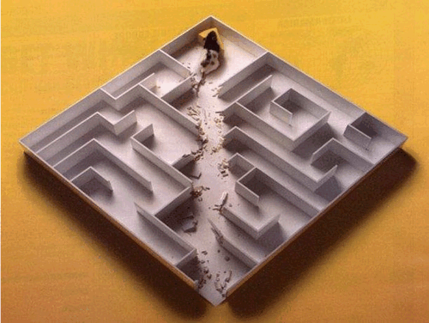
Remember
Do inventory of services and protocols
Lower layers are not dependent on upper layers
Use Network/Application layer for Integrity & Confidentiality
Secure all layers for accessibiliy
TCP/IP is more than 30 years old
  It is not ideal
  But has many security extensions
Notes:
Don’t let any layer depend on the others
Unnecessary information presented on failures
Denial of Service

Slide 25

Trustworthy Computing
Safety and Security Center
http://www.microsoft.com/security
Security Development Lifecycle
http://www.microsoft.com/sdl
Security Intelligence Report
http://www.microsoft.com/sir
End to End Trust
http://www.microsoft.com/endtoendtrust

Slide 26





Resources
  Connect. Share. Discuss.
http://northamerica.msteched.com
Learning
  Sessions On-Demand & Community
  Microsoft Certification & Training Resources
www.microsoft.com/teched
www.microsoft.com/learning
  Resources for IT Professionals
  Resources for Developers
http://microsoft.com/technet
http://microsoft.com/msdn

Slide 27












Complete an evaluation on CommNet and
enter to win!

Slide 28

Notes:
New for TechEd 2011, we will be working with Microsoft Tag (http://tag.microsoft.com/overview.aspx) to create unique Tags for every session at the event. Your session Tag will appear on both the room signage and at the end of your presentation. With your session Tag, attendees will be able to scan as they enter the room to retrieve session details, view speaker bios, and engage in discussions; or scan at the end of the presentation to evaluate your session and download materials. We’re excited to integrate Microsoft Tag across the My TechEd mobile experience this year.

Slide 29
Thank You!

