Slide 1

Cloud Security:
A Live Technical Analysis
SIM312
Marcus Murray
Security Team Manager
Truesec

Slide 2
Well.. This is the format…

Slide 3
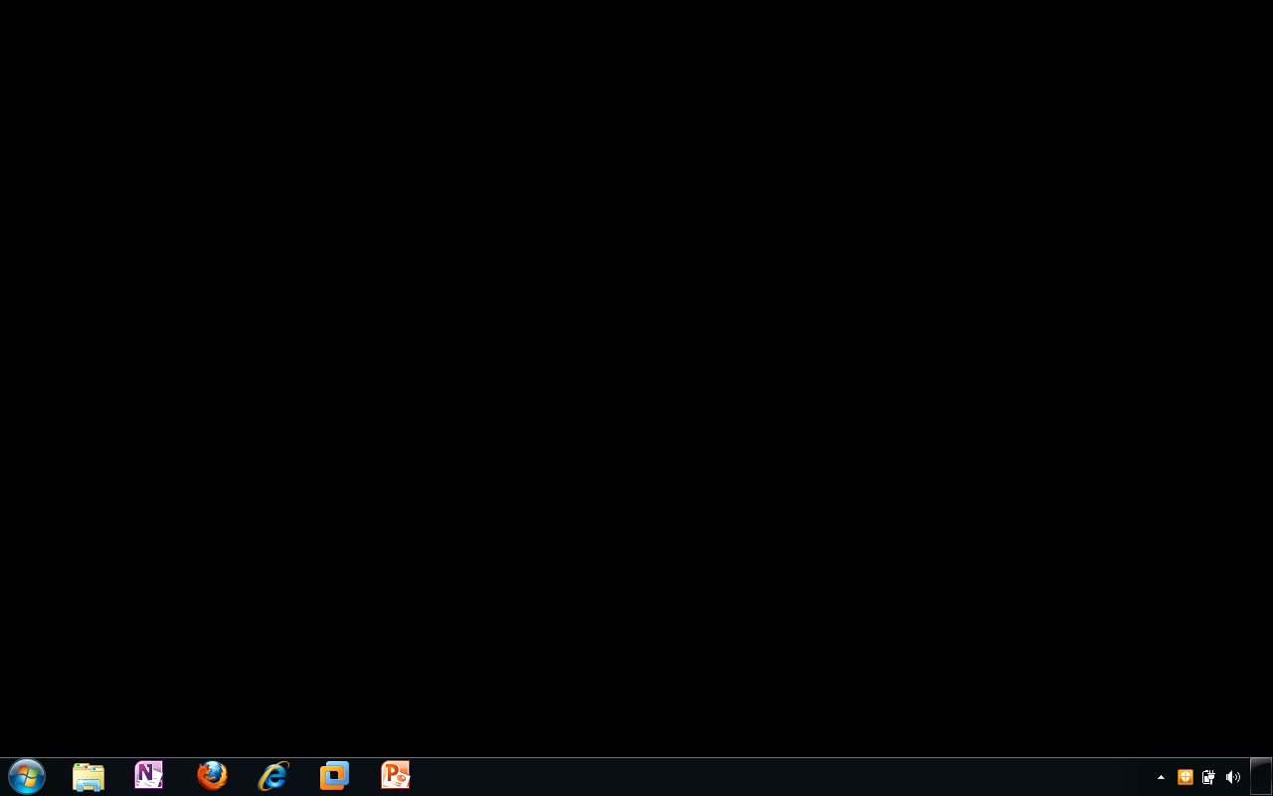

Slide 4
Session Goal
Make you understand cloud security challenges!

Slide 5
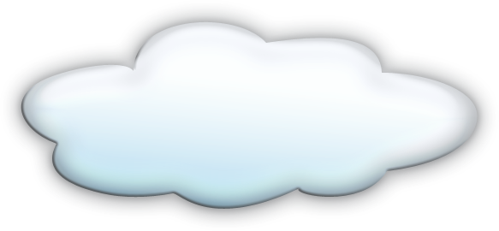
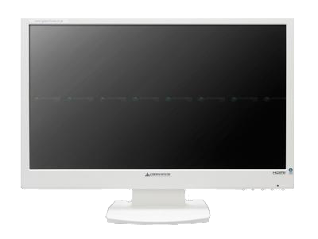
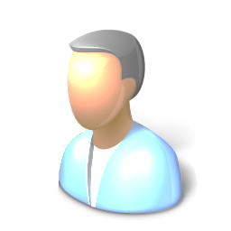
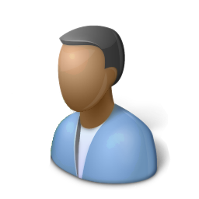
The cloud security landscape
Cloud Backend
Cloud
Admin
Cloud
Service
Evil Hacker
Data transport
Untrusted
Computer
Client
Admin

Slide 6
Divided liability
Cloud Provider
Backend
Virtualization
Sidechannels
Cloud Backend
Who’s responsibility
Communication
Guest OS
Applications
Monitoring
And how about
Incident responce
Data backup/restore
Availability
Etc. Etc.
Cloud
Admin
Cloud
Service
Evil Hacker
Data transport
Untrusted
Computer
Client
Admin
You
Clients
Logons

Slide 7
Targeting the Client plattform
Cloud Backend
Compromizing the legitimate Client
  Client side exploitation
Untrusted Clients
  Keylogging
  Cert export
Cloud
Service
Data transport
Untrusted
Computer
Evil Hacker

Slide 8
Targeting client communication
Cloud Backend
COOKIE STEALING
  MITM Webtraffic client-server
  Sniff traffic
  Identifiy cookie
COOKIE INJECTION
  Connect to target server
  Inject cookie
Cloud
Service
Data transport
Hacker
Computer
Untrusted
Computer
Client
Evil Hacker

Slide 9
Targeting client communication
Cloud Backend
Cookie-stealing
BPOS not vulnerable! ☺
Another concept: Generate a fake site
http://www.social-engineer.org/framework/Computer_Based_Social_Engineering_Tools:_Social_Engineer_Toolkit_(SET)
Cloud
Service
Data transport
Hacker
Computer
Untrusted
Computer
Client
Evil Hacker

Slide 10
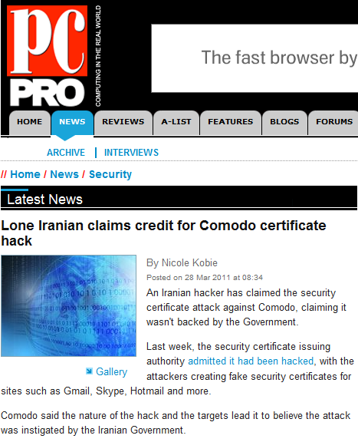
Targeting client communication
Cloud Backend
What if a CA was compromized?
Cloud
Service
Data transport
Hacker
Computer
Untrusted
Computer
Client
Evil Hacker

Slide 11
Targeting Server authentication
Cloud Backend
COOKIE STEALING
BRUTE FORCING BPOS
Enumerate domain
Enumerate users
Brute force passwords
DOS on BPOS
Enumerate domain
Enumerate users
5 invalid passwords/User
Repeat step 3 every 15 min
Cloud
Service
Data transport
Hacker
Computer
Untrusted
Computer
Client
Evil Hacker

Slide 12
Targeting Cloud infrastructure
Cloud Backend
BREAKING OUT OF THE BOX
Install Webapp(Cmd/file/priv)
Run Privilege Escalation
Upload hacker tools
Attack further..
What if the hackers are using your cloud?
Hiding in a cloud server
Install Webapp(Cmd/file/priv)
Run Privilege Escalation
Cloud
Service
Data transport
Hacker
Computer
Untrusted
Computer
Client
Evil Hacker

Slide 13
Sidechannel Attacks
Cloud Backend
  IPv6 Router Announcement DOS?
  http://seclists.org/bugtraq/2011/Apr/51
Cloud
Service 2
Cloud
Service 1
Cloud
Service
Data transport
Hacker
Computer
Untrusted
Computer
Client
Evil Hacker

Slide 14
Vulnerable cloud services
Cloud Backend
ATTACKING USER USING XSS
Hacker purchase service
Hacker identifies XSS
Hacker attacks User
ATTACKING USER USING SQL-inject
Hacker purchase service
Hacker identifies SQL Injection
Hacker attacks platform/database
Cloud
Service
Data transport
Hacker
Computer
Untrusted
Computer
Client
Evil Hacker

Slide 15
Using the cloud for evil
CONTROLLING BOTS FROM THE CLOUD
Hacker purchase service
Hacker attacks clients
Hacker controls clients from the cloud
Cloud
Service
Data transport
Hacker
Computer
Untrusted
Computer
Client
Evil Hacker

Slide 16
Identity Architecture
Exchange
Online
SharePoint
Online
Lync
Online
Trust
Federation
Gateway
Authentication platform
Directory
Store
Customer Premises
Provisioning
platform
AD DS
AD FS
Admin Portal
MS
Dirsync
Client
Service connector

Slide 17
Some of my final thoughts!
Secure your clients and don´t use untrusted clients for your services!
Question cloud service transport security, and authentication mechanisms
Question cloud service internal security
  I trust Microsoft over any small new player
  Microsoft run things better and more secure than most internal networks!
Question how your cloud server is monitored and administered
Realize that nowdays bad traffic can come from good companies

Slide 18

Related Content
Required Slide
Speakers, please list the Breakout Sessions, Interactive Discussions, Labs, Demo Stations and Certification Exam that relate to your session. Also indicate when they can find you staffing in the TLC.
Breakout Session:
Go se me & the Wolf
@
SIM313 – Ultimate Guide to Wireless Security 4.30pm today, Room:B406
Find Me Later At blog:www.truesecurity.se company:www.truesec.com

Slide 19





Resources
  Connect. Share. Discuss.
http://northamerica.msteched.com
Learning
  Sessions On-Demand & Community
  Microsoft Certification & Training Resources
www.microsoft.com/teched
www.microsoft.com/learning
  Resources for IT Professionals
  Resources for Developers
http://microsoft.com/technet
http://microsoft.com/msdn

Slide 20












Required Slide
Complete an evaluation on CommNet and
enter to win!

Slide 21

© 2011 Microsoft Corporation. All rights reserved. Microsoft, Windows, Windows Vista and other product names are or may be registered trademarks and/or trademarks in the U.S. and/or other countries.
The information herein is for informational purposes only and represents the current view of Microsoft Corporation as of the date of this presentation. Because Microsoft must respond to changing market conditions, it should not be interpreted to be a commitment
on the part of Microsoft, and Microsoft cannot guarantee the accuracy of any information provided after the date of this presentation. MICROSOFT MAKES NO WARRANTIES, EXPRESS, IMPLIED OR STATUTORY, AS TO THE INFORMATION IN THIS PRESENTATION.

