Slide 1

Microsoft Forefront Endpoint Protection 2010 and Microsoft System Center Deep Dive into
Management and Reporting
SIM311
Chris Norman
Sr. Escalation Engineer
Microsoft
Adwait Joshi
Sr. Product Manager
Microsoft

Slide 2
Session Objectives and Takeaways
Session Objectives(s):
    Demonstrate simplified management and operations for Forefront Endpoint Protection using System Center Configuration Manager
  Understand how to effectively manage
    FEP Policy
    FEP Monitoring: Dashboard, Alerts & Reporting
    FEP Remediation Tasks: Virus scans and signature updates
Takeaways
  Convergence of FEP and ConfigMgr makes endpoint protection and management easy and more effective

Slide 3
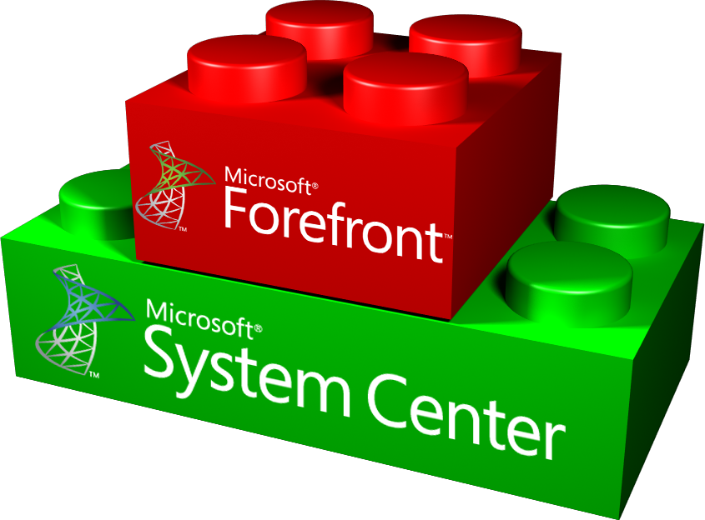




Forefront Endpoint Protection 2010
One infrastructure for desktop management and protection
        Ease of Deployment
        Enhanced Protection
        Simplified Desktop Management
        Built on top of Microsoft® System Center Configuration Manager
        Supports all System Center Configuration Manager topologies and scale
        Facilitates easy migration
        Deploy across various operating systems Windows® client and Server
        Protection against all type of malware
        Proactive security against zero day threats
        Productivity-oriented default configuration
        Integrated management of host firewall
        Backed by Microsoft Malware Protection Center
        Unified management interface for desktop administrators
        Effective alerts
        Simple, operation-oriented policy administration
        Historical reporting for security administrators

Slide 4
Policy Lifecycle
Deploy
Monitor
Requirements
Create

Slide 5
Policy Lifecycle at a Glance
Policy Creation:
  ConfigMgr Console
  Group Policy Management Console
  Export / Import of XML (fep2010gptool.exe)
Policy Deployment:
  ConfigMgr Software Distribution of Policies package
  Group Policy
  Command-line
    During install (FEPInstall.exe /policy <policy>)
    After Install (ConfigSecurityPolicy.exe <policy>)
Policy Monitoring:
  Dashboard and Reports

Slide 6
FEP Policy: CfgMgr or Group Policy?
You should consider managing policy with CfgMgr if… | You should consider managing policy with Group Policy if…
You want unified management (Recommended) You have CfgMgr deployed on all the computers you will manage You have non domain-joined machines You do not want to have to understand and manage many low level settings You don’t need more than one policy per computer, even on servers | Some of the computers you want to manage don’t have CfgMgr You prefer to manage policy with group policy You want extremely granular control over settings You prefer to “layer” policies, that is to apply more than one policy per computer

Slide 7
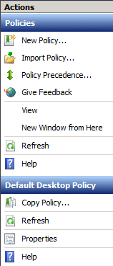
Policy Creation: ConfigMgr Console
New Policy wizard
  Create new policy based on template
Copy existing policy
  Use source policy as template
Import policy from XML

Slide 8
Policy Templates - Client
 | Standard | High Security | Perf. Optimized
Enable NIS | ☑ | ☑ | ◻
Scheduled Scans | Weekly Quick | Daily Quick Weekly Full | Weekly Quick
Scan only when idle | ☑ | ◻ | ☑
Force if 2 scans missed (on reboot) | ◻ | ☑ | ◻
Throttle CPU | 50% | - | 30%
Force definition update after | 1 day | 1 day | -
Firewall | Block incoming in all profiles | Block incoming in all profiles | Not Configured

Slide 9
Available Server Workloads Policies
# | Server Role or Server Application
1 | SQL 2005 Ent/Std (with clustering)
2 | SQL 2008 Ent/Std (with clustering)
3 | SCOM 2007 R2 (with clustering) in FEP-S Configuration
4 | SCCM 2007 (with clustering) in FEP Configuration
5 | Exchange2007 (HubTransport, ClientAccess, Mailbox)
6 | Exchange2010 (HubTransport, ClientAccess, Mailbox)
7 | SharePoint
8 | File Services
9 | Internet Information Services 6
10 | Internet Information Services 7
11 | DNS Server
12 | Active Directory Domain Services (including SYSVOL/FRS/DFS/DFS-R)
13 | DHCP Server
14 | Terminal Services
15 | Hyper-V
16 | Forefront Protection for Exchange

Slide 10
Default Policies
FEP provides 2 default policies:
  Default Desktop Policy
    Weekly quick scan, RTP on, default exclusions, Firewall enabled
    Assigned to Deployment Succeeded\Deployed Desktops Collection
  Default Server Policy
    No scheduled scan, RTP on, default exclusions, Firewall not enabled
    Assigned to Deployment Succeeded\Deployed Servers Collection
  Can be modified but not deleted

Slide 11
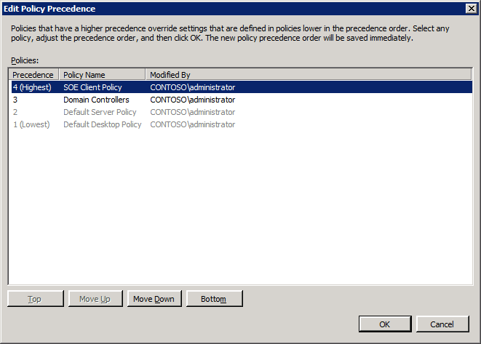
Policy Precedence
Computers can belong to multiple Collections, so may be candidates for multiple policies
Only one policy can be applied via ConfigMgr at a time
  ConfigMgr-delivered policy does not support “layering”
Precedence is used to determine the effective policy

Slide 12
FEP 2010 Policy Management
demo

Slide 13
Under the Hood: Policy Creation
Admin creates/updates a FEP policy in console
  An ConfigMgr Program is created inside the
  “FEP Policies 1.0” Package and set to disabled
  Status Filter launches PlcUpdtr.exe
    Ensures default policies are present and up to date
    Creates actual program and updates the program’s ISV Data
    Updates Client installation Package with default policies if needed
    Enables all disabled programs
    Creates Applypolicy.vbs if missing
All activity is logged to C:\Program Files\Microsoft Configuration Manager\AdminConsole\AdminUILog\FepPolicySourceUpdater.log

Slide 14
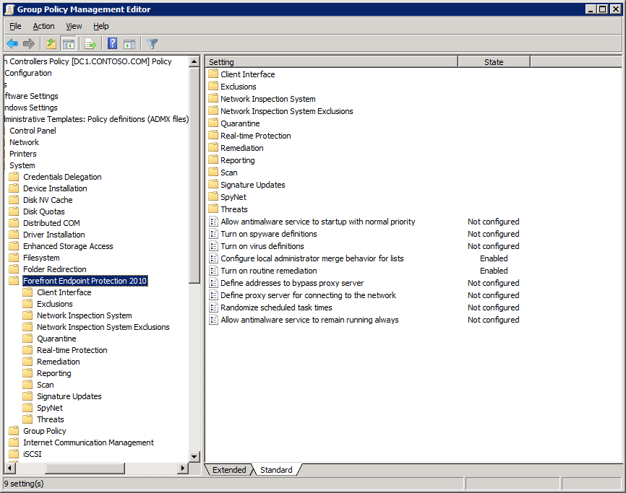
Policy Creation: GPMC
.ADMX / .ADML files on install media
Manage via Vista / Windows 2008 (or later) GPMC

Slide 15
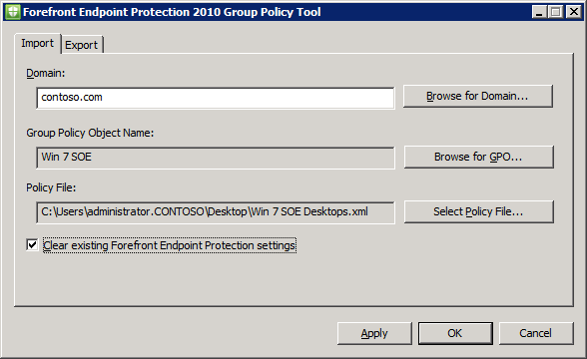
Policy Creation: Import / Export
ConfigMgr GPO

Slide 16
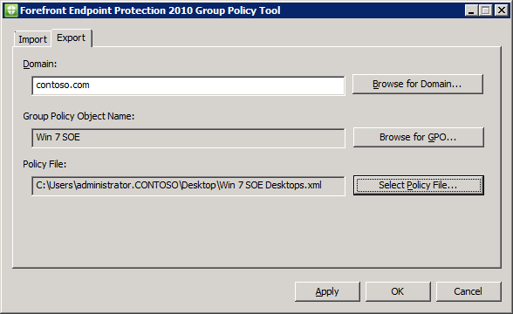
Policy Creation: Import / Export
GPO ConfigMgr

Slide 17
Policy Lifecycle
Deploy
Monitor
Requirements
Create

Slide 18
Policy Lifecycle at a Glance
Policy Creation:
  ConfigMgr Console
  Group Policy Management Console
  Export / Import of XML (fep2010gptool.exe)
Policy Deployment:
  ConfigMgr Software Distribution of Policies package
  Group Policy
  Command-line
    During install (FEPInstall.exe /policy <policy>)
    After Install (ConfigSecurityPolicy.exe <policy>)
Policy Monitoring:
  Dashboard and Reports

Slide 19
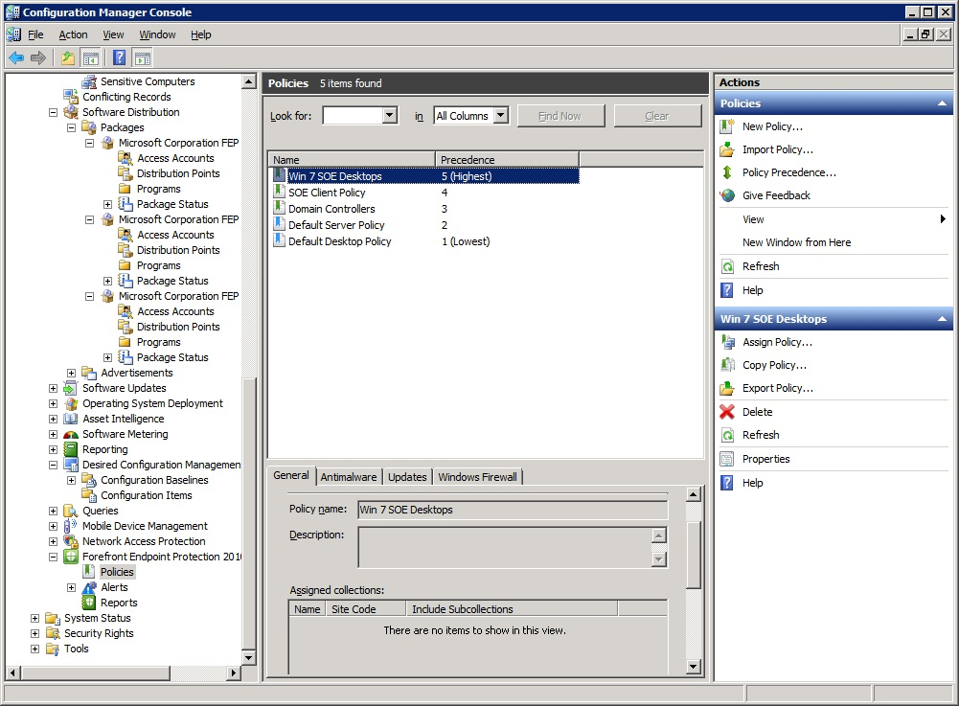
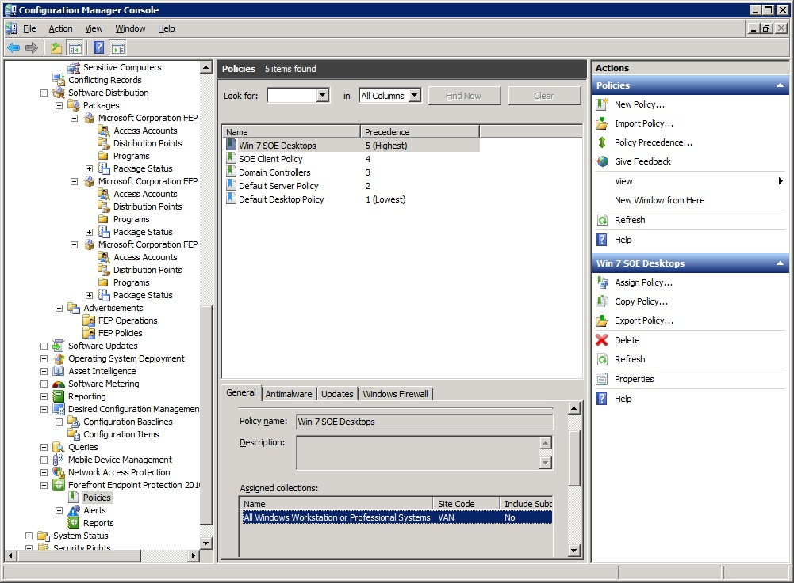
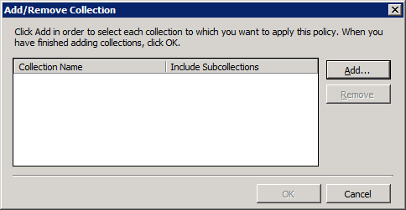
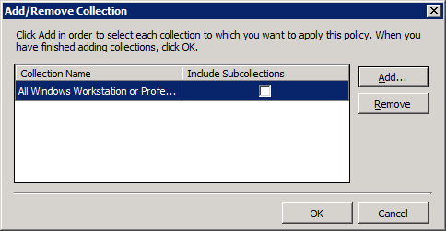
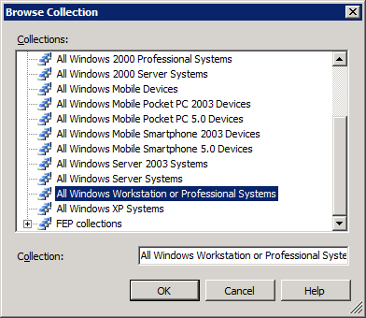
Assign to ConfigMgr Collection(s)

Slide 20
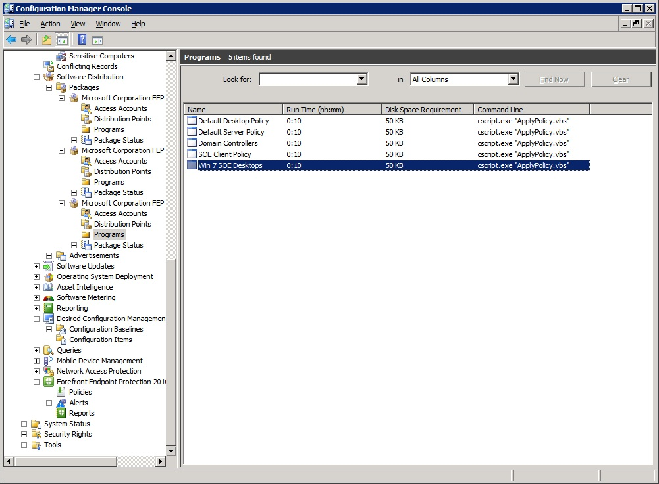
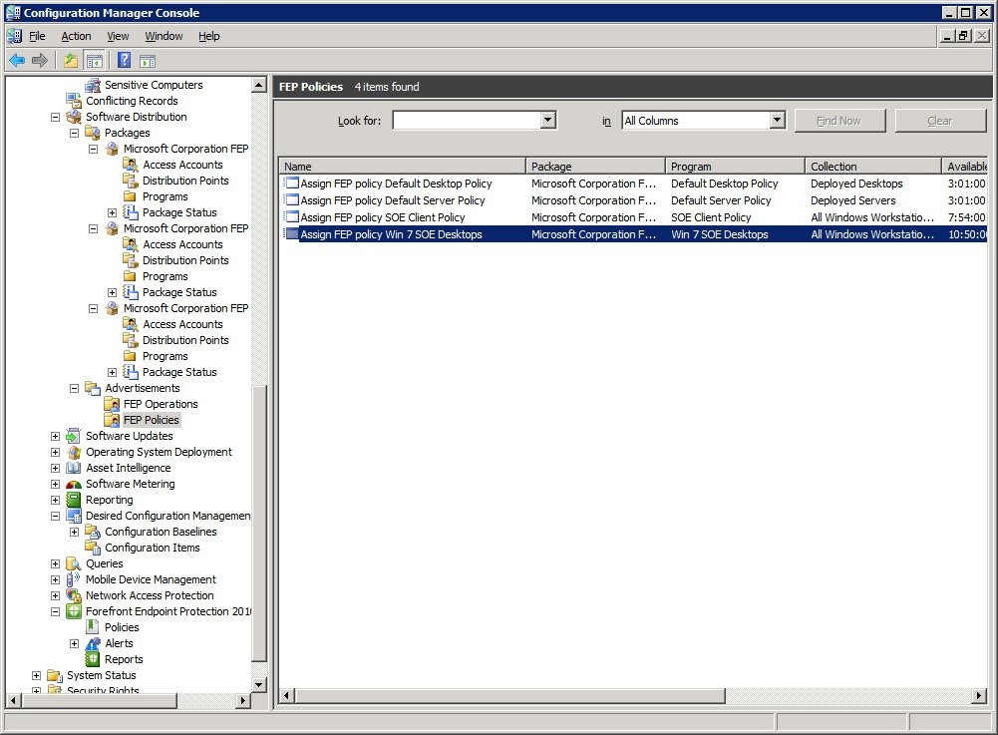
Verify Program Advertisements

Slide 21
Under the Hood: Client Applies Policy
ConfigMgr client receives new policy from advertised program (the FEP policy)
Advertised program (ApplyPolicy.vbs) runs
  Check to see if CCM_ISV_SoftwarePolicy Class exists
  Requests Machine policy and evaluates it
ApplyPolicy.vbs finds the policy with highest precedence
  Builds index of policies and precedence
  Identifies Policy with highest precedence and creates .xml file
Calls C:\Program Files\Microsoft Security Client\
ConfigSecurityPolicy.exe “<Policy>.xml”
All of this logged in %temp%\FEP-Applypolicy-%computername%.log

Slide 22
Policy Lifecycle
Deploy
Monitor
Requirements
Create

Slide 23
Policy Lifecycle at a Glance
Policy Creation:
  ConfigMgr Console
  Group Policy Management Console
  Export / Import of XML (fep2010gptool.exe)
Policy Deployment:
  ConfigMgr Software Distribution of Policies package
  Group Policy
  Command-line
    During install (FEPInstall.exe /policy <policy>)
    After Install (ConfigSecurityPolicy.exe <policy>)
Policy Monitoring:
  Dashboard and Reports

Slide 24
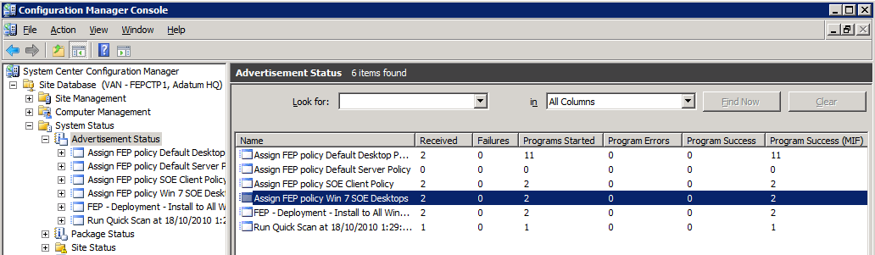
Under the Hood: Display in Dashboard
Client reports status of program installation

Slide 25
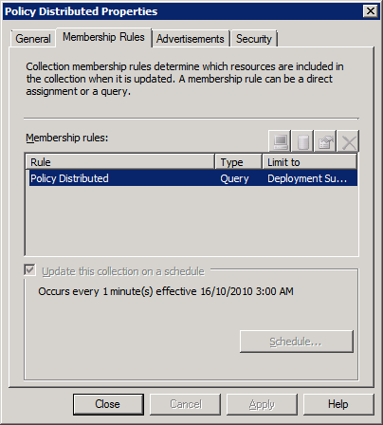
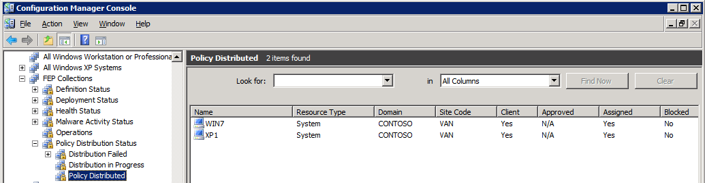
Under the Hood: Display in Console
Client reports status of program installation
Updates Collection membership
Collections updated
every minute

Slide 26
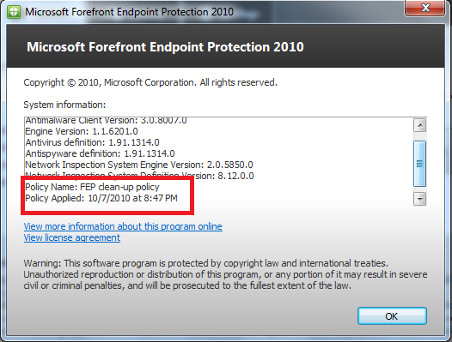
Troubleshooting Policy - FEP Client Gui Policy Information

Slide 27
Troubleshooting Policies – Policy Distribution Report
There are new reports that can help with troubleshooting of policies. You can reach these reports by going to Computer Manager → Reporting → Reports.
“Policy Distribution Overview” - This report displays the breakdown of policy distribution states per collection. This report will only enumerate computers with Microsoft Forefront Endpoint Protection 2010 installed.
“Policy Distribution for a specific collection” - This report displays the policy distribution states for a specific collection. This report is divided into three sections. The Applied Policy section lists the number of computers and the applied policy. The Pending State section lists the number of computers that in a pending state. The Failure section lists the number of computers that have reported failures in applying their policy.
“Policy Distribution for a specific collection in a specific state” - This report displays a list of computers in a specific collection and specific policy state (applied, pending, and failure).
NOTE: Since policy distribution is similar to client roll out (both use the Configuration Manager software distribution capabilities), troubleshooting follows the same concepts and uses similar reports.

Slide 28
Dashboard & Remediation
I want to monitor my computers health and act on policy drifts

Slide 29
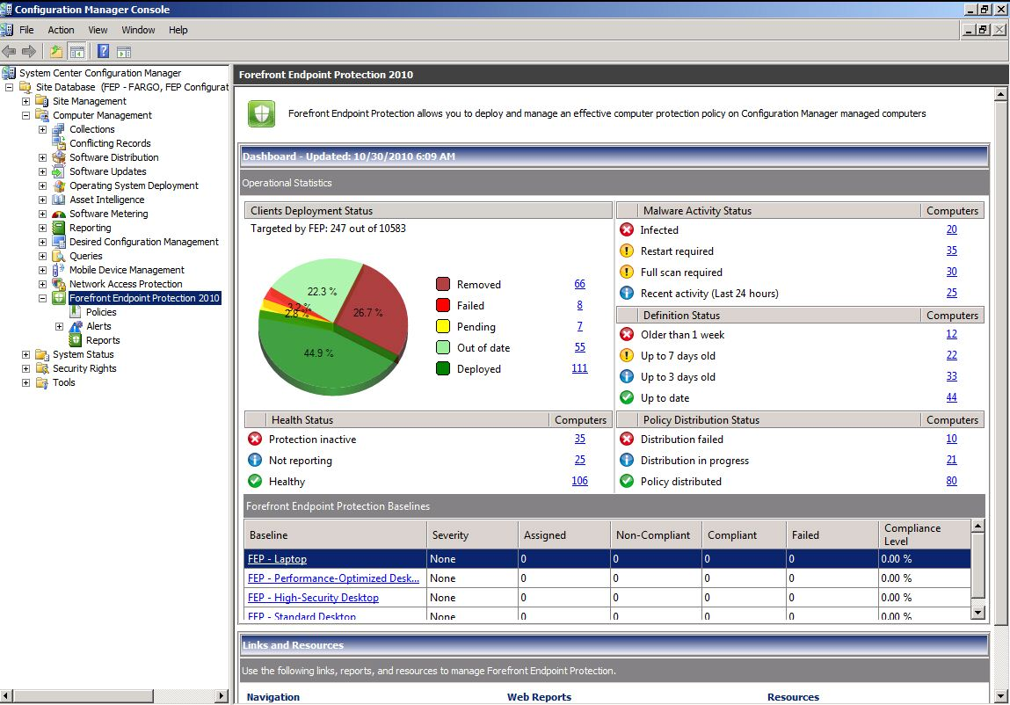
FEP Dashboard & Remediation – Key Concepts
Operationalized security monitoring
    Deployment issues
    Protection status
    Antimalware activity issues
    Definitions updates issues
    Policy distribution issues
    Visibility to FEP DCM baselines
Launchpad to ConfigMgr collections
    Drill down to ConfigMgr collections
    Refresh operation statistics on demand
Manual remediation actions :
    Full/Quick scan
    Signature update

Slide 30
Dashboard and Remediation
demo

Slide 31
Reports
I want to have an historical view of my org protection state

Slide 32
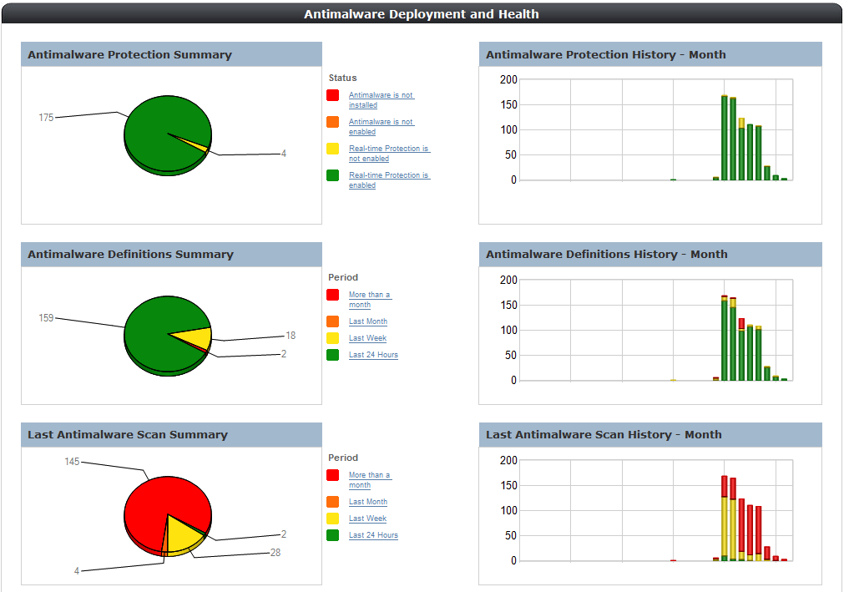
FEP Reports
Security minded
    Operational investigation capabilities
    Operational compliance capabilities
SQL Reporting services
    Export to other formats
    Register for email notifications
    Accessed from browser
Extensibility
    Create you own reports
    Shared schema

Slide 33
Reports in ConfigMgr
demo

Slide 34
Custom FEP Reporting on
FEP DB OLAP
demo

Slide 35
FEP Alerts
I want to be notify on critical security incidents anywhere, anytime

Slide 36
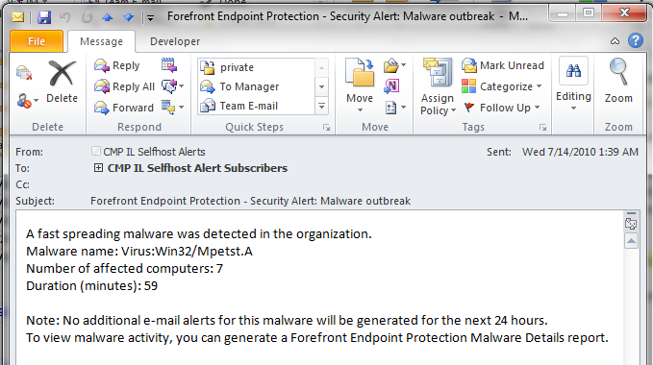
FEP Security Alerts - Concepts
Security alerts – Guidelines:
    Actionable – Actions associated with an alert
    Timely – Expected and accepted delay for an alert to reach its destination
    Manageable – Number & Types of expected alerts
    Sensitivity-based – Different instances per alert type and/or collections
  Security alerts in FEP:
    Rely on CM and FEP data up flows
      Expected response is ~30 – 120 minutes
    E-mail notifications
    Viewed in FEP report (Antimalware activity)
    Event log
    Configurable threshold based

Slide 37
FEP Security Alerts
Malware Detection
Malware detected on a sensitive computer
Threshold:
Malware Outbreak
A specific malware is being detected on multiple computers in a period of 24 hours
Threshold:
Repeated Malware
A specific malware is detected multiple times on the same computer(s)
Threshold:
Multiple Malware
Computer to monitor (collections)
Sensitivity (High = Any, Medium = Manual Action, Low = Infected)
Admin expected response:
Open Computer Details report.
Learn more about the malware
Number of computers
Admin expected response:
Open Malware Details report
Identify FEP mitigation
Scope the infection
Learn more about the malware
Computer to monitor (collections)
Number of detections
Detection interval
Admin expected response:
Open Computer Details report
Learn more about the malware
Several types of malware are detected on a computer(s)
Threshold:
Computer to monitor (collections)
Number of malware types
Detection interval
Admin expected response:
Open Computer Details report
Learn more about the malware

Slide 38
Forefront Endpoint Protection 2012 Beta
Convergence of Management and Security
  Built on System Center Configuration Manager 2012
  Advanced protection with lower impact on productivity
New Enhancements
  Simplified hierarchy model
  Role Based Access Control
  Definition Updates and automatic approval rules through ConfigMgr
  Improved alert timings
Evaluation Options
  FEP 2012 Beta available now: http://www.microsoft.com/fep
  Join Community Evaluation Program (included in ConfigMgr CEP) https://connect.microsoft.com/site1211

Slide 39
Summary
Convergence of Forefront Endpoint Protection with System Center Configuration Manager:
  Lowers ownership costs
  Delivers simplified management and ease of deployment
  Enables improved visibility for identifying and safeguarding potentially vulnerable endpoints
Forefront Endpoint Protection 2012 Beta Available now!
  Evaluate with a community of peers: https://connect.microsoft.com/site1211

Slide 40

Related Content
Required Slide
Speakers, please list the Breakout Sessions, Interactive Discussions, Labs, Demo Stations and Certification Exam that relate to your session. Also indicate when they can find you staffing in the TLC.
SIM317 Planning and Deploying Microsoft Forefront Endpoint Protection 2010 with Microsoft System Center Configuration Manager Monday, May 16 3:00 PM - 4:15 PM
SIM310 Advanced Threat Detection and Remediation Using Microsoft Forefront Endpoint Protection Tuesday, May 17 10:15 AM - 11:30 AM
SIM330 Client Management and Protection at Microsoft: Real-World Deployment Case Study of Microsoft Forefront Endpoint Protection Thursday, May 19 1:00 PM - 2:15 PM
SIM390-HOL | Microsoft Forefront Endpoint Protection (FEP) 2012 Beta Overview
SIM394-HOL | Microsoft Forefront Endpoint Protection 2010 Overview
Find Me Later At Forefront Endpoint Protection Demo Both in the Server and Cloud Technical Learning Center

Slide 41
Track Resources
Don’t forget to visit the Cloud Power area within the TLC (Blue Section) to see product demos and speak with experts about the Server & Cloud Platform solutions that help drive your business forward.
You can also find the latest information about our products at the following links:
Cloud Power - http://www.microsoft.com/cloud/
Private Cloud - http://www.microsoft.com/privatecloud/
Windows Server - http://www.microsoft.com/windowsserver/
Windows Azure - http://www.microsoft.com/windowsazure/
Microsoft System Center - http://www.microsoft.com/systemcenter/
Microsoft Forefront - http://www.microsoft.com/forefront/

Slide 42





Resources
  Connect. Share. Discuss.
http://northamerica.msteched.com
Learning
  Sessions On-Demand & Community
  Microsoft Certification & Training Resources
www.microsoft.com/teched
www.microsoft.com/learning
  Resources for IT Professionals
  Resources for Developers
http://microsoft.com/technet
http://microsoft.com/msdn

Slide 43












Complete an evaluation on CommNet and
enter to win!

Slide 44


Slide 45

© 2011 Microsoft Corporation. All rights reserved. Microsoft, Windows, Windows Vista and other product names are or may be registered trademarks and/or trademarks in the U.S. and/or other countries.
The information herein is for informational purposes only and represents the current view of Microsoft Corporation as of the date of this presentation. Because Microsoft must respond to changing market conditions, it should not be interpreted to be a commitment
on the part of Microsoft, and Microsoft cannot guarantee the accuracy of any information provided after the date of this presentation. MICROSOFT MAKES NO WARRANTIES, EXPRESS, IMPLIED OR STATUTORY, AS TO THE INFORMATION IN THIS PRESENTATION.

