Slide 2

Unmasking Administrator’s Evil
SIM 306
Paula Januszkiewicz
IT Security Auditor, MVP, MCT
CQURE
paula@cqure.pl

Slide 3
Agenda
Introduction
Admin Even Worse!
Summary
1
2
3
4
5
Bad Admin
Non-Technical Issues

Slide 4
Introduction
Innocent Games
Task Manager Is Not Enough
Explorer Is Not Enough
MoveFileEx Function
Diagnostic and Recovery Toolset
Data Is Trickling
Administrators Take Shortcuts
Summary

Slide 5
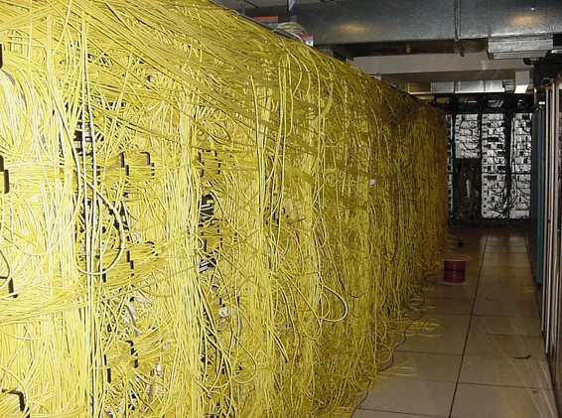

Slide 6
Introduction
Innocent Games
Task Manager Is Not Enough
Explorer Is Not Enough
MoveFileEx Function
Diagnostic and Recovery Toolset
Data Is Trickling
Administrators Take Shortcuts
Summary

Slide 7

Innocent Games
WINLOGON
  Supports user authentication
  Special session in OS with strong limitations
  …but this is a session and can be owned
Image Hijacks
  Attaches debugger to an executable file
  OS does not check if a file is a debugger
Source: Photosur@flickr

Slide 8
WINLOGON
Image Hijacks
The scenario of the deleted account
demo
Notes:
autoruns

Slide 9
Introduction
Innocent Games
Task Manager Is Not Enough
Explorer Is Not Enough
MoveFileEx Function
Diagnostic and Recovery Toolset
Data Is Trickling
Administrators Take Shortcuts
Summary

Slide 10

Task Manager is Not Enough
Tool for home users
Power of Kernel Mode:
  No rules
  Almost no management
  No security
  No time limits
Driver is the method to get to Kernel Mode!

Slide 11
Task Manager vs. Windows Debugger
Under the cover - Processes
demo
Notes:
Task Manager – Program Manager
List DLLs
LiveKD
Zero wątków
Zarejestrować mutexa odnoszącego się do Task Manager

Slide 12
Introduction
Innocent Games
Task Manager Is Not Enough
Explorer Is Not Enough
MoveFileEx Function
Diagnostic and Recovery Toolset
Data Is Trickling
Administrators Take Shortcuts
Summary

Slide 13
Explorer Is Not Enough
Let’s make it clear:
  If you remove admin’s access, he WILL NOT be impressed
Rights
  Should be used according to some patterns
  Should be audited
BackupRead/ BackupWrite
  Copy operation that is more important that ACLs
  Used by backup software
Notes:
Powershell
BackReadWrite
Barta DLL

Slide 14
Under the Cover
Files

Slide 15
Introduction
Innocent Games
Task Manager Is Not Enough
Explorer Is Not Enough
MoveFileEx Function
Diagnostic and Recovery Toolset
Data Is Trickling
Administrators Take Shortcuts
Summary

Slide 16
MoveFileEx Function
Documented in MSDN:
  „Moves an existing file or directory, including its children, with various move options.”
MOVEFILE_DELAY_UNTIL_REBOOT flag
Can rename and delete files during next reboot
  Just after autochk
  Long before normal protection mechanisms start
  Stores data in registry (PendingFileRenameOperations)
  By default ignores system files
Notes:
Useful not only for bad admins

Slide 17
Till The Next Restart
Broken Server Scenario
demo
Notes:
Tylko REG + Restart
Kilbox
Story o GPO – usuniać z GPO i nie usuwa się reg
Trzymane dane co ma być rename

Slide 18
Introduction
Innocent Games
Task Manager Is Not Enough
Explorer Is Not Enough
MoveFileEx Function
Diagnostic and Recovery Toolset
Data Is Trickling
Administrators Take Shortcuts
Summary

Slide 19
Diagnostic and Recovery Toolset
Helps to diagnose and repair a system
Support for
  Windows 7 (x86 and x64 architectures)
  Windows Server 2008 R2 (x86 and x64 architectures)
Allow resetting of local account passwords
Useful for offline activities

Slide 20
File Tracing
Tracing of what could happen
demo

Slide 21
Introduction
Innocent Games
Task Manager Is Not Enough
Explorer Is Not Enough
MoveFileEx Function
Diagnostic and Recovery Toolset
Data Is Trickling
Administrators Take Shortcuts
Summary

Slide 22
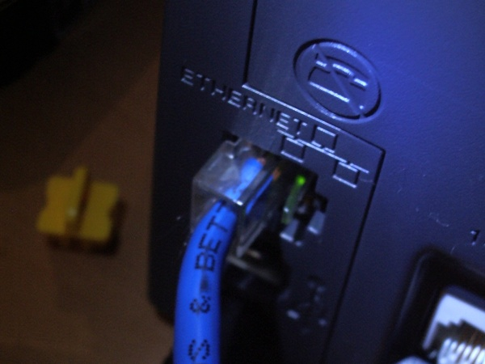
Data Trickling
Perform regular network tracing
  Useful not only in critical situations
  Some applications send sensitive data over the wire
Perform port scanning on the edge
  Evil admin may listen to your network

Slide 23
Watchdog Service
Admin is still working
demo

Slide 24
DNS Tunneling
Interesting way of sending files

Slide 25

Entry TTL!
Ouch!

Slide 26
EntryTTL
Unappropriate attribute usage
demo

Slide 27
Introduction
Innocent Games
Task Manager Is Not Enough
Explorer Is Not Enough
MoveFileEx Function
Diagnostic and Recovery Toolset
Data Is Trickling
Administrators Take Shortcuts
Summary

Slide 28

Administrators Take Shortcuts
Technical „power” against people having 100% power
Non-technical issues
  Law
  Rules and compliance
  Documentation
  Rotate responsibilities
  External audits
Notes:
Mówimy o awansie

Slide 29
Introduction
Innocent Games
Task Manager Is Not Enough
Explorer Is Not Enough
MoveFileEx Function
Diagnostic and Recovery Toolset
Data Is Trickling
Administrators Take Shortcuts
Summary

Slide 30

Be Proactive!
Infrastructure must be well documented
Split and rotate tasks between admins
Use the legal code
Perform periodical checks
  Autoruns
  Kernel Level Files
  Network Traffic
  Processes
Source: Heard.TypePad.com
Notes:
Wina kierownika jak nie jest

Slide 31
Thank You!

Slide 32












Required Slide
Complete an evaluation on CommNet and
enter to win!

Slide 33
Resources
EZNamespaceExtensions.Net v2011
http://blogs.technet.com/b/plitpromicrosoftcom/
Thanks to:
  Grzegorz Tworek
  Bartosz Kierun

Slide 34





Resources
  Connect. Share. Discuss.
http://northamerica.msteched.com
Learning
  Sessions On-Demand & Community
  Microsoft Certification & Training Resources
www.microsoft.com/teched
www.microsoft.com/learning
  Resources for IT Professionals
  Resources for Developers
http://microsoft.com/technet
http://microsoft.com/msdn

Slide 35

© 2011 Microsoft Corporation. All rights reserved. Microsoft, Windows, Windows Vista and other product names are or may be registered trademarks and/or trademarks in the U.S. and/or other countries.
The information herein is for informational purposes only and represents the current view of Microsoft Corporation as of the date of this presentation. Because Microsoft must respond to changing market conditions, it should not be interpreted to be a commitment
on the part of Microsoft, and Microsoft cannot guarantee the accuracy of any information provided after the date of this presentation. MICROSOFT MAKES NO WARRANTIES, EXPRESS, IMPLIED OR STATUTORY, AS TO THE INFORMATION IN THIS PRESENTATION.

