Slide 1

Conficker “ Taming the Threat ”
SIM303
Paul Devlin
Premier Field Engineer
Microsoft

Slide 2
Time to walk through a real-life experience !
From horror to health at a Hospital in Northern Ireland
How great teamwork helped !
How quickly a small alert turned into a major crisis
How I ended up in the middle of a security crisis by total chance !

Slide 3
Session Overview
Identifying the threat and dealing with it.
Creating an action plan that works fast for remediation.
Dealing with the crisis and setting customer expectations for resolution.
Customers who have been infected – how Microsoft helped them.

Slide 4

Conficker – Under the hood!

Slide 5

What is Conficker ?
“ The Conficker worm is a computer worm that can infect your computer and spread itself to other computers across a network automatically, without human interaction.”
http://www.microsoft.com/security/worms/conficker.aspx#EWC

Slide 6
Self updating malware at its best!
Conficker has been named the worst malware outbreak in the past five years!
MS08-067 is the patch for this vulnerability.
Many customers still haven’t installed MS08-067 !

Slide 7
What has happened since Microsoft released MS08-067?
We issued strong and clear guidance on how to avoid the infection. KB960027
Customers quickly realised how important it is to patch! Conficker was the teacher.
Infection rates were very high, despite added press coverage of the threat.
April 1st 2009 had became a day to dread, people believed Conficker would launch a worldwide attack.

Slide 8
This Virus likes to keep in touch!
It contacts 500 of a potential 50,000 domains a day, to check for new instructions or code updates.
Some security vendors actually registered the domains that conficker contacted, this was how they were able to estimate the infection rates.
Some vendors even knew what companies were infected and the amount of machines within that company.

Slide 9
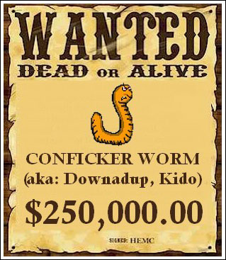
Microsoft issued a reward ☺

Slide 10
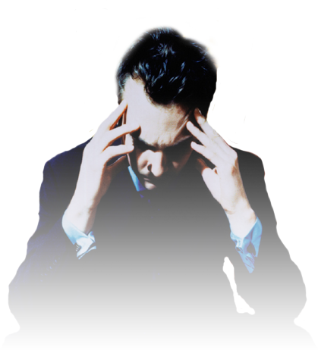
What usually happens, when Conficker strikes?
Infections start to soar
Helpdesk calls come flooding in
THE CIO PANICS!

Slide 11
Signs of Conficker on the network
Domain controllers – Slow response, overwhelmed
Account lockouts = High
Depending on the variant, various security related websites and services will cease to function, however this is very sporadic behavior.
Any application that is network aware will crawl.
High email alerts from the Anti-Virus server.

Slide 12
Why is it called Conficker?
The name of this threat was derived by selecting fragments of the domain 'trafficconverter.biz', a string found in Worm:Win32/Conficker.A: (fic)(con)(er) => (con)(fic)(+k)(er) => conficker
The worm is also known as Downadup by some security companies.

Slide 13
How many variants are there?
Worm:Win32/Conficker. A
Worm:Win32/Conficker. B
Worm:Win32/Conficker. C
Worm:Win32/Conficker. D
Worm:Win32/Conficker. E

Slide 14
The history of conficker
October 23, 2008 – MS08-067 is released (this is three months before the attacks started!)
November 22, 2008: W32.Conficker.A is released
December 28, 2008: W32.Conficker.B is released
March 4, 2009: W32.Conficker.B downloads W32.Conficker.C
April 1, 2009: W32.Conficker.C begins checking 500 of 50,000 domains
April 7, 2009: W32.Conficker.E is seeded into W32.Conficker.C P2P network
W32.Conficker.E updates W32.Conficker.B
W32.Conficker.C downloads other risks

Slide 15
Social Engineering
User Deception – What one would you click?

Slide 16
A Typical autorun.inf
[autorun]
shellexecute=Servers\splash.hta *DVD*
icon=Servers\autorun.ico

Slide 17
Conficker’s autorun.inf
[autorun]
Action=Open folder to view files
Icon=%systemroot%\system32\shell32.dll,4
Shellexecute=.\RECYCLER\S-5-3-42-2819952290-8240758988-879315005-3665\jwgkvsq.vmx,ahaezedrn

Slide 18
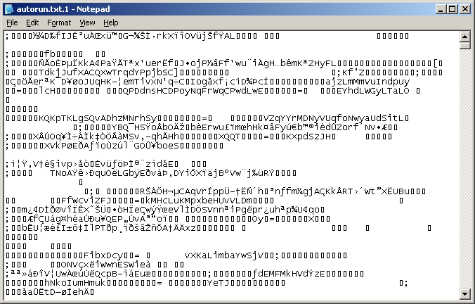
Cont’d – a hidden file created!

Slide 19
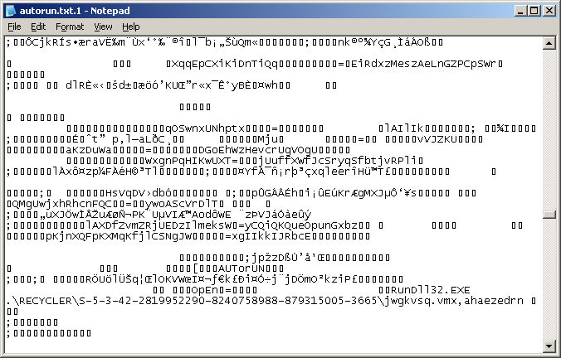
And more… Unique to each Infection!

Slide 20
The infection strategy
Usernames will be used as a form of guessing a password, for example, if James is logged on the payload will try james123 123james or the letters jumbled up.
The first attack will be on the internal network, then out to the public IP’s however there is a blacklist!! That it will not try. Which is interesting.
The worm will not attempt to attack AV company IP addresses, it will generate random domain names.

Slide 21
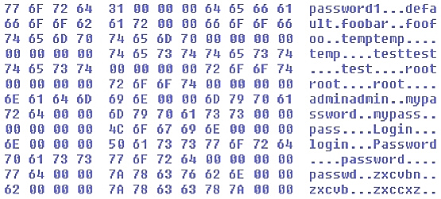
Password guessing

Slide 22
The worm modifies the following registry key to create a randomly named service on the affected system:
HKLM\SYSTEM\CurrentControlSet\Services\{random}\ Parameters\"ServiceDll" = "Path to worm"
When the machine reboots a hidden service will start up! This can be viewed with sysinternals autoruns.

Slide 23
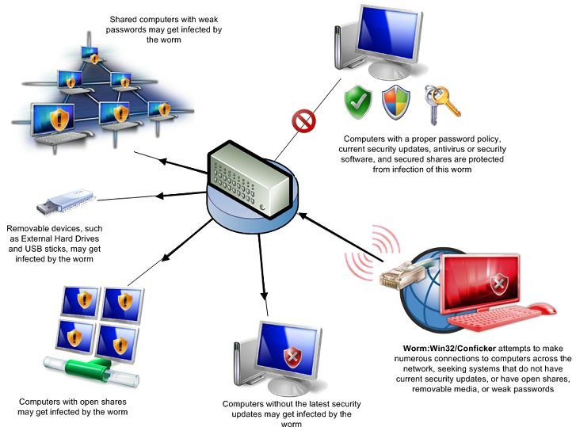
Attack Vectors
Source of graphic www.microsoft.com/mmpc

Slide 24

The MMPC – Your friend in Protection
http://www.facebook.com/note.php?note_id=77362553925#!/pages/Microsoft-Malware-Protection-Center/29456973460
Join there Facebook Page and keep yourself updated on current threats !

Slide 25
The best way to get infected!
You are logged on to a machine as a Domain Administrator with an account that has a weak password and you have an infected USB Pen drive inserted, this will almost guarantee Conficker will spread !

Slide 26
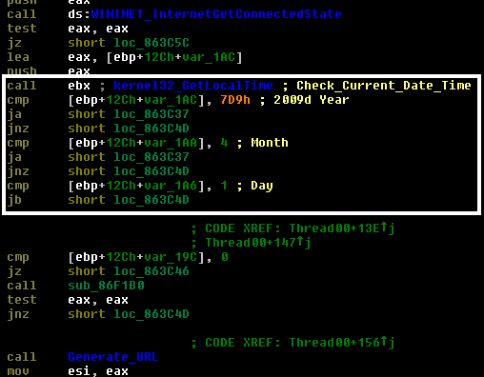
This is what lead to the April 1st Panic.

Slide 27
Interesting facts!
The threat has protected itself from takeover. Transferred payload files were encrypted, as well as digitally signed, and only the Conficker authors had the key.
In many ways, April 8th was what many thought April 1st was supposed to be. Not only did a new variant emerge (W32.Conficker.E), but two other risks (W32.Waledac and SpywareProtect2009) appeared on Conficker-infected computers as well.
If we look at the trends of Conficker being associated with rogue Anti-spyware, financial gain would seem to be the motive behind it.

Slide 28
Cont’d…
You can track Conficker’s activity via http://www.shadowserver.org
Conficker B’s Payload contains a rar (compressed) file with the GEO-IP database compressed inside.
Conficker contacts two well-known web sites and calculates the computer’s average bandwidth, then uses this value to configure how many simultaneous remote procedure call (RPC) exploit scans are allowed at one time.

Slide 29
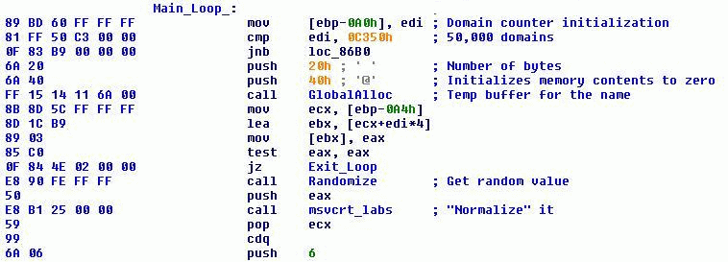
Domain generation
The latest Conficker variant is known to generate 50,000 domain names using its own generator algorithm.

Slide 30
Conficker.C checks the time via the following sites
4shared.com, adobe.com, allegro.pl, ameblo.jp, answers.com, aweber.com, badongo.com, baidu.com, bbc.co.uk, blogfa.com, clicksor.com, comcast.net, cricinfo.com, disney.go.com, ebay.co.uk, facebook.com, fastclick.com, friendster.com, imdb.com, megaporn.com, megaupload.com, miniclip.com, mininova.org, ning.com, photobucket. com, rapidshare.com, reference.com, seznam.cz, soso.com, studiverzeichnis.com, tianya.cn, torrentz.com, tribalfusion.com, tube8.-com, tuenti.com, typepad.com, ucoz.ru, veoh.com, vkontakte.ru, wikimedia.org, wordpress.com, xnxx.com, yahoo. com, youtube.com

Slide 31

Field Experience
Belfast Health & Social Care Trust
customer

Slide 32
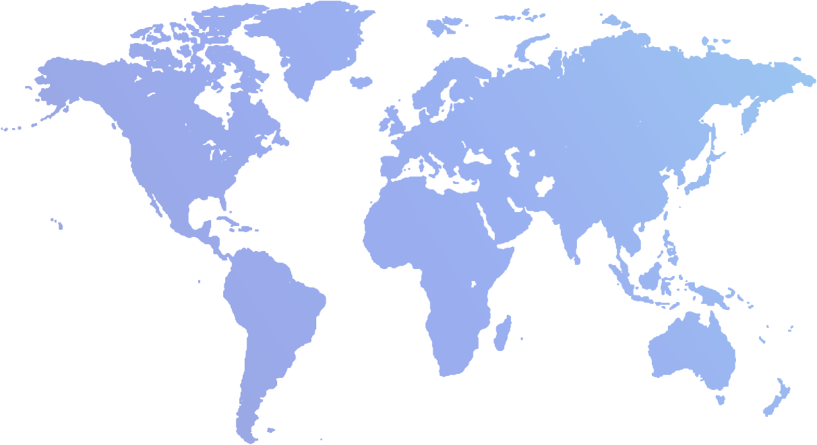

The Belfast Trust
Formed in April 2007 with the merging of 6 existing healthcare trusts
Belfast City Hospital
The Royal Hospitals
Mater Hospital
South and East Belfast
North and West Belfast
Green park Healthcare Trust

Slide 33
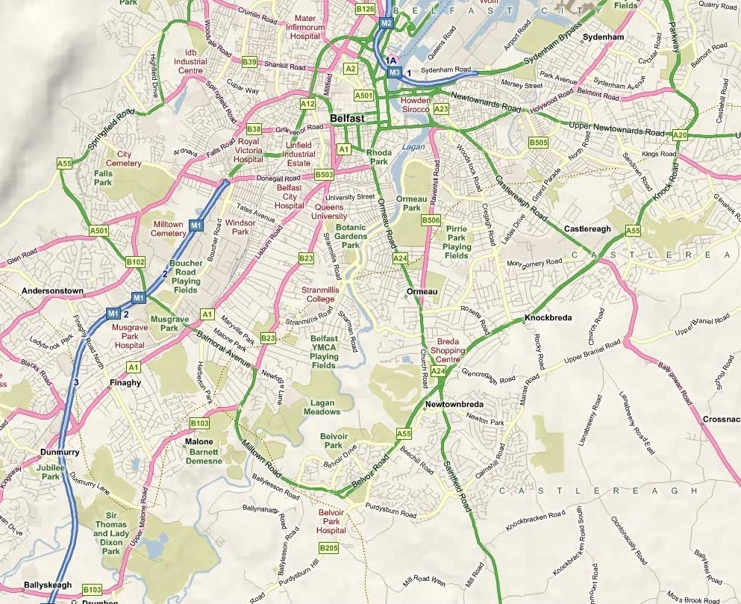
The Belfast Trust Sites
Foster
Green
Hospital
Knockbracken
Healthcare
Park

Slide 34
Conficker’s Impact at BHSCT
2000+ Workstations infected at the largest site.
Clinical services impacted; Children's, The Intensive care unit and General Medical Wards.
Poison database for ER Dept. could not be accessed due to network saturation.
Sophos Anti-Virus server was also infected, so the situation wasn’t looking good!

Slide 35
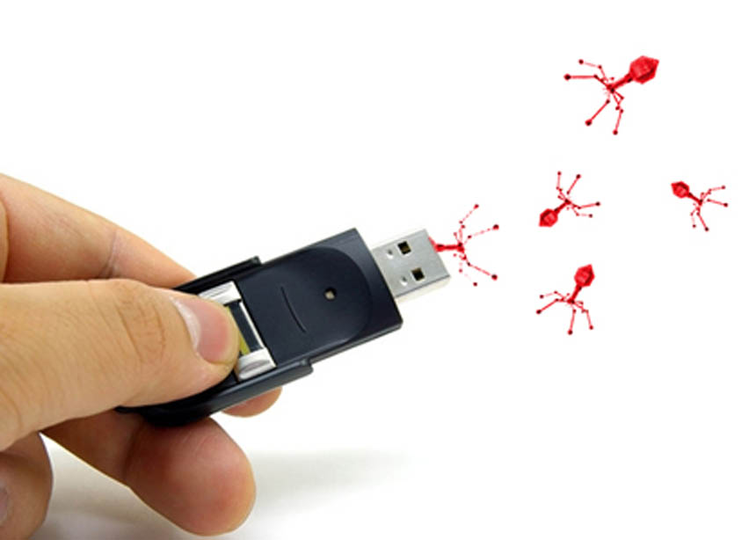
How we successfully tamed the threat.

Slide 36
What resources did we have?
Microsoft Consultancy Services & PFE both happened to be onsite that day.
Internal IT Staff dedicated themselves to working round the clock.
We opened a Sev-A case with PSS Security.
Once we had our action plan in place we acted immediately due to the strain on clinical services.
We also brought in the network team to shut down SMB port 445.

Slide 37
Remediation in action!
Our first step was to assess the number of infections we had, but how? The AV Server was Infected ☹
We used EventCombMT and log parser as per Kurt Faldes guidance. http://blogs.technet.com/b/kfalde/archive/2009/01/28/using-logparser-eventcomb-to-find-malware.aspx
We then scanned the network using McAfee’s Conficker Detection Utility to scan IP ranges.

Slide 38
What happened next?
Active Directory stopped replicating!
As it turned out Kurt Falde our CSS Engineer from Microsoft previously worked in Directory Services and fixed replication ☺
This event put us back by about two hours!
At this stage we became very alarmed ☺ but Kurt kept very calm ☺
Our next step was to follow the guidance in http://support.microsoft.com/kb/962007#Mitigationsteps

Slide 39
We started to become in control instead of Conficker !
As per the KB article we put restrictions on SVCHOST, to prevent the malware spread.
We then disabled Auto-run a common attack vector as mentioned previously.
We made sure nobody was logging on using domain admin credentials!
We had two people dedicated to cleaning servers manually.

Slide 40
We then realised we had a tool that could speed things up!
We turned to our SMS Server it was clean, which was surprising.
We took the removal tool we had been using on servers.
“Kaspersky’s Killer removal tool, this tool was excellent and fast. http://support.kaspersky.com/faq?chapter=207800963&print=true&qid=208279973
We distributed the tool to workstations to run silently on all clients, followed by MS08-067.

Slide 41
The effect was dramatic !
Machines started to report back as cleaned ☺ after we rebooted them.
We had to use PS Shutdown from Sysinternals to reboot all clients so the patch would apply.
The EventComb log files started to show fewer infected IP addresses.
As machines we’re being powered on by users SMS would run the tool and apply the patch.

Slide 42

We looked like heroes ☺

Slide 43
I now had a mantra for Conficker removal.
SVCHOST – Applying special permissions, KB962007
MS08-067 – Make sure its installed!
KK.exe from Kaspersky – Even though its third party it works very fast in emergency situations.

Slide 44

Successful outcome!
Services were now restored to BHSCT.
All together it took 2 and a half days to be completely cleaned.
There were 4 machines that we could not clean, these turned out to be remote workgroups belonging to external medical vendors, they were dealt with manually.

Slide 45
Measuring User Impact from the worm.
Authentication onto the domain is slowed (Impacting perception of IT)
Multiple Messages appearing on machines informing of a virus (Impacting Perception of IT)
Change of Process: No USB access is allowed which restricts some common working practices
There is a reduction in time to fix Service Desk Calls and Work requests due to staff being directed to address virus issues (Impacting perception of IT)

Slide 46
Measuring Business Impact.
The Cost of Overtime.
The Cost of Third Parties.
Impact to projects – being put on hold.
Reputation from users.
Reputation from the other Business Units.

Slide 47

The Conficker Working Group
Combined Industry Teamwork

Slide 48
Typical Customer questions.
Who did this to us?
How do we trace the source?
Why didn’t our Anti-Virus catch this?
We were fully patched why did we get infected?
How do we ensure this doesn’t happen again?

Slide 49
What happened next…..
Since Belfast Trust I have dealt with 14 Conficker outbreaks. I remediated all of them ☺
It now usually takes me 3 days to remove conficker using the plan from BHSCT ‘s outbreak
All customers were large enterprise customers
Only one customer had Forefront – but it was very out of date, dating prior to Conficker. Whenever we updated Forefront the infection was dealt with.
After one particular successful conficker remediation, the customer renewed their premier agreement for another year.

Slide 50
What is happening now?
The last recorded variant was W32.Conficker.E
Infection rates have dropped due to domains being blacklisted by ISP’s and Security companies.
The Conficker Working group has been formed with an alliance of security companies, including Microsoft to keep Monitoring the threat.

Slide 51
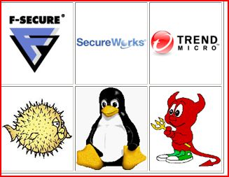
Microsoft Joins the CWG
http://www.confickerworkinggroup.org/
The Conficker eye chart

Slide 52
Industry collaboration message.
As part of the normal threat mitigation process, Microsoft first gathered information about this threat, and then thoroughly analyzed the issue to determine the best course of action. After review, it was determined that Microsoft would reach out to industry partners to address this threat, effectively continuing a long standing trend of community-based defense against malware and online threats.
As many customers around the world are affected by the Conficker worm, Microsoft feels that it is imperative to protect customers by both leveraging internal expertise and partnering with industry allies to proactively prevent the use of DNS exploits in further attacks.
                Credit to J Farenbaugh. Conficker key communications paper.

Slide 53
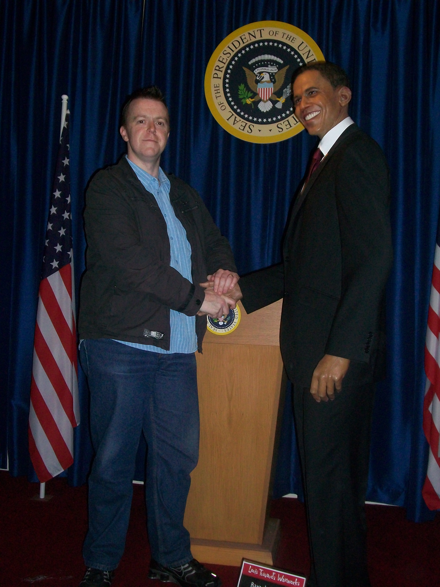
The President thanked me ☺
Just Kidding ☺

Slide 54
Session Objectives and Takeaways
Session Objective(s):
  Learn how to detect and remove Conficker & other malware effectively.
  Measuring Customer Impact, managing expectations and relationships.
Giving you the ability to quickly resolve an outbreak easily.
You do not need to be a security expert to remove this threat! A few simple steps is all you need.

Slide 55
References and interesting information.
http://www.theregister.co.uk/2009/01/20/sheffield_conficker/
http://www.f-secure.com/weblog/archives/00001584.html
http://mtc.sri.com/Conficker/
http://mtc.sri.com/Conficker/P2P/index.html
http://community.ca.com/blogs/securityadvisor/archive/2009/04/15/win32-conficker-teams-up-with-win32-waledac.aspx
http://isc.sans.edu/diary.html?storyid=5860
http://support.kaspersky.com/faq?chapter=207800963&print=true&qid=208279973
http://www.symantec.com/content/en/us/enterprise/media/security_response/whitepapers/the_downadup_codex_ed1.pdf
https://www.dshield.org/diary.html?storyid=5860
http://honeynet.org/node/388
http://www.confickerworkinggroup.org/wiki/
http://technet.microsoft.com/en-us/sysinternals/default.aspx

Slide 56

Trustworthy Computing
Safety and Security Center
http://www.microsoft.com/security
Security Development Lifecycle
http://www.microsoft.com/sdl
Security Intelligence Report
http://www.microsoft.com/sir
End to End Trust
http://www.microsoft.com/endtoendtrust

Slide 57





Resources
  Connect. Share. Discuss.
http://northamerica.msteched.com
Learning
  Sessions On-Demand & Community
  Microsoft Certification & Training Resources
www.microsoft.com/teched
www.microsoft.com/learning
  Resources for IT Professionals
  Resources for Developers
http://microsoft.com/technet
http://microsoft.com/msdn

Slide 58












Complete an evaluation on CommNet and
enter to win!

Slide 59


Slide 60
© 2011 Microsoft Corporation. All rights reserved. Microsoft, Windows, Windows Vista and other product names are or may be registered trademarks and/or trademarks in the U.S. and/or other countries.
The information herein is for informational purposes only and represents the current view of Microsoft Corporation as of the date of this presentation. Because Microsoft must respond to changing market conditions, it should not be interpreted to be a commitment
on the part of Microsoft, and Microsoft cannot guarantee the accuracy of any information provided after the date of this presentation. MICROSOFT MAKES NO WARRANTIES, EXPRESS, IMPLIED OR STATUTORY, AS TO THE INFORMATION IN THIS PRESENTATION.

