Slide 2

Client Management and Security Roadmap and Vision
SIM 214
Garth Fort
General Manager
Microsoft Corporation

Slide 3
What is Consumerization?
video
Notes:
Show video on what people think Consumerization represents

Slide 4


Slide 5

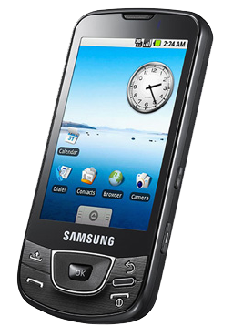
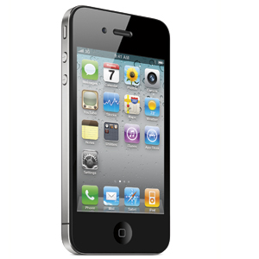
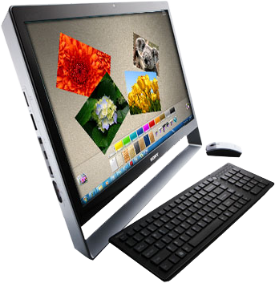
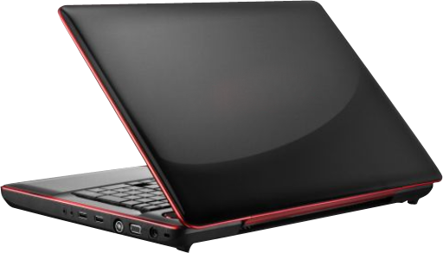
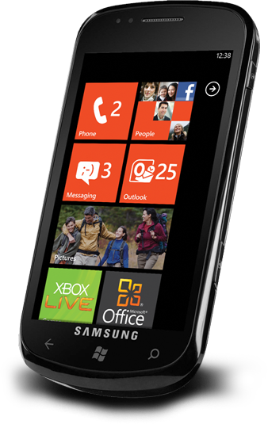
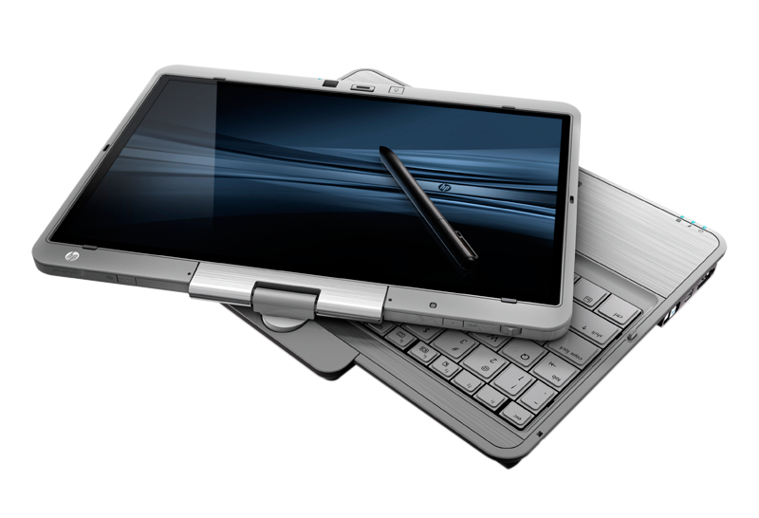


CONSUMERIZATION
Notes:
A trend that represents:
Proliferation of diverse devices
Changing work styles
Self-service models

Slide 6




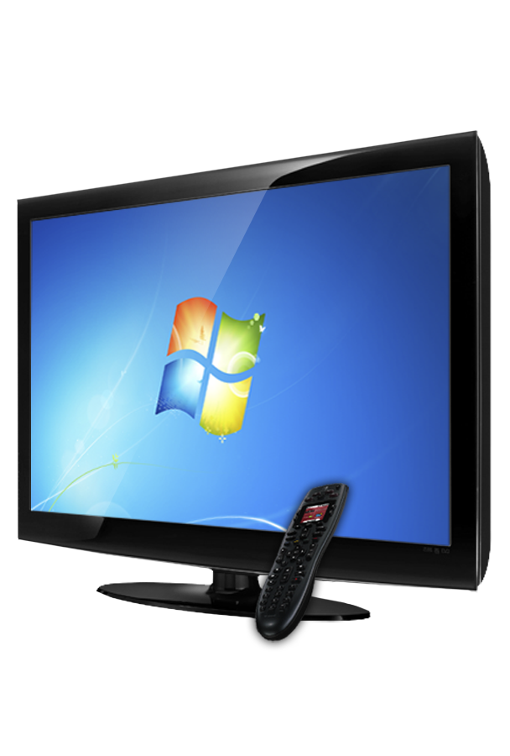
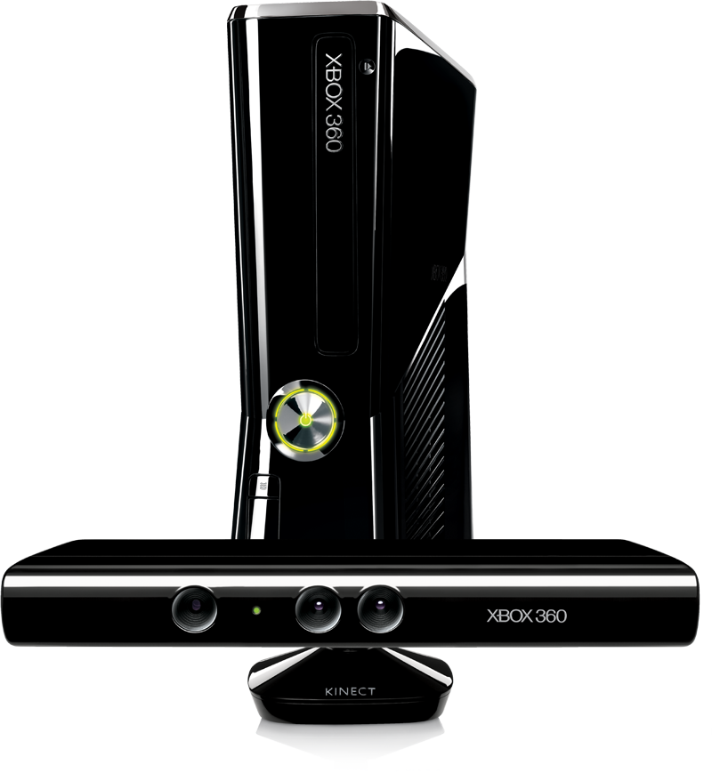
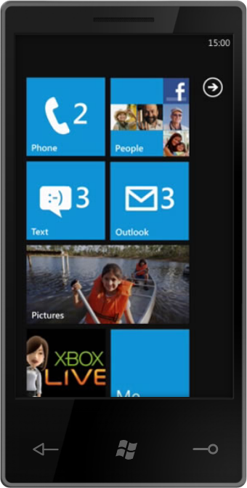
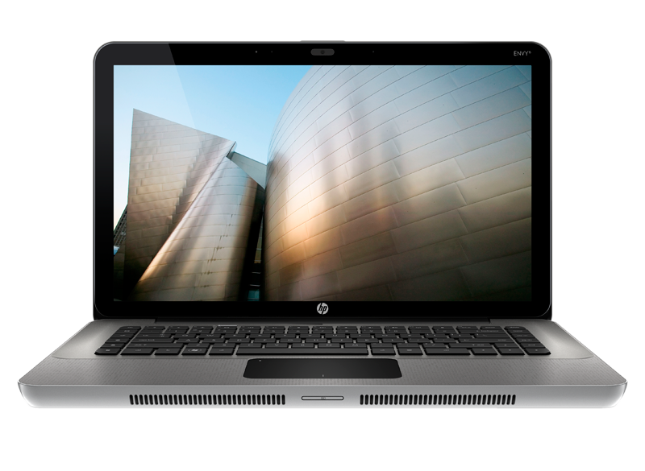
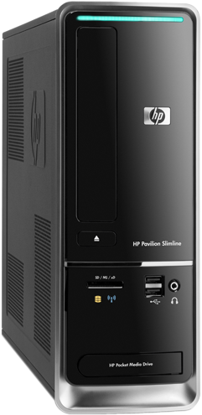
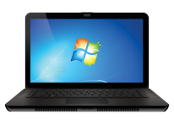
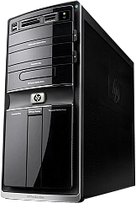
at home
Notes:
In the traditional work style, there was a more clear delineation between home devices for play

Slide 7
at work
Notes:
And devices and locations where work occurred.

Slide 8
at home
at work
Notes:
Today, we see in the modern world that the line between work and home are blurred.

Slide 9
at home
at work
Notes:
People expect to be able to work from their home using consumer devices, as well as use work devices to check on popular social networking sites like facebook and twiter. There is a true blurring of work and life.

Slide 10
How do you…
Ensure Anywhere Productivity?
Protect Data & Maintain Compliance?
Enable The Work/Life Blur?
Notes:
Given these trends, how do you:
Ensure users are productive on diverse devices, from any location and are able to get work done; while protecting corporate data and maintaining compliance
How do you enable this work life blur?
In fact – this is so critical that if IT departments do not facilitate this larger trend, business will lose talent to a company that will support the expectations of the next generation of workers who come to expect productivity anywhere, access to data and application anytime, and social networks used for work and home purposes.

Slide 11
Client management strategies for the future
Shift from a device-centric to user-centric paradigm
Bring mobile devices under management
Support productivity anywhere
Integrate management, security and compliance

Slide 12
System Center
Configuration Manager 2012
Beta 2
http://www.microsoft.com/systemcenter
announcing
Notes:
FEP 2012 is now available
On May 16, 2011, Microsoft is releasing the Forefront Endpoint Protection (FEP) 2012 Beta.
Forefront Endpoint Protection 2012 continues to deliver on the promise of Forefront Endpoint Protection 2010, simplifying and improving endpoint protection while also greatly reducing infrastructure costs. It builds on System Center Configuration Manager 2012, allowing customers to implement endpoint protection as part of a unified infrastructure for securing and managing physical, virtual, and mobile client environments. This shared infrastructure lowers ownership costs while providing improved visibility and control over endpoint management and security.
Key FEP features:
Integration with Configuration Manager. Single interface for managing and securing endpoints reduces complexity and improves troubleshooting and reporting insights.
New Antivirus Engine. Highly accurate and efficient threat detection protects against the latest malware and rootkits with low false positive rate.
New behavioral threat detection. Protection against “unknown” or “zero day” threats provided through behavior monitoring, emulation, and dynamic translation.
Windows Firewall management. Ensures Windows Firewall is active and working properly on all endpoints, and allows administrators to more easily manage firewall protections across the enterprise.
Easy deployment and migration. Using ConfigMgr technology, FEP helps customers migrate from previous and competitive vendors easily.
New FEP 2012 features:
Support for System Center Configuration Manager 2012
Improved real time alerts and reports
Role-based management
User-centric reports
Easy migration from FEP 2010/ConfigMgr 2007
Support for FEP 2010 client agents
http://go.microsoft.com/fwlink/?LinkId=215917

Slide 13



EMPOWER USERS
UNIFY INFRASTRUCTURE
SIMPLIFY ADMINISTRATION
Empower people to be productive from anywhere
Unify IT management across
multiple infrastructures
Improve IT effectiveness
and efficiency
SYSTEM CENTER CONFIGURATION MANAGER 2012
Notes:
Consumerization is a growing challenge for IT organizations. The boundaries between work and life have blurred, and people expect consistent access to corporate services from wherever they are, on any device they’re using—desktops, laptops, smart phones, slates, and other consumer devices. To support rich user experiences across a wide range of mobile devices, IT will need to adopt new processes, new physical infrastructure, and virtualization technologies, while also ensuring that they meet corporate control and compliance requirements. IT must find a way to manage and secure these new enabling technologies without driving up operational costs or increasing administrative complexity.
System Center Configuration Manager 2012 helps IT empower people to use the devices and applications they need to be productive, while maintaining corporate compliance and control. As consumerization becomes a reality, IT organizations face the challenge of delivering a rich experience to users across multiple devices without giving up the control needed to protect corporate assets. Configuration Manager 2012 provides a unified infrastructure for mobile, physical and virtual environments that allows IT to deliver and manage user experiences based on identity, connectivity, and device. Configuration Manager 2012 also makes administrators more impactful with simplified administrative tools and improved compliance enforcement that streamline day-to-day tasks.
---------------------------
Empower
System Center Configuration Manager lets IT empower users with the applications and services they need to be productive from anywhere, on whatever device they choose.
Device Freedom: Configuration Manager 2012 enables the device freedom that people have come to expect while keeping your environment secure and compliant. It manages the wide range of mobile devices that connect to Exchange ActiveSync, including Windows Phone, Symbian, iOS and Android-based devices. It provides a single administrative console for policies, as well as comprehensive asset and compliance reporting.
Optimized, Personalized Application Experience: Configuration Manager 2012 allows users to be productive from anywhere, on both corporate and consumer devices. It evaluates device and network capabilities to deliver applications in the most optimal way for the user, whether that is through a local installation, streaming through App-V, or a presentation server. Through integration with Citrix XenApp, Configuration Manager gives users access to a any business application on a wide array of mobile platforms.
Application Self-Service: Configuration Manager 2012 allows users to securely self-provision applications from anywhere with an easy-to-use web catalog that empowers users to be more productive. Users are only shown the software they have permission to request. I think this should be any – it shouldn’t be limited – it isn’t a defined set.
Unify
System Center Configuration Manager helps IT to streamline IT operations with a unified infrastructure that integrates client management and protection across physical and virtual Windows environments.
Integrated Mobile, Physical and Virtual Management: Configuration Manager 2012 reduces the complexity and cost of implementing virtual environments by providing a single, unified tool to manage all your client desktops, thin clients, mobile devices and virtual desktops. It extends inventory, updating, and configuration capabilities to VDI sessions* and orchestrates application delivery across multiple desktop virtualization platforms.
*This feature will be available in a post-Beta 2 release.
Integrated Security and Compliance: Configuration Manager 2012 reduces IT management and operating costs by providing a single, integrated platform for desktop security and compliance management. Along with Forefront Endpoint Protection 2012, it delivers a single solution for malware protection, identification and remediation of vulnerabilities, while giving visibility into non-compliant systems, including those in pooled VDI environments.
Integrated Service Management: Configuration Manager 2012 helps improve user satisfaction and free up helpdesk resources by connecting to System Center Service Manager. Shared inventory information and self-service tools help shorten time to problem resolution.
Simplify
System Center Configuration Manager simplifies administration and gives IT improved compliance visibility and enforcement controls, including the ability to automatically remediate non-compliant systems.
Comprehensive Client Management: Configuration Manager 2012 continues to deliver world-class inventory, OS deployment, update management, assessment, and settings enforcement, with exceptional support for Windows. The new Configuration Manager 2012 platform allows customers to do more with less.
Increased Administrator Effectiveness: Configuration Manager 2012 makes it easier and faster for IT administrators to perform day-to-day tasks. A new improved user interface that allows IT to organize administrative tasks by business roles ensures that only relevant features are visible to any given role. A new application model allows administrators to define an application for a user once and deliver it across multiple devices. For compliance management, continuous settings enforcement automatically identifies and remediates non-compliant physical or virtual desktops, limiting non-compliance and minimizing downtime.
Reduced Infrastructure Complexity: Configuration Manager 2012 helps make IT more efficient with minimal infrastructure requirements, server role consolidation, reduced data latency and improved scale.

Slide 14
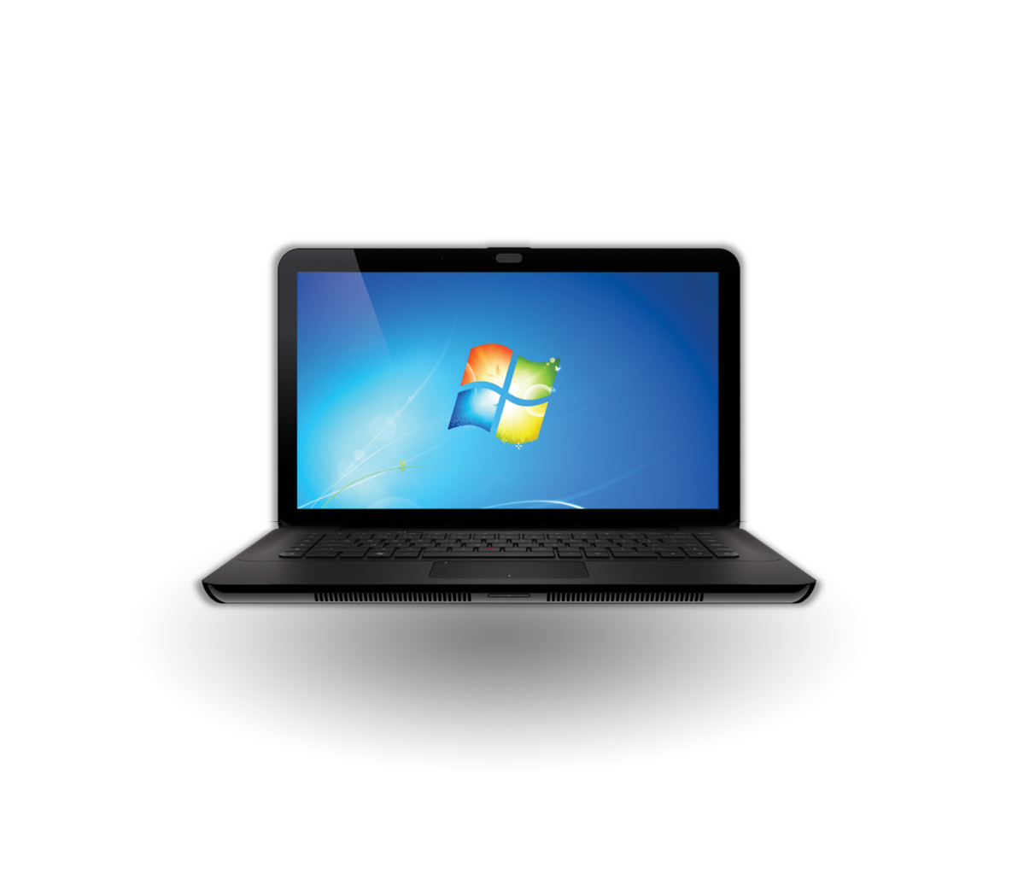
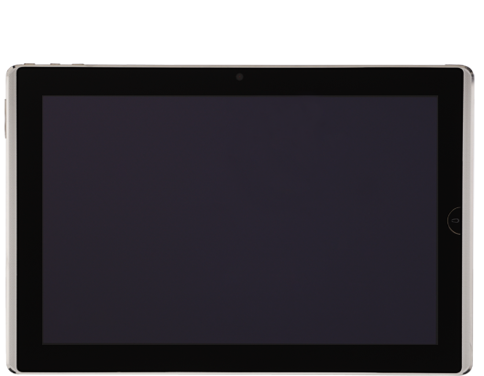

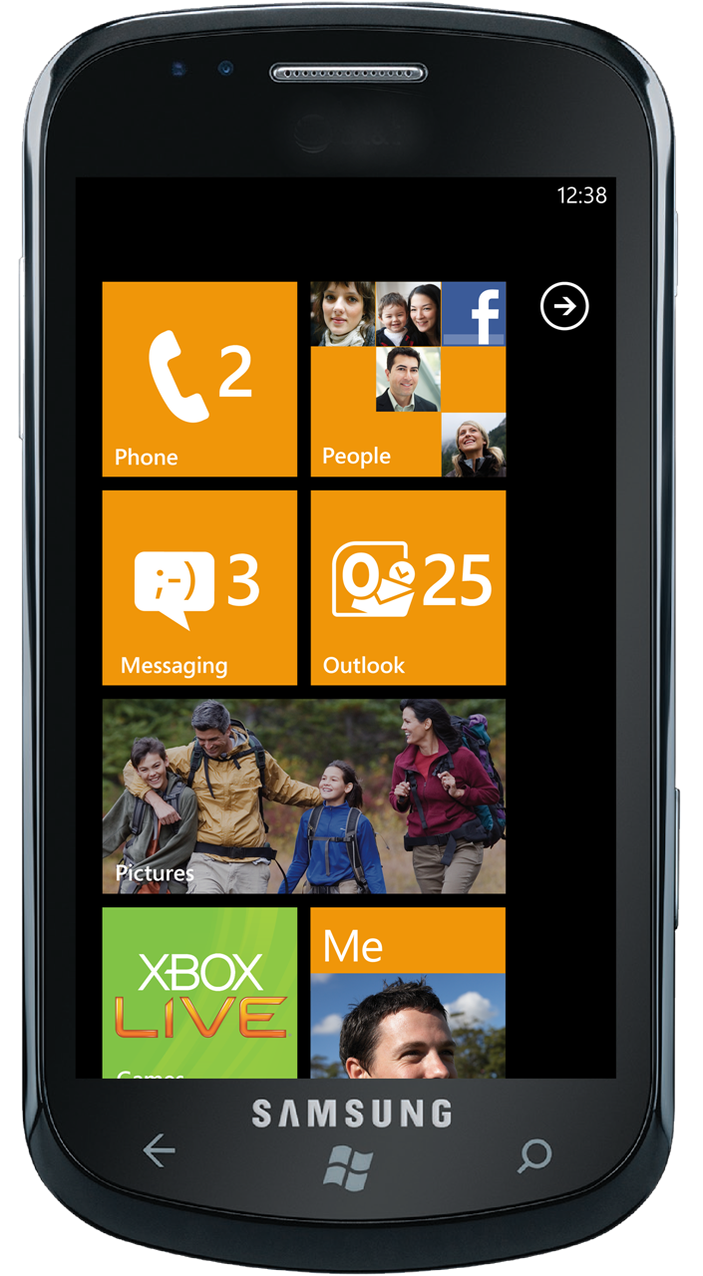
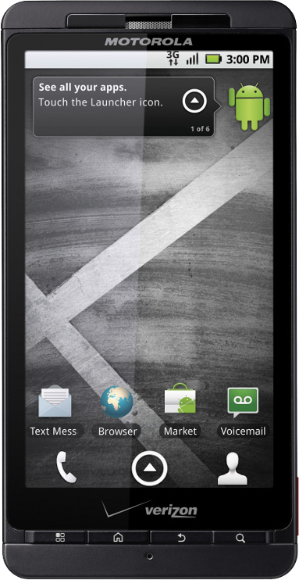
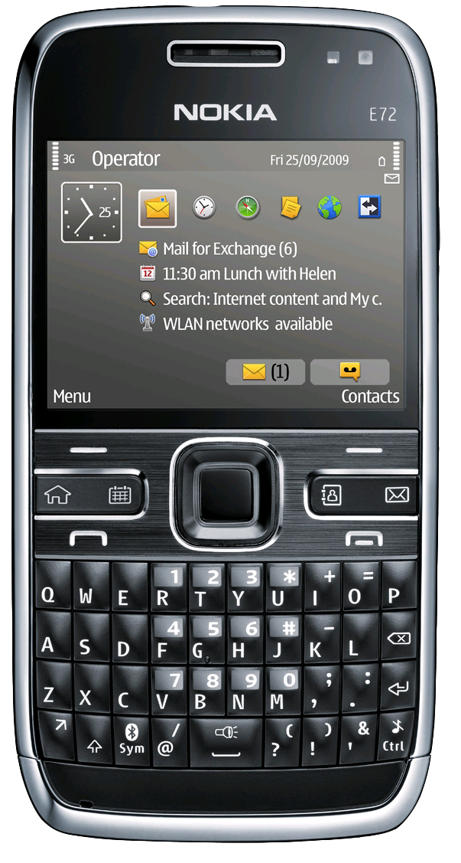
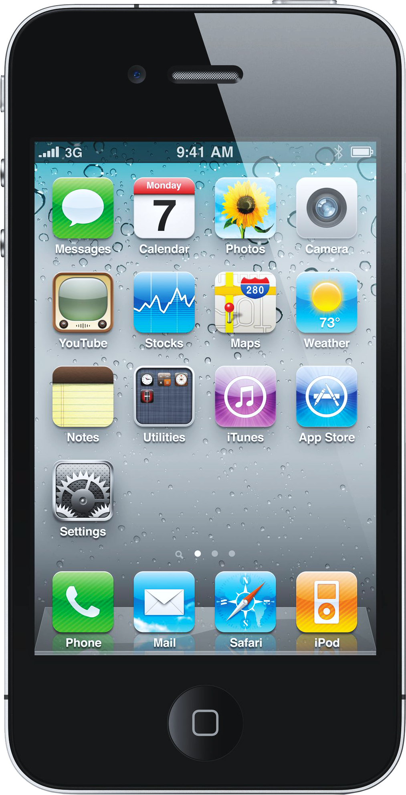
Device freedom
VISIBILITY, POLICY AND CONTROL FOR MOBILE DEVICES
Notes:
Device Freedom: Configuration Manager 2012 enables the device freedom that people have come to expect while keeping your environment secure and compliant. It manages the wide range of mobile devices that connect to Exchange ActiveSync, including Windows Phone, Symbian, iOS and Android-based devices. It provides a single administrative console for policies, as well as comprehensive asset and compliance reporting.

Slide 15
Mobile Device Management
Mike Chan
Sr. Product Manager
System Center
demo

Slide 16

MAKING USERS PRODUCTIVE ANYWHERE
Notes:
Optimized, Personalized Application Experience: Configuration Manager 2012 allows users to be productive from anywhere, on both corporate and consumer devices. It evaluates device and network capabilities to deliver applications in the most optimal way for the user, whether that is through a local installation, streaming through App-V, or a presentation server. Through integration with Citrix XenApp, Configuration Manager gives users access to a any business application on a wide array of mobile platforms.

Slide 17
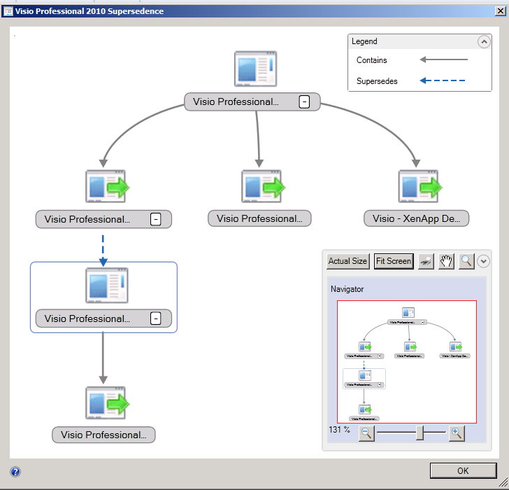
Optimized Application Experiences
Neha Sharma
Group Product Manager
System Center
demo

Slide 18
End Users Empowered
video

Slide 19


Slide 20

UNIFIED INFRASTRUCTURE – SIMPLIFIED IT
Notes:
Unify
System Center Configuration Manager helps IT to streamline IT operations with a unified infrastructure that integrates client management and protection across physical and virtual Windows environments.
Integrated Mobile, Physical and Virtual Management: Configuration Manager 2012 reduces the complexity and cost of implementing virtual environments by providing a single, unified tool to manage all your client desktops, thin clients, mobile devices and virtual desktops. It extends inventory, updating, and configuration capabilities to VDI sessions* and orchestrates application delivery across multiple desktop virtualization platforms.
*This feature will be available in a post-Beta 2 release.
Integrated Security and Compliance: Configuration Manager 2012 reduces IT management and operating costs by providing a single, integrated platform for desktop security and compliance management. Along with Forefront Endpoint Protection 2012, it delivers a single solution for malware protection, identification and remediation of vulnerabilities, while giving visibility into non-compliant systems, including those in pooled VDI environments.
Increased Administrator Effectiveness: Configuration Manager 2012 makes it easier and faster for IT administrators to perform day-to-day tasks. A new improved user interface that allows IT to organize administrative tasks by business roles ensures that only relevant features are visible to any given role. A new application model allows administrators to define an application for a user once and deliver it across multiple devices. For compliance management, continuous settings enforcement automatically identifies and remediates non-compliant physical or virtual desktops, limiting non-compliance and minimizing downtime.

Slide 21
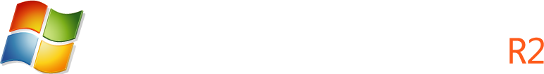
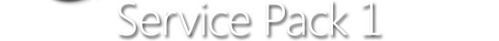



5 VMs, 460,800 concurrent users
1 HP BL680C Blade Server
Each blade with up to 24 cores, 128GB RAM
155 Disk EMC CX4-960 Disk Array
4 VMs, 80,000 concurrent OLTP customers
4 VMs, Scaled to 20,000 mailboxes
HYPER-V VIRTUALIZATION SCALE
Notes:
Whitepaper located at:
http://download.microsoft.com/download/A/D/2/AD21FD07-51A0-418E-BA8B-937FB5777A90/ESG%20Lab%20Combined%20Hyper-V%20Workload%20Summary%20Mar%2011[4].pdf
Tier -1 Workloads testing, promoted at MMS 2011: Microsoft commissioned third-party to conduct performance testing of Windows Server 2008 R2 SP1 Hyper-V, running four key Microsoft workloads:
SharePoint Server 2010
SQL Server 2008 SP2
Exchange Server 2010
Windows 7 based VDI Workload
Testing parameters: Take existing VMware public workload whitepapers, align the Microsoft testing with those methodologies, and demonstrate Hyper-V with equivalent or better performance. Tests were not exact replicas (the MSFT tests had newer hardware but were also running newer version of software [Exchange 2010 vs. Exchange 2007]), but all the tests produced results that were equal to or better than the published VMware benchmarks.
Sharepoint Server:
Configuration: One HP Blade, 128GB of RAM, with 155 disk EMC array; Single Hyper-V R2 SP1 server, running five VMs
Results: 460,800 concurrent users
SQL Server 2008 Enterprise:
Configuration: One HP Blade, 128GB of RAM, with 155 disk EMC array; Single Hyper-V R2 SP1 server, running four VMs
Results: Hosted 80,000 simulated concurrent OLTP customers
Exchange Server 2010:
Configuration: One HP Blade, 128GB of RAM, with 155 disk EMC array; Single Hyper-V R2 SP1 server, running four VMs
Results: Scaled to IO requirements of 20,000 mailboxes
Windows VDI:
Configuration: One HP Server with 110GB RAM, 42 disk iSCSI target running 120 VMs
Results: With With Dynamic Memory, VDI workloads results in a 40% increase in density using the Dell reference architecture. Disk now limited factor for VDI scale, not memory

Slide 22
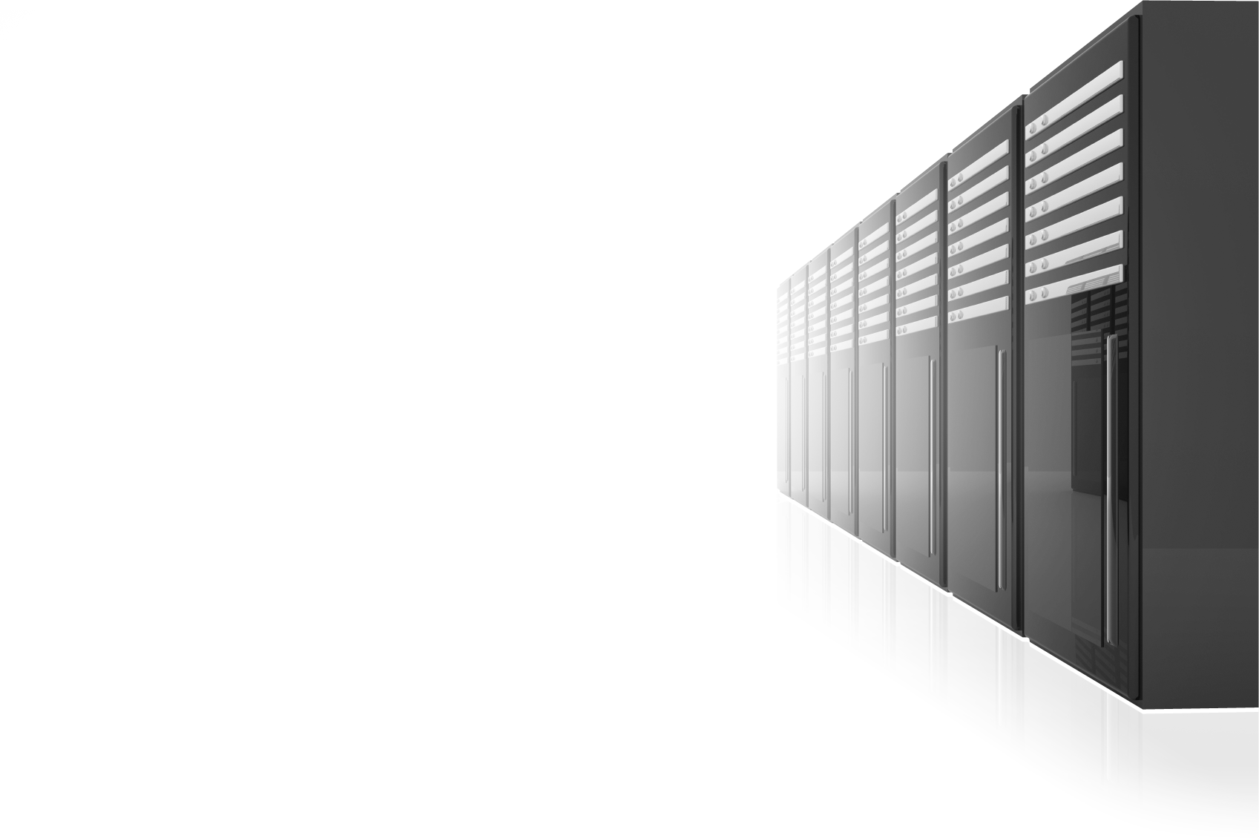
Highest VM Density, Up 40% Over Windows Server 2008 R2
Remote FX – Rich User Experiences
Lowest Cost Per User
VIRTUAL DESKTOP INFRASTRUCTURE
Notes:
SP1 increased VM density using Windows 7 SP1 as the Guest OS
Remote FX allows for offloading of graphics processing to the local GPU allowing for Aero, video and full, rich UI
Lowest Cost Per User VDI environment

Slide 23
Managing a Virtual Desktop Infrastructure
Neha Sharma
Group Product Manager
System Center
demo

Slide 24

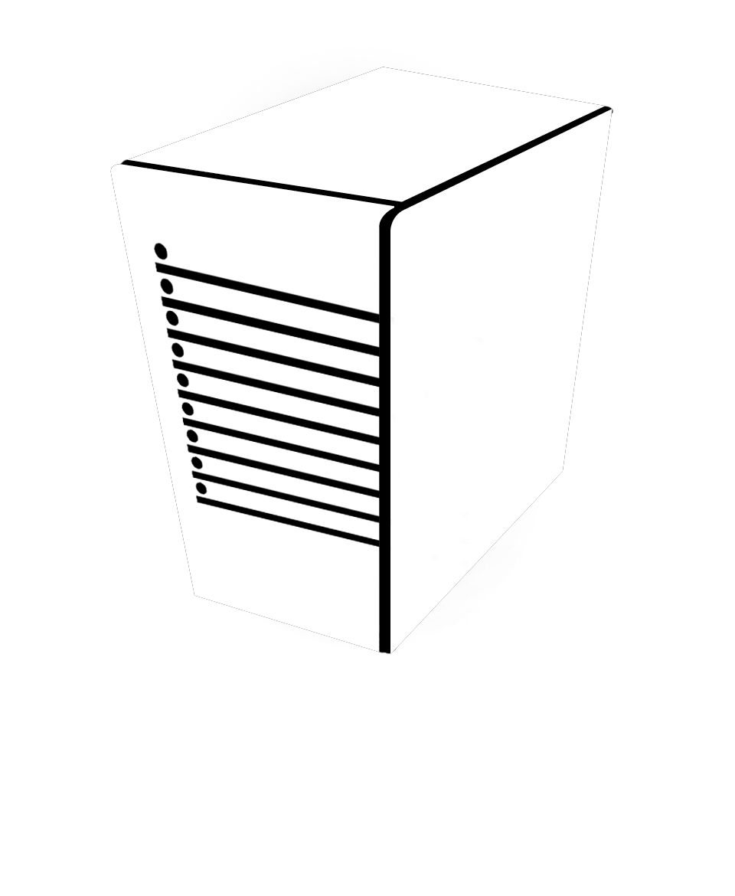
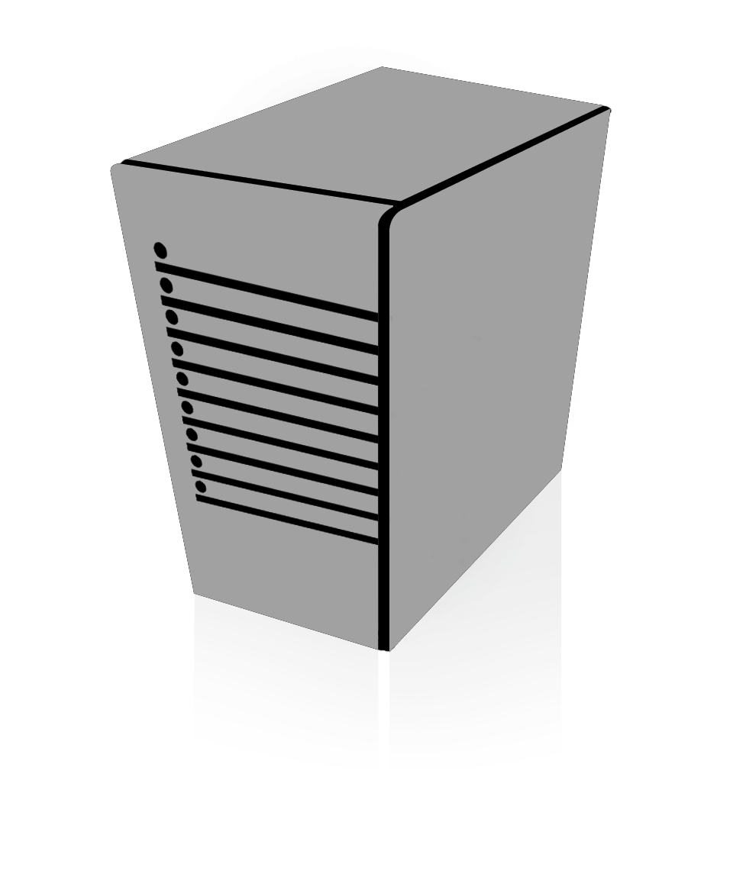




Now a part of Core CAL!
For customers already using SCCM, adding FEP 2010 is a perfect solution because it leverages their investments in SCCM and reduces cost and complexity.
Single Infrastructure for Management & Security
Two Separate Infrastructures for Management & Security
- Neil MacDonald, VP & Fellow, Gartner | Search Security News, Jan. 5, 2011
Notes:
FEP 2010 now a part of CoreCAL
Aligns with Microsoft’s strategy to bring together Management and Security
CoreCAL contains Windows Server CAL, Exchange CAL, SharePoint CAL and ConfigMgr CAL and now includes Lync Std. and FEP.
Existing customers can apply for early user rights.
MSIT Case Study – Deployment of FEP 2010 only required 1 additional ConfigMgr server for reporting purposes across 300,000 client machines

Slide 25
Forefront
Endpoint Protection 2012
Beta
http://www.microsoft.com/fep
announcing
Notes:
FEP 2012 is now available
On May 16, 2011, Microsoft is releasing the Forefront Endpoint Protection (FEP) 2012 Beta.
Forefront Endpoint Protection 2012 continues to deliver on the promise of Forefront Endpoint Protection 2010, simplifying and improving endpoint protection while also greatly reducing infrastructure costs. It builds on System Center Configuration Manager 2012, allowing customers to implement endpoint protection as part of a unified infrastructure for securing and managing physical, virtual, and mobile client environments. This shared infrastructure lowers ownership costs while providing improved visibility and control over endpoint management and security.
Key FEP features:
Integration with Configuration Manager. Single interface for managing and securing endpoints reduces complexity and improves troubleshooting and reporting insights.
New Antivirus Engine. Highly accurate and efficient threat detection protects against the latest malware and rootkits with low false positive rate.
New behavioral threat detection. Protection against “unknown” or “zero day” threats provided through behavior monitoring, emulation, and dynamic translation.
Windows Firewall management. Ensures Windows Firewall is active and working properly on all endpoints, and allows administrators to more easily manage firewall protections across the enterprise.
Easy deployment and migration. Using ConfigMgr technology, FEP helps customers migrate from previous and competitive vendors easily.
New FEP 2012 features:
Support for System Center Configuration Manager 2012
Improved real time alerts and reports
Role-based management
User-centric reports
Easy migration from FEP 2010/ConfigMgr 2007
Support for FEP 2010 client agents
http://go.microsoft.com/fwlink/?LinkId=215917

Slide 26
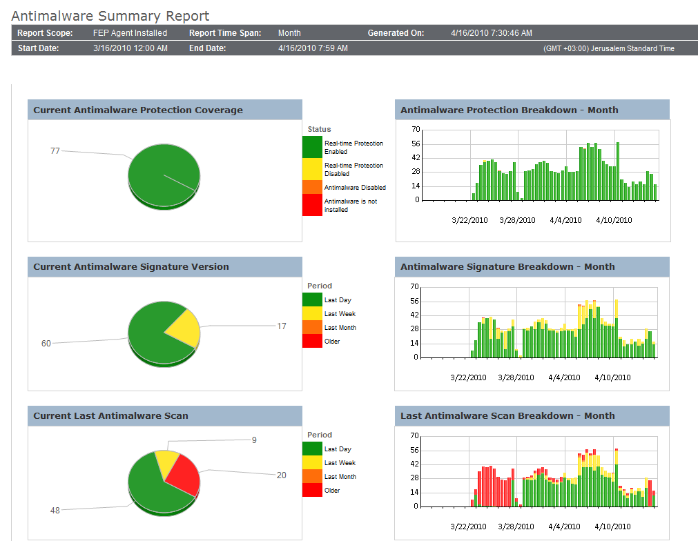
Security & Client Management Convergence
Adwait Joshi
Sr. Product Manager
System Center
demo
Notes:
Integrated Security and Compliance: Configuration Manager 2012 reduces IT management and operating costs by providing a single, integrated platform for desktop security and compliance management. Along with Forefront Endpoint Protection 2012, it delivers a single solution for malware protection, identification and remediation of vulnerabilities, while giving visibility into non-compliant systems, including those in pooled VDI environments.
Increased Administrator Effectiveness: Configuration Manager 2012 makes it easier and faster for IT administrators to perform day-to-day tasks. A new improved user interface that allows IT to organize administrative tasks by business roles ensures that only relevant features are visible to any given role. A new application model allows administrators to define an application for a user once and deliver it across multiple devices. For compliance management, continuous settings enforcement automatically identifies and remediates non-compliant physical or virtual desktops, limiting non-compliance and minimizing downtime.

Slide 27

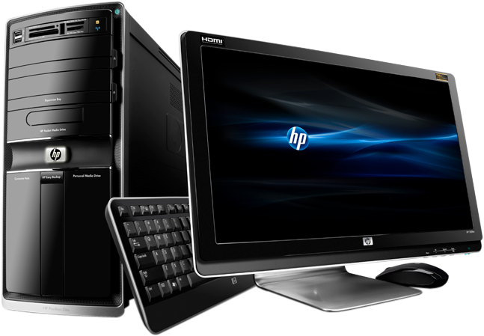
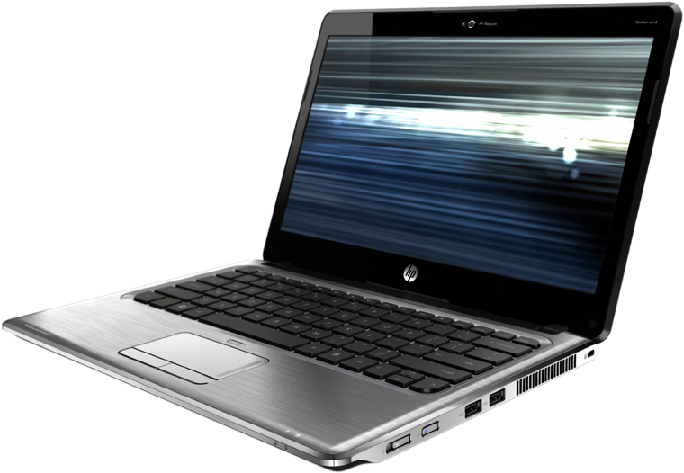
MANAGEMENT & SECURITY FROM THE CLOUD
Notes:
We are entering a new era of simplified systems management. The future is cloud based management.
Unmanaged or undermanaged PC’s : Highly distributed workers, off corporate network workers, mergers & acquisitions, field & contract employees, non-domain joined PCs (home machines)
Limited IT Resources:
Limited budget & staff to setup the internet-facing infrastructure or manage additional servers.
Early Cloud Adopters:
Interested in moving IT infrastructure to the cloud or reduce server footprint—and are willing to make other tradoffs
Quick deployment:
Customer needs a solution that can be setup very quickly (i.e. M&A)

Slide 28


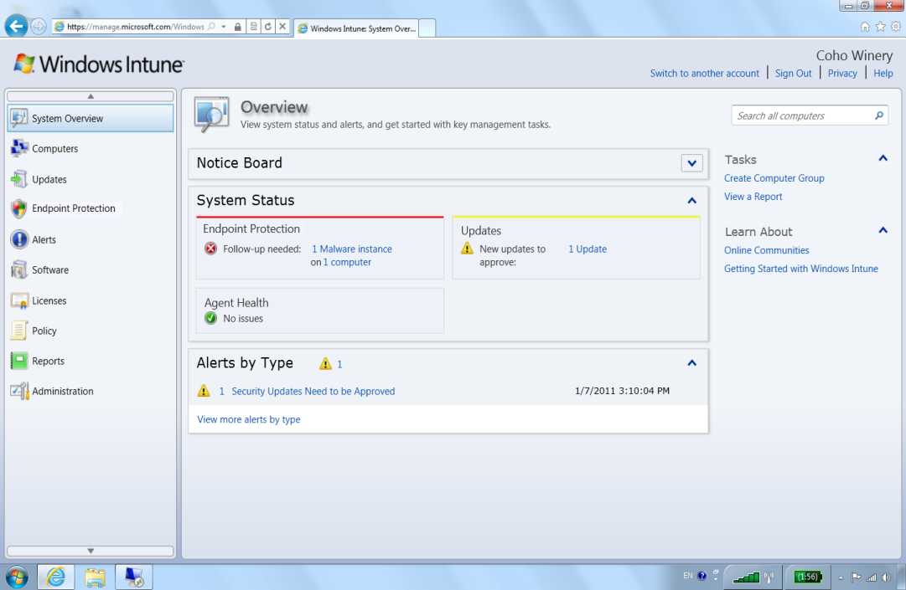
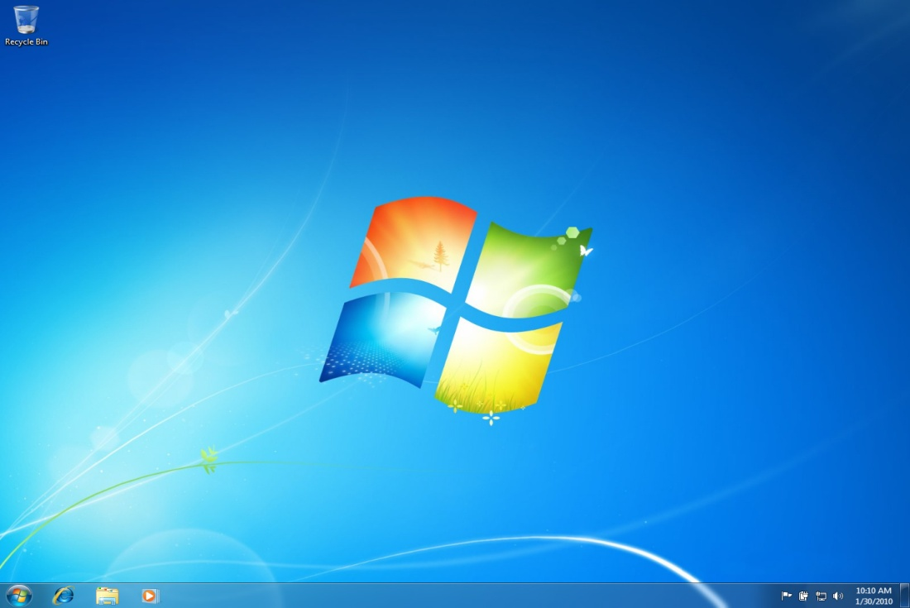
MANAGE & SECURE PCS ANYWHERE
GET THE BEST WINDOWS EXPERIENCE
announcing
www.windowsintune.com
Notes:
GA recently announced at MMS 2011.
Windows Intune simplifies and helps businesses manage and secure PCs using Windows cloud services and Windows 7. The Windows Intune cloud service delivers management and security capabilities through a single Web-based console so you can keep your computers and users operating at peak performance from anywhere.
Give your users the best Windows experience with Windows 7 Enterprise or standardize your PCs on the Windows version of your choice. Windows Intune fits your business by giving you big tech results with a small tech investment.
The result? Less hassle, and peace of mind knowing that your employees' PCs are well-managed and highly secure.
Windows Intune can be used by in-house IT professionals or by solution providers to manage the PCs of multiple businesses.
Whether you are in search of a solution that can deliver the essentials of management and protection for all your PCs or just those hard-to-reach PCs—highly distributed workers, non-domain joined PCs, field employees, or recent acquisitions—Windows Intune can help.

Slide 29
Security & Client Management From the Cloud
Garth Fort
General Manager
System Center
demo

Slide 30

EMPOWER YOUR USERS
UNIFY YOUR INFRASTRUCTURE
SIMPLIFY IT
CONSUMERIZATION ON YOUR TERMS

Slide 31
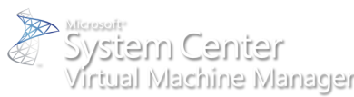









System Center Roadmap
Available Now
Coming Soon
  1H CY10
  2H CY10
  1H CY11
  2H CY11
Beta
RTM
Beta
2007 R3
Beta 2
RTM
Beta 2
6.3
Beta
RTM
Acquired
Beta
Beta
RTM
Beta
2010
IT GRC
Beta & RTM
2010
Beta & RTM
Beta & RTM
Beta
RC
RC
RTW
System Center
Codename “Concero”
Beta & RTM
GA
GA
Notes:
31
© 2008 Microsoft Corporation. All rights reserved. Microsoft, Windows, Windows Vista and other product names are or may be registered trademarks and/or trademarks in the U.S. and/or other countries.
The information herein is for informational purposes only and represents the current view of Microsoft Corporation as of the date of this presentation. Because Microsoft must respond to changing market conditions, it should not be interpreted to be a commitment on the part of Microsoft, and Microsoft cannot guarantee the accuracy of any information provided after the date of this presentation.
MICROSOFT MAKES NO WARRANTIES, EXPRESS, IMPLIED OR STATUTORY, AS TO THE INFORMATION IN THIS PRESENTATION.

Slide 32

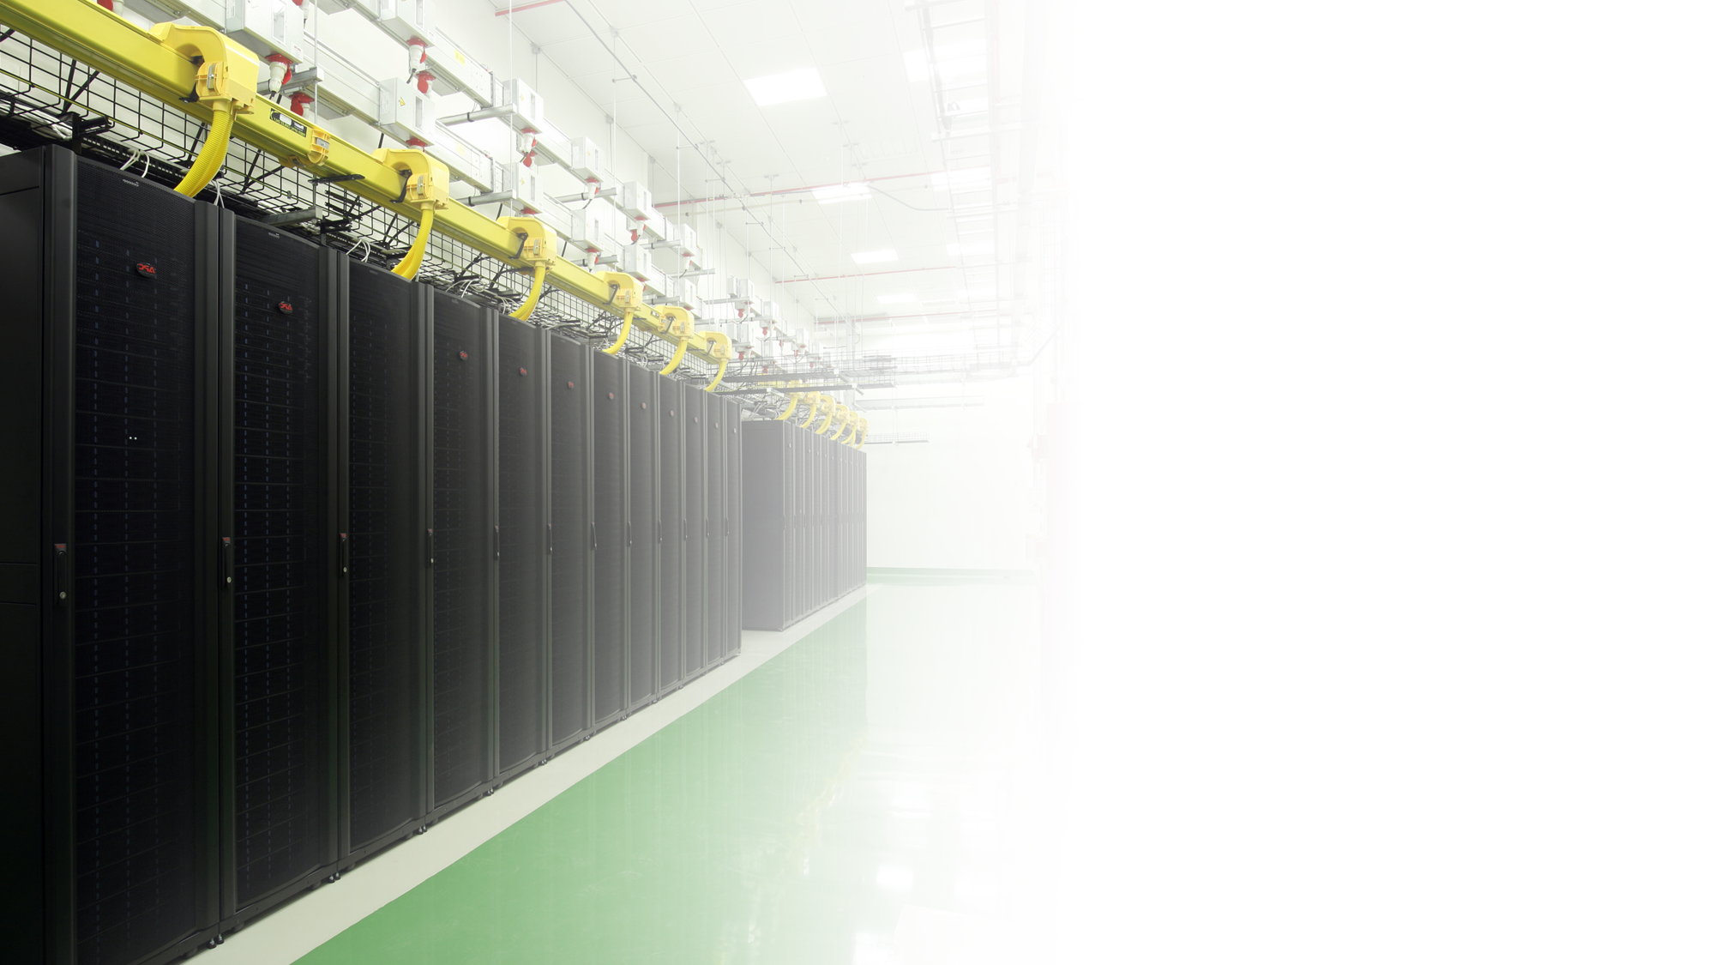
CONSUMERIZATION

Slide 33

Related Sessions
SIM311 – FEP 2010 and ConfigMgr Deep Dive into Management and Reporting
SIM317 – Planning and Deploying FEP 2010 with Configuration Manager
SIM330 – Client Management and Protection at Microsoft: FEP Deployment
SIM346 – ConfigMgr 2012: Application Management
SIM347 – ConfigMgr 2012: Deployment and Infrastructure Technical Overview
SIM348 – ConfigMgr 2007 R3: Technical Overview
SIM351 – ConfigMgr 2012: Migrating from 2007 to 2012
SIM352 – ConfigMgr 2012: Technical Overview
SIM407 – ConfigMgr: Hints, Allegations and Other Things Left Unsaid

Slide 34
Hands On Labs
SIM378-HOL – Introduction to ConfigMgr 2012
SIM379-HOL – Deploying ConfigMgr 2012
SIM380-HOL – Basic Software Distribution in ConfigMgr 2012
SIM381-HOL – Advanced Software Distribution in ConfigMgr 2012
SIM382-HOL – Migrating from ConfigMgr 2007 to ConfigMgr 2012
SIM383-HOL – Implementing Role Based Administration in ConfigMgr 2012
SIM384-HOL – Deploying a ConfigMgr 2012 Hierarchy
SIM385-HOL – Implementing Settings Management in ConfigMgr 2012
SIM386-HOL – Implementing Software Updates in ConfigMgr 2012
SIM387-HOL – Maintaining Healthy Clients in ConfigMgr 2012
SIM388-HOL – Deploying ConfigMgr 2012 Device Management
SIM389-HOL – Deploying Windows 7 with ConfigMgr 2007
SIM390-HOL – FEP 2012 Beta Overview
SIM394-HOL – FEP 2010 Overview

Slide 35












Required Slide
Complete an evaluation on CommNet and
enter to win!

Slide 36
Q&A
Thank You!

Slide 37

© 2011 Microsoft Corporation. All rights reserved. Microsoft, Windows, Windows Vista and other product names are or may be registered trademarks and/or trademarks in the U.S. and/or other countries.
The information herein is for informational purposes only and represents the current view of Microsoft Corporation as of the date of this presentation. Because Microsoft must respond to changing market conditions, it should not be interpreted to be a commitment
on the part of Microsoft, and Microsoft cannot guarantee the accuracy of any information provided after the date of this presentation. MICROSOFT MAKES NO WARRANTIES, EXPRESS, IMPLIED OR STATUTORY, AS TO THE INFORMATION IN THIS PRESENTATION.

Slide 38
Notes (hidden)
Some speakers at Microsoft like to use this slide for hidden “notes slides”.
Delete it if you don’t want to use it.
NEXT: <next slide title>

Slide 39
Deadlines & Resources
Thank you for taking part in TechEd North America 2011.
Below is a list of key dates and resources:
Important Content Deadlines – detailed instructions are found on the Speaker Portal at https://northamerica.msteched.com/signin:
  March 21 at Noon: Upload a DRAFT of your PPT for subject-matter expert (SME) review.
    March 21 to April 8: CONTENT REVIEW (track specific instructions are found on the speaker portal)
    May 10 at 5 pm PDT: Upload FINAL PPT presentation on the Speaker Portal. This is the version that
    you will use at the event.
    YOUR PROMPT FINAL PPT SUBMISSION IS APPRECIATED.
    No design support will be offered onsite.
  Slide Design Resources – Located on the Speaker Portal (graphics, webinar, etc.)
  If you include any third-party photography or art, licensing information and permission must be credited
  in the PPT or it will be deleted.
  Points of Contact
  Direct presentation questions to tespkr@microsoft.com
  Direct content questions to your Track PM
  PRINTING: This template is intentionally set to print in color or grayscale, not black and white
Notes:
© 2010 Microsoft Corporation. All rights reserved. Microsoft, Windows, Windows Vista and other product names are or may be registered trademarks and/or trademarks in the U.S. and/or other countries.
The information herein is for informational purposes only and represents the current view of Microsoft Corporation as of the date of this presentation. Because Microsoft must respond to changing market conditions, it should not be interpreted to be a commitment on the part of Microsoft, and Microsoft cannot guarantee the accuracy of any information provided after the date of this presentation.
MICROSOFT MAKES NO WARRANTIES, EXPRESS, IMPLIED OR STATUTORY, AS TO THE INFORMATION IN THIS PRESENTATION.

Slide 40
MS Tag Placeholder Slide
Required Slide
Your MS Tag will be inserted here during the final scrub.
Notes:
New for TechEd 2011, we will be working with Microsoft Tag (http://tag.microsoft.com/overview.aspx) to create unique Tags for every session at the event. Your session Tag will appear on both the room signage and at the end of your presentation. With your session Tag, attendees will be able to scan as they enter the room to retrieve session details, view speaker bios, and engage in discussions; or scan at the end of the presentation to evaluate your session and download materials. We’re excited to integrate Microsoft Tag across the My TechEd mobile experience this year.

Slide 41
Demo Title
Name
Title
Group
demo

Slide 42
Video Title
video

Slide 43

Announcement Title
announcement

Slide 44
Title

