Slide 2

Hybrid Cloud Management with Microsoft System Center Code-Named “Concero”
SIM212
Vijay Tewari
Group Program Manager
System Center
Microsoft Corporation

Slide 3
Agenda
IT Landscape
Concero Vision
Overview of capabilities
Q & A

Slide 4

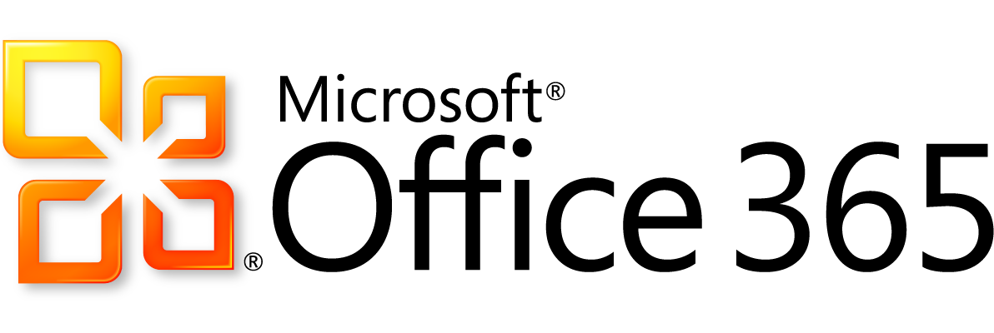


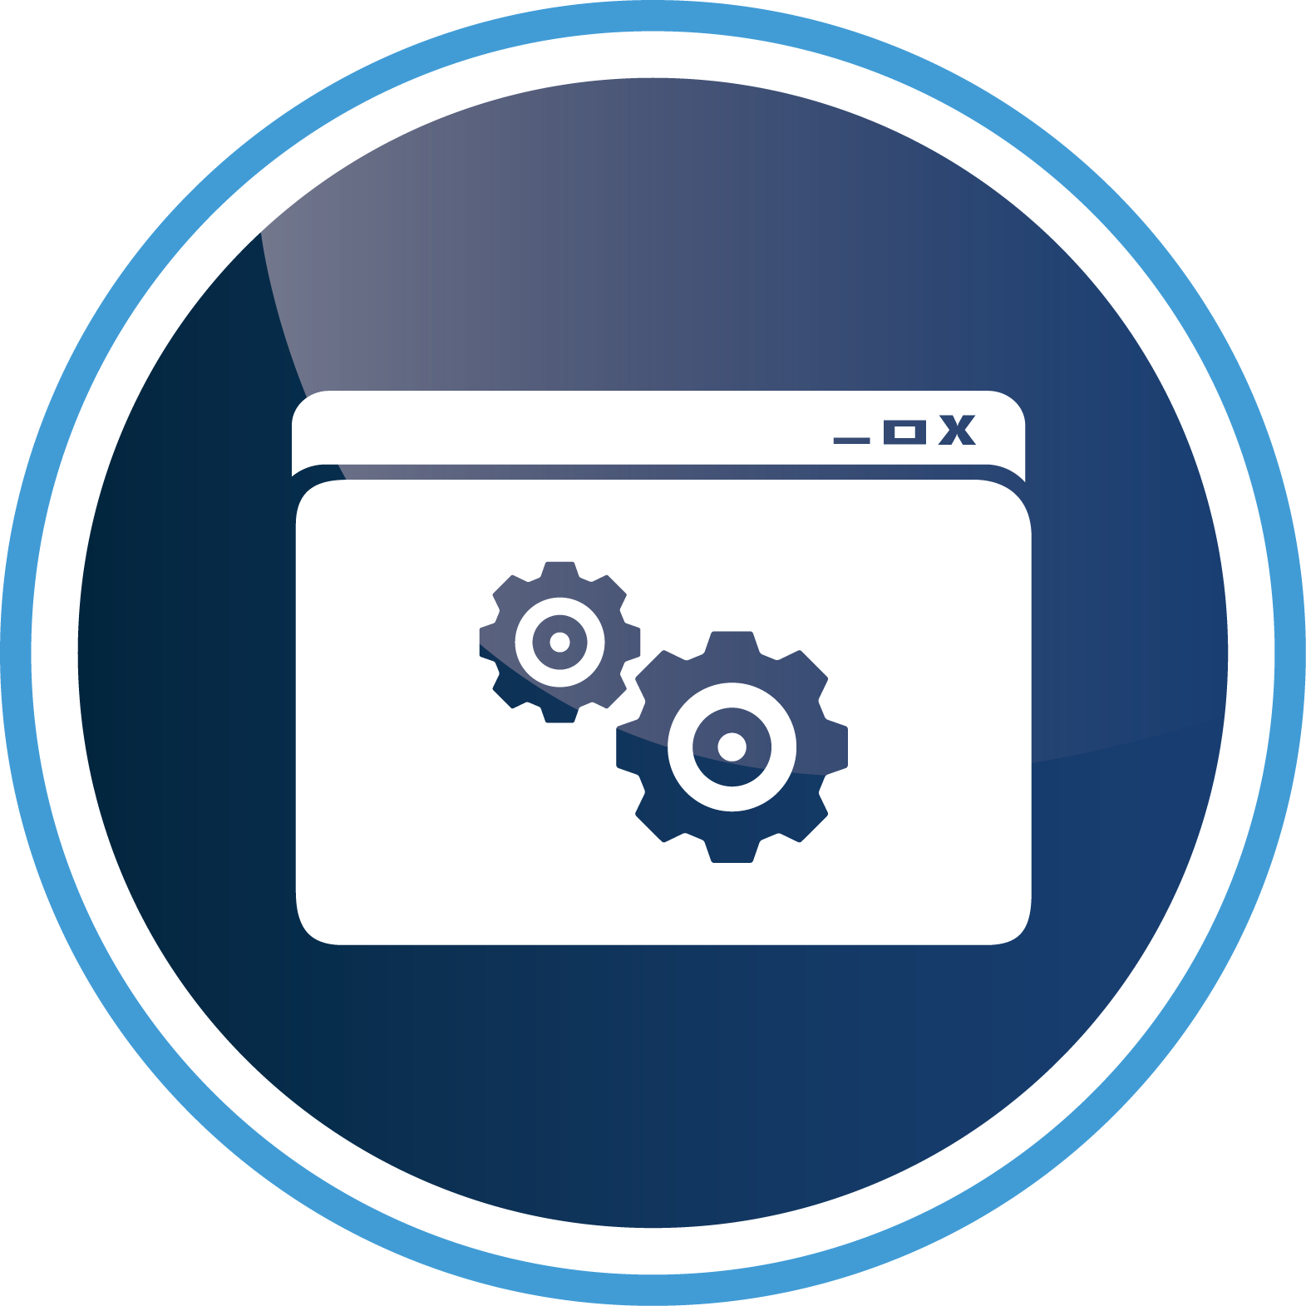
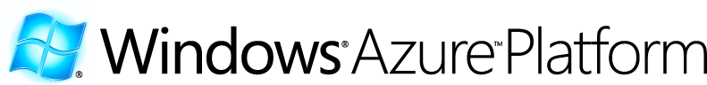



Clouds - IT as a Service
SAAS
PAAS
Service Management in Clouds
IAAS
Hyper-V

Slide 5
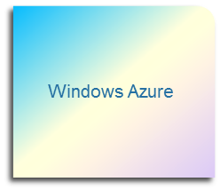

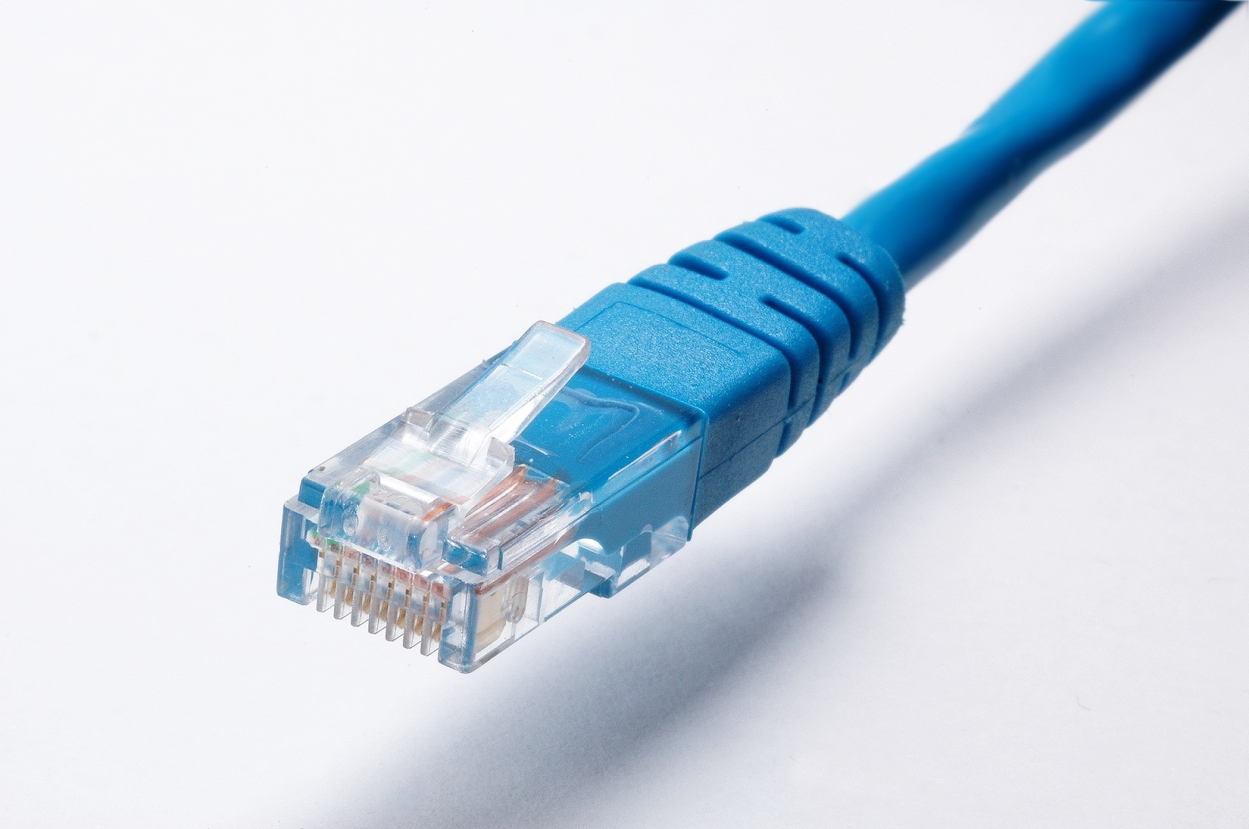
IT as a Service: Providers and Consumers
(Key Tenets)
Empowerment – Time to market --Simplicity
(Key Tenets)
Multi-tenant -- Automation -- Scalable
PaaS
Self-Service -- Metered -- Elastic
PaaS
Windows Azure, SQL Azure, AppFabric, Azure Platform Appliance
Services
Application Owner
“Service Consumer”
Clouds
(resource abstraction)
Datacenter Admin
“Service Provider”
Service Consumer
Service Provider
IaaS
???
Compute
IaaS
Hyper-V + System Center
Storage
Network, Load Balancers, Firewalls

Slide 6

System Center “Concero” – Managing Services in Multiple Clouds
System Center “Concero”
Services
Cloud “1”
Cloud “2”
Cloud “n”
System Center Virtual Machine Manager 2012
Windows Azure
Hyper-V
Hyper-V
vmware
Xen
Server
Hardware
Vendor A
Vendor B
Vendor n
……….
SAN
SAN
Switches/Routers
Networks

Slide 7



System Center Concero Vision
Customer
Microsoft
Partner
Services
“Concero”
  Windows Azure Platform Appliance
  Windows Azure
  Windows Azure Platform Appliance
VMM 2012
VMM 2012
VMM 2012
VMM 2012
Fabric
VMM 2012
VMM Future
  Hyper-V, VMware, Xen
  Hyper-V, VMware, Xen
  Hyper-V, VMware, Xen
  Hyper-V, VMware, Xen
  Hyper-V, VMware, Xen
  Hyper-V, VMware, Xen
Concero 1.0
Customer Problems Addressed
Self-service agility and empowerment for application owners
Bring service management across multiple clouds under IT management processes
Visibility and control into services deployed in multiple clouds
VMM – Private Clouds
  Manage services across multiple VMM servers
  Web based – self service experience
Windows Azure – Public Cloud
  IT Pro experience for Azure
  RBAC using on-premise domain credentials
  Single view for multiple Azure subscriptions

Slide 8
Key Features of Concero
Cloud Registration
  Support for multiple VMM servers and Windows Azure
Services and VM’s
  Deployment
  Operations
  Upgrade
Library and Job History

Slide 9
Quick Lap through Concero
Deploying Virtual Machines
Multi-VMM and Windows Azure support
demo

Slide 10
Application Owner Responsibilities
Plan
  Budgeting
  Agility – time to market
  Package
Deployment
  Application deployment of package obtained from developers
  Validate deployment
  Interface with infrastructure engineering for support/SLA/Change control…
Operate and Maintain
  Control (start/stop), scale-in/out
  Audit
  Performance monitoring and optimization
  Root cause analysis
  2nd or 3rd tier of support for application
  Feedback to engineering for future enhancements
Upgrades
Decommission

Slide 11
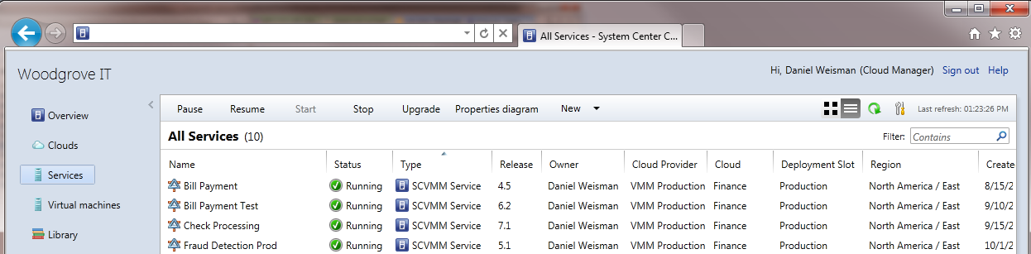

Multi VMM support
Bridges private clouds provided by multiple VMM Server installations
Web-based self-service for deployment of VMs and Services into VMM private clouds
Search/View/Manage VMs and Services across VMM clouds
Copy library templates from one VMM cloud library to another
Boston Lab
Boston Production
Beijing
Lab
Beijing Production

Slide 12
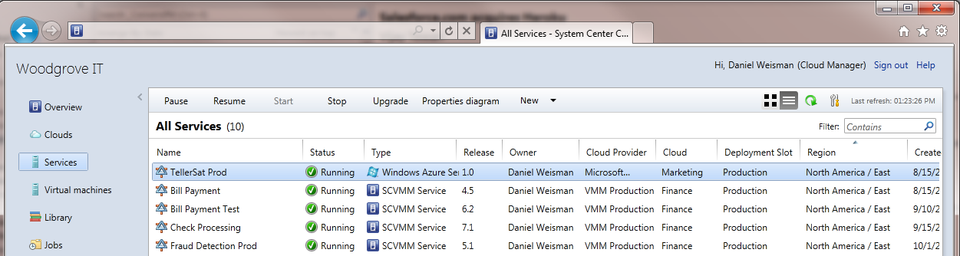

Windows Azure Support
Aggregates multiple Windows Azure subscriptions into a single management view
Provides a tool to the IT Pro for deploying and upgrading Windows Azure services
Delivers IT processes for Windows Azure platform with user roles, library, and auditing
Boston Lab
Boston Production
Beijing
Lab
Beijing Production
Azure
Test
Azure Production

Slide 13
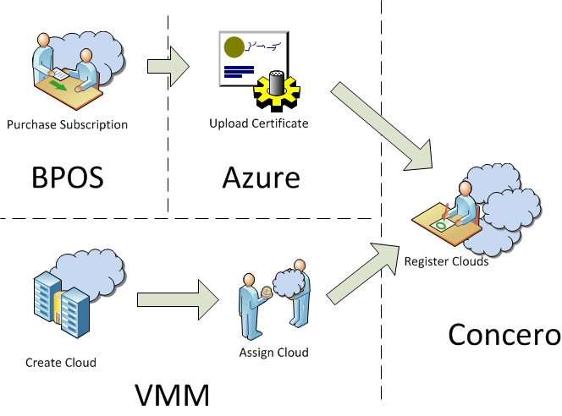

Application Owner: Capacity Acquisition (Plan)
Cloud registration
The hybrid cloud management feature encompasses registering clouds, delegating access to the clouds, and providing basic cloud management operations
Register VMM servers
Register Azure subscriptions
In VMM, create and assign clouds
Assign access to Windows Azure
Windows

Slide 14
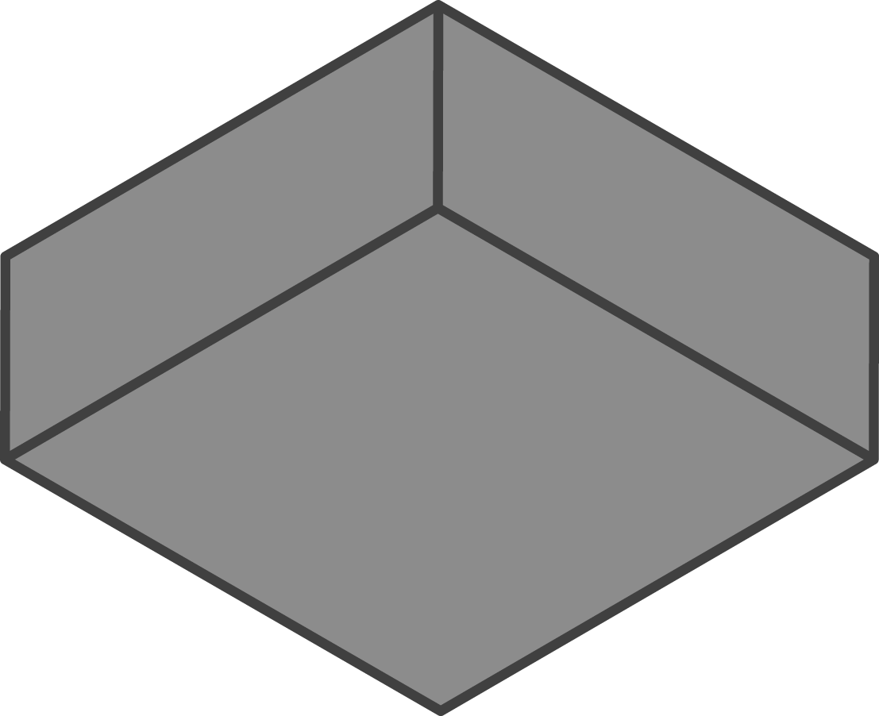
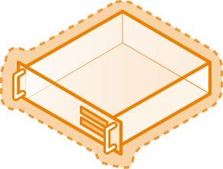
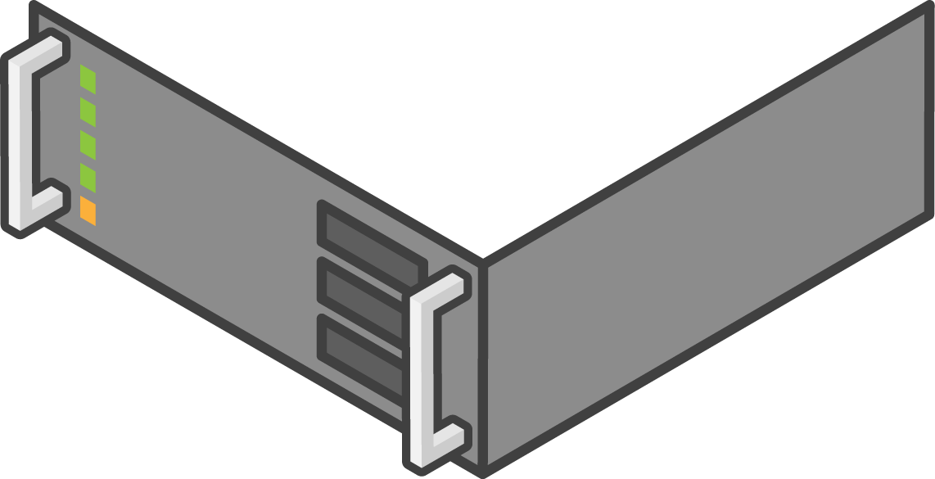

VMM 2012 Services
Virtualization Host
Virtualization Host
Service
  Groups of machines that work together
  Includes machine definitions as well as applications
  Supported application types:
    Web Applications (WebDeploy)
    Virtual Applications (Server App-V Package)
    Database Applications (SQL DAC)
SQL
Template
  Starting point for services and source of truth
  Specifies machine and connectivity requirements
  Deployed services are always linked to their templates
  Updates to services must be applied by changing the template first
Virtualization Host

Slide 15
What is a Windows Azure Service?
Discrete Roles
  Web Role: Customized for web application programming
  Worker Role: Generalized development used for long running tasks, components that do not need UI, compute intensive jobs
  VM Role: Full control over the OS image
.cspkg: Binaries and global settings
.cscfg: Configuration for deployment
  Eg. Number of instances of each role
Web Role
Worker Role
VM Role
Web Role
Web Role
Web Role
Web Role
Web Role
Web Role
ServiceDefinition.cspkg
ServiceConfiguration.cscfg
Storage Services
SQL Azure

Slide 16
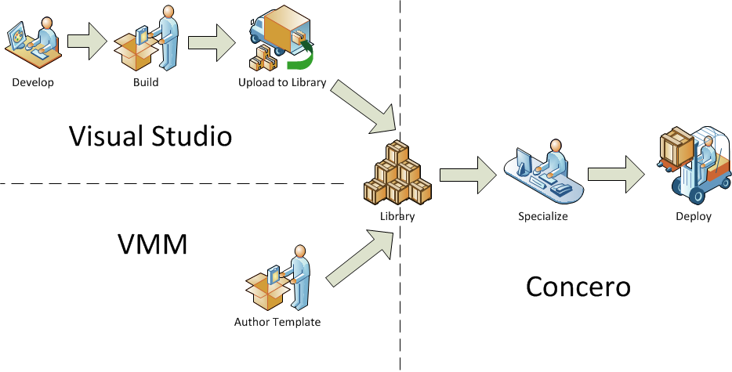
Application Owner: Packaging/Deployment
Service and VM deployment
This feature allows users to deploy services and VMs within managed clouds.
Windows Azure
Deploy a VMM service or
VM template
Deploy an Azure service
Remote desktop
Private Cloud

Slide 17
Service Authoring and Deployment
VMM Service Authoring and Deployment
Windows Azure Service and Deployment
demo

Slide 18
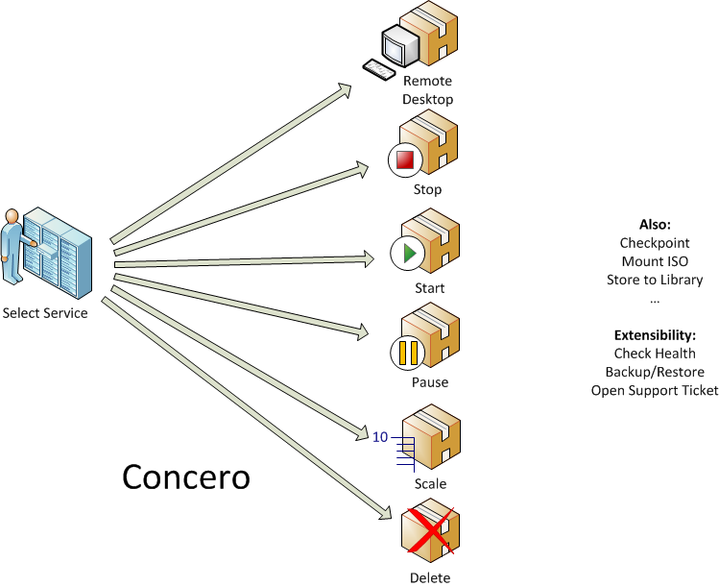
Application Owner: Operate
Service and VM management
The service management feature allows users to manage services and VMs within managed clouds.
Windows Azure and Private Clouds
Control the state of the Service or VM (Stop, Start, Pause, Reboot)
Scale in/out
Remote desktop

Slide 19
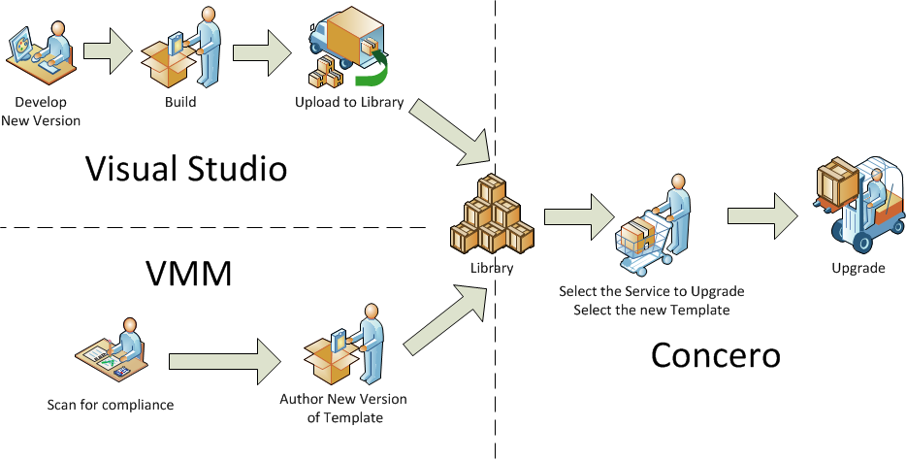
Application Owner: Upgrade Services
This feature allows the application owner to upgrade services
Windows Azure
Private Cloud

Slide 20
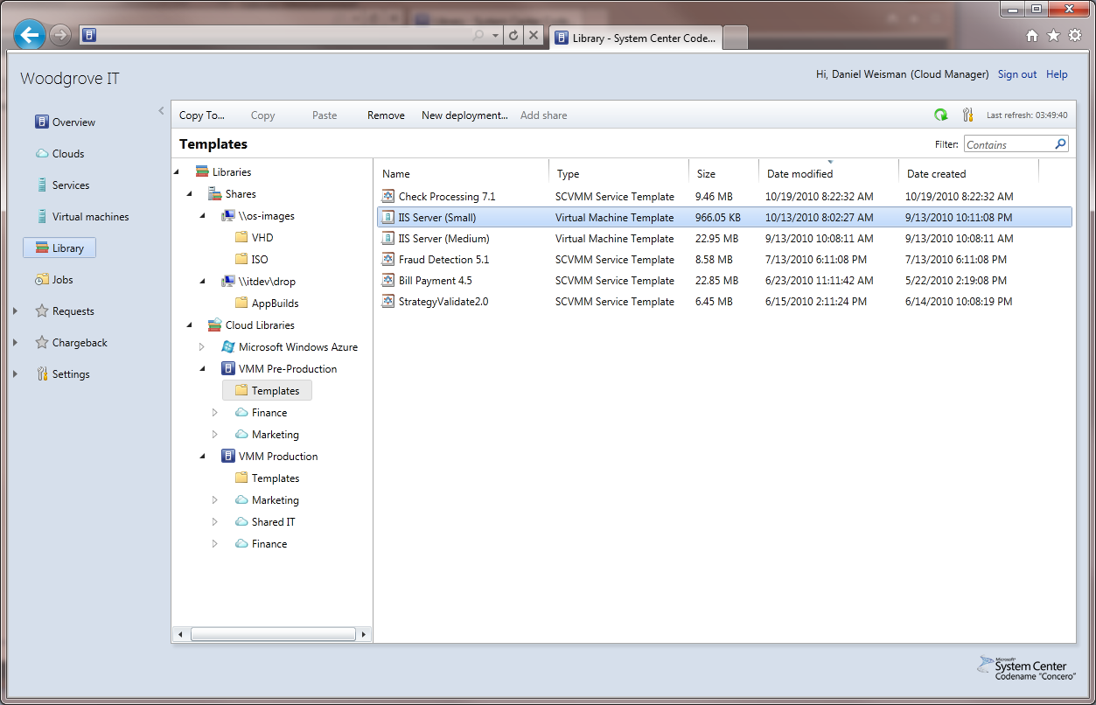
Cloud Library
The cloud library feature provides a single logical representation of all library objects from registered clouds
Copy VMM templates from one system to another
  Template only copy with mapping
  Template and file copy (VHD’s, SQL DAC packages, SAV packages etc)
Upload Azure deployment files into Azure clouds
  cscfg, cspkg
  VHD’s for VM Role
  Certificates (SSL, RDP etc)

Slide 21
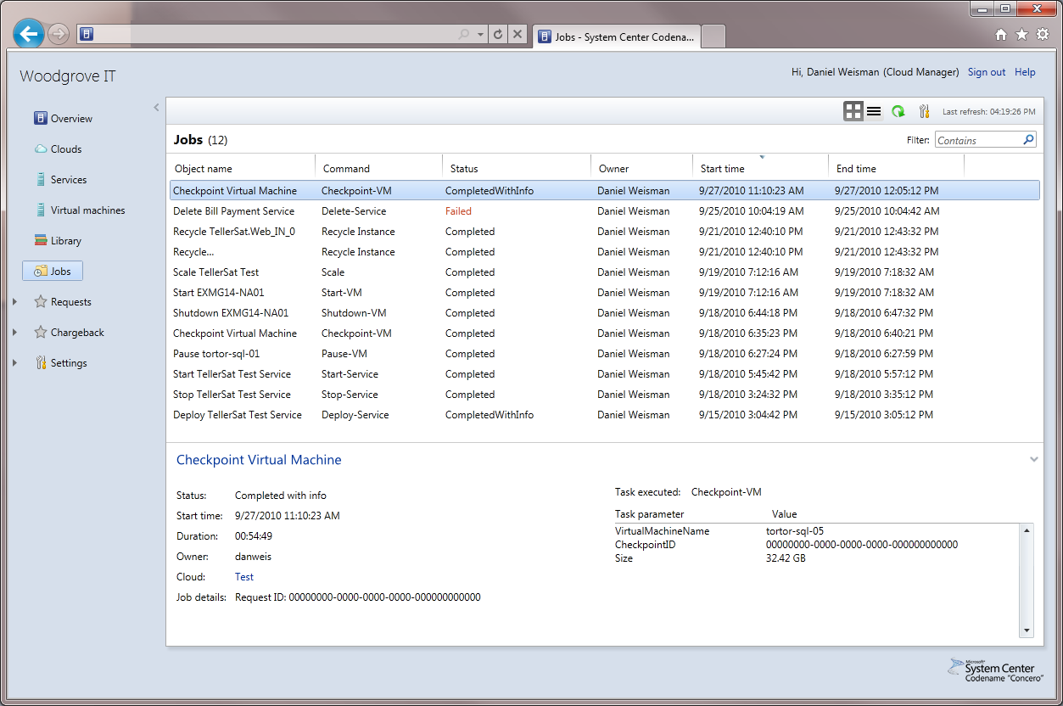
Job History
The jobs feature enable users to track the progress of jobs and maintain a history for auditing changes and troubleshooting of issues
Track the progress long running actions
Troubleshoot actions that do not complete successfully
Audit changes to managed objects to identify who, what, when,
and result

Slide 22
Service Management
View and operate Services and Virtual Machines
Jobs
Cloud Library
demo

Slide 23
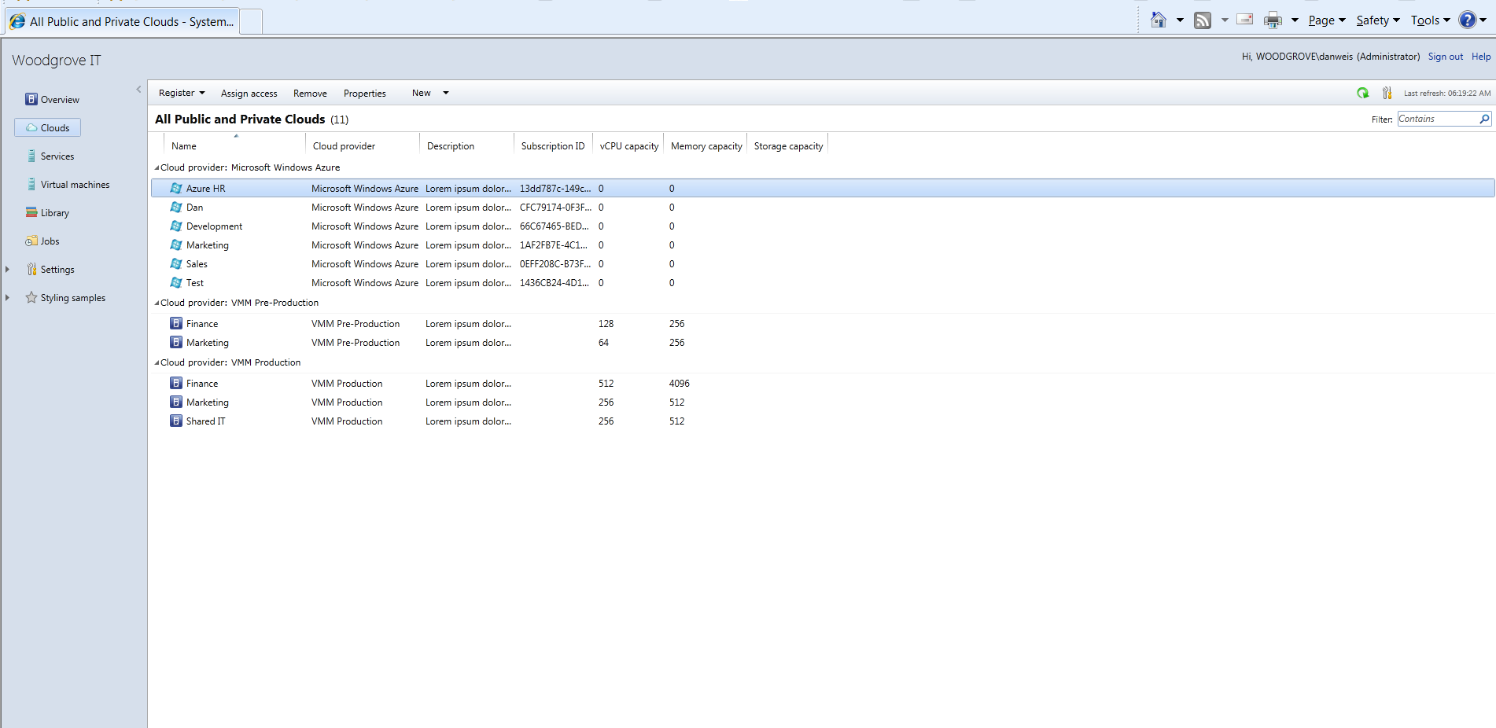
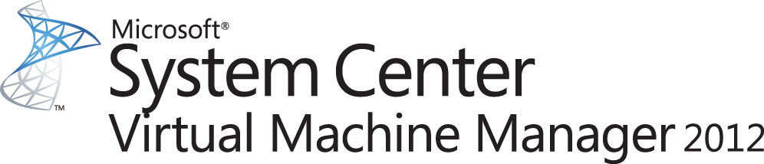
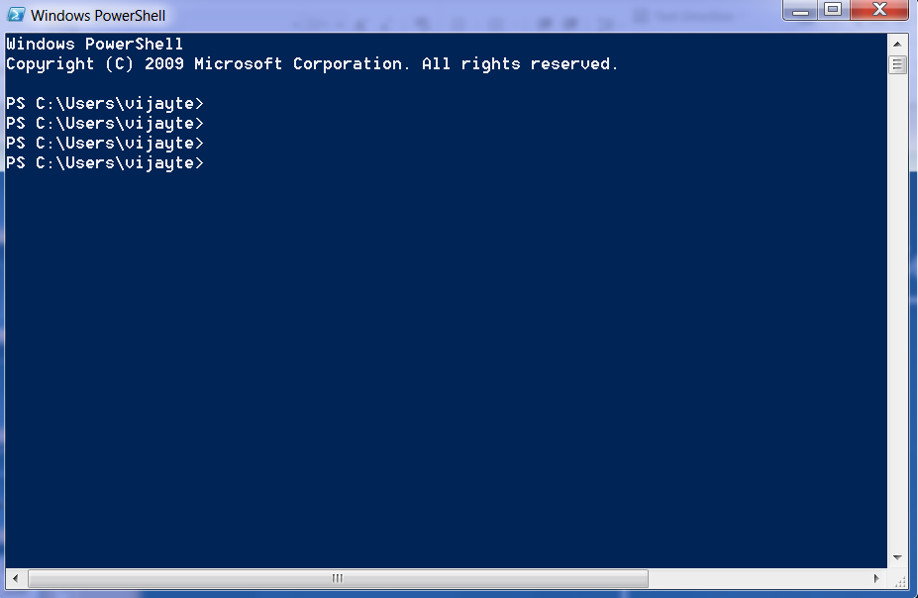


Architecture
IIS “Concero” Server App
Browser
VMM Server
VMM Server
VMM Provider
VMM Server
RBAC Provider
Silverlight Client
Concero Server API
Provider Dispatcher
Powershell
Windows Azure Provider

Slide 24
Concero CTP Pre-Reqs
Windows Server 2008 R2 (SP1)
Microsoft SQL Server 2008 SP2/R2
  Can reuse VMM dB Server
VMM 2012 Beta admin console installed on box where Concero is installed
IIS
  Concero will enable IIS and appropraite role services
.Net 4.0
  Concero setup will install if not available
Bi-directional trust between domains that Concero server and VMM Server are joined to

Slide 25
Concero, VMM 2012 Console & VMM 2012 SSP
Feature | VMM 2012 SSP | VMM 2012 SSU Console | Concero
Store To Library | X | X | X
Expose All VMM Quota Dimensions | Custom Quota Point Only | X | X
Deploy VM | X | X | X
Deploy Service |  | X | X
Manage VM (Start, Stop, Connect, Checkpoint, Mount ISO, etc.) | X | X | X
Manage Service (Start, Stop, etc.) |  | X | X
Transfer VM Or Service Template Between VMM Servers |  |  | X
Scale Out A Service |  | X | X
View Service Structure |  |  | X
Web-based Client | X |  | X
View VMs and Services across multiple VMM servers |  |  | X

Slide 26
Timeline
VMM 2012 Public Beta AVAILABLE NOW
Concero Beta → H2 CY’11
VMM 2012 and Concero RTM H2 CY’11

Slide 27
Call to Action
Deploy VMM 2012 Beta and familiarize yourself with clouds and services
Familiarize yourself with Windows Azure, SQL Azure, AppFabric
Provide feedback to us

Slide 28
Summary
System Center 2012 portfolio provides robust private cloud offering
“Concero” offers
  Self-service empowerment for your application owners
    Agility and flexibility
  Visibility and control over applications/services in hybrid clouds
    VMM Private clouds and Windows Azure

Slide 29
Related Content
Breakout Sessions
  SIM208, Management in the Datacenter
  SIM211, Microsoft System Center Virtual Machine Manager 2012: What’s in It, and How It Enables the Building of Private Clouds and Federation to the Public Cloud
  SIM336, Microsoft System Center Virtual Machine Manager 2012: Server Fabric Lifecycle, Part 1 - Configuring Networking and Storage
  SIM361, Microsoft System Center Virtual Machine Manager 2012: Server Fabric Lifecycle, Part 2 - OSD, OOB and Agent Management
  SIM357, Microsoft System Center Virtual Machine Manager 2012: Server Fabric Lifecycle, Part 3 - Cluster Creation, Update Management
  VIR314, Understanding Server App-V, Sequencing and Deploying Datacenter Applications
  COS202, Introducing the Windows Azure Platform
Hands on Lab
  VIR374-HOL | Getting Started with Microsoft System Center Virtual Machine Manager 2012
  COS271-HOL | Introduction to Windows Azure

Slide 30
Track Resources
Don’t forget to visit the Cloud Power area within the TLC (Blue Section) to see product demos and speak with experts about the Server & Cloud Platform solutions that help drive your business forward.
You can also find the latest information about our products at the following links:
Cloud Power - http://www.microsoft.com/cloud/
Private Cloud - http://www.microsoft.com/privatecloud/
Windows Server - http://www.microsoft.com/windowsserver/
Windows Azure - http://www.microsoft.com/windowsazure/
Microsoft System Center - http://www.microsoft.com/systemcenter/
Microsoft Forefront - http://www.microsoft.com/forefront/

Slide 31





Resources
  Connect. Share. Discuss.
http://northamerica.msteched.com
Learning
  Sessions On-Demand & Community
  Microsoft Certification & Training Resources
www.microsoft.com/teched
www.microsoft.com/learning
  Resources for IT Professionals
  Resources for Developers
http://microsoft.com/technet
http://microsoft.com/msdn

Slide 32












Complete an evaluation on CommNet and
enter to win!

Slide 33

Notes:
New for TechEd 2011, we will be working with Microsoft Tag (http://tag.microsoft.com/overview.aspx) to create unique Tags for every session at the event. Your session Tag will appear on both the room signage and at the end of your presentation. With your session Tag, attendees will be able to scan as they enter the room to retrieve session details, view speaker bios, and engage in discussions; or scan at the end of the presentation to evaluate your session and download materials. We’re excited to integrate Microsoft Tag across the My TechEd mobile experience this year.

Slide 34

© 2011 Microsoft Corporation. All rights reserved. Microsoft, Windows, Windows Vista and other product names are or may be registered trademarks and/or trademarks in the U.S. and/or other countries.
The information herein is for informational purposes only and represents the current view of Microsoft Corporation as of the date of this presentation. Because Microsoft must respond to changing market conditions, it should not be interpreted to be a commitment
on the part of Microsoft, and Microsoft cannot guarantee the accuracy of any information provided after the date of this presentation. MICROSOFT MAKES NO WARRANTIES, EXPRESS, IMPLIED OR STATUTORY, AS TO THE INFORMATION IN THIS PRESENTATION.

