Slide 1

Sneak Peek at Microsoft System Center Service Manager
2012 Concepts
SIM210
Travis Wright & Sean Christensen
Senior Program & Technical Product Managers
Microsoft Corporation

Slide 2
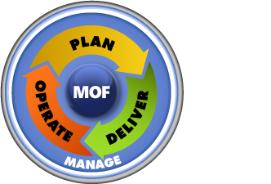
Achieving IT as a Service Objectives
MOF®
Automation
ITaaS Objectives
Standardization
Reduce Costs
Increase Service Levels
Faster Time to Delivery
Provide More Data
More Transparency
Compliance
ITIL®
Self-service
COBIT®
Compliance
Process Design
Implementation

Slide 3








Service Manager Enables Controlled Automation
IT Data
Warehouse
Configuration Management DB
Work Items
Configuration Items
Knowledge
Automation Services
Centralized Data Storage
Integration

Slide 4
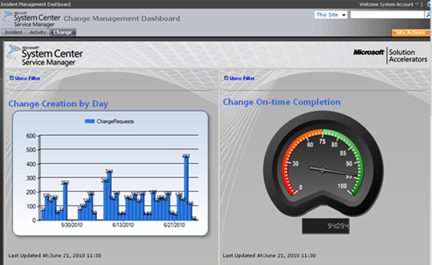
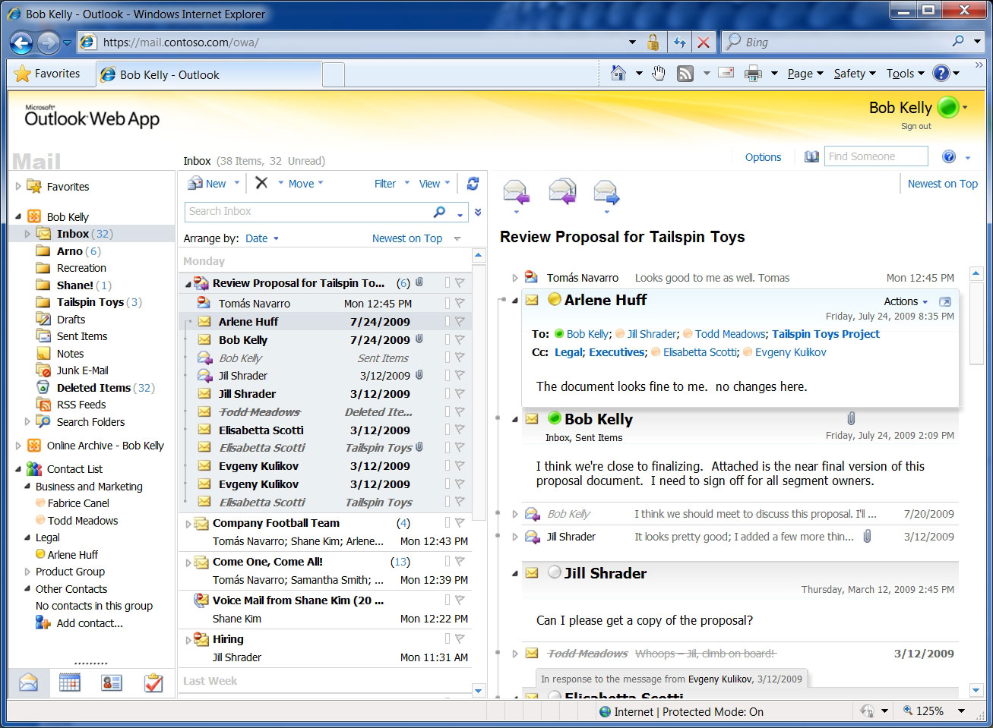
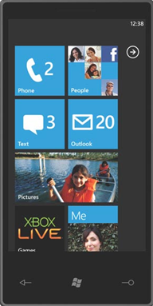
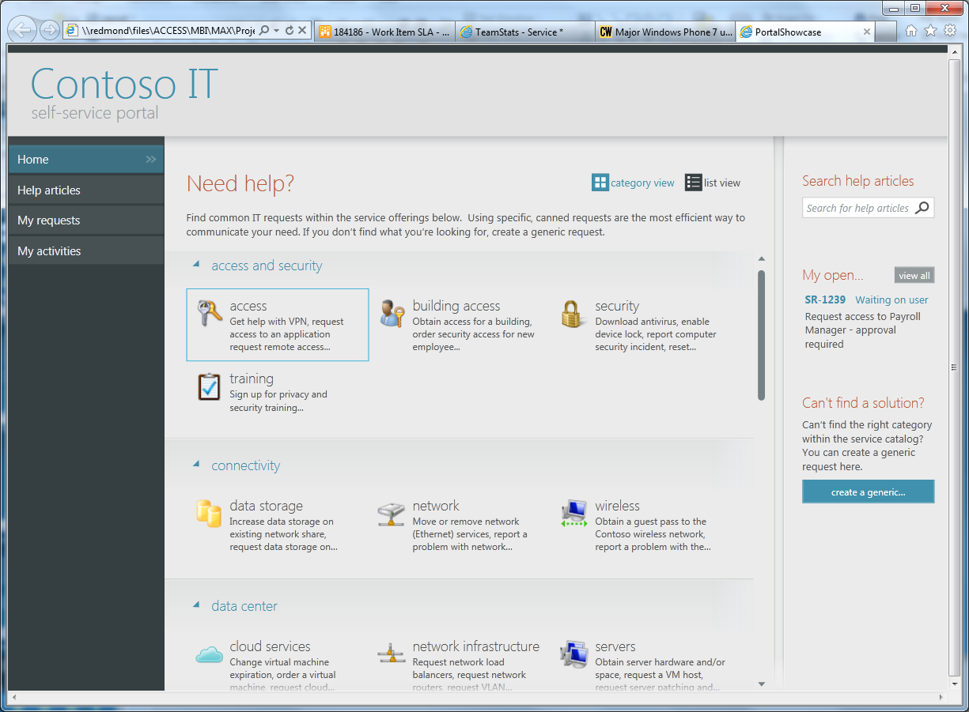
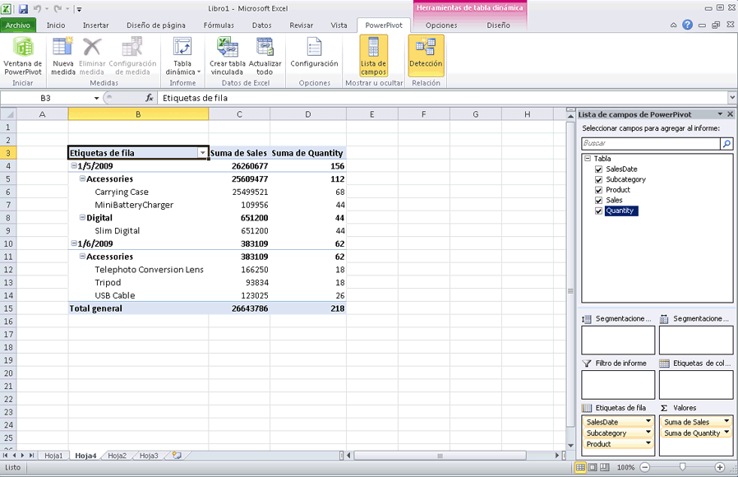
Service Manager Enables Self-Service
Reports &
Dashboards
E-Mail &
Other Clients
Portal
Excel

Slide 5
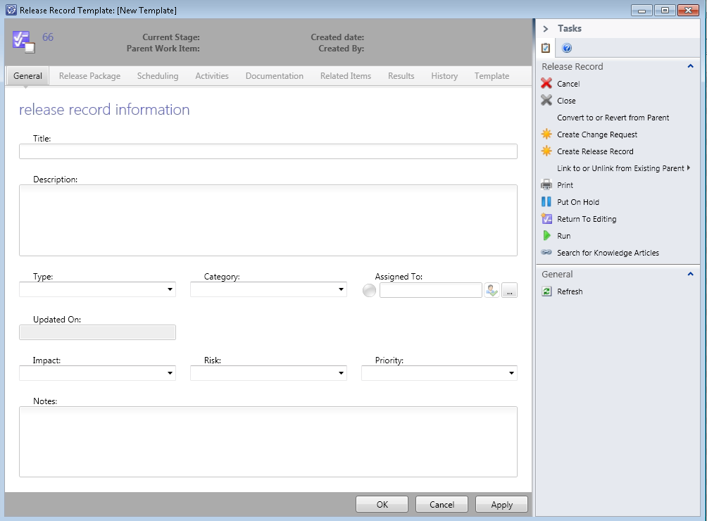
Service Manager Enables Standardization
Business Process Defined in Templates
CMDB Data Standardization
  Common Model
  Reconciliation of Data
Service Catalog

Slide 6

Service Manager Enables Compliance
Compliance is embedded in process, standards, self-service, and automation
Compliance library maps legalese to actionable IT control activities
Compliance is continuously and automatically evaluated in real time
Bob Lemur

Slide 7
Your Feedback → Incremental Improvements
Incident SLA
Parent/Child Work Items
AD Connector Improvements
PowerShell
Subscription Infrastructure Improvements
Parallel Activities
Performance Improvements
Bug Fixes
Thank You!

Slide 8

Service Catalog & Self-Service Portal
Orchestrator / VMM Integration
Automation
ITaaS Objectives
Reduce Costs
Increase Service Levels
Faster Time to Delivery
Provide More Data
More Transparency
Compliance
Standardization
Release Management
System Center
Data Warehouse
Compliance
Self-service

Slide 9

IT as a Service Architecture for Service Manager 2012
DW
PRESENTATION
IT Service Offerings
DATA
CMDB enables standardization and compliance
Portal: Role-based Access, Self Service
Service Catalog: Service and Request Offerings
CMDB
Models / Objects:
Quota, Access, Costs, Templates, VMs, Services, Clouds, Runbooks
WORKFLOW
Request processes drive automation
Request Processing:
Business process WF engine
Request Processes
Business Events Subscriptions
Notifications
Approvals
WI activities
Monitor
Invoke
Automation
Orchestrator: IT process automation
Run books
Connectors
Integration Packs
OM
VMM
Other IT Systems

Slide 10















Data: CMDB enables standardization and compliance
Service & Request Offerings
4
1. Connectors import cloud objects & VMM templates, including SCO runbooks
SLA
Private Cloud
VM Provisioning
Request Cloud
Applications
Service Provisioning
Request Fix for Service
Users
Access Requests
Request Quota Increase
Knowledge
2. Admin creates SM templates to capture business process and the role of runbooks within the process
Schedule
5
Cost
Business Process
3. Admin defines models and defaults to standardize offerings
User Roles
3
2
Data and Process Templates
(standardized configurations)
Self service models and defaults
(Quotas, access tiers, costs)
4. Admin specifies interaction with users – create questions and map to CMDB data
Review
Runbook
Email
Work Items
(in-progress processes)
Review
Runbook
Email
Review
Runbook
Email
Review
Runbook
Email
5. Admin configures access roles to the offerings
1
CMDB Objects
Data Sources
(OM, AD, VMM, SCO, CM)
Runbooks
Clouds
Templates
Services
VMs
Fabric
Users

Slide 11
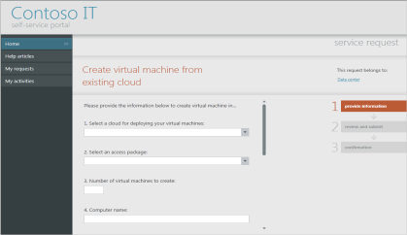
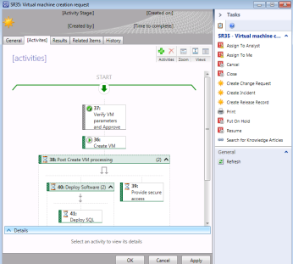
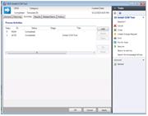
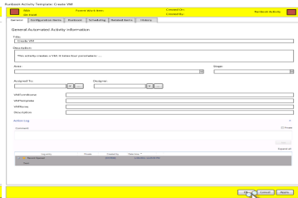
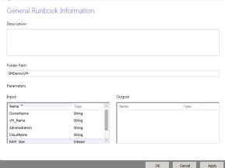
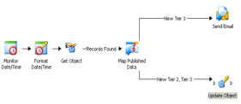
Workflow: Request processes drive automation
Service Catalog - Request Offering
1. SCO Connector syncs Runbook data to CMDB
2. Admin uses SM task to create RB activity w/ parameters mapped to properties
3
CMDB
3. Admin adds to request template includes RB activity, added to Service Catalog
4
Request Template
5
4. User creates SR from request offering
Service Request
Invoke
5. Runbook invoked with user inputs
6. SM workflow monitors RB status
Monitor
SM Runbooks Folder
SCO Web Service
6
Runbook Activity
SM Runbook Items
2
SCO Runbook
SCO
Connector
SCO Runbook
SCO Runbook
1

Slide 12
Presentation: IT Service Offerings
Completely new portal
  Silverlight web parts hosted in SharePoint Foundation 2010 or higher
  Customize out-of-box web parts using SharePoint admin tools
  Extensible via SharePoint extensibility for hosting web parts
Portal features
  Service Catalog Scoped to User Roles
  Customizable, Dynamic Forms

Slide 13
Terminology
Service Request:
  Work item used for requesting standard IT services
Request Fulfillment:
  Process for managing Service Requests
Service Catalog:
  The set of service offerings and request offerings provided by IT to users
Request Offering
  Request offered by IT to users (e.g., Request mailbox storage increase)
Service Offering:
  Service offered by IT to users including request offerings, SLA & cost/chargeback details (e.g., Mailbox Provisioning)
Technical Service (Service Maps):
  IT-facing service containing a configuration item dependency map supporting incident & change management scenarios – (e.g., Exchange, Active Directory)

Slide 14

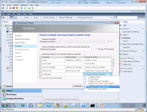



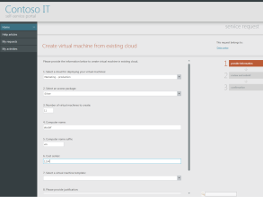
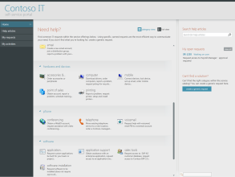
Service Catalog Theory of Ops
Service Request Templates defines business processes
Request Offering maps User Input to Service Request Template
Service Offerings is a collection of requests
Author
Request Template
Author
Request Offerings
Author
Service Offerings
Processes defined here drives automation
Dynamic Request Form on the Portal
Service Catalog Portal home page
Request triggers Workflows, approvals, notifications as defined by processes in templates
Role-based access
Integrated CMDB
Runbooks
Clouds
Templates
Services
VMs
Fabric
Users

Slide 15
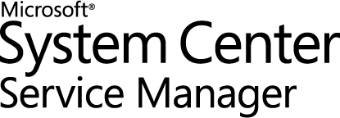
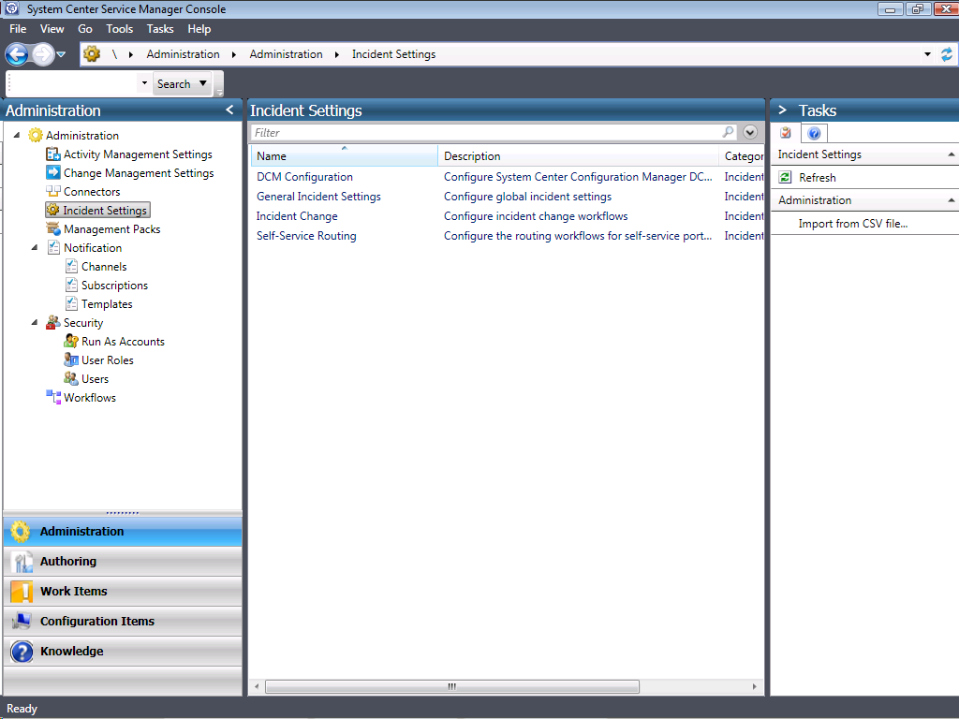
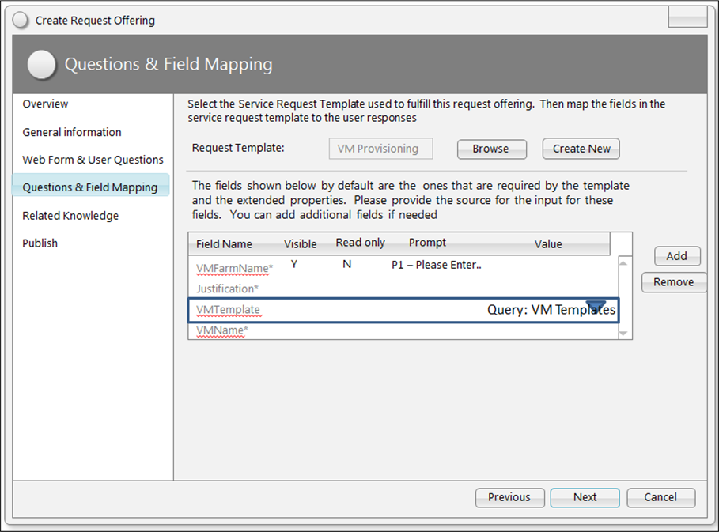
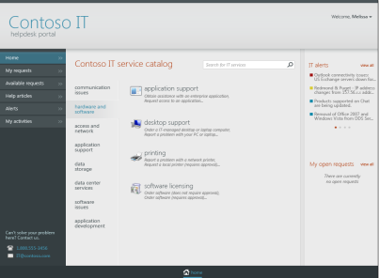
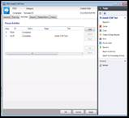
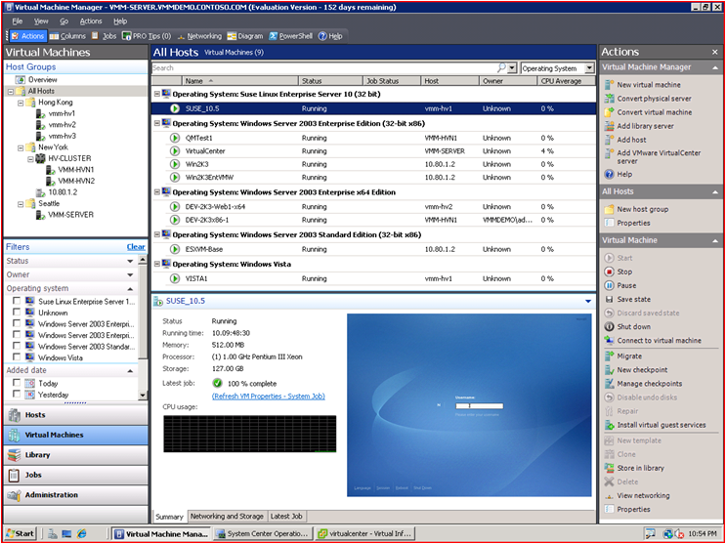




Scenario: Automated Self-service Cloud Requests
Import Runbooks
Configure Request
Offering
Request VM from Service Catalog
Service
Request
Created
Runbook
Invoked
Create VM
  SM Admin
  BUIT End User
  VMM Admin

Slide 16
IT as a Service: Portal, Service Catalog, Service Requests, Orchestrator and VMM Integration
Sean Christensen
demo

Slide 17
Service Catalog & Self-Service Portal
Orchestrator / VMM Integration
Automation
ITaaS Objectives
Reduce Costs
Increase Service Levels
Faster Time to Delivery
Provide More Data
More Transparency
Compliance
Standardization
Release Management
System Center
Data Warehouse
Compliance
Self-service

Slide 18
Release Management
Travis Wright
demo

Slide 19
Service Catalog & Self-Service Portal
Orchestrator / VMM Integration
Automation
ITaaS Objectives
Reduce Costs
Increase Service Levels
Faster Time to Delivery
Provide More Data
More Transparency
Compliance
Standardization
Release Management
System Center
Data Warehouse
Compliance
Self-service

Slide 20
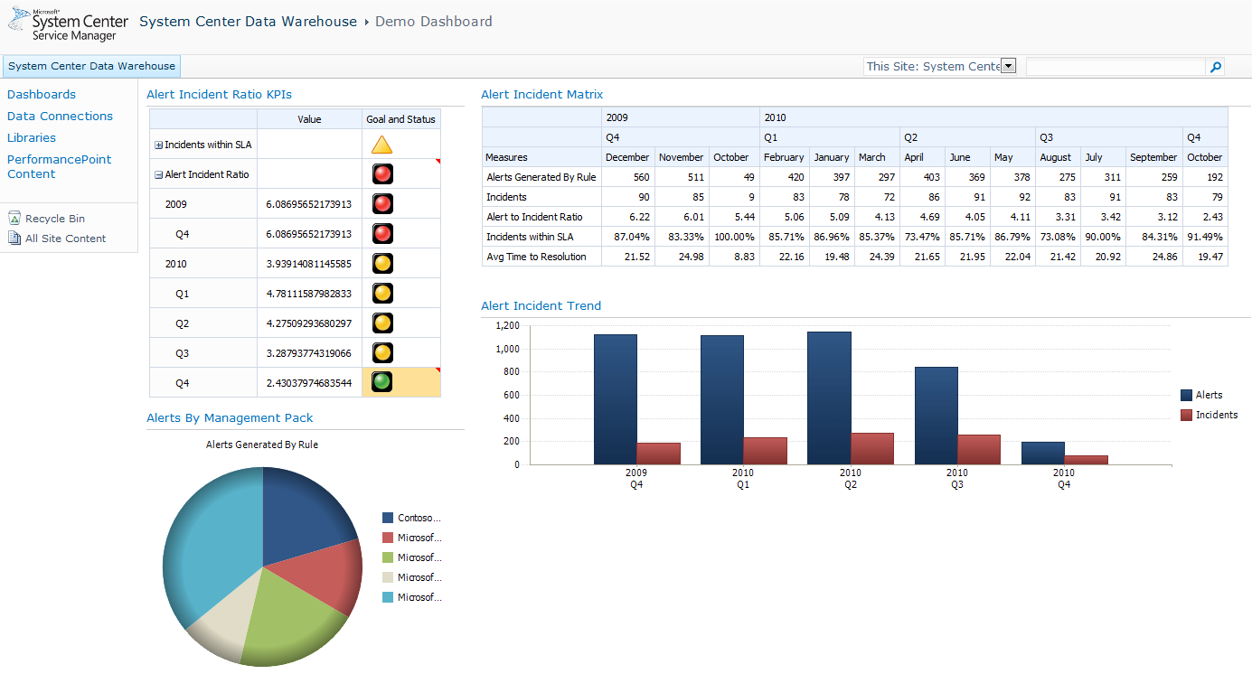
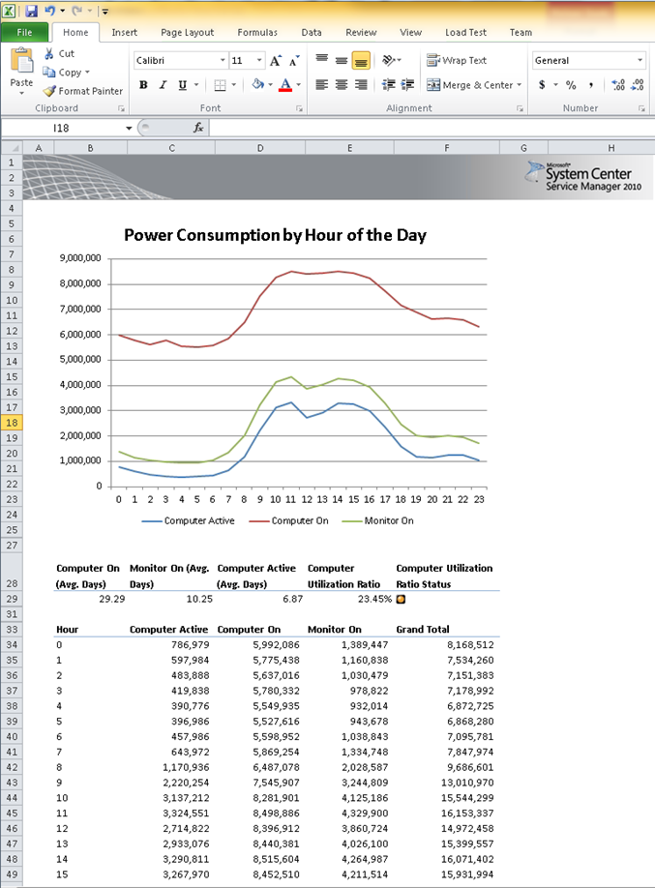
System Center Data Warehouse
Replace System Center Reporting Manager (SCRM)*
  Pull data from SM, OM & CM for a comprehensive view of IT
  Enable direct publish to the Data Warehouse from custom sources (i.e. SAP, HR
Enable self service report & dashboard authoring with OLAP cubes
  OLAP cubes powered by the System Center management pack model
  Report authoring with Office integration for knowledge workers
Data Warehouse
OLAP

Slide 21
System Center Data Warehouse
Travis Wright
demo

Slide 22
Scope of Service Manager 2012
Major Investment Areas
Incremental Improvements
Service Requests
Self-Service Portal
Release Management
Data Warehouse/Reporting
Orchestrator/VMM Integration
Incident SLA
Parent/Child Work Items
AD Connector Improvements
PowerShell
Subscription Infrastructure
Parallel Activities
Performance Improvements
Bug Fixes

Slide 23
Schedule
Public Beta – Q3 CY 2011
RTM – Q4 CY 2011

Slide 24
Related Content
Required Slide
Speakers, please list the Breakout Sessions, Interactive Discussions, Labs, Demo Stations and Certification Exam that relate to your session. Also indicate when they can find you staffing in the TLC.
Breakout Sessions
  SIM 208 - Management in the Datacenter
  SIM 209 - Microsoft System Center Service Manager - A Deep Dive on How to Automate ITIL or MOF
  SIM 210 - Sneak Peak at Microsoft System Center Service Manager 2012
  SIM 335 - Automation - Service Manager & Orchestrator - Better Together
  SIM 340 - Extending Microsoft System Center Service Manager - Modeling your Business Process
  SIM 362 - Monitoring IT as a Service with Microsoft System Center
  SIM??? - Taking the Next Step in IT GRC
Interactive Sessions
  SIM 372INT - How to Deploy and Configure Microsoft System Center Service Manager
  SIM 373INT - Stump The Microsoft System Center Service Manager team
  SIM383INT - Managing the Datacenter: Ask a Panel of Experts
Hands-on Labs
  SIM371-HOL Building a Microsoft System Center Service Manager Test Lab - Hall B1
  SIM372-HOL Incident and Change Management in Microsoft System Center Service Manager 2010 - Hall B1
  SIM373-HOL Microsoft System Center Service Manager 2010 Data Warehouse and Reporting - Hall B1
  SIM374-HOL IT Governance, Risk and Compliance Configuration in Microsoft System Center Service Manager 2010 - Hall B1
Product Demo Stations TLC – SIM – station 21
Find Me Later At…TLC station 21 or @SeanC_MSFT

Slide 25
Track Resources
Don’t forget to visit the Cloud Power area within the TLC (Blue Section) to see product demos and speak with experts about the Server & Cloud Platform solutions that help drive your business forward.
You can also find the latest information about our products at the following links:
Cloud Power - http://www.microsoft.com/cloud/
Private Cloud - http://www.microsoft.com/privatecloud/
Windows Server - http://www.microsoft.com/windowsserver/
Windows Azure - http://www.microsoft.com/windowsazure/
Microsoft System Center - http://www.microsoft.com/systemcenter/
Microsoft Forefront - http://www.microsoft.com/forefront/

Slide 26





Resources
  Connect. Share. Discuss.
http://northamerica.msteched.com
Learning
  Sessions On-Demand & Community
  Microsoft Certification & Training Resources
www.microsoft.com/teched
www.microsoft.com/learning
  Resources for IT Professionals
  Resources for Developers
http://microsoft.com/technet
http://microsoft.com/msdn

Slide 27












Complete an evaluation on CommNet and
enter to win!

Slide 28


Slide 29

© 2011 Microsoft Corporation. All rights reserved. Microsoft, Windows, Windows Vista and other product names are or may be registered trademarks and/or trademarks in the U.S. and/or other countries.
The information herein is for informational purposes only and represents the current view of Microsoft Corporation as of the date of this presentation. Because Microsoft must respond to changing market conditions, it should not be interpreted to be a commitment
on the part of Microsoft, and Microsoft cannot guarantee the accuracy of any information provided after the date of this presentation. MICROSOFT MAKES NO WARRANTIES, EXPRESS, IMPLIED OR STATUTORY, AS TO THE INFORMATION IN THIS PRESENTATION.

