Slide 2

Microsoft System Center Orchestrator 2012 Overview
SIM207
Adam Hall
Senior Technical Product Manager
Server and Cloud

Slide 3
Session Objectives and Takeaways
Objectives:
  You understand what the Orchestrator capability pillars are
  You can effectively describe what Orchestrator does and the benefits to your organization
  You gain an insight into the new capabilities and benefits that System Center Orchestrator will bring
Key Takeaways:
  Orchestrator is all about Integration, Orchestration and Automation
  Orchestrator is part of the System Center Suite
  Every organization has at least one scenario that Orchestrator answers!

Slide 4
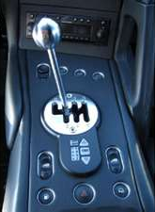
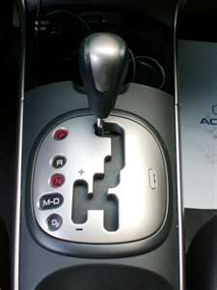
Why are we investing in IT
Process Automation?
How does System Center provide ITPA?
  Consistency
  Compliance
  Cohesion
Removal of the manual
The ability to choose
Notes:
A common question asked is why Microsoft is investing in process automation in the System Center suite. The answer is quite simple … because it is a critical component that is required to gain full benefit from the System Center suite.
The name Process Automation is a bit misleading, because Automation is the last thing you do. Before you can automate across the datacenter, you need to have Integration and the ability to Orchestrate across systems. We are investing heavily in these tools because they are a critical component of a management suite and required to bring all the components of the datacenter together and build towards the services you will deliver in a Private Cloud.
The adoption of Opalis and looking ahead to Orchestrator brings you 3 immediate benefits – Consistency in your operations, Compliance against your regulatory requirements and the Cohesion of your datacenter components.
And whether you are looking to start out with the removal of manual tasks, or move to dynamic fully automated services, we give you the choice on where you fit on that scale and how quickly you move from where you are to where you want to be.

Slide 5

TODAY
Leveraging the Power of Opalis 6.3
Notes:
So lets start with where we are today. Opalis 6.3 is the solution we have in market right now, and you can get started right now!
(speaker note: Opalis is a subsidiary of Microsoft. It is NOT “Microsoft Opalis” or “System Center Opalis”. It can only legally be referred to as “Opalis”. And if you want to be completely accurate, the company name is Opalis and the product is Opalis Integration Server ☺).

Slide 6
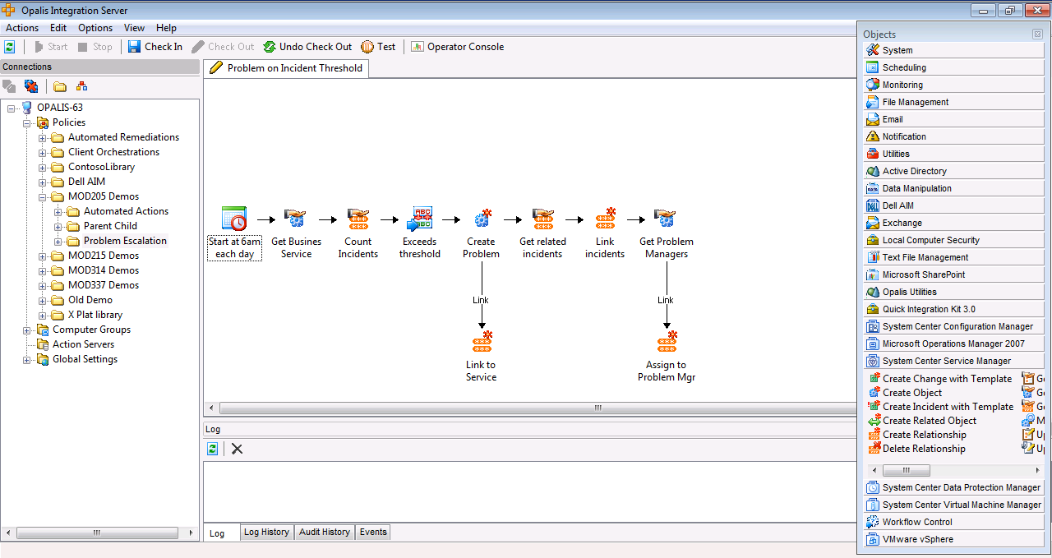
Opalis History
Opalis is a mature solution set
  Founded in 1999
  Current version is 6.3 (Nov 2010)
Acquired by Microsoft
in December 2009
Opalis is a subsidiary of Microsoft
  The current version of Opalis is a grant to Microsoft customers

Slide 7
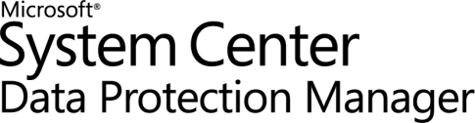

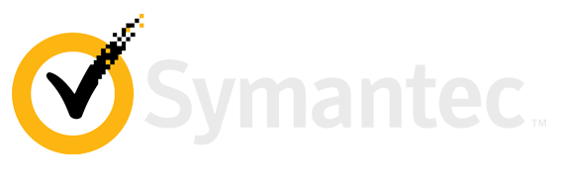
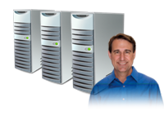
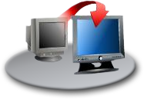






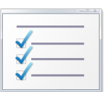
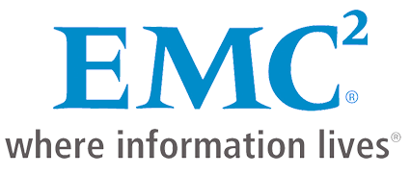

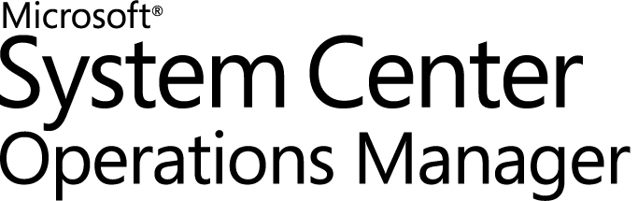
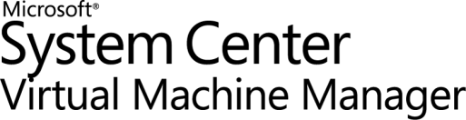

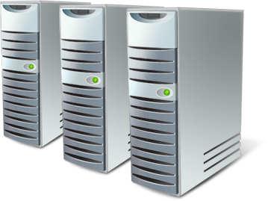


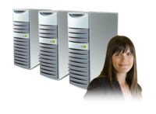

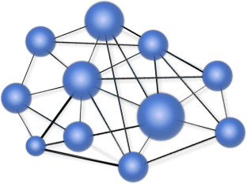



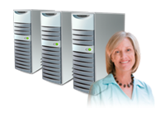
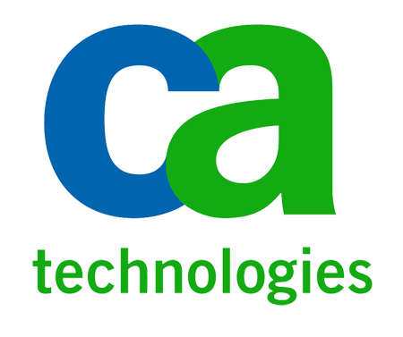

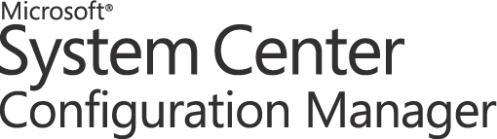

Opalis brings it all together!
Service Management
Configuration
Monitoring
Provisioning
Protection
Service Manager
Automation
Integration
HP Service Manager Software
Make your IT service desk enterprise strength
.
Orchestration
OpenView Operations
Notes:
You can break down the core capabilities required to manage a Datacenter into 5 key areas. And in all likelihood, you will have a range of solutions in your datacenter from a variety of vendors.
The System Center suite provides solutions to all of these areas, and with the addition of Opalis to the suite we also provide the mechanism to integrate to the 3rd party solutions. This is an investment that we are committed to and will continue to maintain as part of Orchestrator.
There are 3 words we associate with Opalis/Orchestrator. The first is Integration.
Bringing all of the components of your datacenter together and being able to communicate and execute across all the different moving parts is the first step. This brings us to Orchestration.
Once you have integrated your datacenter and can reference it is a single entity, then you can start to map out how to co-ordinate all the different parts to work together.
And then you can automate all of this to deliver consistent and repeatable results.

Slide 8
Opalis Concepts
Activities
  Intelligent tasks that perform defined actions
Integration Packs
  The way Opalis integrates to and executes activities against other systems and solutions
Databus
  The mechanism Opalis uses to publish and consume information between
  activities as the runbook executes
Runbooks
  System level workflows that execute a series of linked activities to complete
  a defined set of actions

Slide 9
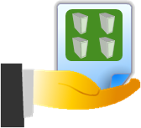
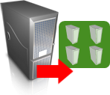

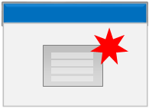

Authoring Made Easy
Get Clone
Requests
Clone
VMs
Add Storage
To Each
Create
Advertisement
Protect
VMs
Opalis Databus
Request ID | VM Size | VM Disk | …
CR3453 | Large | 8GB | …
CR3460 | Small | 1GB | …
CR3750 | Small | 4GB | …
CR2762 | Med | 5GB | …
VM Size | VM Disk
Large | 8GB
Small | 1GB
Small | 4GB
Med | 5GB
VM Disk
8GB
1GB
4GB
5GB
VM ID
233113
233114
233115
233116
VM ID | VM Name | …
233113 | VM233 | …
233114 | VM234 | …
233115 | VM235 | …
233116 | VM236 | …
VM Name
VM233
VM234
VM235
VM236
VM Name
VM233
VM234
VM235
VM236
Disk ID | …
33434 | …
33435 | …
33436 | …
33437 | …
Job ID | …
6655 | …
6657 | …
6659 | …
6670 | …
Protection Group | …
LargeVMs | …
SmallVMs | …
SmallVMs | …
MedVMs | …
Notes:
The Opalis Databus is one of the most important capabilities and benefits that Opalis delivers. The Databus is a subscribe and publish mechanism that allows you to interact with all the information that is created or consumed as a runbook executes.
What you see as this animation proceeds is a representation of what happens on the Databus. As the runbook executes, the data associated with the activity is put onto the bus, and is available to subsequent activities. Each activity can interact with information from all previous activities.

Slide 10
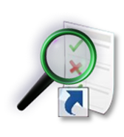




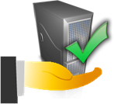


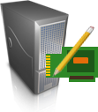
Automating Across Datacenter IT Silos
Event Mgmt
Monitor
for request
Application Service Management
VM Lifecycle Management
Incident
Response
Service Desk
Initiate
Change
Update
CMDB
Close
Request
Change & Compliance
Provisioning
Asset/CMDB
Create
Deployment
Configuration
Clone
VM
Associate
Server to Service
Virtual
Security
Storage
Create
Disk
Connect
Disk to VM
Server
Create
Server
Network
Join
Network
Notes:
As you all will be aware, there are many different silos within an IT environment. The diagram we have here is representative of what a lot of customers have in their technology organizations. With Opalis, we are able to integrate and automate across these silos.
If we take an example of VM lifecycle, you can see an example of a runbook and how it cuts across these silos to provide the complete process required to deploy out a new virtual machine.

Slide 11



Opalis target scenario examples
Manual tasks
Batch Scripts
Compliance requirements
User request scenarios
Provisioning
Disaster Recovery
Desktop scenarios
Responding to incidents
Change Control
Multiple Service Desks
Capacity Management
Release Management
SLA adherence issues
Rapid change environments
Diverse system integrations
Patch Remediation
  Every customer has at least one scenario that Opalis answers!
Notes:
Everyone has a place to start! There are a number of example targets as you can see. This list is not exhaustive, merely suggestive.
There is a story that will help you understand how to get going.
We have a customer, and they have a task where every morning they move a pile of rocks from A to B. So the person who does this comes in, and every morning moves the rocks from one place to another.
So we create a runbook that moves rocks. Now, every morning that person comes in, and instead of moving the rocks, its done for them and they can do something else.
But there is a second step after that. Once the rocks are moved, they are then sorted by size, small, medium and large.
So we update the runbook. Now the rocks are moved from one place to another, and then sorted by size, so now we have 3 piles of rocks.
This is great! Now the person comes in, and can do something even more interesting.
But then we discover there is a 3rd step, and once the rocks are sorted by size, they are sorted again by color.
No problem, we update the runbook again, and now we move the rocks, sort them by size and then by color, red green and blue.
Now this example is typical of what happens, and is import for 2 reasons.
Firstly, its important to start with something small and get to understand how to build runbooks.
But more importantly, secondly the planning takes longer than the building. If you understand your process up front and what it looks like in completeness, you can build the entire runbook from the start!

Slide 12
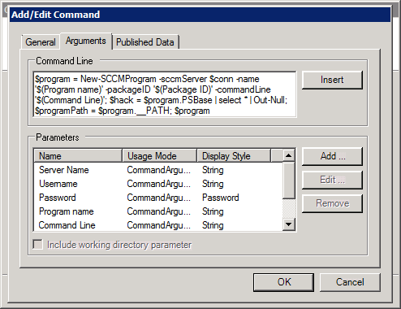
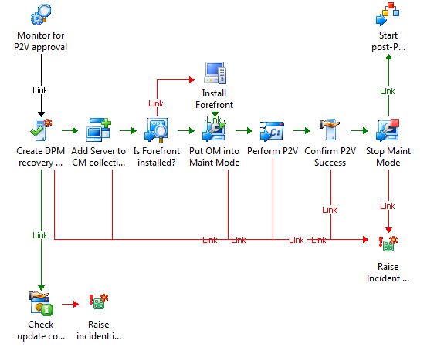
The Power of the Opalis solution
Market-tested
  Currently on 6th version of product which has seen broad customer adoption for a variety of use cases
Easy authoring and debugging
  Drag and drop, Visio-like authoring, nested runbooks, built in features like looping and branching.
Databus
  Abstracts developer-level complexity from the runbook author and enables Hub-and-spoke integration model
Out of box Integration Packs
  All major enterprise products covered (HP, IBM, CA, BMC, EMC)
  Easy extensibility
  Quick Integration Kit (QIK)
Operations console
  Role-based views provide visibility to the runbooks
  Cost
  All Management licensing vehicles (SMSE/D, ECI, e-CAL and SPLA) include a license grant for Opalis
Notes:
Opalis is an incredibly powerful solution. It’s been market tested, its several generations old and we have a lot of customers using it today.
There are 2 keys to the success of Opalis. Firstly there is the authoring and debugging capabilities. It is very easy to learn how to build runbooks with graphical drag and drop interfaces, and a very powerful debugging console that lets you see exactly what is going on when the runbook executes.
Secondly there is the Databus which you saw earlier.
We have a wide range of OOB integration packs, and provide the Quick Integration kit to build your own as well!
And of course we make it very cost effective by including it in all the major licensing constructs.

Slide 13
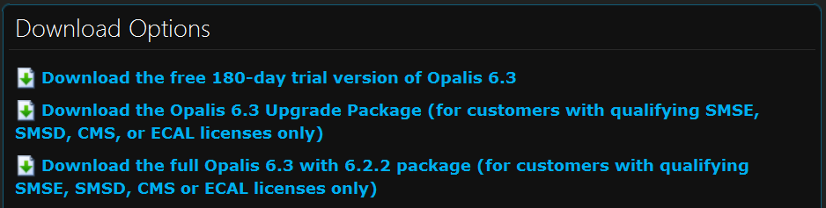
How do you get Opalis?
The Opalis subsidiary has granted Microsoft customers rights
to Opalis:
  Server Management Suite Enterprise/Datacenter (SMSE/D)
  New into Service Provider Licensing (SPLA)!
  New into Enterprise CAL (eCAL) for client scenarios!
Getting the bits:
  180 day trial available on
  microsoft.com
  Full version and licenses also
  on microsoft.com
  Opalis will not be on MVLS, TechNet
  or MSDN
Notes:
Opalis is currently a subsidiary of Microsoft, so just a note that you get the Opalis product a little differently than normal.

Slide 14

TOMORROW
Lets go take a look at System Center Orchestrator!

Slide 15





System Center Orchestrator Investments
IT Pro
Authoring, Debugging & Scripting
Operator
Trigger, Monitor &Troubleshoot
Developer
Application integration
IT Business Manager
Report & Analyze
Notes:
There are 4 key investment areas for Orchestrator.
For the IT Pro, we are continuing the rich authoring experience from Opalis 6.3 which will remain very similar to how it is today.
Then we head into new capabilties. For the Operator we have a new Silverlight console that provides the ability to start, monitor progress and troubleshoot runbooks.
For the developer, we have a new PowerShell Provider to interact with Orchestrator through the command line, and also a new rich ODATA REST based web service.
And for the ITBM, that same web service is used to get statistical information about the Orchestration environment and build reports in BI tool like PowerPivot and SQL.

Slide 16

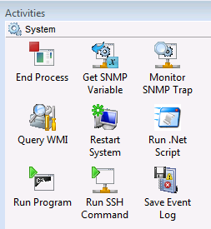
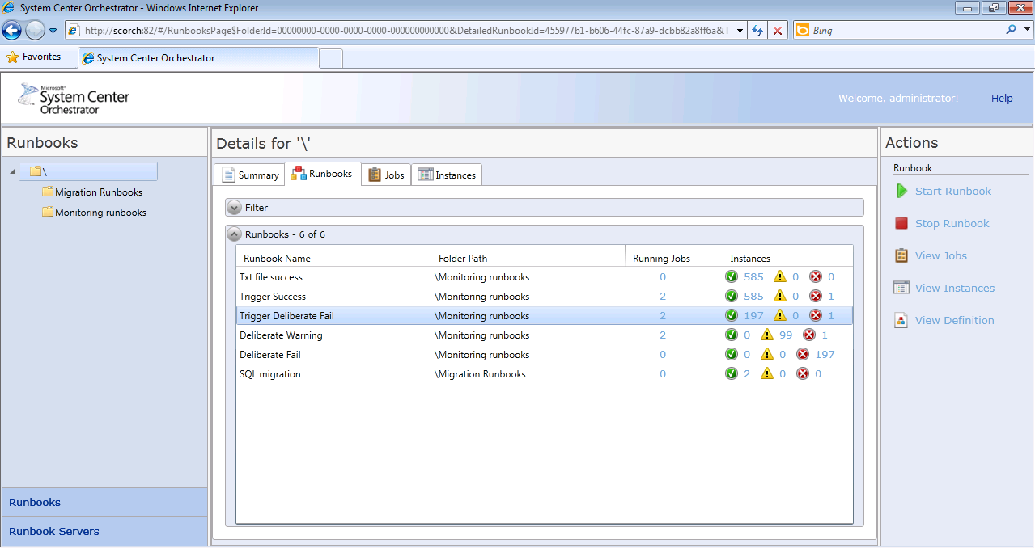
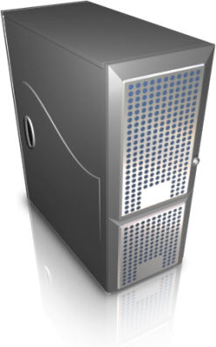
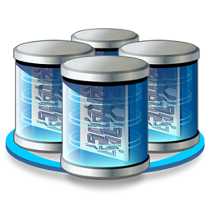
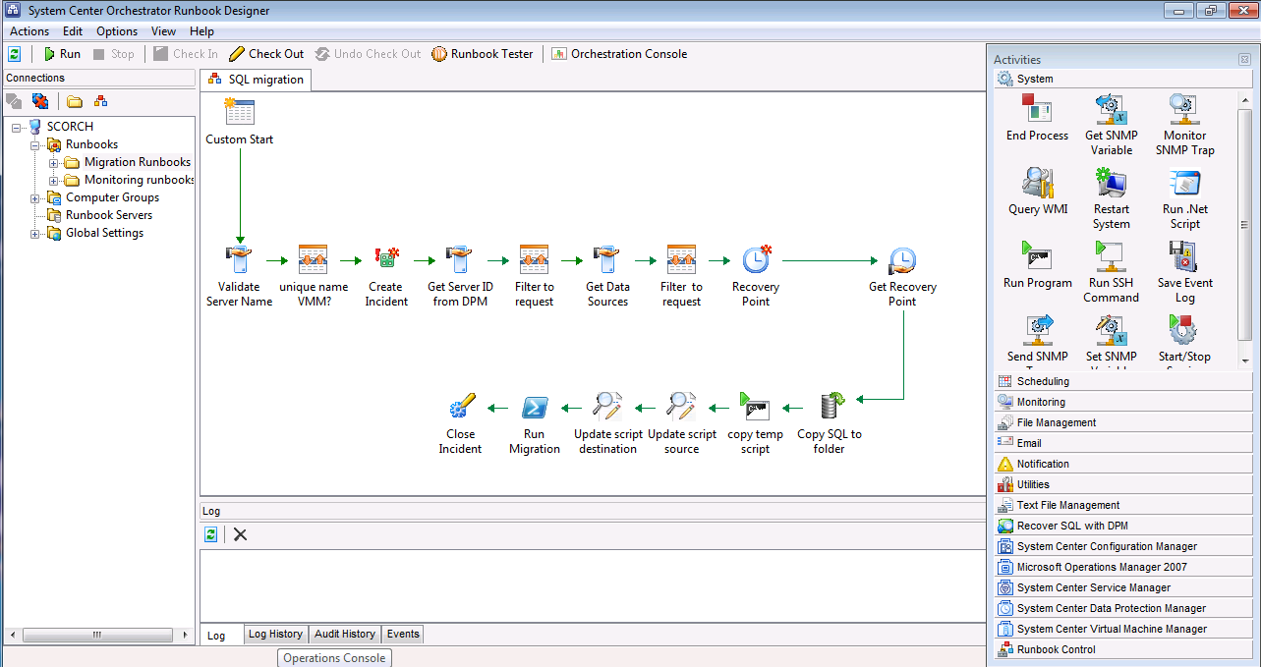
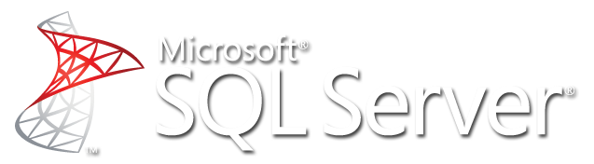



What are the Components of Orchestrator?
External Integration
Developer
Service Management
Configuration
Monitoring
Provisioning
Protection
Automation
Integration
Web Service
.
Quick Integration Kit
Orchestration
IT Pro
Operator
IT Business
Manager
Notes:
These are the components of an Opalis implementation.

Slide 17
System Center Orchestrator
Beta!
Demo

Slide 18
Frequently Asked Questions!
OS support
  Orchestrator will be supported on Windows Server 2008 R2
  The Runbook Designer client will additionally be supported on Windows 7 (x86 and x64)
Datastore Database support
  SQL 2008 R2

Slide 19
Frequently Asked Questions!
Opalis to Orchestrator migration
  Export / Import of Runbooks
  No Legacy activities
  Some changes to foundation activities
Web Console
  Java/JBOSS console is deprecated
  Replaced by IIS/Silverlight console

Slide 20
Frequently Asked Questions!
Localization / Globalization
  We are globalizing for Orchestrator (run on non EN_US OS)
  Localization (languages other than EN_US) will follow in a future release
Operations Manager Management Pack
  YES!
  Released with Orchestrator

Slide 21
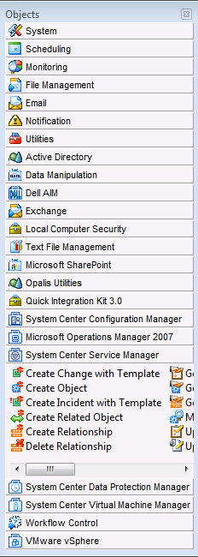
FAQ – IP remediation and support
We are committed!
Remediation is underway!
More IP’s are planned ☺
For every remediation:
  Validate we should have the IP
  Ensure we have the right activities
  Document the use scenario’s
  Update for new versions, API changes
  Adhere to EULA’s
  Remediate code

Slide 22
Opalis 3rd party Integration Packs - OOBE
BladeLogic Operations Manager
BMC Atrium CMDB
BMC Remedy AR System
BMC Event Manager
BMC Patrol
CA Spectrum
CA Unicenter Service Desk
CA Autosys
CA eHealth
CA Unicenter NSM
EMC Smarts InCharge
VMware vSphere
Active Directory
FTP
HP iLO and OA
HP OpenView Operations (Windows)
HP Service Manager
HP Asset Manager
HP Network Node Manager
HP OpenView Operations (Unix - HPUX)
HP OpenView Operations (Unix - Solaris)
HP OpenView Service Desk
IBM Tivoli Netcool Omnibus
IBM Tivoli Enterprise Console
IBM Tivoli Storage Manager
UNIX
Veritas NetBackup

Slide 23
Updated IPs for the Orchestrator release
In the Orchestrator Beta timeframe
  Active Directory
  FTP
  VMware vSphere
  IBM Tivoli Netcool Omnibus
Further information will be released at a later date

Slide 24
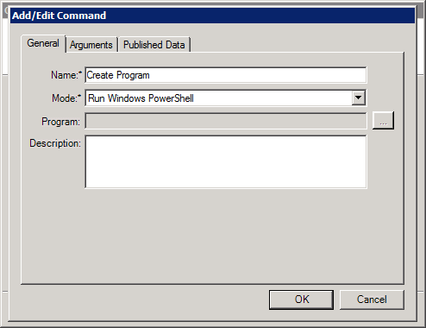

No IP? No Problem!
QIK is a Software Development Kit (SDK)
  Programming Interface for
  Microsoft .NET 2.0 (C#, VB)
  Programming Interface for Java SE5+
  API documentation, C# examples, FAQs
  Integration Packs for running QIK objects
  Wizard for packaging Integration Packs
  Wizard for creating integrations with command
  line based solutions
Quickly Develop Integrations
  Simple APIs that are easy to learn and use
  Integration details are encapsulated
  Easy wizard-driven approach to building integrations with data center tools
  that provide a command-line interface

Slide 25
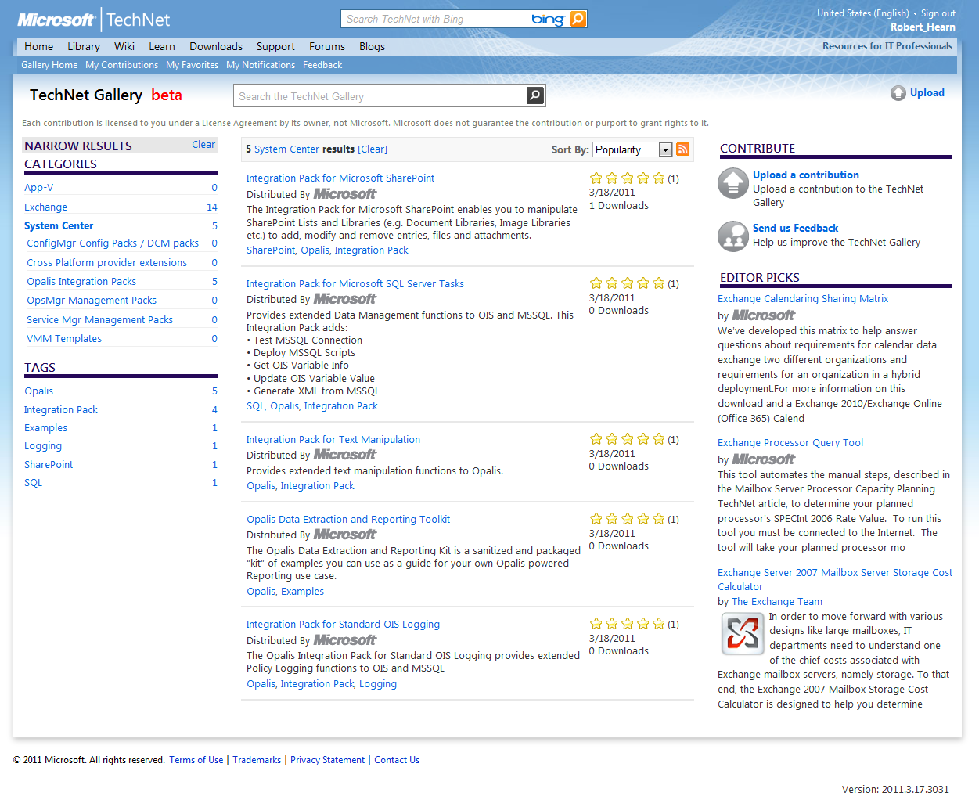
Announcing the TechNet Gallery!
A central place to find community content for System Center
Opalis community created Integration Packs!
Easy to share & download
See ratings of download & author, Q&A, and more!
http://gallery.technet.microsoft.com/

Slide 26
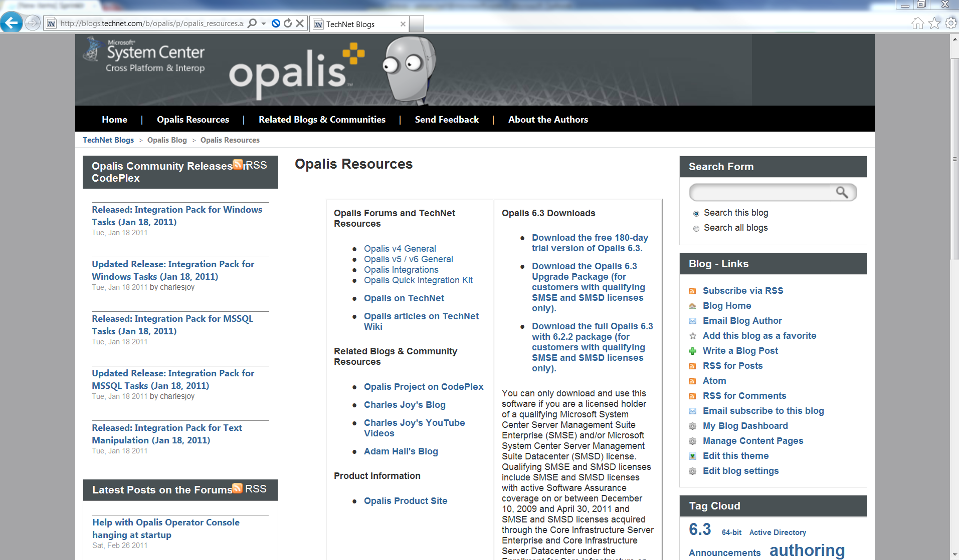
Useful Links
http://msft.it/opalisresources
http://msft.it/opalis
http://msft.it/opalisblog
http://msft.it/opalistechnet
http://msft.it/CharlesJoy
http://msft.it/adamhall
http://opalis.codeplex.com

Slide 27









System Center Roadmap
Available Now
Coming Soon
  1H CY10
  2H CY10
  1H CY11
  2H CY11
Beta
RTM
Beta
2007 R3
Beta2
RTM
Beta2
6.3
Beta
RTM
Acquired
Beta
Beta
RTM
Beta
2010
IT GRC
Beta & RTM
2010
Beta & RTM
Beta & RTM
Beta
RC
RC
RTW
System Center
Codename “Concero”
Beta & RTM
GA
GA
Notes:
27
© 2008 Microsoft Corporation. All rights reserved. Microsoft, Windows, Windows Vista and other product names are or may be registered trademarks and/or trademarks in the U.S. and/or other countries.
The information herein is for informational purposes only and represents the current view of Microsoft Corporation as of the date of this presentation. Because Microsoft must respond to changing market conditions, it should not be interpreted to be a commitment on the part of Microsoft, and Microsoft cannot guarantee the accuracy of any information provided after the date of this presentation.
MICROSOFT MAKES NO WARRANTIES, EXPRESS, IMPLIED OR STATUTORY, AS TO THE INFORMATION IN THIS PRESENTATION.

Slide 28
Community Evaluation Program
Guided evaluation of Management & Security Products
  Access to evaluation bits and VHDs
  Access to product group at Virtual Chalk Talks
Community of Participants
  Share feedback on product and documentation
  Share best practices and experiences
Learn more about programs at
  http://msft.it/cep
  Or email mscep@microsoft.com with your interest
Be the first to know when the Beta is available.
Sign up at the Orchestrator Expo Booth!

Slide 29
Adam Hall
Senior Technical Product Manager
System Center Orchestrator
E-mail: adhall@microsoft.com
Close, Q & A

Slide 30
Track Resources
Don’t forget to visit the Cloud Power area within the TLC (Blue Section) to see product demos and speak with experts about the Server & Cloud Platform solutions that help drive your business forward.
You can also find the latest information about our products at the following links:
Cloud Power - http://www.microsoft.com/cloud/
Private Cloud - http://www.microsoft.com/privatecloud/
Windows Server - http://www.microsoft.com/windowsserver/
Windows Azure - http://www.microsoft.com/windowsazure/
Microsoft System Center - http://www.microsoft.com/systemcenter/
Microsoft Forefront - http://www.microsoft.com/forefront/

Slide 31





Resources
  Connect. Share. Discuss.
http://northamerica.msteched.com
Learning
  Sessions On-Demand & Community
  Microsoft Certification & Training Resources
www.microsoft.com/teched
www.microsoft.com/learning
  Resources for IT Professionals
  Resources for Developers
http://microsoft.com/technet
http://microsoft.com/msdn

Slide 32












Complete an evaluation on CommNet and
enter to win!

Slide 33

Notes:
New for TechEd 2011, we will be working with Microsoft Tag (http://tag.microsoft.com/overview.aspx) to create unique Tags for every session at the event. Your session Tag will appear on both the room signage and at the end of your presentation. With your session Tag, attendees will be able to scan as they enter the room to retrieve session details, view speaker bios, and engage in discussions; or scan at the end of the presentation to evaluate your session and download materials. We’re excited to integrate Microsoft Tag across the My TechEd mobile experience this year.

Slide 34

© 2011 Microsoft Corporation. All rights reserved. Microsoft, Windows, Windows Vista and other product names are or may be registered trademarks and/or trademarks in the U.S. and/or other countries.
The information herein is for informational purposes only and represents the current view of Microsoft Corporation as of the date of this presentation. Because Microsoft must respond to changing market conditions, it should not be interpreted to be a commitment
on the part of Microsoft, and Microsoft cannot guarantee the accuracy of any information provided after the date of this presentation. MICROSOFT MAKES NO WARRANTIES, EXPRESS, IMPLIED OR STATUTORY, AS TO THE INFORMATION IN THIS PRESENTATION.

