Slide 1
Microsoft Identity and Access Strategy
SIM203
Mark Ryland
Principal Program Manager
Identity Platforms Group
Microsoft Corporation

Slide 2

Outline
Key Industry Trends
Meet Jeff
Building Blocks
Of Social and Persona Graphs
Next Steps

Slide 3


Key Industry Trends
Consumerization:
  Devices: variety of platforms must be secured and managed
  Applications: user experiences that move the bar upwards … and sideways
Cloud:
  Massive efficiencies will compel change; when, not if
  Another dimension of consumerization: of expectations and app models
Collaboration:
  Agility requires new forms of sharing, yet security requirements remain
Advanced identity systems are key in all these trends
  Smarter systems and richer security fabrics enabling new trust frameworks with minimal trade-offs in GRC

Slide 4
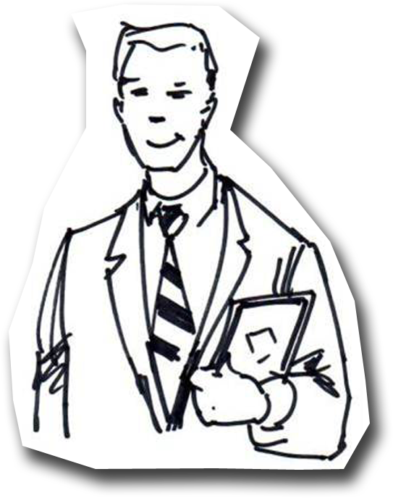
Meet Jeff
Jeff is married and has a
13 year old daughter Sarah
He works for Fabrikam Design,
a company that contracts
with several architecture
firms, including Contoso

Slide 5
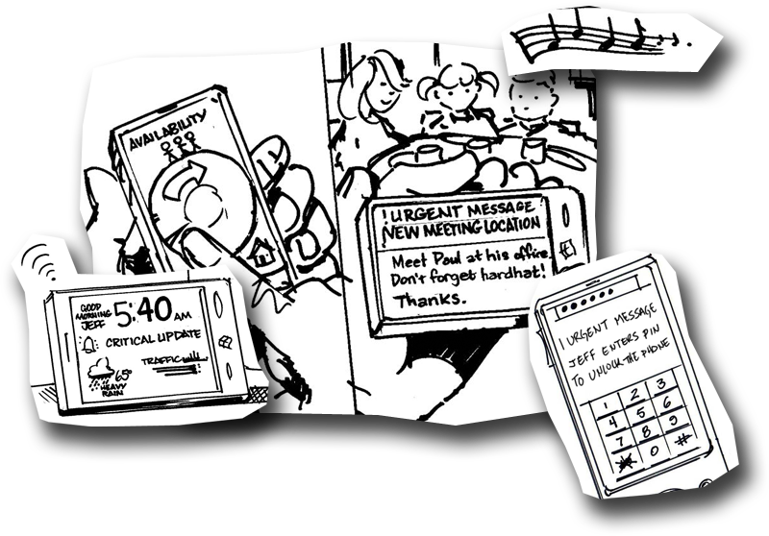
Availability & Messages Based on Context
During breakfast, his phone contextually
adjusts presence and availability
Critical message alert regarding
morning meeting, passing
the filter

Slide 6
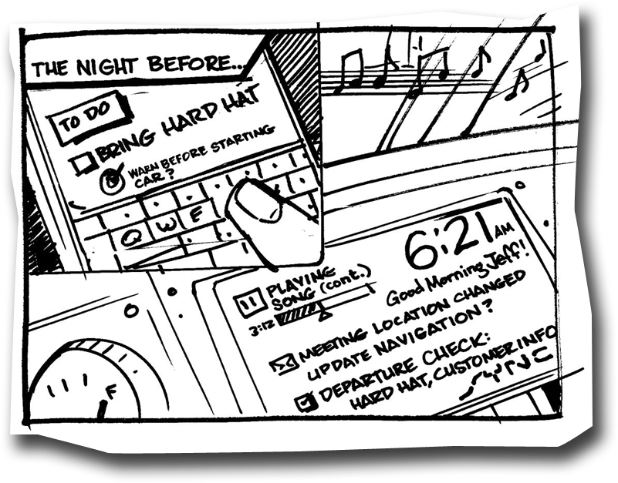
Information & Entertainment
Flow Across Devices
Car syncs the reminders
he set up the night
before using his phone
Continues to play music
he was listening to in the
house on the family PC

Slide 7
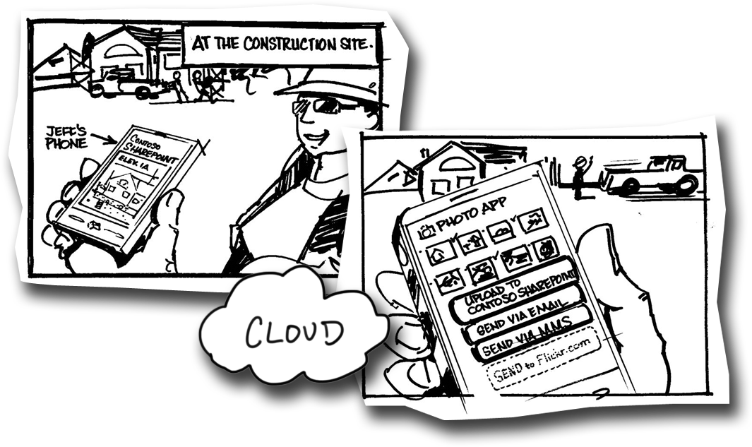
Onsite Document Access, Photo Upload
Construction site access to blueprints from Contoso’s
cloud document store
Site requires two-factor authentication by PIN
for partially-trusted devices
Or, with Jeff’s agreement, phone participates
in more than one trust fabric
Photo application automatically
shows a new activity to upload
pictures to business storage;
only trusted apps can do so

Slide 8
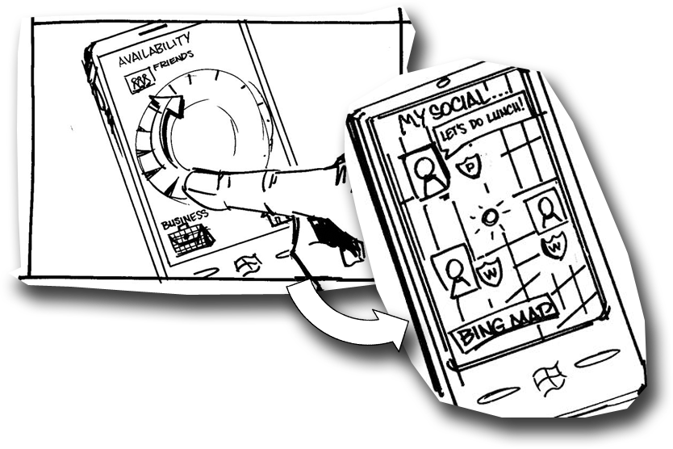
Finding Friends for Lunch
To avoid traffic, Jeff drives to his afternoon meeting
location early and decides to have lunch
Uses mobile device to adjust
availability and advertises
this status plus location
only to friends, all not
Fabrikam colleagues
Friends in proximity
can join him

Slide 9
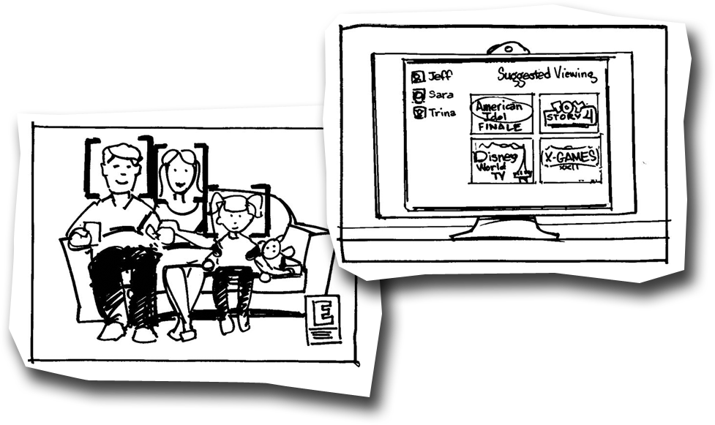
Blended Identities & Recommendations
Jeff’s family watches TV. The TV knows who is in the room
Sometimes they let the TV recommend shows to watch
When Sarah is there, material TV-14 and
above is filtered
When their daughter goes
to bed, Jeff and his wife
see that several R-rated
movies are available

Slide 10
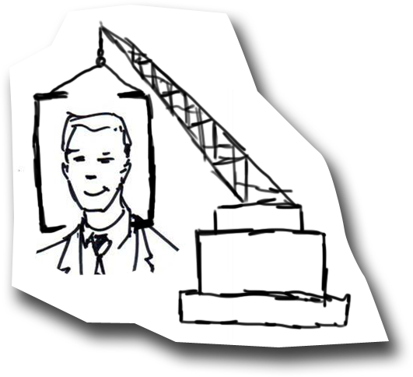
Building Great Experiences on
Identity Foundations
Identity systems enable more than just access to
applications and information
Access depends on rich context – time of day,
purpose, privacy, presence, location, devices…
Access control goes both ways: users
are critical & protected resources too!
Modern, cross-platform device trust and
management / policy framework
Policies should be easy to manage and
applied broadly – applications, sure, but
also what my kids can watch, my availability…
All on the basis of an interoperable,
trust-based identity ecosystem

Slide 11
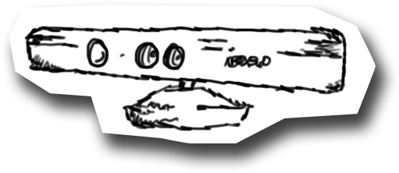
Science Fiction?
Too “science fiction-y”? Many pieces are here now…
Kinect shipping by the millions…
Facebook knows my friends…
LinkedIn knows my business contacts…
My company directory knows my colleagues; collaborator data coming soon
Netflix knows a lot about what I watch…
Cloud directory services and device management here today in early form
Standards works in process on delegated access, although far more needs to be done…

Slide 12

Goal: Personal Control and
End-to-End Trust
Reasonable control over personal data in a collaborative
and consumerized IT world
Anonymity protected when requested & appropriate,
but illegitimate actions much harder for bad actors
No longer forced to make trade-offs between strong
security and disclosure of personal information
End-to-end trust required to take
on-line society to the next level of
convenience, efficiency, & safety

Slide 13
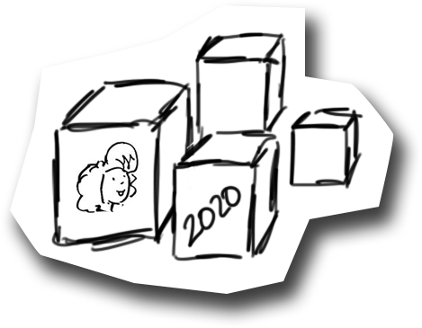
The Building Blocks for Identity in 2020
Some are (nearly) here today:
  Claims and federation are critical building blocks
  Increasingly ubiquitous access to cloud services
But many pieces missing:
  Cloud-based services that provide composition
  and blending of identity data
  Making relationships first-class entities
  Ways to create, distribute, manage, and
  use logically centralized access policies;
  and re-centralize resulting audit logs

Slide 14

The Importance of Claims & Federation
Claims and federation provide key patterns needed to enable identity at Internet scale
  Layered: federation needs claims, but not vice versa
Claims:
  Attribute-based identity artifacts with completely
  flexible syntax; can readily be “compiled” into
  different token types
  Flexible primitives to build a variety of higher level
  models (e.g., RBAC)
  Substrate for transitive trust models of federation
  Semantic agreement remains the hard part

Slide 15
Four Key Patterns of Federation
Abstraction:
  Externalizing identity details from code
Late binding:
  Resource-relative acquisition of security context
  You can’t “log in to the Internet”
Composition:
  Accessing resources thru trust chains (authority composition)
  Identities/attributes are added, transformed (identity composition)
  Challenge: discovery of authorities, management of trust chains
Attribute transformation:
  Dynamic re-mapping of attributes across trust boundaries
  Challenge: provisioning and management

Slide 16

Ubiquitous Access to Cloud Services
The identity systems of tomorrow require
  A range of inter-connected systems
  Broad platform support
  Passive & active clients
  Simple & powerful network programming models
We have all these today!
Enhancements needed
  Connecting users and devices across multiple
  identity / trust fabrics simultaneously
  Occasionally connected, offline/online
  support in a generic / device-independent manner

Slide 17
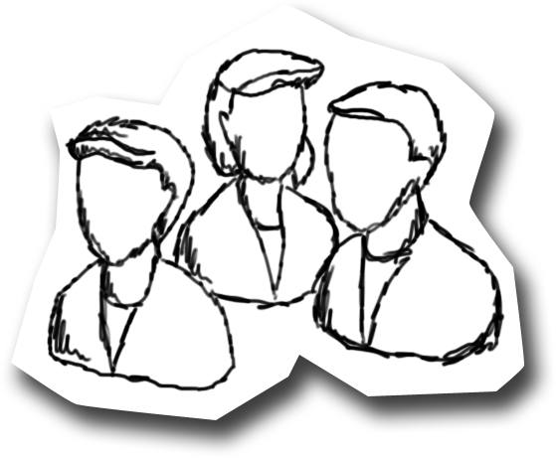
Compound Identities
Compose identities in multiple dimensions
Principal composition:
  User+device: device state, health, ownership/control
  Persona-persona: e.g., same user authenticated to both consumer
  (“i-owned”) and corporate (“org-owned”) ID systems
  User-user: two different users working cooperatively
Profile composition:
  Huge amount of common (often stale)
  data across identity systems; why?
  Need to provide a safe, managed way
  to connect and flow profile data
  And to compose personas from “identity atoms”…

Slide 18

Of Social Graphs…
Next stop: add relationship data to identity systems
  Imagine employer-verified LinkedIn job history data
  Imagine security systems based on social knowledge, behavior
  Privacy-enhancing security obviously key
Not just social graphs, responsibility graphs
Expanding “access control”: not
just people to resources, but
also resources to people!

Slide 19

And Persona Graphs
Digital identities not only need to be interconnected…
“Personas” (context-relative identity aspects, a.k.a. “facets”) interrelate in complex but comprehensible ways
Personas also form the basis of distinct social graphs
So beyond social graphs, systems must support:
  Creating and managing persona graphs
  Linking social graphs to personas

Slide 20
Composing Personas from “Identity Atoms”
First Tech CU
MSFT Federation Partners
U.S. Gov’t
Microsoft
Bank Accounts
  Checking
  Savings
  Money market
Public (fed) data
  conradb@microsoft.com
  Stable per-partner UUID [for correlation]
Social Security #
  599-59-5959
Bank Accounts
  Checking
  Savings
  Money market
Public (fed) data
  conradb@microsoft.com
  Stable per-partner UUID [for correlation]
Social Security #
  599-59-5959
Tax Payer Data
  Tax returns
  Filing status
  List of employers
Business address (public)
  1 Microsoft Way
  Redwest-D
  Redmond, WA 98052
Tax Payer Data
  Tax returns
  Filing status
  List of employers
Business address (public)
  1 Microsoft Way
  Redwest-D
  Redmond, WA 98052
Home Address
  Walker Drive
  Redmond, WA
  425-555-1212
Payroll Data
  Monthly withholding
  W2 data
Personal email #2
  mpryland@gmail.com
Home Address
  Walker Drive
  Redmond, WA
  425-555-1212
Payroll Data
  Monthly withholding
  W2 data
Personal email #2
  mpryland@gmail.com
Shipping Address
  Lake Joy Drive
  Carnation, WA
Personal email #1
  mark_ryland@hotmail.com
Shipping Address
  Lake Joy Drive
  Carnation, WA
Personal email #1
  mark_ryland@hotmail.com
ID data (quasi-private)
  Redmond\Mark
  NT SID
  Password
Mobile phone #
  202-555-1212
401K Data
  Monthly contributions
  Account status
ID data (quasi-private)
  Redmond\Mark
  NT SID
  Password
Mobile phone #
  202-555-1212
401K Data
  Monthly contributions
  Account status
Amazon
Fidelity
Google
Live

Slide 21

Access Policies and Authorization
Universal, manageable access control is the goal of identity systems
Claims and federation help a lot, but also shift the access management
center of gravity
  Decrease in central control on identity side (users, groups, roles) increases need for rich access capabilities on resource/application side…
  Inherently distributed nature of resources and apps raises the bar for logically centralized policies, management, and audit

Slide 22


Access: Shifting Center of Gravity
Identities
Authority\Principal
Groups, roles
Other attributes
Client app identity (and attributes)
Device identity (and attributes)
Location
Other context
Access Control & Management: AuthN & AuthZ; Central policies, reporting & auditing
Resources
(Authority\Principal) 
Data sensitivity 
(labels, classifications) 
Operation requested 
Location (cloud/prem) 
Other context 
Information (special 
case discussed below) 
Identity side: industry has more mature solutions
  Claims & federation are simply techniques that allow late binding and composition and of identity attributes and security authorities; they help with authz but are far from complete
Resource/app side: generally bespoke, difficult to manage (sea of ACLs)
  This is the key area for progress in the next 10 years!

Slide 23
Holy Grail: E2E Access & Info Protection
Operation request includes relevant app/device claims
Access Control & Management
Identities
Authority\Principal
Groups, roles
Device identity (and attributes)
Location
Etc
Resources
Data sensitivity 
(labels, classifications) 
Operation requested 
Etc. 
❖
Local protection model
Operation generates protected information
Information protected like originating operation
Information protection should be logical extension of authorization model
  Same policies, IDs; same labels & classifications, same (subset of) operations
  Ideally, resource protection programming model provides semi-automatic information protection model as well for externalized information
    Information protection is “local cache” of the authorization/resource protection model

Slide 24

Where We Stand Today
Significant progress on some of building blocks
Available (or nearly so):
  Claims & federation added to Active Directory family via AD FS
  Cloud-based IdP STSs for both consumer & business users
    Live IDs and Microsoft Online IDs
  Just shipped: Access Control Service 2.0
    Programmable Cloud-based RP STS
    OpenID, Live ID (RPS), and Facebook Connect
    WS-Fed/WS-Trust and ADFS 2.0 bridging to AD
    OAuth 2.0 (draft) specs for delegated access
  SAML-P support coming
    CTP for WIF shipped yesterday

Slide 25
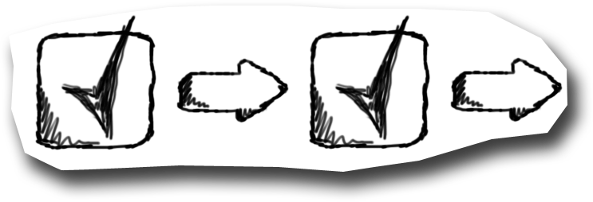
Next Steps
Enhance claims & federation technologies
  Continue standards work on delegated access
  Identity selection and user agents for active and passive clients
Enhance cloud identity services & interoperability
Develop industry patterns and practices for:
  Identity composition (both dimensions)
  Access control policies and management
  Linking social & persona graphs to identity
Build a safer, more powerful Internet based
on user control and end-to-end trust

Slide 26
Microsoft Identity and Access Strategy
Questions & Discussion

Slide 27
Track Resources
Don’t forget to visit the Cloud Power area within the TLC (Blue Section) to see product demos and speak with experts about the Server & Cloud Platform solutions that help drive your business forward.
You can also find the latest information about our products at the following links:
Cloud Power - http://www.microsoft.com/cloud/
Private Cloud - http://www.microsoft.com/privatecloud/
Windows Server - http://www.microsoft.com/windowsserver/
Windows Azure - http://www.microsoft.com/windowsazure/
Microsoft System Center - http://www.microsoft.com/systemcenter/
Microsoft Forefront - http://www.microsoft.com/forefront/

Slide 28





Resources
  Connect. Share. Discuss.
http://northamerica.msteched.com
Learning
  Sessions On-Demand & Community
  Microsoft Certification & Training Resources
www.microsoft.com/teched
www.microsoft.com/learning
  Resources for IT Professionals
  Resources for Developers
http://microsoft.com/technet
http://microsoft.com/msdn

Slide 29












Complete an evaluation on CommNet and
enter to win!

Slide 30


Slide 31
Microsoft Identity and Access Strategy
Additional scenarios

Slide 32
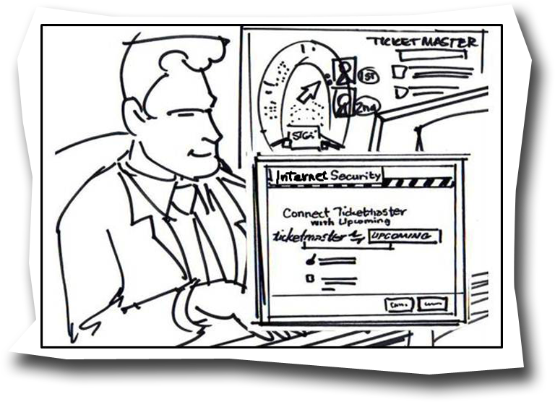
Commerce Augmented by Social Data
After work, Jeff goes to Ticketmaster to buy concert tickets
Ticketmaster pulls Jeff’s social
data from Yahoo and finds
that some of his friends
are attending as well
It offers Jeff a chance to
buy seats next to them

Slide 33
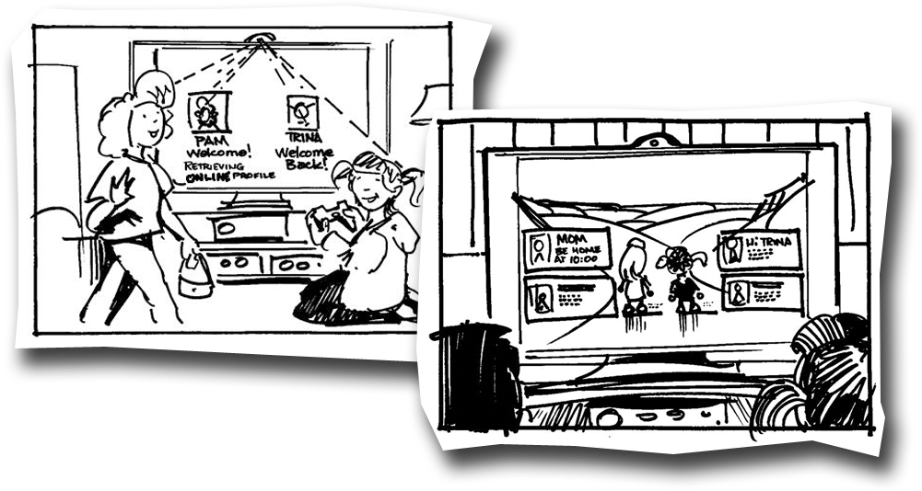
Bring Apps & Entertainment with You
Suzie comes over to play with Sarah. Suzie is identified by her face within
Sarah’s social graph and she has access to the games and media she
previously purchased
The TV/game console silently downloads apps in the
background in case they want to use
them from Sarah’s console
Together they can buy items for
their avatars and both see
which of their friends are
online while staying
caught up on
Facebook

Slide 34

© 2011 Microsoft Corporation. All rights reserved. Microsoft, Windows, Windows Vista and other product names are or may be registered trademarks and/or trademarks in the U.S. and/or other countries.
The information herein is for informational purposes only and represents the current view of Microsoft Corporation as of the date of this presentation. Because Microsoft must respond to changing market conditions, it should not be interpreted to be a commitment
on the part of Microsoft, and Microsoft cannot guarantee the accuracy of any information provided after the date of this presentation. MICROSOFT MAKES NO WARRANTIES, EXPRESS, IMPLIED OR STATUTORY, AS TO THE INFORMATION IN THIS PRESENTATION.

