Slide 1

The Taming of the Clouds:
Integrating SaaS with Your
On-Premise Environment
OSP324
Dmitry Sotnikov
Director of Cloud Solutions
Quest Software

Slide 2






The Good Old Days of Enterprise Intranet
Active Directory

Slide 3



Here Comes the Cloud
Active Directory

Slide 4
Bringing cloud under on-premise control
Active Directory
User directory synchronization
User single-sign on
Client distribution
Availability monitoring

Slide 5
Microsoft Cloud Productivity Tools
Office 365: Directory Synchronization, Monitoring
Microsoft IT Tools
Salesforce.com: Single Sign-On
3rd-party clouds
Windows Intune: Client software

Slide 6
Office 365
Administrative access is Windows Live ID account
End-user records can be synchronized with AD
Single sign-on can be enabled via ADFS
Monitoring can be done as web monitoring

Slide 7




Directory Synchronization
Has directory in the cloud for Exchange, SharePoint, Lync
Need this for GAL and for user identities
Three ways to maintain those:
  No sync, just use web UI to maintain accounts
  Sync from AD but not federate (so no SSO)
  Federation
Office 365

Slide 8
Directory Synchronization
demo

Slide 9
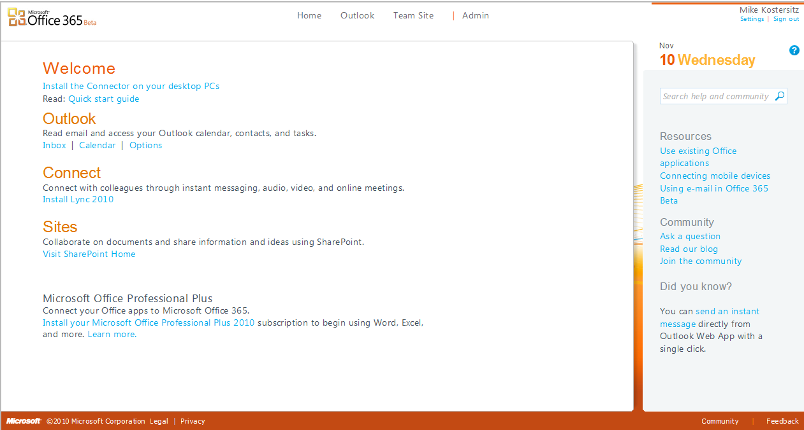

Slide 10
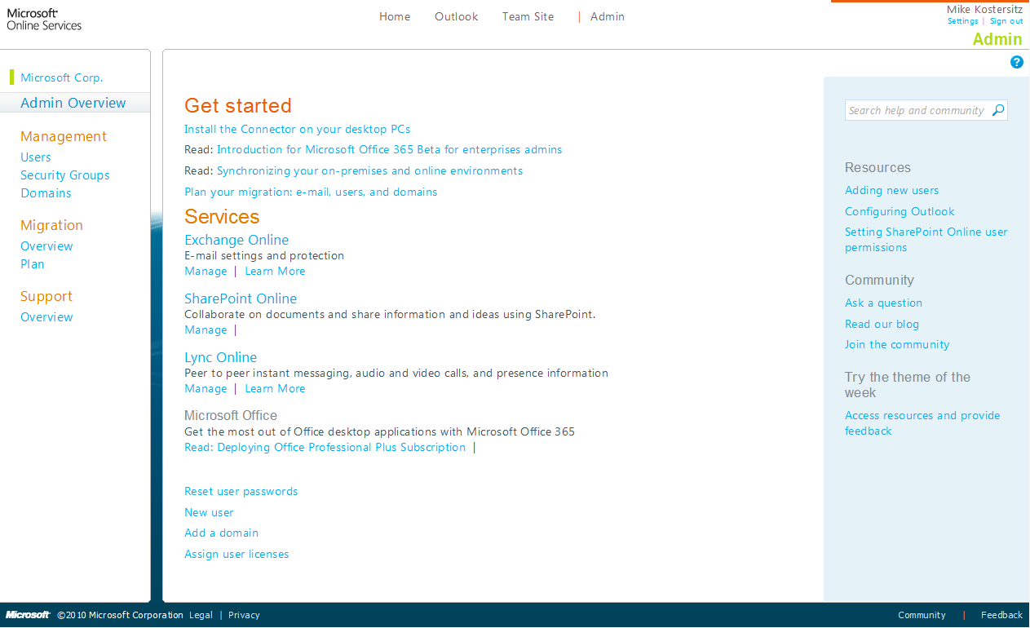

Slide 11
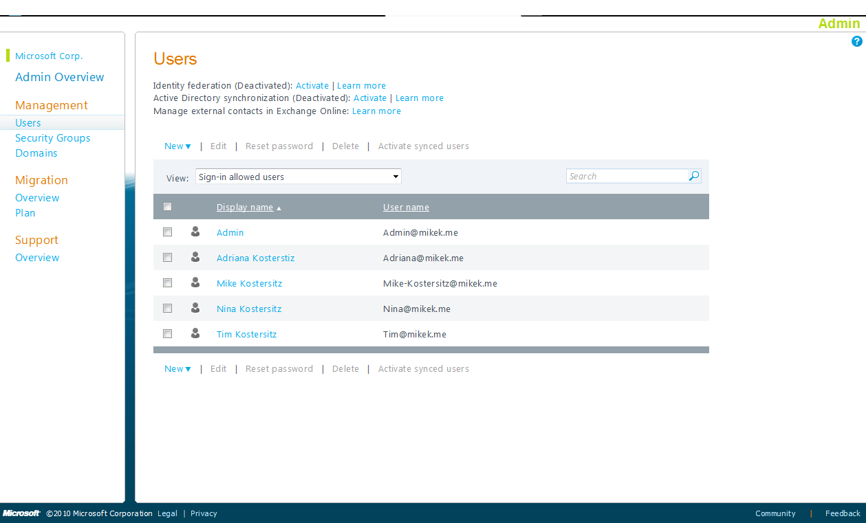

Slide 12
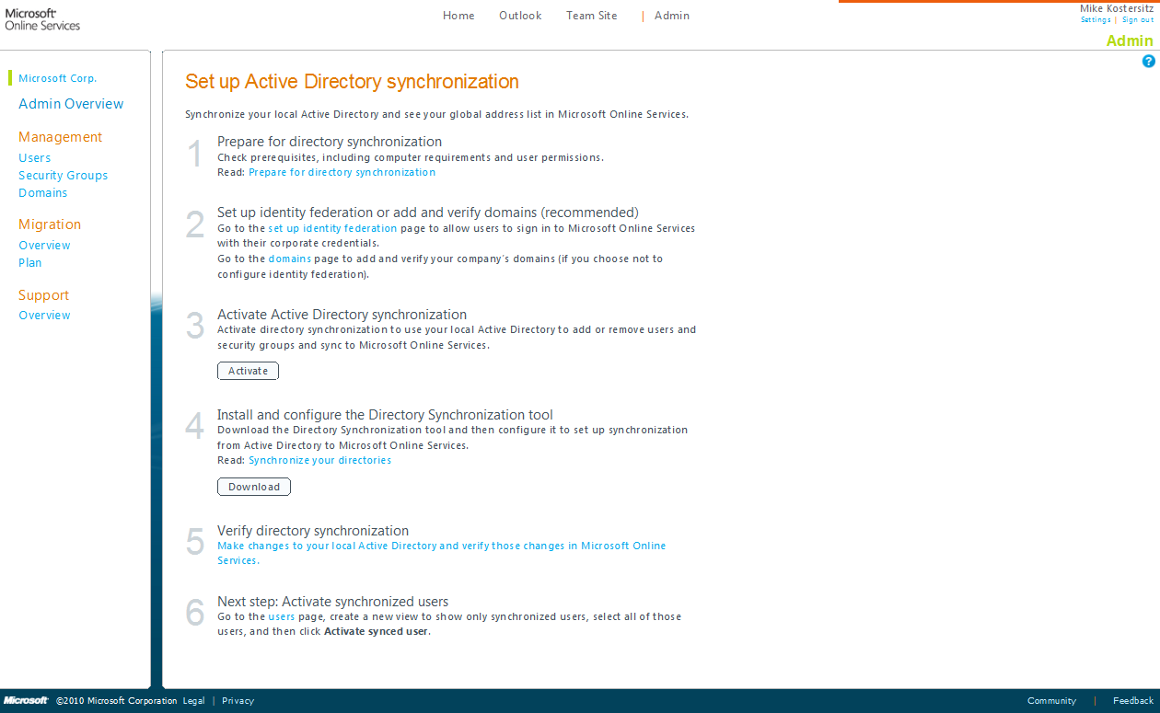

Slide 13
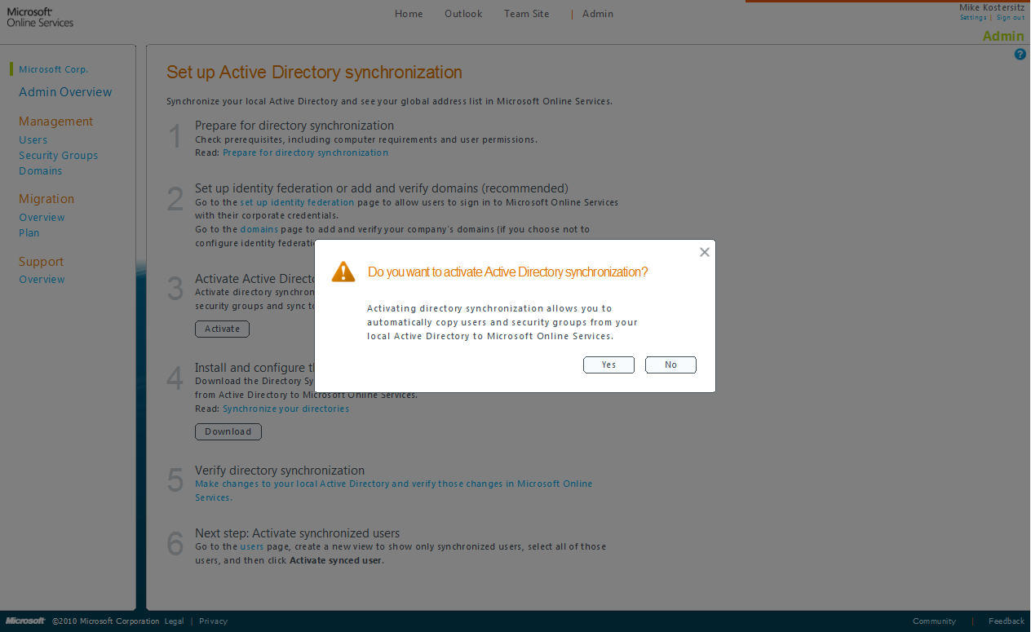

Slide 14
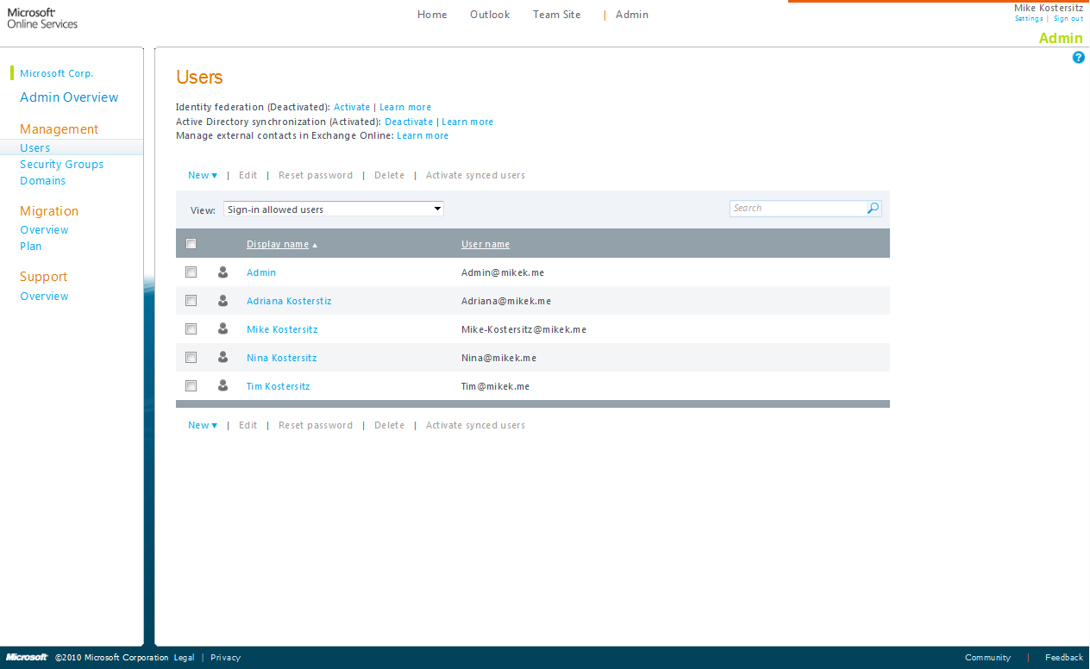

Slide 15
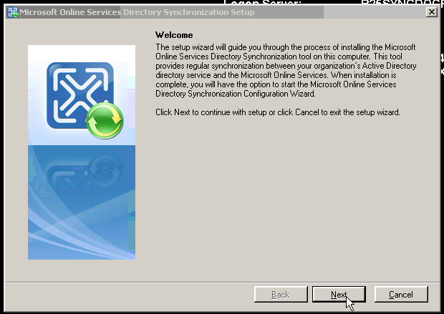
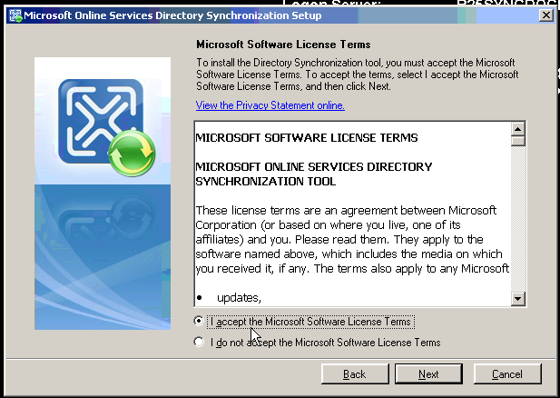
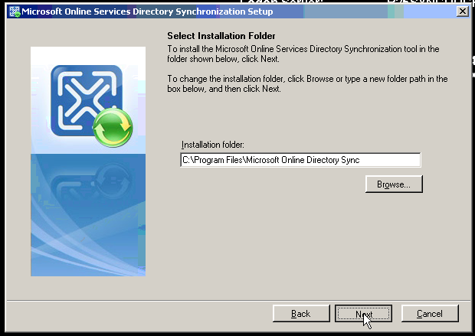
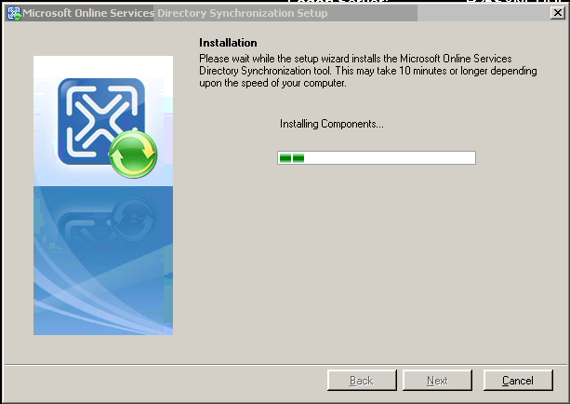
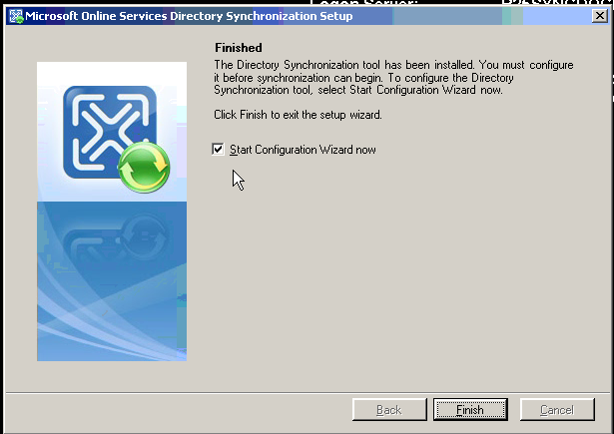
Installation
54 MB, Single File Download

Slide 16
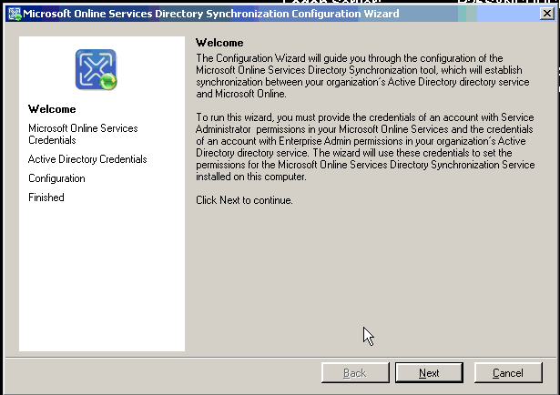
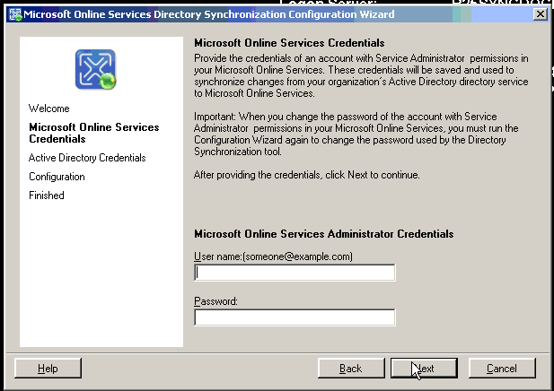
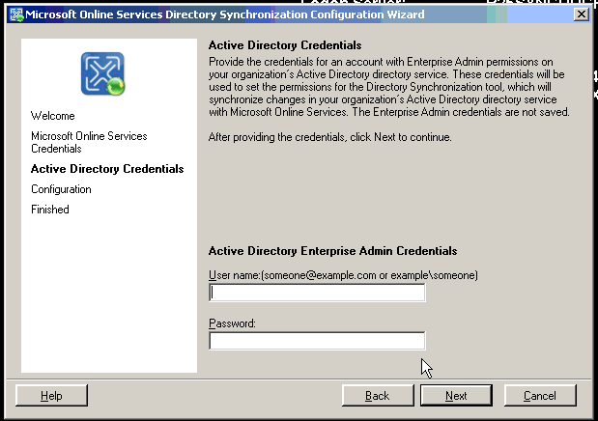
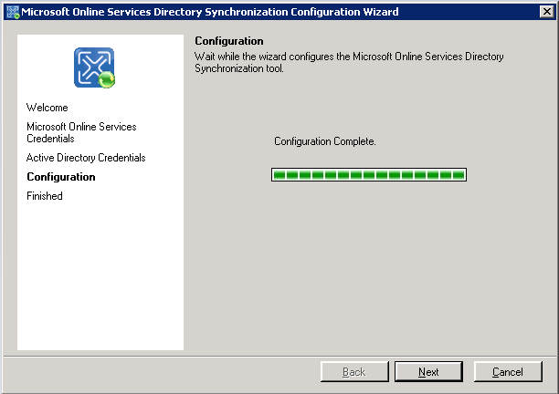
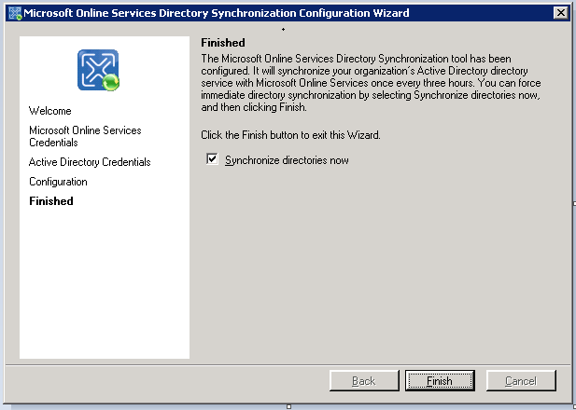
Configuration
admin@mikek.me
mikek.local\Administrator
wwwwwwwwww
wwwwwwwwwwwwwwww

Slide 17
Full vs. Delta Syncs
After the install
  Microsoft Online DirSync will sync the entire forest
    Single forest only
    Syncs all users, mail-enabled groups, security groups, and contacts
  Initial Full Sync can take some time, depending on the number of objects
Subsequent syncs (Delta Syncs)
  Default every three hours
  Syncs all changes on premise to Microsoft Online
  Can be very quick, depending on the rate of change on premise

Slide 18
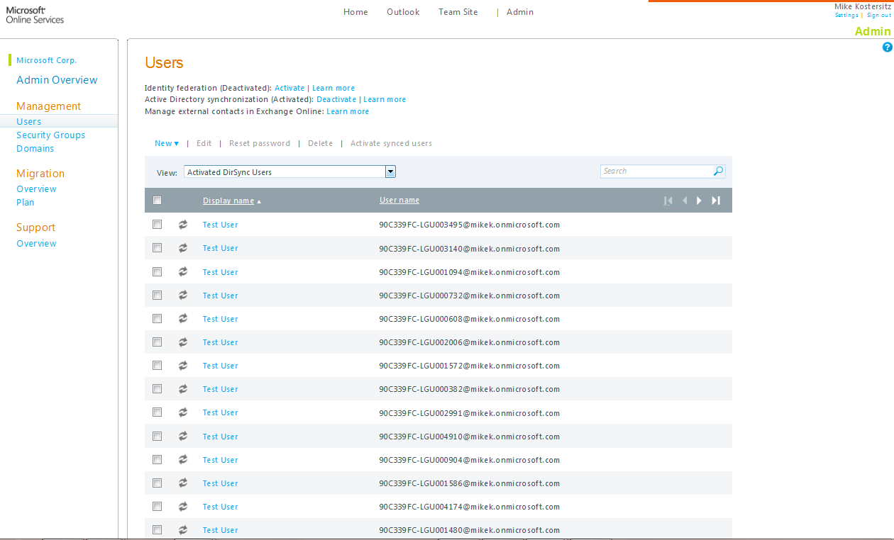

Slide 19

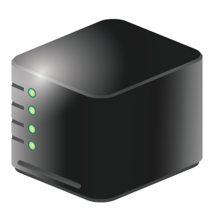
Cloud Monitoring
Vendors often have online dashboards and feeds
Your own monitoring is also important:
  Helps identify last mile issues
  Locates partial availability
  Affects SLAs
Systems Center Operations Manager
  Web probes
  Script probes
Office 365

Slide 20
Monitoring
demo

Slide 21
Microsoft Cloud Productivity Tools
Office 365: Directory Synchronization, Monitoring
Microsoft IT Tools
Salesforce.com: Single Sign-On
3rd-party clouds
Windows Intune: Client software

Slide 22
Windows Intune
Does not have a user directory
Administrators are just Live IDs
Enroll computers – not users

Slide 23
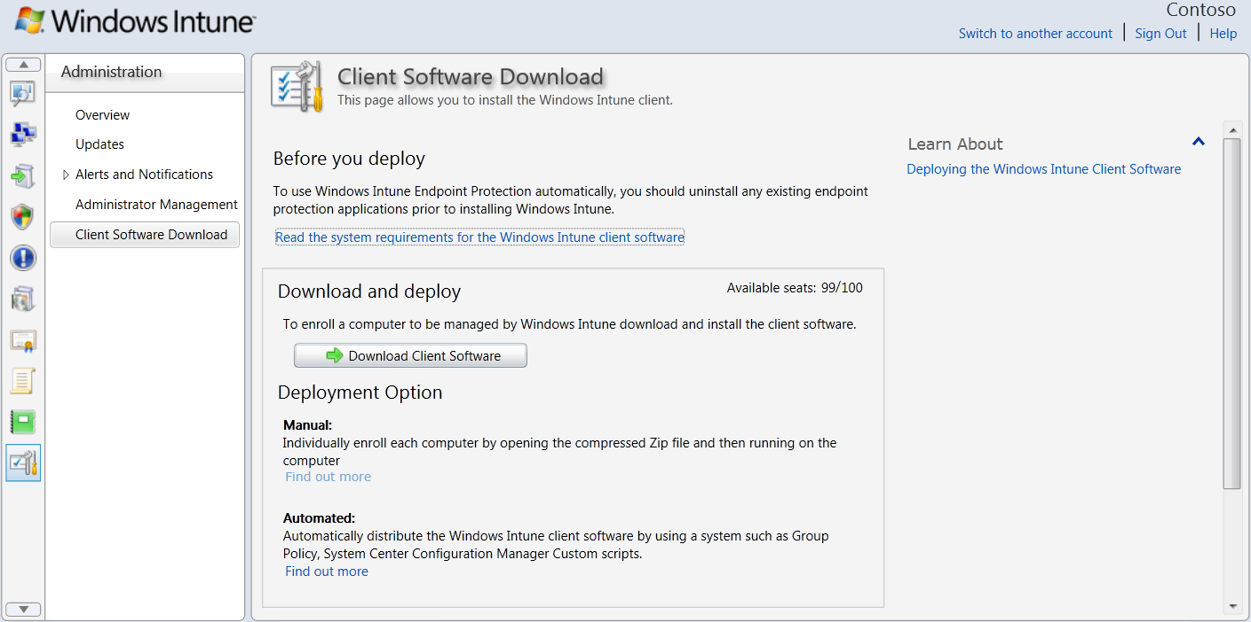


The Client Enrollment Package
The installation package includes a private certificate that is specific to the Windows Intune account

Slide 24

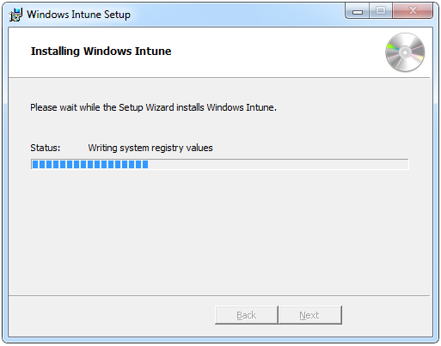
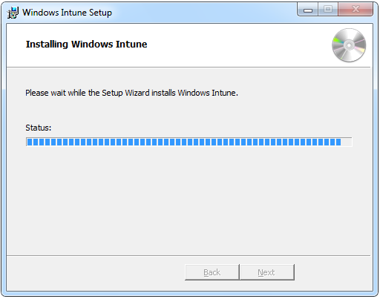
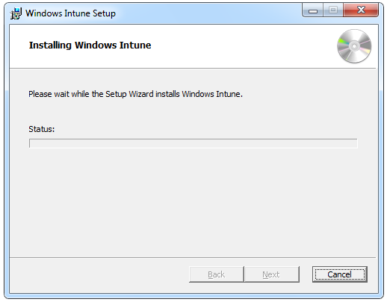
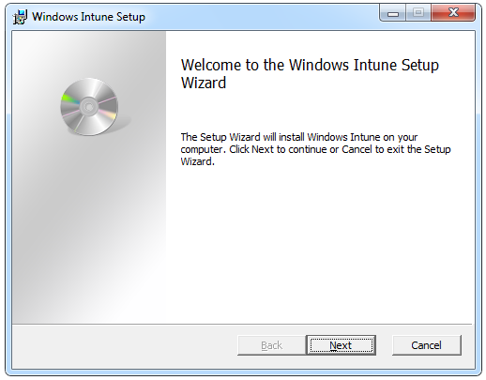
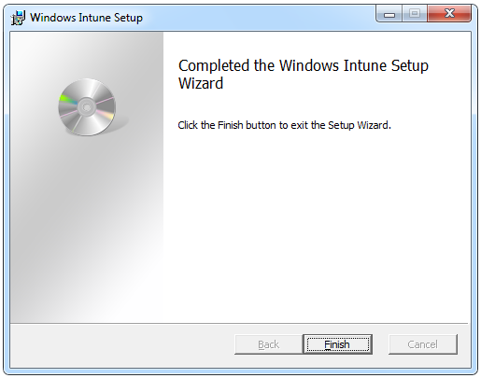
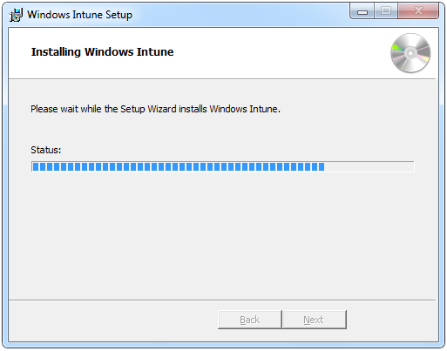
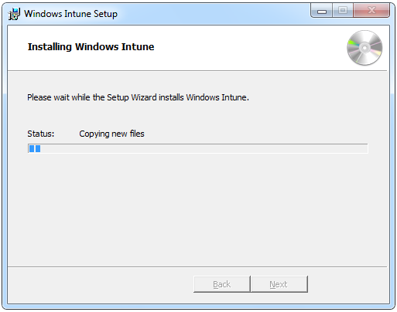
Using the Installation Executable File (.EXE)
Windows_Intune_Setup.exe
Invokes Setup Wizard
Can operate in “Quiet” mode
Contains MSIs
Requires administrator privileges
Requires certificate
Works for both 64-bit and
32-bit installations
Command-line options
/Quiet
/Extract %temp%

Slide 25








Deploying Using Software Distribution Tools
Two platform specific MSI files can be extracted from Windows_Intune_Setup.exe
Provided as an alternative to the Setup executable
Deployment scripts must determine which version to run for operating system

Slide 26
Client Distribution
demo

Slide 27
Microsoft Cloud Productivity Tools
Office 365: Directory Synchronization, Monitoring
Microsoft IT Tools
Salesforce.com: Single Sign-On
3rd-party clouds
Windows Intune: Client software

Slide 28
Third-Party Directory Integration: SAML 2.0
Single sign-on across domains/enterprises
OASIS standard (March 2005)
Widely supported
  Google Apps since October 2006
  salesforce.com since Winter ’09 (October 2008)
  Active Directory Federation Services (AD FS) since version 2.0 (May 2010)

Slide 29
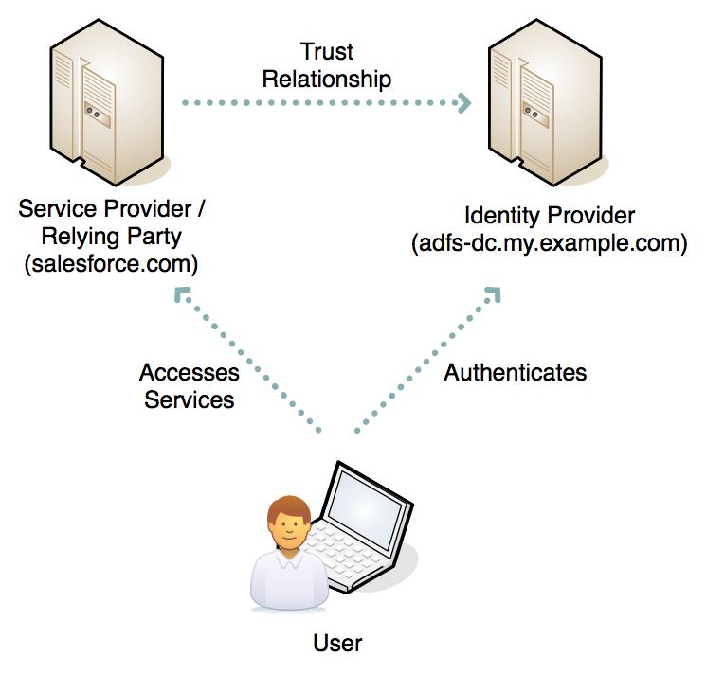
SAML 2.0 Roles

Slide 30
Terminology
ADFS | Google | Salesforce.com
End point | Sign-in page URL | Identity Provider Login URL
Token signing certificate | Identity Provider Certificate | Verification certificate
Relying party EndPoint | Domain Specific Issuer | Entity Id

Slide 31
SAML 2.0 Protocol
Identity Provider
Service Provider
Browser
GET /something
HTTP/1.1 302 Found
Location: http://idp.ex.com/saml?SAMLrequest=hf7893b…&RelayState=HKFDhh383
GET http://idp.ex.com/saml?SAMLrequest=hf7893b…&RelayState=HKFDhh383
Authenticate
200 OK
SAML Assertion in HTML FORM
POST /acs
SAML Assertion
HTTP/1.1 302 Found
Location: http://sp.ex.net/something
Set-Cookie: token=value; Domain=.ex.net

Slide 32
SAML 2.0 Assertion
<Assertion>
<Issuer/>
<Signature/>
<Subject/>
<Conditions/>
<AttributeStatement/>
<AuthnStatement/>
</Assertion>

Slide 33
Integrated Windows Authentication
Single sign-on within an AD domain/forest
Browser requests Kerberos token from desktop OS, wraps according to SPNEGO and includes in HTTP request
Scope is limited to Windows Infrastructure
  Server must be Kerberized
What about partners/vendors/customers?

Slide 34
SAML 2.0 + IWA
Compose the two protocols
AD FS acts as a broker between the AD domain and the outside world

Slide 35
SAML 2.0 + IWA Protocols
Identity Provider
Browser
Service Provider
GET /something
HTTP/1.1 302 Found
Location: https://idp.ex.com/saml?...
GET https://idp.ex.com/saml?...
WWW-Authenticate: Negotiate
Authorization: Negotiate a874…
WWW-Authenticate: Negotiate he83…
Authorization: Negotiate k83g…
200 OK
SAML Assertion in HTML FORM
POST /acs
SAML Assertion
HTTP/1.1 302 Found
Location: https://sp.ex.net/something
Set-Cookie: token=value; Domain=.ex.net

Slide 36
Salesforce.com
Same as Office 365: employee accounts are required
Can use Salesforce.com credentials or can be federated with AD FS

Slide 37
Federation and Single Sign-On
demo

Slide 38
Summary: Bringing cloud under on-premise control
Active Directory
User directory synchronization
User single-sign on
Client distribution
Availability monitoring

Slide 39





Resources
  Connect. Share. Discuss.
http://northamerica.msteched.com
Learning
  Sessions On-Demand & Community
  Microsoft Certification & Training Resources
www.microsoft.com/teched
www.microsoft.com/learning
  Resources for IT Professionals
  Resources for Developers
http://microsoft.com/technet
http://microsoft.com/msdn

Slide 40












Complete an evaluation on CommNet and
enter to win!

Slide 41


