Slide 1

Applying Branding from an Existing Website to Microsoft SharePoint 2010
OSP323
Jon Flanders
Senior Consultant
MCW Technologies

Slide 2
Agenda
Learn the techniques to create a SharePoint 2010 web site from an existing branded web site

Slide 3
Skills Needed – Team must haves!
SharePoint 2010
  Understand Master Pages, Page Layouts, and other WCM capabilities
Web design skills
  HTML, CSS, JavaScript, XSLT, and any other client technologies used on your customers’ websites
Understanding of ASP.NET a plus
Image manipulation skills are also helpful (Expression, Photoshop, Fireworks, etc.)

Slide 4
Step #1 – Decide what to build
Pick a portion of the customer’s site to build
Don’t overcommit - keep it as simple as possible
At the very least, build out a homepage and a subsection with several pages inside that section

Slide 5
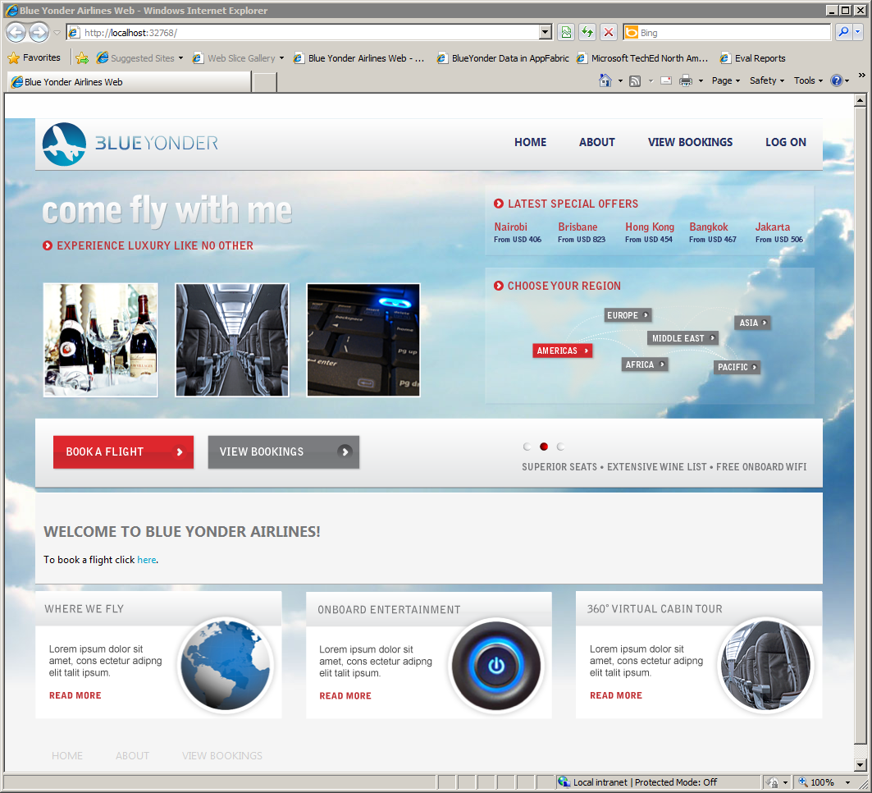
Blue Yonder Airlines

Slide 6
Step #2 – Create the site
Provision a new site using one of the “Publishing” site templates
Create a hierarchy based on customer’s existing site structure
  Think about navigation when creating sub-sites
For complex structures, don’t use the SharePoint UI, use PowerShell
  If creating more than four nodes, it’s faster to script the creation of sites and much easier when creating many sub-sites
  Having such a script is also very useful for development and potentially for deployment

Slide 7
Script site and sub-site creation
param(
[Array] $sites,
[string] $uri
)
foreach($s in $sites){
New-SPWeb –URL ($uri + $s) –Template BLANKINTERNET#1 -Name $s
}
createsubsites.ps1 “http://localhost:8080” “Booking”,”About”,”Contact”

Slide 8
Create Site Hierarchy

Slide 9
Step #3 – Create Master Page
First step is to find a starter master page
  Starter master page found on MSDN
  Extremely well documented
    Easy to remove stuff you don’t need
    Installation can be automated
Second step is to download your customer’s existing site
  In Internet Explorer, File->Save the “complete webpage”
After saving, examine the page to separate Master Page from Page Layout

Slide 10
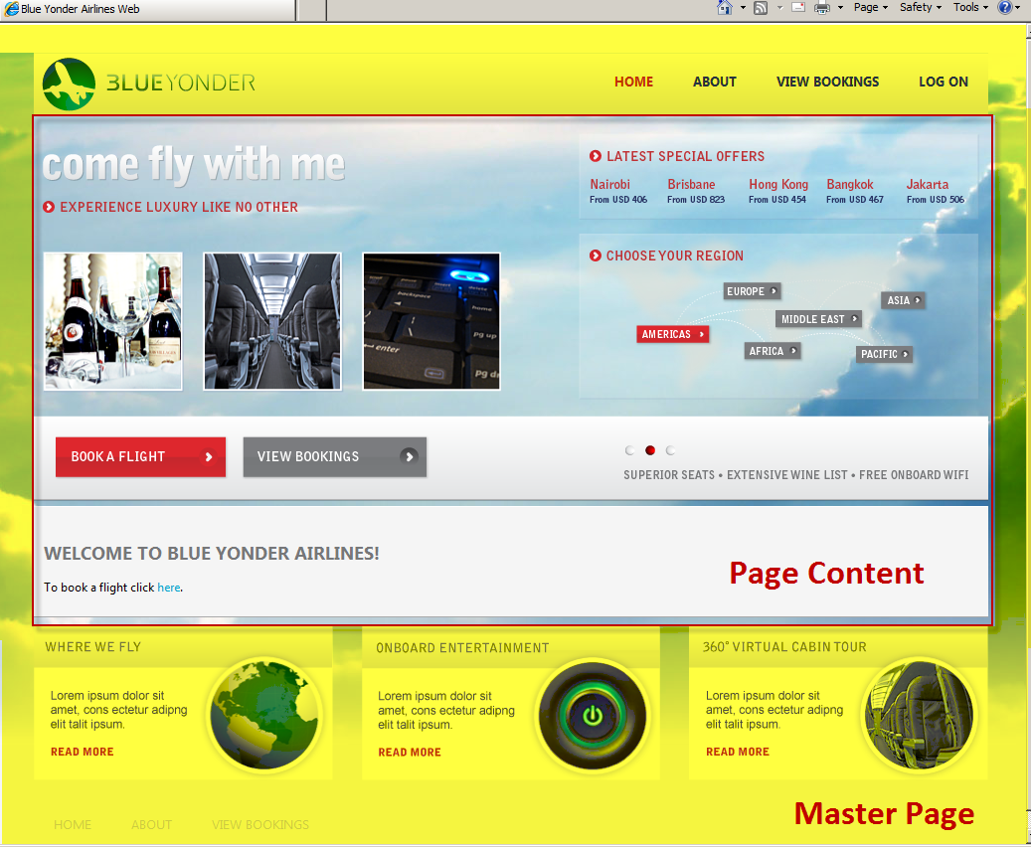

Slide 11
Create Master Page

Slide 12
Step #4 – Create Content Type(s) and Page Layout(s)
Derived from the structure of the content page you’re recreating
You likely will need to create more than one content type/page layout
For more control with customization you may need to create custom field types and field controls

Slide 13
Create Content Type and Page Layout

Slide 14
Step #5 – Create Navigation
Try to mirror existing navigation
SharePoint navigation tied to sub-sites or pages
Using sub sites is generally preferable
  Enables top-level URIs to be the main navigation
  E.g. /About /Contact
Use the PortalSiteMapDataSource in SPD with the ASP.NET navigation provider control
  Style using customer’s existing CSS

Slide 15
Step #6 – Clean up using CSS
Styling a SharePoint site is a combination of
  Creating a custom master page
  Creating Content Types and Page layouts
  Adding custom CSS
  Modifying SharePoint CSS style selectors

Slide 16
Style Sheets
Browsers apply CSS using a “cascade”
  Closest style wins
Different kind of selectors
  Element (e.g. h1, h1.extra)
  Class (e.g. brand - <div class=“brand”/>
  Id (e.g. #logo - <div id=“logo”/>
Same selector can be “overridden” in a .css file closer to the element
You can override the SharePoint selectors in your custom .css files
  Preferable to complete replacement of SharePoint OOB styles
  Many OOB features require some or all of the attributes from the OOB selectors
*
{ margin: 0px; }
h1
{ padding: 5px; }
h1.extra
{ color: red; }
.brand
{ padding: 0px; }
#logo {
border: 0px;
position: absolute;
top: 50px;
left: 50px;
}

Slide 17
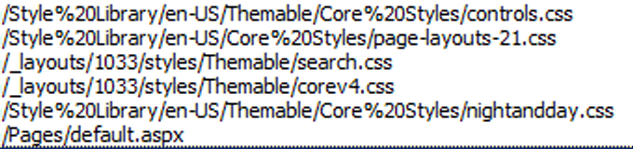
SharePoint OOB CSS
SharePoint CSS links are placed in every page rendered
  You cannot completely remove all those CSS links

Slide 18
Adding custom CSS
Use CssRegistration control
  after attribute enables designers to control order css files are added to the page
  This provides control over the cascade
  $SPUrl:~sitecollection gets replaced with correct URL at runtime
<SharePoint:CssRegistration
runat="Server"
name="<% $SPUrl:~sitecollection/Style Library/blueyonder/default.css%>"
after="corev4.css" />
<SharePoint:CssRegistration
runat="Server"
name="<% $SPUrl:~sitecollection/Style Library/blueyonder/layout.css%>"
after="<% $SPUrl:~sitecollection/Style Library/blueyonder/default.css%>"/>
<SharePoint:CssRegistration
runat="Server"
name="<% $SPUrl:~sitecollection/Style Library/blueyonder/blueyonder.css%>"
after="<% $SPUrl:~sitecollection/Style Library/blueyonder/layout.css%>"/>

Slide 19
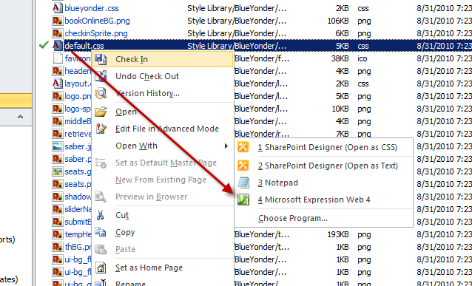
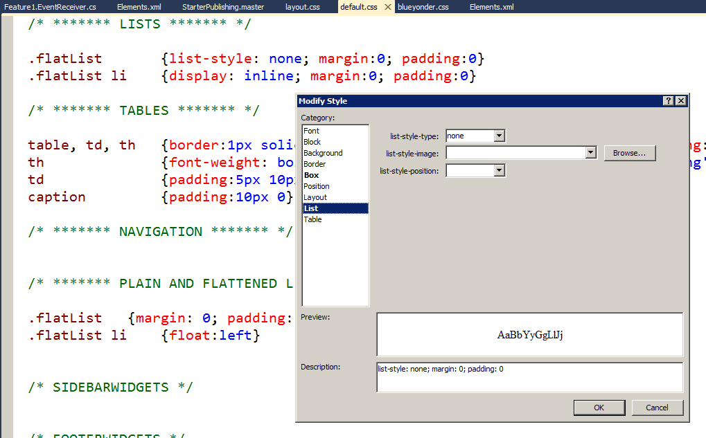
CSS tools
Expression Web
  Full integration from SPD
Visual Studio 2010
  CSS files in modules fully editable
IE Developer tool
  Can view and modify attributes on elements
  “CSS Debugging”

Slide 20
Hiding SharePoint UI
CSS is useful for hiding SharePoint UI
PublishingWebControls:EditModePanel can be used for similar effect
  Only hides content when the page isn’t in Edit Mode
<style type="text/css">
body #s4-ribbonrow {
display: none;
}
</style>

Slide 21
Using CSS to modify branding

Slide 22
What this is, and what it isn’t
This demo so far has been all about branding – the look and feel.
  This is a good way to show someone who is already familiar with SharePoint how SharePoint can run internet-facing sites.
  This is not a good demo of Web Content Management.

Slide 23
Summary
SharePoint 2010 has a powerful branding system
Master Pages can be used to create overall look and feel
CSS can be used to integrate with existing SharePoint CSS styles
Page Layouts allow fine-grained control over pages

Slide 24





Resources
  Connect. Share. Discuss.
http://northamerica.msteched.com
Learning
  Sessions On-Demand & Community
  Microsoft Certification & Training Resources
www.microsoft.com/teched
www.microsoft.com/learning
  Resources for IT Professionals
  Resources for Developers
http://microsoft.com/technet
http://microsoft.com/msdn

Slide 25












Complete an evaluation on CommNet and
enter to win!

Slide 26


