Slide 1

Working with the New SharePoint Logging Database
OSP307
Elijah Van Eenwyk
Senior SharePoint Consultant
Inergex, Inc.

Slide 2
Agenda
Health & Usage Logging
  Overview
  Configuring Usage Logging
  Database Schema
  Using your data
  Extending Logging
Web Analysis
  Overview
  Configuring Web Analysis
  Using OOTB reports and features
  Customizing your own reports
SharePoint Diagnostics Studio 2010

Slide 3
Health & Usage: Overview
Available to all editions of SharePoint, including Foundation
Consists of four core pieces
  Log Files (.usage) – stores binary data about usage
  Two primary timer jobs
  Single Database
Stores data for a default of 14 days, can be extended to 31
Required for the Web Analysis service application

Slide 4
Health & Usage: Core Timer Jobs
Microsoft SharePoint Foundation Usage Data Import
  Runs every 30 minutes on each server
  Processes new entries in the .usage files located in LOGS directory
Microsoft SharePoint Foundation Usage Data Processing
  Runs daily
  Does any aggregation of data requested by providers
  In charge of truncating data to retention limits

Slide 5
Health & Usage: Event Selection
Don’t enable if you don’t plan on using it…
Event Selection
  Content Import Usage
  Content Export Usage
  Page Requests
  Feature Use
  Search Query Usage
  Site Inventory Usage
  Timer Jobs
  Rating Usage

Slide 6
Health & Usage: Events – “Hidden”
Mostly performance related events
  Performance Counters – Database Servers
  Performance Counters – Web Front Ends
  SQL Blocking Queries
  SQL DMV & SQL Memory DMV
Also ability to capture error log and ULS
  Trace Log
  Event Log

Slide 7
Health & Usage: Configuring
demo

Slide 8
Health & Usage: Database
Typically called WSS_UsageApplication
Extremely write heavy
Optimal to have on its own disks / spindles
Larger environments should have a dedicated SQL box
Size is dependent on how much data is collected, for how long and the size the environment
Backup requirements are minimal because new data will be generated

Slide 9
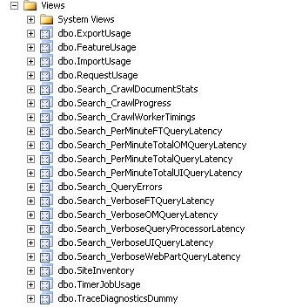
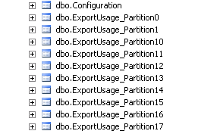
Health & Usage: Database Schema
Fully supported to query and extend
  Extendable in a sense you can add your own objects
Each Event provider contains a SQL view and 32 partitioned tables (a table for each day)

Slide 10
Health & Usage: Database
demo

Slide 11
Health & Usage: Reports
Nothing really provided OOTB but lots of potential
Ability to query data like any other normal data source
  Microsoft Excel
  SQL Server Reporting Services (Integrated or Native)
  Custom Application
  Custom SharePoint Web Parts (Contextually aware)

Slide 12
Health & Usage: Reports
demo

Slide 13
Health & Usage: Extending
Custom Usage Provider (SPUsageProvider)
  Collect additional data to be logged
Custom Usage Receiver (SPUsageReceiver)
  Perform additional processing on OOTB data

Slide 14
Health & Usage: Extending
demo

Slide 15
Web Analysis: Overview
Feature of SharePoint Standard / Enterprise
Additional built-in reports – End user friendly
Retention Period: Maximum of 25 months
Special web parts
  Best Bet
Ability to add your own customized reports
Ability to schedule alerts and reports

Slide 16
Web Analysis: Configuring
demo

Slide 17
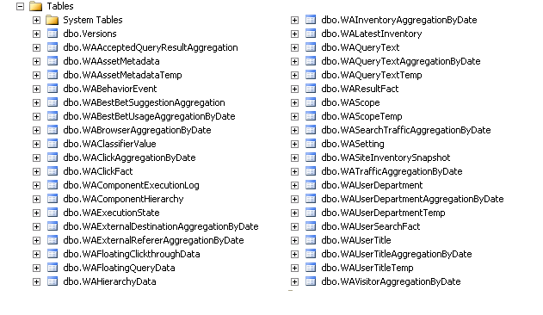
Web Analysis: Databases
Consists of two databases
  Staging – Temporary stores un-aggregated data
  Reporting – Stores aggregated data for reports
Reporting database can get extremely large
Consists of 38 tables

Slide 18
Web Analysis: Some Available Reports
Traffic Reports
  Page Views
  Unique Visitors
  Top Pages, Visitors, Browsers, etc
Search Reports
  Number of Queries
  Top Queries
Inventory
  Number of Sites
  Storage Usage
  Top Site Languages

Slide 19
Web Analysis: Reports
demo

Slide 20
SharePoint Diagnostic Studio 2010
Included as part of Administration Toolkit
Aggregates data from ULS, Event log, performance counters and SQL databases
Contains a number of preconfigured reports about Farm
Ability for snapshots for trend analysis
Download @ http://tinyurl.com/3ydlkdn

Slide 21


Slide 22





Resources
  Connect. Share. Discuss.
http://northamerica.msteched.com
Learning
  Sessions On-Demand & Community
  Microsoft Certification & Training Resources
www.microsoft.com/teched
www.microsoft.com/learning
  Resources for IT Professionals
  Resources for Developers
http://microsoft.com/technet
http://microsoft.com/msdn

Slide 23












Complete an evaluation on CommNet and
enter to win!

Slide 24


Slide 25

© 2011 Microsoft Corporation. All rights reserved. Microsoft, Windows, Windows Vista and other product names are or may be registered trademarks and/or trademarks in the U.S. and/or other countries.
The information herein is for informational purposes only and represents the current view of Microsoft Corporation as of the date of this presentation. Because Microsoft must respond to changing market conditions, it should not be interpreted to be a commitment
on the part of Microsoft, and Microsoft cannot guarantee the accuracy of any information provided after the date of this presentation. MICROSOFT MAKES NO WARRANTIES, EXPRESS, IMPLIED OR STATUTORY, AS TO THE INFORMATION IN THIS PRESENTATION.

