Slide 1

Developing Powerful Workflows in the Cloud with Microsoft SharePoint Online
Chris Mayo
Snr. Technical Evangelist, Office 365
Microsoft Corporation
http://blogs.msdn.com/cmayo

Slide 2
Agenda
SharePoint Online Overview
Workflow in SharePoint Online
  Prototyping in Visio 2010
  Implementing in SharePoint Designer 2010
  Extending with Visual Studio 2010
  Deploying with SharePoint Designer 2010
Summary
Resources

Slide 3
SharePoint Online Overview
Ships with Office 365
  Exchange Online, Lync Online, SharePoint Online, Office 2010 Pro Plus
  Cloud-based subscription service
  Beta today, GA in H1 2011
SharePoint 2010 hosted in the cloud (SaaS)
  Hosted in Microsoft datacenters
  Reliable (99.9% guaranteed uptime)
  Secure (ISO27001 and SAS70 certified)
  Subset of features, subset of platform

Slide 4
Workflow in SharePoint Online
SharePoint Online only supports Sandboxed Solutions
  Declarative workflows are supported
  Custom Actions in Sandboxed Solutions are supported
  Code workflows are not supported
Prototype in Visio 2010
  SharePoint specific flowchart diagram
  Export to SharePoint Designer 2010
Implement in SharePoint Designer 2010
  Improved workflow designer
  Integration of forms with InfoPath 2010
Extend with Visual Studio 2010
  Custom SPD2010 actions
  Events, Event Receivers
Deploy as *.wsp via SPD2010 Save As Template feature

Slide 5
Workflow in SharePoint Online
Based on SharePoint 2010
  Picks up new SP2010 features
New Workflow targets
  Reusable Workflows can be applied to any list
    Allow distribution of workflow as *.wsp
  Site Workflows can execute on site
New Workflow events
  Emitted by SharePoint Online (i.e. WorkflowStarted)
  Custom Events, Event Receivers

Slide 6
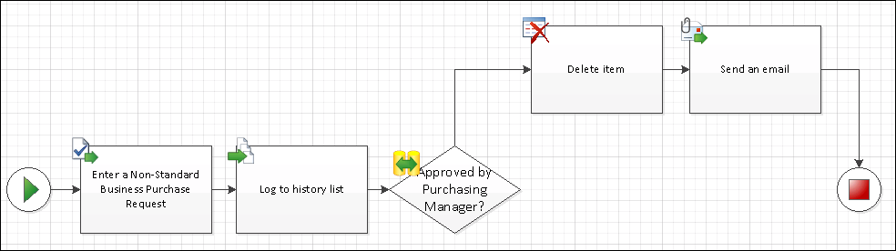
Prototyping in Visio 2010
SharePoint specific Workflow template
  Design in Visio using SharePoint shapes
  Provides workflow Visualization

Slide 7
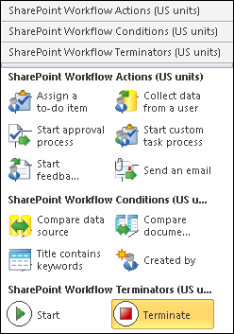
SharePoint Workflow Shapes
Terminators
  Start/Terminate
Conditions
  Data
  Permissions
  Dates
Actions
  Send Email
  Create List Item
  Check In/Out

Slide 8
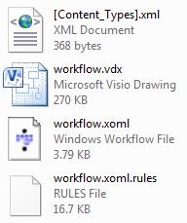
Export to SharePoint Designer 2010
Visio exports to a VWI file
  Renamed zip file containing all workflow files
  .xoml and .xoml.rules define workflow
  .vdx file contains Visio drawing

Slide 9
Visio 2010
demo

Slide 10
SharePoint Designer 2010
Power tool for customizing SharePoint 2010
  Data
  Design
  Create Site Templates
  Workflow
New User Interface
  Fluent UI from Office 2010/SharePoint 2010
  Easy navigation from artifact to summary to galleries
Does not require developer/web skills
  Useful for Power Users, IT Pros and Developers
Free!

Slide 11
SPD2010 Workflow
Supports List, Reusable, Site workflows
Custom or based on built in workflows
Workflow Summary
  Manage settings, start options, forms
Task designer
  Define advanced settings for process
Workflow designer
  Actions, Conditions, Steps
InfoPath 2010 for forms customization

Slide 12
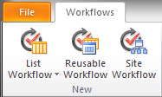
Creating Custom Workflows
New workflows are attached to a container
  List Workflows attached to a specific list
  Reusable Workflows are not attached to a list
    May be constrained to a content type
    Attached later using browser or SPD2010
  Site Workflows are attached to the current site

Slide 13
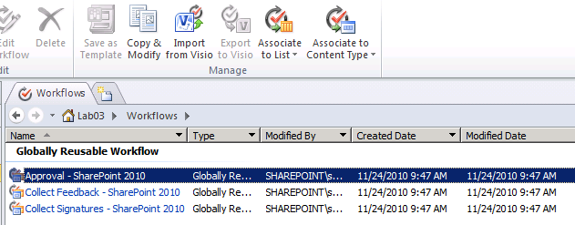
Copy & Modify Workflows
Based on any Globally Reusable Workflows
  Approval
  Collect Feedback
  Collect Signatures
  Publishing Approval
Can be limited to specific Content Type

Slide 14
Actions
Actions get work done in the workflow
Examples:
  Create, copy, change, or delete list items/documents
  Check items in or out
  Send an e-mail
  Create a task for person or group
  Collect data via task for use in the workflow
  Pause or stop the workflow
  Log workflow information to a History list
  Set workflow variables or perform calculations

Slide 15
Conditions
Control flow of the workflow
Examples:
  If any value equals value
  If current item field equals value
  Created by a specific person
  Create in a specific date span
  Title field contains keywords

Slide 16
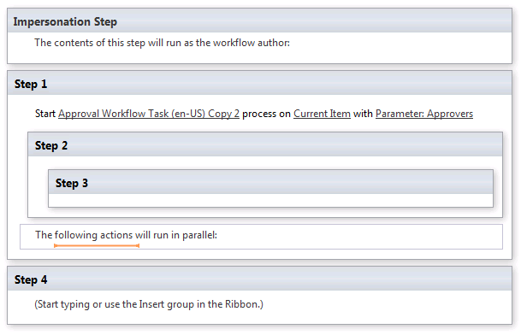
Steps
Organize your workflow
Serial or Parallel

Slide 17
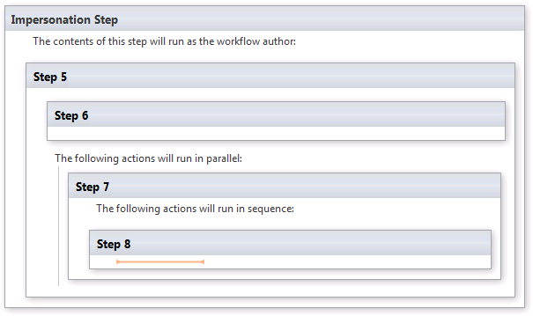
Impersonation Step
Workflows run with permissions of user
Use impersonation step to run as workflow author

Slide 18
SharePoint Designer 2010
demo

Slide 19
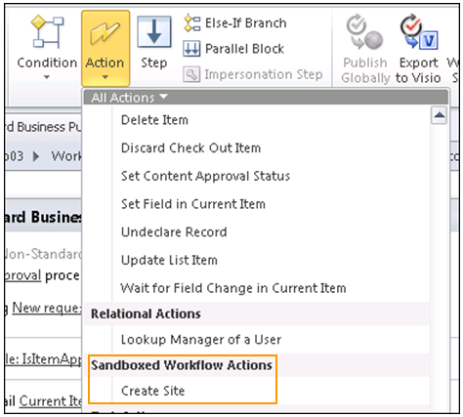
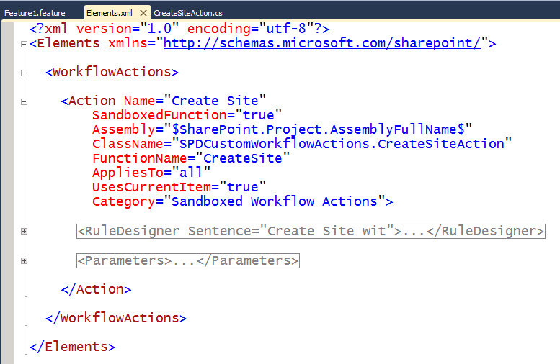
Custom Workflow Actions
Define class/method in Visual Studio 2010
  Sandbox Solutions API
Define new action via <WorkflowActions> schema
  Maps designer to method call
  <Action>
    Maps actions to method call
  <RuleDesigner>
    Defines sentence in SPD2010
  <Parameters>
    Maps sentence to method call

Slide 20
Visual Studio 2010
demo

Slide 21
Summary
Prototype workflows in Visio 2010
  Use to communicate, visualize
Implement the workflow in SharePoint Designer 2010
  Custom or copy & modify built in workflow
  Actions, conditions and steps
Develop custom workflow actions and events in Visual Studio 2010
Deploy as *.wsp via Save as Template in SharePoint Designer 2010

Slide 22
Resources
Office 365 Beta
  http://office365.com
Microsoft Office 365 Fact Sheet
  http://www.microsoft.com/presspass/presskits/office/docs/office365FS.docx
Office 365 Beta Service Descriptions
  http://www.microsoft.com/downloads/en/details.aspx?FamilyID=6c6ecc6c-64f5-490a-bca3-8835c9a4a2ea
Cloud-Based Collaboration with SharePoint Online
  http://blogs.msdn.com/b/cmayo/archive/2011/03/11/new-sharepoint-online-article-on-msdn-magazine.aspx
SharePoint Online Developer Resource Center
  http://msdn.microsoft.com/sharepointonline
Office 365 Developer Training Course
  http://msdn.microsoft.com/en-us/Office365TrainingCourse

Slide 23
Resources
Download SharePoint Designer 2010
  http://www.microsoft.com/downloads/en/details.aspx?displaylang=en&FamilyID=d88a1505%2D849b%2D4587%2Db854%2Da7054ee28d66
Introducing SharePoint Designer 2010
  http://office.microsoft.com/en-us/sharepoint-designer-help/introducing-sharepoint-designer-2010-HA101782482.aspx
SharePoint Designer 2010 Workflow
  http://office.microsoft.com/en-us/sharepoint-designer-help/introduction-to-designing-and-customizing-workflows-HA101859249.aspx
Creating SharePoint Workflow Solutions
  http://msdn.microsoft.com/en-us/library/ee231606.aspx
Walkthrough: Create a Custom Site Workflow Activity
  http://msdn.microsoft.com/en-us/library/ee231574.aspx

Slide 24

Related Content
Required Slide
Speakers, please list the Breakout Sessions, Interactive Discussions, Labs, Demo Stations and Certification Exam that relate to your session. Also indicate when they can find you staffing in the TLC.
OSP212 | Microsoft Office 365: The Future of Productivity
OSP210 | Microsoft SharePoint Online Overview
OSP305 | Developing Collaboration Solutions in the Cloud with Microsoft SharePoint Online
OSP306 | Developing Powerful Workflows in the Cloud with Microsoft SharePoint Online
OSP301 | Integrating Microsoft SharePoint 2010 with Windows Azure
OSP302 | Advanced SharePoint Data Access with Microsoft Silverlight
OSP303 | HTML, jQuery, and JavaScript in SharePoint 2010 Development

Slide 25





Resources
  Connect. Share. Discuss.
http://northamerica.msteched.com
Learning
  Sessions On-Demand & Community
  Microsoft Certification & Training Resources
www.microsoft.com/teched
www.microsoft.com/learning
  Resources for IT Professionals
  Resources for Developers
http://microsoft.com/technet
http://microsoft.com/msdn

Slide 26












Complete an evaluation on CommNet and
enter to win!

Slide 27


Slide 28

© 2011 Microsoft Corporation. All rights reserved. Microsoft, Windows, Windows Vista and other product names are or may be registered trademarks and/or trademarks in the U.S. and/or other countries.
The information herein is for informational purposes only and represents the current view of Microsoft Corporation as of the date of this presentation. Because Microsoft must respond to changing market conditions, it should not be interpreted to be a commitment
on the part of Microsoft, and Microsoft cannot guarantee the accuracy of any information provided after the date of this presentation. MICROSOFT MAKES NO WARRANTIES, EXPRESS, IMPLIED OR STATUTORY, AS TO THE INFORMATION IN THIS PRESENTATION.

