Slide 2

What Do Existing BPOS Customers Need to Do to Prepare for Microsoft Office 365?
OSP213
Edward Wu
Lead Program Manager
Microsoft
Michael O’Neill
Product Manager
Microsoft

Slide 3
Office 365 is an Evolution of the Existing Service
SERVICE
+
New features and offerings
Office 365
BPOS
Business Value of
Microsoft Online Services
People | Technology | Financial | Process
No server upgrades
No data migration
24x7 technical support
Predictable price
Familiar Experiences

Slide 4

Help People Accomplish More
Put the Power of the 2010 Servers into Their Hands with Office 2010
Client
Server
Share an Office application with others in one click
Lync 2010
Lync Server 2010
Unified Communications
See presence and contact others from within your shared document with IM or voice
Word 2010
Lync 2010
Lync Server 2010
See voice mail transcripts and faxes right in your inbox
Outlook 2010
Exchange 2010
Business Intelligence
Consolidate & quickly analyze vast amounts of data. Share & Refresh powerful BI models in SharePoint
Power Pivot for Excel add-in
SharePoint 2010
Edit the same document at the same time
Word 2010
PowerPoint 2010
SharePoint 2010
Use & update SharePoint documents and lists when you’re not connected
SharePoint Workspace 2010
SharePoint 2010
Collaboration
Quickly broadcast a slideshow right from within PowerPoint
PowerPoint 2010
SharePoint 2010
Avoid sending sensitive mail to the wrong people with help from Mail Tips and keep security a priority with Retention Policy and Automated Policy Application
Outlook 2010
Exchange 2010
Enterprise Content Management
Enhance content management with smart templates that populate document metadata
Word 2010
SharePoint 2010
Easily access rich client/server capabilities with the Backstage view in Office 2010
Office 2010
SharePoint 2010

Slide 5







BPOS to O365 Transition Plans
Business Productivity Online Suite
Business Productivity Online Suite
  Plan E1
  Plan 1
  Deskless
  Kiosk
  Plan 1
  Plan 1
  Plan 2

Slide 6
Office 365 Plans
Components
Suites
Voice
Office 365 E4
Includes:
Exchange Plan 2
SharePoint Plan 2
Lync Plan 2
Office ProPlus
Office Web Apps
Lync Plus (Voice)
Office Pro Plus
Office 365 E3
Includes:
Exchange Plan 2
SharePoint Plan 2
Lync Plan 2
Office ProPlus
Office Web Apps
Voicemail & Archive
Forms, Access/Excel/
Visio Services
BPOS Transition
Office Web Apps
Office 365 E2
Includes:
Exchange Plan 1
SharePoint Plan 1
Lync Plan 2
Office Web Apps
Email, calendar, AV/AS
Office 365 E1
Includes:
Exchange Plan 1
SharePoint Plan 1
Lync Plan 2
Collaboration Portal
Conferencing
IM & presence
Office Web Apps
Not offered standalone
Office 365 K2
Includes:
Exchange Kiosk
SharePoint Kiosk
Office Web Apps
SharePoint Online Kiosk
Not offered standalone
Office 365 K1
Includes:
Exchange Kiosk
SharePoint Kiosk
Exchange Online Kiosk
6 | Microsoft Confidential

Slide 7
BPOS (Wave12) – Sunset SKU
Business Productivity Online Suite
  Additional Storage SKU
  Customer will be given for free
  Deskless Worker SKU
SharePoint Deskless will be retired
No SharePoint Kiosk SKU
  Standalone SKU
LM will not be offered as Standalone
V2 customers can get rights to LM until end of FY13 (GA+18)
EA customer with LM standalone will be offered rights to Lync and will get Lync Online once they renew their contract

Slide 8
System requirements

Slide 9
Key Areas of Change
New features
New Offerings
SharePoint Online Deskless Worker Deprecation
Live Meeting to Lync transition
New System Requirements
New Portal Experiences
URL Changes for OWA and Portals
Online Desktop Setup
(one-time only)
replaces Sign-in App
New Password Requirements
Optional: Federated Identity
Optional: Rich Coexistence

Slide 10
System Requirements Key Changes
Office 2003 Not Supported
Internet Explorer 6 Not Supported
Office Communicator 2007 R2 Not Supported
BPOS Sign In Application Deprecated
Online Desktop Setup Required

Slide 11
Office 365 Password Requirements
Office 365 has updated strong-password requirements. When users reset their passwords via the normal password expiration process, new passwords must meet the following requirements:
  Passwords must be between 8 and 16 characters
  Passwords cannot contain characters from different language sets, e.g. Arabic or Greek or German.
  Passwords can only be comprised of basic, English-language letters and symbols, called ASCII characters.
    ASCII characters include:
    A-Z, a-z, 0-9, ! @ # $ % ^ & * - _ + = [ ] { } | \ : ‘ , . ? / ` ~ “ < > ( ) ;

Slide 12
Identity
Microsoft Online Identity (Current)
Federated Identity (SSO) with ADFS 2.0
Separate online credentials
Log in each session
No on-prem server required for authentication
Single Sign-On with corporate credentials
Requires ADFS 2.0 on premises
Supports 2 factor authentication
Optional
Notes:
Next session is all about Identity OSP 215 3:15 – 4:30 PM B314

Slide 13
New System Requirements
Operating System
The Windows® 7 operating system
The Windows Vista® operating system with SP2
Windows XP with SP3
Mac OS X 10.5 (Leopard), 10.6 (Snow Leopard)
Windows Server 2008
Browser—Microsoft Online Portal
Internet Explorer 7 or later
Mozilla Firefox 3.x
Apple Safari 4.x
Browser—Outlook Web App
Internet Explorer 7
Firefox 3 or higher
Safari 4 or 5 on Macintosh OS X 10.5
Chrome 6 and later versions (OWA Light)
Outlook Web App also has a light version that supports a reduced set of features across almost any browser
System
Microsoft .NET Framework 2.0
Java client 1.4.2 (for Macintosh OS X)
Office Clients
Microsoft Office 2010 or Office 2007 with SP2
Office 2008 for Mac and Entourage 2008 Web Services Edition
Office 2011 for Mac and Outlook 2011 for Mac
Lync 2010
Client Applications
Microsoft Online Desktop Update

Slide 14
Transition Overview
..
.

Slide 15
Transition Benefits
Office 365 brings many top-requested features from customers
The term “transition” describes the end-to-end experience of a customer moving from BPOS to Office 365, including planning, piloting, data upgrade, client access and configuration work.
New Identity Platform
New Server Platforms
Improved Administration
Single Sign-In (SSO)
Federated identity
Live ID infrastructure
Microsoft Federation Gateway
Exchange 2010, SharePoint 2010,
Lync 2010
Architected from the ground up for multi-tenancy
Server-service parity
Improved coexistence
Native migration tools
Role-based access control
Remote PowerShell
Extended control panels
Self-serve user admin
More settings / options exposed to admin.

Slide 16
Transition Roles and Responsibilities
Microsoft
Make customers aware
Customer
Propose schedule
Information and guidance
All changes within Microsoft datacenters
Uninterrupted mail flow
Migrate all data
Respond to schedule proposal
End-user training and communications
Optional: Deploy ADFS role, Exchange Server 2010 CAS role
Update end-user computer software and devices if necessary
Configure Domain DNS settings for Outlook and Lync

Slide 17
Availability and Timeline
Office 365 GA
CY2011
Limited Transitions
1-3 months post GA
Transition Available
GA +4 months
English, Japanese & French first supported languages
Transitions End
GA +16 months
BlackBerry Transition
Late 2011 or early 2012
Education Transition Available
Spring or Summer 2012
12 Months to Transition

Slide 18
Transition Experience: Phases
Plan & Prepare
Transition
Configuration
Learn
Schedule
Deploy end-user software
48 hours
Mail flow uninterrupted
Admin &customer portal locked
SharePoint locked for part of weekend
Configure end-user computers and devices as needed
Re-configure mail-enabled applications (Exchange Online)
Prepare end-users
Pilot
New Deployment
New Office 365 users and services
Rich Co-existence & Exchange CAS
ADFS and
Single Sign On

Slide 19
The Transition Experience

Slide 20
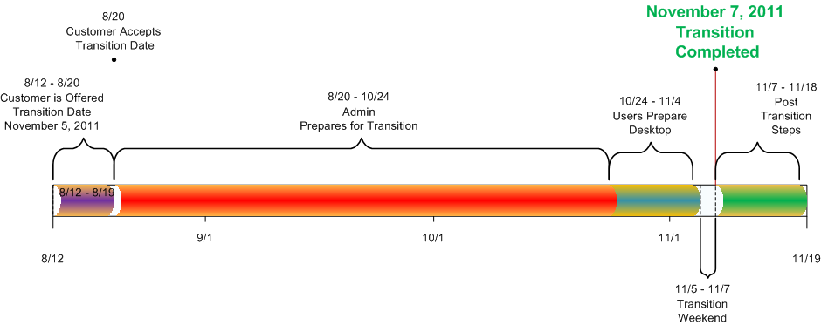
Transition Experience
Pre-Transition

Slide 21
Administrator Pre-Transition Experience
Administrator Continues to manage tenant from V1 BPOS Admin Portal before transition
Admin receives Notification of the Proposed Transition date: Admin accepts or chooses alternative date
Admin Prepares Company for Transition
  Add/Update DNS AutoDiscover and SPF records for all Domains
  Add DNS SRV Records for Lync Online
  Select mailboxes for piloting if desired
  Test On-premise to Office365 DirSynch with “sand-box” tenant
Admin Prepare End Users for Transition experience
  Validate users have Outlook 2007 or 2010
  Guide Users to Install Lync 2010 and run Office 365 Desktop Setup

Slide 22
End-User Pre-Transition Experience
Continues to use V1 BPOS services before transition (Sign-In Client, Outlook, SharePoint, OCS,
LiveMeeting etc.)
Receives information from Administrator about Transition
  When, What, How
Prepare Desktops for Transition
  Upgrade to Outlook 2007 or 2010
  Prepare desktop for New Office 365 services: Install Lync 2010, and Run Office 365 Desktop Setup
    Installs KBs, Patches, Configures Lync 2010 and SharePoint Online Etc.

Slide 23
V1 Microsoft Online Administration Console MOAC
Scheduling your transition

Slide 24
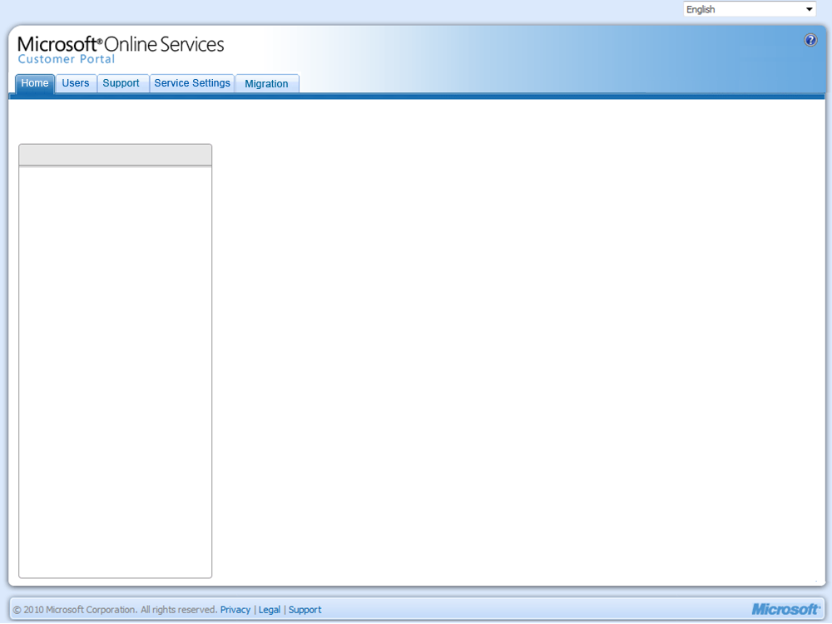


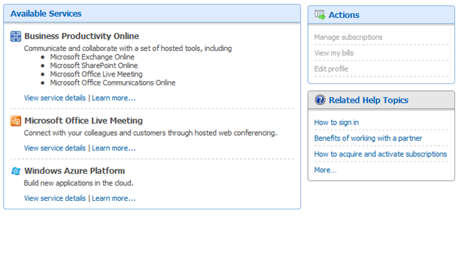
Administration Portal
A date for your transition to Office 365 is available. Confirm your date now
Information
Upcoming service transition
What is the service transition?
Frequently Asked Questions
What happens after transition?
V2 Documentation
. . . . . . . . . . . . . . . . . . . . . . . . . . . . . . . . . . . .
Get Started
Customize a plan for setting up email, collaboration, IM and conferencing
. . . . . . . . . . . . . . . . . . . . . . . . . . . . . . . . . . . .
Get Help
Explore the Help and How-to Portal
Search support articles
Important URLs
. . . . . . . . . . . . . . . . . . . . . . . . . . . . . . . . . . . .
Recommended Reading
Verify a Domain from any Registrar
Connect a Mobile Device to Exchange Online
Reset a Users Password
Alert notifies user a date has been assigned

Slide 25
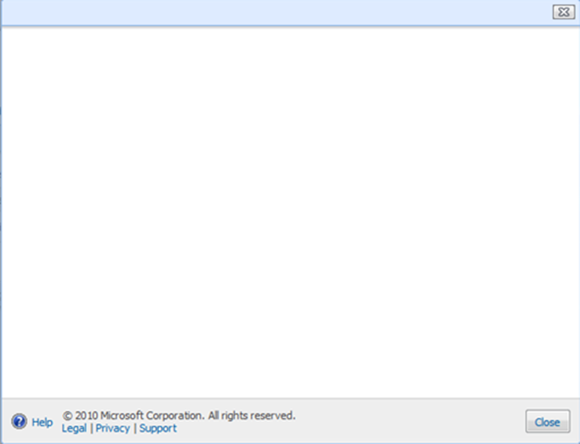

Confirm your transition date
Administration Portal
To schedule your transition to Office 365, click Confirm. Learn more
Your transition will begin on August 15, 2011
Confirm
You have a date for transitioning to Office 365. Confirm your date now.
. . . . . . . . . . . . . . . . . . . . . . . . . . . . . . . . . . . . . . . . . . . . . . . . . . . . . . . . . . . . . . . . . . . . . . . . . . . . . . . . . . . . . . . . . . . . . . . . . . . . . . . . . . . .
Information
Upcoming service transition
If the transition date does not work for your company, select a different time period, and then click Change date.
What is the service transition?
Frequently Asked Questions
What happens after transition?
V2 Documentation
Change your transition date
. . . . . . . . . . . . . . . . . . . . . . . . . . . . . . . . . . . .
View available time periods

Change date
Get Started
Customize a plan for setting up email, collaboration, IM and conferencing
. . . . . . . . . . . . . . . . . . . . . . . . . . . . . . . . . . . .
Get Help
Explore the Help and How-to Portal
Search support articles
Important URLs
. . . . . . . . . . . . . . . . . . . . . . . . . . . . . . . . . . . .
Recommended Reading
Verify a Domain from any Registrar
Connect a Mobile Device to Exchange Online
Reset a Users Password
Confirm/Decline dialog is shown in upper portion

Slide 26

Confirm your transition date
Confirm your transition date
Administration Portal
To schedule your transition to Office 365, click Confirm. Learn more
If the transition date does not work for your company, select a different time period, and then click Change date.
To schedule your transition to Office 365, click Confirm. Learn more
Your transition will begin on August 15, 2011
Confirm
Your transition has been scheduled . Confirm your date now.
. . . . . . . . . . . . . . . . . . . . . . . . . . . . . . . . . . . . . . . . . . . . . . . . . . . . . . . . . . . . . . . . . . . . . . . . . . . . . . . . . . . . . . . . . . . . . . . . . . . . . . . . . . . .
Information
Upcoming service transition
If the transition date does not work for your company, select a different time period, and then click Change date.
What is the service transition?
Frequently Asked Questions
What happens after transition?
V2 Documentation
Change your transition date
. . . . . . . . . . . . . . . . . . . . . . . . . . . . . . . . . . . .

Change date
View available time periods

View available time periods
Get Started
1 month after August 15, 2011
2 months after August 15, 2011
3 months after August 15, 2011
As late as possible
As early as possible
Customize a plan for setting up email, collaboration, IM and conferencing
. . . . . . . . . . . . . . . . . . . . . . . . . . . . . . . . . . . .
Get Help
Explore the Help and How-to Portal
Search support articles
Important URLs
. . . . . . . . . . . . . . . . . . . . . . . . . . . . . . . . . . . .
Recommended Reading
Verify a Domain from any Registrar
Connect a Mobile Device to Exchange Online
Reset a Users Password

Slide 27
Colin Wilcox | sign out
Administration Portal
Colin Wilcox scheduled your transition to Office 365 to begin on November 5, 2011.
Information
Upcoming service transition
What is the service transition?
Frequently Asked Questions
What happens after transition?
V2 Documentation
. . . . . . . . . . . . . . . . . . . . . . . . . . . . . . . . . . . .
Get Started
Customize a plan for setting up email, collaboration, IM and conferencing
. . . . . . . . . . . . . . . . . . . . . . . . . . . . . . . . . . . .
Get Help
Explore the Help and How-to Portal
Search support articles
Important URLs
. . . . . . . . . . . . . . . . . . . . . . . . . . . . . . . . . . . .
Recommended Reading
Verify a Domain from any Registrar
Connect a Mobile Device to Exchange Online
Reset a Users Password
Upon accepting date, alert updates to show confirmation & confirmer

Slide 28
End User Pre-Transition
DEMO

Slide 29
Transition Weekend

Slide 30
Experience During Transition Weekend
Admin Experience
User Experience
  V1 BPOS administration center will be locked on DAY BEFORE transition starts
    Administration center displays only the information panel; all other areas are locked
    Support team is available for issue escalations and password reset.
  License/Subscription portal also locked on DAY BEFORE transition starts
  Exchange mailboxes will move Office 365 over 48-hour transition period
    Outlook will continue to function, mail flow continues to work, but user will be prompted to re-start Outlook
    Outlook Web App (OWA) URL will stop working, and users will need to start using Office 365 URL
    Mobile devices will stop working and will need to be re-configured
  SharePoint site collections will be locked to ‘Read Only’ for some time during the weekend
  OCS, LiveMeeting continue working

Slide 31
Post Transition

Slide 32
Post Transition Experience
Admin Post-Transition Experience
End-User Post-Transition Experience
  Administrators can access Office 365 portal and manage tenant
  Post-Transition Tasks
    Re-Communicate instructions to users on how to reconfigure mobile devices and using new OWAL URL
    Start On-premise to V2 Directory Sync
    Recreate mailbox retention policies
    Setup ADFS and Exchange rich coexistence if desired
  Users logon with same Credentials
  Users should continue logging on with V1 Service Client (V1 Sign-On Client)
  Outlook and SharePoint work immediately
    Outlook will automatically re-configure (no OST re-download required, existing profile preserved)
    Old SharePoint URLs will remain as-is and updated in DNS to direct to new O365 SPO service, along with new O365 SharePoint URLs
  Manually replace old OWA URL with the new one, Reconfigure mobile devices
  Client reconfiguration will be pushed to end users via V1 Single Sign-On Service and V1 Service Client
    Removes V1 Autodiscover Settings and disables AutoStart/AutoLogon ofV1 Service Client
  Users Uninstall V1 Service Client

Slide 33
Behind the Scenes

Slide 34


Upgrade Process Overview
WW
Sync
Live
1. Sync V1-V2 Directory (World Wide)
  Sync all paid tenants from V1 to MSODS and Live Org
  Ongoing for duration of upgrade project
V1- Active Directory
BPOS V2
MSODS
2. Upgrade OCS (World Wide)
  One-Time upgrade of entire OCS service
  V1 customers will be able to access V2 OCS
WW Move
V1 OCS
V2 OCS
3. Run Batches: Remaining services are upgraded over time through periodic batches of tenants
  Batches:
    Tenants are grouped together based on V1 datacenter, and specific upgrade date
  Services:
    Exchange: Move all mailboxes associated with batch
    SharePoint: ‘Upgrade’ the SP DB associated with batch
    MOCP/FOPE: Inplace ‘Upgrade’ of tenants associated with batch
Upgrade Batches (N Times…)
V1 Exchange
MBX Move
Exchange
V1 SharePoint
DB Move
SharePoint
MOCP
Tenant Update
FOPE

Slide 35

Tenant Phases of V1-V2 Transition
Add tenant to V1-V2 Sync Process
(2) Tenant Approval
(3) Prestage (T-14)
(1) Initial Directory Sync (GA)
Add tenant to sync engine
Add tenant to specific schedule
Get approval from admin to upgrade
Pre-migrate Mailbox Content
Prestage SharePoint sites
(4) Tenant Lock (T-1)
Lock V1 admin and block directory sync
Lock MOCP
(5) Data Upgrade (T)
Migrate Exchange Mailboxes
Upgrade OCO (Independent)
Move SharePoint Sites
(6) Finalize (T+48)
Convert Exchange Domains
Move FOPE Tenants
Convert OCP Licenses
Stop V1-V2 Sync Process
Enable V2 Admin Access
Lock
Customer
MOCP
OCP Handler
Live
OK
BPOS V1
Lock
BPOS V2
4
6
MOAC
Upgrade Engine
Open!
V1- Active Directory
2
1
MSODS
5
Directory Sync
3
V1 SharePoint
SharePoint
Handler
SharePoint
Prep SP Sites
Move SP Content
V1 Exchange
Exchange Handler
Exchange
MRS
Pre-Copy Mailbox
Finish Move Mailbox
FOPE
Handler
FOPE
V1 Reseller
V2 Reseller

Slide 36
V1 Company Mailboxes being migrated to Office 365
demo

Slide 37
Additional Sessions
Office 365 Identity and Access Solutions ADFS
  OSP 215 Tuesday 3:15-4:30PM B314
More Migration/Transition Questions?
  OSP 274 – Interactive Session Wed 3:15-4:30 PM B304
Hosted Blackberry in Office 365
Questions? Ask RIM and Microsoft
Wed 10:30AM – 12 Noon
Bldg B “Authority Boardroom” in Bldg B Lobby – just
inside, from where the Hotel Shuttle Buses park

Slide 38
Thank you!

Slide 39
Appendix

Slide 40


Exchange Transition Data Flow
BPOS
Exchange Server
Begin
Single Mailbox
Initial Data Copy
T-7 Days
Final Data Copy
Transition
Incoming Email
Complete
Mailbox
Copy
Single Mailbox
Office 365
Exchange Server

Slide 41
SharePoint Transition Data Flow
Begin
T-7 Days
Transition
T+7 Days
Complete
Your Data
Your Data
Your Data
Your Data
Pre-Transition Staging Server
Post Transition Staging Server
Production SharePoint Servers
Production SharePoint Servers

Slide 42




Lync Transition Flow
Microsoft Online
IM
Conferencing
Begin
All servers upgraded to…
IM Contacts Copied
GA +90 Days
Option 1: Pre-Transition
Install Lync client gradually before Transition
Office Communicator remains functional
Transition
Option 2: Post-Transition
Office Communicator no longer functions
Install Lync client all at once
+120 Days
All Recurring Live Meeting events should be replaced before Live Meeting service deactivated

Slide 43





Resources
  Connect. Share. Discuss.
http://northamerica.msteched.com
Learning
  Sessions On-Demand & Community
  Microsoft Certification & Training Resources
www.microsoft.com/teched
www.microsoft.com/learning
  Resources for IT Professionals
  Resources for Developers
http://microsoft.com/technet
http://microsoft.com/msdn

Slide 44












Complete an evaluation on CommNet and
enter to win!

Slide 45

Notes:
New for TechEd 2011, we will be working with Microsoft Tag (http://tag.microsoft.com/overview.aspx) to create unique Tags for every session at the event. Your session Tag will appear on both the room signage and at the end of your presentation. With your session Tag, attendees will be able to scan as they enter the room to retrieve session details, view speaker bios, and engage in discussions; or scan at the end of the presentation to evaluate your session and download materials. We’re excited to integrate Microsoft Tag across the My TechEd mobile experience this year.

Slide 46

© 2011 Microsoft Corporation. All rights reserved. Microsoft, Windows, Windows Vista and other product names are or may be registered trademarks and/or trademarks in the U.S. and/or other countries.
The information herein is for informational purposes only and represents the current view of Microsoft Corporation as of the date of this presentation. Because Microsoft must respond to changing market conditions, it should not be interpreted to be a commitment
on the part of Microsoft, and Microsoft cannot guarantee the accuracy of any information provided after the date of this presentation. MICROSOFT MAKES NO WARRANTIES, EXPRESS, IMPLIED OR STATUTORY, AS TO THE INFORMATION IN THIS PRESENTATION.

