Slide 1

Microsoft Office 365:
The Future of Productivity
OSP212
Eron Kelly
Senior Director
Microsoft Corporation

Slide 2
Agenda
Microsoft Cloud strategy
Office 365 overview
What’s new compared to BPOS
What’s different compared to servers
Demo
IT controls and Identity Federation
Where to learn more

Slide 3


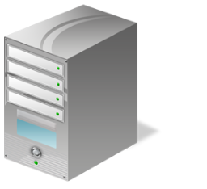


Cloud Impact
New Economics
Reduced Management
Increased Productivity
Pay for what you use
Lower and
predictable costs
Shift from capex to opex
Accelerate speed to value
No patching, maintenance
Faster deployment
Robust multi-layered security
Reliability and fault-tolerance
Latest software for users
Internet collaboration
Anywhere access
Instant self-provisioning

Slide 4












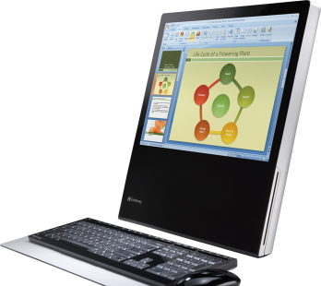


Layers of the Cloud
Consumer Services
Business Services
3rd Party
Apps and Solutions
Platform As A Service
Datacenters
Computers
Networks

Slide 5








What is Microsoft Office 365?
Bringing together cloud versions of our most trusted communications and collaboration products with the latest version of our desktop suite for businesses of all sizes

Slide 6













Office 365 Value
Office 365 delivers the power of cloud productivity to businesses of all sizes,
helping to save time, money and free up valued resources
Productivity and Collaboration
Work together, smarter
Access
Anywhere
Solve problems
from more places
Works With
What You Know
No learning curve
Enterprise Security and Reliability
99.9% uptime
guaranteed
It Control
and Efficiency
Cloud control

Slide 7

What’s New in Office 365
Flexible service offering
with pay-as-you-go,
per-user licensing
The complete Office experience with services integration in Office 365
Always the latest version of the Office apps, including Office Web Apps
Familiar Office
user experience
to access services
Voicemail with
unified messaging
Integrated
personal archiving
Retention policies
and legal hold
Exchange Control Panel
Free/busy coexistence
Cross-premises management
My Sites to manage
and share documents
Access documents offline
Improved team and
project sites
Document-level permissions to protect sensitive content
Share documents securely with external users
Cross-site collection search
IM and presence
Video calls with Lync and Windows Live users
Click-to-Lync in Office
Ad-hoc content sharing
Virtual meetings with audio/video/web conferencing
Native and web clients
Interop with 3rd party dial-in audio conferencing services
New user interface
Role-based administration
Identity federation
Multifactor authentication support
Platform
Capabilities

Slide 8
Exchange Online and Exchange Server
Email and Calendar
Email Archiving
Voicemail in Your Inbox
Mobile Collaboration
  EXCHANGE SERVER
✓
✓
✓
✓
  EXCHANGE ONLINE
✓
✓
✓
✓

Slide 9
Exchange Online and Exchange Server
Email and Calendar
Email Archiving
Voicemail in Your Inbox
Mobile Collaboration
Rich client access via Outlook
Premium web experience via OWA
NEW
Large mailbox sizes (25 GB)
  EXCHANGE SERVER
✓
✓
✓
✓
Calendar sharing and publishing
Premium antispam and
antivirus (Forefront)
NEW
  EXCHANGE ONLINE
✓
✓
✓
✓
Information protection and control
NEW

Slide 10
Exchange Online and Exchange Server
Email and Calendar
Email Archiving
Voicemail in Your Inbox
Mobile Collaboration
NEW
Personal archive
Move and delete policies
Legal hold policies
  EXCHANGE SERVER
✓
✓
✓
✓
Multi-mailbox search
for eDiscovery
  EXCHANGE ONLINE
✓
✓
✓
✓
Transport rules

Slide 11
Exchange Online and Exchange Server
NEW
Voicemail in Your Inbox
Mobile Collaboration
Email and Calendar
Email Archiving
Text preview of voicemail
Customized greetings
and call-transfer options
Voice access to e-mail,
calendar, and contacts
  EXCHANGE SERVER
✓
✓
✓
✓
Message waiting indicator
  EXCHANGE ONLINE
✓
✓
✓
✓
Lower total cost of ownership with email
and voicemail on one platform

Slide 12
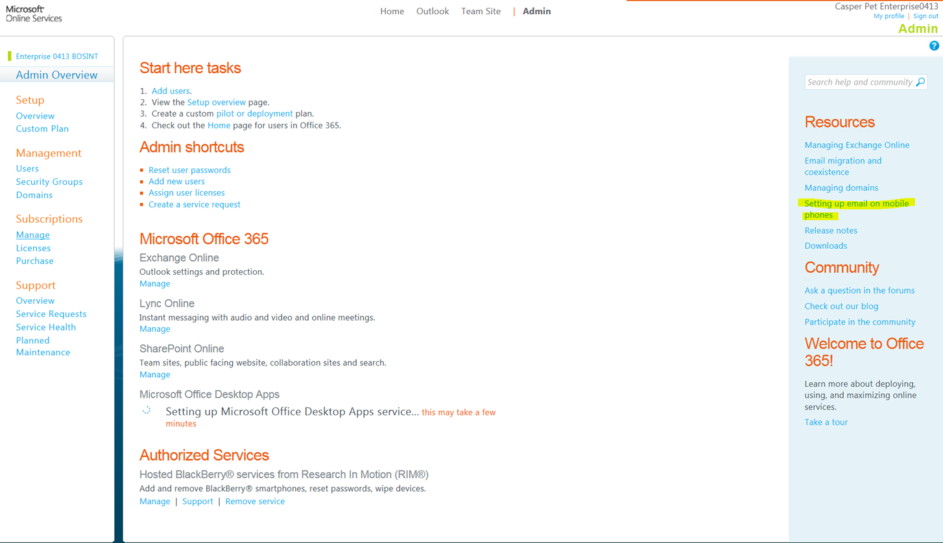
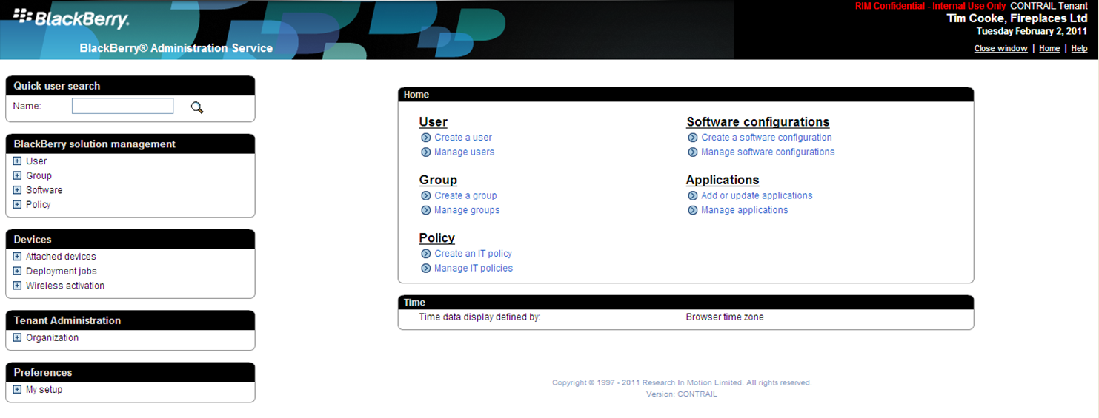
Exchange Online and Exchange Server
Partner Service:
BlackBerry Business Cloud Services
NEW
Email and Calendar
Email Archiving
Voicemail in Your Inbox
Mobile Collaboration
Sync email, contacts, calendar
Supports popular mobile devices
Remote device wipe
  EXCHANGE SERVER
✓
✓
✓
✓
Mobile device security policies
  EXCHANGE ONLINE
✓
✓
✓
✓
Block and quarantine devices

Slide 13
Exchange Server Features Not Available in Exchange Online
Client Access
Outlook 2003 support
OWA login: public/private radio buttons
Administration
Automated PST import and export
Provision users in multiple datacenters
Multiple on-premises AD forests
Resource forest topologies
Directory
Hierarchical address book
Global Address List segmentation
Compliance/
Archiving
Exchange 2007-style Managed Folders
GUI for creating Retention Policies
Multi-mailbox search: export to PST
Third-party add-ins for transport rules
Voice Mail
Speech-enablement of directory and auto-attendant
Applications
MAPI/CDO access
Server-side code, .dlls, transport agents
Custom OWA themes, logos, add-ins
Public folders
Security
S/MIME in OWA
S/MIME certificate sync

Slide 14

SharePoint Online and SharePoint Server
Sites & Communities
Content Management
Search
Business Intelligence & Composite Applications
  SHAREPOINT SERVER
  SHAREPOINT ONLINE
No SharePoint for Internet Sites
No Records Center or
e-discovery
No FAST Search or Unified Search
No BCS, PerformancePoint
No full-trust code

Slide 15
SharePoint Online and SharePoint Server
My Sites
Sites & Communities
Content Management
Search
Business Intelligence & Composite Applications
NEW
Team Sites
Intranet Sites
Office Integration (2007/2010)
  SHAREPOINT SERVER
SharePoint Workspace 2010
for Offline Working
External Sharing
  SHAREPOINT ONLINE
NEW
No SharePoint for Internet Sites
No Records Center or
e-discovery
No FAST Search or Unified Search
Simple Public-Facing Website designed for
small businesses and professionals
NEW
No BCS, PerformancePoint
No full-trust code

Slide 16
SharePoint Online and SharePoint Server
Sites & Communities
Content Management
Search
Business Intelligence & Composite Applications
Document Libraries
Slide and Media Libraries
Business Taxonomies and Tagging
  SHAREPOINT SERVER
Document Sets and ID’s
  SHAREPOINT ONLINE
Office Web Apps
NEW
No SharePoint for Internet Sites
No Records Center or
e-discovery
No FAST Search or Unified Search
No BCS, PerformancePoint
No full-trust code

Slide 17
SharePoint Online and SharePoint Server
NEW
Sites & Communities
Content Management
Search
Business Intelligence & Composite Applications
Cross-site Collection Search
Search Refiners
Indexing Controls
  SHAREPOINT SERVER
People Search
  SHAREPOINT ONLINE
Phonetic Search
No SharePoint for Internet Sites
No Records Center or
e-discovery
No FAST Search or Unified Search
No BCS, PerformancePoint
No full-trust code

Slide 18
SharePoint Online and SharePoint Server
NEW
Sites & Communities
Content Management
Search
Business Intelligence & Composite Applications
Excel Services
Access Services
Visio Services
  SHAREPOINT SERVER
Forms Services
Silverlight Web part
  SHAREPOINT ONLINE
Sandbox Solutions
No SharePoint for Internet Sites
No Records Center or
e-discovery
No FAST Search or Unified Search
No BCS, PerformancePoint
No full-trust code

Slide 19

SharePoint Server Features
Not Available in SharePoint Online
Sites and Communities
SharePoint for Internet Sites
WCM workflow and approval
Site Variations
Search
‘Unified’ Search results combining online and customer site sources
FAST Search including thumbnails, previews, visual best bets, and deep search refinement
Content Management
Access to 3rd party content management systems
Support for end-to-end
eDiscovery scenarios
Records Center
Information Rights Management (IRM)
Business Intelligence and Composite Applications
PerformancePoint Services
Business Connectivity Services
Power Pivot
Full Trust Code Solutions

Slide 20
Lync Online and Lync Server
IM and Presence
Online Meetings
Voice
Enterprise Voice
  LYNC SERVER
✓
✓
✓
✓
  LYNC ONLINE
✓
✓
Post Launch
Not Available

Slide 21
Lync Online and Lync Server
IM and Presence
Online Meetings
Voice
Enterprise Voice
  IM and Presence
  Lync audio and video calls
Click-to-Lync right from Office
  LYNC SERVER
✓
✓
✓
✓
Presence updates based on Exchange calendar
  Lync with external orgs and Windows Live
NEW
  LYNC ONLINE
✓
✓
Post Launch
Not Available
  Lync IM on smart phones*
NEW
* Available in Lync Online post Office 365 launch (late 2011)

Slide 22
Lync Online and Lync Server
New Integrated Client
IM and Presence
Online Meetings
Voice
Enterprise Voice
  Lync meetings with audio/video/web conferencing*
  Ad-hoc screen and application sharing
  Easy scheduling via Outlook
  LYNC SERVER
✓
✓
✓
✓
  Native and web clients for external attendees
  LYNC ONLINE
✓
✓
  Interop with 3rd party dial-in audio conferencing services
Post Launch
Not Available
* Multi-party audio/video not available in some countries due to regulatory restrictions

Slide 23
Lync Online and Lync Server
IM and Presence
Online Meetings
Voice
Enterprise Voice
  Place and receive calls to landline and mobile phones (PC to PSTN)
  ‘Optimized for Lync’ PC peripherals (headsets, speaker phones etc…)
  Set incoming calls to ring mobile number
  LYNC SERVER
✓
✓
✓
✓
  Drag-and-drop conference calling*
  LYNC ONLINE
✓
✓
  Interop with Exchange Online voice mail
Post Launch
Not Available
  Lync Online Voice to become available post Office 365 launch
Requires separate phone service from a certified telco partner (phone numbers and calling plans)
* Multi-party audio/video not available in some countries due to regulatory restrictions

Slide 24
Lync Online and Lync Server
IM and Presence
Online Meetings
Voice
Enterprise Voice
  Interop with PBX, gateways and SIP trunks
  Call admission control
  Branch office appliance
  LYNC SERVER
✓
✓
✓
✓
  E-911
  Response groups
  LYNC ONLINE
✓
✓
FY12
Not Available
  Lync IP desk phones and analog devices
  To take advantage of PBX capabilities, all Lync workloads must run on-premises
Lync server can work with SharePoint and Exchange Online – Purchase Office 365 Plan E4

Slide 25
demo

Slide 26
Security Program
A risk-based, multidimensional approach to help safeguard services and data
Security Management
Security monitoring and response, threat and vulnerability management
Data
Access control and monitoring, file/data integrity
User
Account management, training and awareness, screening
Application
Secure development lifecycle, access control and monitoring, antimalware
Host
Access control and monitoring, antimalware, patch and config. management
Internal Network
Dual-factor authentication, intrusion detection, vulnerability scanning
Network Perimeter
Edge routers, firewalls, intrusion detection, vulnerability scanning
Facility
Video surveillance, biometrics, access control

Slide 27
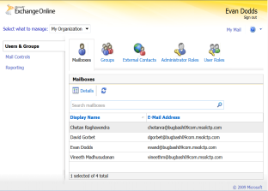

Programmability and More Control
Service-specific control
Fall through experience to specific services to gain similar server configuration control
Platform Web services
New programmability layer allowing third party to interact with platform, by-passing the user interface
Remote PowerShell
Manage the Exchange Online environment via command line, build applications that leverage the service to meet your existing business requirements and processes
Collaboration customization
Visual Studio 2010 and SharePoint tools for building, testing, and packaging Sandboxed Solutions
Role-based admin
Five distinct admin roles let you assign the right level of responsibility to helpdesk, billing, and technical teams

Slide 28



Identity
1
Synchronize Directory from
On-Premises Active Directory to the Cloud
Two identity options:
1
Microsoft Online Services IDs
Sign in with cloud identity
Same across commerce/billing and use
Users and administrators have two identities –
one for the cloud, one for on premise
Identity is administered both on
premise and in the cloud
Users authenticate directly with Office 365
2
Users authenticate directly with Office 365
2
Federated IDs (new)
Sign in to the cloud with your corporate ID
Single sign on for end users and administrators
Identity is administered only on premise
2 factor authentication options available
ADFS 2.0
Windows Server 2008
Users are authenticated by local ADFS server

Slide 29






























Customers are Embracing the Cloud with Microsoft
BPOS customers quadrupled last year
15 million
Live@edu users
16,000+ partners
Office 365 beta
  17 languages
  38 countries
  100,000+
  beta signups

Slide 30
Next Steps
  Sign up for the Beta: www.office365.com
  Explore the Community and Blogs: community.office365.com
  Read all the details: Office 365 Beta Service Descriptions

Slide 31

Microsoft Office 365 for IT Professionals
Jump Start
Microsoft Productivity, Email & Collaboration in the Cloud. Training designed for experienced technologists and IT leaders whose jobs demand they know how to best leverage new, emerging
Microsoft technologies.
Three-Day Jump Start Course
  May 24: “Office 365 Platform”
  May 25: “Exchange Online”
  May 26: “Lync & SharePoint Online”
May 24 – 26, 2011
  Week after TechEd
  Tailored for IT Pros
  Learn from the Best
REGISTER NOW: http://bit.ly/Office365-JUMP

Slide 32
Key Office 365 Sessions at Tech∙Ed
Monday | EXL202 | Microsoft Lync 2010: In the Cloud | B206 | 3:00 PM
Tuesday | OSP273-INT | Microsoft Office 365 Administration and Automation Using Windows PowerShell | B301 | 8:30 AM
 | OSP213 | What Do Existing BPOS Customers Need to Do to Prepare for Microsoft Office 365? | C201 | 1:30 PM
 | OSP276-INT | Microsoft Office 365 Client Connectivity | B304 | 1:30PM
 | OSP215 | Microsoft Office 365: Identity and Access Solutions | B314 | 3:15 PM
Wednesday | EXL302 | Archiving and Discovery in Microsoft Exchange 2010 SP1 and Exchange Online | B207 | 10:15 AM
 | OSP305 | Developing Collaboration Solutions in the Cloud with Microsoft SharePoint Online | B314 | 1:30 PM
 | OSP325 | Microsoft Office 365: Directory Synchronization | B313 | 3:15 PM
 | EXL311 | Microsoft Exchange Server & Microsoft Office 365: How to Set Up a Hybrid Deployment | B206 | 3:15 PM
Thursday | OSP306 | Developing Powerful Workflows in the Cloud with Microsoft SharePoint Online | C208 | 2:45 PM
 | OSP214 | Security and Compliance on the Microsoft Business Productivity Online Standard Suite and Microsoft Office 365 Platforms | B313 | 4:30 PM

Slide 33












Required Slide
Complete an evaluation on CommNet and
enter to win!

Slide 34





Resources
  Connect. Share. Discuss.
http://northamerica.msteched.com
Learning
  Sessions On-Demand & Community
  Microsoft Certification & Training Resources
www.microsoft.com/teched
www.microsoft.com/learning
  Resources for IT Professionals
  Resources for Developers
http://microsoft.com/technet
http://microsoft.com/msdn

Slide 35


Slide 36

© 2011 Microsoft Corporation. All rights reserved. Microsoft, Windows, Windows Vista and other product names are or may be registered trademarks and/or trademarks in the U.S. and/or other countries.
The information herein is for informational purposes only and represents the current view of Microsoft Corporation as of the date of this presentation. Because Microsoft must respond to changing market conditions, it should not be interpreted to be a commitment
on the part of Microsoft, and Microsoft cannot guarantee the accuracy of any information provided after the date of this presentation. MICROSOFT MAKES NO WARRANTIES, EXPRESS, IMPLIED OR STATUTORY, AS TO THE INFORMATION IN THIS PRESENTATION.

Slide 37
Appendix

Slide 38
Additional Office 365 Links
Get all the details
  Office 365 Developer Training
  SharePoint Online for Office 365 Developer Guide
  Office 365 Marketplace
Connect with the team
  Office 365 Facebook
  Office 365 Twitter
  Office 365 Linked In Site
  Office 365 You Tube

Slide 39
Office 365 Track Sessions
Monday, May 16
OSP212: Microsoft Office 365: The Future of Productivity (Room 307 | 1:15 PM)
OSP216: Microsoft Office 365: Deployment Overview (Room B313 | 3:00 PM)
Tuesday, May 17
OSP273-INT: Microsoft Office 365 Administration and Automation Using Windows PowerShell (Room B301 | 8:30 AM)
OSP213: What Do Existing BPOS Customers Need to Do to Prepare for Microsoft Office 365? (Room C201 | 1:30 PM)
OSP276-INT: Microsoft Office 365 Client Connectivity (Room B304 | 1:30PM)
OSP215: Microsoft Office 365: Identity and Access Solutions (Room B314 | 3:15 PM)
OSP324: The Taming of the Clouds: Integrating SaaS with Your On-Premise Environment (Room C211 | 5:00 PM)
Wednesday, May 18
OSP272-INT: Licensing Microsoft Online Services (Room B302| 10:15 AM)
OSP274-INT: What Do Existing BPOS Customers Need to Do to Prepare for Microsoft Office 365?
Q&A Follow Up (Room B304 | 3:15 PM)
OSP 325: Microsoft Office 365: Directory Synchronization (Room B313 | 3:15 PM)
Thursday, May 19
OSP381-INT: Microsoft Office 365: Identity and Access Solutions - Q&A Follow Up (Room B301 | 10:15 AM)
OSP219: Deploying Microsoft Office Professional Plus Subscription (Room B314 | 2:45 PM)
OSP214: Security and Compliance on the Microsoft Business Productivity Online Standard Suite
and Microsoft Office 365 Platforms (Room B313 | 4:30 PM)

Slide 40
Related Office 365 Sessions
Monday, May 16
EXL202: Microsoft Lync 2010: In the Cloud (Room B206 | 3:00 PM)
OSP210: Microsoft SharePoint Online Overview (Room B402 | 3:00 PM)
Tuesday, May 17
OSP309: Integrating Microsoft SharePoint 2010 and Microsoft Dynamics CRM Online (Room C302 | 1:30 PM)
EXL319: Microsoft Lync 2010: Setup, Deployment, Upgrade and Coexistence Scenarios (Room B206 | 3:15 PM)
OSP301: Integrating Microsoft SharePoint 2010 with Windows Azure (Room C203 | 5:00PM)
Wednesday, May 18
EXL302: Archiving and Discovery in Microsoft Exchange 2010 SP1 and Exchange Online (Room B207| 10:15 AM)
OSP308: Claims Identity in Microsoft SharePoint 2010 (Room B314 | 10:15 AM)
OSP372-INT: Building Cloud Apps Using Microsoft Dynamics CRM Online and Windows Azure
(Room B303 | 10:15 AM)
OSP305: Developing Collaboration Solutions in the Cloud with Microsoft SharePoint Online (Room B314 | 1:30 PM)
EXL311: Microsoft Exchange Server & Microsoft Office 365: How to Set Up a Hybrid Deployment
(Room B206 | 3:15 PM)
Thursday, May 19
EXL375-INT: Understanding Archiving and Compliance in Microsoft Exchange Online (Room B302 | 8:30 AM)
EXL322: Microsoft Exchange Online: Unified Messaging in Microsoft Office 365 (Room B207 | 1:00 PM)
EXL309: Microsoft Exchange Online in Microsoft Office 365: Migration Case Study (Room B207 | 2:45 PM)
OSP306: Developing Powerful Workflows in the Cloud with Microsoft SharePoint Online (Room C208 | 2:45 PM)

