Slide 2

Complete Enterprise Content Management in Microsoft SharePoint 2010
OSP207
Israel Vega
Kurt Allebach
Oleg Kofman

Slide 3

Who We Are
Israel Vega - Tampa, FL
  e: ivega@microsoft.com
  SharePoint 2010 MCM Candidate
Kurt Allebach-Tampa, FL
  e: kalleba@microsoft.com
  ECM Community Lead
Oleg Kofman-New Jersey
  e: olegkofm@microsoft.com
  SharePoint 2010 MCM Candidate

Slide 4
Session Objectives
Understand the big decisions that need to made during an ECM implementation
Know what the consequences are and more importantly, what can be changed later
Learn the ingredients for making good decisions

Slide 5
Adventures in SharePoint
A Choose your own Adventure Story

Slide 6
What is a Choose Your Own Adventure Story?
Popular in the late 1980’s, Early 1990’s
A Series of Children's game-books written from a second-person point of view
The reader is the protagonist and makes choices that determine the main character's actions in response to the plot and its outcome

Slide 7
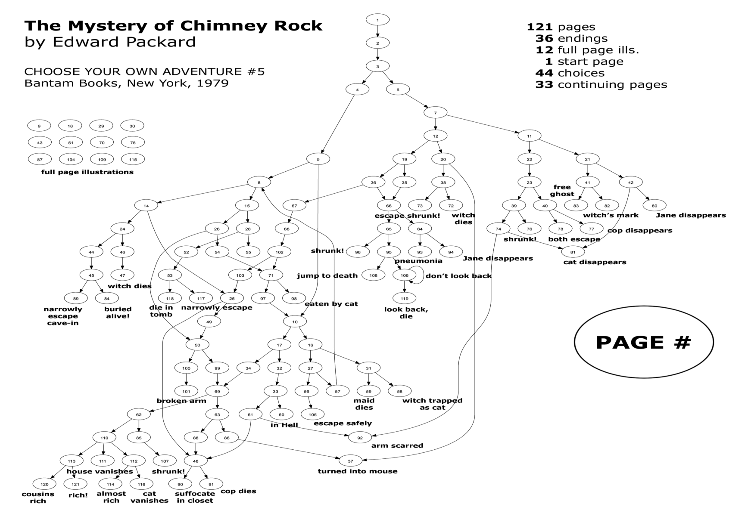
Source: http://samizdat.cc/cyoa/

Slide 8
How is SharePoint just like a CYOA book?
 | CYOA | SharePoint
Several pages of decisions | Avg Book has 47 Decisions
Several different outcomes | Avg book has 40 outcomes
Make the wrong decisions most of the times | 10 catastrophic, 6 disappointing, 7 mediocre
Sometimes the outcome is good | 11 favorable, 6 great endings
Some fatal outcomes can be changed for the good | Turn to another page
Some decisions cannot | A poor decision can lead to death
Avg TechNet Article has 10 hyperlinks to 10 other decisions
Avg SharePoint solution is…well. It depends
It depends but most of the times it wrong
SharePoint usage grows and you get a raise
Throw hardware at the problem
A poor decision can lead to getting fired

Slide 9
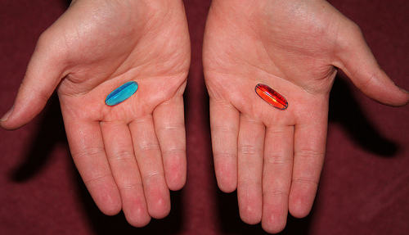
Blue Pill – Come with us if you want to deploy SharePoint ECM
Red Pill –
Come with us anyway

Slide 10
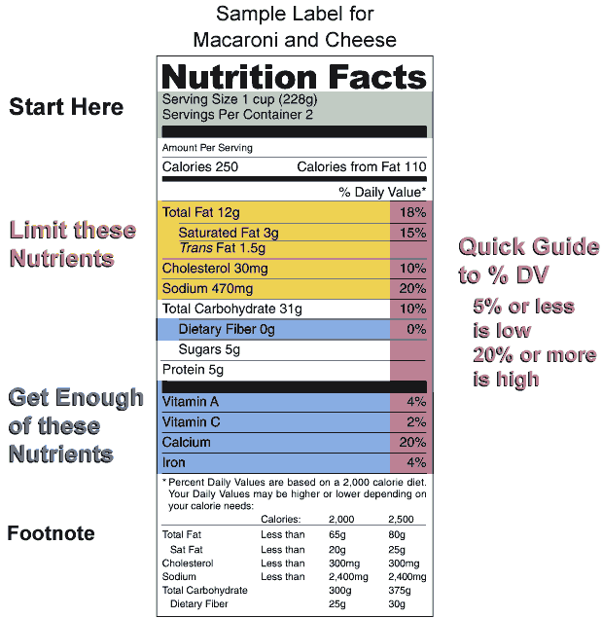
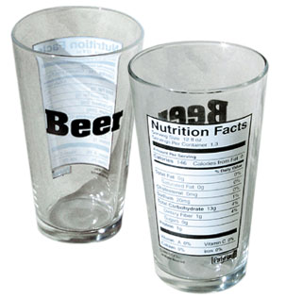
If ECM was like a Nutrition Label…
SharePoint ECM Ale
Governance
Requirements
Metadata
Content Types
Storage 200g
Security 1000g
Retention 8 mg
Notes:
This slide discusses the fact that ECM is made up of many components, many of which are optional. Some are better than others. Solution completeness is not measured in percentages as a whole. A complete ECM solution is may be 30% Governance or 10% requirements for your organization and 100% will mean something different.

Slide 11

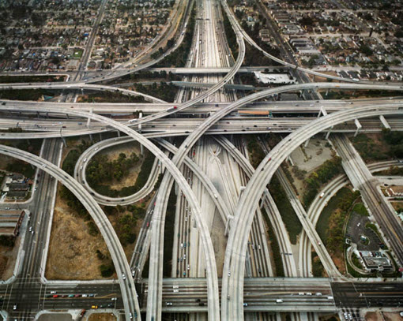
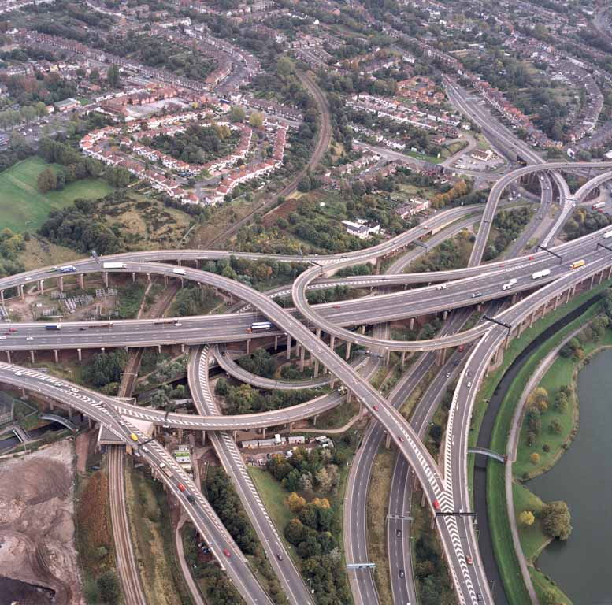
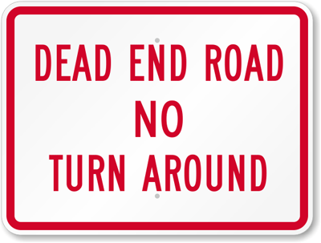
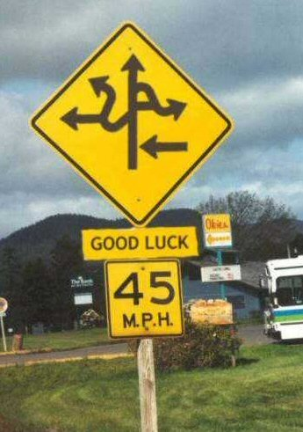

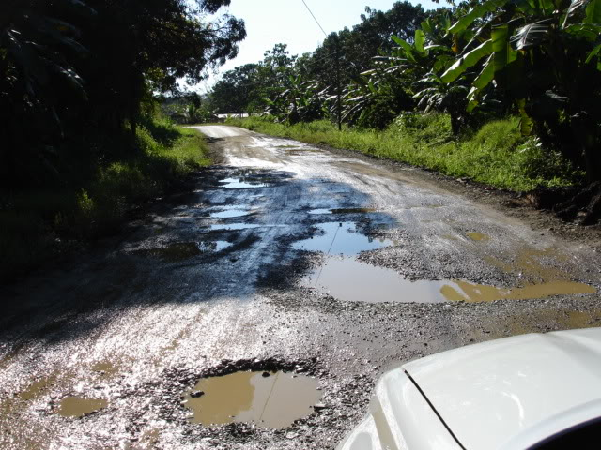
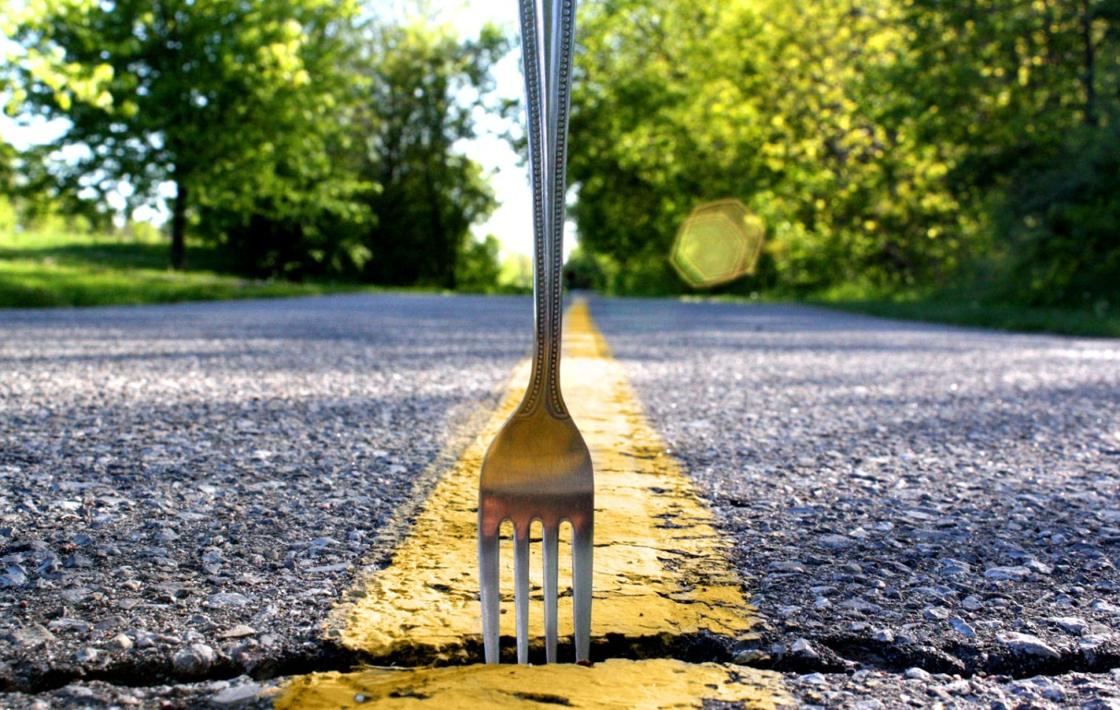
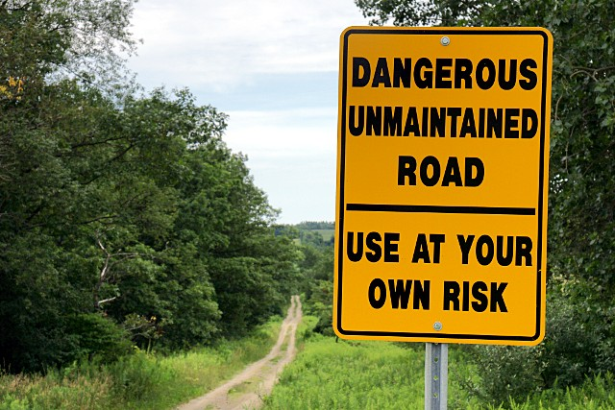
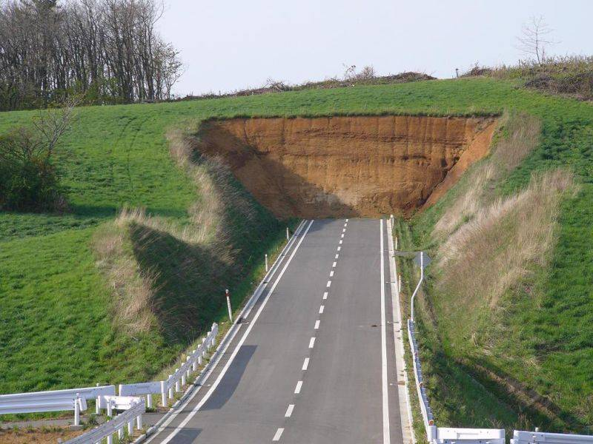
…then The Road to a Complete ECM Diet …
Notes:
There are many roads to choose from and turns to make
Some turns lead to smooth roads
Some, not so much
Some are bumpy
Some are .. We don’t know
Sometimes you come to a fork in road and you have to choose
Sometimes you choose and it leads to more choices
Other times it leads to a point of no return
At these times, you may look back at your choices and reflect

Slide 12
Context
ECM is…
We are going to talk about…
We are not going to talk about…
We are Assuming…
We are using the point of view of…

Slide 13


Key ECM Architectural Decisions
Records Center or In-place Records Management
Smaller Specialized Farms or Large Multi-purpose Farms
Centralized or Distributed Metadata Management
Sensitive Content: Coexistence or Isolation
RBS for SQL
Migrate File Shares or Leave in Place
General Decision Guidance
Go to end

Slide 14
Begin Several Small vs. Single Large
Farm Story

Slide 15
When Defining My ECM Architecture…
Do I create one large farm to serve the enterprise?
Do I create smaller, specialized farms focused on specific workloads or functions?

Slide 16
Typical Decision Tree (Requirements First)
Deploy SharePoint
How many users? How much content?
Assume 500 GB of initial content, 100k users
Global
Where are your data centers?
Global
Regional
Local
Regional
Local

Slide 17
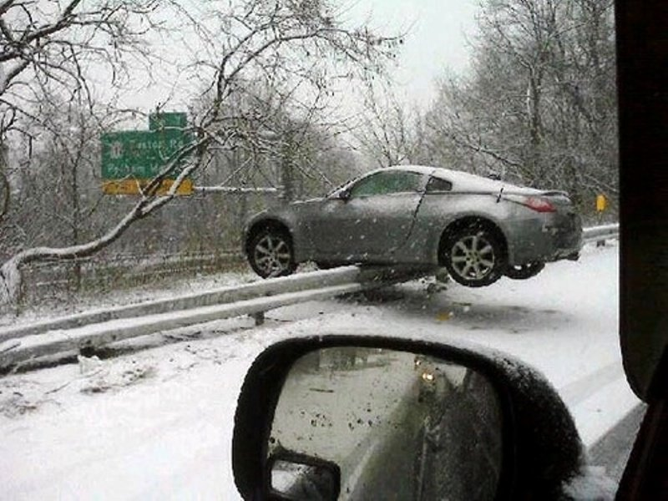

Set up Decision Guardrails
Design for the Knowns
Not Unknowns
You have a finite budget
You need to meet a specific RTO and RPO
You may need to patch it or upgrade it eventually
SharePoint works best in a single “live” R/W datacenter
  The Farm is boundary
Other Business Specific Needs
  Current system classification
  Any Legal or local data requirements
  Chargebacks
  Licensing
What happens when the aliens show up?
How do I manage DR in case I decide to do DR?
Wait for SP1
Politics
128 Bit Architectures are coming

Slide 18
Using the Knowns as Guardrails
Align the Opposing Forces and Drivers
System Classification
Budget
RTO and RPO
Number of Data Centers
Sometimes the answer needs no questions; we just like asking
SharePoint Architecture
System Design Principals
Actuals
Goals
Answer

Slide 19
Tipping Points
Politics and Budget
RTO and RPO
Customization and Development
Regulatory and Security

Slide 20
My “Righter” Recommendation - Workloads
Publishing Sites
(Web app or farm)
Division
Enterprise
Business Unit
Department
Project
Group
Individual
Team
Targeted Sites and Applications
(web app or farm)
Commodity Sites
(Web app or farm)

Slide 21
How Do I know I’m on the Wrong Road?
Single when you should have deployed multiple
Multiple when you should have deployed single
Customization outages affect collaboration
Security Model is Inconsistent with the Data Classification
Patching takes longer
Backups and restore SLA’s are ambiguous
Not as much flexibility
Splitting content can be difficult
Overall Complexity is high
Backups are complicated
Storage is under utilized
$$$$
  Servers; Software; People
Can scale back but
  Broken URL’s
  Extra Capacity
  Can take time
Start Again

Slide 22
Begin Records management story

Slide 23
When Defining My ECM Architecture…
Do I use a Records Center Approach?
Do I use an In-Place Management Approach?
Follows the practice of “vaulting” content at some point in its lifecycle
Centralized, tightly managed, often a sub-set of the corpus
Allows to the full lifecycle management of content in the same location
Decentralized, adaptable to local needs

Slide 24
Decision Tree
Lifecycle
(Collab, WF)
User Expectations
Compliance
Development
Boundaries Important
Flexible
Strict
Context Important
Context Unimportant
All in One Place
Fragmented
Boundaries Unimportant
In Place
Record Center

Slide 25
Tipping Points
Politics
Compliance

Slide 26
Consequences and Change Points
Record Center when you should have implemented In Place
In Place when you should have implemented Record Center
Too bureaucratic
  disempowers the business; sluggish; complicates the lifecycle, findability; compliance drops
Too much work
Things get out of synch
Compliance drops
Audits difficult
Configuration drift increases

Slide 27
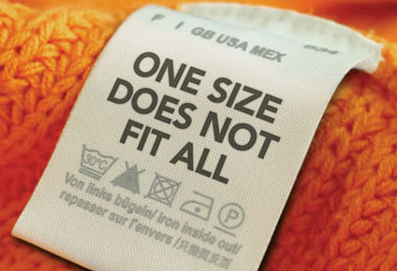
My “Righter” Recommendation - Hybrid
Look at making this decision on a per solution bases…not on a farm or enterprise bases…after considering all of the questions.
Start Again

Slide 28
Begin Metadata story

Slide 29
When Defining My ECM Architecture…
Do I Centralize Metadata Management?
Do I Distribute Metadata Management?
Centralized Management uses the Content Type Federation feature or a third party tool
Distributed Management configures content types at each site collection

Slide 30
Decision Tree
Quality
Velocity of Change
Management
Distribution
Used Everywhere
Central Resources
No Central Resources
Slow
Rapid
Important
Not as Important
Only in one Site Collection
Centralize
Distribute

Slide 31
Tipping Points
Politics
Compliance
SME Maturity

Slide 32
Consequences and Change Points
Centralized when you should have Distributed
Distributed when you should have Centralized
Too bureaucratic
  disempowers the business; sluggish; compliance drops
Metadata-to-Business alignment drops off
Things get out of control
Search breaks down

Slide 33

My “Righter” Recommendation - Hybrid
Look at a hybrid approach.
  Common, multi-solution/site collection content types can be managed via a federated service
  Single solution/site collection content types can be managed at the site collection via a distributed model of SMEs
Start Again

Slide 34
Begin Isolate story

Slide 35
How Should I Handle Sensitive Content?
Sensitive Content is any content that requires special handling due to its nature such as medical records, trade secrets, intellectual property, financial information, etc.
Do I Isolate?
Do I Coexist?
Isolation is separating content by class into separate farms, web applications, site collections, or sites
Coexistence is allowing sensitive content to be hosted in the same site collections as non-sensitive content…often on the same site…occasionally in the same libraries

Slide 36
Decision Tree
Regulations
Context
Synergy
Business Process
Only Sensitive Content Created
No Connections
Connections
Not Important
Valuable
Strict
Flexible
Both Created
Isolate
Coexist

Slide 37

Tipping Points
Politics
Compliance
Security/Privacy Risk

Slide 38
Consequences and Change Points
Isolated when you should have Coexisted
Coexisted when you should have Isolated
Bi-container users
Misclassified content
Connections between items missed
Context absent
Compliance violations
Security misconfigured; inappropriate access granted; rights trimming fails
Burdensome processes

Slide 39
My “Righter” Recommendation - Hybrid
Determine your risk tolerance and the content’s risk profile and lean toward coexistence when possible
Start Again

Slide 40
Begin RBS Story

Slide 41
Remote Blob Storage Guidance
RBS will help me with performance!
RBS is not something that was invented to increase the performance of a farm. It allows you to reduce the upfront cost of a farm (SAN Disks) and replace it with cheaper ones (and increase the operational costs of the farm)
Shrinking the DB will NOT increase the SharePoint performance. It will increase the performance of some maintenance tasks, and you can get slightly better performance if you only store large files… BUT… You just added another server for the RBS Storage, and that one has also some extra disks in it… So guess where the SLIGHT performance gain comes from…

Slide 42
Remote Blob Storage Guidance
Does your friendly SQL Server admin know that…
Backup and restore operations take considerably longer
Index and statistics defragmentation takes considerably longer.
This is a particular concern if the database must be taken offline during defragmentation.
Regular DBCC consistency checks will take much longer.
If database integrity is not regularly monitored, the risk of a corrupted database is considerably increased.
Larger databases will have a higher risk of corruption due to physical storage errors simply because of the large quantity of storage they consume

Slide 43

BLOB Storage Technology Comparison
Unstructured Data
Unstructured Data
Unstructured Data
Solution | Dedicated BLOB Store | File System or File Share | BLOBs in Database
Advantages | Lower cost per GB at scale Scalability & Expandability | Low cost per GB Streaming Performance | Integrated management Data-level consistency
Disadvantages | Complex application development & deployment Separate data management Enterprise-scales only | Complex application development & deployment Integration with structured data | Poor data streaming support File size limitations Highest cost per GB
Example | EMC Centera Fujitsu Nearline | Windows File Servers NetApp | SQL Server VARBINARY(MAX)

Slide 44



RBS
RBS means I don’t have to have a SQL license | No, this is still required, the primary SQL Server must be EE
RBS allows me to store data in the cloud | No, SQL must still respond in 20mS
RBS allows for much larger document storage | No, but you might want RBS in a large implementation due to backup, cost of storage and migration from ISVs
RBS improves SharePoint performance | It may be faster due to the second machine storage by up to 10% or it may be slower depending on various factors
RBS breaks through the software boundaries and limits | No
RBS avoids having to back up the blobs | No, you must backup both SharePoint metadata and Blobs at the same point in time
RBS makes my data more manageable | This is debatable, we think it increases operational cost
Start Again

Slide 45
Begin File Share Story

Slide 46
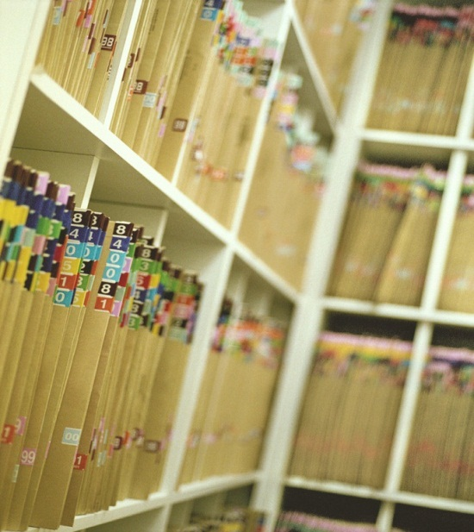
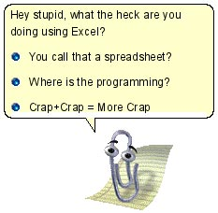

Then ..
IF Your File Shares =
It looks like your file shares are very organized, would you like to add them to your SharePoint ECM solution?
Else

Slide 47
File Share Guidance
Use SharePoint When:
Use a File Share When:
You need version tracking
There is a need for collaboration
You need a flexible security model
All users have access to SharePoint
You need to describe the file using metadata
You have compliance requirements that can’t be met with file shares
File sizes are smaller than 75 MB and
  Available to users close to the datacenter
File sizes are more than 75 MB or
  Users are far from the datacenter
  No collaboration needed
You need a rigid security model
The files have a client-server usage profile
Files are archive, data dumps or backups or do not change much
Files need to be locally available

Slide 48
Consequences and Change Points
If I Leave them In Place..
If I Migrate en masse
eDiscovery and Legal Holds
Archive
Storage
Strategy
Search and Crawl
Storage
Metadata
Data owner identification
Align with architecture
Start Again

Slide 49
Begin General Guidance

Slide 50
Avoiding Analysis Paralysis
Decide…
who decides
when to decide
what deciding is
Apply
Implement the decision
Measure
Reconcile and assess
Perform root cause analysis on failures
Decide how to measure, when to adjust, when to re-decide
Measure and maintain
Refine
Lather
Rinse
Repeat if Necessary

Slide 51
Decide the Deciders
Identify key stakeholders
Align arguments to generate stakeholder momentum
Create an engagement strategy
Identify trigger events
Plan to be wrong

Slide 52
Key Decision Ingredients
1 Part Experience
  Have we seen many bad decisions?
2 Parts Potential Impact
  User experience or adoption
  Storage management
  Performance
4 Parts Strategy
  Can we change it later?
  If so, how Painful is it to change Later?
    New kitchen or roof (mediocre)
    Gut the house (disappointing)
    Tear down and rebuild (catastrophic)

Slide 53
Measure the Quality of the decision
At the time you make the decision, given the information you have is it the right thing to do?
Good decisions don’t always lead to good outcomes but the process is constant
Rational Plug pulling (Fail fast, fail early, fail cheap)

Slide 54
Why we make bad decisions
People factors
  Not consulting the implementers
  Not consulting key stakeholders
Technical factors
  Fighting with the technology
  Rationalize the technology
Political Factors
  Premature decision making
  Forced non-strategic not rational (gut feeling)
Start Again

Slide 55
Notable Decision Quotes
Fail Fast, Fail Early, Fail Cheap
You can learn or you can listen and learning is expensive
“Best Practice” is made up of 2 parts, the BEST of all the times I’ve PRACTICEd. Go practice.
There is never enough time to do it right but we can always find time to do it again
There is no right or wrong, only degrees of righter
Success is a lousy teacher. It seduces smart people into thinking they can't lose. Bill Gates, The Road Ahead-1995

Slide 56
Related Content
Breakout Sessions
  OSP202 - SharePoint Governance and Lifecycle Management with Microsoft Project Server 2010
  OSP201 - The Ten Immutable Laws of Microsoft SharePoint Security
  OSP321 - Microsoft SharePoint 2010 as a Platform for LOB Composite Applications
  OSP318 - Plan and Deploy My Site for Microsoft SharePoint Server 2010
  OSP317 - Automate Business Processes with Microsoft InfoPath, Business Connectivity Services, SharePoint Workflows and Microsoft Word Services
  OSP313 - Scaling Document Management on Microsoft SharePoint 2010
  OSP401 - Configuring Cross-Farm Services in Microsoft SharePoint 2010

Slide 57
Related Content
Interactive Sessions
  OSP373-INT - Microsoft SharePoint 2010 Upgrade and Migration
  OSP376-INT - Microsoft SharePoint Web Content Management (WCM): What Do You Want to Know?
  OSP380-INT - Real Life Experiences with Enterprise Deployments Using Microsoft Fast Search Server 2010 for SharePoint
Hands On Labs
  OSP273-HOL - Document and Metadata Management in Microsoft SharePoint 2010
  OSP371-HOL - FILESTREAM with Microsoft SharePoint 2010
  OSP271-HOL - Rich Media Management in Microsoft SharePoint 2010

Slide 58
Find Us Later At
OSP Info Desk
SharePoint for Developers Kiosk
SharePoint for IT Pros Kiosk

Slide 59
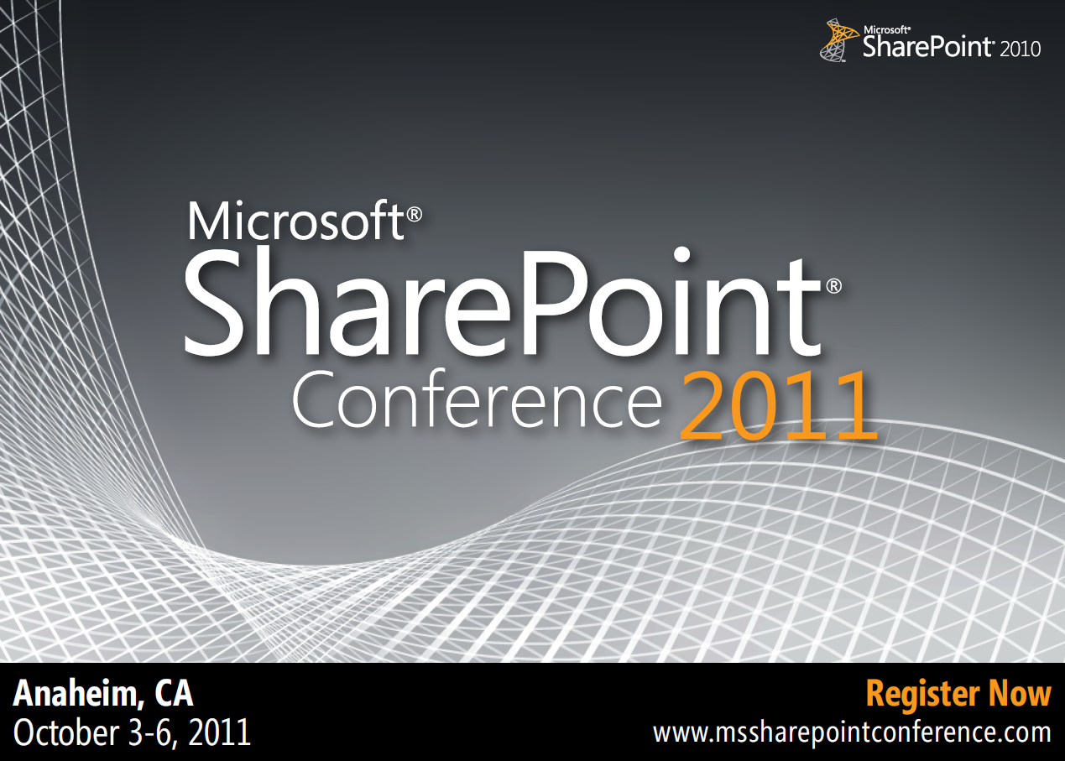

Slide 60





Resources
  Connect. Share. Discuss.
http://northamerica.msteched.com
Learning
  Sessions On-Demand & Community
  Microsoft Certification & Training Resources
www.microsoft.com/teched
www.microsoft.com/learning
  Resources for IT Professionals
  Resources for Developers
http://microsoft.com/technet
http://microsoft.com/msdn

Slide 61












Complete an evaluation on CommNet and
enter to win!

Slide 62

Notes:
New for TechEd 2011, we will be working with Microsoft Tag (http://tag.microsoft.com/overview.aspx) to create unique Tags for every session at the event. Your session Tag will appear on both the room signage and at the end of your presentation. With your session Tag, attendees will be able to scan as they enter the room to retrieve session details, view speaker bios, and engage in discussions; or scan at the end of the presentation to evaluate your session and download materials. We’re excited to integrate Microsoft Tag across the My TechEd mobile experience this year.

Slide 63

© 2011 Microsoft Corporation. All rights reserved. Microsoft, Windows, Windows Vista and other product names are or may be registered trademarks and/or trademarks in the U.S. and/or other countries.
The information herein is for informational purposes only and represents the current view of Microsoft Corporation as of the date of this presentation. Because Microsoft must respond to changing market conditions, it should not be interpreted to be a commitment
on the part of Microsoft, and Microsoft cannot guarantee the accuracy of any information provided after the date of this presentation. MICROSOFT MAKES NO WARRANTIES, EXPRESS, IMPLIED OR STATUTORY, AS TO THE INFORMATION IN THIS PRESENTATION.

