Slide 1

SharePoint Governance and
Lifecycle Management with
Microsoft Project Server 2010
OSP202
Scott Jamison
Managing Partner & CEO
scott.jamison@jornata.com
Jornata
Christophe Fiessinger
Senior Technical Product Manager chrisfie@microsoft.com
Microsoft Corporation

Slide 2


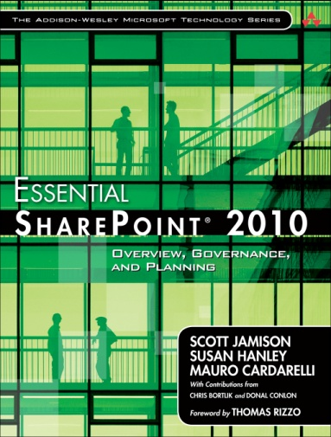
About Scott Jamison
CEO of Jornata, a Gold Certified SharePoint & Office 365 partner
Works closely with Microsoft on product planning, business & technical guidance
SharePoint Certified Master
Author:
  Essential SharePoint 2007
  Essential SharePoint 2010
  Five whitepapers on SharePoint 2010
Contact: scott.jamison@jornata.com
Twitter: @sjam
Blog: www.scottjamison.com
Website: www.jornata.com

Slide 3
Agenda
Review IT challenges of managing SharePoint business requests
Assess the options for SharePoint application lifecycle management
Introduce and demonstrate the SharePoint Lifecycle Management Solution with Project Server 2010
Summary and Next Steps

Slide 4
Why do companies choose SharePoint?
Flexible way to create applications quickly
  Collaborative
  Search
  Document Management
  Business Intelligence
  Workflow
  Forms
Business Empowerment: Self-service applications
SharePoint is starting to become *the* central service platform for many new business requests

Slide 5

Various Types/Sizes of SP Business Requests
Self-service
IT Minor Project
IT Major Project
(minutes/hours)
(hours/days/weeks)
(weeks/months)
Creating subsites
Creating pages
Page edits
Creating lists
Custom columns
CQWP edits
New site collection
Deploy Custom Solution
Restore Deleted Site
Feature Activation
Custom Content Type
Install 3rd Party Software
Major version upgrade
Social Features
Search Content Source
Business workflow process
Business entity (BCS) connection
Executive dashboard
Build custom web part(s)

Slide 6
SharePoint Lifecycle Management
IT Challenges
  Managing change in the production environment
  Capturing proposals and requests for new functionality
  Objectively evaluating and prioritizing solution requests
  Forecasting resource needs and support costs
  Effectively managing selected projects
  Measuring the effectiveness of completed requests

Slide 7
The SharePoint Application Lifecycle
Business Self-Service
Business Need
Business Creates Application
Deploy
Support
Needs governance model!

Slide 8
The SharePoint Application Lifecycle
Minor Requests
Business Request
Review
Deploy
Support
Simple selection process…but how do you manage lots of requests?

Slide 9
The SharePoint Application Lifecycle
Major Project Requests
Business Request
Review
Select
Plan
Deploy
Support
Manage

Slide 10
The SharePoint Application Lifecycle
Major Project Requests
Selection process should include real thought and objective criteria
Depends on company maturity
Should use SharePoint-specific business drivers for project selection:
    Productivity Gains
    Employee Retention
    Quality Improvements
    Risk
    ROI/TCO
    Cost Avoidance
    Time-to-market
Business Request
Review
Select
Plan
Deploy
Support
Manage

Slide 11
The SharePoint Application Lifecycle
Major Project Requests
Business Request
Review
Select
Plan
Deploy
Support
Manage
Managing the project…customer should have:
  A place to store artifacts
  Task tracking
  Time/resource tracking
  At-a-glance view of current projects
A mature project tracking process is important, since SharePoint projects often involve many interested parties

Slide 12















SharePoint Maturity
Five sample phases of a SharePoint project’s lifecycle
Create
Select
Plan
Manage
Finish
Capture Business
Requests
Project Selection
Resource
Planning
Execution
Reporting /
Assessment

Slide 13
SharePoint Lifecycle Management
Effectively Managing Business Requests: Option 1
Use SharePoint Server 2010
  Store all SharePoint documentation in a central repository
  Centrally capture all SharePoint proposals and requests

Slide 14
SharePoint Lifecycle Management
Effectively Manage Business Requests: Option 2
Use SharePoint Server 2010
  Store all SharePoint documentation in a central repository
  Centrally capture all SharePoint proposals and requests
Use Project Professional 2010
  Provide a clearer view of tasks, schedule, assignments, and status of SharePoint projects
  Allow team members to directly update project task status from a SharePoint task list

Slide 15
SharePoint Lifecycle Management
Effectively Manage Business Requests: Option 3
Use SharePoint Server 2010
  Store all SharePoint documentation in a central repository
  Centrally capture all SharePoint proposals and requests
Use Project Professional 2010
  Provide a clearer view of tasks, schedule, assignments, and status of SharePoint projects
  Allow team members to directly update project task status from a SharePoint task list
Use Project Server 2010
  Create and manage the portfolio of SharePoint proposals and existing projects
  Consistently evaluate and prioritize SharePoint proposals
  Provide a graphical dashboard for SharePoint projects

Slide 16













Project and Portfolio Management For SharePoint
Demand Management
BI & Reporting
Portfolio Selection
Project Team Collaboration
Resource Management
Schedule Management
Synch to SharePoint
Sites
Composites
Communities
Insights
Content
Search
The Business Collaboration Platform for the Enterprise and the Internet

Slide 17
The SharePoint Lifecycle Management Solution with
Project Server 2010
announcing

Slide 18
SharePoint Lifecycle Management Solution
What is it?
  A no-code solution and guidance for managing SharePoint business requests
  Guidance – two white papers
    BDM/TDM White Paper that describes the business solution and benefits
    Technical White Paper that describes the “how-to” of installing and configuring
  Sample dataset that can be used to illustrate concepts
    A configurable starting point for common SharePoint environments
How do I use it?
  Customers can either deploy it themselves or engage a partner
When is it available?
  Today! Download at http://go.microsoft.com/fwlink/?LinkID=218030

Slide 19
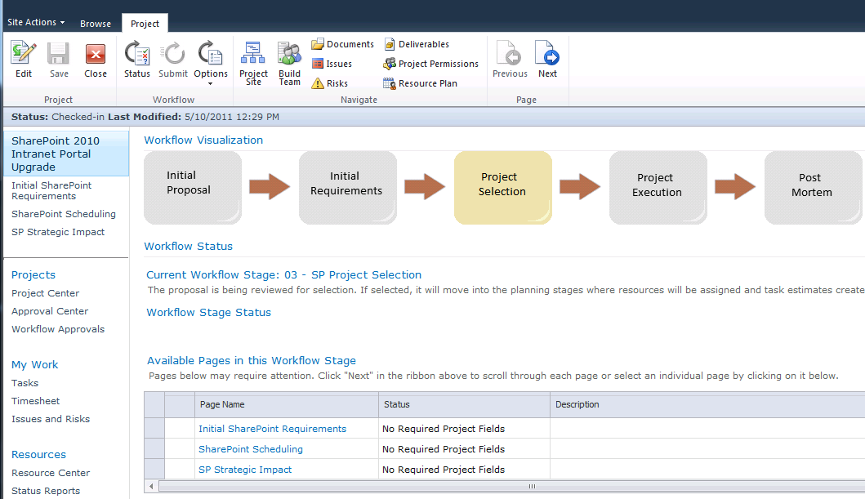
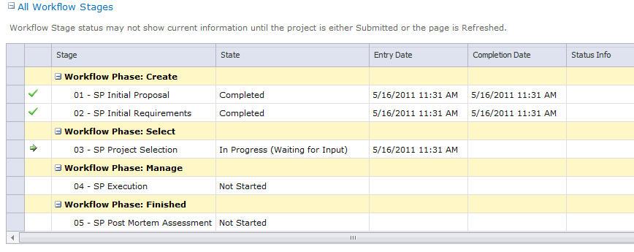
Sample Five-Stage SharePoint Solution Lifecycle
SharePoint Request Submission
Title & description
Discovery and further definition
Specific requirements
Project Selection
Evaluation based on cost & resource constraints
Cost & resource estimate
Risk evaluation
Strategic assessment
Plan & Manage
Assess & Improve
Assign resources
Manage and track project
Assess execution
Identify areas for improvements

Slide 20


SharePoint Lifecycle Management Solution with Project Server 2010
demo

Slide 21
Breaking down the solution…
Project Server 2010 Provides:
  Project request and tracking framework
  Project selection via Portfolio analysis tools
  Project management toolset
Solution Provides:
  Whitepapers that describe the concepts and instructions for configuring Project Server, including:
    SharePoint-specific project request types and workflow
    SharePoint-specific business drivers for project selection
    SharePoint-specific project plan template
    SharePoint-specific lookup tables on custom fields
    Sample PWA instance (five database attach)

Slide 22
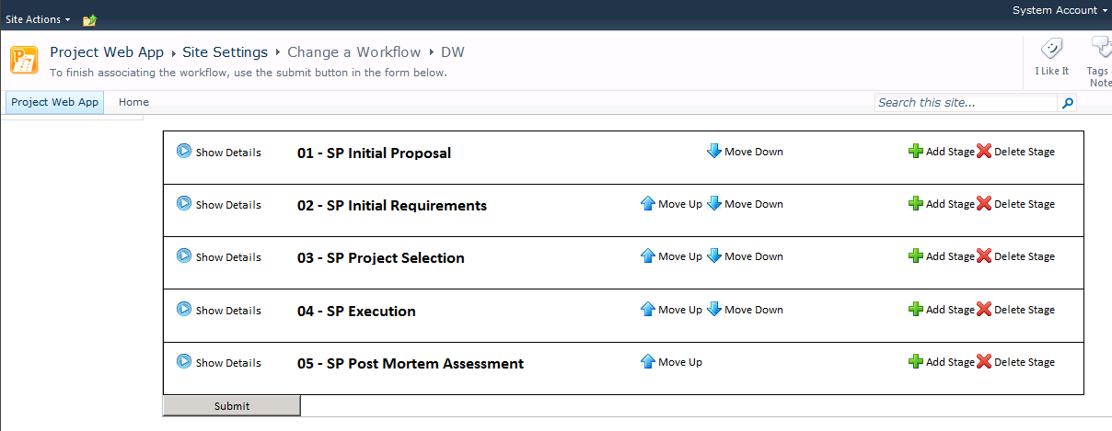
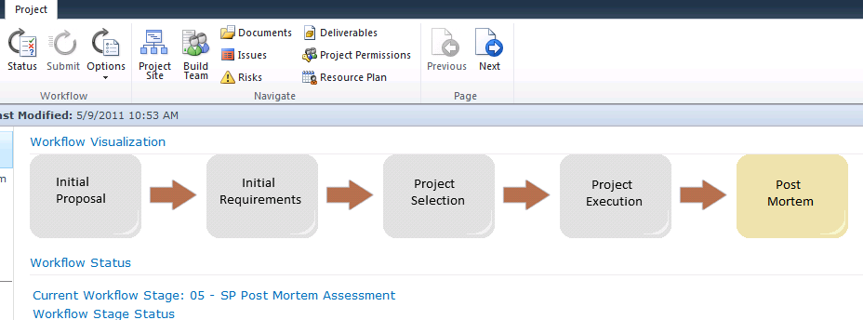
Uses Two of the Microsoft Project Server 2010 Solution Starters
Dynamic Workflow
Workflow Visualization web part

Slide 23
Summary
There are IT challenges in managing SharePoint business requests
Properly managing SharePoint as a central service requires a degree of SharePoint Maturity
Project Server 2010 can be a great tool for managing requests and the corresponding implementations

Slide 24
Next Steps
Evaluate your SharePoint maturity level
Download the SharePoint Lifecycle Management Solution white papers and sample data
Set up an evaluation environment
Learn more about Project Server 2010
Engage a certified partner to make it real

Slide 25
Microsoft Project 2010 Content at Tech.Ed
Sessions
  OSP202 SharePoint Governance and Lifecycle Management with Microsoft Project Server 2010
  OSP203 Application Lifecycle Management: Microsoft Project Server 2010 and Microsoft Team Foundation Server 2010, Better Together
  OSP371-INT Best Practices Troubleshooting Microsoft Project Server 2010 Deployments
Hands-on Labs
  OSP384-HOL Deep Dive into Managing Projects with Microsoft Project Professional 2010
  OSP385-HOL Microsoft Project Server 2010 Demo: Virtual Machine Walkthrough
Product Demo Stations
  Project Server 2010 – stop by for demos & get your questions answered

Slide 26


Slide 27





Resources
  Connect. Share. Discuss.
http://northamerica.msteched.com
Learning
  Sessions On-Demand & Community
  Microsoft Certification & Training Resources
www.microsoft.com/teched
www.microsoft.com/learning
  Resources for IT Professionals
  Resources for Developers
http://microsoft.com/technet
http://microsoft.com/msdn

Slide 28












Complete an evaluation on CommNet and
enter to win!

Slide 29


Slide 30

© 2011 Microsoft Corporation. All rights reserved. Microsoft, Windows, Windows Vista and other product names are or may be registered trademarks and/or trademarks in the U.S. and/or other countries.
The information herein is for informational purposes only and represents the current view of Microsoft Corporation as of the date of this presentation. Because Microsoft must respond to changing market conditions, it should not be interpreted to be a commitment
on the part of Microsoft, and Microsoft cannot guarantee the accuracy of any information provided after the date of this presentation. MICROSOFT MAKES NO WARRANTIES, EXPRESS, IMPLIED OR STATUTORY, AS TO THE INFORMATION IN THIS PRESENTATION.

Slide 32
Microsoft Project Resources
Product information
  http://www.microsoft.com/project/2010
  Case Studies : http://www.microsoft.com/project/en/us/customer-success.aspx
  Project Team Blog http://blogs.msdn.com/project
End-User Product Help
  Project 2010 Help http://office2010.microsoft.com/project-help
  Project Server 2010 Help http://office2010.microsoft.com/project-server-help
Interactive content - Videos & Sessions & Webcasts
  http://www.microsoft.com/showcase/en/US/channels/microsoftproject
  http://www.microsoft.com/events/series/epm.aspx
IT Professional related
  TechCenter @ TechNet http://technet.microsoft.com/ProjectServer
  Admin Blog http://blogs.technet.com/projectadministration
Developer related
  Developer center @ MSDN http://msdn.microsoft.com/Project
  Programmability blog http://blogs.msdn.com/project_programmability
Additional questions? Project 2010 Forums!
  http://social.msdn.microsoft.com/Forums/en-US/category/projectserver2010,projectprofessional2010
SharePoint 2010 resources
  http://sharepoint.microsoft.com

