Slide 1

Services Made Easy with WCF 4, Microsoft Visual Studio 2010 and Windows Server AppFabric
MID314
Daniel Roth
Program Manager Lead
Microsoft

Slide 2
Session Objectives
Demonstrate how Visual Studio 2010, .NET 4 and Windows Server AppFabric make creating, hosting and managing WCF services easy
Preview new features that will simply the WCF experience even further

Slide 3
Creating WCF Services Using
Visual Studio 2010 and .NET 4

Slide 4

So you want to create a service . . .
…that exposes some functionality
…is easy to consume
…is reusable
…is loosely coupled
…is interoperable
EASY!

Slide 5
Create a WCF service using
Visual Studio 2010
Daniel Roth
Program Manager Lead
WCF
demo

Slide 6


The ABC’s of WCF Services
WSDL
Client
Service
A
B
C
C
B
A
A
B
C
A
B
C
Be
Be
Endpoint
Address
Where?
Binding
How?
Contract
What?
Behavior
Local Only Details

Slide 7
Default Service Endpoints
Set of default service endpoints provided by the host
  Implicit <service> tag
Endpoints exposed per (base address, implemented contract) combination
  Address is the service base address
  Binding derived from base address URI scheme
  Contract implemented by the service

Slide 8
Configuration Improvements
WCF configuration before .NET 4
service.cs
[ServiceContract] public interface ICalculator { … }
public class CalculatorService : ICalculator { … }
service.svc
<%@ServiceHost Service="Microsoft.ServiceModel.Samples.CalculatorService" %>
web.config
<system.serviceModel>
<services>
<service name="Microsoft.ServiceModel.Samples.CalculatorService">
<endpoint address=""
binding="basicHttpBinding"
contract="Microsoft.ServiceModel.Samples.ICalculator" />
</service>
</services>
</system.serviceModel>

Slide 9
Configuration Improvements
WCF configuration after .NET 4
service.cs
[ServiceContract] public interface ICalculator { … }
public class CalculatorService : ICalculator { … }
service.svc
<%@ServiceHost Service="Microsoft.ServiceModel.Samples.CalculatorService" %>
web.config is not needed!

Slide 10
Protocol Mappings
Map base address URI scheme to a binding
<protocolMapping>
<add scheme="http" binding="basicHttpBinding" />
<add scheme="net.tcp" binding="netTcpBinding" />
<add scheme="net.pipe" binding="netNamedPipeBinding" />
<add scheme="net.msmq" binding="netMsmqBinding" />
</protocolMapping>

Slide 11
Default Service Endpoints Example
Contracts
X
(Base Addresses
Protocol Mappings)
Endpoints
→
=
public class Service1 : IService1, IService2
{
……
}
http://localhost/Services
net.tcp://localhost/Services
http → BasicHttpBinding
net.tcp → NetTcpBinding
net.pipe → NetNamedPipeBinding
net.msmq → NetMsmqBinding
A:http://localhost/Services/IService1
B:BasicHttpBinding,
C:IService1
A:net.tcp://localhost/Services/IService1
B:NetTcpBinding,
C:IService1
A:http://localhost/Services/IService2
B:BasicHttpBinding
C:IService2
A:net.tcp//localhost/Services/IService2
B:NetTcpBinding
C:IService2
?

Slide 12
Configuring Default Bindings and Behaviors
Just don’t specify a name
Change Default BasicHttpBinding
Change Default Service Behavior
<bindings>
<basicHttpBinding>
<binding>
<security mode="Transport“ />
</binding>
</basicHttpBinding>
</bindings>
<behaviors>
<serviceBehaviors>
<behavior>
<serviceMetadata httpGetEnabled="true"/>
</behavior>
</serviceBehaviors>
</behaviors>

Slide 13
Service Specific Configuration
Use the <location> tag to configure a specific service
  Same functionality as in ASP.NET
<system.serviceModel>
……
<\system.serviceModel>
<location path="service2.svc">
<system.serviceModel>
<protocolMapping>
<add scheme="http" binding="wsHttpBinding"/>
</protocolMapping>
</system.serviceModel>
</location>

Slide 14
Smarter Default Settings
Service Throttles
Throttlings | .NET 3.5 | .NET 4
MaxConcurrentSessions | 10 | 100 * ProcessorCount
MaxConcurrentCalls | 16 | 16 * ProcessorCount
MaxConcurrentInstances | 26 | MaxConcurrentSessions + MaxConcurrentCalls

Slide 15
Simplified WCF Service Configuration
Daniel Roth
Program Manager Lead
WCF
demo

Slide 16
WCF Service Configuration Guidelines
Avoid using <service> tag
Tweak the default bindings and behaviors (no name)
Adjust protocol mappings as needed
Use <location> tag or separate vdirs for service specific configuration

Slide 17
Hosting WCF Services in Windows Server AppFabric

Slide 18
What is Windows Server AppFabric?
Technologies for deploying, managing and scaling applications hosted on IIS7
  Manage and monitor services and workflows via IIS Manager and Windows PowerShell
  Distributed in-memory cache
How to get it?:
  http://msdn.microsoft.com/appfabric
  Use Web Platform Installer for dev environments
  Use stand alone setup for server installations

Slide 19
Windows Server AppFabric Overview
Visual Studio
IIS Manager
WF and WCF Templates
WF and WCF IIS Manager Modules
AppFabric Runtime Services and Components
Management APIs (PowerShell command-lets)
Persistence
Hosting
Monitoring
Caching
Server Manager
System Center
Windows Server AppFabric Integration
Windows Server AppFabric Management Pack
.NET Framework
WF
WCF
ASP.NET
IIS/WAS

Slide 20
AppFabric hosting features for WCF Services
Deploy applications using Web Deploy
Easily view application services and endpoints
Out-of-the-box monitoring infrastructure
  No coding or config required!
Health monitoring dashboard
Troubleshoot issues using tracked events
Rich configuration UI
Service AutoStart

Slide 21
Deploy a WCF Service to
Windows Server AppFabric
Daniel Roth
Program Manager Lead
WCF
demo

Slide 22
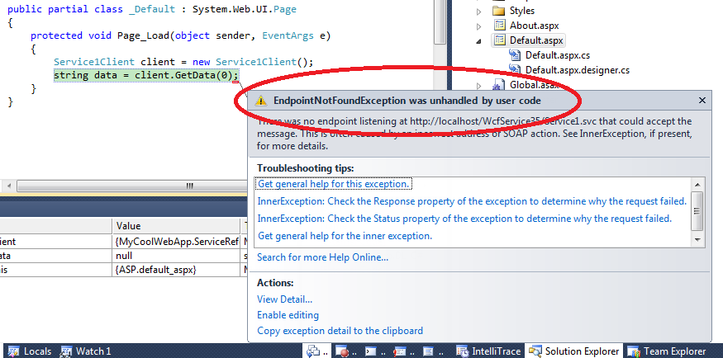
Where’s my service?

Slide 23
View WCF Services and Endpoints
Daniel Roth
Program Manager Lead
WCF
demo

Slide 24


Monitoring WCF services
?
?
?
.svclog
.svclog
.svclog

Slide 25
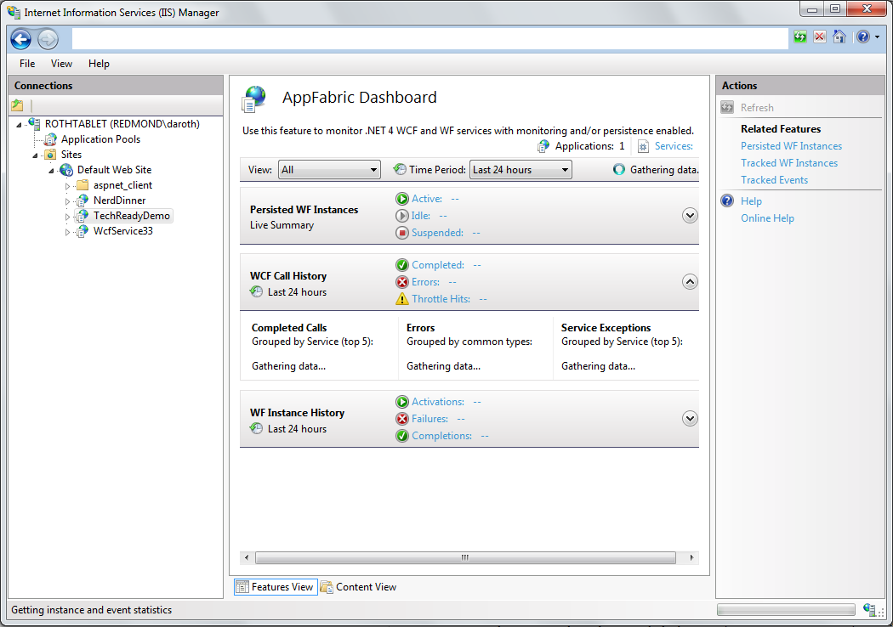


Monitoring WCF services
AppFabric monitoring store

Slide 26
Monitoring WCF Services
Daniel Roth
Program Manager Lead
WCF
demo

Slide 27

Managing WCF configuration settings
Metadata
Monitoring
Performance
Security
AutoStart

Slide 28
Managing WCF configuration settings
Daniel Roth
Program Manager Lead
WCF
demo

Slide 29
WCF Futures: It just keeps getting easier . . .

Slide 30
Future WCF Improvements
Configure less
  Smart configuration defaults ready for production
  Inherit IIS security settings by default
  Cleaned up client config generation
  Service discovery integrated with Windows Azure AppFabric
Configure easier
  Config Intellisense, validation and tooltips
  Code-based configuration
  Centralized configuration management in Windows Azure AppFabric
Misconfiguration is debuggable
  Beefed up ETW tracing

Slide 31
Future WCF Config Simplifications
Daniel Roth
Program Manager
WCF
demo

Slide 32
Better WCF Config Defaults
Property | On | Old Value | New Value
MaxArrayLength | ReaderQuotas (buffered+text only) | 16384 elements | Int32.MaxValue
MaxBytesPerRead | ReaderQuotas (buffered+text only) | 4096 bytes | Int32.MaxValue
MaxDepth | ReaderQuotas (buffered+text only) | 32 nodes deep | 128
MaxNameTableCharCount | ReaderQuotas (buffered+text only) | 16384 chars | Int32.MaxValue
MaxStringContentLength | ReaderQuotas (buffered+text only) | 8192 chars | Int32.MaxValue
ChannelInitializationTimeout | NetTcpBinding | 5 sec | 30 secs
ListenBacklog | NetTcpBinding SMSvcHost.exe.config | 10 | 12 * # of procs
MaxPendingAccepts | TcpTransportBindingelement/ NamedPipeTransportBindingElement, SMSvcHost.exe.config | 1, 2 | 2 * # of procs, 4 * # of procs
MaxPendingConnections | TcpTransportBindingelement/ NamedPipeTransportBindingElement | 10 | 12 * # of procs
ReceiveTimeout | SMSvcHost.exe.config | 10 seconds | 30 seconds

Slide 33
Key Takeaways
Simplified WCF configuration
  No configuration required by default
  Smart configuration defaults are ready for production
  Full alignment with the hierarchical web configuration model
  Configuration tooling, IntelliSense and validation
Simplified WCF security
  Certificate configuration using Windows Server AppFabric
  Inherit IIS security settings by default
Simplified WCF monitoring and troubleshooting
  Out of the box monitoring and troubleshooting infrastructure in Windows Server AppFabric
  Production ready tracing using Event Tracing for Windows (ETW)

Slide 34

Related Content
Breakout Sessions:
  MID302 AppFabric Caching: How It Works and When You Should Use It
  MID307 Make Yourself Comfortable and REST with Microsoft .NET
  MID311 Windows Communication Foundation RIA: Ready for Business
  MID310 Windows Communication Foundation Futures
  MID315 Building Highly Scalable and Available WCF Services with Windows Azure AppFabric
Hands-on Labs:
  MID374-HOL | Windows Communication Foundation (WCF) 4: Configuration is Much More Simple - Learn How
  MID378-HOL | Windows Server AppFabric Hosting: Developer Basics - Workflow Services
  MID377-HOL | Windows Server AppFabric Hosting: Developer Basics - Windows Communication Foundation (WCF) Services

Slide 35
Track Resources
Windows Azure Platform Training Kit
Windows Server AppFabric Training Kit
BizTalk 2010 Developer Training Kit
AppFabric Team Blog
Windows Azure AppFabric on MSDN
Windows Server AppFabric on MSDN

Slide 36





Resources
  Connect. Share. Discuss.
http://northamerica.msteched.com
Learning
  Sessions On-Demand & Community
  Microsoft Certification & Training Resources
www.microsoft.com/teched
www.microsoft.com/learning
  Resources for IT Professionals
  Resources for Developers
http://microsoft.com/technet
http://microsoft.com/msdn

Slide 37












Complete an evaluation on CommNet and
enter to win!

Slide 38


Slide 39

© 2011 Microsoft Corporation. All rights reserved. Microsoft, Windows, Windows Vista and other product names are or may be registered trademarks and/or trademarks in the U.S. and/or other countries.
The information herein is for informational purposes only and represents the current view of Microsoft Corporation as of the date of this presentation. Because Microsoft must respond to changing market conditions, it should not be interpreted to be a commitment
on the part of Microsoft, and Microsoft cannot guarantee the accuracy of any information provided after the date of this presentation. MICROSOFT MAKES NO WARRANTIES, EXPRESS, IMPLIED OR STATUTORY, AS TO THE INFORMATION IN THIS PRESENTATION.

