Slide 2
Windows Communication Foundation Futures MID310
Kirill Gavrylyuk
Group Program Manager
Microsoft

Slide 3
1000+ HTTP&TCP services
“Make configuration / e2e lifecycle easier”
SOAP & REST
“Provide richer HTTP & REST support”
Phone & tablet clients
Web API
“Provide richer HTTP REST support, security”
100s rich data entry forms
Use RIA Services
Rich client support is critical

Slide 4
WCF Wish List
Simplicity
Clients
Cloud
HTTP/REST
Notes:
Make WCF Simpler
End-to-end life cycle management, hosting services
Provide great support for HTTP/REST (aka Web API)
Support the key client platforms: Silverlight, JS, Phone, PHP

Slide 5
Make WCF Simpler
demo

Slide 6
AppFabric > MyService
Summary
State | Imported
Errors (24 hrs) | 0
Module
Monitoring
Configuration
Admin Log
Application Logs
Module MyService
This page lets you manage your stateless AppFabric Container module. You can perform configuration, monitoring, and troubleshooting tasks.
Common Tasks
Configure this module
Components
Name | State | Type | Errors (24 hrs)
MyService | Imported | WCF Service | 2
 | Imported | Workflow Service | 0
Notes:
Add other services
Remove MS internall
Sync to the latest portal image

Slide 7
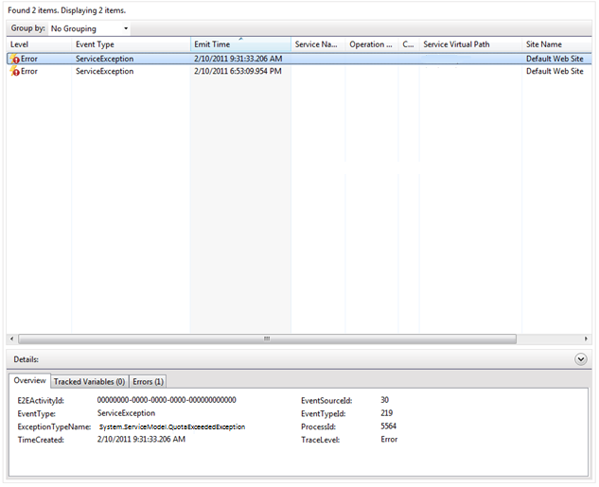
AppFabric > MyService
Summary
State | Imported
Errors (24 hrs) | 0
Module
Monitoring
Configuration
Admin Log
Application Logs
Component MyService
This page lets you manage your stateless AppFabric Container component.
Tracked Events

Slide 8
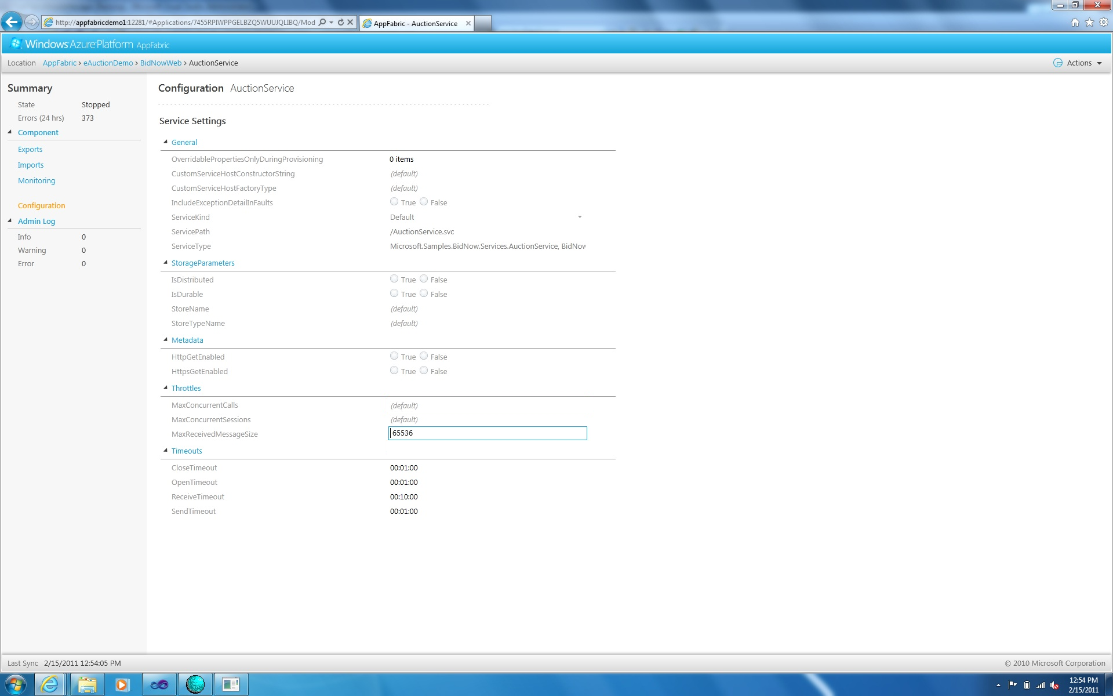
MyService

Slide 9
MyService

Slide 10
Simpler end-to-end
Configuration
minimalistic, task-oriented, debuggable
Elevate common app and dev patterns
RIA, Web API, Data Service, Queues,…
Async, IoC
End-to-end lifecycle management
Notes:
It’s important to approach simplicity in a holistic manner.

Slide 11
WCF Wish List
Simplicity
Clients
Cloud
HTTP/REST
Notes:
Make WCF Simpler
End-to-end life cycle management, hosting services
Provide great support for HTTP/REST (aka Web API)
Support the key client platforms: Silverlight, JS, Phone, PHP

Slide 12
AppFabric: Next-generation Middleware Platform A platform and middleware services for Cloud and Server applications
AppFabric
App
Manager
Custom Code
Caching
Service Bus
Integration
Access Control
WCF Services
Workflows
AppFabric Services
AppFabric Container
Server
Cloud
Notes:
Container brings elastic scale, resiliency and multi-tenancy
Middle-ware functionality offered as services composable with your WCF services
Caching service will provide RAM-resident distributed caching
ServiceBus provides two critical capabilities for distirbuted, hybrid deployments:
Connectivity across network boundaries
Asynchrounous messaging and eventing: queues, topics
Key points to make:
We are building a next gen middleware platform, a single platform that spans Server and Cloud – a symmetric platform and a platform that works with the web and data tiers.
Talk about the individual middleware services as you build this piece in. These services sit on the container which provides cloud scale and resilience for the services as well as abstracts them from the underlying platform. This is HOW we deliver one set of capabilities that are symmetrical.
Investments in end-to-end application deployment and management with the App Manager.

Slide 13
WCF Wish List
Simplicity
Clients
Cloud
HTTP/REST
Notes:
Make WCF Simpler
End-to-end life cycle management, hosting services
Provide great support for HTTP/REST (aka Web API)
Support the key client platforms: Silverlight, JS, Phone, PHP

Slide 14
Industry Trends
WebSites → Web APIs
Richer client experience on devices
Infrastructure/business logic monetization
On Prem → Cloud
Additional shift to Web API.
Need to support API both on-prem and cloud
Need to support a broader set of clients
HTTP is available on all client platforms

Slide 15
WCF Web API Goals
HTTP
HTTP++: OData, WebSockets, OAuth
Patterns flexibility
Format flexibility
OData, XML, JSON, ATOM, BYOF
Security
Simplicity
Code-based configuration, conventions, integration with routes

Slide 16
WebSockets
HTTP Client
HTTP Upgrade Request
HTTP Server
1
Existing
HTTP/1.1
HTTP Client
HTTP Server
2
HTTP “Switch Protocols” Response
Web Socket
TCP
Web Socket
New protocol
3
Use HTTP for Request URI (query etc.), redirects, authentication, SSL, cookies, proxy traversal…
Use WebSockets for bi-di communication
any message exchange pattern; streamed or buffered

Slide 17
WebSockets http://tinyurl.com/wcfwebsockets
demo

Slide 18
http://wcf.codeplex.com/
WCF Web API early previews
announcement

Slide 19
WCF Wish List
Simplicity
Clients
Cloud
HTTP/REST
Notes:
Make WCF Simpler
End-to-end life cycle management, hosting services
Provide great support for HTTP/REST (aka Web API)
Support the key client platforms: Silverlight, JS, Phone, PHP

Slide 20
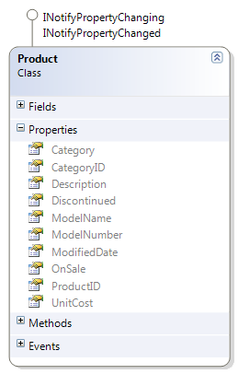
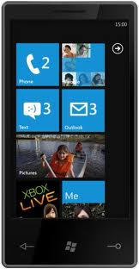
WCF RIA Services
Great dev experience for a broad class of LOB applications
Prescriptive, tooling supported CRUD+ pattern for services
Data access agnostic
Built-in application services: authn/authz/profiles
Service

Slide 21
WCF RIA for jQuery http://wcf.codeplex.com/wikipage?title=WCF jQuery
demo

Slide 22
WCF vNext
Simplicity
Clients
Cloud
HTTP/REST
Notes:
Cloud and Hybrid applications are the future of WCF
WCF will continue to provide first class support for HTTP/RESTfull services
HTTP/REST is important for the Cloud/Hybrid.
AppFabric will provide
simplified end-to-end life-cycle management
critical middleware functionality (Pub/Sub, Cache, access control)
whether your service is running on-prem or in the Cloud
Great end-to-end experience for service consumption from the key client platforms: HTML5/JQuery, Win Phone, iOS, Android, etc

Slide 23
© 2011 Microsoft Corporation. All rights reserved. Microsoft, Windows, Windows Vista and other product names are or may be registered trademarks and/or trademarks in the U.S. and/or other countries.
The information herein is for informational purposes only and represents the current view of Microsoft Corporation as of the date of this presentation. Because Microsoft must respond to changing market conditions, it should not be interpreted to be a commitment on the part of Microsoft, and Microsoft cannot guarantee the accuracy of any information provided after the date of this presentation. MICROSOFT MAKES NO WARRANTIES, EXPRESS, IMPLIED OR STATUTORY, AS TO THE INFORMATION IN THIS PRESENTATION.

Slide 24
Boneyard

Slide 25
PowerPoint Guidelines
Font, size, and color for text have been formatted for you in the Slide Master
This template uses Arial a standard font included in Office 2007, Office 2010, Windows Vista and Windows 7
Use the color palette shown below
Sample Fill
Sample Fill
Sample Fill
Sample Fill
Sample Fill
Sample Fill
Sample Fill
Sample Fill

Slide 26
MS Tag Placeholder Slide
Required Slide
Your MS Tag will be inserted here during the final scrub.
Notes:
New for TechEd 2011, we will be working with Microsoft Tag (http://tag.microsoft.com/overview.aspx) to create unique Tags for every session at the event. Your session Tag will appear on both the room signage and at the end of your presentation. With your session Tag, attendees will be able to scan as they enter the room to retrieve session details, view speaker bios, and engage in discussions; or scan at the end of the presentation to evaluate your session and download materials. We’re excited to integrate Microsoft Tag across the My TechEd mobile experience this year.

Slide 27
Slide for Showing Developer’s Software Code
Use this layout to show software code
The font is Consolas, a monospace font
The slide doesn’t use bullets but levels can be indented using the “Increase List Level” icon on the Home menu

Slide 28
Related Content
Required Slide
Speakers, please list the Breakout Sessions, Interactive Discussions, Labs, Demo Stations and Certification Exam that relate to your session. Also indicate when they can find you staffing in the TLC.
Breakout Sessions (session codes and titles)
Interactive Sessions (session codes and titles)
Hands-on Labs (session codes and titles)
Product Demo Stations (demo station title and location)
Related Certification Exam
Find Me Later At…

Slide 29
Track Resources
Required Slide
Track PMs will supply the content for this slide, which will be inserted during the final scrub.
Resource 1
Resource 2
Resource 3
Resource 4

Slide 30
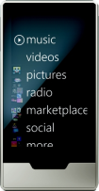
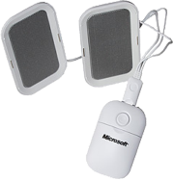
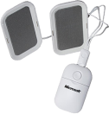
Required Slide
Complete an evaluation on CommNet and enter to win!

