Slide 1

Configuring Microsoft BizTalk
Server for Performance
MID309
Mikael Håkansson
BizTalk MVP
Enfo Zystems

Slide 2

Zündapp ZD20 1976
This picture has been released into the public domain by its author, ChiemseeMan at the German Wikipedia project

Slide 3
Configuring Microsoft BizTalk
Server for Performance
MID309
Mikael Håkansson
BizTalk MVP
Enfo Zystems

Slide 4



-”So what’s in it for me?”
How to optimize BizTalk?
How to find and resolve bottlenecks?
How to minimize the risk of BizTalk becoming a hot spot?

Slide 5
Session overview
First Test
”Base-line”
Apply Settings
Re-run Test
Introduction
Configuration Best Practices

Slide 6
Goal
-”For you as a IT-Pro / Developer to be able to help your customers / employer to better leverage their BizTalk Server investment.”

Slide 7






Verify & Configure
Setup
Configure
Test
BizTalk Server 2010 Performance Optimization Guide
BizTalk Server Best Practices Analyzer
BizTalk Benchmark Wizard

Slide 8
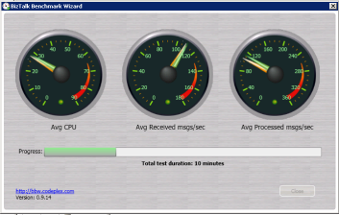
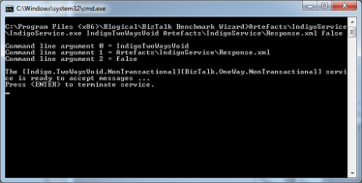

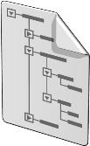


The BizTalk Benchmark Wizard
The ”Back-end service”
BizTalk Benchmark Wizard
Received msgs/sec
Processed msgs/sec
WCF One-Way Receive Location
WCF One-Way Send port
netTcp
Passthrough
Passthrough
netTcp
BizTalkMsgBoxDb

Slide 9
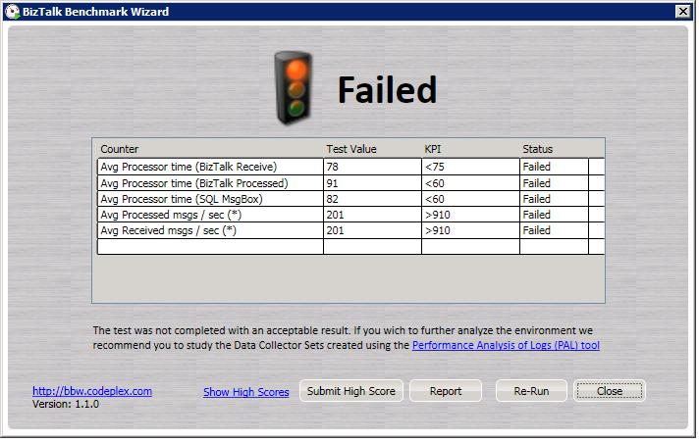
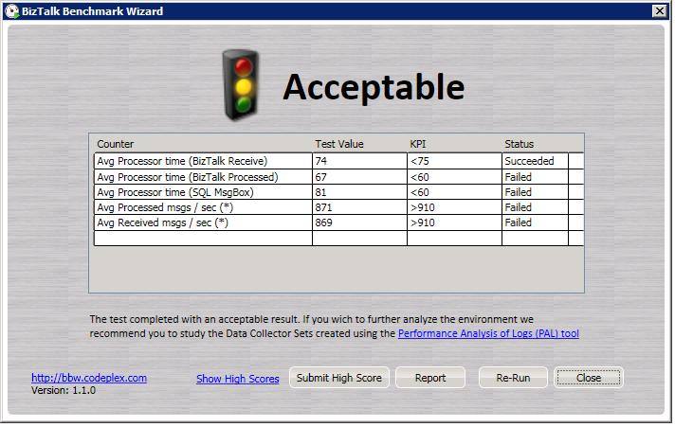
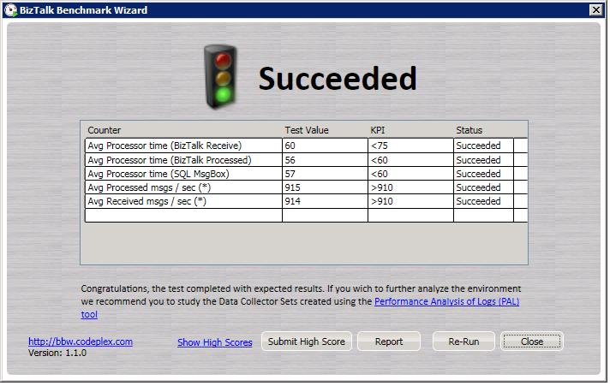
Tested Environments
# of Bts Srv | #CPU/Bts Srv | # SQL Srv | #CPU/SQL Srv | Msgs/Sec
1 | 1 Quad | (1) | (1) | 200
1 | 1 Quad | 1 | 1 Quad | 350
1 | 1 Quad | 1 | 2 Quad | 490
1 | 2 Quad | 1 | 2 Quad | 700
2 | 1 Quad | 1 | 2 Quad | 770
2 | 2 Quad | 1 | 2 Quad | 910
2 | 2 Quad | 1 | 4 Quad | 980

Slide 10
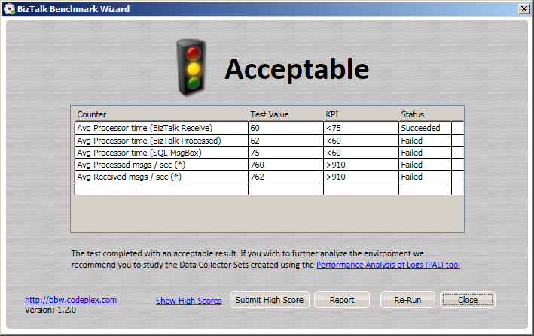
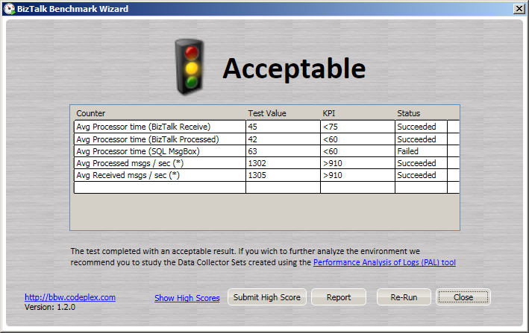
2 * BizTalk Servers
2 * CPU(HEX)
24Gb RAM
Windows Server 2008 R2
BizTalk Server 2010
2 * SQL Servers (Active/Passive)
4 * CPU(QUAD)
96Gb RAM
Windows Server 2008 R2
SQL Server 2008 R2

Slide 11
First test – ”Baseline”
demo

Slide 12
BizTalk performance
SQL performance
Storage performance
”But I’m a Developer!!! I am not meant to know about this stuff. The X department take care of that.”

Slide 13



Roles
I’ll let him share the disk array with the SAP system..
I like to order a SQL cluster with 12 disks...
I like to order 12 LUNS...
”the BizTalk guy”
”the SQL guy”
”the Storage guy”

Slide 14
Sometimes, separating resources relieves internal contention…

Slide 15

Eliminating bottlenecks
Data
Log

Slide 16



PFS Contention
Data
file
PFS Page

Slide 17
PFS Contention Resolved
Data
Data
Data
Data

Slide 18
Multiple files and filegroups for the BizTalk MsgBoxDb
Primary
(default file group)
Misc Data
Misc Indexes
Predicate Data
Predicate Indexes
Message Data
Message Indexes
For more information:
BizTalk Server MessageBox Database Filegroups SQL Script

Slide 19
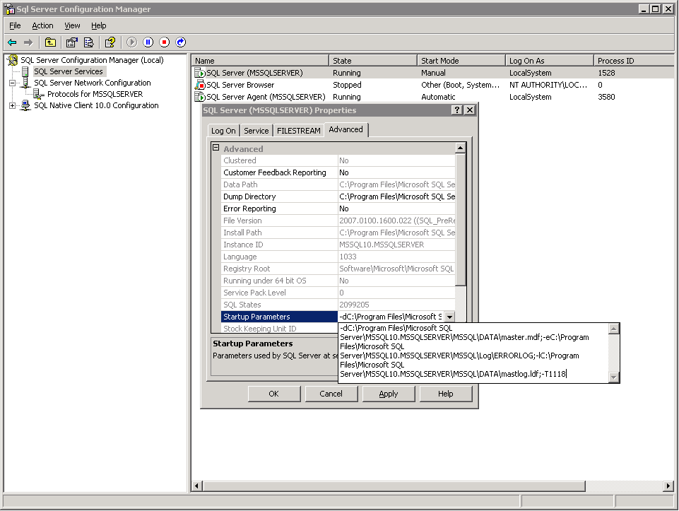


Tune TempDB for Best Performance
Creating multiple data files of the same size, one for each available CPU core on the SQL machine, for the TempDb, makes it possible to spread I/O contention across multiple files.
  The SQL CAT team has also found that in 2005 and 2008, there's usually no gain from having more than 8 tempdb data files, even for systems with larger numbers of processor cores.
Implementing Trace Flag –T1118 helps reduce contention across the SQL Server instances by removing almost all single page allocations

Slide 20
Sometimes, it’s better to keep it together…

Slide 21
Text In Row table option
Data
file
*
*
*
*
*
* LOB data types = Large OBject data types

Slide 22
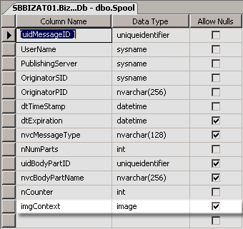
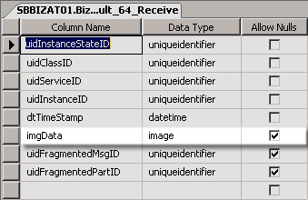
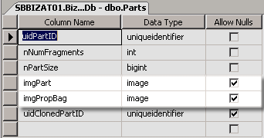

Text In Row table option
EXEC sp_tableoption N'Parts' 'text in row',‘7000‘
EXEC sp_tableoption N‘Spool' 'text in row',‘7000‘
EXEC sp_tableoption N'DynamicStateInfo_[HOST]' 'text in row',‘7000'
*There are one DynamicStateInfo table per host.

Slide 23
I/O is important…

Slide 24
I/O Contention
Data
Data
Data
Data

Slide 25
The Traditional Hard Disk Drive
Cover mounting holes
(cover not shown)
Base casting
Spindle
Slider (and head)
Case mounting holes
Actuator arm
Actuator axis
Platters
Actuator
Flex Circuit
(attaches heads
to logic board)
SATA interface
connector
Power connector
Performance: 200-250 IO Per Second (IOPS)

Slide 26
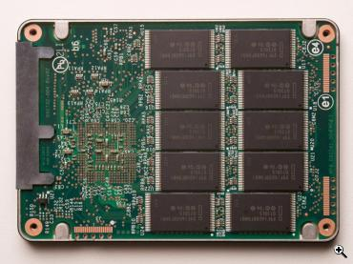
The “New” Hard Disk Drive (SSD)
No moving parts!
Performance: 4000-4500 Read IO Per Second (IOPS)
Less writes! 1500 Write IOPS

Slide 27

“Short Stroking”
By partitioning < 50% of the disk, the data will be allocated on the
outer track, making all reads and writes done from outside edge.
Partition
Example:
A 1 TB disk with an access time of 12 ms at 200 IOPS
~ throughput of 100 MB/s
A 300 MB partition from the same drive might
end up with an access time of 6 ms at 300 IOPS
~ throughput of 200 MB/s *
*For sequential workloads this can be even higher

Slide 28
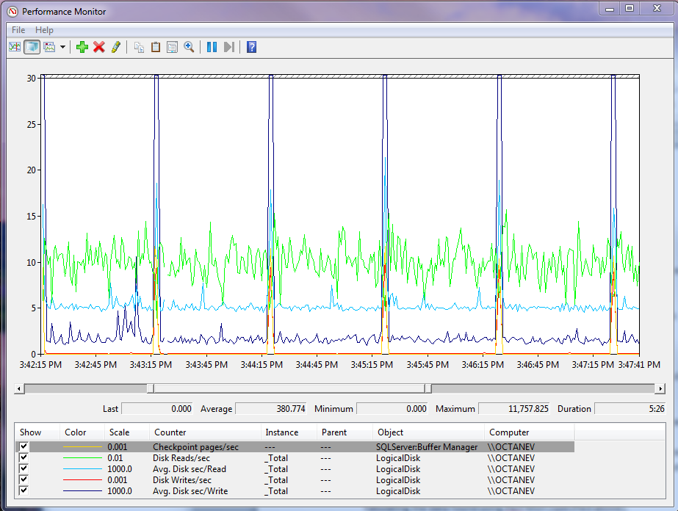
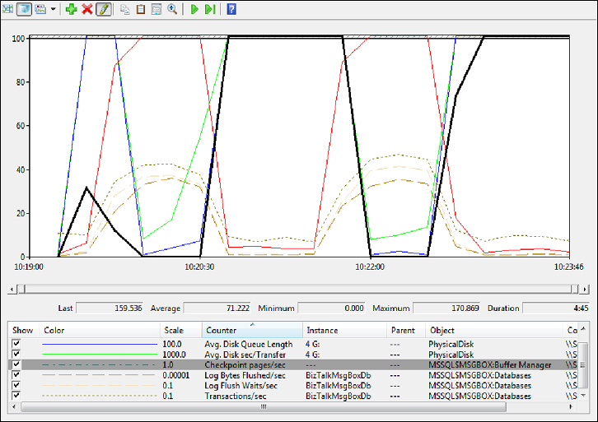
Normal Behavior During Checkpoint
Checkpoint Activity
These are short-lived burst of writes with a large amount of outstanding I/O requests. It is normal for latency to increase a bit during this operation.
Hosting BizTalk databases on poor performing disks, a SQL checkpoint can cause a message processing drop.
High throughput storage for SQL Server data and log files is absolutely critical to BizTalk performance.
Latency (response time)
Reads are in the 5-6ms range and writes 1-2ms with spikes to 20-30ms during checkpoints.

Slide 29
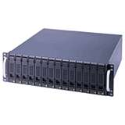

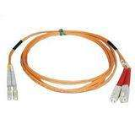

SAN Storage
DB
I/O Controller / HBA
Windows
CPU
PCI Bus
Cabling
Array
Cache
Spindle
SQL Serv.
Key Takeaway: This is NOT going to be easy…

Slide 30
SAN Storage - Simplyfied
LUN
”Disk Array”
LUN
I’ll let him share the disk array with the SAP system..
Key Takeaway: There might be a conflict of interest…
RAID 5
RAID 10
”the Storage guy”

Slide 31
RAID- Simplyfied
RAID 0
(Striping)
RAID 1
(Mirroring)
RAID 5
(Distributed parity)
RAID 10 (1+0)
(Mirroring + Spriping)
+ Very fast
- No redundancy
+ Total data redundancy
- Slow(er)
- Expensive
+ Cost efficient
+ Fault-tolerant
+ Good performance
- The extra time required to calculate and store parity degrades the write performance
+ Total data redundancy
+ Increased write transfer rate
- Expensive
  * New generation SAN technology tends to use huge caches so RAID choice is becoming unimportant

Slide 32
Useful counters
Memory\Available Mbytes (> 25%)
  the amount of physical memory available
Memory\Page Reads/sec (< 5)
  indicates that the working set of your process is too large for the physical memory
PhysicalDisk\Avg. Disk Read|Write Queue Length < 2
  indicates the average number of read|write requests that were queued
PhysicalDisk\Avg. Disk sec/Read|Write < 10 ms
  indicates the average time, in seconds, of a read of data from the disk.
SQLServer:BufferManager/Checkpoint pages/sec
  Number of pages flushed by checkpoint or other operations that require all dirty pages to be flushed.
BizTalk:Message Agent/Message delivery|publishing state (0)
  indicates that the BizTalk is throttling
BizTalk:MessageBox:General Counters/Spool size (stable)
  the size of the spool on a particular message box on a particular server.

Slide 33

To-do list...
Separate the Data- and Log files on different drives. (Applies to MsgBox, DTA & tempDB)
Partition Data files on MsgBox, DTA & tempDB
Separate Indexes and less used tables from tables such as the Spool and Part table.
Exploit Text in row for Parts and Spool table
Allocate enough storage
Enable the –T1118 flag

Slide 34
Apply configuration and re-run the test
demo

Slide 35
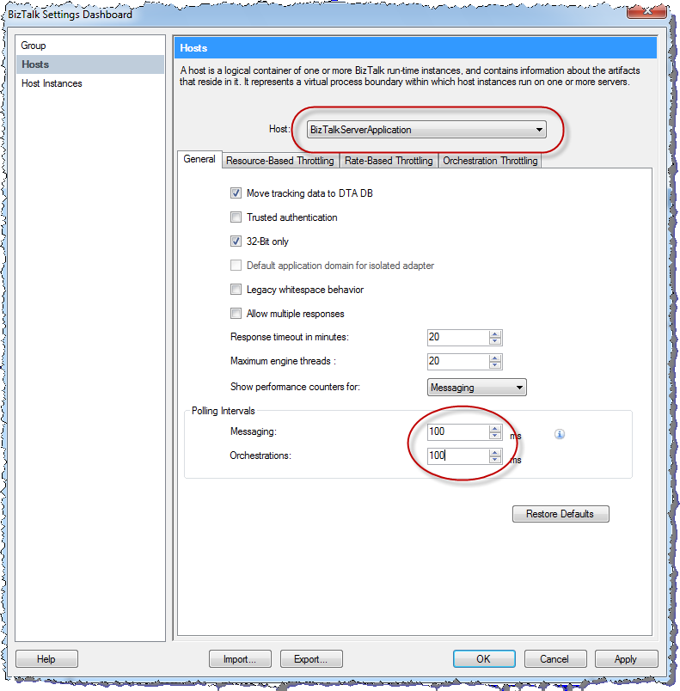
BizTalk 2010 Host-level Polling Interval !!!

Slide 36
Opitmizing BizTalk for Low Latency
demo

Slide 37
Orchestrations
Tune the orchestration dehydration settings per the BizTalk Operations / Performance Guides
  E.g. VirtualMemoryThrottlingCriteria
Eliminate persistence points when possible
  Take advantage of Atomic Scopes.
Keep orchestration state as small as possible
  Create variables and messages late and release early
    Use Scope shapes to your advantage
    Use static methods on .NET classes
Eliminate unnecessary context properties and distinguished fields

Slide 38
Pipeline components
Stream-based approach to pipeline components
  Processing in the stream implementation instead of the Execute method
  Yossi Dahan’s WP on MSDN: “Developing a Streaming Pipeline Component”
Take advantage of BizTalk’s Streams (Microsoft.BizTalk.Stream.dll)
  VirtualStream and Event Streams
  XPathMutatorStream
  NamespaceTranslatorStream and XmlTranslatorStream
Use PassThruReceive and PassThruTransmit pipelines whenever possible
Promote items to the message context only if you need them for:
  Message Routing (Orchestrations, Send Ports)
  Demotion of message context properties (Send Ports)
Use the IPipelineContext.ResourceTracker to track and dispose non-CLR resources
Instrument your source code to make your components simple to debug
Avoid ordered delivery and transaction support whenever possible

Slide 39
Zündapp ZD20 1976
This picture has been released into the public domain by its author, ChiemseeMan at the German Wikipedia project

Slide 40
References
Mikael Håkansson:
  wmmihaa@hotmail.com
  http://blogical.se/blogs/mikael/
Windows Server AppFabric CAT Blog:
  http://blogs.msdn.com/b/appfabriccat/
BizTalk Benchmark Wizard
  http://msdn.microsoft.com/en-us/biztalk/ee946766
BizTalk Server 2006 Best Practices Analyzer
  http://www.microsoft.com/downloads/en/details.aspx?FamilyID=93d432fe-1370-4b6d-aaa8-a0c43c30f5ab&displaylang=en
Performance Analysis of Logs (PAL)
  http://pal.codeplex.com/

Slide 41

Related Content
Required Slide
Speakers, please list the Breakout Sessions, Interactive Discussions, Labs, Demo Stations and Certification Exam that relate to your session. Also indicate when they can find you staffing in the TLC.
Breakout Sessions
  DBI371-INT Getting Optimal Performance Out of Your SAN with Microsoft SQL Server
    Monday, May 16 | 1:15 PM - 2:30 PM (Passed event)
  DBI301 Microsoft SQL Server Reference Architecture and Appliances
    Wednesday, May 18 | 5:00 PM - 6:15 PM
Find Me Later At The Middleware & Integration booths

Slide 42
Track Resources
Required Slide
Track PMs will supply the content for this slide, which will be inserted during the final scrub.
Windows Azure Platform Training Kit
Windows Server AppFabric Training Kit
BizTalk 2010 Developer Training Kit
AppFabric Team Blog
Windows Azure AppFabric on MSDN
Windows Server AppFabric on MSDN

Slide 43





Resources
  Connect. Share. Discuss.
http://northamerica.msteched.com
Learning
  Sessions On-Demand & Community
  Microsoft Certification & Training Resources
www.microsoft.com/teched
www.microsoft.com/learning
  Resources for IT Professionals
  Resources for Developers
http://microsoft.com/technet
http://microsoft.com/msdn

Slide 44












Complete an evaluation on CommNet and
enter to win!

Slide 45


