Slide 1

Windows Server AppFabric Cache:
A Methodology for Capacity Planning and Analyzing Performance Data
MID301
Jason Roth
Principal Programming Writer
Microsoft

Slide 2
Session Objectives and Takeaways
Session Objectives:
  Not a technology deep dive session
  Systematic methodology for capacity planning and monitoring
  AppFabric Caching performance data & capacity indicators
Takeaways:
  Some real life customer deployment scenarios
  AppFabric Cache performance & scalability data
    Grid Dynamics white paper
  Capacity planning guidance to support customer deployments
    Capacity planning methodology white paper

Slide 3
Customer discussion Playbook
A pattern seen from several customer engagements
What is AppFabric Cache & Why should I care?
Are others using this in real-world applications?
For our scenario(s), how much memory and how many servers do we need?
Can we see detailed performance and scalability data?
What are the capacity indicators & performance to monitor?

Slide 4
Customer discussion Playbook
A pattern seen from several customer engagements
What is AppFabric Cache & Why should I care?
Are others using this in real-world applications?
How much memory do we need? How many servers?
Can we see detailed performance and scalability data?
What are the capacity indicators & performance to monitor?

Slide 5

Problem Scenario
Need for activity/reference data store
Database must scale with more users
Local caching (ex: session state):
  Sticky routing
  Limited to server memory
Database used for caching:
  Same scenario: database must scale
How can you have a design that is more dynamic and flexible for future growth?
App
Server 1
App
Server 2
App
Server 3
Local Store
Local Store
Local Store
Database

Slide 6
Windows Server AppFabric Caching
Web
App 1
Web
App 2
Web
Service 1
Database
Local Cache
Local Cache
Local Cache
Distributed In-Memory Cache
Server
Server
Server
Server
Distributed In-Memory Cache
Server
Server

Slide 7
Windows Azure AppFabric Caching
Distributed In-Memory Cache
Auto managed by Microsoft
Similar programming model as on-premise server
Some capacity planning processes apply while others are unecessary
Distributed In-Memory Cache
Server
Server
Server
Server
Available as of the April 2011 Windows Azure AppFabric release.

Slide 8
Customer discussion Playbook
A pattern seen from several customer engagements
What is AppFabric Cache & Why should I care?
Are others using this in real-world applications?
How much memory do we need? How many servers?
Can we see detailed performance and scalability data?
What are the capacity indicators & performance to monitor?

Slide 9


AppFabric Caching Customer Examples
 | Scenario
 | Reduced the CPU usage of SQL servers from 80% to 10% by caching
 | ~27 GB of data across 4 cache servers each with 12 GB of memory
 | System now supports 1000 reads / sec and 200 writes / sec
 | Improved resource utilization
 | 50% faster response times
 | http://www.microsoft.com/casestudies/Case_Study_Detail.aspx?CaseStudyID=4000007903
Based on Microsoft Customer Advisory Team (CAT) work
Multiple customers have adopted caching
Capacity planning guidelines based on these interactions

Slide 10
Customer discussion Playbook
A pattern seen from several customer engagements
What is AppFabric Cache & Why should I care?
Are others using this in real-world applications?
How much memory do we need? How many servers?
Can we see detailed performance and scalability data?
What are the capacity indicators & performance to monitor?

Slide 11
Case Study: Trey Research
Online portal that provides general health forums, doctor & hospital reviews and shopping cart for buying medicines from partner pharmacies
Software Systems overview
  4 Web Servers hosting the ASP.NET web application
    Session state stored in SQL
  2 Application servers hosting WCF services
  Clustered SQL Server with 32 GB RAM
Challenges
  Performance & Availability concerns
  Scalability needs – 2M new users expected in the next 6 months

Slide 12
Case Study
Which part of the system is having performance issues?
  Is it high response times for medical forums page or reading doctor & hospital reviews?
  Is the database or the webservers the scaling bottleneck?
  With how many concurrent users does the problems show up?
Workload mix & load?
  How many users are issuing writes Vs reads – updating forums, adding items to shopping cart, writing reviews Vs simply reading
  Total Trey Research database size, Transitory writes generated

Slide 13
Capacity Planning Methodology
Understand bottlenecks & identify caching candidates
Evaluate current workload patterns
Understand physical infrastructure and hardware resources
Finalize the required performance SLA for all applications
Identify appropriate features & configuration settings
Estimate #servers with memory & network bandwidth

Slide 14
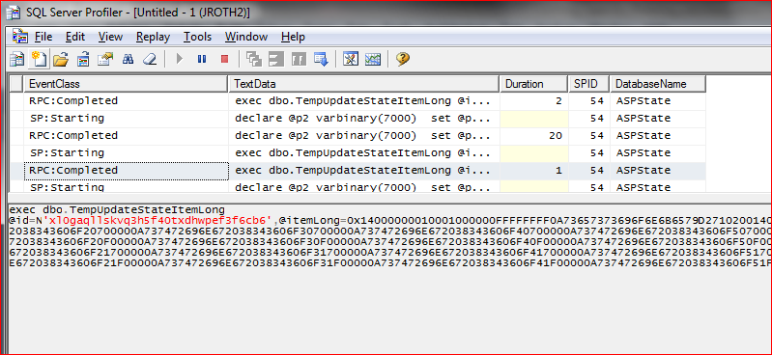
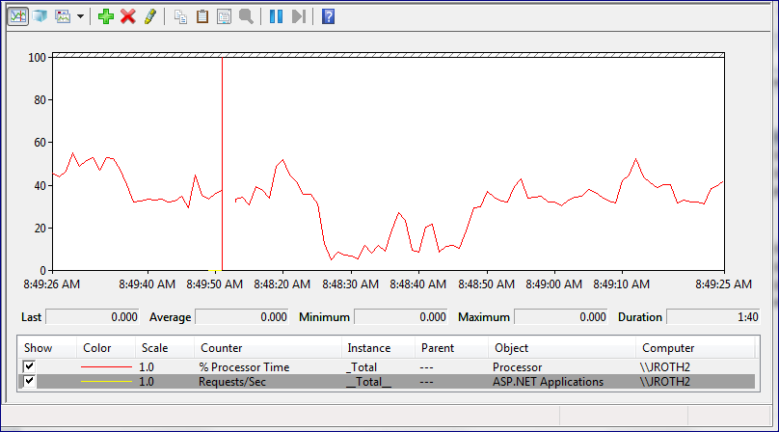
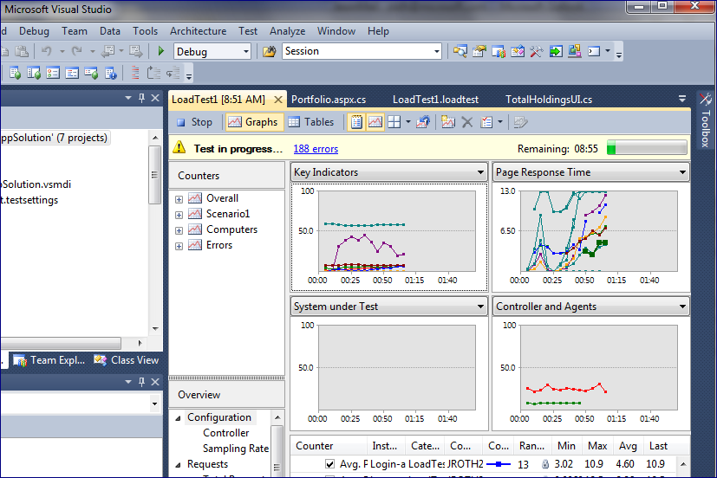
Analyze Application Performance (1 of 2)

Slide 15
Analyze Application Performance (2 of 2)
Evaluate Bottlenecks and Identify Caching Opportunities
Application Object(s) | Type
Health tips, doctors, medications | Reference
User shopping cart | Activity
Inventory, forums | Resource
Analysis Results:
  “Hot” stored procedures
  Slow-performing pages/service calls
Identify the candidates for caching
  Reference: read-only shared across users
  Activity: read/write per user
  Resource: read/write shared across users

Slide 16
Evaluate Workload Requirements (1 of 3)
Understand Current Patterns & Future Needs
Understand performance profile
  Read/write profile? (90%/10%, etc.)
  Read/write frequency?
  Number of concurrent users
  Any batched / bulk operations?
Understand future needs:
  Number of projected users for the next 6-12 months

Slide 17
Evaluate Workload Requirements (2 of 3)
Understand maximum active objects to be cached
Object to Analyze: | Activity Data
Peak Concurrent Users | 25000
New Users During Expiry Period (30 minutes) | 2500
Existing Users Starting New Browser Sessions | 250
Future Growth (25%): | 6940
Total Active Objects (Max): | ~35000 Max Active Objects
Object to Analyze: | Activity Data
Peak Concurrent Users | 25000
New Users During Expiry Period (30 minutes) | 2500
Existing Users Starting New Browser Sessions | 250
Future Growth (25%): | 6940
Object to Analyze: | Activity Data
Peak Concurrent Users | 25000
New Users During Expiry Period (30 minutes) | 2500
Object to Analyze: | Activity Data
Peak Concurrent Users | 25000
Object to Analyze: | Activity Data
Peak Concurrent Users | 25000
New Users During Expiry Period (30 minutes) | 2500
Existing Users Starting New Browser Sessions | 250

Slide 18
Evaluate Workload Requirements (3 of 3)
Estimate the Required Memory for Cache Candidates
Estimate average object size (Post-Serialization)
Caching overheads: Objects, Regions, High Availability
Object to Analyze: | Activity Data | Reference Data
Average Serialized Object Size: | 250 KB | 60 KB
Cache Cluster Overhead per Object: | .5 KB | .5
Adjusted Average Serialized Object Size: | 250.5 KB | 60.5 KB
Max Active Objects: | ~35000 | ~68000
Caching Memory Requirements: | 8.2 GB | 4 GB
High Availability Enabled? | 16.4 GB | No
Internal Data Structures Overhead (5%) | 0.8 GB | 0.2 GB
Object to Analyze: | Activity Data | Reference Data
Average Serialized Object Size: | 250 KB | 60 KB
Cache Cluster Overhead per Object: | .5 KB | .5
Adjusted Average Serialized Object Size: | 250.5 KB | 60.5 KB
Max Active Objects: | ~35000 | ~68000
Caching Memory Requirements: | 8.2 GB | 4 GB
High Availability Enabled? | 16.4 GB | No
Internal Data Structures Overhead (5%) | 0.8 GB | 0.2 GB
Total Memory Requires | 17.2 GB | 4.2 GB
Object to Analyze: | Activity Data | Reference Data
Average Serialized Object Size: | 250 KB | 60 KB
Object to Analyze: | Activity Data | Reference Data
Average Serialized Object Size: | 250 KB | 60 KB
Cache Cluster Overhead per Object: | .5 KB | .5
Object to Analyze: | Activity Data | Reference Data
Average Serialized Object Size: | 250 KB | 60 KB
Cache Cluster Overhead per Object: | .5 KB | .5
Adjusted Average Serialized Object Size: | 250.5 KB | 60.5 KB
Object to Analyze: | Activity Data | Reference Data
Average Serialized Object Size: | 250 KB | 60 KB
Cache Cluster Overhead per Object: | .5 KB | .5
Adjusted Average Serialized Object Size: | 250.5 KB | 60.5 KB
Max Active Objects: | ~35000 | ~68000
Object to Analyze: | Activity Data | Reference Data
Average Serialized Object Size: | 250 KB | 60 KB
Cache Cluster Overhead per Object: | .5 KB | .5
Adjusted Average Serialized Object Size: | 250.5 KB | 60.5 KB
Max Active Objects: | ~35000 | ~68000
Caching Memory Requirements: | 8.2 GB | 4 GB
Object to Analyze: | Activity Data | Reference Data
Average Serialized Object Size: | 250 KB | 60 KB
Cache Cluster Overhead per Object: | .5 KB | .5
Adjusted Average Serialized Object Size: | 250.5 KB | 60.5 KB
Max Active Objects: | ~35000 | ~68000
Caching Memory Requirements: | 8.2 GB | 4 GB
High Availability Enabled? | 16.4 GB | No

Slide 19
Physical Infrastructure (1 of 2)
Understand the Type and Availability of Hardware Resources
Physical or virtual machines?
If existing, server configuration(s)?
  #CPUs, speed, memory, network card, etc.
Deployment topology
  Servers’ location relative to application servers

Slide 20
Physical Infrastructure (2 of 2)
Evaluate Networking Requirements and Capabilities
Network backbone & bandwidth:
  Network card bandwidth per cache host
  Network bandwidth across path
Example:
Number of object reads/writes per second: | 240
Number of machines in the cache cluster: | 1
Number of cache operations per machine per second: | 240
Average object size: | 500.5 KB
Size of data transmitted per machine per second: | 240 * 500.5 = 117.3 MB
Number of object reads/writes per second: | 240
Number of machines in the cache cluster: | 3
Number of cache operations per machine per second: | 80
Average object size: | 500.5 KB
Size of data transmitted per machine per second: | 80 * 500.5 = 39 MB

Slide 21
Performance SLA & Manageability
Business Requirements
Different applications (cache clients) share cache cluster(s)
  Heavy workload spikes of 1 application affecting the rest
  High memory usage of 1 application affecting the rest
Key metric goals:
  Acceptable Latency vs. Highest Throughput?
Operational Needs
  Mission critical applications with minimal or no downtime
  Security is maintained the cluster level

Slide 22
Configuration Settings (1 of 3)
Factoring in AppFabric Features & Settings
Feature | Requirement
Regions: Bulk operations, Tags | No
Local cache | Yes * Cache client machines need to account for this.
High Availability (HA) | Yes * Minimum of 3 servers to maintain HA if 1 crashes
Notifications | No
How many Named caches? | 6 * Max 128

Slide 23
Configuration Settings (2 of 3)
Configuring and Understanding Cache Host Memory
Understand available caching memory per machine
Non-expired objects evicted
High Watermark (90%)
Cached Data
Expired objects evicted
Low Watermark (70%)
Cached Data
Cache Host Memory Size (Example: 8 GB on a 16 GB machine)
Caching Memory Target
(Example: .70 * 8 = 5.6 GB)
Cached Data
Server (Cache Host)

Slide 24
Configuration Settings (2 of 2)
Example:
HA setting minimum number of hosts satisfied (>=3)
Buffer for both forced eviction & garbage collection
Initial Memory per Machine | 16 GB
Memory Limit for Cache (Size value) | 8 GB
Low Watermark | 70%
Total Caching Memory: | 5.6 GB
Number of Cache Hosts: | 21.4 GB / 5.6 = 4 servers

Slide 25
Case Study: Trey Research Recommendations
Web
Server 1
Web
Server 2
Web
Server 3
Web
Server 4
1 Cache Cluster
4 Servers
16 GB
22.4 GB of caching space for 21.4 GB requirement
1 Gbps network
Shopping cart cache: non-evictable, high availability, session state
Other caches: evictable, direct cache access
Distributed In-Memory Cache
16 GB
16 GB
16 GB
16 GB
Shopping Cart Cache
Medical Documents Cache
Other Caches

Slide 26
Information Gathering
White Paper & Spreadsheet Tool
demo

Slide 27
Customer discussion Playbook
A pattern seen from several customer engagements
What is AppFabric Cache & Why should I care?
Are others using this in real-world applications?
How much memory do we need? How many servers?
Can we see detailed performance and scalability data?
What are the capacity indicators & performance to monitor?

Slide 28
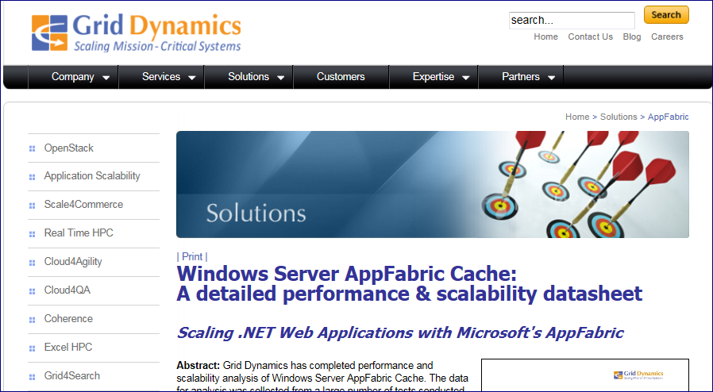
Grid Dynamics Study
Windows Server AppFabric Cache: A detailed performance & scalability datasheet

Slide 29
Grid Dynamics: Testing Methodology
Vary one or two parameters per test. These include:
Most tests directly against cache
Two tests with WCF and ASP.NET “layers”
Variable | Description
Load Pattern | Cache usage pattern (percentage of reads and writes)
Cached Date Size | Amount of data stored in cache during the test
Cluster Size | Number of cache hosts (servers) in the cache cluster
Object Size | Size of objects post-serialization
Type Complexity | Simple types (for example, byte[]) versus complex objects
Security | Security settings of the cache

Slide 30
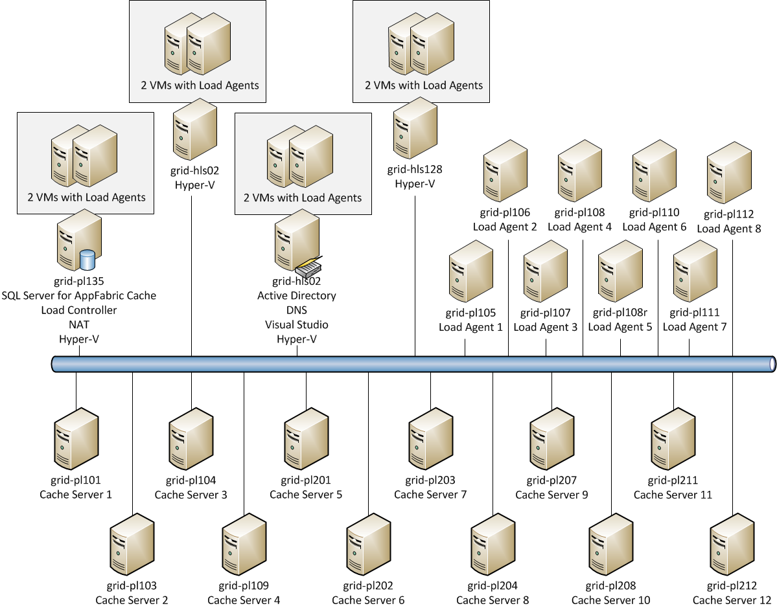
Grid Dynamics: Testing Environment

Slide 31
Grid Dynamics: Scalability
Point | 90% reads / 10% writes | 50% reads / 50% writes
High | 7.5 | 9
Balanced | 4.3 | 4.3
Low | 2.3 | 2.4
Latency (ms)
Dependency of throughput from cluster size for direct cache access (16KB byte array objects, 90% reads & 10% writes, default security)

Slide 32
Grid Dynamics: Security

Slide 33
Grid Dynamics: Workload and Object Size

Slide 34
Grid Dynamics: Conclusions
Cache size has low impact, except for large caches with high percentage of writes
High type complexity only affects client-side performance due to serialization
BulkGet result in better resource utilization
Direct cache access is much faster than proxies (ASP.NET, WCF)
Pessimistic and optimistic locking perform similarly
Cache cluster security does decrease performance, but may be required and is enabled by default
Network bottlenecks are reduced by using dedicated network between application servers and cache servers

Slide 35
Customer discussion Playbook
A pattern seen from several customer engagements
What is AppFabric Cache & Why should I care?
Are others using this in real-world applications?
How much memory do we need? How many servers?
Can we see detailed performance and scalability data?
What are the capacity indicators & performance to monitor?

Slide 36
Ongoing Performance Monitoring
Performance counters (More Complete List in Guides):
Windows PowerShell Commands (ex: Get-CacheClusterHealth)
Capacity Planning Guide:
  http://go.microsoft.com/fwlink/?LinkID=216759
Caching Deployment & Management Guide:
  http://go.microsoft.com/fwlink/?LinkId=210215
AppFabric Caching:Host | Network Interface(*)\Bytes Received/sec
.NET CLR Memory(DistributedCacheService) | Network Interface(*)\Bytes Sent/sec
Memory\Available MBytes | Network Interface(*)\Current Bandwidth
Process(DistributedCacheService)\% Processor Time | Processor(_Total)\% Processor Time
Process(DistributedCacheService)\Thread Count

Slide 37
Validating Capacity Estimates in Test/Production
demo

Slide 38

Related Content
Required Slide
Speakers, please list the Breakout Sessions, Interactive Discussions, Labs, Demo Stations and Certification Exam that relate to your session. Also indicate when they can find you staffing in the TLC.
MID302 AppFabric Caching: How it Works and When You Should Use It
MID201 An Overview of the Microsoft Middleware Strategy
MID376-HOL Windows Server AppFabric Cache: Setup and First Steps
MID375-HOL Windows Server AppFabric Cache: Developer Basics
AppFabric Product Booth

Slide 39
Track Resources
Required Slide
Track PMs will supply the content for this slide, which will be inserted during the final scrub.
Windows Azure Platform Training Kit
Windows Server AppFabric Training Kit
BizTalk 2010 Developer Training Kit
AppFabric Team Blog
Windows Azure AppFabric on MSDN
Windows Server AppFabric on MSDN

Slide 40





Resources
  Connect. Share. Discuss.
http://northamerica.msteched.com
Learning
  Sessions On-Demand & Community
  Microsoft Certification & Training Resources
www.microsoft.com/teched
www.microsoft.com/learning
  Resources for IT Professionals
  Resources for Developers
http://microsoft.com/technet
http://microsoft.com/msdn

Slide 41












Complete an evaluation on CommNet and
enter to win!

Slide 42


Slide 43

© 2011 Microsoft Corporation. All rights reserved. Microsoft, Windows, Windows Vista and other product names are or may be registered trademarks and/or trademarks in the U.S. and/or other countries.
The information herein is for informational purposes only and represents the current view of Microsoft Corporation as of the date of this presentation. Because Microsoft must respond to changing market conditions, it should not be interpreted to be a commitment
on the part of Microsoft, and Microsoft cannot guarantee the accuracy of any information provided after the date of this presentation. MICROSOFT MAKES NO WARRANTIES, EXPRESS, IMPLIED OR STATUTORY, AS TO THE INFORMATION IN THIS PRESENTATION.

