Slide 1

Collaboration in the Cloud with SharePoint:
A New World of Productivity
FDN02
Eron Kelly
Sr. Director, Product Management
Microsoft Corp.

Slide 2






“We were cautious of how many people would embrace a new tool. What we found was that 80% of our users wanted to be on a Microsoft type platform and were using one at home”
  John Kalka, Vice Preseident
  Ingersoll Rand
Older Millennials (23-27) spend an ave. of 6.8hrs/w interacting with work email. Younger Millennials in work spend just 4.2hrs/w on email and more time on text messaging (3hrs) or IM (3.2hrs).
  Accenture, Jan. 2010
The world's mobile worker population will pass the one billion mark this year and grow to nearly 1.2 billion people – more than a third of the world's workforce – by 2013.
  IDC, Feb. 2010
CONSUMERIZATION
MULTI-GENERATIONAL
ANYTIME, ANYWHERE
Trends Driving the Future of Productivity
“The move to Microsoft Online Services will help cut operational costs by an estimated 30% and create a variable cost model that will provide increased flexibility in the future.”
  Ingo Elfering, Vice Preseident
  GlaxoSmithKline
“By 2012, 80% of Fortune 1000 enterprises will be using some cloud computing services, 20% of businesses will own no IT assets.”
  Gartner, Jan. 2010
INFRASTRUCTURE LIMITATIONS
RISE OF THE CLOUD

Slide 3

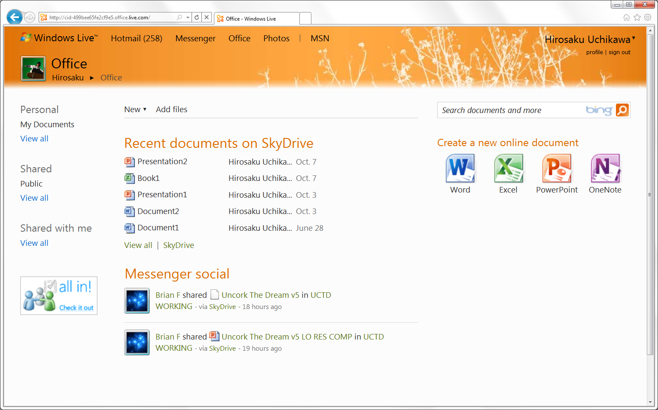




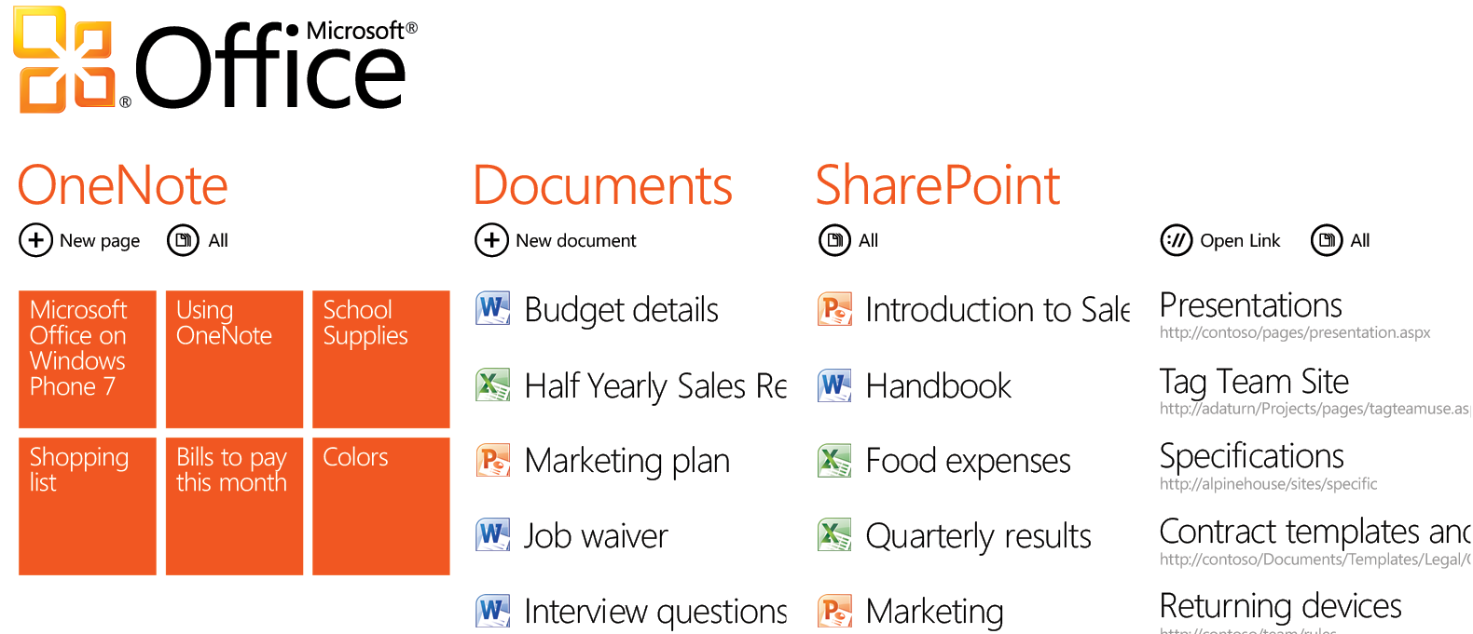






The Future of Productivity: Office 365
Best productivity experience
across PC, phone, and browser
Convenience and Choice
Online
On-premises
+
+
+
ENTERPRISE
CONTENT
MANAGEMENT
UNIFIED
COMMUNICATIONS
BUSINESS
INTELLIGENCE
ENTERPRISE
SEARCH
COLLABORATION

Slide 4

SharePoint Online and SharePoint Server
Sites & Communities
Content Management
Search
Business Intelligence & Composite Applications
  SHAREPOINT SERVER
  SHAREPOINT ONLINE
No SharePoint for Internet Sites
No Records Center or
e-discovery
No FAST Search or Unified Search
No BCS, PerformancePoint
No full-trust code

Slide 5
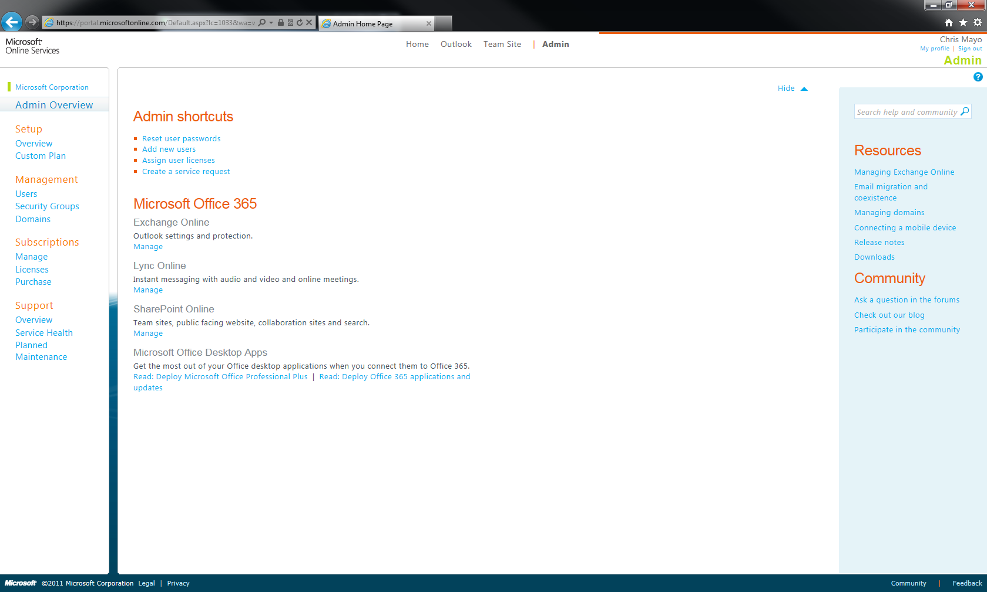
Getting Started in the Cloud
Chris Mayo
Sr. Technical Evangelist
Microsoft
demo

Slide 6

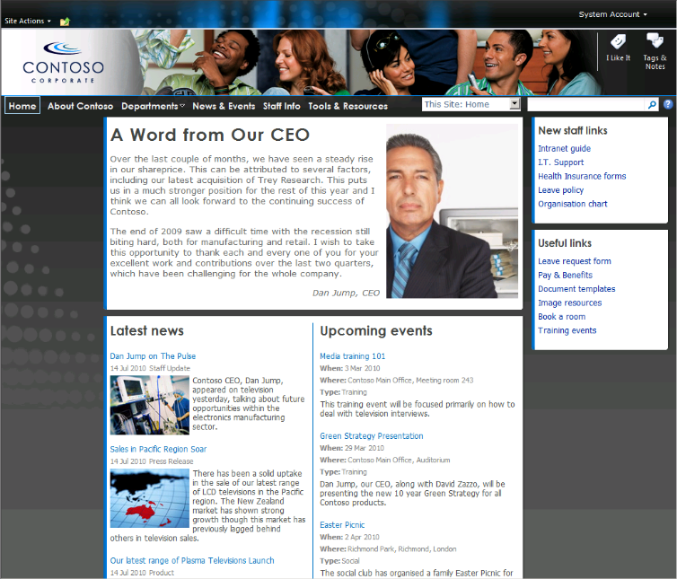
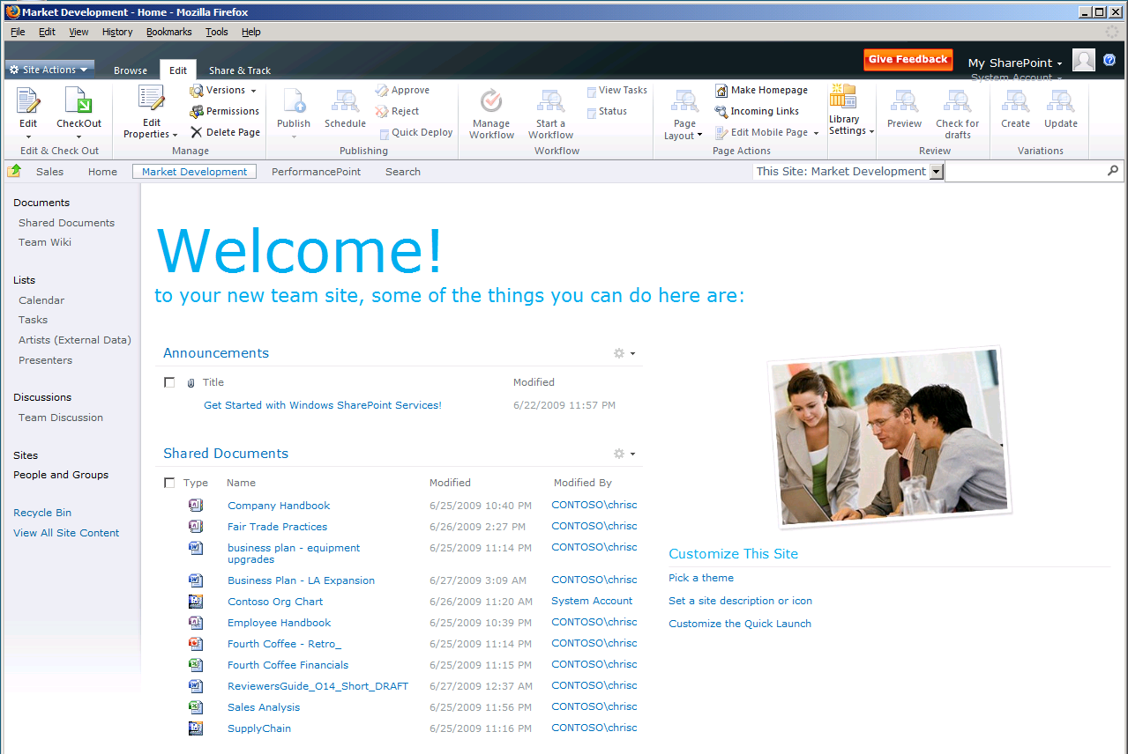
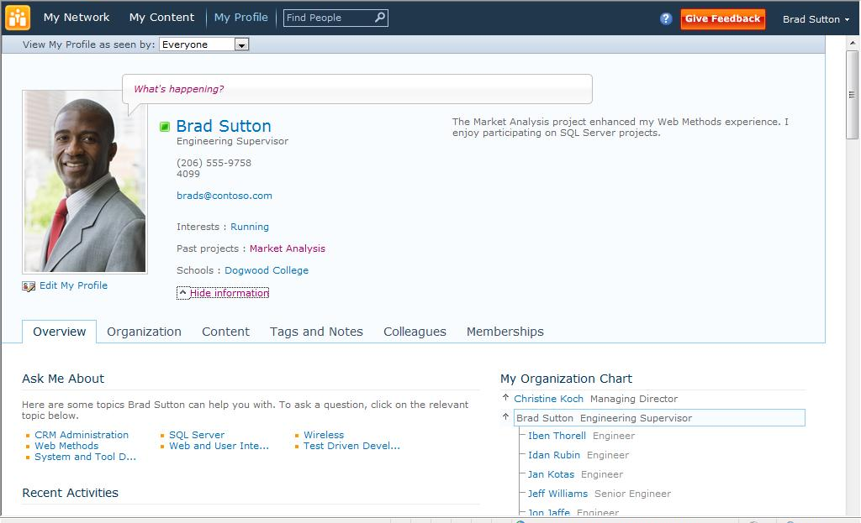
SharePoint Online
Manage documents & information
Share personal information & expertise
Create and edit documents real-time
Real-time communication using Lync
Manage key business processes
Easy-to-use site templates
Customize and update site quickly

Slide 7
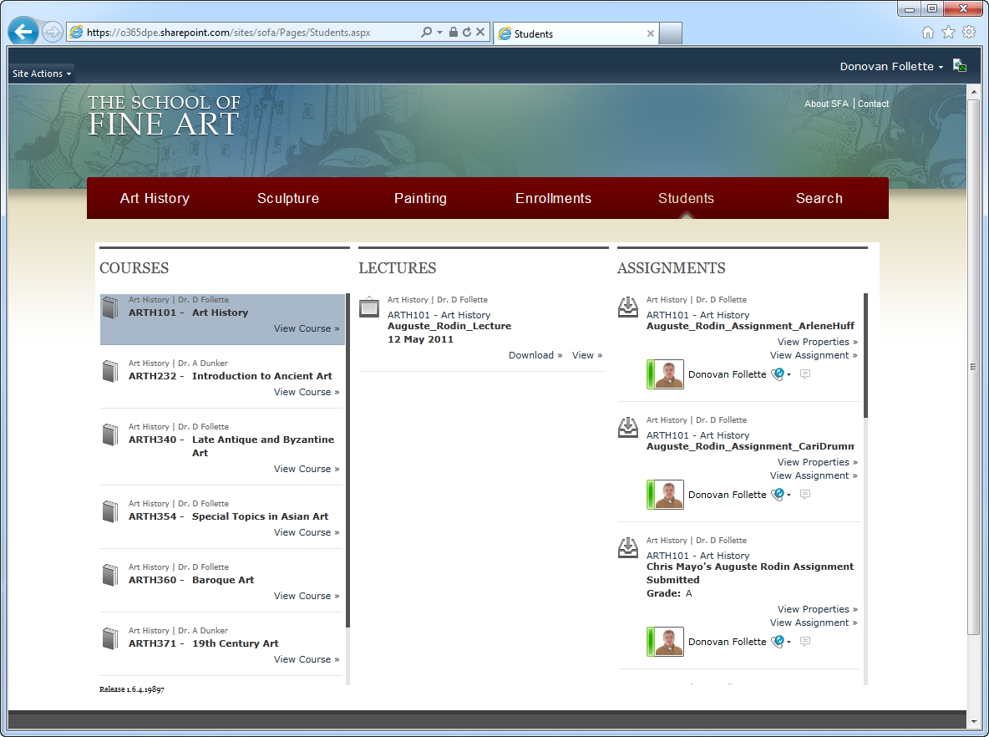
Learning in the Cloud
Donovan Follette & Chris Mayo
Sr. Technical Evangelists
Microsoft
demo

Slide 8

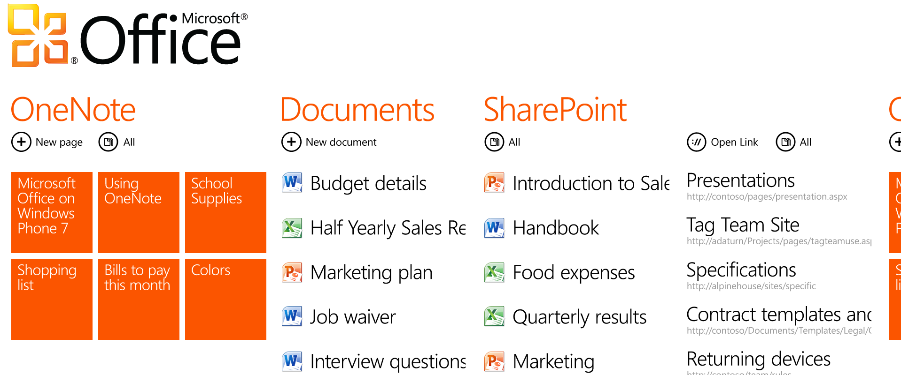
SharePoint Online and Windows Phone 7
Sync notes anywhere using OneNote
View, add and edit comments in Word & Excel
View and edit documents on SharePoint
Access SharePoint lists and document libraries
Native integration with Office 365
access SharePoint sites,
lists, and libraries
Productivity anywhere through the Office Hub

Slide 9





Windows Phone 7 “Mango” & Office 365
Augusto Valdez
Sr. Product Manager
Microsoft
demo

Slide 10





Developing Everywhere
Develop for and with the cloud

Slide 11
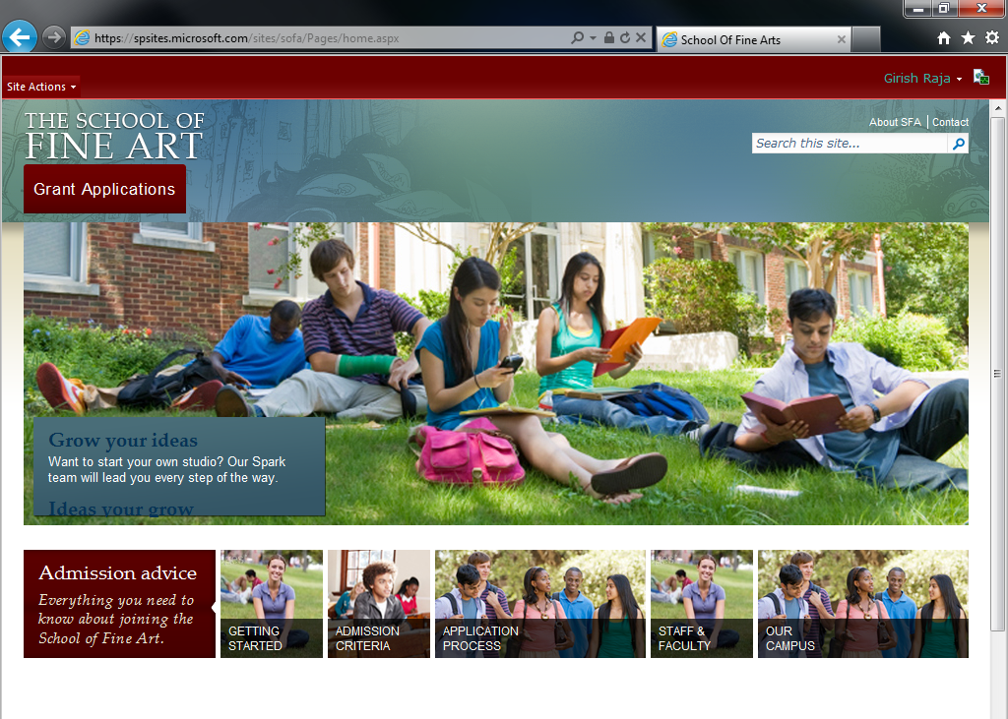
Grants Management
Girish Raja
Technical Evangelist
Microsoft
demo

Slide 12


Developing Everywhere
Complete Cloud-Based Solution
Manage grants submission with SharePoint Online
WCF service code runs in Windows Azure
Windows Azure connects CRM and SharePoint Online
CRM provides rich data management
Grants Mgmt.
Student Data Mgmt.
Grants WCF Svc

Slide 13
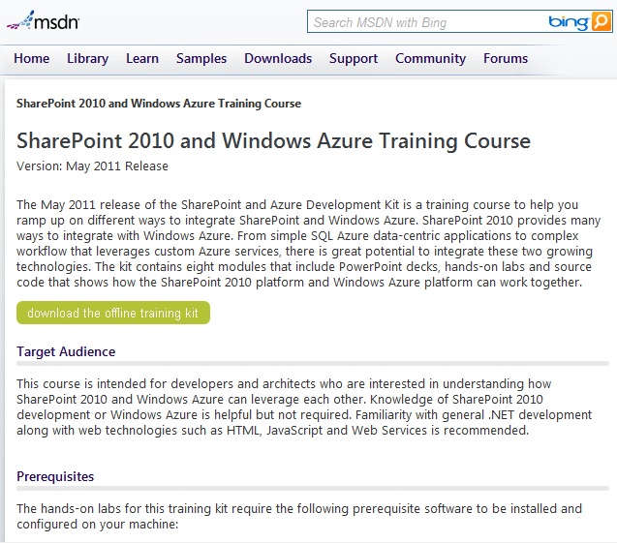
announcing
SharePoint 2010 & Windows Azure Developer Kit
Getting Started
WCF, Windows Azure & SharePoint
Windows Azure & Office
Business Connectivity Services & Windows Azure
BI Solutions using SQL Azure
Bing Maps, Windows Azure & SharePoint
Review online or download today!
http://msdn.microsoft.com/en-us/SPAzureTrainingCourse

Slide 14











momentum
SharePoint is a $B+ business
70% of enterprise customers use SharePoint
Powers more than 2000 .COM web sites
2 out of every 3 IWs have SharePoint
Gartner & Forrester leader in all workloads
16,000 partners signed up to Office 365
http://www.microsoft.com/evidence

Slide 15
Call to Action
1
2
3
Get started with the Office 365 Beta today at
www.Office365.com
Download the training kits at http://msdn.microsoft.com/trainingcourses.aspx
Check out related TechEd Sessions: OSP 212, OSP210, OSP 301, & OSP 372.

Slide 16












Required Slide
Complete an evaluation on CommNet and
enter to win!

Slide 17

© 2011 Microsoft Corporation. All rights reserved. Microsoft, Windows, Windows Vista and other product names are or may be registered trademarks and/or trademarks in the U.S. and/or other countries.
The information herein is for informational purposes only and represents the current view of Microsoft Corporation as of the date of this presentation. Because Microsoft must respond to changing market conditions, it should not be interpreted to be a commitment
on the part of Microsoft, and Microsoft cannot guarantee the accuracy of any information provided after the date of this presentation. MICROSOFT MAKES NO WARRANTIES, EXPRESS, IMPLIED OR STATUTORY, AS TO THE INFORMATION IN THIS PRESENTATION.

