Slide 1

What's New in Microsoft Exchange Server
2010 SP2: Featuring GAL Segmentation
EXL326
Greg Taylor
Sr. Program Manager
Microsoft Corp

Slide 2
Agenda
Some facts, figures and otherwise interesting info about Exchange 2010 SP2
Four new features in SP2
  OWA Mini
  Hybrid Configuration Wizard
  Address Book Policies
  OWA Cross Site Silent Redirection

Slide 3
Exchange SP2 Facts
You can get your hands on SP2 in the second half of CY 2011
There are over 20 million lines of code in Exchange, and over half is test code! So bugs are inevitable!
Service packs these days are about bugs AND features
In SP2 there will be something like 500 bug fixes in addition to at least 4 new features
Every bug is triaged for risk, cost and applicability (i.e. how many customers will benefit)– bugs that simply make us look dumb are not fixed for that reason alone. We can take it and deserve to sometimes
Each new feature gets a Functional Spec, a Development Spec and a Test Spec – and undergoes a thorough team review

Slide 4
The Technology Adoption Program (TAP)
Exchange has a long history in this area
  JDP, RDP, TAP – any TLA works for us
TAP consists of customers who are prepared to deploy beta bits INTO PRODUCTION
They get ‘special’ support for doing so
They get access to a TAP DL, a Wiki with all the latest info and conference calls with the team developing the features
They get to provide early feedback, change the product and find bugs ☺

Slide 5
So Let’s Get To It…. First Up….
OWA Mini

Slide 6
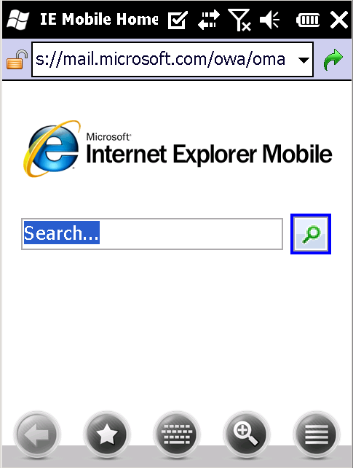
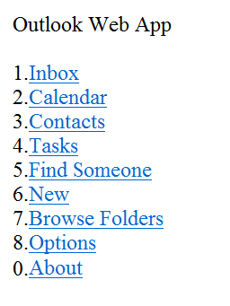
OMA? Forget About It, This is OWA Mini!
Yes, what you previously knew as OMA is back in SP2!
This feature was driven by demand from markets where browser phones still rule
Simple to administer, though all via EMS
This is a complete re-write, none of the 2003 code was re-used
Look, Tasks!
It is built as a set of OWA forms, rather than as a separate application – hence OWA Mini

Slide 7
Managing OWA Mini
Enabled and disabled using Set-OWAMailboxPolicy
  Set-OWAMailboxPolicy Name -OWALightEnabled:$True
OWA Mini is effectively an alternative view of OWA, so OWA mailbox policies and segmentation are inherited
  Any unsupported features (IRM for example) in the policy are secure by default – i.e. disabled for OWA Mini
ActiveSync policies are not applied to OWA Mini
Fully supported features such as calendar, contacts etc. can be enabled or disabled on a per policy basis
Will ship in all OWA languages. If a new language is added to OWA, OWA mini gets it, as it’s OWA, just mini-ma-ized

Slide 8
OWA Mini
demo

Slide 9
The Hybrid Configuration Wizard

Slide 10
The Hybrid Configuration Wizard
Designed to take away some of the difficulties with setting up on-premises Exchange and O365 to work together – in Hybrid mode
What once took 49 steps, now takes 6 (your mileage may vary) >80% reduction for the administrator
For more details see EXL311 | Microsoft Exchange Server and Microsoft Office 365: How to Set Up a Hybrid Deployment - Wed 3.15PM Room B206

Slide 11
Address Book Policies
(the artist formally known as GAL Segmentation)

Slide 12
What Is GAL Segmentation Anyway?
By default in Exchange, the Global Address List contains every mail enabled object
GAL Segmentation means dividing up the GAL and Address Lists
Why would you want to do this?
  Legal or compliance reasons – people are not allowed to see each other in the GAL
  Optimization reasons – You have a huge GAL but operate in smaller logical units
  Hosting reasons – you want to host multiple organizations on one platform and don’t want them seeing each other

Slide 13
Some History…
In the Exchange 2000 timeframe a KB that was released that outlined to how carve up your GAL but we pulled it when HMC was created
For 2003, no such paper, but lots of support cases ☹
For 2007, a new whitepaper was born
For 2010, we decided to engineer the solution into the product fully
  It enables us to systematically test the solution
  It allows CSS to fully support the solution
  And because you asked for it ☺

Slide 14
How Did The Previous Solutions Work?
Based on a combination of methods
  Using ACL’s on GAL’s and AL’s (Outlook and EAS)
    Deny at the root level
    Allow to a specific AL
    Requires security group membership and all ACL’s to be evaluated
  MsExchQueryBaseDN (for OWA but not needed since SP1)
    Specify per user the base OU the user can search from (this means the OU hierarchy is rigid)
  Per User OAB assignment
    Specify per user the OAB the user can access
Relied upon Outlook and Exchange choosing the largest or ‘best’ GAL when there are a few to choose from

Slide 15
What Was Wrong With That Then?
Using security groups, QBDN’s and per user OAB’s meant creating users with scripts to get the right settings – or things start to go wrong….
As we change things in Exchange, things can (and did) start to break
The OU hierarchy was too restrictive for some customers – a user cannot exist in more than one OU…

Slide 16
Introducing Address Book Policies
New in SP2: Address Book Policies (ABP’s) enable you to achieve GAL Segmentation in Exchange 2010
ABP’s work on the principal of direct GAL and Address List assignment rather than allowing or denying access to all available lists
ABP’s only apply to users with mailboxes on Exchange 2010 as they plug in to the Address Book Service on the 2010 SP2 CAS role
Any request that comes through the Address Book Service on CAS is evaluated against the ABP assigned to the user

Slide 17

It Speaks a Thousand Words….
Address Book Policy A
Address Lists
Address Book Policy Assignment
AL1
AL2
AL5
AL6
Address Book Policy A
Default Address List
GAL1
Room Address List
RM AL 1
User
Offline Address Book
OAB B
Saved Filter = LDAP=AL1+AL2+AL5+AL6+RM AL 1+ GAL1
Address List Objects
Offline Address Book Objects
Global Address List Objects
Room Address List Objects
OAB A = AL1 + AL3 + AL4
AL 1
AL 2
AL 3
OAB A
GAL 1
GAL 2
RM AL 1
OAB B = AL1 + AL2 + AL5 + AL6 + GAL1
AL 4
AL 5
AL 6
OAB B
GAL 3
GAL 4
RM AL 2

Slide 18
What Kind Of Actions Are Impacted?
ABP’s work for any client that goes through CAS for directory and;
  Opens the address list picker
  Tries to resolve a name or an alias
  Adds a room resource to a meeting request
  Searches the GAL
  Searches the directory from Outlook Voice Access
  Queries the directory from a mobile device
  Views someone’s DL memberships, or views the members of a DL
    Yes – if a user in a DL is outside the scope of your ABP, you won’t see them
    This prevents GAL mining by surfing up and down the member/memberof properties in some scenarios
    This does mean you might be sending to more people than you think you are… and that MailTips might not be telling the truth…

Slide 19


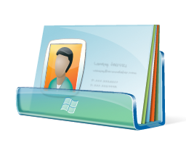

ABP Deployment Scenarios
Two Independent Companies
Fabrikam Inc.
Tailspin Inc.
Users and DL’s
Users and DL’s
Address Book Policy ‘Fab’
Address Book Policy ‘TAIL’
Address Lists
AL-FAB-Users-DL’s
AL-TAIL-Users-DL’s
Address Lists
AL-FAB-Users-DL’s
AL-FAB-Rooms
AL-FAB-Contacts
AL-TAIL-Users-DL’s
AL-TAIL-Rooms
AL-TAIL-Contacts
Default Address List
Default Address List
GAL-FAB
Contacts
Room Mailbox
Contacts
Room Mailbox
GAL-TAIL
Room Address List
Room Address List
AL-FAB-Rooms
AL-FAB-Contacts
AL-FAB-Rooms
AL-TAIL-Contacts
AL-TAIL-Rooms
AL-TAIL-Rooms
Offline Address Book
Offline Address Book
OAB-FAB
OAB-TAIL
GAL-FAB
OAB-FAB
GAL-TAIL
OAB-TAIL

Slide 20


ABP Deployment Scenarios
Two Companies Sharing One CEO
Fabrikam Inc.
Tailspin Inc.
Big Boss
Users and DL’s
Users and DL’s
Address Book Policy ‘Boss’
Address Book Policy ‘Fab’
Address Book Policy ‘TAIL’
Address Lists
Address Lists
Address Lists
AL-FAB-Users-DL’s
AL-TAIL-Users-DL’s
All The AL’s There Are
AL-FAB-Users-DL’s
AL-FAB-Rooms
AL-FAB-Contacts
AL-TAIL-Users-DL’s
AL-TAIL-Rooms
AL-TAIL-Contacts
Default Address List
Default GAL
Default Address List
Default Address List
Contacts
Room Mailbox
Contacts
Room Mailbox
Room Address List
GAL-FAB
GAL-TAIL
Default All Rooms
Room Address List
Room Address List
AL-FAB-Rooms
AL-TAIL-Rooms
AL-FAB-Contacts
AL-FAB-Rooms
AL-TAIL-Contacts
AL-TAIL-Rooms
Offline Address Book
Default OAB
Offline Address Book
Offline Address Book
OAB-FAB
OAB-TAIL
GAL-FAB
OAB-FAB
GAL-TAIL
OAB-TAIL

Slide 21

ABP Deployment Scenarios
Education
Principal
Faculty
Address Book Policy
‘Student Class A’
Address Book Policy
‘Principal’
Teacher A
Teacher B
Address Lists
Address Lists
AL-Class A
AL-All Teachers
AL-All Groups
Class A
Class B
AL-Class A
AL-Class B etc
AL-All Teachers
AL-All Students
AL-All Groups
Class A - All
Student 1
Student 2
Class B - All
Default Address List
Default Address List
GAL-Class-A
GAL-Principal
Everyone
DL Object
Members
Address List
Scope
DL Object
Members
Class A - All
3
Class X
All students in a specific class (one per class)
Class A - All
3
Class B - All
2
All Teachers
Where attribute y = ‘teacher’ or ‘principal’
Class B - All
3
Everyone
4
All Students
Where attribute z = ‘student’
Everyone
5
Faculty
3
All Groups
Where object = type - group
Faculty
3

Slide 22
Address Book Policies
demo

Slide 23
ABP Deployment Considerations
Deploying ABP’s successfully is all about PLANNING and understanding what they can, and cannot do
Some tips are
  Use standard, built-in and existing Custom Attributes to represent company/division/class or whatever you want to divide upon
    DL’s don’t have Company attributes so you can’t filter on those
    Custom Attributes are consistent on all mail enabled objects
  Build simple AL and GAL filters where possible and group them together into ABP’s
  Try not to span DL’s over ABP’s unless you really need to hide DL membership and prevent GAL mining
  Build OAB’s based on GAL’s, not AL’s (yes, we fixed this too)
  Make sure a user exists in their own GAL

Slide 24
Anything Else We Need To Know?
ABP’s cannot prevent anyone directly connecting to AD and bypassing ABP logic
    So any LDAP clients, for example Outlook Mac/Entourage using LDAP will not work with ABP’s
So you can’t use ABP’s if Exchange is installed on a GC as NSPI is provided by AD, not Address Book Service
If you span DL’s over ABP’s you need to disable Group Management in ECP as ECP uses Get-Group which ignores ABP’s
Don’t try and mix and match ABP’s and ACL’s (unless migrating) or use QBDN’s

Slide 25
What About Migration From ACL’s?
If you are using an ACL based model today in 2007 you might be able to migrate without too many problems
  First create ABP’s that mirror your security groups and ACL’s
  Installing 2010 will result in some downtime as setup must be able to read the Default GAL
  As you migrate mailboxes, you need to assign an ABP and remove the QBDN from the user object
  You can also remove the OAB setting as that comes from the ABP as well
  You will need to test against YOUR environment

Slide 26
From Here To There
Exchange 2007 with ACL Based Segmentation
Exchange 2010 SP2 with Address Book Policies
Guidance
Exchange 2010 with ACL Based Segmentation
No Guidance
No Guidance
HMC
Exchange 2010 /Hosting
Guidance

Slide 27
If You Are A Hoster…
We will support hosting Exchange with SP2 and ABP’s but there are some caveats to this
We are not producing prescriptive guidance on hosting using this feature, but will document some support boundaries
ABP’s don’t solve all the problems hosters usually face
  ABP’s are not providing legal separation
  ABP’s don’t stop ‘Default’ permissions meaning the entire platform
  ABP’s don’t stop Lync presence between organizations
  Internal OOF’s will still be sent between companies sharing the same platform
  Provisioning, billing, service plans, throttling etc
Bottom line is – we still recommend you use /hosting mode

Slide 28
OWA Cross Site Silent Redirection

Slide 29
Why You Want This Feature (And You Will)
Pre Exchange 2010 SP2, if you try to use OWA on a CAS in the ‘wrong’ AD site, CAS has a decision to make
It can proxy or redirect the connection to the target site
If there is no ExternalURL in that site, we proxy, the mailbox opens and the user gets access
If the target site has an ExternalURL we show the user a page with a link to click
The user clicks the link, and logs in again, and gets access
The user has to log in twice
We are removing the need to click the link
Which for some scenarios will result in a Single Sign On experience

Slide 30
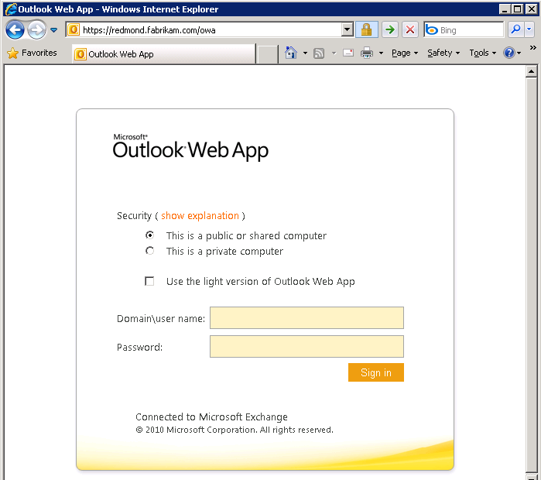

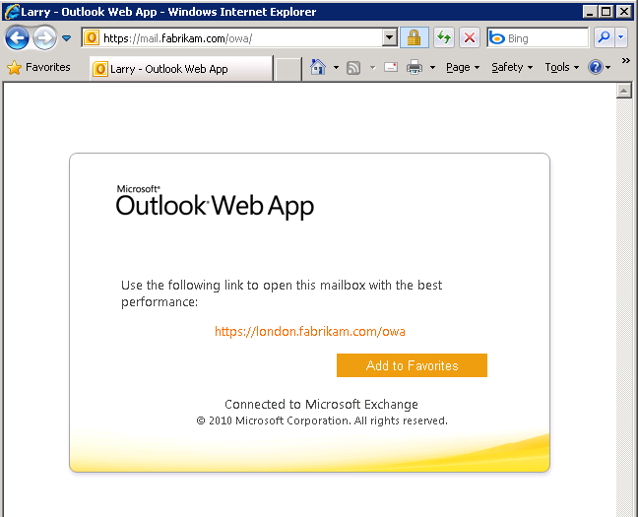
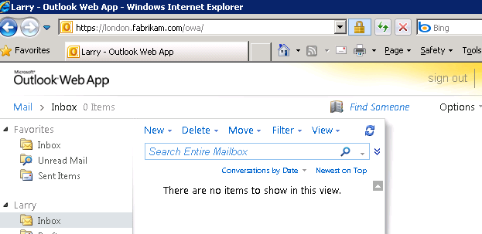
Experience, Before
and After
Cue Applause….

Slide 31
So To Summarize Service Pack 2
We fixed a good few bugs and added some new features too!
Make sure you check the release notes – no, really, do check them!
With any new software, take the time to test it works in your environment, and with your users
Check http://blogs.technet.com/b/exchange/ for the latest release dates and information (the new location for msexchangeteam.com)
Exchange Still Rocks

Slide 32

Related Content
Breakout Sessions
  EXL311 | Microsoft Exchange Server and Microsoft Office 365: How to Set Up a Hybrid Deployment - Wed 3.15PM
Find Me Later At…
  Technical Learning Center from 6-9pm today!
  And again Tuesday from 10:30am to 1:30pm

Slide 33





Resources
  Connect. Share. Discuss.
http://northamerica.msteched.com
Learning
  Sessions On-Demand & Community
  Microsoft Certification & Training Resources
www.microsoft.com/teched
www.microsoft.com/learning
  Resources for IT Professionals
  Resources for Developers
http://microsoft.com/technet
http://microsoft.com/msdn

Slide 34












Complete an evaluation on CommNet and
enter to win!

Slide 35


Slide 36

© 2011 Microsoft Corporation. All rights reserved. Microsoft, Windows, Windows Vista and other product names are or may be registered trademarks and/or trademarks in the U.S. and/or other countries.
The information herein is for informational purposes only and represents the current view of Microsoft Corporation as of the date of this presentation. Because Microsoft must respond to changing market conditions, it should not be interpreted to be a commitment
on the part of Microsoft, and Microsoft cannot guarantee the accuracy of any information provided after the date of this presentation. MICROSOFT MAKES NO WARRANTIES, EXPRESS, IMPLIED OR STATUTORY, AS TO THE INFORMATION IN THIS PRESENTATION.

