Slide 1

Microsoft Exchange Server and Microsoft
Office 365: How to Set Up a Hybrid Deployment
EXL311
Jim Lucey
Sr. Product Manager
Microsoft Exchange

Slide 2
Session Objectives
Review hybrid features
Learn about the core hybrid components
Understand the planning requirements
Review deployment stages
What’s new in Exchange 2010 SP2?

Slide 3

Planning For Deployment
“Can I do it in a weekend?”
Source Server
Size
Identity
Management
Exchange
IMAP
Lotus Notes
Google
Large
Medium
Small
On-Premises
Single Sign-On
On-Cloud
Hybrid
Provisioning
DEPLOYMENT PLAN
Migration solution is part of the plan
Hybrid
Exchange sharing features
DirSync
Bulk Provisioning

Slide 4
New Migration Options
Choices to fit your organization
IMAP migration
  Supports wide range of e-mail platforms
  E-mail only (no calendar, contacts, or tasks)
Cutover Exchange migration (CEM)
  Good for fast, cutover migrations
  No server required on-premises
Staged Exchange migration (SEM)
  No server required on-premises
  Identity federation with on-premises directory
 | IMAP migration | Cutover migration | Staged migration | Hybrid
Exchange 5.5 | X
Exchange 2000 | X
Exchange 2003 | X | X | X | X
Exchange 2007 | X | X | X | X
Exchange 2010 | X | X |  | X
Notes/Domino | X
GroupWise | X
Other | X
Migration
Hybrid deployment
  Manage users on-premises and online
  Enables cross-premises calendaring, smooth migration, and easy off-boarding
Hybrid
* Additional options available with tools from migration partners

Slide 5
Hybrid
Staged Exchange Migration vs Hybrid Feature-set
Today’s
Focus
Feature | Staged | Hybrid
Mail routing between on-premises and cloud (recipients on either side) | ■ | ■
Mail routing with shared namespace (if desired) - @company.com on both sides | ■ | ■
Unified GAL | ■ | ■
Free/Busy and calendar sharing cross-premises |  | ■
Mailtips, messaging tracking, and mailbox search work cross-premises |  | ■
OWA Redirection cross-premise (single OWA URL for both on-premises and cloud) |  | ■
Exchange Online Archive |  | ■
Exchange Management Console used to manage cross-prem relationship & mailbox migrations |  | ■
Native mailbox move supports both onboarding and offboarding |  | ■
No outlook reconfiguration or OST resync required after mailbox migration |  | ■
Online Mailbox Move allows users to start logged into their mailbox while it is being moved to the cloud |  | ■
Secure Mail ensure emails cross-premises are encrypted, and the internal auth headers are preserved |  | ■
Centralized mailflow control, ensures that all email routes inbound/outbound via On Premises |  | ■
Exchange Sharing
Mailbox Move
Secure Transport

Slide 6
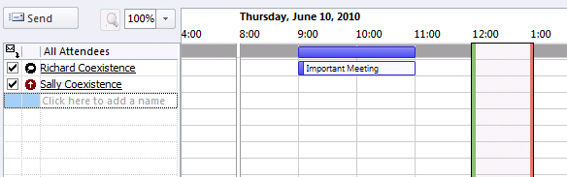
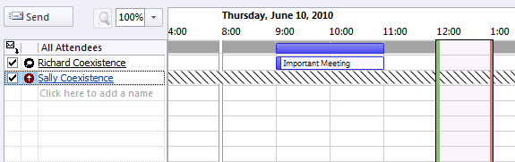
Hybrid Feature-set
Cross-Premises Free/Busy and Calendar Sharing
Cross-Premises Free/Busy and Calendar Sharing
  Creates the look and feel of a single, seamless organization for meeting scheduling and management of calendar
  Works with any supported Outlook client; the heavy lifting is done by the Exchange Server 2010 CAS servers and the MS Federation Gateway and is transparent to the client

Slide 7
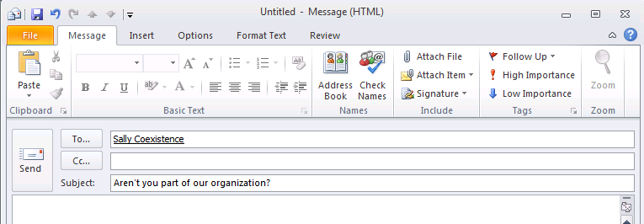
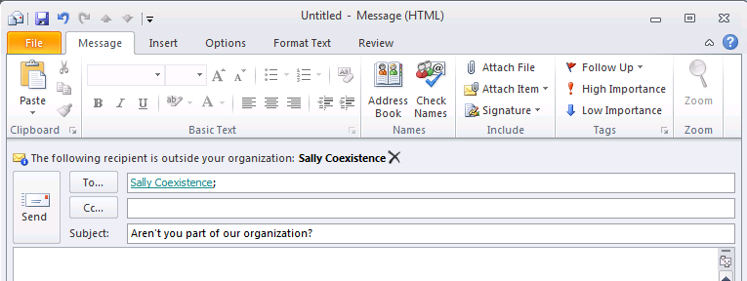
Hybrid Feature-set
Cross-Premises MailTips
Cross-Premises MailTips
  Creates the look and feel of a single, seamless organization. Correct evaluation of “Internal to” vs. “External to” organization context
  Allows awareness and correct Outlook 2010 representation of mail-tips for size and quantity limits on DGs, etc.

Slide 8
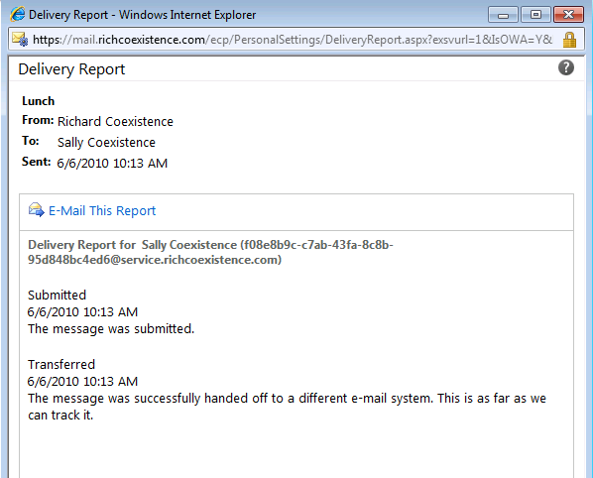
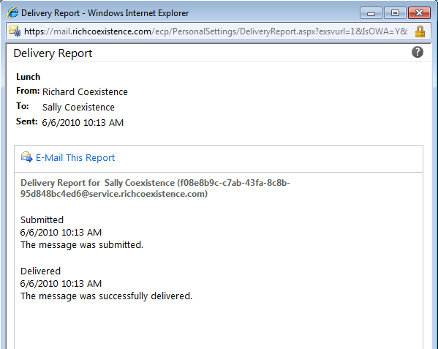
Hybrid Feature-set
Cross-Premises Message Tracking
Cross-Premises Message Tracking
  Creates the look and feel of a single, seamless organization
  Message tracking started from on-premises or from the cloud will track through to the edge of the combined organization
    Tracking fidelity across Exchange Server 2010 SP1 servers will be identical to fully on-premises organizations (i.e. – high fidelity)
    Tracking fidelity across pre-2010 servers will be identical to fully on-premises organizations (i.e. – lower fidelity)

Slide 9
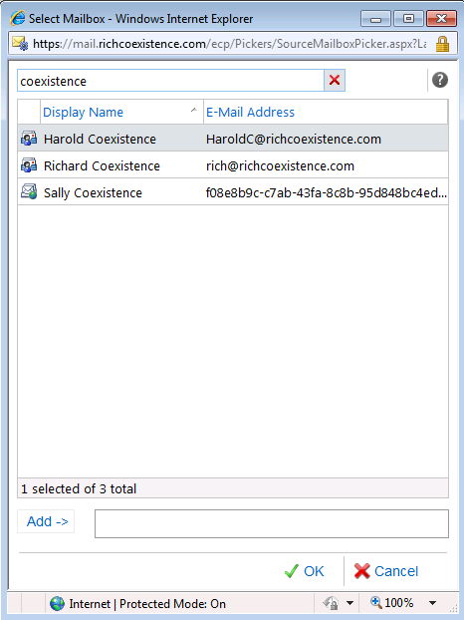
Hybrid Feature-set
Cross-Premises mailbox search
Cross-Premises mailbox search
  Allows compliance officers to select/manage mailboxes for mailbox searches from on-premises or cloud-hosted mailboxes
  Graphical representation allows to differentiate between on-premises and cloud-hosted mailboxes in the picker
  Search results returned across all selected mailboxes, regardless of mailbox location!

Slide 10
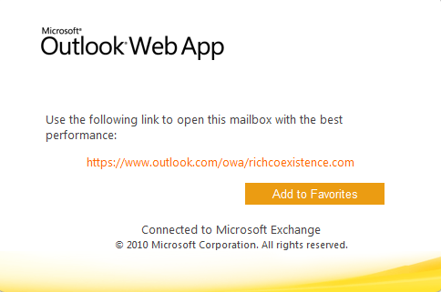
Hybrid Feature-set
Cross-Premises OWA redirection
Single URL
  Allows mailbox access to OWA via a single URL (pointed to on-premises CAS)
  Ensures a good end-user experience as mailboxes are moved in-and-out of the cloud, since OWA URL remains unchanged
Better Cloud log in experience
  Log in experience can be greatly improved by adding your domain name into your cloud URL so that you can access your cloud mailbox without the interruption of Go There page

Slide 11
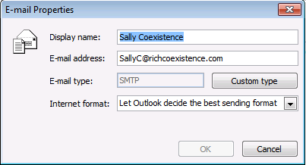
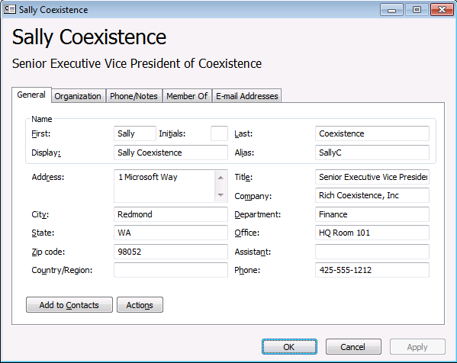
Hybrid Feature-set
Cross-Premises Mailflow
Cross-Premises Mailflow
  Hybrid adds the ability to preserve internal organizational headers.
  Most important header: Auth header
    Allows us to treat a message from the cloud as authenticated. This means we trust the message and resolve the sender to a recipient in the GAL.
    Restrictions specified for that recipient get honored.
    When sender expanded in Outlook, GAL card is opened (not SMTP address).

Slide 12
Hybrid
Feature summary
Makes your on-premises organization and cloud organization work together like a single, seamless organization
  Offers near-parity of features/experience on-premises and in the cloud
  Seamless interactions between on-premises and cloud mailboxes
  Migrations in and out of the cloud transparent to end-user
Features not supported:
  Coexistence of Delegate permissions – Delegate permissions are migrated, but do not work when Delegator and Delegate are split between on-prem & cloud
  Migration of Send As/Full Access permissions
  Multi-forest – Only single forest source environments
  Public Folders

Slide 13
Planning & Concepts

Slide 14
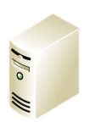



Hybrid Server Roles
2 Required Server Roles:
Office 365 Active Directory Synchronization
Exchange Server 2010 SP1 CAS/Hub*
FREE!
with paid Exchange Online subscription
1 Optional Server Role:
Active Directory Federation Services
Office 365 Directory Sync
Unified Global Address List
Single Sign On
AD FS
Exchange Sharing
Mailbox Move
Secure Transport
Exchange Server 2010 SP1 CAS/Hub
Exchange Server 2010 SP1 CAS/Hub
* Mbx role is required for legacy Public Folder based free/busy support

Slide 15
Shared Namespace

Slide 16
Single Namespace – Core Concepts
Email from joe@foo.com to ben@contoso.com

Slide 17
Shared Namespace – Core Concepts
Email is forwarded to ben@service.contoso.com
Email from joe@foo.com to ben@contoso.com

Slide 18
Exchange Sharing

Slide 19


Federation Scenarios
“Federation” – a very overloaded word
Sign-On Scenarios ADFSv2 - “Identity Federation”
  User uses corporate credentials to access Online resources in the cloud
  Single Sign-on cloud mailbox login
  Direct Logon for LOB apps
Applies to all Office 365 services, not just Exchange Online
  Cross-premises Free/Busy, Shared Calendaring
  Cross-premises Mailtips
  Cross-premises Message Tracking
  Cross-premises Mailbox Search
  Cross-premises Mailbox Move authentication
  Cross-premises OWA redirection (single URL)
  Cross-premises Archiving
Delegation Scenarios – “Exchange Federation”
  Services act on behalf of a user to access Exchange resources
Specific to hybrid features provided by
Exchange Online

Slide 20
Standard On-Premises Free/busy
Ben requests free/busy info for Brad
CAS Server locates Brad’s mailbox and resolves the request
Brad’s free/busy is returned to the Outlook client

Slide 21
Federated Free/busy
CAS Server finds that Joe’s mailbox is external and there is a matching Organization Relationship
Ben requests free/busy info for Joe
MFG returns a Delegation Token
CAS Server passes the MFG token and requests Joe’s free/busy on behalf of Ben
Free/busy info is returned to the CAS Server
CAS connects to the MFG to request a Delegation Token
Free
Busy
Request
From Ben
To Joe
Joe’s free/busy is returned to the Outlook client

Slide 22
Exchange Online Archive
CAS Server finds that Ben’s archive is held within Exchange Online
Ben Attempts to access his Online Archive
MFG returns a Delegation Token
CAS Server requests access to Ben’s online archive
Archive hierarchy is returned
CAS connects to the MFG to request a Delegation Token
Archive
Request
From Ben
To Archive
MAPI
MAPI
Ben’s Archive hierarchy builds within the Outlook client

Slide 23
Secure Transport

Slide 24
Secure Mail – TLS
Domain Secure
The FOPE transport certificate subject is “mail.messaging.microsoft.com”
TLS
The Hub/Edge transport certificate subject is “mail.contoso.com”

Slide 25
Secure Mail - Sending Internal Headers to the Cloud
FOPE records the sender’s certificate subject. In this example it’s:
“mail.contoso.com”
TLS
XOORG Data
Certificate Subject
Exchange Online verifies cert subject matches the configured value. If cert subject is valid, Exchange promotes internal header
Cross-premises emails are authenticated as “Internal”
If the outbound email is destined for Exchange Online, internal headers are added to the email.
XOORG Data

Slide 26
Secure Mail – Sending Internal Headers to On-premises
TLS
XOORG Data
Exchange on-premises verifies cert subject matches the configured value. If cert subject is valid, Exchange promotes internal headers.
If the outbound email is destined for Exchange On-premises, internal headers are added to the email.
Emails from the cloud are seen as Internal by Transport
XOORG Data

Slide 27
Centralized Mail flow Control
Only Exchange on-premises is allowed to send mail into the cloud
All outbound cloud email is sent via on premises
Exchange Online to On Premises Connector Address Space = *@*
TLS
Centralized Mail flow Control

Slide 28
Deployment

Slide 29
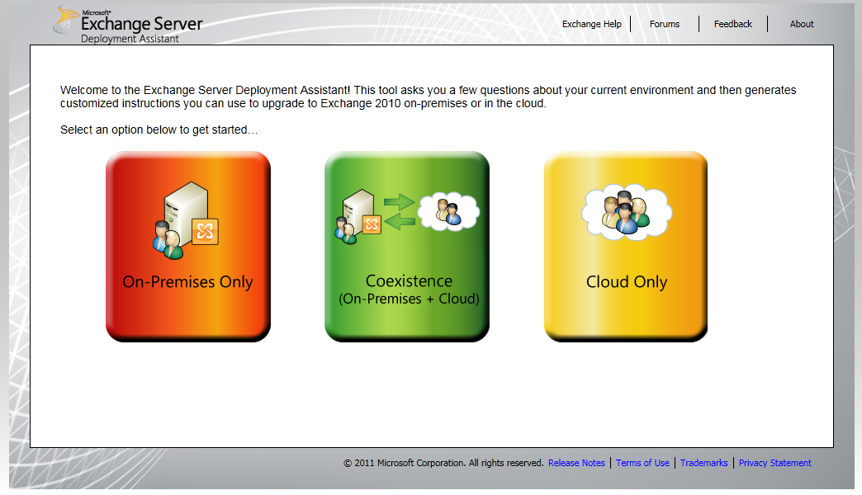
Exchange Deployment Assistant
Exchange Deployment Assistant
http://technet.microsoft.com/exdeploy2010
Currently supports hybrid configuration with Exchange Server 2003 or 2007
Exchange Server 2010 SP1 support before GA

Slide 30
Hybrid Setup
Step 1 – Office 365 configuration steps
Step | Details | Required/ Recommended
Register your custom domains in the Office 365 portal | Register any primary SMTP domains | Required
Configure Federated Identity | On-premises ADFS/Geneva server allows on-premises (single) identity to be used for cloud authentication | Recommended
Configure DirSync | On-premises appliance synchronizes on-premises directory/GAL with the cloud | Required
Enable DirSync Writeback | Allows rich off-boarding with message-repliability, archiving in the cloud, and UM in the cloud | Recommended

Slide 31
Hybrid Setup
Step 2 – Exchange Configuration Steps
Step | Details |  | Required/ Recommended
Install Exchange Server 2010 SP1 server On-premises | On-premises Exchange Server 2010 SP1 CAS/Hub server (also MBX role for some scenarios) required for hybrid features |  | Required
Configure cloud Autodiscover DNS record | Allows on-premises targeted autodiscover Outlook client to redirect to cloud without prompts |  | Required
Publish MRS Proxy | Allows Exchange Online Mailbox Replication Service to connect On Premises and perform a move to the cloud |  | Required
Implement Cloud Configuration Policies | Create configuration policies in the cloud to match (or complement) on-premises configuration policies (e.g. – ActiveSync policies, OWA policies, etc.) |  | Recommended
Configure RBAC in the cloud | Create/manage Role Based Access Control (RBAC) settings in the cloud to match (or complement) on-premises RBAC configuration |  | Recommended
Configure Federation Trust / Org Relationship “Federated Sharing” | Enable infrastructure for delegated Live namespace federation. Allows the following features: |  | Recommended
 | Cross-premises Free/Busy, Shared Calendaring | Cross-premises OWA redirection (single URL)
 | Cross-premises Mailtips | Cross-premises Mailbox Search
 | Cross-premises Message Tracking | Cross-premises Archiving
Configure Cross-premises mail routing | Configure Cross-premises mail routing. This configuration ensures proper anti-spam/header handling for mail sent between on-premises and the cloud. |  | Recommended

Slide 32
Creating the Exchange Federation Trust
Create Exchange Federation Trust with the MFG using a “unique namespace”
e.g. “exchangedelegation.contoso.com”
Automatic implied trust between the Exchange Online tenant and MFG
Exchange Online Org Relationship with “contoso.com”
On-premises Org Relationship with “service.contoso.com”

Slide 33
Creating the Secure Mail Connectors
Create the Exchange Send Connector
Create the FOPE Inbound Connector
Remote Domains define the use of internal headers
Create the FOPE Outbound Connector
Create the Exchange Receive Connector
Remote Domains define the use of internal headers

Slide 34
What’s New in Exchange 2010 SP2?
New Hybrid Configuration Wizard
  Exchange federation trust
  Organization relationships
  Remote domains/accepted domains
  Email address policies
  Send/Receive connector
  Forefront inbound/outbound connectors
  MRSProxy
  Pre-req checks (i.e. Office365 Active Directory Sync, Exchange certificates, registered custom domains, etc…)
New PowerShell cmdlets
  New/Get/Set/Update-HybridConfiguration
Namespaces improvements
  Removing requirement for unique namespace
  Providing every customer a coexistence domain, for every hybrid deployment
    Service.contoso.com is now Contoso.mail.onmicrosoft.com
Pre-SP2: Approximately 50 manual steps
With SP2: Now only 6 manual steps

Slide 35
In Review: Session Takeaways
Hybrid is about 3 core components:
  Migration
  Exchange Sharing
  Secure Transport
Hybrid setup has a bunch of steps, but it’s primarily about getting the planning right:
  Namespaces & Certificates are the two key areas to think about
Moving to Exchange Server 2010 on-premises sets you up for a smooth path to the cloud
What’s new in SP2?

Slide 36
Related Content
Required Slide
Speakers, please list the Breakout Sessions, Interactive Discussions, Labs, Demo Stations and Certification Exam that relate to your session. Also indicate when they can find you staffing in the TLC.
Breakout Sessions (session codes and titles)
  EXL326: What’s New in Exchange Server 2010 SP2
  EXL310: Exchange Online and Office 365: Simple Migration Live
  EXL305: Best Practices for Successfully Transitioning to Exchange 2010
  EXL309: Exchange Online in Office 365: Migration Case Study
  OSP325: Microsoft Office 365: Directory Synchronization
Find Me Later At….
  The Exchange booth today after the session

Slide 37
Track Resources
Required Slide
Track PMs will supply the content for this slide, which will be inserted during the final scrub.
http://technet.microsoft.com/exdeploy2010
http://msexchangeteam.com
Deployment Options Whitepaper: http://bit.ly/iXS4EH

Slide 38





Resources
  Connect. Share. Discuss.
http://northamerica.msteched.com
Learning
  Sessions On-Demand & Community
  Microsoft Certification & Training Resources
www.microsoft.com/teched
www.microsoft.com/learning
  Resources for IT Professionals
  Resources for Developers
http://microsoft.com/technet
http://microsoft.com/msdn

Slide 39












Complete an evaluation on CommNet and
enter to win!

Slide 40


Slide 41

© 2011 Microsoft Corporation. All rights reserved. Microsoft, Windows, Windows Vista and other product names are or may be registered trademarks and/or trademarks in the U.S. and/or other countries.
The information herein is for informational purposes only and represents the current view of Microsoft Corporation as of the date of this presentation. Because Microsoft must respond to changing market conditions, it should not be interpreted to be a commitment on the part of Microsoft, and Microsoft cannot guarantee the accuracy of any information provided after the date of this presentation.
MICROSOFT MAKES NO WARRANTIES, EXPRESS, IMPLIED OR STATUTORY, AS TO THE INFORMATION IN THIS PRESENTATION.

Slide 42
Migration & Management
Appendix

Slide 43
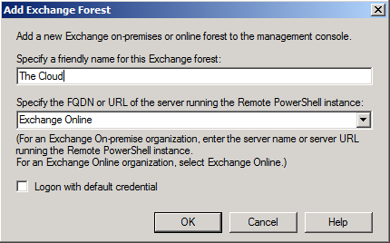
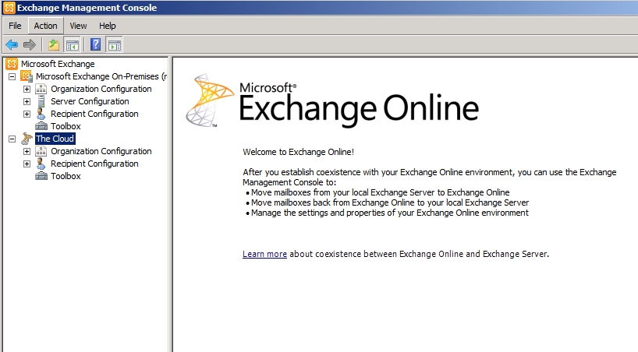
Hybrid – GUI Management
Connecting on-premise GUI to the cloud
Once you have installed Exchange Server 2010 SP1 on-premises and connected it to your Exchange Online 2010 organization, you can use EMC GUI for a number of the configuration steps on the previous slides

Slide 44
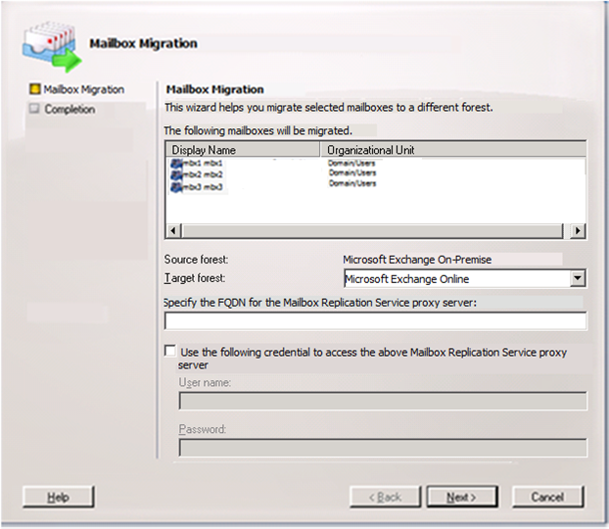

Hybrid Migration
Administrator uses EMC on-premises tool to manage mailbox moves and other administrative cross-premises tasks
  Note: There is no requirement to move mailboxes on-premises to an Exchange Server 2010 server prior to moving them to the cloud
Dirsync keeps GAL in sync as mailboxes are moved
Exchange Server 2010 CAS
Mailbox migration
Exchange Server
2010 SP1
Exchange Server 2003
Exchange Server 2007

Slide 45
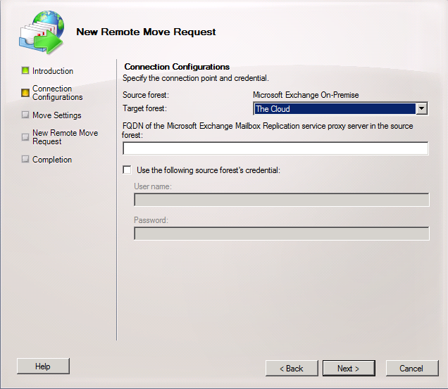
Hybrid Migration
Cross-Premises mailbox move experience
Cross-Premises moves just like on-premises
  Cross-Premises mailbox moves driven out of EMC GUI “Remote Move” wizard
  With federated sharing configuration in place, it eliminates the explicit-credentials requirement, allowing mailbox moves to be executed seamlessly to and from the cloud

Slide 46
Autodiscover
Outlook Profile Generation
(3) Outlook attempts to discover endpoint through DNS record “autodiscover.service.contoso.com”
(1) Where is my mailbox?
(2) Local Exchange passes a redirect to “service.contoso.com”
(4) Request Authentication
(5) Authentication Success
(6) Profile Builds

Slide 47
Hybrid Migration
The stuff you need to know
It’s a true “online” move – user stays connected to their mailbox through the move
  Client switchover happens automatically at the end
  Traditional “offline” move when moving from Exchange 2003 source
Outlook uses Autodiscover to detect the change and fixes up the user’s Outlook profile automatically on the client machine
Since it’s a move (not a new mailbox + data copy), Outlook doesn’t see it as a new/different mailbox. End result = No OST resync
Moves are queued and paced by the datacenter
Object conversion for mail routing happens automatically after data move
  Mailbox on-premises gets converted to Mail-enabled user automatically
  Admin can override this automation and stage the move-then-convert steps

Slide 48
Hybrid Migration
Mailbox offboarding
Why might you care about offboarding?
  Long term hybrid scenarios
  Compliance requirements (retaining ex-employee data)
  Piloting online but not committed to the move
What you need to know about offboarding?
  Offboarding is available using EMC toolset while in hybrid scenario
  Offboarding to on-premises Exchange Server 2010 database is online mailbox move
  Offboarding to on-premises Exchange Server 2003/Exchange Server 2007 database is an offline mailbox move
    Can’t stay connected to cloud mailbox receiving mail during offline move
  Offboarding without hybrid (i.e. – any other scenario, including V1 offboarding) is PST via Outlook or partner driven

Slide 49
Hybrid Recipient Management
Exchange Management Console
All recipient management should be performed through EMC 2010 SP1
Object should be created through the on-premises node
Any Policies (e.g. OWA Policy) should be assigned through the Cloud node

Slide 50
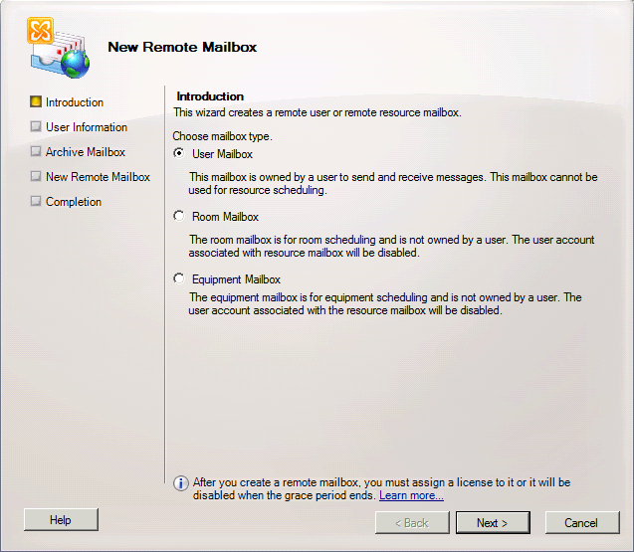
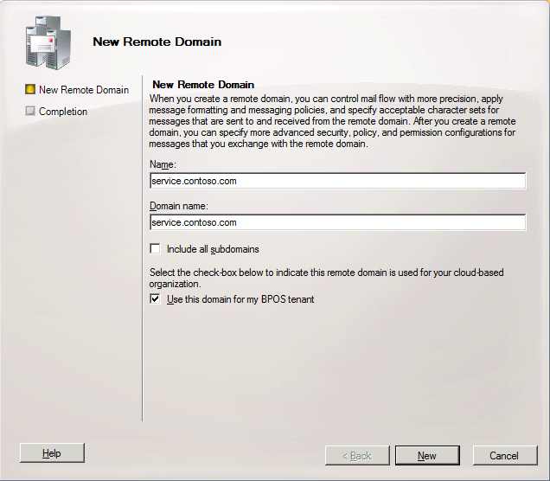
Hybrid Recipient Management
What is new to recipient management in Exchange Online?
New on-premises recipient, called “Remote Mailbox”
  Represents a Mailbox that exists in Exchange Online (Found under Contacts)
  Specific to hybrid scenario
  Appears as a Mailuser to legacy Exchange
  MRS Mailbox Move to Exchange Online will leave a Remote Mailbox in the on-premises directory
New flag on a Remote Domain allows the targetAddress to be automatically calculated

Slide 51
Hybrid Recipient Management
Cross-premises object mapping – groups & contacts
On Premises Object | Exchange Online Recipient | Details
Mail enabled contact or AD contact (non mail enabled) | Mail enabled contact | Mail enabled or plain AD contacts are synchronized as is
Mail enabled group (distribution or security group) | Mail enabled group | Mail enabled groups are synchronized to Exchange Online. Group type (sec/dis) is preserved
Non mail enabled security group | Not synchronized | Non mail enabled groups are non functional in Exchange Online and therefore not synced

Slide 52
Hybrid Recipient Management
Cross-premises object mapping - users
On Premises Object | Exchange Online Recipient | Details
Mailbox | Mailuser | If Exchange Online detects the presence of a mailbox then it creates a Mailuser in the cloud
Mailuser | Mailuser | Synchronized as is
Remote Mailbox | Mailbox | A mailbox is automatically provisioned with a 30 day license grace period
AD User (non mail enabled) | Not synchronized | Non mail enabled users are not synchronized. A “placeholder” object may be visible via PowerShell
Note: Licensing a user that does not have a Mailbox will trigger Exchange Online to provision one. This is to support a staged Exchange migration and not required for hybrid

