Slide 1

Best Practices for Virtualization of Microsoft Exchange 2010
EXL306
Jeff Mealiffe
Sr. Program Manager
Jim Lucey
Sr. Product Manager

Slide 2
Session Objectives
Exchange and Virtualization
Updated Support Guidance
Best Practices
  Basic Exchange Server Considerations
  Capacity, Sizing and Performance
  Server Deployment
  High Availability & VM Migration
  Coexistence With Other Workloads
Tools & Resources

Slide 3
Exchange and Virtualization

Slide 4
Trends – Virtualization Landscape
Virtualization is exploding resulting in VM proliferation and impacting OS share
Number of physical servers shipments used for virtualization will grow to 1.7M+ in 2012 at a CAGR of 15%
IDC Server Virtualization Forecast
9.00
8.00
7.00
6.00
5.00
4.00
3.00
2.00
1.00
VM Density
19% of physical server shipments will be used for virtualization, increasing from 11.7% in 2007
* Data from IDC Server Virtualization Forecast

Slide 5

Server Virtualization Maturity Model
75% of the market
  58% are less than 30% virtualized
  70% of organizations using more than one hypervisor
  31% expect 25:1 VM consolidation in next 24 months
  75% expect to be more than 30% virtualized in 24 months

Slide 6
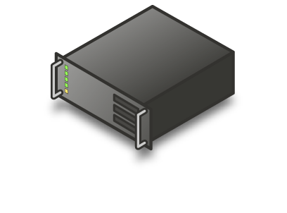


Why Virtualize Exchange
Take advantage of virtualization capabilities to optimize server utilization
Host in Datacenter
VM
1
Exchange 2010
CAS & HUB
Exchange 2010 MBX
File &
Print Server
DC 1
DAG
2
Exchange 2010 MBX
Database Server
NLB
DC 2
3
Exchange 2010
CAS & HUB
Exchange 2010 UM
Management Server
  Consolidate under-utilized servers into a single virtualized hosts
  Lower costs by reducing space needs and power consumption
  Rapid provisioning of a mobile infrastructure

Slide 7
Updated Support Guidance
Support for virtualized Exchange servers since Exchange Server 2007 SP1
Exchange 2010 release continued support for virtualization
Expanding support scenarios
Release of Exchange 2010 Virtualization Guidance whitepaper
 | Ex 2007 | Ex 2010 RTM | Ex 2010 SP1 (Now)
Any hypervisor validated under Windows SVVP
All storage used by an Exchange guest must be block level storage
Virtual storage must be fixed size, SCSI pass-through, or iSCSI
Taking virtual snapshots of Exchange guest, not supported
Virtual processor-to-logical processor ration no greater than 2:1
Exchange HA in combination with hypervisor clustering or migration
Unified Messaging role supported

Slide 8
Best Practices:
Basic Exchange Server Considerations

Slide 9
Does Virtualization Make Sense for Exchange?
No conclusive answer for all customer scenarios
Many reasons to virtualize
If virtualizing
  Understand the goals that lead to virtualization – make sure you get the platform value you designed for
  Understand the trade-offs that come with virtualization – there are costs associated with virtualization, must plan for these costs

Slide 10
Scale Up or Scale Out?
Exchange architected for scale out
  Large mailboxes, low cost, DAS, redundant inexpensive servers, etc.
Virtualization typically implies scale up (root hardware)
Avoid “all eggs in one basket”:
  Where possible, scale out Exchange servers across many root servers

Slide 11
General Deployment Reminders
Exchange isn’t “virtualization aware”
Virtualization isn’t free
  Hypervisor adds CPU overhead: ~12% in our Exchange 2010 tests
Virtualization doesn’t provide resources where they don’t truly exist
  Size for required physical resources for each VM
  Make sure you can deliver those resources

Slide 12
Unsupported Configurations
Snapshots
Differencing/delta disks
Processor over-subscription greater than 2:1
Apps running on the root
VSS backup of root for passthrough disks or iSCSI disks connected to initiator in guest

Slide 13
Best Practices:
Capacity, Sizing and Performance

Slide 14
Sizing Process Overview
Start with the physical server sizing process
  Calculator & TechNet guidance
Account for virtualization overhead
Determine VM placement
  Account for VM migration if planned
Size root servers, storage, and network infrastructure

Slide 15
Guest Sizing Rules of Thumb
Size Mailbox role first
  CPU ratios for other roles based on Mailbox role sizing
  Mailbox role performance is key to user experience
  High availability design significantly impacts sizing
Don’t over-subscribe/over-allocate resources
  Size based on anticipated peak workload, don’t under provision physical resources
Don’t forget network needs

Slide 16
Guest Sizing for Unified Messaging
Newly supported for virtualization
  Requires Exchange 2010 SP1 (or greater)
Role is susceptible to poor voice quality and/or latency if undersized
Requires min. 4 virtual processors
UM must be able to utilize physical processors on demand
Consider network requirements (low latency, sufficient bandwidth) to meet UM needs
Tests show that 4VP/16GB VM can handle 40 concurrent calls with VM Preview and 65 calls without

Slide 17
Root Server Sizing
Root server storage sizing includes space for the OS & required hypervisor components, plus connectivity to storage for guest VMs
  Don’t forget about high availability of storage if required (multi-path HBAs or iSCSI NICs, redundant paths, etc.)
Network sizing is critical: number of interfaces and bandwidth
  Consider app connectivity, storage networking, heartbeats, CSV, VM migration

Slide 18
Root Server Sizing
CPU sizing should include root needs plus per-guest overhead
  Follow hypervisor vendor recommendations
Memory sizing should not assume overallocation
  Follow hypervisor vendor recommendations
  Provide memory for root plus sum of running VM requirements
  Memory for Hyper-V root = the larger of 512MB or the per-VM value (summed for running VMs) of 32MB for the first 1GB of virtual RAM + 8MB for each additional GB of virtual RAM
    Example: 8 VMs running, each with 32GB RAM. Root requires 8 * (32MB + 8MB*31) = 2240MB

Slide 19
Virtual Processors
Scale up CPU on VMs as much as possible
  Don’t deploy 4 x 1 vCPU machines vs. 1 x 4 vCPU machine: take advantage of Exchange scalability
Don’t over-subscribe CPUs unless consolidating with P2V, or similar scenario
Generally assume 1 logical CPU == 1 virtual CPU, don’t assume that a hyperthreaded (SMT) CPU counts

Slide 20
Best Practices:
Server Deployment

Slide 21
Locating Virtual Machines
VM placement is important for high availability
Don’t co-locate DAG database copies on physical hosts
Exchange unaware of VM location relative to other VMs
  No path correction in transport to avoid data loss
Ensure peak workload can run in standard VM locations
  OK to move temporarily for maintenance assuming high availability requirements are met and current workload can be serviced

Slide 22
Storage Decisions
Exchange performance and health highly dependent on availability and performance of storage
Many options for presentation of storage to VMs
  VHD
  FC
  iSCSI, FCoE
  DAS
Optimize for performance and general design goals
  We recommend looking for options that provide large mailboxes and low cost

Slide 23
Storage Decisions
Exchange storage should be on spindles separate from guest OS VHD physical storage
Exchange storage must be fixed VHD, SCSI passthrough or iSCSI
  Preference is to use SCSI passthrough to host queues, DBs, and logfile streams
  Hyper-V Live Migration suggests Cluster Shared Volumes with fixed VHD (faster “black-out” period)
FC/SCSI HBAs must be configured in Root OS with LUNs presented to VMs as passthrough or VHD
Internet SCSI (iSCSI)
  Standard best practices for iSCSI connected storage apply (dedicated NIC, jumbo frames, offload, etc…)
  iSCSI initiator in the guest is supported but need to account for reduced performance
Exchange storage must be block-level
  Network attached storage (NAS) volumes not supported

Slide 24
Exchange VM Deployment
Exchange setup must be run when VM is provisioned
  Not “sysprep friendly”
Possible to script Exchange setup to fully automate Exchange VM provisioning
Build “starter image” with desired OS, patches, pre-reqs, and Exchange install binaries

Slide 25
Best Practices:
High Availability & VM Migration

Slide 26
High Availability And Disaster Recovery
Exchange High Availability Definition
  Automatic switch over of application services which doesn’t compromise the integrity of application data
  Selection of “active” data set occurs within the application automatically
Exchange Disaster Recovery Definition
  Manual fail over of application services with high retention of data integrity
  Selection of “active” data set occurs manually outside the application, Exchange application provides support to minimize data loss through replication

Slide 27
Exchange 2010 High Availability
Database Availability Group (DAG)
  A group of up to 16 Exchange Server 2010 Mailbox servers that provide automatic database-level recovery
  Uses continuous log replication and a subset of Windows Failover Clustering technologies
  Can extend across multiple datacenters/AD sites
Benefits of Exchange Native Data Protection
  Protection from database, server or network failure
  Automatic failover protection and manual switchover control is provided at the mailbox database level instead of at the server level.
  Support for up to 16 copies, support for lag copies

Slide 28
Host Based Failover Clustering
Host Based Failover Clustering HA
  Using Host Based Failover Clustering and automatically failing VMs to an alternate cluster node in the event of a critical hardware issue (virtualization platform independent)
What you need to be aware of:
  Not an Exchange Aware Solution
  Only protects against server hardware/network failure
  No HA in the event of storage failure / data corruption
  Trend is larger mailboxes = larger database sizes = longer time to recover from data loss = DAG
  Requires a shared storage deployment

Slide 29
VM Migration and Exchange 2010
Physical Computer Maintenance
  Operating System/Application Updates
  Hardware Maintenance
Rebalancing Workloads
  Dynamic redistribution of VM’s to optimize workload on physical hardware
Green IT
  ‘Off Peak’ Virtual Machine Consolidation

Slide 30
VM Cluster & Migration Considerations
Minimize “outage” during migration operations
  Consider CSV rather than pass-through LUNs for all Mailbox VM storage
Disable migration technologies that save state and migrate: always migrate live or completely shut down
Consider relaxing cluster heartbeat timeouts
  Cluster nodes considered down after 5 seconds by default
Be aware of additional network interface requirements for VM migration technologies – size network appropriately

Slide 31
Best Practices:
Coexistence With Other Workloads

Slide 32
Private Cloud Considerations
Given fixed resource requirements, isolate Exchange within private cloud as much as possible
Be prepared to apply different resource management polices to Exchange VMs vs. other workloads which may be less mission critical
Use private cloud as pre-built infrastructure, not necessarily dynamic
  Based on deployment sizing, understand overall resource requirements and allocate accordingly from pool of cloud resources

Slide 33
Resource Allocation & Balancing
Disable hypervisor-based auto tuning features
  Dynamic memory
  Storage tuning/rebalancing
Exchange Mailbox role IOPS heavily dependent on ESE cache, dynamic memory can negatively impact
Size for calculated resource requirements – no reliance on dynamic tuning should be needed

Slide 34
Tools & Resources

Slide 35
Server Virtualization Validation Program
List of validated 3rd party virtualization solutions
Matrix includes:
  Vendor
  Product & version
  OS architecture
  Processor architecture
  Max supported processors & memory
  http://www.windowsservercatalog.com/svvp/

Slide 36
Exchange 2010 Solutions (on Hyper-V)
HP configurations
  HP BladeSystem Matrix and Microsoft Exchange Server 2010: http://bit.ly/jE2yPn
  Exchange Server 2010: HP LeftHand P4000 SAN for 5,000 users: http://bit.ly/m7z7B4
  Exchange Server 2010: StorageWorks EVA8400 using CA-EVA and CLX-EVA for 20,000 users: http://bit.ly/mNAsDO
Dell configurations
  Dell servers running in single site for 500 users: http://bit.ly/loEl9r
  Dell M610 servers with Dell Equalogic storage for 9,000 users: http://bit.ly/krUecS
  Dell R910 servers with EMC CLARiion storage for 20,000 users: http://bit.ly/kWthfD
Unisys configurations
  Unisys ES7000 servers for 15,000 users: http://bit.ly/kOBSuo
EMC configurations
  EMC unified storage and Cisco unified computing system for 32,000 users: http://bit.ly/9DBfoB

Slide 37
Support Guidelines
TechNet is the single source for Exchange support guidelines:
http://technet.microsoft.com/en-us/library/aa996719.aspx
SVVP Support Policy Wizard is a great tool:
http://www.windowsservercatalog.com/svvp.aspx?svvppage=svvpwizard.htm
  Always confirm SPW results with our TechNet article
Check back for updates
  Clarifications published frequently

Slide 38
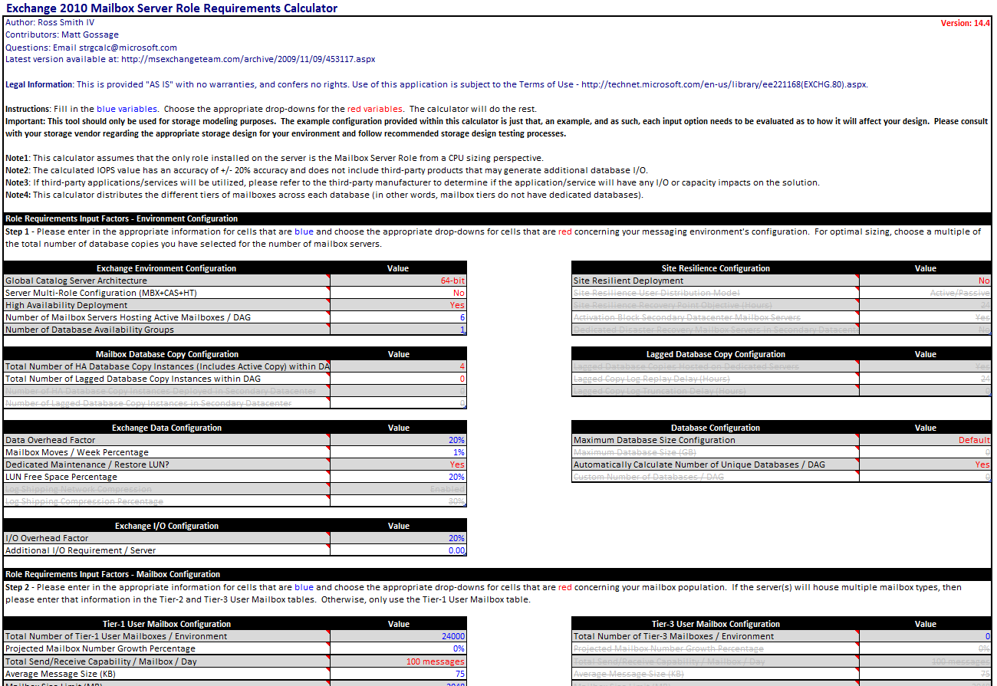
Sizing Calculator
Mailbox Role Requirements Calculator
  Follows Product Group recommendations on storage configuration, memory, mailbox sizing
  Produces I/O and capacity requirements, LUN design, Mailbox server count and processor requirements
  Available from http://tinyurl.com/y9shhpx

Slide 39
Summary
Exchange and Virtualization
Updated Support Guidance
Best Practices
  Basic Exchange Server Considerations
  Capacity, Sizing and Performance
  Server Deployment
  High Availability & VM Migration
  Coexistence With Other Workloads
Tools & Resources

Slide 40
Related Content
Required Slide
Speakers, please list the Breakout Sessions, Interactive Discussions, Labs, Demo Stations and Certification Exam that relate to your session. Also indicate when they can find you staffing in the TLC.
Breakout Sessions
  VIR317: Understanding How Microsoft Virtualization Compares to VMware
  VIR320: Virtualizing Exchange Server with Hyper-V
Interactive Sessions
  EXL376-INT: Hewlett-Packard & Microsoft Q&A on Exchange Virtualization
Find Us Later At…
  At the Exchange booth after the EXL376-INT session

Slide 41
Track Resources
Required Slide
Track PMs will supply the content for this slide, which will be inserted during the final scrub.
Exchange Virtualization Guidance whitepaper
http://msexchangeteam.com
http://www.microsoft.com/virtualization
Exchange virtualization case studies

Slide 42





Resources
  Connect. Share. Discuss.
http://northamerica.msteched.com
Learning
  Sessions On-Demand & Community
  Microsoft Certification & Training Resources
www.microsoft.com/teched
www.microsoft.com/learning
  Resources for IT Professionals
  Resources for Developers
http://microsoft.com/technet
http://microsoft.com/msdn

Slide 43












Complete an evaluation on CommNet and
enter to win!

Slide 44


Slide 45

© 2011 Microsoft Corporation. All rights reserved. Microsoft, Windows, Windows Vista and other product names are or may be registered trademarks and/or trademarks in the U.S. and/or other countries.
The information herein is for informational purposes only and represents the current view of Microsoft Corporation as of the date of this presentation. Because Microsoft must respond to changing market conditions, it should not be interpreted to be a commitment
on the part of Microsoft, and Microsoft cannot guarantee the accuracy of any information provided after the date of this presentation. MICROSOFT MAKES NO WARRANTIES, EXPRESS, IMPLIED OR STATUTORY, AS TO THE INFORMATION IN THIS PRESENTATION.

