Slide 1

Microsoft Lync 2010:
In the Cloud
EXL202
Ziv Fass
Senior Product Manager, Lync Online
Microsoft

Slide 2
Today’s session
Overview of Lync online
Lync Server and Lync Online
Lync and Private cloud

Slide 3







What is Microsoft Office 365?
Bringing together cloud versions of our most trusted communications and collaboration products with the latest version of our desktop suite for businesses of all sizes
Office 365

Slide 4

Lync Online
Connecting with people in new ways
Instant Messaging
Online Meetings
IM, presence & video calls
Audio, video and web conferencing

Slide 5
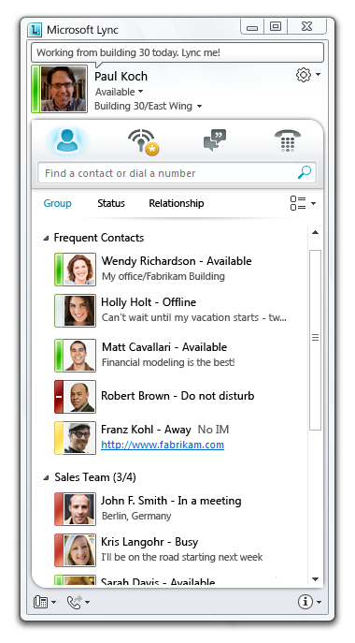
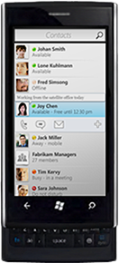
IM & Presence
Connect in the right way right from Office apps
Rich Presence
Instant Messaging
Lync-to-Lync video calls
Click-to-Lync right from Office
Lync with external orgs and
Windows Live
Presence updates based on
Exchange calendar
Lync IM on smart phones*
* Available in Lync Online post Office 365 launch (late 2011)

Slide 6
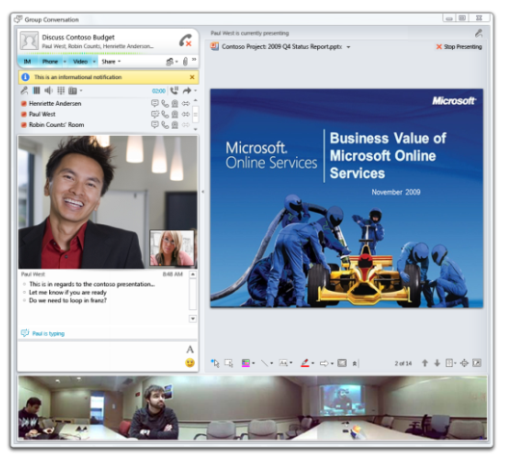
Online Meetings
Communicate more effectively and reduce travel costs
Ad-hoc and scheduled virtual meetings (up to
250 attendees)
audio/video/web conferencing
Easy scheduling via Outlook
Native and web clients for external attendees
Interop with 3rd party dial-in audio conferencing services

Slide 7
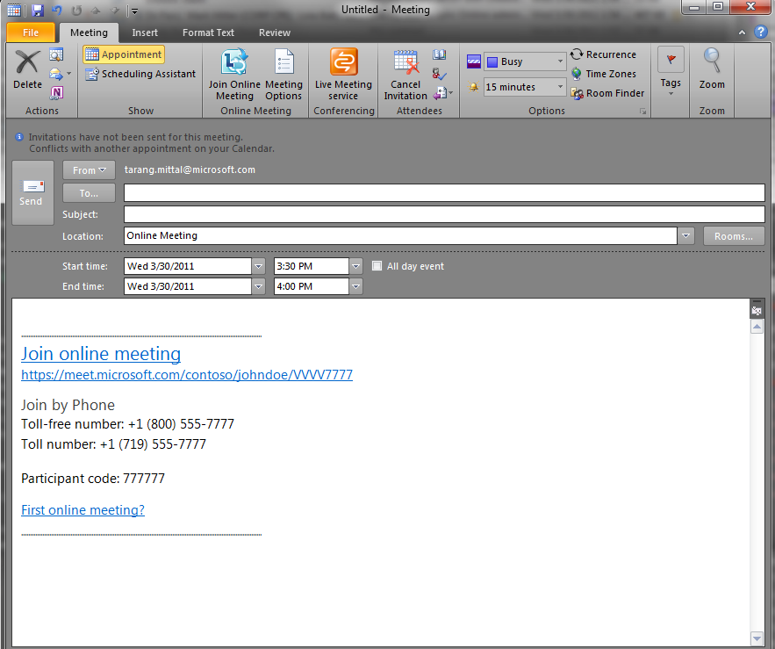
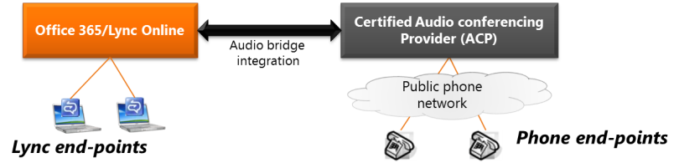
Interop with Dial-in Audio Conferencing
Audio conferencing services purchased directly from certified partners
Passcodes and access numbers imported to Lync Online admin console
  Initial partners for launch: BT, Intercall, Premiere Global (PGi)

Slide 8
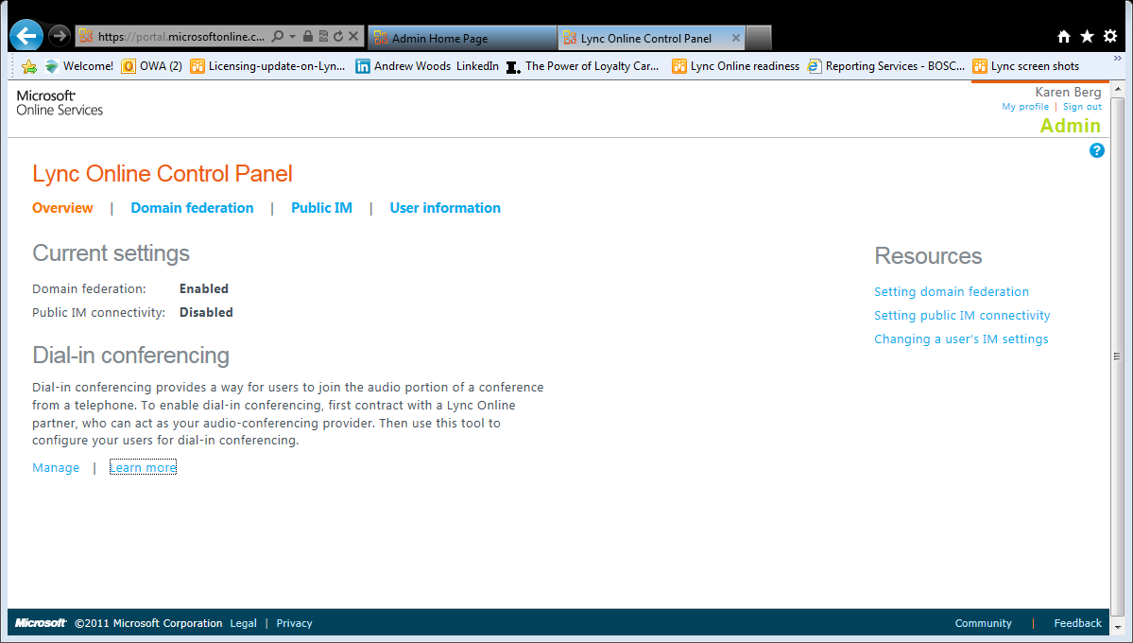
Lync Online Admin Console
Tenant level settings
Lync Federation (on/off, white/black list)
Lync with Windows live
User level settings
Lync Audio/video*
Dial-in audio conferencing information
File Transfer
Lync with external organizations (Lync federation)
Lync with Windows live
* Multiparty audio/video not available in some countries due to regulatory restrictions

Slide 9
Lync Online & Office 365
demo

Slide 10
Lync Online Voice – Available Post Launch
Instant Messaging
Online Meetings
Voice
IM, presence & video calls
Audio, video and web conferencing
Soft phone for mobile information workers

Slide 11
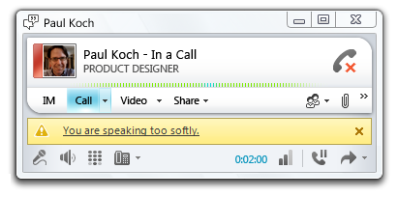
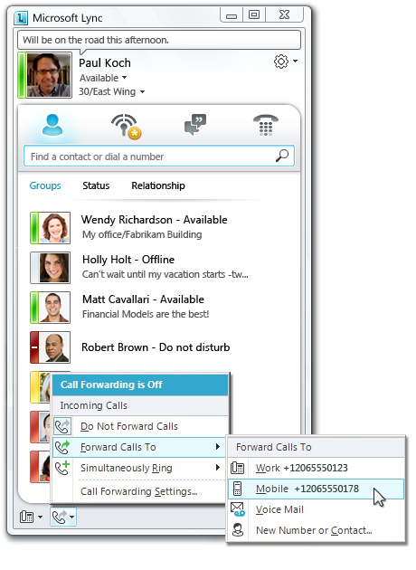
Voice for Mobile Information Workers*
Work from anywhere as if you are sitting at your office desk
Make and receive calls to any number
Set incoming calls to ring mobile phone
Drag-and-drop conference calling
Interop with Exchange Online voice mail
‘Optimized for Lync’ PC peripherals
* Coming to Lync Online post Office 365 launch

Slide 12




Lync Online Voice – Solution Architecture
Microsoft Data Center
Partner
Carrier
Lync Online
Exchange Online
SIP
PSTN
Internet
Phone numbers and calling plans purchased from carrier partner – separate contract and bill
Provisioning of phone numbers performed in Lync Online administration console
Available with select partners and countries at launch…expanding over time

Slide 13
Lync Online and Lync Server
Instant Messaging
Online Meetings
Voice
Enterprise Voice
  LYNC SERVER
✓
✓
✓
✓
  LYNC ONLINE
✓
✓
Post Launch
Not Available

Slide 14
Lync Server Provides Full Enterprise Voice
Enterprise Voice
Interop with PBX, gateways and SIP trunks
Lync IP phones and analog devices
E-911
Call Admission Control
Branch office appliance
Response groups
Conferencing
Interop with room-based conferencing systems
Native Lync dial-in audio conferencing
Platform & compliance
Server side APIs
3rd party archiving solutions
  Lync Server 2010 only – all Lync workloads must be run on Lync Server

Slide 15




Lync Server with Exchange Online
Email & Calendar
Voice Mail
Email Archiving
Single identity &
Interoperability
Lync Server delivers the full value of UC
Start moving to the Office 365 cloud with Exchange Online
Lync Server can be managed
On-premises or via private cloud
IM & Presence
Online Meetings
Enterprise Voice (w/ PBX replace)
Interop with existing infrastructure

Slide 16
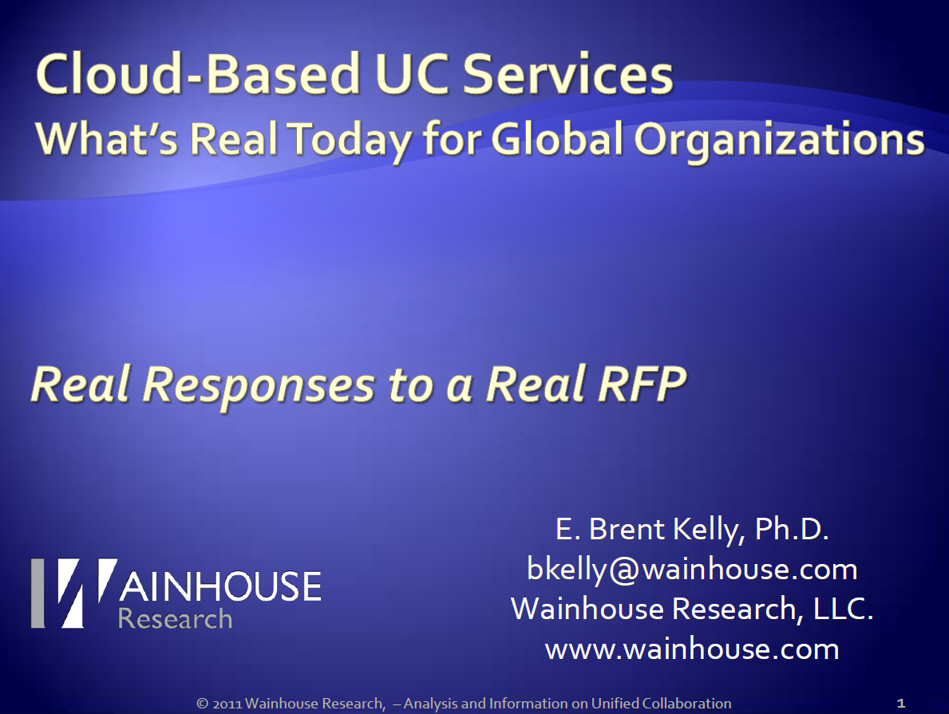
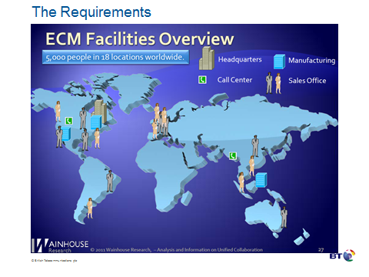
A ‘Real World’ Example for Cloud UC
Requirement:
Cloud UC solution
For 5000 seats

Slide 17
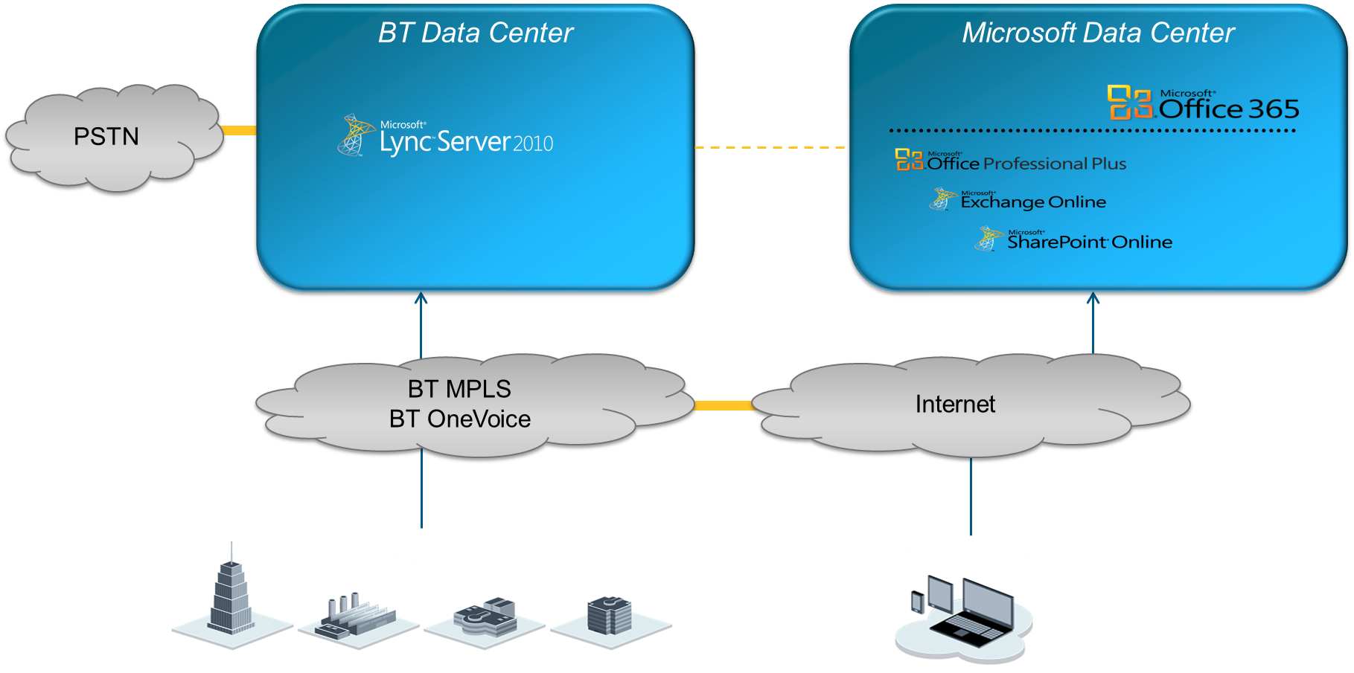
Combined Cloud Offering from BT & Microsoft
Lync in BT private cloud, rest of Office 365 in Microsoft multi-tenant cloud
Managed network with QoS for Lync audio and video traffic
Highly redundant and survivable design (geo-redundancy and branch survivability)

Slide 18
What You Need To Remember
Lync Online delivers IM & online meetings as part of Office 365 (public cloud)
  Voice (Lync-to-PSTN) is coming post Office 365 launch
Lync Server delivers Enterprise Voice w/ PBX replace
  On-premises or private cloud
  Works with Exchange Online in Office 365
Not on Lync yet? Try out Lync Online at Office365.com

Slide 19

Related Content
Required Slide
Speakers, please list the Breakout Sessions, Interactive Discussions, Labs, Demo Stations and Certification Exam that relate to your session. Also indicate when they can find you staffing in the TLC.
Key Breakout Sessions:
EXL314: Microsoft Lync 2010 and the Enterprise Network
EXL315: Microsoft Lync 2010: Core Voice Planning and Deployment
EXL303: Four Ways to Leverage the Microsoft Lync 2010 Client API's in Your Applications
…
Lync Online service description on Microsoft download center
Office 365 online community – http://community.office365.com
Find me after the session at the Lync demo booth

Slide 20





Resources
  Connect. Share. Discuss.
http://northamerica.msteched.com
Learning
  Sessions On-Demand & Community
  Microsoft Certification & Training Resources
www.microsoft.com/teched
www.microsoft.com/learning
  Resources for IT Professionals
  Resources for Developers
http://microsoft.com/technet
http://microsoft.com/msdn

Slide 21












Required Slide
Complete an evaluation on CommNet and
enter to win!

Slide 22


Slide 23

© 2011 Microsoft Corporation. All rights reserved. Microsoft, Windows, Windows Vista and other product names are or may be registered trademarks and/or trademarks in the U.S. and/or other countries.
The information herein is for informational purposes only and represents the current view of Microsoft Corporation as of the date of this presentation. Because Microsoft must respond to changing market conditions, it should not be interpreted to be a commitment
on the part of Microsoft, and Microsoft cannot guarantee the accuracy of any information provided after the date of this presentation. MICROSOFT MAKES NO WARRANTIES, EXPRESS, IMPLIED OR STATUTORY, AS TO THE INFORMATION IN THIS PRESENTATION.

Slide 24
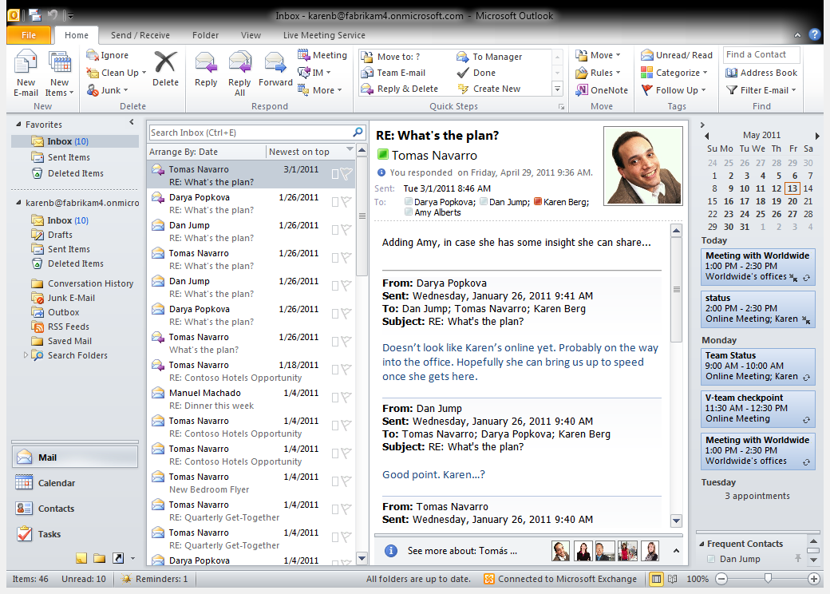
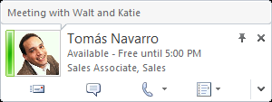

Slide 25
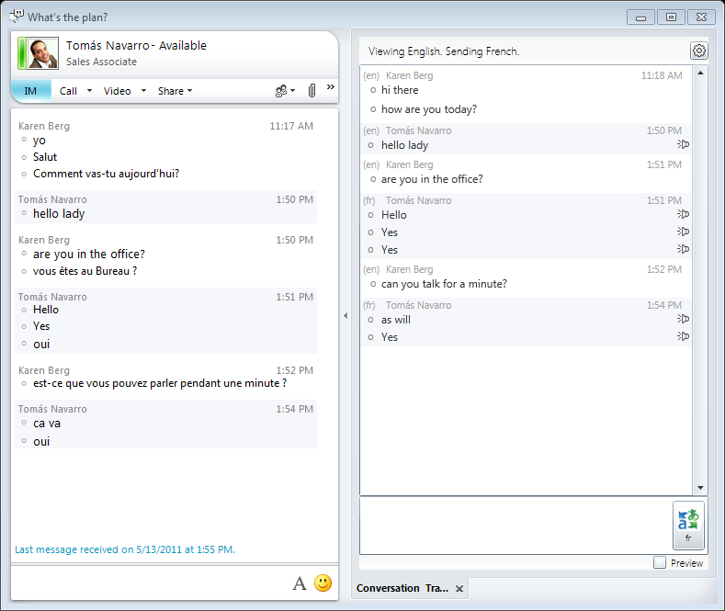

Slide 26
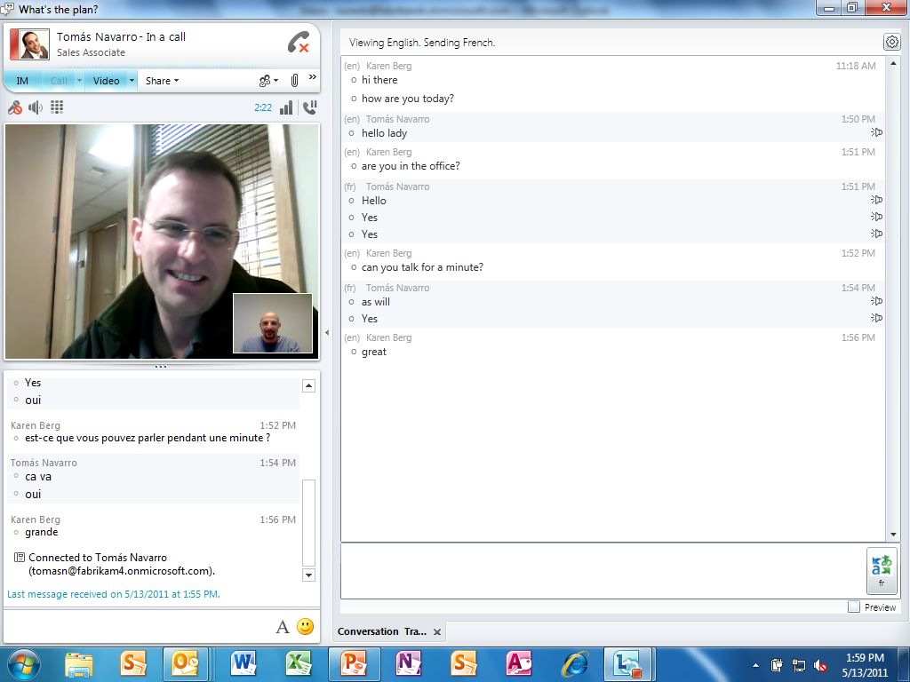

Slide 27
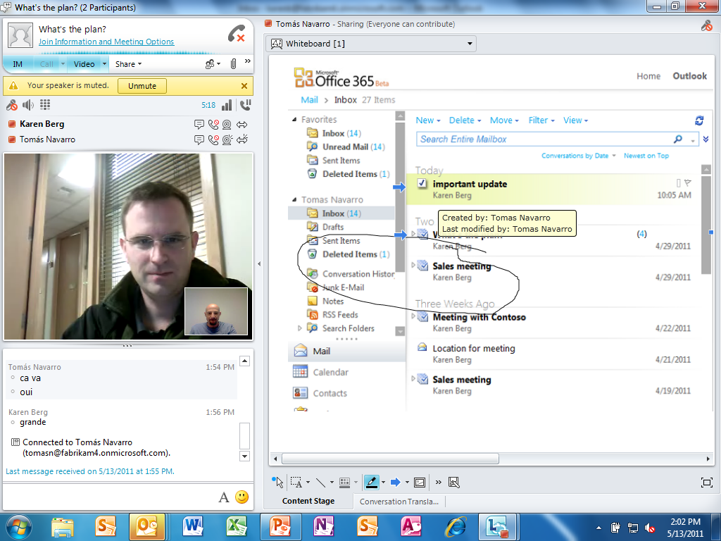

Slide 28
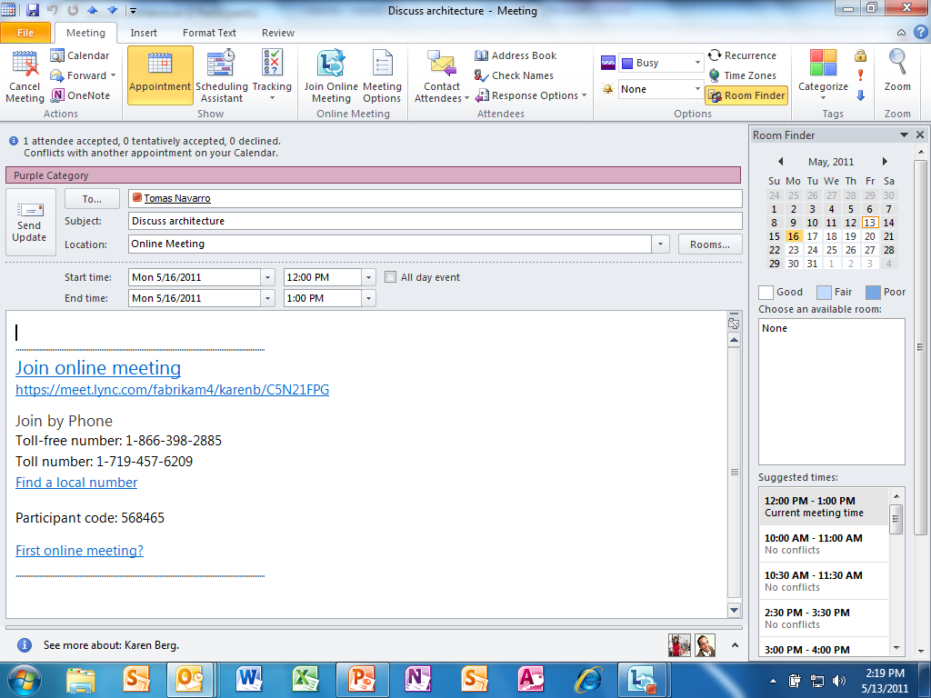

Slide 29
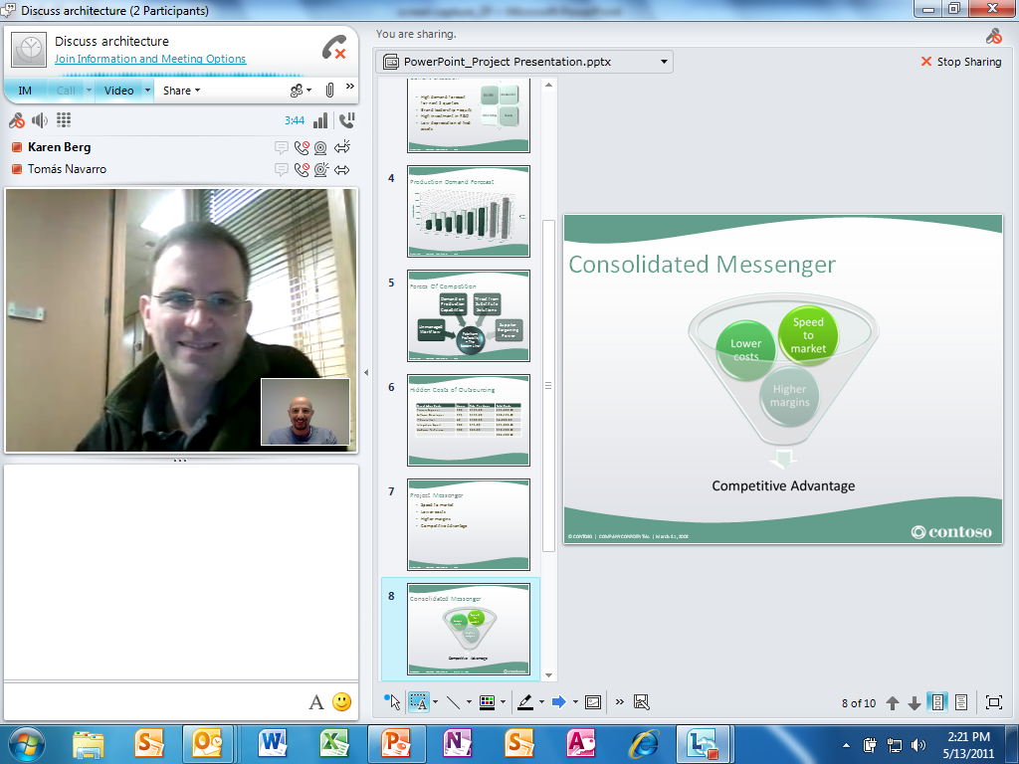

Slide 30
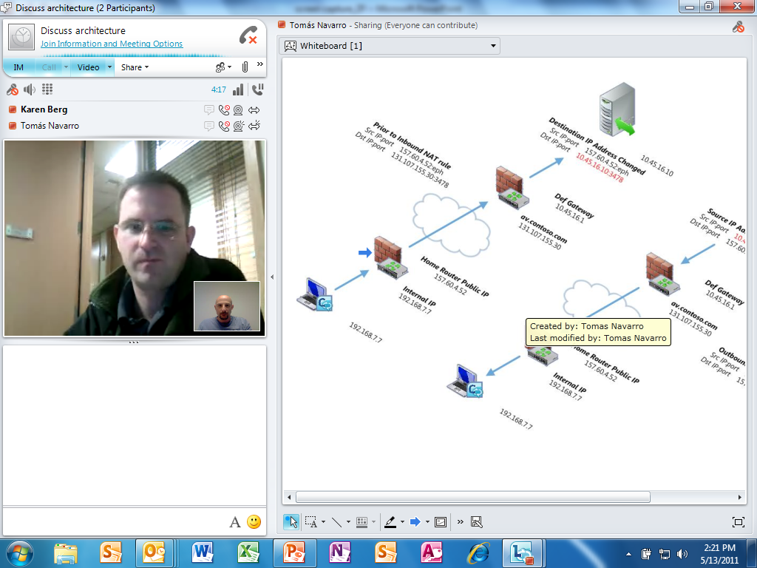

Slide 31
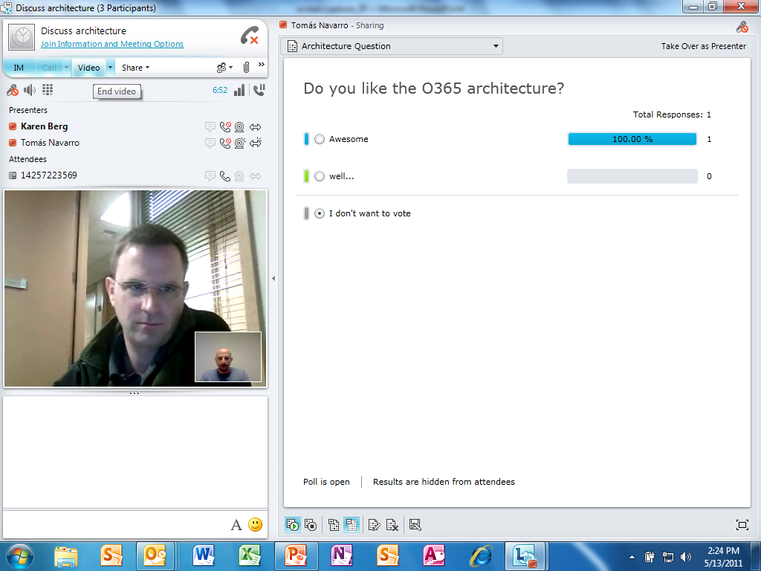

Slide 32
