Slide 1
Asymptotes and Algorithms
What You’ve Forgotten
Since University
DPR302
By Gary Short
Developer Evangelist
Developer Express

Slide 2
Agenda
Introduction
What is an Algorithm?
Why Optimization is Important
Optimisation is Child’s Play
Why do we Use Mathematics?
One Tactic for Optimizing an Algorithm
But .Net Saves me from all that, Right?
Questions.

Slide 3
Introduction
Gary Short
Developer Evangelist DevExpress
Microsoft MVP in C#
garys@devexpress.com
@garyshort

Slide 4

What is an Algorithm?
… a finite list of well defined steps to complete a task or calculation.

Slide 5
There are simple ones…

Slide 6
There are complex ones…

Slide 7
Prove no three positive integers a, b, and c can satisfy the equation a^{n} + b^{n} = c^{n} for any integer value of n greater than two

Slide 8
Why is optimization important?

Slide 9
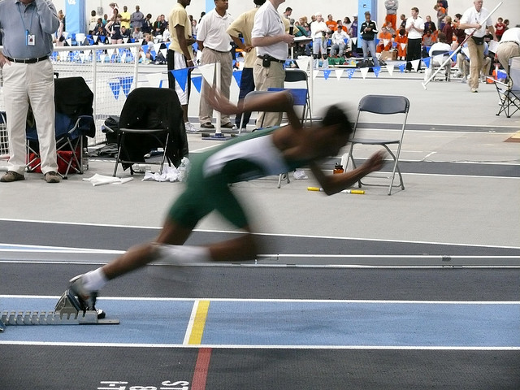
http://www.flickr.com/photos/mushjazzlexima-leakpaalex/2237327967/

Slide 10
Optimization is Child’s Play

Slide 11
Take This Algorithm…
Stop current task
Wash hands
Sit at table
  Foreach item of food in MainCourse
    Consume food
Wait for dessert
Consume dessert
Wait for meal completion
Foreach dish in dishes
  Clear dish from table
Foreach dish in dishes
  Wash dish
Return to previous task

Slide 12
Optimized by my 4 Year Old Daughter to…
Pause current game
Set velocity = MAX_INT
Move to table
TakeSliceBread(2)
Foreach item of food in MainCourse
  Place item on BreadSlice(1)
Place BreadSlice(2) on top
Leave table
Resume current game

Slide 13
And it’s not a skill we lose in adulthood

Slide 14
Morning Algorithm
Rise
Shower
Boil kettle
Make tea
Toast bread
Spread butter on toast
Consume breakfast
Brush teeth
Commute to work

Slide 15
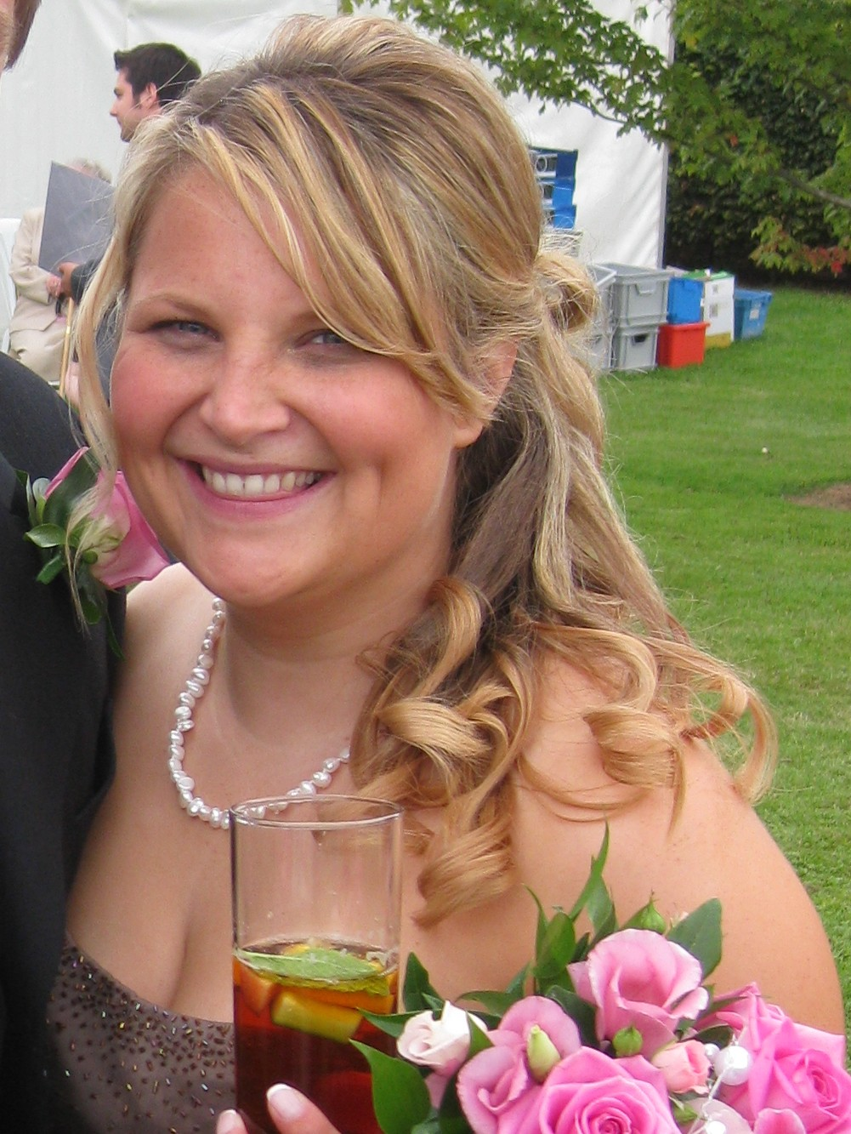

Slide 16


Slide 18
Optimized for Smallville…
Rise
Rush downstairs
Put kettle on to boil
Put toast in toaster
Rush back upstairs
Shower
Rush downstairs
Make tea and spread toast
Watch Smallville
Consume tea and toast

Slide 19
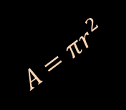
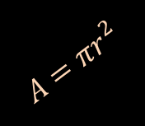
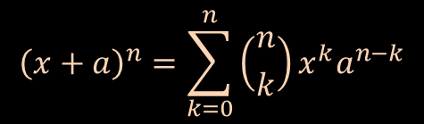
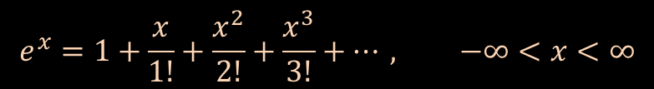
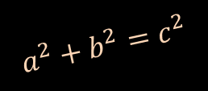

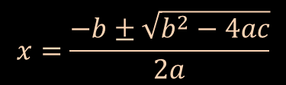
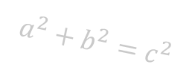
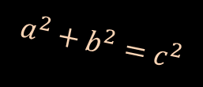
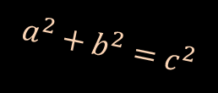
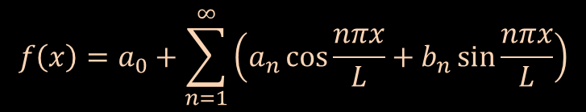

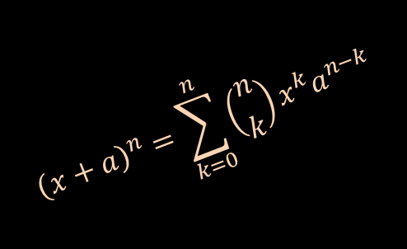
The Only Thing Hard About This is…
$$f\left(x\right)=a_{0}+\sum_{n=1}^{∞}{\left(a_{n}\cos{\frac{nπx}{L}}+b_{n}\sin{\frac{nπx}{L}}\right)}$$
$$A=πr^{2}$$
$$a^{2}+b^{2}=c^{2}$$
The language we chose to use to describe it
$$a^{2}+b^{2}=c^{2}$$
$${\left(x+a\right)}^{n}=\sum_{k=0}^{n}{\left({n \atop k}\right)x^{k}a^{n−k}}$$
$${\left(x+a\right)}^{n}=\sum_{k=0}^{n}{\left({n \atop k}\right)x^{k}a^{n−k}}$$
$$A=πr^{2}$$
$$a^{2}+b^{2}=c^{2}$$
$$x=\frac{−b±\sqrt{b^{2}−4ac}}{2a}$$
$$A=πr^{2}$$
$$A=πr^{2}$$
$$e^{x}=1+\frac{x}{1!}+\frac{x^{2}}{2!}+\frac{x^{3}}{3!}+…, −∞<x<∞$$
$$a^{2}+b^{2}=c^{2}$$

Slide 20
So Why do we use Math?

Slide 21

http://www.flickr.com/photos/truelifeimages/2102930162/

Slide 22
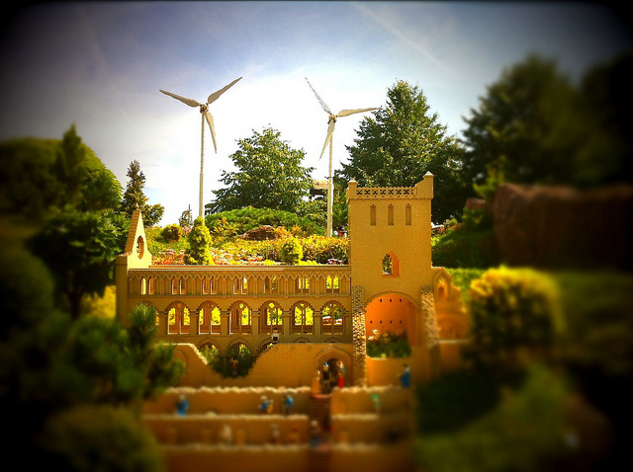
http://www.flickr.com/photos/29019866@N00/4783131736/

Slide 23
Our Model Has…
Single processor
RAM
Understands arithmetical instructions
  Add
  Subtract
  Pop
  Push
All instructions executed sequentially
All instructions take constant time to complete.

Slide 24
demo

Slide 25
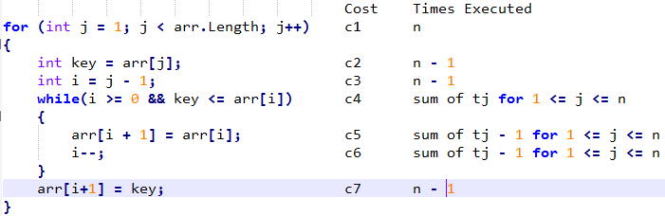

Slide 26
Running Time is Then…
Sum running times for each statement
Product of the cost and the time
So…
T(n) = c1n + c2(n-1) + c3(n-1) + c4(sum of tj for 1 <= j <= n) + c5(sum of tj -1 for 1 <= j <= n) + c6(sum of tj -1 for 1 <= j <= n) + c7(n-1).

Slide 27
Best Case Running time
When the collection is already sorted
T(n) = c1n + c2(n-1) + c3(n-1) + c4(n-1) + c7(n-1-)
T(n) = (c1+c2+c3+c4+c7)n – (c2+c3+c4+c7)
Which is a function in the form an + b
Thus T(n) is a linear function of n.

Slide 28
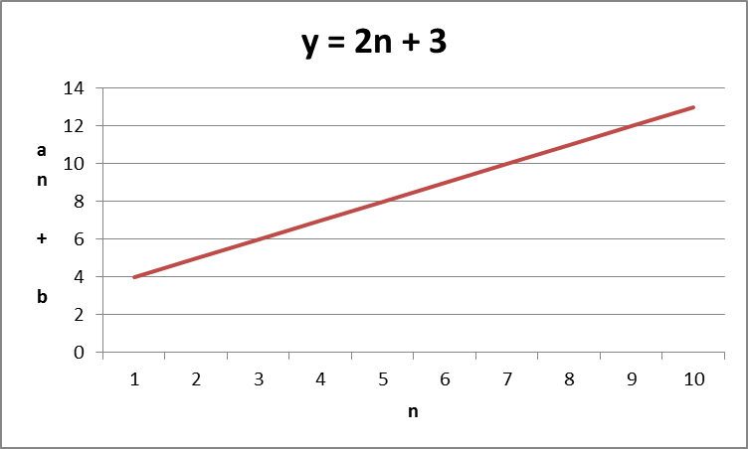
Let’s Quickly Prove That…

Slide 29
Worst Case Running Time
Reverse sorted order
T(n) = c1n + c2(n-1) + c3(n-1) + c4(n(n+1)/2 -1) + c5(n(n-1)/2) + c6(n(n-1)/2) + c7(n-1)
T(n) = (c4/2 + c5/2 + c6/2)n^2 + (c1 + c2 + c3 + c4/2 – c5/2 – c6/2 + c7)n – (c2 + c3 + c4 + c7)
Which is a function in the form an^2 + bn + c
Thus T(n) is a quadratic function of n.

Slide 30
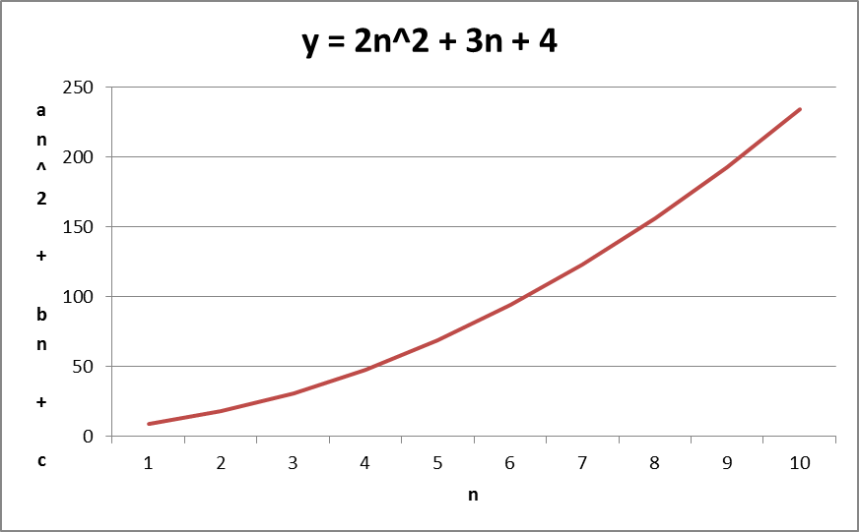
Again Let’s Quickly Prove That

Slide 31
So Now We Can Prove Speed
an + b
Is faster than
an^2 + bn + c

Slide 32
Can we Make The Notation More Readable?

Slide 33
Asymptotic Notation
Big ‘O’ Notation
For the functions
  an + b
  an^2 + bn + c
If n is sufficiently large
  Then the largest term of n dominates the function
So
  T(n) = an + b = O(n)
  T(n) = an^2 + bn + c + O(n^2).

Slide 34
So Now we Can Say…
Insertion Sort is
  Best Case
    O(n)
  Worst Case
    O(n^2)

Slide 35
But we only care about the worst case

Slide 36
Let’s Optimize Our Search Algorithm

Slide 37
Let’s do What we Did When we Were Kids
Divide the problem up into smaller parts and conquer each
of those smaller parts before combining the solutions.

Slide 38
Demo

Slide 39
Okay, so How Fast is That Algorithm?

Slide 40
Merge Sort in 3 Easy Parts
Divide
  Computes the middle of the array
  Constant time
    D(n) = O(1)
Conquer
  Recursively solve two n/2 sized sub problems
    Each contribute 2T(n/2)
Combine
  Combine step is linear
    C(n) = O(n)
So worst case
  2T(n/2) + O(n)

Slide 41
Use The Master Method to Solve This Recursion

Slide 42
What is The Master Method?
‘Recipe’ for solving recurrences in the form
  T(n) = aT(n/b) + f(n)
  Where
    The constants a >= 1 and b > 1
    And f(n) is asymptotically positive
  Our function 2T(n/2) + O(n) is in this form ☺

Slide 43
How Does it Work?
Recall it works with function of the form
  aT(n/b) + f(n)
We compare f(n) with n log ba
The larger of the two determines the solution
If n log ba is larger then
  T(n) = O(nlogba)
If f(n) is larger then
  T(n) = O(f(n))
If they are equal then we multiply by log factor
  T(n) = O(f(n) log n)

Slide 44
So in Our Example
We’re in case three
Worst case Merge Sort is
  O(n log n)
Which is much better than Insertion Sort
  O(n^2)

Slide 45
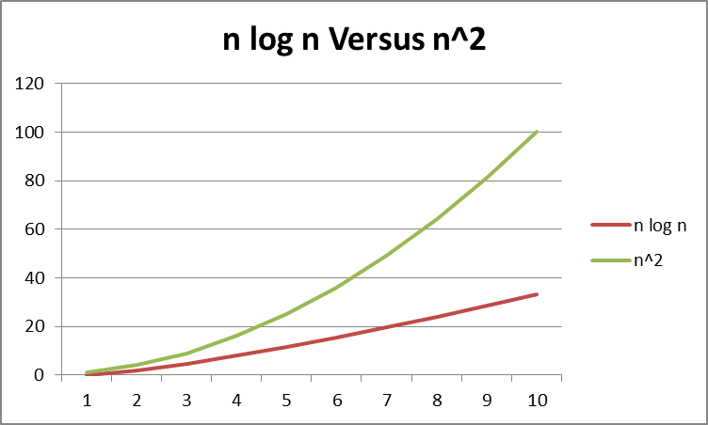

Slide 46
But .net Handles all this for me

Slide 47
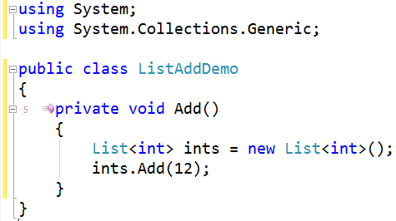
List<T> - Add

Slide 48
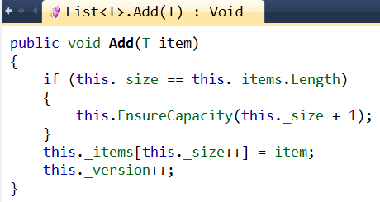
List<T> - Growing

Slide 49
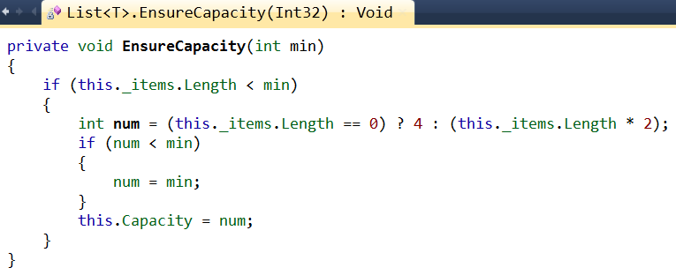
List<T> - EnsureCapacity

Slide 50
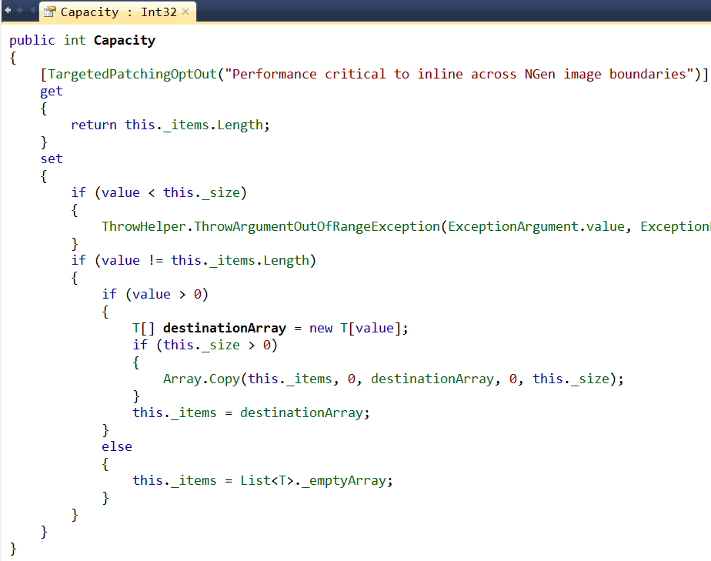
List<T> - Capacity

Slide 51
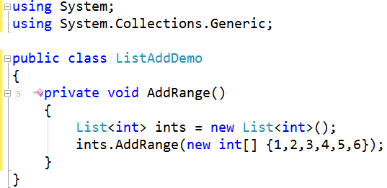
List<T> - AddRange

Slide 52
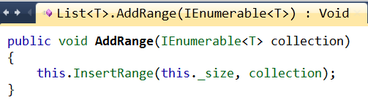
List<T> - AddRange

Slide 53
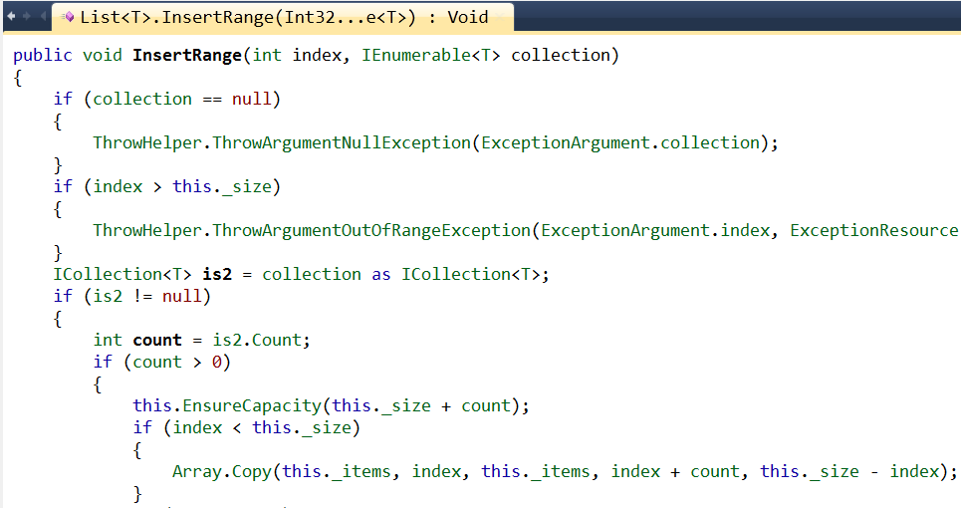
List<T> - InsertRange

Slide 54
So What are the Performance Implications?

Slide 55
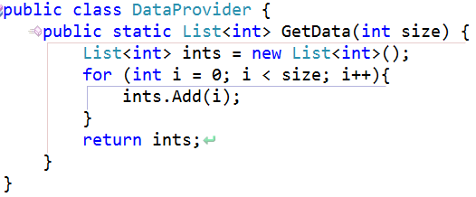
Data Provider

Slide 56
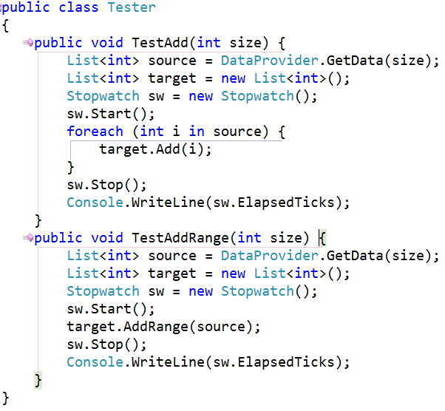
Tester

Slide 57
Results

Slide 58
What We’ve Learned
Performance is important
Optimization comes naturally to us
Divide and conquer
Running time is the sum of product of cost and execution
Maths syntax makes this all seem scary
Asymptotic notation simplifies language
This stuff matters, even in the age of .net.

Slide 59
Questions?
garys@devexpress.com
@garyshort

Slide 60
DPR Track Resources
http://www.microsoft.com/visualstudio
http://www.microsoft.com/visualstudio/en-us/lightswitch
http://www.microsoft.com/expression/
http://blogs.msdn.com/b/somasegar/
http://blogs.msdn.com/b/bharry/
http://www.microsoft.com/sqlserver/en/us/default.aspx
http://www.facebook.com/visualstudio

Slide 61





Resources
  Connect. Share. Discuss.
http://northamerica.msteched.com
Learning
  Sessions On-Demand & Community
  Microsoft Certification & Training Resources
www.microsoft.com/teched
www.microsoft.com/learning
  Resources for IT Professionals
  Resources for Developers
http://microsoft.com/technet
http://microsoft.com/msdn

Slide 62












Complete an evaluation on CommNet and
enter to win!

Slide 63


