Slide 1

Offline Microsoft Silverlight Applications
DEV339
Steve Lasker
Lead Program Manager
Microsoft Silverlight

Slide 2

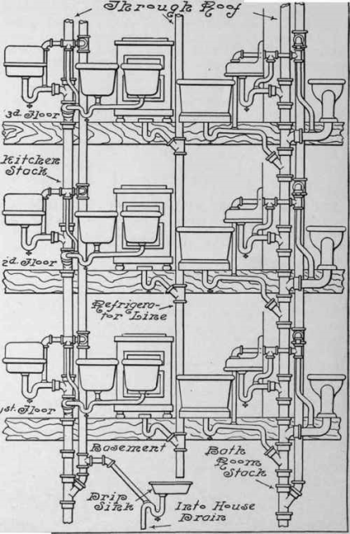
Offline & Silverlight
Basics of enabling your app for offline scenarios
Silverlight Implementation

Slide 3
Recipe
Determining Online/Offline State
Local Storage
Defined Offline Operations
Categorized Data
How To Retrieve Data
  Not just about services
How to Sync Changes
Saving

Slide 4











Silverlight Application - MVVM
Views
View Models
Fulfillment
Models
Accounting
Service
Proxies

Slide 5





Silverlight Offline Application
Views
View Models
Fulfillment
Models
Accounting
Service
Proxies
Local Storage

Slide 6
Determining Offline State
demo

Slide 7
Determining Online/Offline State
private bool _isOnline;
public bool IsOnline {
get {
if (WorkOffline)
return false;
return NetworkInterface.GetIsNetworkAvailable();
}}
private void CheckOnlineState() {
if (IsOnline != _isOnline) {
_isOnline = this.IsOnline;
NotifyPropertyChanged("IsOnline");
}}
Use: NetworkInterface
Wrap w/WorkOffline
Monitor NetworkAddressChanged Event
return NetworkInterface.GetIsNetworkAvailable();
// Monitor Network Changes (Online/Offline)
NetworkChange.NetworkAddressChanged += NetworkAddressChanged;
…
void NetworkAddressChanged(object sender, EventArgs e) {
CheckOnlineState();
}

Slide 8
Recipe
Determining Online/Offline State √
Local Storage
Defined Offline Operations
Categorized Data
How To Retrieve Data
  Not just about services
How to Sync Changes
Saving

Slide 9





Local Storage
Too much to cover in this session
Canonical Requirements
  Persistence – survive app restarts
  Indexed – data grows quickly, need quick access
  Disk Paging – Only pull what you need from disk
  Relationships & Graphs
  Locking – multi threaded/app access
  Transactions
  Programming Model (T-SQL, LINQ, …)
Customer
Vehicle
Customer_Id
Name
Address
Vehicle_Id
Year
Make
Model
HTML5
Claim
Claim_Id
Customer_Id
Vehicle_Id
WEB SQL
Database
IndexDB

Slide 10
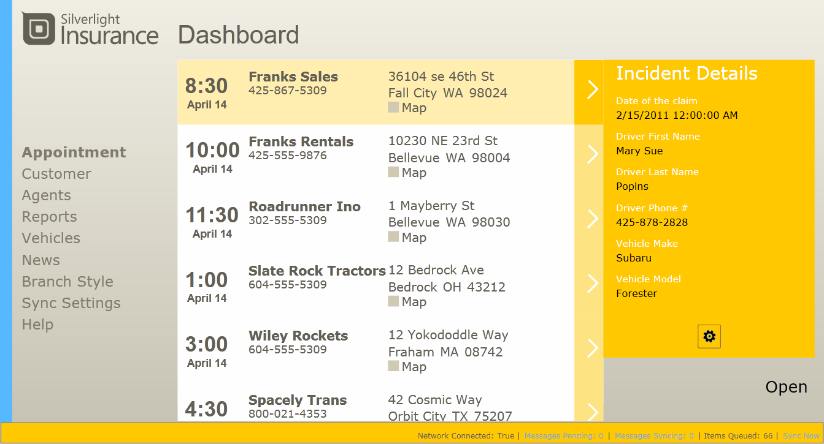
Application Overview
demo

Slide 11
Operations – What Should Work Offline?
Calendar of Appointments
Claims
Damages
  Upload Images, w/descriptions & vehicle location
Reports
Vehicles
News
Branch Styles
Help

Slide 12
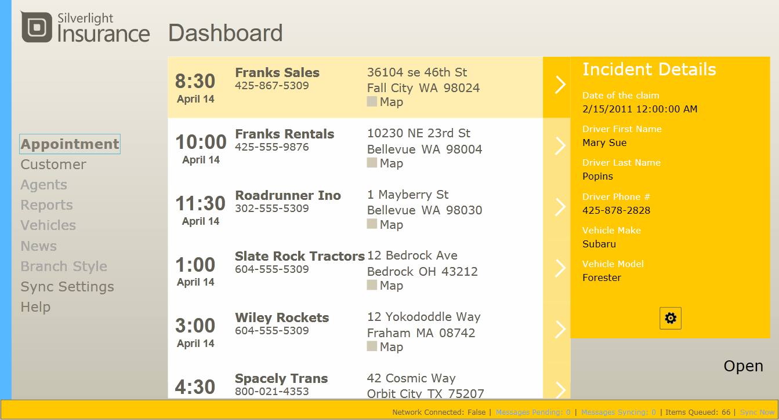
Offline Operations
Calendar of Appointments
Claims
Damages
  Upload Images, w/descriptions & vehicle location
Reports
Vehicles
News
Branch Styles
Help

Slide 13
Disabling Online Operations
demo

Slide 14
Check Point
Determining Online/Offline State √
Local Storage √
Defined Offline Operations √
Categorized Data
How To Retrieve Data
  Not just about services
How to Sync Changes
Saving

Slide 15
Categorize Your Data
Vehicle Info
User/Branch Info
Lookups
VehicleBodyType
VehicleBodyType
UserInfo
UserInfo
State*
State*
ClaimStatus
ClaimStatus
Branch_Id
Appointments & Claims
StandardVehicleImage
StandardVehicleImage
Appointment
BranchOffice
Appointment
BranchOffice
Appraiser_Id
Claim
Claim
VehicleReference
Photo
BranchStyles
VehicleReference
Photo
BranchStyles
ClaimDamage
ClaimDamage
Reference Data
Typically cached in completeness
Partitioned Reference Data
Cached for offline
Partitioned, per user
Activity Data
Typically partitioned per user

Slide 16
How To Retrieve Data
Passive Caching
  Cache results as requested
Active Caching
  Always work locally
  Sync all changes
Hybrid
  Actively cache Reference & Activity data
  When online, request from remote
    Passively cache results

Slide 17
Silverlight Offline Application w/Messaging
Views
View Models
Entity Manager
Fulfillment
Models
Accounting
Message
Service
Proxies
Local Storage

Slide 18




Message Pipeline
Views
View Models
OnEntityChanged(…)
Entity Manager
ProcessMessage(Message message)
public class GetAppointmentsMessage : Message {
OnlineOperation(){ … }
OfflineOperation() { … }
ProcessMessageResults(List<MessageResult> messageResults) {
MessageCompleted.Invoke(message);
}

Slide 19
Messaging Operations
demo

Slide 20
Synching Local Data
Views
View Models
Entity Manager
Fulfillment
Models
Sync Groups
Accounting
Reference Data
Message
Activity Data
Service
Proxies
Local Storage

Slide 21
Getting Deltas
Challenge
  How to manage changes for N users
Solutions
  Server Side Tracking
    Client asks for “my” changes?
    Simple for the client, hard for the server – scalability limits
  Client Side Tracking
    Client asks give me changes since X
    A little more work for the client, but endless scale

Slide 22

Anchor Based Changes
Client stores “Last Sync Time” for each collection
  Create “Sync Groups”
  Group Collections / Sync Group
SyncGroup | Frequency ^{(TimeSpan)}
Reference | 24 hours
Activity | 5 minutes
Entity | SyncGroup | Anchor
States | Reference | 5/1/11 7:00:00 AM UTC
ClaimStatus | Reference | 5/1/11 7:00:00 AM UTC
StandardVehicleImage | Reference | 5/1/11 7:00:00 AM UTC
VehicleReferencePhoto | Reference | 5/1/11 7:32:05 AM UTC
Appointments | Activity | 5/16/11 8:08:15 AM UTC
Claims | Activity | 5/16/11 8:08:15 AM UTC
ClaimDamage | Activity | 5/16/11 8:08:15 AM UTC

Slide 23
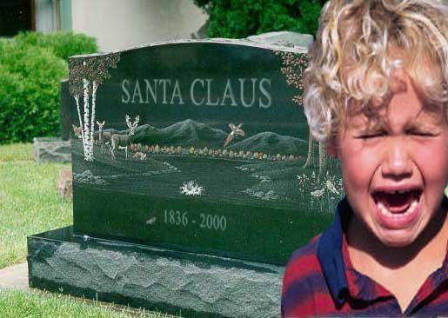
Deltas Include…
Inserts
Updates
Deletes
  But, how do I get a delete, if it’s deleted?
Tombstones

Slide 24
Tombstones???
Maintained by Database Triggers
Appointment
Appointment_Tombstone
Claim
Claim_Tombstone
Appointment_Id
Appraiser_Id
Customer_Id
Vehicle_Id
…
Created
LastEdit
Appointment_Id
Appraiser_Id
DeletedDate
ClaimDamage
ClaimDamage_Tombstone
CREATE TRIGGER AdjusterAppointment_Delete_UpdateTombstone
ON AdjusterAppointment AFTER DELETE
AS
INSERT INTO AdjusterAppointment_Tombstone
( AdjusterAppointmentGuid, Adjuster_Id )
SELECT AppointmentGuid, Adjuster_Id
FROM deleted

Slide 25
Getting Deltas
demo

Slide 26
Check Point
Determining Offline State √
Defined Offline Operations √
Categorized Data √
Local Storage √
Getting Deltas √
Saving

Slide 27
Saving
Save Locally
Sync w/Server
Just another message

Slide 28
Saving
demo

Slide 29
Offline Silverlight Application w/Messaging
Views
View Models
Entity Manager
Fulfillment
Models
Sync Groups
Accounting
Reference Data
Message
Activity Data
Service
Proxies
Local Storage

Slide 30
Check Point
Determining Offline State √
Defined Offline Operations √
Categorized Data √
Local Storage √
Getting Deltas √
Saving √

Slide 31
Summary
Network resiliency doesn’t happen as an afterthought
Building resilient applications is the future, not a stop gap
  It’s how all important resources are managed
Design your apps to work offline from the beginning
  When things are connected, they work great
  When “stuff” happens, your business continues to function
Contribute to usability & business stability

Slide 32

Hands On Labs
DEV386HOL: Microsoft Silverlight Data Binding
DEV388HOL: Web Services and Microsoft Silverlight
DEV389HOL: Using WCF RIA Services
DEV390HOL: Using the MVVM Pattern in Microsoft Silverlight Applications
Find Me Later At the Silverlight Booth
http://Blogs.MSDN.com/SteveLasker

Slide 33
Related Sessions
DEV209: From Zero to Silverlight in 75 Minutes
DEV210: Microsoft Silverlight, WCF RIA Services and Your Business Objects
DEV330: Delivering End-End Video Workflow Using Microsoft SharePoint, IIS Media Services, Microsoft Expression Encoder and Microsoft Silverlight
DEV331: A Lap around Microsoft Silverlight 5
DEV337: Moving Your App and Skills from Windows Forms to Microsoft Silverlight (and WPF)
DEV339: Offline Microsoft Silverlight Applications
DEV340: Tackle the Complexity of Async Calls in Microsoft Silverlight and WPF Clients
DEV356: Integrating Security Roles into Microsoft Silverlight Applications
WPH306: Building Windows Phone Applications with Microsoft Silverlight and XNA
WPH312: What’s New for Windows Phone Development with Microsoft Silverlight?
OSP302: Advanced SharePoint Data Access with Microsoft Silverlight
Find Me Later At the Silverlight Booth
http://Blogs.MSDN.com/SteveLasker

Slide 34

Sample
http://SilverlightLOB.CodePlex.com/

Slide 35
Web Track Resources
http://www.asp.net/
http://www.silverlight.net/
http://www.microsoft.com/web/gallery/
http://www.iis.net/
http://weblogs.asp.net/Scottgu/
http://www.hanselman.com/blog/

Slide 36





Resources
  Connect. Share. Discuss.
http://northamerica.msteched.com
Learning
  Sessions On-Demand & Community
  Microsoft Certification & Training Resources
www.microsoft.com/teched
www.microsoft.com/learning
  Resources for IT Professionals
  Resources for Developers
http://microsoft.com/technet
http://microsoft.com/msdn

Slide 37












Complete an evaluation on CommNet and
enter to win!

Slide 38


Slide 39

© 2011 Microsoft Corporation. All rights reserved. Microsoft, Windows, Windows Vista and other product names are or may be registered trademarks and/or trademarks in the U.S. and/or other countries.
The information herein is for informational purposes only and represents the current view of Microsoft Corporation as of the date of this presentation. Because Microsoft must respond to changing market conditions, it should not be interpreted to be a commitment
on the part of Microsoft, and Microsoft cannot guarantee the accuracy of any information provided after the date of this presentation. MICROSOFT MAKES NO WARRANTIES, EXPRESS, IMPLIED OR STATUTORY, AS TO THE INFORMATION IN THIS PRESENTATION.

