Slide 2

Moving Your App and Skills from Windows Forms to Microsoft Silverlight (and WPF)
DEV337
Pete Brown (@pete_brown)
Developer Community Ninja
Microsoft
http://10rem.net

Slide 3
A Windows Forms Application
A demo already? Cool! ☺
demo

Slide 4
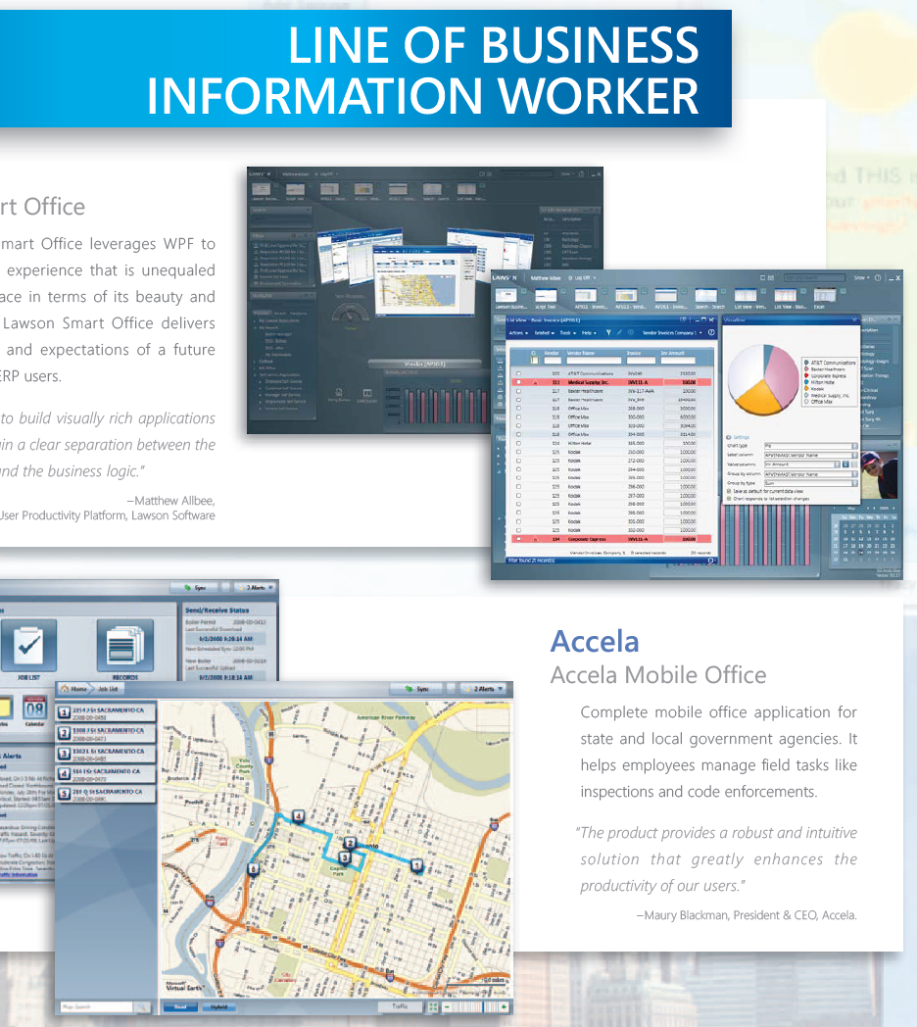
Why Move from Windows Forms
Better branding and styling possibilities
  With less effort - no WM_PAINT overrides
Excellent data binding and pattern support (MVVM)
Momentum
  Windows Forms not getting significant features at this point
  However, Windows Forms will continue to be supported
Better skill reuse (web, phone, desktop, more)
From The Book of WPF, available from my site 10rem.net

Slide 5
Technology Options
Silverlight
WPF
Validation in control templates
WCF RIA Services
IDispatch for breaking out of the sandbox
Web-based deployment
  Apps are content
Full access to the local machine
Mix and match WPF and Windows Forms components
Best support for oddball and extended network protocols
Crisp GDI-compatible font rendering
Current
P/Invoke for calling native code
Better font rendering
Increased network performance
Vector printing support
Better support for mixing Silverlight, WPF, Browser, and Windows Forms in same application
Improvements in binding with large collections
Improvements in UI virtualization
v.next

Slide 6
Additional Options
WCF RIA Services
  Simplifies multi-tier applications
  Works with Silverlight 4 and 5
Visual Studio LightSwitch
  Creates Silverlight / WCF RIA Services applications
  Great way to get started quickly or build relatively small applications
Native Extensions for Silverlight
  Also, COM in Silverlight 4 and COM and P/Invoke in Silverlight 5

Slide 7
Challenges
Third-party Controls
  Often, but don’t always, have equivalents
  Behavior is usually different
MDI
  Not popular in the WPF / Silverlight space
  One promising WPF toolkit on codeplex
Local Databases
  Not supported in Silverlight
ADO Recordsets
  Not in Silverlight
  Not the recommended approach in WPF
GDI Drawing vs. Retained Mode
  For apps that incorporate pixel graphics

Slide 8
Reuse vs. Rewrite
Silverlight 5, WPF 4 and WPF v.next
Rewrite
Reuse

Slide 9
How to Choose
WPF
Typical forms-over-data business apps and then some
Apps that don’t need deep system integration
ASP.NET HTML / JS
Broad reach across the web and devices
Basic Media
Content
Advanced Media
Broad-reach Mobile
WP7 Native Mobile
Integrating Windows Forms, Silverlight, DirectX, Native
Deep system integration
“ISV” type applications (shrinkwrapped apps)
Silverlight

Slide 10
A Phased Migration Approach for Big Apps
Port back-end
Compatible with Windows Forms and Silverlight or WPF
Modify Windows Forms app to use new back end
Port Logic
Apply modern patterns during refactor
Design New User Interface
Take the time to refresh the UX
If WPF, you can do this in phases
Choose Silverlight, and migrate layer by layer
Choose WPF, and migrate vertical slices (WPF can host Windows Forms content)

Slide 11
Phased Migration Options
Silverlight by layers
WPF by slices
Data Access
DAL
Data Access
DAL
DAL
DAL
Business Logic
Business Logic
BL
BL
BL
BL
UI
UI
UI
UI
UI

Slide 12
Porting an Application
demo

Slide 13
What’s Next?
Visit http://silverlight.net and view tutorials
  Also see http://windowsclient.net for some WPF
  Also see my book, Silverlight 4 in Action
  Learn the basics of XAML UI development
Consider
  WPF for porting large applications with partial migration support
  Silverlight (or LightSwitch) for forms-over-data and other typical business applications
  Starting with Silverlight if this is all brand new to you
  Learning Expression Blend for speeding up UI development

Slide 14
Web Track Resources
http://www.asp.net/
http://www.silverlight.net/
http://www.microsoft.com/web/gallery/
http://www.iis.net/
http://weblogs.asp.net/Scottgu/
http://www.hanselman.com/blog/

Slide 15





Resources
  Connect. Share. Discuss.
http://northamerica.msteched.com
Learning
  Sessions On-Demand & Community
  Microsoft Certification & Training Resources
www.microsoft.com/teched
www.microsoft.com/learning
  Resources for IT Professionals
  Resources for Developers
http://microsoft.com/technet
http://microsoft.com/msdn

Slide 16












Complete an evaluation on CommNet and
enter to win!

Slide 17

Notes:
New for TechEd 2011, we will be working with Microsoft Tag (http://tag.microsoft.com/overview.aspx) to create unique Tags for every session at the event. Your session Tag will appear on both the room signage and at the end of your presentation. With your session Tag, attendees will be able to scan as they enter the room to retrieve session details, view speaker bios, and engage in discussions; or scan at the end of the presentation to evaluate your session and download materials. We’re excited to integrate Microsoft Tag across the My TechEd mobile experience this year.

Slide 18

© 2011 Microsoft Corporation. All rights reserved. Microsoft, Windows, Windows Vista and other product names are or may be registered trademarks and/or trademarks in the U.S. and/or other countries.
The information herein is for informational purposes only and represents the current view of Microsoft Corporation as of the date of this presentation. Because Microsoft must respond to changing market conditions, it should not be interpreted to be a commitment
on the part of Microsoft, and Microsoft cannot guarantee the accuracy of any information provided after the date of this presentation. MICROSOFT MAKES NO WARRANTIES, EXPRESS, IMPLIED OR STATUTORY, AS TO THE INFORMATION IN THIS PRESENTATION.

