Slide 1

Delivering End-End Video Workflow Using Microsoft
SharePoint, IIS Media Services, Microsoft Expression
Encoder and Microsoft Silverlight
DEV330
Steven Woodward
Principal Evangelist
Microsoft Corporation

Slide 2
Agenda
Video Workflow
MMP Content Manager
  VOD File Conversion/Streaming
  Live Event Management
  Video Editing
  Ad Insertion
Summary

Slide 3
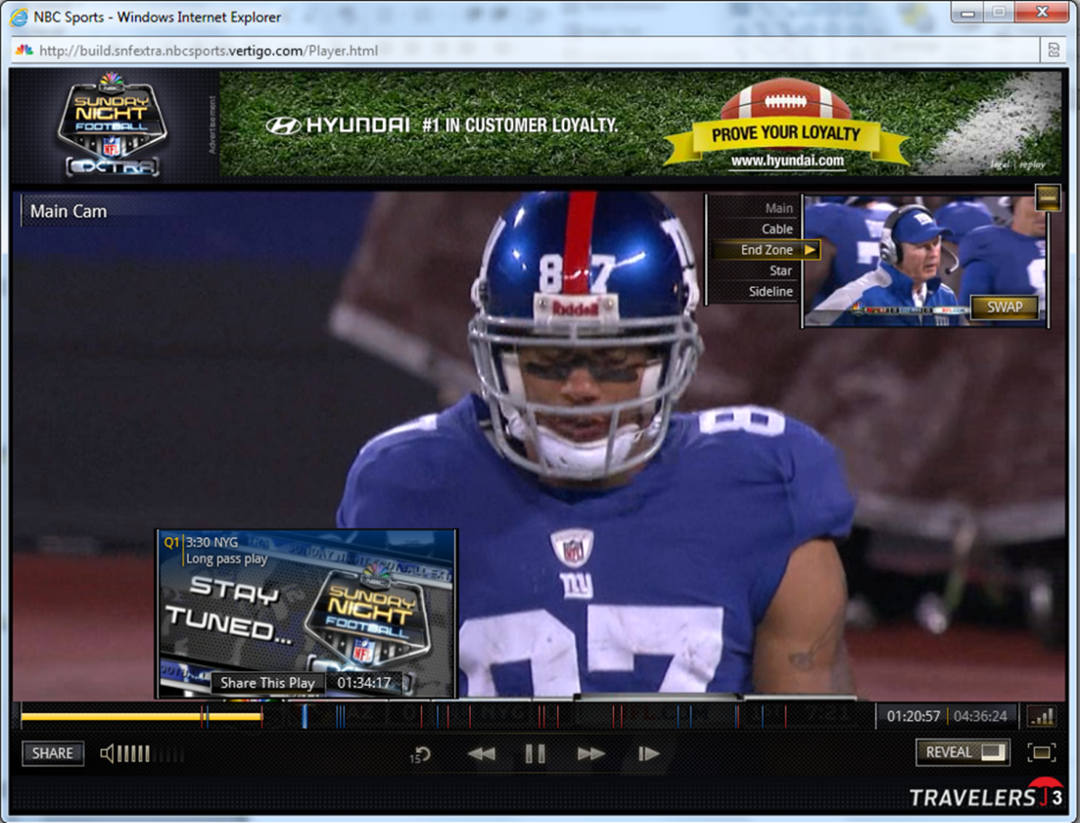

Sunday Night Football
NFL Sunday Night Football
nbcsports.msnbc.com
3.5Mbps 720p Live smooth streaming
Full DVR support
5 simultaneous camera views
Instant Replay and Slow-Motion
Live Chat and Real-time Statistics

Slide 4










Live Video Workflow
Venue
iStreamPlanet
Akamai
Your House
Ingest
Origin
Primary
Ingest
Origin
Secondary

Slide 5
Advanced Capabilities
Adaptive Streaming
VOD workflow
Live Streaming
Video Editing
Ad Insertion
Publishing

Slide 6
Smooth streaming overview

Slide 7



Adapting Bit Rate in Real-Time
300K @ 00:00?
700K @ 00:02?
2.4M @ 00:04?
1.5M @ 00:06?
2.4M @ 00:08?
300K (start quickly)
00:00
00:02
00:04
00:06
00:08
700K (good network)
2.4M (great network)
2.4M
1.5M (glitch)
2.4M (play on…)
…
Bit Rate Heuristics
300K

Slide 8
Microsoft media Platform

Slide 9









Microsoft Media Platform Components
Services
Tools
Clients
Frameworks
Microsoft®
PlayReady®
Smooth Streaming
& PlayReady®
Client Porting Kits
Microsoft® Media Platform
Video
Editor
Content
Manager
Player
Framework
Audience
Insight

Slide 10
Content Manager

Slide 11
Content Manager
Features and Demo’s
  Project Based Video Management
  Video On Demand
  Live Event Broadcasting
  Video Editing
  Ad Insertion
Architecture

Slide 12
Server Roles
Sharepoint 2010
SQL Server 2008
IIS Media Services Transform Manager
IIS Media Services Origin (Live & VOD)
Encoder

Slide 13
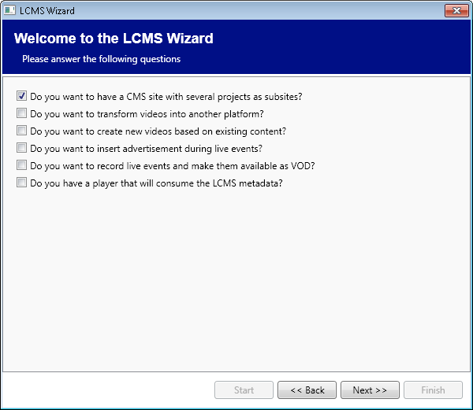
Installation
Wizard based Installation
  Installs Content Manager on Sharepoint
    Select required features
    Define user accounts
  Creates Install Packages for;
    Transform Manager
    IIS Media Services Origin
    Expression Encoder

Slide 14
Project Based Video Management
Site Template == Video Project
  Project Owners
  Project Profiles
  Video Assets
Encoding Resources
IIS Media Origins
FTP Servers

Slide 15
Content Manager Assets
DEMO

Slide 16
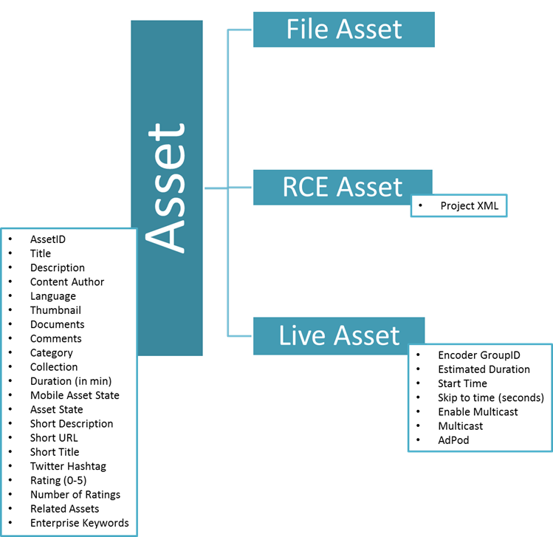
Asset MetaData

Slide 17
Video On Demand
Transform Manager monitors drop folders
  Encodes an asset once dropped to all profiles
  Imports asset metadata into Sharepoint
Asset appears in New Assets List
  QA all encoded versions
  Edit metadata, add categories
  Approve asset to publish it
Once approved updated category XML’s can be published

Slide 18
Transform Manager
Beta 1.0 Released!
Batch transcode of video/audio files
Transmux to other formats (Apple HLS)
Task chaining
Support for Windows HPC Server 2008

Slide 19
VOD Workflow
DEMO

Slide 20
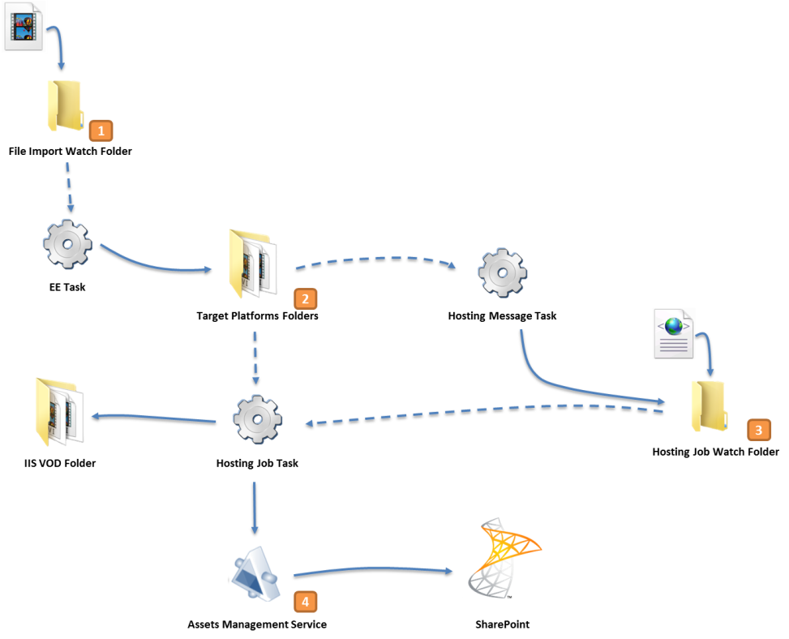
VOD Workflow

Slide 21
Live Event Broadcast
Define a New Live Asset
Edit Metadata
Approve asset
Use Live Event Manager to manage the Start and On-Air status of an event.
Monitor broadcast status
Off-Air and Stop (Generates VOD)

Slide 22
Live Event Workflow
DEMO

Slide 23
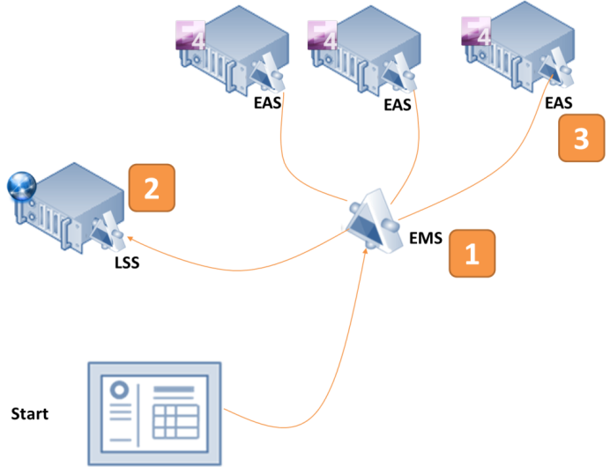
Live Workflow - Start

Slide 24
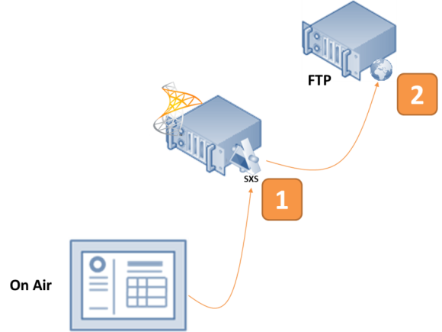
Live Workflow – On Air

Slide 25
Video Editor (formally RCE)
Create Highlight Clips from Live or VOD Content
Edit Clips Together
Publishes a Composite Manifest File
NO ENCODING

Slide 26
Video Editing
DEMO

Slide 27
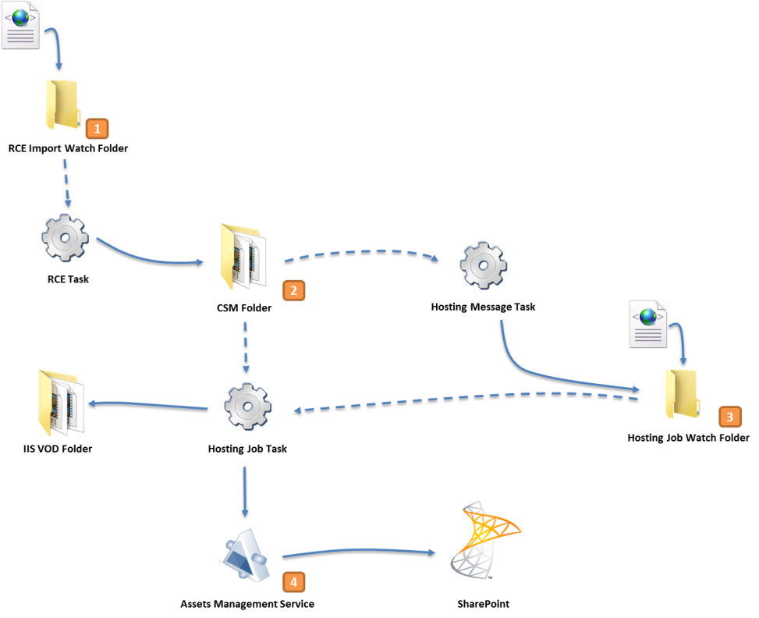
RCE Workflow

Slide 28
Ad Insertion
Categorize asset(s) as an Ad
Create groups of ads to be played together (AdPods)
Assign AdPods to be used with a specific Live Event
Insert the Ads into Live Event Stream.

Slide 29
Ad Insertion
DEMO

Slide 30
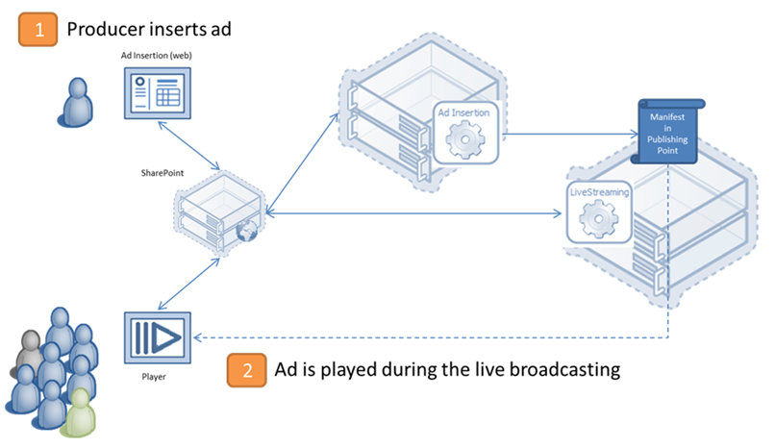
Ad Insertion Workflow

Slide 31
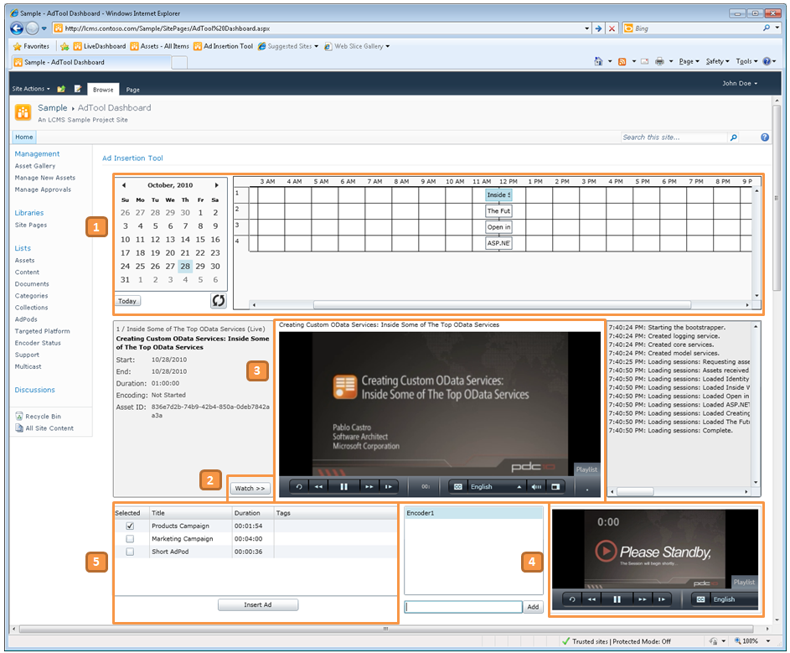
Ad Insertion

Slide 32
Architecture

Slide 33
Architecture
Silverlight
MMP Video Player
Sharepoint
Projects
Live Dashboard
Media Viewer
Assets
Ad Insertion
Workflows
Publish
Transform Manager Tasks
MMP Video Editor
Encoder Management
Publishing Point Management
SQL Server
Expression Encoder
IIS
Media Services
Transform Manager
Publishing Points

Slide 34
Dependencies
IIS Media Services 4.0
IIS Media Services Transform Manager (Beta)
Sharepoint 2010
Expression Encoder 4.0 SP1

Slide 35
Summary
Sharepoint 2010
Microsoft Media Platform
  http://www.microsoft.com/en-us/mediaplatform/
MMP – Content manager
  COMING SOON!
IIS Media Services Transform Manager Beta
  http://www.microsoft.com/downloads/en/details.aspx?FamilyID=182f9522-d212-4d6d-a06b-d4817ed2e28f

Slide 36
Questions, Feedback and Comments?
Steven Woodward
stwood@microsoft.com

Slide 37
Web Track Resources
http://www.asp.net/
http://www.silverlight.net/
http://www.microsoft.com/web/gallery/
http://www.iis.net/
http://weblogs.asp.net/Scottgu/
http://www.hanselman.com/blog/

Slide 38





Resources
  Connect. Share. Discuss.
http://northamerica.msteched.com
Learning
  Sessions On-Demand & Community
  Microsoft Certification & Training Resources
www.microsoft.com/teched
www.microsoft.com/learning
  Resources for IT Professionals
  Resources for Developers
http://microsoft.com/technet
http://microsoft.com/msdn

Slide 39












Complete an evaluation on CommNet and
enter to win!

Slide 40


Slide 41

© 2011 Microsoft Corporation. All rights reserved. Microsoft, Windows, Windows Vista and other product names are or may be registered trademarks and/or trademarks in the U.S. and/or other countries.
The information herein is for informational purposes only and represents the current view of Microsoft Corporation as of the date of this presentation. Because Microsoft must respond to changing market conditions, it should not be interpreted to be a commitment
on the part of Microsoft, and Microsoft cannot guarantee the accuracy of any information provided after the date of this presentation. MICROSOFT MAKES NO WARRANTIES, EXPRESS, IMPLIED OR STATUTORY, AS TO THE INFORMATION IN THIS PRESENTATION.

