Slide 1

Using Microsoft Visual Basic to Build Windows Phone Applications
DEV317
Lucian Wischik
VB spec lead
Microsoft

Slide 2
Using Microsoft Visual Basic to Build Windows Phone Applications
DEV317
New: Async CTP SP1 Refresh
(works on Windows Phone)
New: Async
“as is” EULA
Lucian Wischik
VB spec lead
Microsoft
New: XNA
for VB

Slide 3


Slide 4
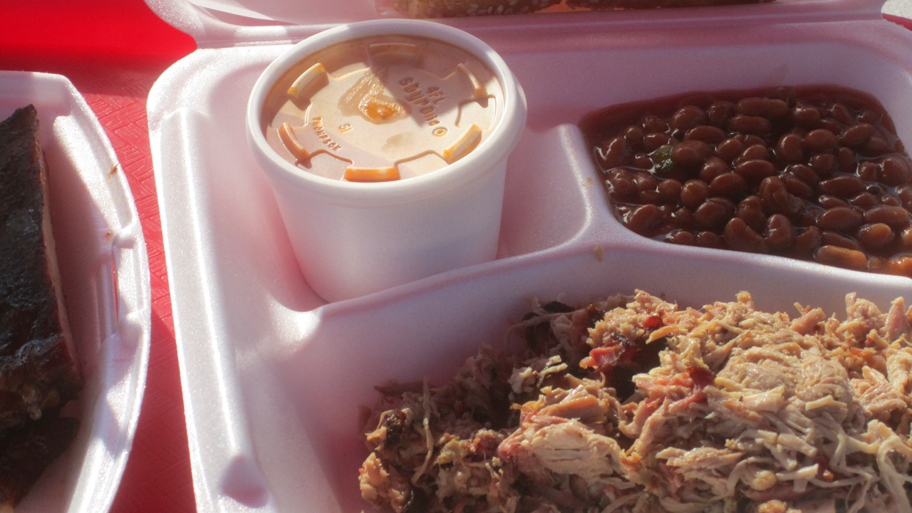

Slide 5
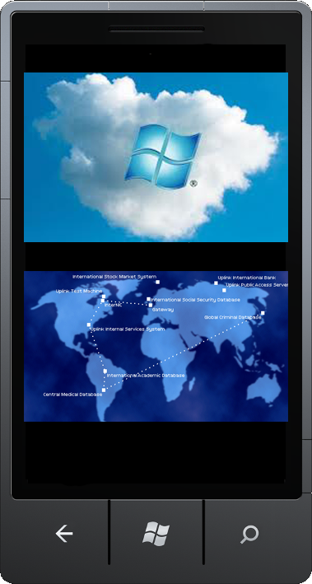
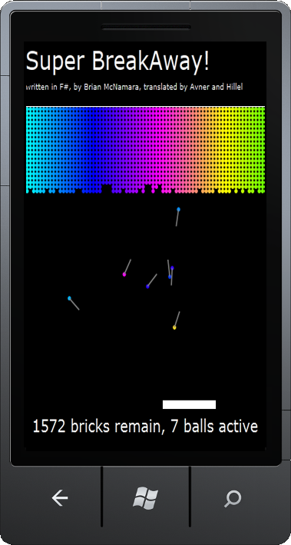
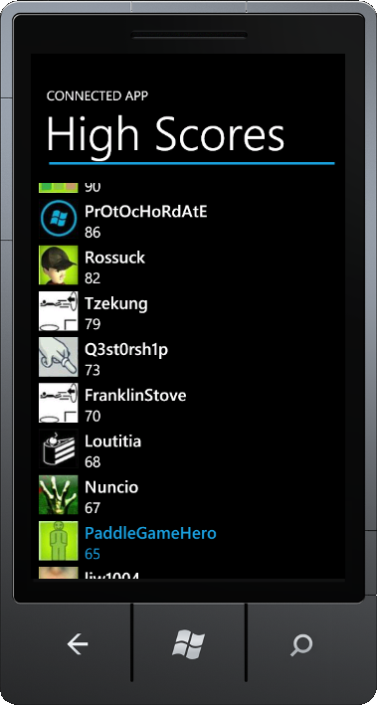
What are the three parts to my connected WP7 app?
The Server…
Tech:
Windows Azure Toolkit for WP7
Demo:
Server to store high-scores
Analysis:
“Social”,
Identity,
security
The Game…
Tech:
XNA for VB,
in Mango
Demo:
PaddleGame, a breakout clone
Analysis:
VBCore, an
investment in VB’s future
High scores…
Tech:
Async CTP -
SP1 Refresh
Demo:
Fetch highscores asynchronously
Analysis:
“As Is” EULA for async: evaluate
whether to use

Slide 6














$10 to Doctors Without Borders for every eval.
CommNet, or
http://gettag.mobi
Complete an evaluation on CommNet and
enter to win!

Slide 7

1. The Server
Most phone apps will need a server
    Here we’ve used it for “social”
    Also, for battery-efficiency, e.g. updating tiles
    We’re back to doing work on the server…

Slide 8
I know I want to serve high-scores,
avatars, some kind of “social”.
Will my app generate enough revenue to justify the cloud service costs?
How do I store login credentials on the phone?
Can I get to Xbox Live?
What do I know
about security on the server
or client?
Can I extend to other mobile platforms?

Slide 9
Windows Azure Toolkit for WP7
demo

Slide 10
2. The Game
XNA is getting VB support…
    You’re amongst the first audiences to see VB XNA code
    Will come in the “Mango” phone SDK, this month
    For phone, windows and xbox 360
VBCore…
    It’s what made VB support possible for Phone and XNA
    It removes VB’s obstacles on other platforms

Slide 11
Paddle Game
demo

Slide 12

VB+C#: NoPIA
C#: named and
optional params
C#: late-binding
VB: multiline statement lambdas
co-evolution…

Slide 13
VB gets iterators
VB+C#: NoPIA
XNA gets VB
Async was developed in C# and VB simultaneously
C#: named and
optional params
C#: late-binding
VB: multiline statement lambdas
co-evolution…

Slide 14
3. Making it connected -- highscores
In the past…
    “Connected” has often required multithreading, or difficult spaghetti code, or just lead to a UI that freezes.
Now: the Async CTP…
    A new easier way to write connected apps.
    Two new keywords: Await and Async in VB and C#
    A new Task-based design pattern for the APIs, the “T.A.P.”
    A new set of .NET Framework APIs

Slide 15


Slide 16
webClient.DownloadStringString(uri);
print("done");
UI thread
STOP

Slide 17
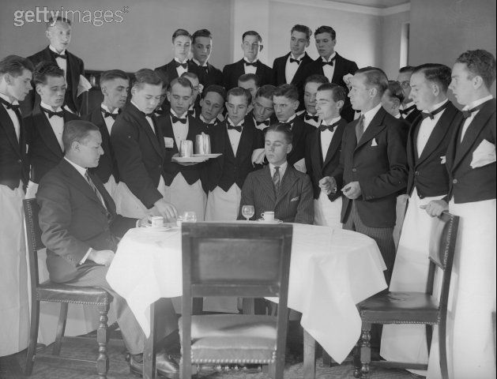
“A waiter’s job is to wait on a table until the patrons have finished their meal.
If you want to serve two tables concurrently, you must hire two waiters.”

Slide 18
How best to explain the sequence of events in a restaurant with several tables?
From the perspective of the waiter?
or of the patrons?
UI thread

Slide 19


Slide 20
Async CTP - SP1 Refresh
demo

Slide 21

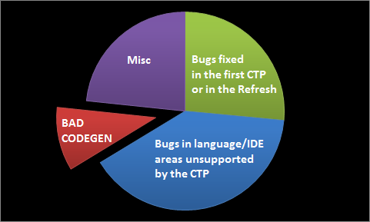
Analysis
Consider coding with Async CTP
It’s a CTP. Install+use at your own risk. “As is” license; known bugs
blogs.msdn.com/lucian

Slide 22
CALL TO ACTION
Azure for Windows Phone toolkit…
    Download: http://watoolkitwp7.codeplex.com/
    Eval: http://www.microsoft.com/windowsazure/economics/
Phone dev tools…
    Download: Jan update of phone tools + VB extras
    Download: Mango in May
Async CTP Refresh…
    Download: http://vstudio.msdn.com/async
    Evaluate: http://blogs.msdn.com/lucian

Slide 23
DEV Track Resources
http://blogs.msdn.com/lucian
http://blogs.msdn.com/vbteam
http://msdn.com/vstudio/async
http://www.facebook.com/visualstudio

Slide 24





Resources
  Connect. Share. Discuss.
http://northamerica.msteched.com
Learning
  Sessions On-Demand & Community
  Microsoft Certification & Training Resources
www.microsoft.com/teched
www.microsoft.com/learning
  Resources for IT Professionals
  Resources for Developers
http://microsoft.com/technet
http://microsoft.com/msdn

Slide 25

© 2011 Microsoft Corporation. All rights reserved. Microsoft, Windows, Windows Vista and other product names are or may be registered trademarks and/or trademarks in the U.S. and/or other countries.
The information herein is for informational purposes only and represents the current view of Microsoft Corporation as of the date of this presentation. Because Microsoft must respond to changing market conditions, it should not be interpreted to be a commitment
on the part of Microsoft, and Microsoft cannot guarantee the accuracy of any information provided after the date of this presentation. MICROSOFT MAKES NO WARRANTIES, EXPRESS, IMPLIED OR STATUTORY, AS TO THE INFORMATION IN THIS PRESENTATION.

