Slide 1

Microsoft SQL Server Developer Tools, Code-Named "Juneau" and the ADO.NET Entity Framework: Best Friends Forever
DEV314
Adi Unnithan
Software Developer
Microsoft
Sarah McDevitt
Program Manager
Microsoft

Slide 2
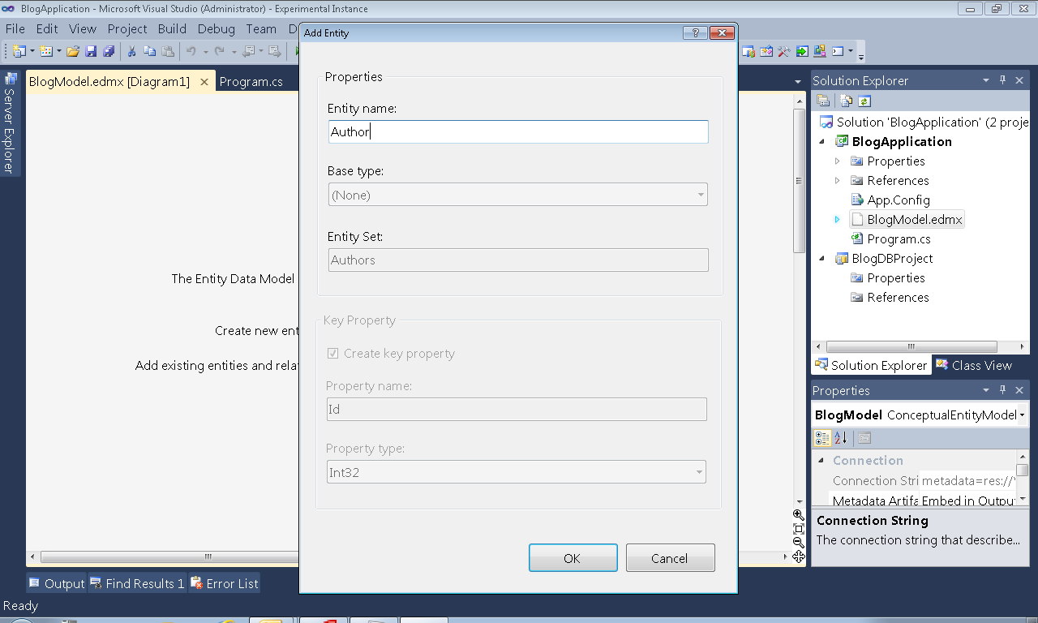
(screenshot)

Slide 3
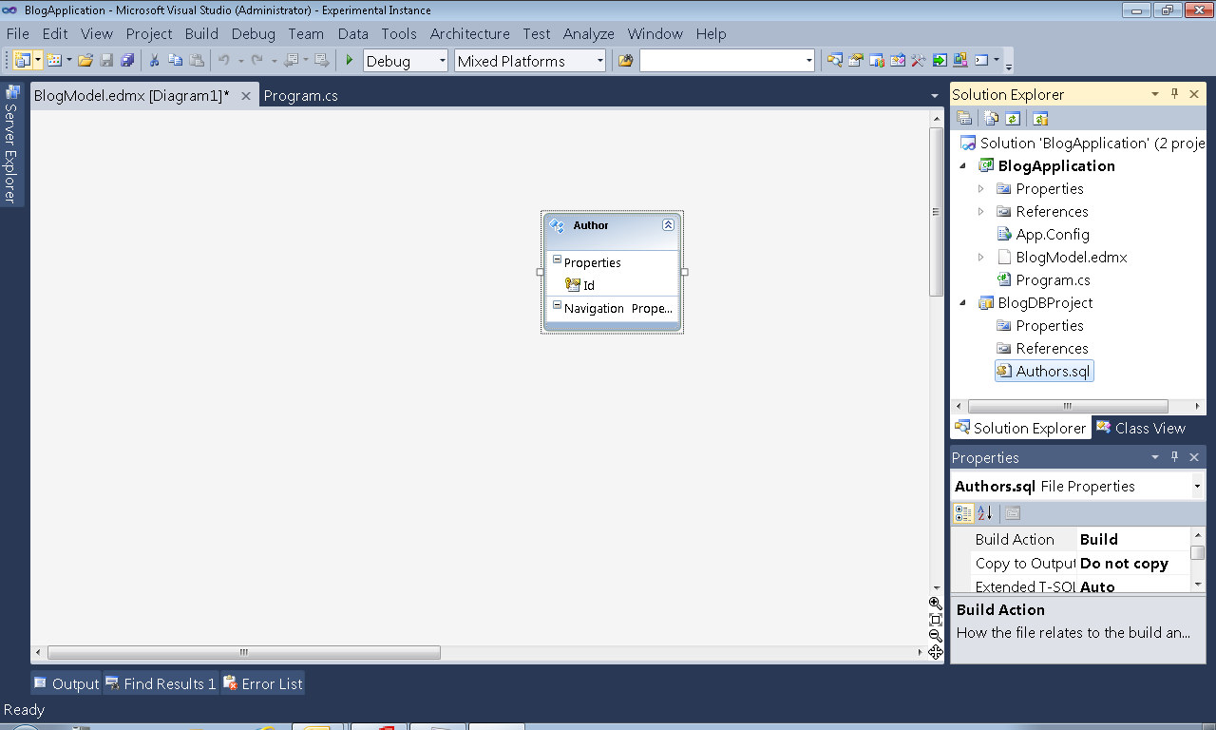
(screenshot)

Slide 4
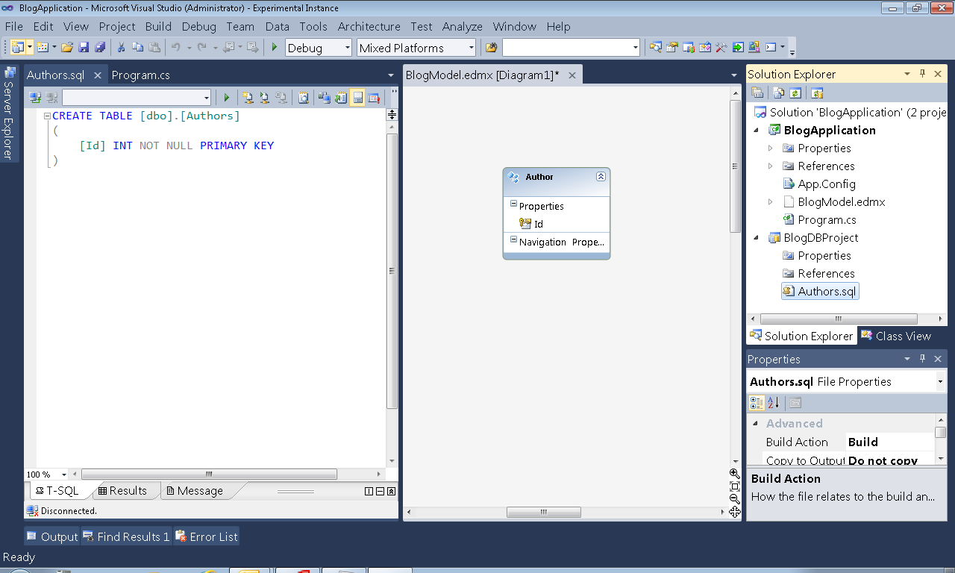

Slide 5
SSDT “Juneau”: One Stop Shop
SQL Server Database Development in one suite
Enhanced Database Project and Tools
Deep integration with .NET Projects via Entity Framework
Application Project
Entity Data Model
Analysis Services
Reporting Services
Integration Services
Database Services
Database Services

Slide 6
SSDT “Juneau” Project Integration is…
…the most productive way for you to
develop applications and databases together
Application Project
Entity Data Model
Database Services
Database Services

Slide 7
Application development begins…
Build the application and database together
demo

Slide 8
Application development begins…
Interaction between Database Project
and Entity Data Model
Seamless F5 experience
Local DB Runtime
Application Project
Entity Data Model
Database Services
Database Services

Slide 9
Application development continues…
T-SQL Language Services
Cross-language Refactoring
Stored Procedure sensing
Application Project
Entity Data Model
Database Services
Database Services

Slide 10
Application debugging…
Configure the application without
affecting the database
Debug new changes
Run against SQL Azure
demo

Slide 11
Application Development with SSDT “Juneau”
Integration with SSDT Database Services
.SQLX Snapshot
Preserve your application configurations
Cross-language Refactoring and Debugging
Efficient team development
Development for SQL Azure
Application Project
Entity Data Model
Database Services
Database Services

Slide 12
Session Takeaway
SSDT “Juneau” Project Integration is the
most productive way to develop
applications and databases together
Application Project
Entity Data Model
Database Services
Database Services

Slide 13

Related Content
Required Slide
Speakers, please list the Breakout Sessions, Interactive Discussions, Labs, Demo Stations and Certification Exam that relate to your session. Also indicate when they can find you staffing in the TLC.
Breakout Session
  DEV207: Introducing SQL Server Developer Tools, Code-named "Juneau": An Introduction to Doing Database Development in a Modern Way
Hands-on Lab
  DEV385-HOL | DBI376-HOL: Using SQL Server Developer Tools, Code-named "Juneau", to develop your SQL Server Database
Product Demo Station
  Entity Framework & SQL Server Developer Tools, Codename “Juneau”

Slide 14
SSDT “Juneau” Resources
SSDT on MSDN: http://msdn.microsoft.com/en-us/data/tools.aspx
SSDT Forum: http://social.msdn.microsoft.com/Forums/en-US/ssdt/threads
SSDT Team Blog: http://blogs.msdn.com/b/ssdt
Sarah McDevitt: sarahmcd@microsoft.com
Adi Unnithan: adiunni@microsoft.com
SSDT on Twitter: #sqlsdt

Slide 15
DEV Track Resources
http://www.microsoft.com/visualstudio
http://www.microsoft.com/visualstudio/en-us/lightswitch
http://www.microsoft.com/expression/
http://blogs.msdn.com/b/somasegar/
http://blogs.msdn.com/b/bharry/
http://www.microsoft.com/sqlserver/en/us/default.aspx
http://www.facebook.com/visualstudio

Slide 16





Resources
  Connect. Share. Discuss.
http://northamerica.msteched.com
Learning
  Sessions On-Demand & Community
  Microsoft Certification & Training Resources
www.microsoft.com/teched
www.microsoft.com/learning
  Resources for IT Professionals
  Resources for Developers
http://microsoft.com/technet
http://microsoft.com/msdn

Slide 17












Complete an evaluation on CommNet and
enter to win!

Slide 18


Slide 19

© 2011 Microsoft Corporation. All rights reserved. Microsoft, Windows, Windows Vista and other product names are or may be registered trademarks and/or trademarks in the U.S. and/or other countries.
The information herein is for informational purposes only and represents the current view of Microsoft Corporation as of the date of this presentation. Because Microsoft must respond to changing market conditions, it should not be interpreted to be a commitment
on the part of Microsoft, and Microsoft cannot guarantee the accuracy of any information provided after the date of this presentation. MICROSOFT MAKES NO WARRANTIES, EXPRESS, IMPLIED OR STATUTORY, AS TO THE INFORMATION IN THIS PRESENTATION.

