Slide 1
Modern Native C++ Development for Maximum Productivity
DEV303
Kate Gregory
Gregory Consulting
www.gregcons.com/kateblog, @gregcons

Slide 2
Agenda
Language and Library updates
  C++0x and TR1
  Lambdas, auto
  unique_ptr, make_shared
IDE improvements
  Intellisense – no ncb
  Navigate To , red squiggles
Concurrency
  PPL
  New debug windows
  Concurrency profiler
What there isn’t time for
  MFC Updates
    Ribbon designer
    Windows 7 support
  shared_ptr, nullptr
  Rvalue references, move constructors, std::move
  More library additions eg copy_if, is_sorted etc

Slide 3
TR1 and C++0x
TR1 is Technical Report 1, released in 2005
C++0x is the upcoming C++ standard
Some of each were added in Visual C++ 2008 SP 1
  (VC9SP1)
More are now in Visual C++ 2010
  (VC10)

Slide 4
Lambdas for C++
What’s a Lambda?
Lambda expression or lambda function: an expression that specifies an anonymous function object
Imagine handing an operation or function (code) to some other operation or function
  For generic work
  For a functional style
  For concurrency
  For readability
    Eliminate tiny functions

Slide 5
Tiny Functions
void print_square(int i)
{
cout << i*i << endl;
}
int main()
{
vector<int> v;
for_each(v.begin(), v.end(), print_square);
}

Slide 6
Why Does It Need a Name?
int main() {
vector<int> v;
for_each(v.begin(), v.end(),
[](int i) { cout << i*i << endl; } );
}

Slide 7
Lambdas
demo

Slide 8
Lambdas That Return Something
vector<int> v;
deque<int> d;
transform(v.begin(), v.end(),
front_inserter(d),
[](int n) { return n * n * n; });
transform(v.begin(), v.end(),
front_inserter(d),
[](int n) -> double {
if (n % 2 == 0) {return n * n * n;}
else {return n / 2.0;}
});

Slide 9
Using Variables from Local Scope
v.erase(remove_if(v.begin(), v.end(),
[x, y](int n) { return x < n && n < y; }),v.end());
v.erase(remove_if(v.begin(), v.end(),
[=](int n) { return x < n && n < y; }), v.end());
for_each(v.begin(), v.end(),
[&x, &y](int& r) {
const int old = r;
r *= 2;
x = y;
y = old; });

Slide 10
Auto
Automatic type deduction
auto x = new HugeObject(42);
No more gnarly iterator declarations
for (auto it = v.begin(); it != v.end(); ++it)
Powered by template argument deduction rules
  const auto* p = new foo and const auto& r = bar work

Slide 11
C++0x Standard Library in VC 2010
Rvalue references
  vector reallocation, etc. exploits move semantics
  Perfect forwarding: make_shared<T>(), etc.
  Std::move
  unique_ptr
New member functions: cbegin(), cend(), etc.
New algorithms: copy_if(), is_sorted(), etc.
Code conversions: <codecvt>
Exception propagation: exception_ptr
Diagnostics: <system_error>

Slide 12
Smart pointers
shared_ptr
  Arrived in VC9 SP1
  In VC10: make_shared
unique_ptr
  Like a shared_ptr without the sharing

Slide 13
make_shared<T>()
VC9 SP1:
  shared_ptr<T> sp(new T(args));
  shared_ptr<T> sp(new T(args), del, alloc);
VC10:
  auto sp = make_shared<T>(args);
  auto sp = allocate_shared<T>(alloc, args);

Slide 14
unique_ptr
Supersedes auto_ptr, which is now deprecated
Lightweight and performant
  No reference counting overhead
Noncopyable but movable
Works just fine in containers

Slide 15
Const iterators: cbegin and cend
vector<int> v;
for (auto i = v.begin(); i != v.end(); ++i) {
// i is vector<int>::iterator
}
for (auto i = v.cbegin(); i != v.cend(); ++i) {
// i is vector<int>::const_iterator
}

Slide 16
Visual Studio 2010 Architecture Changes
Intellisense decoupled from navigation
  No need to reparse entire solution after
  header change
No more .ncb file – SQL CE store instead
  Much quicker to insert/update single symbol
Intellisense faster even in larger solutions
  After a small code change
  Switching build (e.g., debug to release)

Slide 17
Visual Studio 2010 New Features
Navigate To
  Find a symbol
Red Squiggles
  Without a build
Call Hierarchy
  Calls From
  Calls To
  Replaces Call Browser

Slide 18
Native Concurrency Stack
C/C++ Application or Library
Parallel Patterns Library
parallel_for
parallel_for_each
Concurrent Algorithms
parallel_accumulate
parallel_partialsum
parallel_invoke
…
Concurrency Primitives
task handles
task groups
futures
synchronization types
Messaging Primitives
send, receive
asend, try_receive
message buffers
…
Concurrent Collections
concurrent_queue
concurrent_vector
concurrent_hash_map
…
Concurrency Runtime
Schedulers with
Work-Stealing Queues
chores
…
…
chores
…
Resource Manager
Threads + UMS
Proc 1
…
Proc p

Slide 19
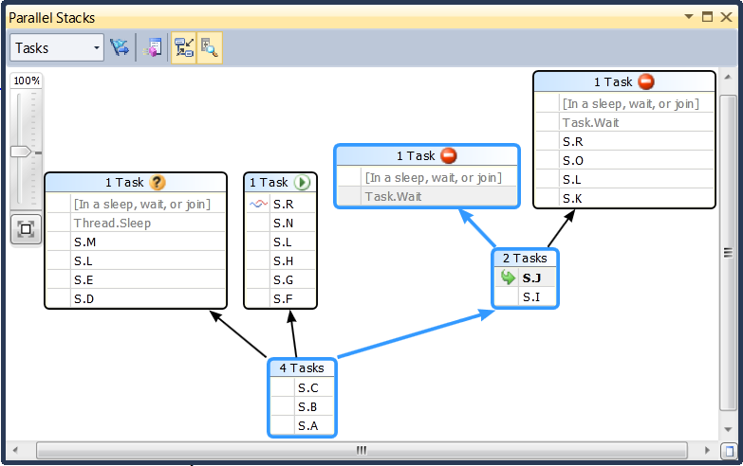
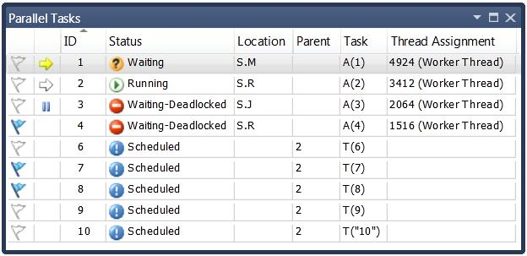
Concurrency and Debugging

Slide 20
Concurrency
demo

Slide 21
C++ Is Very Much Alive
Native code is still a fully supported way of life
Interop is dramatically easier from C++
Templates offer power no other language can match
  For both native-only and interop development
Microsoft is committed to C++
  IDE improvements
  MFC improvements
  Language-level improvements

Slide 22
DEV Track Resources
http://www.microsoft.com/visualstudio
http://www.microsoft.com/visualstudio/en-us/lightswitch
http://www.microsoft.com/expression/
http://blogs.msdn.com/b/somasegar/
http://blogs.msdn.com/b/bharry/
http://www.microsoft.com/sqlserver/en/us/default.aspx
http://www.facebook.com/visualstudio

Slide 23





Resources
  Connect. Share. Discuss.
http://northamerica.msteched.com
Learning
  Sessions On-Demand & Community
  Microsoft Certification & Training Resources
www.microsoft.com/teched
www.microsoft.com/learning
  Resources for IT Professionals
  Resources for Developers
http://microsoft.com/technet
http://microsoft.com/msdn

Slide 24












Complete an evaluation on CommNet and
enter to win!

Slide 25


