Slide 1

The Future of Parallel Programming in the Microsoft .NET Framework
DEV301
Danny Shih
Program Manager
Microsoft Corporation

Slide 2
Disclaimer
This is a talk about the future…
  All content is subject to change.
  The technology being discussed…
    …is almost entirely available in CTP form NOW.
    …but may never actually ship (we’re doing the best we can).

Slide 3
Agenda
Present
  Recap of parallel programming in the .NET Framework 4
Future
  Visual Studio Async
  TPL Dataflow

Slide 4
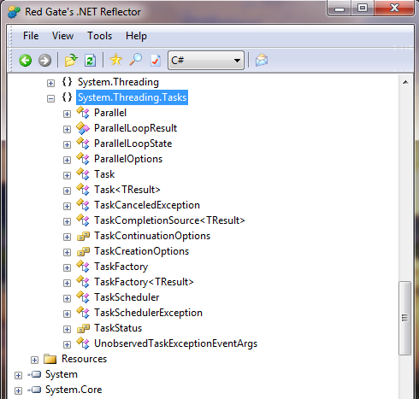
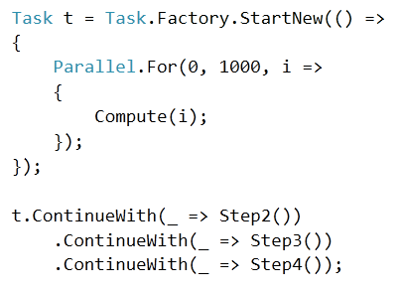
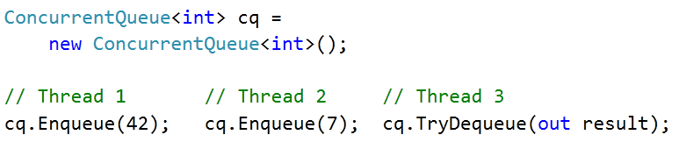
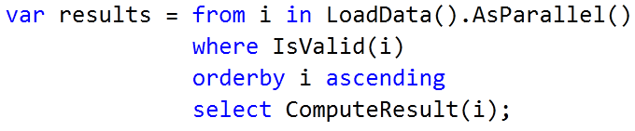


Parallel Programming in .NET 4
Recap
Feature Areas
  Task Parallel Library (TPL)
  Parallel LINQ (PLINQ)
  Thread-safe data structures and synchronization primitives
Pure .NET libraries

Slide 5
Agenda Checkpoint
Present
  Recap of parallel programming in the .NET Framework 4
Future
  Visual Studio Async
  TPL Dataflow

Slide 6
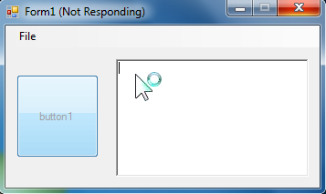
Visual Studio Async
Trends
Increasingly connected applications
More latency (e.g. everything as a service)
More UI responsiveness problems
More scalability issues
User → =(

Slide 7
Visual Studio Async
Asynchronous Programming in .NET Today
// Synchronous
TResult Foo(...);
// Asynchronous Programming Model (APM)
IAsyncResult BeginFoo(..., AsyncCallback callback, object state);
TResult EndFoo(IAsyncResult asyncResult);
// Event-based Asynchronous Pattern (EAP)
public void FooAsync(...);
public event EventHandler<FooCompletedEventArgs> FooCompleted;

Slide 8
Visual Studio Async
Your synchronous code with .NET 4
public void CopyStreamToStream(Stream source, Stream destination)
{
byte[] buffer = new byte[0x1000];
int numRead;
while ((numRead = source.Read(buffer, 0, buffer.Length)) != 0)
{
destination.Write(buffer, 0, numRead);
}
}

Slide 9

Visual Studio Async
An expert’s asynchronous code
With .NET 4
public IAsyncResult BeginCopyStreamToStream(
Stream source, Stream destination)
{
var tcs = new TaskCompletionSource<object>();
byte[] buffer = new byte[0x1000];
Action<IAsyncResult> readWriteLoop = null;
readWriteLoop = iar =>
{
try
{
for (bool isRead = iar == null; ; isRead = !isRead)
{
switch (isRead)
{
case true:
iar = source.BeginRead(buffer, 0, buffer.Length,
readResult =>
{
if (readResult.CompletedSynchronously) return;
readWriteLoop(readResult);
}, null);
if (!iar.CompletedSynchronously) return;
break;
case false:
int numRead = source.EndRead(iar);
if (numRead == 0)
{
tcs.TrySetResult(null);
return;
}
iar = destination.BeginWrite(buffer, 0, numRead,
writeResult =>
{
if (writeResult.CompletedSynchronously)
return;
destination.EndWrite(writeResult);
readWriteLoop(null);
}, null);
if (!iar.CompletedSynchronously) return;
destination.EndWrite(iar);
break;
}
}
}
catch (Exception e) { tcs.TrySetException(e); }
};
readWriteLoop(null);
return tcs.Task;
}
public void EndCopyStreamToStream(IAsyncResult asyncResult)
{
((Task)asyncResult).Wait();
}
public void CopyStreamToStream(Stream source, Stream destination)
{
byte[] buffer = new byte[0x1000];
int numRead;
while ((numRead = source.Read(buffer, 0, buffer.Length)) != 0)
{
destination.Write(buffer, 0, numRead);
}
}

Slide 10
Visual Studio Async
Your asynchronous code
with the Visual Studio Async CTP
public void CopyStreamToStream(Stream source, Stream destination)
{
byte[] buffer = new byte[0x1000];
int numRead;
while ((numRead = source.Read(buffer, 0, buffer.Length)) != 0)
{
destination.Write(buffer, 0, numRead);
}
}
public async Task CopyStreamToStreamAsync(Stream source, Stream destination)
{
byte[] buffer = new byte[0x1000];
int numRead;
while ((numRead = await source.ReadAsync(buffer, 0, buffer.Length)) != 0)
{
await destination.WriteAsync(buffer, 0, numRead);
}
}

Slide 11
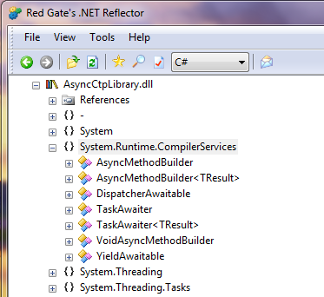
Visual Studio Async
Tasks and Language
Language
  “async” modifier marks method or lambda as asynchronous
  “await” operator yields control until awaited Task completes
Framework
  Task and Task<TResult> represent “ongoing operations”
    E.g. Async I/O, background work, etc.
    Single object for status, result, and exceptions
  New APIs round out the experience

Slide 12
Visual Studio Async
Related Additions
Combinators
  Task.WhenAll, Task.WhenAny
Timer integration
  Task.Delay(TimeSpan), CancellationTokenSource.CancelAfter(Timespan)
Task scheduling
  ConcurrentExclusiveSchedulerPair
Fine-grained control
  TaskCreationOptions.DenyChildAttach
  EnumerablePartitionerOptions
  TaskCreationOptions.HideScheduler
ThreadLocal.Values

Slide 13
Visual Studio Async
Async in .NET Tomorrow
// Synchronous
TResult Foo(...);
System.IO.Stream:
Task<int> ReadAsync(...);
Task<int> WriteAsync(...);
Task FlushAsync();
Task<int> CopyToAsync(...);
// Asynchronous Programming Model (APM)
IAsyncResult BeginFoo(..., AsyncCallback callback, object state);
TResult EndFoo(IAsyncResult asyncResult);
// Event-based Asynchronous Pattern (EAP)
public void FooAsync(...);
public event EventHandler<FooCompletedEventArgs> FooCompleted;
// Task-based Asynchronous Pattern (TAP)
Task<TResult> FooAsync(...);

Slide 14
Ants (Sleeping on the UI)
Async CTP: http://msdn.microsoft.com/en-us/vstudio/async.aspx
demo

Slide 15
Agenda Checkpoint
Present
  Recap of parallel programming in the .NET Framework 4
Future
  Visual Studio Async
  TPL Dataflow

Slide 16
TPL Dataflow
Complementing Parallel Programming in .NET 4
Proactive in nature
  “Here’s the data. Now set up the computation.”
  Primitives for task and data parallelism
Missing the reactive piece
  “Set up the computation. Now here’s the data.”
  Primitives for dataflow parallelism

Slide 17
TPL Dataflow
Overview
Primitives for in-process message passing
  Blocks that can buffer and process data
  Can be linked together to create networks
Inspired by
  Decades of computer science research/history
  Related Microsoft technologies
    Asynchronous Agents Library in Visual C++ 2010
    CCR from Microsoft Robotics
    Axum incubation project

Slide 18

TPL Dataflow
Async Posting Example
ActionBlock<int>
  var c = new ActionBlock<int>(i =>
  {
  Process(i);
  });
  for(int i = 0; i < 5; i++)
  {
  c.Post(i);
  }
Message Queue
Process(4);
Process(0);
Process(1);
Process(2);
Process(3);
4
0
1
2
3

Slide 19
TPL Dataflow
Dataflow Blocks
IDataflowBlock
ISourceBlock<TOuput>
(a source of data)
ITargetBlock<TInput>
(a target for data)
IPropagatorBlock<>
(a source and target)
Built-in blocks for Buffering and Propagation
Built-in blocks for Executing
Built-in blocks for Joining

Slide 20
TPL Dataflow
Blocks for Buffering and Propagation
BufferBlock<T>
  Buffers an unlimited number of elements
  Delivers each element to at most 1 target
WriteOnceBlock<T>
  Accepts and buffers only 1 element, ever
  Delivers the 1 element to all linked targets
BroadcastBlock<T>
  Overwrites each element with the next
  (buffers meanwhile
  Delivers each element to all linked targets

Slide 21
TPL Dataflow
Blocks for Executing
ActionBlock<TInput>
  Executes an Action<TInput> for each element
  Buffers input until processed
TransformBlock<TInput, TOutput>
  Executes a Func<TInput, TOutput>
  for each element
  Buffers input until processed
  and output until consumed
TransformManyBlock<TInput, TOutput>
  Executes a Func<TInput,
  IEnumerable<TOutput>> for each element
  Buffers input until processed and output until consumed

Slide 22
TPL Dataflow
Blocks for Joining
BatchBlock<T>
  Groups multiple Ts into one T[ ]
  Supports greedy and non-greedy
JoinBlock<T1, T2>
  Groups one T1 and one T2 to form
  a Tuple<T1, T2>
  Supports greedy and non-greedy
BatchedJoinBlock<T1, T2>
  Groups a collection of T1s and a
  collection of T2s into one
  Tuple<IList<T1>, IList<T2>>

Slide 23

TPL Dataflow
Try them out!
http://www.clipartheaven.com/clipart/kids_stuff/images_(a_-_f)/child_with_blocks.gif

Slide 24
TPL Dataflow
Options and Utility Functions
DataflowBlockOptions
TaskScheduler
MaxMessagesPerTask
CancellationToken
BoundedCapacity
ExecutionDataflowBlockOptions
MaxDegreeOfParallelism
GroupingDataflowBlockOptions
Greedy
MaxNumberOfGroups
DataflowBlock extensions methods and utility functions
  SendAsync
  Receive, ReceiveAsync
  Choose
  ToObservable/ToObserver
  Etc.

Slide 25
Related Content
DEV324 | C# and Visual Basic Future: Async Made Simple
Wednesday, May 18 | 3:15 PM – 4:30 PM | Room: C305
CTPs
  VS Async: http://msdn.com/async
  TPL Dataflow: http://msdn.com/gg585582
Forums
  http://social.msdn.microsoft.com/Forums/en-US/parallelextensions/
  http://social.msdn.microsoft.com/Forums/en-US/async
  http://social.msdn.microsoft.com/Forums/en-US/tpldataflow

Slide 26
DEV Track Resources
http://www.microsoft.com/visualstudio
http://www.microsoft.com/visualstudio/en-us/lightswitch
http://www.microsoft.com/expression/
http://blogs.msdn.com/b/somasegar/
http://blogs.msdn.com/b/bharry/
http://www.microsoft.com/sqlserver/en/us/default.aspx
http://www.facebook.com/visualstudio

Slide 27





Resources
  Connect. Share. Discuss.
http://northamerica.msteched.com
Learning
  Sessions On-Demand & Community
  Microsoft Certification & Training Resources
www.microsoft.com/teched
www.microsoft.com/learning
  Resources for IT Professionals
  Resources for Developers
http://microsoft.com/technet
http://microsoft.com/msdn

Slide 28












Complete an evaluation on CommNet and
enter to win!

Slide 29


Slide 30

© 2011 Microsoft Corporation. All rights reserved. Microsoft, Windows, Windows Vista and other product names are or may be registered trademarks and/or trademarks in the U.S. and/or other countries.
The information herein is for informational purposes only and represents the current view of Microsoft Corporation as of the date of this presentation. Because Microsoft must respond to changing market conditions, it should not be interpreted to be a commitment
on the part of Microsoft, and Microsoft cannot guarantee the accuracy of any information provided after the date of this presentation. MICROSOFT MAKES NO WARRANTIES, EXPRESS, IMPLIED OR STATUTORY, AS TO THE INFORMATION IN THIS PRESENTATION.

