Slide 1
What can .NET 4 do for me?
DEV208
16 Great Reasons to
Adopt and Leverage .NET 4
Shy Cohen
Principal
Shy Cohen Consulting

Slide 2




Who Am I?
Worked for 13 Years at Microsoft
.NET 3.0, .NET 3.5 ← WCF (5 years)
ISA, Windows, MSMQ, MSN …
Microsoft MVP
Technology Consulting
Special “Ninja” Projects
Entrepreneurship
www.ShyCohen.com

Slide 3



Microsoft and Me
Advisory Boards
Design Reviews
Conferences
Projects
15 minutes

Slide 4
How We Got to .NET 4
SP1
3.5
3.0
.NET 1.0
.NET 1.1
.NET 2.0
.NET 4
.NET vNext
CLR 1.0
CLR 1.1
CLR 2.0
CLR 4
CLR vNext?
2002
2003
2005-2008
2010
Future

Slide 5
Themes for This Talk
.NET 4 enhances your Current investments
.NET 4 gives you New tools
.NET 4 prepares you for the Future

Slide 6
Developers, Developers, Developers
Visual Studio 2010
  New, WPF based IDE
  Multi-monitor support, better navigation, etc.
  Highly customizable
Multi-targeting improvements
One IDE, Multiple Platforms
  Windows, Web, Phone, Cloud
  Office 2010, SharePoint 2010

Slide 7
Your current investments

Slide 8
Existing “Stuff” Keeps Working
In-Process Side-by-Side Execution
  Starting in .NET 4, apps can load and start multiple versions of the .NET Framework in the same process
  .NET 4 offers finer control over which version of .NET will be used in mixed-version cases
More details

Slide 9
Benefits of the New SxS Model (1/2)
End users and system administrators
  Existing apps continue to run as they did after upgrading the runtime
Application developers
  SxS has almost no effect on application developers
  By default, apps run against the version of the .NET Framework they were built on
  But you can override this and tell an app to run under a newer version of .NET

Slide 10
Benefits of the New SxS Model (2/2)
Library developers and consumers
  SxS doesn’t solve the library compatibility problems
  Libraries continue to use the runtime of the AppDomain they’re is loaded into
  However, if an app was built using an earlier runtime, and the library was built using.NET 4, you must force the app to also use the .NET 4
Managed COM component developers
  In the past: managed COM components automatically ran using the latest version of the runtime installed
  Now: You can run COM components against the runtime they were built with

Slide 11
Current Investments
Base Class Library
Client Profile
Web Applications
Client Applications (WPF)
Frameworks (WCF, WF, EF)

Slide 12
Investing in Basics: BCL Improvements
Garbage Collection: Background GC replacing Concurrent GC
  Memory intensive apps are more responsive
Networking improvements
  NAT traversal via IPv6 & Teredo
File system access improvements
Memory mapped files
Arbitrary-precision math & complex numbers
Globalization
Many more improvements and additions across the board…
  TimeSpan, String, StringBuilder, Stopwatch, Enum, SpecialFolder, Stream, Path, IObservable<T> and System.IObserver<T>, IntPtr and UIntPtr, Lazy<T>, SortedSet<T>, ISet<T>, DeflateStream and GZipStream, Monitor, Thread.Yield, Guid, RegistryOptions, …

Slide 13
Current Investments
Base Class Library
Client Profile
Web Applications
Client Applications (WPF)
Frameworks (WCF, WF, EF)

Slide 14
Client Profile
15% Smaller installer
41MB vs. 48MB
“Minified” version of .NET
Slightly faster deployment experience
Has only the pieces client apps care about
No “server stuff” or deprecated features

Slide 15




Client Profile
Full Framework
WPF + WinForms
LINQ
ADO.NET
ASP.NET
Entity Framework
WF 3.5 + 4
WF 3.5
WCF (Client)
WCF (Server)
CLR v4
X86
X64
IA64

Slide 16
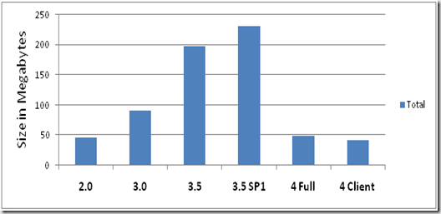
15% Smaller? Why Should I Care?
It’s what your users probably have!
Distributed via Windows Update
The Benefit: Smaller installer for your apps, and
fewer framework deployment failures
kb article
Shipped w/ Windows 7
“Recommended Update”

Slide 17
More Benefits of the Client Profile
Safer for client machines
  No ASP.NET = reduced machine attack surface
Fewer servicing events (updates, etc.)
Broad OS support
  3.5 Client: Windows XP SP2 or SP3 (x86) w/o .NET
  4 Client: Everywhere .NET can run (except IA64)
More details: http://msdn.microsoft.com/en-us/library/cc656912.aspx

Slide 18
Why move to .NET 4?
Reason 1
Because It’s Everywhere!

Slide 19
Current Investments
Base Class Library
Client Profile
Web Applications
Client Applications (WPF)
Frameworks (WCF, WF, EF)

Slide 20
Web: Migration Path to the Future
ASP.NET WebForms and MVC2 / MVC3
  Running side by side
  Even in the same app
  Great migration path

Slide 21
Web: Application Usability
More details
A fast, concise, cross-browser library that simplifies traversing HTML documents, event handling, animations, and using AJAX.
Embraces jQuery
  Included in web apps by default
  Serve it from your own server, OR
  Use the Microsoft CDN for free!
Intelligently target specific Browsers
and Devices
  iPhone, Google Chrome, etc.
Create more memorable, user-friendly URLs
  Routing improvements
  And improve SEO while at it
You can also get the AJAX libraries and other ASP.NET framework JavaScript files from it!
The benefits:
Lower server load +
Dramatic speedup for remote audiences

Slide 22
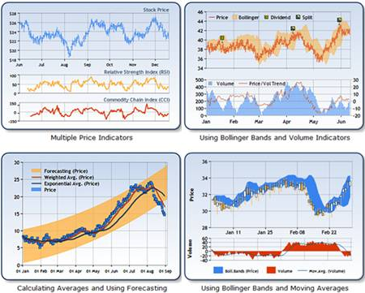
Web: More Useful Apps
ASP.NET Chart control
Add-on to .NET 3.5 SP1, built-in in .NET 4
More details
35 distinct chart types
An unlimited number of chart areas, titles, legends, and annotations
A wide variety of appearance settings for all chart elements
3-D support for most chart types
Smart data labels that can automatically fit around data points
Strip lines, scale breaks, and logarithmic scaling
More than 50 financial and statistical formulas for data analysis and transformation
Simple binding and manipulation of chart data
Support for common data formats such as dates, times, and currency
Support for interactivity and event-driven customization using Ajax
State management
Binary streaming
More details
.NET 4 also includes charting components for use in WinForms & WPF apps

Slide 23
Web: Performance Improvements
Support for session-state compression
Permanently redirecting pages
Extensible ASP.NET Output Caching
Cleaner markup
  Smaller HTML = quicker download
  Easier to use w/ things like jQuery
Fine grained control over AJAX script download

Slide 24
Fine Grained Control over AJAX
<asp:ScriptManager ID="sm1"
AjaxFrameworkMode="Explicit" runat="server">
<Scripts>
<asp:ScriptReference Name="MicrosoftAjaxCore.js" />
<asp:ScriptReference Name="MicrosoftAjaxComponentModel.js" /> <asp:ScriptReference Name="MicrosoftAjaxSerialization.js" /> <asp:ScriptReference Name="MicrosoftAjaxNetwork.js" />
</Scripts>
</asp:ScriptManager>

Slide 25
Web: Standard Compliance
Enhanced support for Web standards
  Esp. around accessibility (Section 508)
Enhanced CSS compatibility
  Many more ASP.NET controls are CSS enabled
  Error messages don’t have to be red anymore ☺

Slide 26
Why move to .NET 4?
Reason 2
Because It Makes Web Apps Shine Brighter!

Slide 27
Web: Deployment
Automation of many common deployment tasks
  Reduced deployment time
  Reduced deployment errors
Deploying an application
  Web packaging
  Web.config transformation
  Database deployment
  One-click publish for Web applications

Slide 28
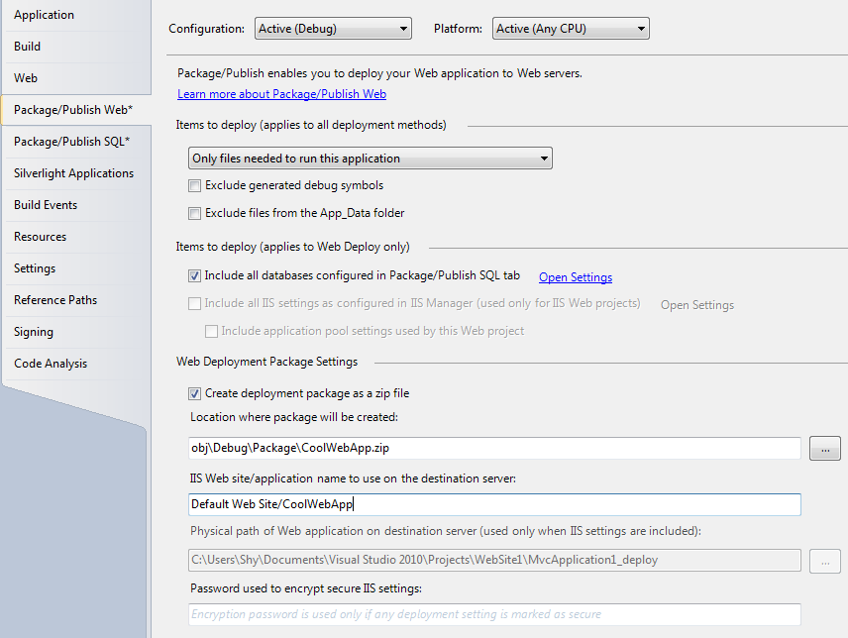


Slide 29
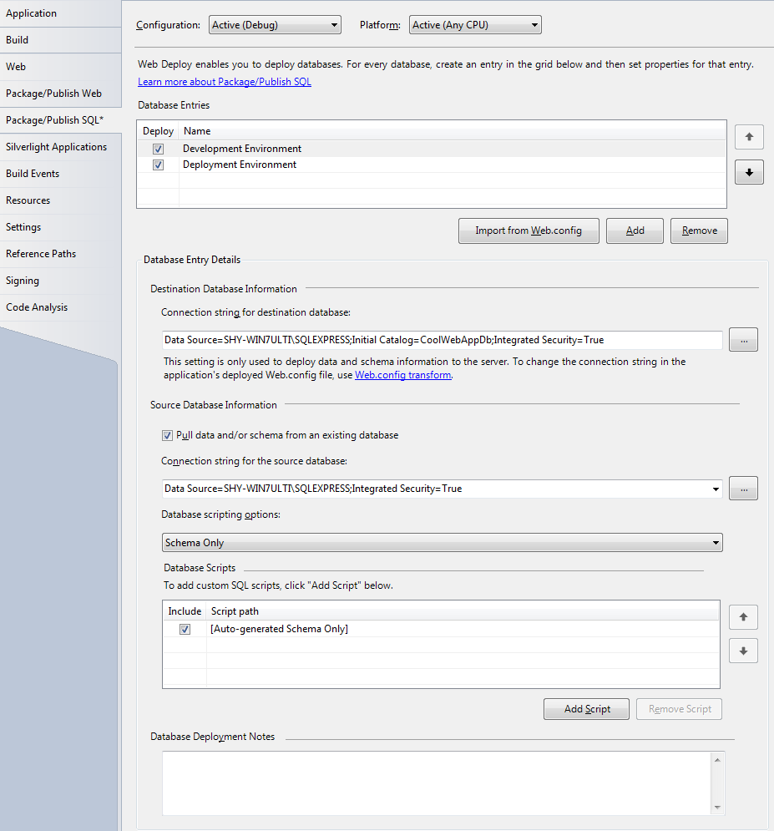


Slide 30
Deployment Automation - Summary
Create an IIS apps on destination server
Configure IIS settings
Copy files to the destination server
Change Web.config settings that must be different in the destination environment
  E.g. database connection string
Provide data and/or schemas for the
SQL Server databases used by the app
More details

Slide 31
Why move to .NET 4?
Reason 3
Because It Makes Web Deployment Really Easy!

Slide 32
Web: Developers Productivity
JavaScript IntelliSense support
Auto-complete snippets
  HTML and ASP.NET
Dynamic Data
  RAD experience for data-driven Web sites
  Introduced in .NET 3.5 SP1 (mid-2008)
  Improved on in .NET 4

Slide 33
“Instant CRUD”
Using
Dynamic Data
demo

Slide 34
Dynamic Data in .NET 3.5 SP1
Customizations
  Optional control of markup using templates
  Validation using attributes on data classes
    Required fields, range checking, type checking, pattern matching (RegEx), custom validation
Limitations
  Data access must be based on EF or LINQ to SQL
  Web project must be created using the Dynamic Data or Dynamic Data Entities templates

Slide 35
Dynamic Data in .NET 4
Enables Dynamic Data for existing projects
Customization enhancements
  Entity templates
  New field templates for URLs & e-mail addresses
  Creating links
  More …
Enhancements in the data model
  Inheritance in the Data Model
  Support for Many-to-Many Relationships
More details

Slide 36
Why move to .NET 4?
Reason 4
Because It Saves Me TONS Of Time!

Slide 37
What Can .NET 4 Do For Your Web Apps? - Summary
Create more usable applications
Improve application performance
Be more standard compliant
Deploy more efficiently
Make developers more productive

Slide 38
Current Investments
Base Class Library
Client Profile
Web Applications
Client Applications (WPF)
Frameworks (WCF, WF, EF)

Slide 39

WPF 4 + Win7 =
demo

Slide 40
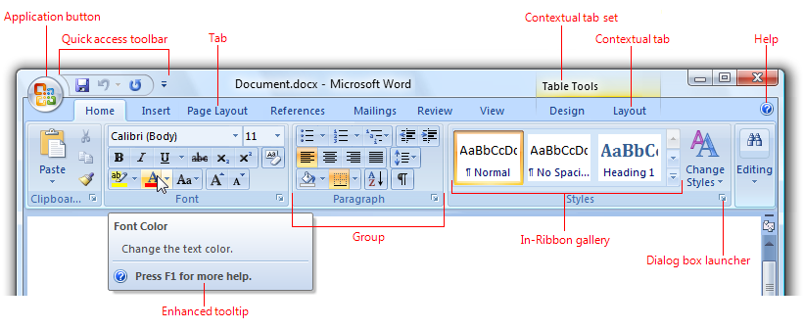
WPF 4 = More Compelling Apps
Leverage multi-touch support on Win7
Create Office-looking applications
Ribbon download link (it's an out-of-band release)

Slide 41
Why move to .NET 4?
Reason 5
Because It Makes My Apps Shine on Windows 7!

Slide 42
WPF 4 Productivity & Usability
Improved Visual Studio 2010 designer
Customization of control’s look by its state
Calendar, DataGrid, and DatePicker
Improved animation support
Improved text rendering

Slide 43
Why move to .NET 4?
Reason 6
Because It Makes My Desktop Apps Rock!

Slide 44
Easy Deployment, Same Power
XAML browser applications (XBAPs)
  WPF apps running in a browser
  Introduced in .NET 3.0
The benefits of XBAP
  Over Silverlight: Full access to all of .NET (partial trust)
  Over other EXEs: Runs from the web page
.NET 4 Enhancements
  Full-trust deployment
    WCF, local file system, registry, etc.
  Interaction with the hosting Web page
More details

Slide 45
XBAP + WCF =
demo

Slide 46
Why move to .NET 4?
Reason 7
Because It Unleashes the Potential of XBAP!

Slide 47
Current Investments
Base Class Library
Client Profile
Web Applications
Client Applications (WPF)
Frameworks (WCF, WF, EF)

Slide 48
Windows Communication Foundation
A unified communication API
Routing Service
  Route messages based on content
Support for WS-Discovery
  Create and search for discoverable services
Various WCF REST enhancements
  Integration with System.Web.Routing, Caching, Formats Support, HTTP REST Error Handling, Cross Domain JavaScript (JASONP), WCF REST Service Help Page
Better integration with IIS
  Support for HTTP Decompression
  Multiple IIS Site Bindings Support
Simplified configuration
  Reduces the likelihood of configuration errors
  Default Endpoints (based on the URI), Standard Endpoints (mexEndpoint, discoveryEndpoint),
Configuration Based Activation
  .SVC file no longer required
More details

Slide 49
Windows Workflow Foundation
An embeddable workflow engine
It’s rewritten & significantly better!
  Redesigned activity & data models
  New flow-control activities
  Expanded built-in activity library
  WPF-based designer
WF 3.5 included in Full for backwards compatibility
  Your current WF app will just work - no need to port
More details

Slide 50
Entity Framework 4
A bridge between data and objects
Easily migrate from (or leverage) T-SQL
Leverage your existing data model investments
  e.g. SPROCs
Data-first, Model-first*, and Code-first **
Better performance and testability
foreach (string name in context.ExecuteStoreQuery<string>
("Select Name from Department where DepartmentID < {0}", 5))
{
Console.WriteLine(name);
}

Slide 51
EF 4.0 Enhancements
Model-First Support
Foreign Keys in the Conceptual Model
Self-Tracking Entities for N-Tier Application Development
New Methods for N-Tier Application Development
EntityDataSource Support for the QueryExtender Control
Testability with IObjectSet<T>
Direct Execution of Store Commands
Persistence-Ignorant Objects
Lazy Loading of Related Objects
Functions in LINQ to Entities Queries
  SPROCs, canonical, database, and more
Complex Type Support
Improved Model Browser Functionality
Entity Designer Extensibility
  Extend the .edmx file generation process, the .edmx file update process, add custom properties to objects, load and save custom file formats, extend the .edmx file loading and saving processes.
And many more!

Slide 52
EF 4.1
More details + download links
RTW on April 11th, 2011
Code First Support
  Define your model using C#/VB.NET classes
  Map them to an existing database, OR
  Generate a database schema
DbContext API
  A simplified abstraction over ObjectContext
  Optimized for common tasks and coding patterns
  Can be used with Database First, Model First & Code First

Slide 53
MVC3 + EF 4.1 = Awesome 7.1
demo

Slide 54
.NET 4 is Enhancing Your
Current Investments
The .NET platform
Web & Client apps
Frameworks

Slide 55
Why move to .NET 4?
Reason 8
Because It Gives Me More of What I Love!

Slide 56
New Tools

Slide 57
Major Improvements in COM Interop
Type Embedding
  Interop Assemblies are now Design-Time-Only
  No more PIA Significantly smaller deployments!
Type Equivalence
  Target multiple Office version from a
  single add-in!
Optional & Named Parameters in C#
  Clean up you COM-calls code
  Fewer bugs, easier maintenance
Faster interop marshaling
  The more complex the function
  signature, the greater the speed-up
class Program
{
static void Main(string[] args)
{
Utils.Alert("Warning");
Utils.Alert("Error", beep:true, prefix:"Sys");
}
}
class Utils
{
public static void Alert(string content,
string prefix = "",
bool beep = false)
{
Console.WriteLine("{0}{1} {2}", prefix,
prefix.Length>0 ? ">" : "",
content);
if (beep) Console.Beep();
}
}

Slide 58
Why move to .NET 4?
Reason 9
Because It Makes It Easy To Leverage The Office Platform!

Slide 59
SharePoint Development
SharePoint 2010 developer deployment
  A local copy of SharePoint
  No need to run a server OS on the dev box
  No need to have a server for dev testing
Integrated with VS 2010 F5 experience
  Auto deployment
  Source-level debugging
  etc.

Slide 60
Why move to .NET 4?
Reason 10
Because It Makes It So Much Easier to Develop SharePoint Apps!

Slide 61
WCF Data Services
Formerly codenamed “Astoria”, then ADO.NET Data Service, and now
Safe CRUD over data sources
Implements OData
  Open Source, REST-based protocol
Self describing data model
Broadly accessible
  Browsers
  Client applications
  Server applications
More about OData
.NET 3.51 & 4, Silverlight 3 & 4,
JavaScript (including jQuery),
Excel 2010 PowerPivot, Java, PHP, AJAX , …

Slide 62
WCF Data Services
demo

Slide 63
WCF Data Services Improvements
Support for OData 2.0 functionality
  Counting entities in an entity set
    $count, $inlinecount
  Query Projections
    $select
  Partial Entity Sets
    $skiptoken
New features
  Server-driven paging
  Data binding
  Streaming of binary resources
  Custom data service providers
More about WCF Data Services

Slide 64
Why move to .NET 4?
Reason 11
Because It Lets Me Set My Data Free!

Slide 65
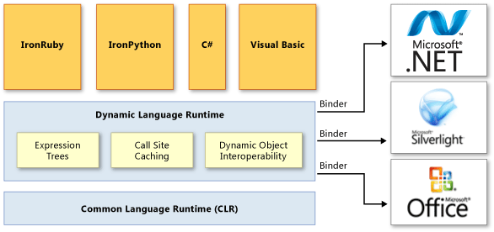
Dynamic Language Runtime
A new runtime environment that adds a set of services for dynamic languages on the CLR

Slide 66
What Does the DLR Provide?
For languages, it makes it easier to:
  Develop dynamic languages on .NET
  Add dynamic features to static languages
For apps, it makes it easier to integrate with:
  Dynamic languages (IronPython, IronRuby, …)
  Dynamic objects (expandos) built in C# or VB
  Anything that implements IDispatch (COM)

Slide 67
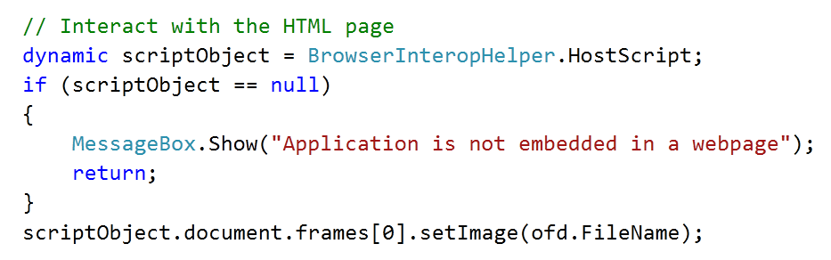
Seriously, What Is It Good For?
Access stuff in a simple, familiar, uniform way
  HTML, DOM
  Office
  .NET reflection
  Dynamic languages
  And more…
Easily add scripting support to apps
  Customizations and extensions
  Complex things that are better done using text
Reaching into the browser’s DOM
DOM
JavaScript function
CLR string

Slide 68
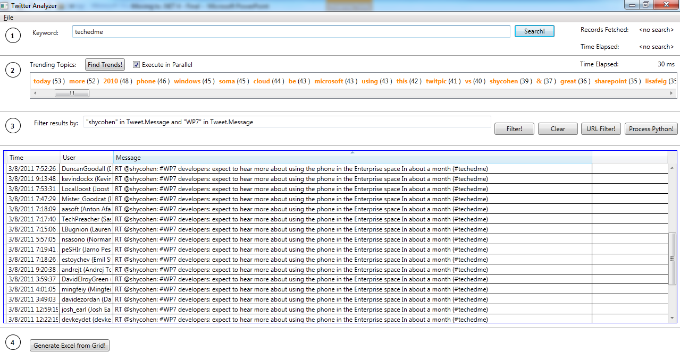
http://code.msdn.microsoft.com/twitter

Slide 69
Why move to .NET 4?
Reason 12
Because It Helps Me Bridge the
“Dynamic-to-Static Gap”!

Slide 70

Managed Extensibility Framework
=
USB for Code
http://tashadean.com/wp-content/uploads/2009/10/usb_lego_hub.jpg

Slide 71
MEF
Helps you build extensible and composable apps
  By adhering to the Opened-Closed Principle
  Opens your applications for extension
  Keep them closed to modification
“Plug-and-Play” integration
  Specify points where an app can be extended
  Offer services to extensible applications
  MEF hooks things up

Slide 72
MEF in Action
demo

Slide 73
Why move to .NET 4?
Reason 13
Because It Takes The Hassle Out Of App Extensibility!

Slide 74
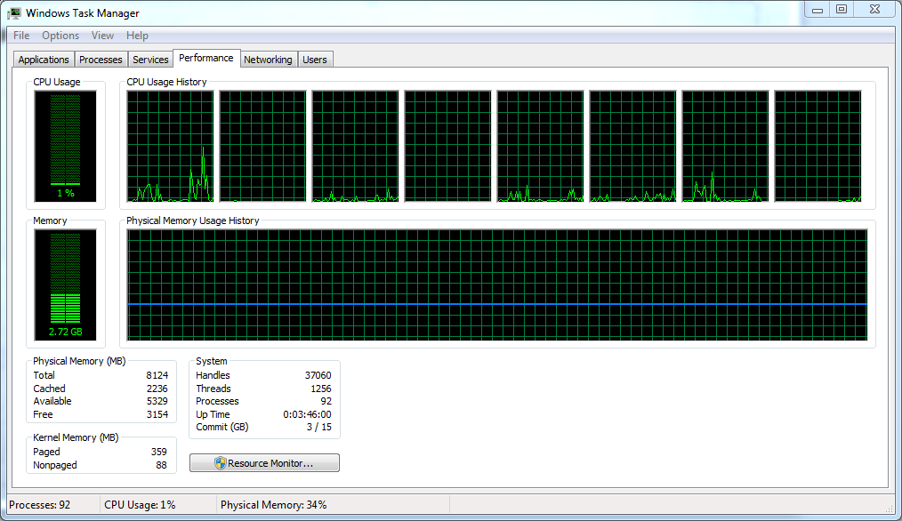
Multi-Core is Here!
Z
Z
Z
Z

Slide 75

http://www.laurathomas.co.uk/public/gallery/resonate/thread1.jpg

Slide 76
The Problem With Threads
Threads are heavyweight
  Threads take a relatively long time to create
  Each thread is allocated 1 MB of VM for its stack
  Context switching is expensive
  Optimizing threads usage is not trivial
  Not so good for “quick” parallelism
Threads are hard to compose
  Passing data to and from threads is not simple
  Managing errors that happen on other threads is not trivial
  Coordinating the work of multiple threads is not simple
    Especially when you need to stop/cancel work

Slide 77
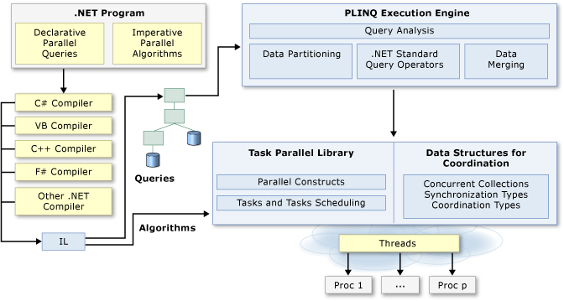
Ok, What’s The Alternative?
Declarative: Parallel LINQ (PLINQ)
Imperative: A Task-oriented Parallel Library (TPL) + Parallel-Safe Data Structures
More about parallel programming in .NET 4

Slide 78
Task Parallel Library
A new programming model for writing multithreaded and asynchronous code
  Efficient, fine-grained, and scalable
Simplifies the work of app and library developers
  Makes it easy to use and compose async operations
  Makes it easy to create async operations
Shields developers from threads & the thread pool

Slide 79
What Can the TPL Do For Me?
It makes parallelism Simpler
  Implementing common scenarios
  Passing data in & out of parallel operations
  Handling errors in parallel operations
  Interrupting work in progress
It makes parallelism Efficient
  Work stealing and variable work-chunk sizes
  Auto-adjusting the thread-pool to address varying loads
  Reduced overhead for parallel work
It gives me Control, if I want it
  Creation and continuation options
  Scheduling tasks outside of the thread-pool

Slide 80
Why move to .NET 4?
Reason 14
Because It Helps Me Leverage Multi-Core and Hyper-Threading!

Slide 81
New Tools - Summary
Office & SharePoint Development
WCF Data Services & OData
Dynamic Language Runtime
Manages Extensibility Framework (MEF)
Task Parallel Library (TPL)

Slide 82
The Future

Slide 83

Next Generation Platforms
The Cloud
Mobility
Windows Azure Tools
for Visual Studio
Windows Phone Developer Tools

Slide 84
Why move to .NET 4?
Reason 15
Because It Take My Apps to New Places!

Slide 85
The Future of Parallel Computing
Async Programming Model
  Announced at the last PDC (October, 2010)
  Powered by the TPL
.NET Framework is aligning with this!
  WCF, ADO.NET, …
Download the Async CTP here

Slide 86
Async Programming Model
Tasks & The Async Programming Model
CPU
Network
Disk
Composite
An asynchronous scenario
  User clicks a button
  Search YouTube for video links
  Download two videos (concurrently)
  Create a mashup from downloaded videos
  Save the resulting video

Slide 87
Linear Logic,
Executing Asynchronously
Tasks & The Async Programming Model
CPU
Network
Disk
Composite
try {
string[] videoUrls = await SearchYoutubeAsync(url); // Network-bound
Task<Video> t1 = DownloadVideoAsync(videoUrls[0]); // Start 2 downloads
Task<Video> t2 = DownloadVideoAsync(videoUrls[1]);
Video[] vids = await Task.WhenAll(t1, t2); // Wait for both
Video v = await MashupVideosAsync(vids[0], vids[1]); // CPU-bound
await v.SaveAsync(textbox.Text); // Disk-bound
}
catch (WebException ex) {
ReportError(ex);`
}

Slide 88
Why move to .NET 4?
Reason 16
Because It Prepares Me For The Future!

Slide 89
Why Move to .NET 4?
Because it’s everywhere
Because it makes web apps shine
Because it makes web deployment really easy
Because it saves me tons of time
Because it makes my apps shine on windows 7
Because it makes my desktop apps rock
Because it unleashes the potential of XBAP
Because it gives me more of what i love
Because it makes it easy to leverage the office platform
Because it makes it so much easier to develop SharePoint apps
Because it lets me set my data free
Because It help me bridge the “dynamic-to-static gap”!
Because it takes the hassle out of application extensibility
Because it helps me leverage multi-core and hyper-threading
Because it takes my apps to new places
Because it prepares me for the future
At Least 16 Reasons!

Slide 90
.NET 4
Provides tons of value
  It enhances your Current investments
  It gives you New powerful tools
  It prepares you for the Future
Adopt it today & leverage the benefits
Go forth and innovate! ☺

Slide 91

Related Content
DEV317 | Using Microsoft Visual Basic to Build Windows Phone Applications
DEV324 | C# and Visual Basic Future: Async Made Simple
DEV203 | Introduction to SharePoint Development with Microsoft Visual Studio 2010
DEV279-HOL | Introduction to the Managed Extensibility Framework
DEV308 | Creating and Consuming Open Data Protocol (OData) Services
DEV304 | Advanced Programming Patterns for Windows 7
Find me later at the Visual Studio booth (TLC) or the CloudValue booth (1050)

Slide 92
DEV Track Resources
http://www.microsoft.com/visualstudio
http://www.microsoft.com/visualstudio/en-us/lightswitch
http://www.microsoft.com/expression/
http://blogs.msdn.com/b/somasegar/
http://blogs.msdn.com/b/bharry/
http://www.microsoft.com/sqlserver/en/us/default.aspx
http://www.facebook.com/visualstudio

Slide 93





Resources
  Connect. Share. Discuss.
http://northamerica.msteched.com
Learning
  Sessions On-Demand & Community
  Microsoft Certification & Training Resources
www.microsoft.com/teched
www.microsoft.com/learning
  Resources for IT Professionals
  Resources for Developers
http://microsoft.com/technet
http://microsoft.com/msdn

Slide 94












Complete an evaluation on CommNet and
enter to win!

Slide 95


Slide 96

© 2011 Microsoft Corporation. All rights reserved. Microsoft, Windows, Windows Vista and other product names are or may be registered trademarks and/or trademarks in the U.S. and/or other countries.
The information herein is for informational purposes only and represents the current view of Microsoft Corporation as of the date of this presentation. Because Microsoft must respond to changing market conditions, it should not be interpreted to be a commitment
on the part of Microsoft, and Microsoft cannot guarantee the accuracy of any information provided after the date of this presentation. MICROSOFT MAKES NO WARRANTIES, EXPRESS, IMPLIED OR STATUTORY, AS TO THE INFORMATION IN THIS PRESENTATION.

