Slide 1

Introduction to SharePoint Development with Microsoft Visual Studio 2010
DEV203
Mike Morton
Senior Program Manager
Microsoft

Slide 2
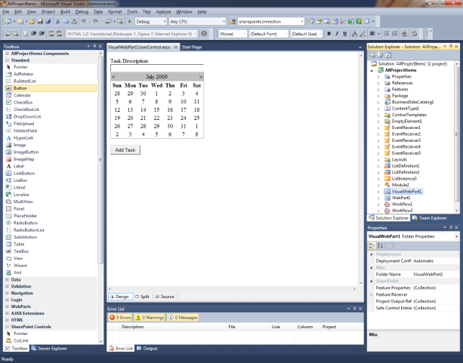
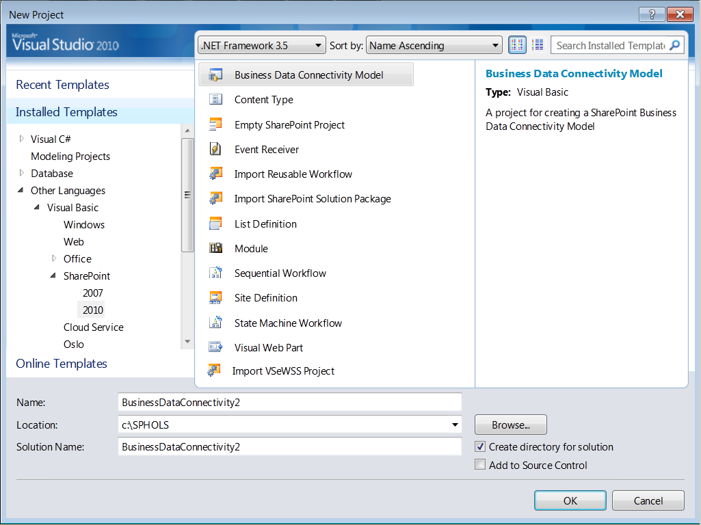
Developer Tools for SharePoint
Familiar versus experience
  Build, debug, deploy SharePoint projects
  Designers for Web parts, BDC & workflows
  View SharePoint sites in Server Explorer
  Team Foundation Server integration
  Application lifecycle management
Broad SharePoint support
  Supports SharePoint Foundation and Server
  Sandboxed and farm solutions
  Business Connectivity Services
  Expanded workflow support
  SP Designer → Visual Studio continuum

Slide 3



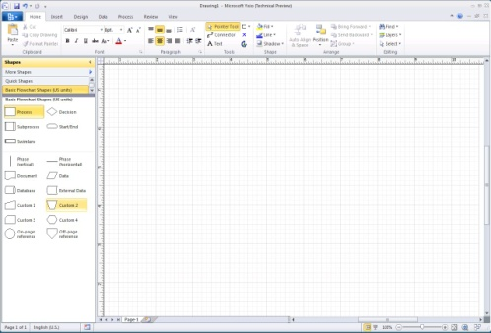
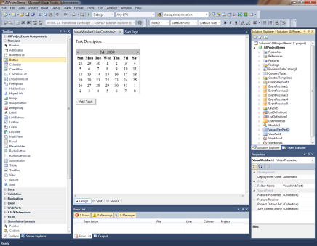
Development Continuum
NOTE to Speaker:
In the center SharePoint Designer box, the last rectangle “Coded workflows” has another rectangle underneath, entitled “Declarative works”. Both are formatted.
Business Analyst/Process Designer
Import
Designer/IW/Power User
Professional developer
Design skeleton process
Create lists and libs
Custom web parts
View WF visualizations
Design web pages
List definitions
Design business diagrams
Web part hook-up
WSP
Package
Event receivers
Export
View and forms
Application pages
Declarative workflows
Coded workflows
Coded workflows

Slide 4
Developer Environment
Visual Studio 2010 and SharePoint 2010 on same machine
Must use 64-bit OS
  Windows 7 and Windows Vista SP1
  Windows Server 2008 (R2)
How to setup a SP2010 developer environment
SharePoint Easy Setup for Developers

Slide 5
Templates, Designers and Workflows
Project and item templates
  Templates for many SharePoint artifacts
  Wizards collect artifact information
  Support for sandboxed solutions
Visual designers
  Design web parts
  Build Business Data Connectivity (BDC) models
  Create workflows

Slide 6
Templates and Designers
demo

Slide 7
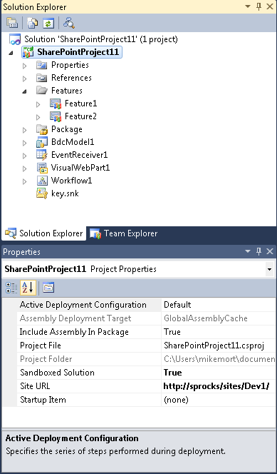
Project System
Project commands
  Package, retract
Project properties
  Sandboxed, site URL, etc…
Features and package nodes
Mapped folders
Items/files have SharePoint
specific properties

Slide 8
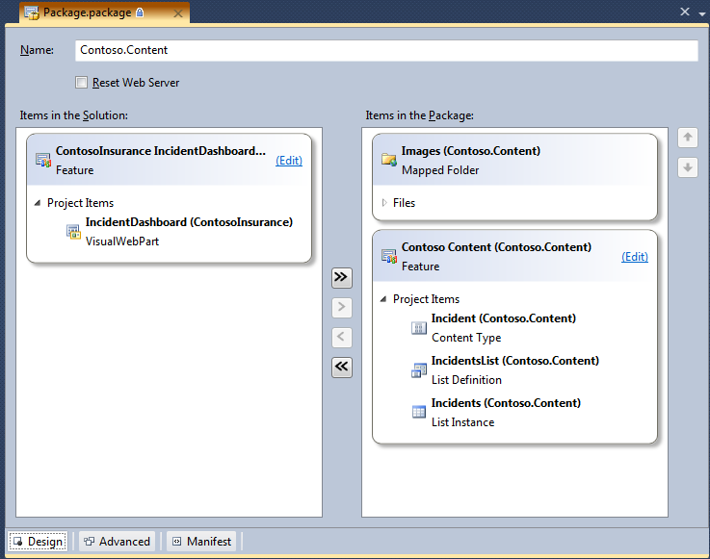
Features and Packaging
Feature designer
  Add/remove items to feature
  View/change manifest directly
Package designer
  Add/remove items to package
  View/change manifest directly
Packaging Explorer
  Hierarchically view all packages,
  features, artifacts in solution (across projects)

Slide 9
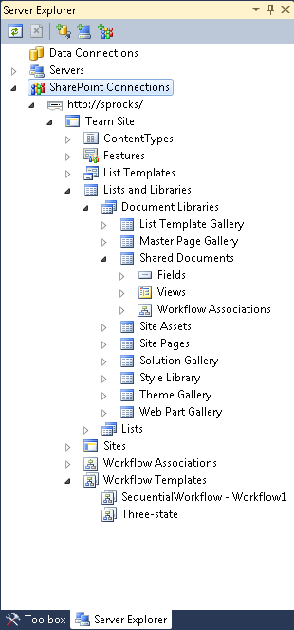
Server Explorer Integration
Hierarchical view of local SharePoint sites and artifacts
View sites, features,
lists, fields, etc…
View properties of artifacts

Slide 10
Project System and Packaging
demo

Slide 11




Application Lifecycle
Developer Machine
Fix Bugs (repeat as necessary)
Team Foundation Server
Check In
Development
F5 Deploy
Nightly
Build
or
Continuous
Integration
Testing
Staging
TFS Build Server
Open/Close Bugs
SharePoint Projects
Warm-Blooded User Testing
Build
SP2010 DLL’s
WSP
Automated Testing
Deploy Using PowerShell
Run Tests?

Slide 12
Visual Studio 2010 Service Pack 1
IntelliTrace
  Break execution to replay code
  Save iTrace log file for later viewing
Unit tests
  Create and execute unit tests in Visual Studio
Available now!

Slide 13
Team Build and Unit Tests
demo

Slide 14
Extensibility
Project and item extensions
  Context menus, project properties, project events
Server Explorer extensions
  Extend in-the-box nodes or create new nodes
Deployment extensions
  New deployment steps and configurations
Packaging validation rules
  Add custom feature/package validation rules
MSBuild extensibility
  Custom tasks can be created

Slide 15
Extensibility in the Wild
Visual Studio 2010 SharePoint Power Tools (VS team)
  Enhanced Sandbox Support
Silverlight SharePoint Web Parts (Microsoft DPE team)
  Project templates for creating Silverlight web parts
Community Kit for SharePoint: Dev Tools Edition (MVPs)
  Project, item, deployment, and server explorer extensions

Slide 16
Resources
MSDN SharePoint developer team blog
MSDN SharePoint developer forum
MSDN SharePoint developer center
MSDN library – SP development in VS2010
Channel9 SharePoint 2010 developer training course
Microsoft patterns and practices SP2010 guidance
SharePoint 2010 developer platform white paper
SharePoint developer samples
Using TFS TeamBuild for SharePoint projects

Slide 17

Related Content
Required Slide
Speakers, please list the Breakout Sessions, Interactive Discussions, Labs, Demo Stations and Certification Exam that relate to your session. Also indicate when they can find you staffing in the TLC.
Related Sessions
  OSP301 – Integrating Microsoft SharePoint 2010 with Windows Azure
  OSP302 – Advanced SharePoint Data Access with Microsoft Silverlight
  OSP378-INT – Developer’s Roadmap to Building Office-Based Solutions
Hands-on Labs
  OSP276-HOL – Intro to SharePoint 2010 and Developing a Visual Web Part
Follow me on Twitter – MikeMorton_MSFT

Slide 18
DEV Track Resources
http://www.microsoft.com/visualstudio
http://www.microsoft.com/visualstudio/en-us/lightswitch
http://www.microsoft.com/expression/
http://blogs.msdn.com/b/somasegar/
http://blogs.msdn.com/b/bharry/
http://www.microsoft.com/sqlserver/en/us/default.aspx
http://www.facebook.com/visualstudio

Slide 19





Resources
  Connect. Share. Discuss.
http://northamerica.msteched.com
Learning
  Sessions On-Demand & Community
  Microsoft Certification & Training Resources
www.microsoft.com/teched
www.microsoft.com/learning
  Resources for IT Professionals
  Resources for Developers
http://microsoft.com/technet
http://microsoft.com/msdn

Slide 20












Complete an evaluation on CommNet and
enter to win!

Slide 21


Slide 22

© 2011 Microsoft Corporation. All rights reserved. Microsoft, Windows, Windows Vista and other product names are or may be registered trademarks and/or trademarks in the U.S. and/or other countries.
The information herein is for informational purposes only and represents the current view of Microsoft Corporation as of the date of this presentation. Because Microsoft must respond to changing market conditions, it should not be interpreted to be a commitment
on the part of Microsoft, and Microsoft cannot guarantee the accuracy of any information provided after the date of this presentation. MICROSOFT MAKES NO WARRANTIES, EXPRESS, IMPLIED OR STATUTORY, AS TO THE INFORMATION IN THIS PRESENTATION.

