Slide 1

Performance Tuning and Optimization in Microsoft SQL Server 2008 R2 and SQL Server Code-Named "Denali"
DBI402
Adam Machanic
Consultant
SQLblog.com
Michael Wachal
Senior Program Manager
Microsoft

Slide 2

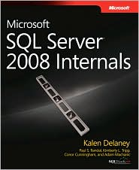
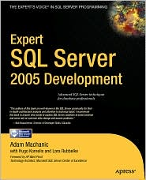


Adam Machanic
SQL Server Specialist, Financial Industry
Boston, MA
Author
SQL Server 2008 Internals
Expert SQL Server 2005 Development
Conference and INETA Speaker
Connections, PASS, TechEd, DevTeach, etc.
Founder: SQLblog.com
The SQL Server Blog Spot on the Web
amachanic@gmail.com

Slide 3

Mike Wachal
SQL Server Diagnostic Infrastructure
Redmond, WA
Occasional speaker
PASS, TechEd, Ballroom Dance Competitions
Blog
http://blogs.msdn.com/b/extended_events
Michael.Wachal@microsoft.com

Slide 4
Agenda
Overview: The Tuning Process
Using DMVs
Using Extended events
Use Cases

Slide 5
Overview
The “virtuous” circle of performance problems
Monitor
Troubleshoot
Tune / Optimize
Test
Deploy

Slide 6
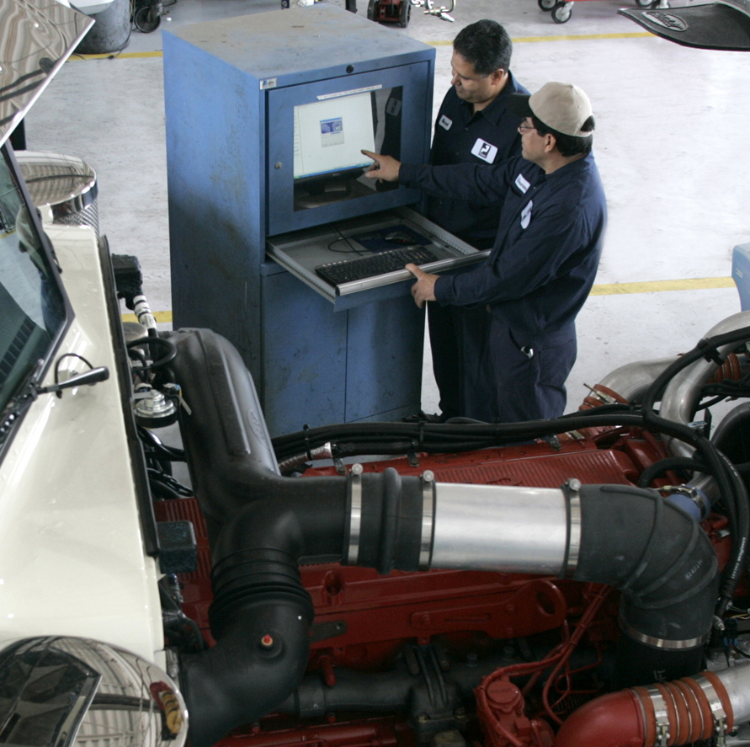
Monitoring
Collection of Metrics
Storage of Time-Stamped Data
Calculation of Baseline Measures

Slide 7
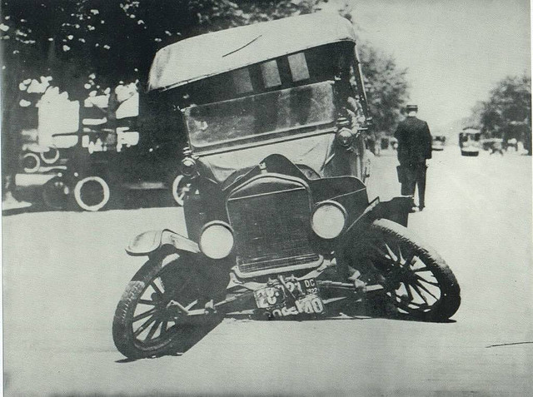
Troubleshooting
Identify the Problem
Measure the Impact
Refine Data Collection

Slide 8

Tuning and Optimizing
Correct the Problem
Improve the Query
Modify your Approach

Slide 9
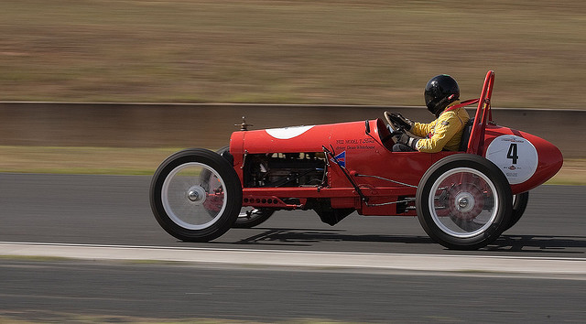
Testing and Deploying
Validate the Behavior
Move to Production
Confirm with Users

Slide 10
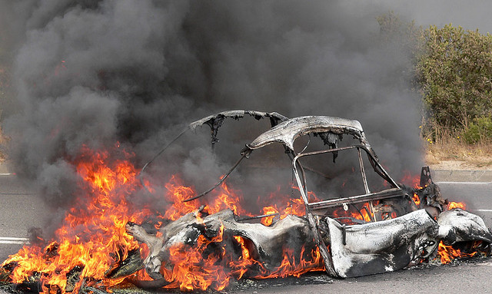
Don’t Forget to Test!

Slide 11
Finding the Problem is Key
Dynamic Management Views
  Point-in-time information
  Usually exposes cumulative data
  Must be stored for snapshot/delta comparisons
Extended Events
  Used for diagnostic tracing
  Replaces SQL Trace/Profiler in SQL Server “Denali”
  User interface introduced in Denali

Slide 12
Dynamic Management Views

Slide 13
DMVOs
Dynamic Management ViewsObjects
Added in SQL Server 2005
  Regularly enhanced
Views over internal memory structures
  Data may be inconsistent
Deliver a vast amount of information

Slide 14
Why DMOs?
If you can write queries, you can use DMOs to get answers
Fast (usually), totally flexible, as much or as little data as you want
Cons
  Lots and lots of data--can be overwhelming
  Queries can get tricky

Slide 15
Lots, and lots, and lots, and lots, and lots, and lots of DMOs…
dm_audit_actions, dm_audit_class_type_map, dm_broker_activated_tasks, dm_broker_connections, dm_broker_forwarded_messages,
dm_broker_queue_monitors, dm_cdc_errors, dm_cdc_log_scan_sessions, dm_clr_appdomains, dm_clr_loaded_assemblies, dm_clr_properties,
dm_clr_tasks, dm_cryptographic_provider_algorithms, dm_cryptographic_provider_keys, dm_cryptographic_provider_properties,
dm_cryptographic_provider_sessions, dm_database_encryption_keys, dm_db_file_space_usage, dm_db_index_operational_stats,
dm_db_index_physical_stats, dm_db_index_usage_stats, dm_db_mirroring_auto_page_repair, dm_db_mirroring_connections, dm_db_mirroring_past_actions,
dm_db_missing_index_columns, dm_db_missing_index_details, dm_db_missing_index_group_stats, dm_db_missing_index_groups, dm_db_partition_stats,
dm_db_persisted_sku_features, dm_db_script_level, dm_db_session_space_usage, dm_db_task_space_usage, dm_exec_background_job_queue,
dm_exec_background_job_queue_stats, dm_exec_cached_plan_dependent_objects, dm_exec_cached_plans, dm_exec_connections, dm_exec_cursors,
dm_exec_plan_attributes, dm_exec_procedure_stats, dm_exec_query_memory_grants, dm_exec_query_optimizer_info, dm_exec_query_plan,
dm_exec_query_resource_semaphores, dm_exec_query_stats, dm_exec_query_transformation_stats, dm_exec_requests, dm_exec_sessions, dm_exec_sql_text,
dm_exec_text_query_plan, dm_exec_trigger_stats, dm_exec_xml_handles, dm_filestream_file_io_handles, dm_filestream_file_io_requests, dm_fts_active_catalogs,
dm_fts_fdhosts, dm_fts_index_keywords, dm_fts_index_keywords_by_document, dm_fts_index_population, dm_fts_memory_buffers,
dm_fts_memory_pools, dm_fts_outstanding_batches, dm_fts_parser, dm_fts_population_ranges, dm_io_backup_tapes, dm_io_cluster_shared_drives,
dm_io_pending_io_requests, dm_io_virtual_file_stats, dm_os_buffer_descriptors, dm_os_child_instances, dm_os_cluster_nodes, dm_os_dispatcher_pools,
dm_os_dispatchers, dm_os_hosts, dm_os_latch_stats, dm_os_loaded_modules, dm_os_memory_allocations, dm_os_memory_brokers,
dm_os_memory_cache_clock_hands, dm_os_memory_cache_counters, dm_os_memory_cache_entries, dm_os_memory_cache_hash_tables,
dm_os_memory_clerks, dm_os_memory_node_access_stats, dm_os_memory_nodes, dm_os_memory_objects, dm_os_memory_pools, dm_os_nodes,
dm_os_performance_counters, dm_os_process_memory, dm_os_ring_buffers, dm_os_schedulers, dm_os_spinlock_stats, dm_os_stacks, dm_os_sublatches,
dm_os_sys_info, dm_os_sys_memory, dm_os_tasks, dm_os_threads, dm_os_virtual_address_dump, dm_os_wait_stats, dm_os_waiting_tasks,
dm_os_worker_local_storage, dm_os_workers, dm_qn_subscriptions, dm_repl_articles, dm_repl_schemas, dm_repl_tranhash, dm_repl_traninfo,
dm_resource_governor_configuration, dm_resource_governor_resource_pools,dm_resource_governor_workload_groups, dm_server_audit_status,
dm_sql_referenced_entities, dm_sql_referencing_entities, dm_tran_active_snapshot_database_transactions, dm_tran_active_transactions, dm_tran_commit_table,
dm_tran_current_snapshot, dm_tran_current_transaction, dm_tran_database_transactions, dm_tran_locks, dm_tran_session_transactions,
dm_tran_top_version_generators, dm_tran_transactions_snapshot, dm_tran_version_store, dm_xe_map_values, dm_xe_object_columns, dm_xe_objects,
dm_xe_packages, dm_xe_session_event_actions, dm_xe_session_events, dm_xe_session_object_columns, dm_xe_session_targets, dm_xe_sessions

Slide 16

DMO Categories
SQL Audit
SQLCLR
Exection Environment
I/O Information
Replication
Transactions
SQL Service Broker
Cryptographic
Filestream
SQLOS Information
Resource Governor
Extended Events
Change Data Capture
Database-Level Information
Full-Text Search
Query Notifications
T-SQL Modules

Slide 17
Performance Troubleshooting Categories
Execution Environment
Execution Details
Transaction Information
Query Processor Components
TempDB

Slide 18
Execution Environment
Connect
Get a Session
Session Makes Requests

Slide 19
Execution Environment DMOs
sys.dm_exec_sessions
One row per connected session
sys.dm_exec_requests
One row per active request
(Usually 0 or 1 row(s) per session)

Slide 20
Execution Details
What Query is Running?
Why is it Slow?
What is the Query Plan?

Slide 21

Execution Details DMOs
Binary “handle” from sys.dm_exec_requests
Feed the handle to the appropriate function
Functions
sys.dm_exec_sql_text
sys.dm_exec_query_plan

Slide 22
Transactions
Start a Transaction
(Implicit or Explicit)
It’s Associated With Your Session
Work Gets Logged in the Database(s)

Slide 23
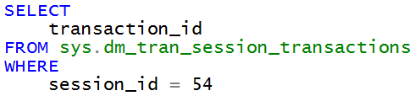
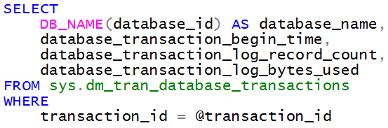
Transaction Information DMOs
Correlate session_id with transaction_id using sys.dm_tran_session_transactions
(Also check sys.dm_exec_requests)
In which database(s) was work done?
Ask sys.dm_tran_database_transactions

Slide 24
The Query Processor (In Brief)
Requests Spin Up Tasks
Tasks are Bound to Workers (Threads)
Threads Consume CPU Time, or Wait

Slide 25
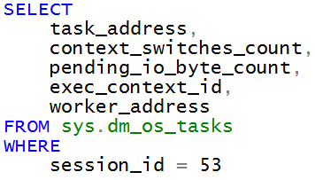
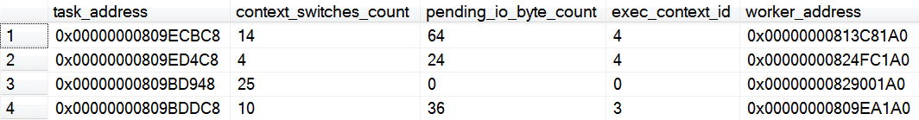
Which Tasks are Running?
Tasks are referred to using binary “addresses”
Real-time bonus data available in sys.dm_os_tasks

Slide 26
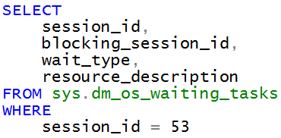
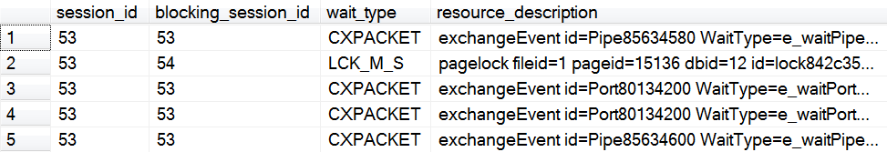
Why is My Query Slow?
When a task isn’t working… it’s waiting!
sys.dm_os_waiting_tasks
Blocking, disk I/O, memory, and any other wait that
can slow down your query is reported here!

Slide 27
TempDB
Used a Lot More Than You Think
(even if you think it‘s used a lot)
Temp tables. Sorts. Hashes. Spools. Row versions. DBCC. Index rebuilds. And more.

Slide 28
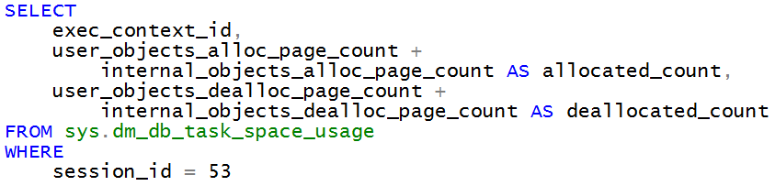
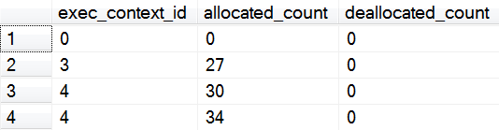
Task-Scoped TempDB Information
Find out which requests are causing TempDB to blow up
sys.dm_db_task_space_usage

Slide 29
Extended Events

Slide 30
New Problems for Diagnostics
We have more complex systems
Need to reduce performance impact of diagnostics
Desire for more detailed information
Need to find unexpected interactions

Slide 31
Unique Value of Extended Events
Scalability
  Bigger machines, more work, more events – no problem.
Events are dynamic
  Collect additional data on any event
  Perform an action when an event happens
Cross process event tracking
  Track relationship between different tasks/threads/processes
Integrates with Windows eventing
  Expose tracing information to Windows tools such as Xperf
  Coordinate with trace data from other ETW Providers

Slide 32
New Capabilities in Denali
User Interface!
  Advanced & Wizard UI for Create
  Display & Analysis
Parity with SQL Trace diagnostic data collection
Managed code API
  Object model for runtime and meta data
  Reader for XEL files and near real time stream
Eliminated the XEM file
Expanded to other systems
  Analysis Services, Replication, PDW

Slide 33
Extended Events Package Objects
Module
Packages
Events
Actions
Types
Predicates
Targets
Maps
33

Slide 34
Object Details
Events
  A well known point of execution
  Unique schema for each event
  Support optional fields
Actions
  Can be added to any event
  Adds data to the event payload
  Trigger a memory dump
  Synchronous execution
Targets
  Many event consumers supported
  Asynchronous & Synchronous
  Storage & Analysis
Predicates
  Runtime filter
  Boolean expressions
  Local or Global data
  State: count, min, max

Slide 35
Collecting Data: The Event Session
Multiple targets per session
Event can be in many sessions
  Actions/Predicates are per event
Mix objects from different packages
Session buffers
  Asynchronous processing
  Reduces perf impact
  “Tunable” latency
Event Session
Enabled Events
Buffers
Actions
Targets
Predicates

Slide 36




Tracking Related Events
Tracked Activity
Process 1
A: 1.1
P: NULL
A: 1.2
P: NULL
A: 1.3
P: NULL
A: 1.4
P: NULL
A: 1.5
P: NULL
A: 1.6
P: NULL
Event
Event
Event
Event
Event
Event
Process 1 requests work on new thread.
Process 2
A: 2.1
P: 1.2
A: 2.2
P: NULL
A: 2.3
P: NULL
A: 2.4
P: NULL
A: 2.5
P: NULL
Event
Event
Event
Event
Event

Slide 37
Use Cases
Demo

Slide 38
Summary
Performance tuning is:
  80% Monitoring & Troubleshooting
  5% Fixing
  15% Testing
DMOs – Activity monitoring and baselining
Extended Events – Diagnostic tracing
Used together = Complete solution

Slide 39
Apendix

Slide 40
Extended Events Catalog Views
server_event_sessions
  All sessions that have been defined
server_event_session_targets
  All targets for all sessions
server_event_session_events
  All events for all sessions and predicate strings
server_event_session_actions
  All actions for all events
server_event_session_fields
  Customizable attributes for events and targets

Slide 41
Extended Events DMVs
Package and object metadata
  dm_xe_packages
  dm_xe_objects
  dm_xe_object_columns
  dm_xe_map_values
Run time information
  dm_xe_sessions
  dm_xe_session_targets
  dm_xe_session_object_columns
  dm_xe_session_events
  dm_xe_session_event_actions

Slide 42
Related Content
Required Slide
Speakers, please list the Breakout Sessions, Interactive Discussions, Labs, Demo Stations and Certification Exam that relate to your session. Also indicate when they can find you staffing in the TLC.
Breakout Sessions (session codes and titles)
Interactive Sessions (session codes and titles)
Hands-on Labs (session codes and titles)
Product Demo Stations (demo station title and location)
Related Certification Exam
Find Me Later At…

Slide 43
Track Resources
Required Slide
Track PMs will supply the content for this slide, which will be inserted during the final scrub.
Resource 1
Resource 2
Resource 3
Resource 4

Slide 44
Database Platform (DAT) Resources
Required Slide
Track PMs will supply the content for this slide, which will be inserted during the final scrub.
  Visit the updated website for SQL Server® Code Name “Denali” on www.microsoft.com/sqlserver and sign to be notified when the next CTP is available
  Follow the @SQLServer Twitter account to watch for updates
Try the new SQL Server Mission Critical BareMetal Hand’s on-Labs
Visit the SQL Server Product Demo Stations in the DBI Track section of the Expo/TLC Hall. Bring your questions, ideas and conversations!
Microsoft® SQL Server® Security & Management | Microsoft® SQL Server® Optimization and Scalability
Microsoft® SQL Server® Programmability | Microsoft® SQL Server® Data Warehousing
Microsoft® SQL Server® Mission Critical | Microsoft® SQL Server® Data Integration

Slide 45





Resources
  Connect. Share. Discuss.
http://northamerica.msteched.com
Learning
  Sessions On-Demand & Community
  Microsoft Certification & Training Resources
www.microsoft.com/teched
www.microsoft.com/learning
  Resources for IT Professionals
  Resources for Developers
http://microsoft.com/technet
http://microsoft.com/msdn

Slide 46












Complete an evaluation on CommNet and
enter to win!

Slide 47


Slide 48

© 2011 Microsoft Corporation. All rights reserved. Microsoft, Windows, Windows Vista and other product names are or may be registered trademarks and/or trademarks in the U.S. and/or other countries.
The information herein is for informational purposes only and represents the current view of Microsoft Corporation as of the date of this presentation. Because Microsoft must respond to changing market conditions, it should not be interpreted to be a commitment
on the part of Microsoft, and Microsoft cannot guarantee the accuracy of any information provided after the date of this presentation. MICROSOFT MAKES NO WARRANTIES, EXPRESS, IMPLIED OR STATUTORY, AS TO THE INFORMATION IN THIS PRESENTATION.

