Slide 2

Using Cloud (Microsoft SQL Azure) and PowerPivot to Deliver Data and
Self-Service BI at Microsoft
DBI323
Sanjay Soni
BI Platforms Evangelist
Microsoft Corporation
Diana Putnam
Principal Program Manager Lead
Microsoft Corporation
Harinarayan
Senior Software Development Engineer
Microsoft Corporation
Notes:
SS DP and HP

Slide 3
Agenda
Microsoft BI Overview
Microsoft IT infrastructure and Cloud Situation
Microsoft IT BI Engineering EDW Context
  Business Challenge
  SharePoint Integration and Demo
  Our EDW Journey
  Data as a Service using Cloud and Demo
  PowerPivot Overview and Demo with IT Scenario
Top 10 Lessons Learned while Delivering BI to the Masses
Notes:
SS

Slide 4
Top 10 questions/lessons learned while enabling data as a service and self service BI
10 | What to do first - EDW or BI reporting consolidation?
9 | How do you enable users to have a seamless experience while consuming data?
8 | How do you implement seamless security across layers ?
7 | How do you enable Data Governance and control data movement?
6 | Who should create BI and should we actually give control of the report catalog to business and enable self-service BI?
5 | Why Azure?
4 | How do I know who is consuming and how are they consuming data?
3 | How do you evangelize & achieve enterprise adoption?
2 | What front end tools do BI publishers use and how do you integrate various tools?
1 | How do you achieve high customer satisfaction?
Notes:
SS

Slide 5
This session does:
Not cover
  SQL Azure and Windows Azure Technical Details
  Cloud hosted PowerPivot reports on SharePoint online
Cover
  Real world implementation through the Microsoft IT BI journey from
    Consolidated BI to
    EDW to
    Running Data as a Service using Windows Azure based Data Services Layer application and SQL Azure as data source
  Enabling Self-Service BI at Microsoft using PowerPivot, SQL Azure, SharePoint etc.
  Top 10 lessons learned through the BI journey
Notes:
SS

Slide 6


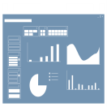


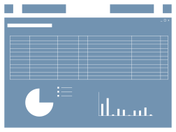







Evolution of BI
Traditional BI
Self-Service BI
Provision
Analysis
Reports
Dashboards & Scorecards
End Users
Data
Staging
ETL/Data Quality
Analysis
Cubes
Data Warehouse
Specialized Tools
?
Spreadsheets
Existing Data
LOB Applications
Data Marts
Files
IT Pro
IT has been busy keeping up with the growing demand for BI…
Harvesting existing data, cleaning it and staging it …
To provision reports, dashboards & scorecards to meet End User demand.
But business is outpacing IT and End Users are demanding Agility …
Rapidly breaking down the barriers of Control with Self-Service BI!
Is it possible to balance Control with Agility?
Notes:
SS

Slide 7

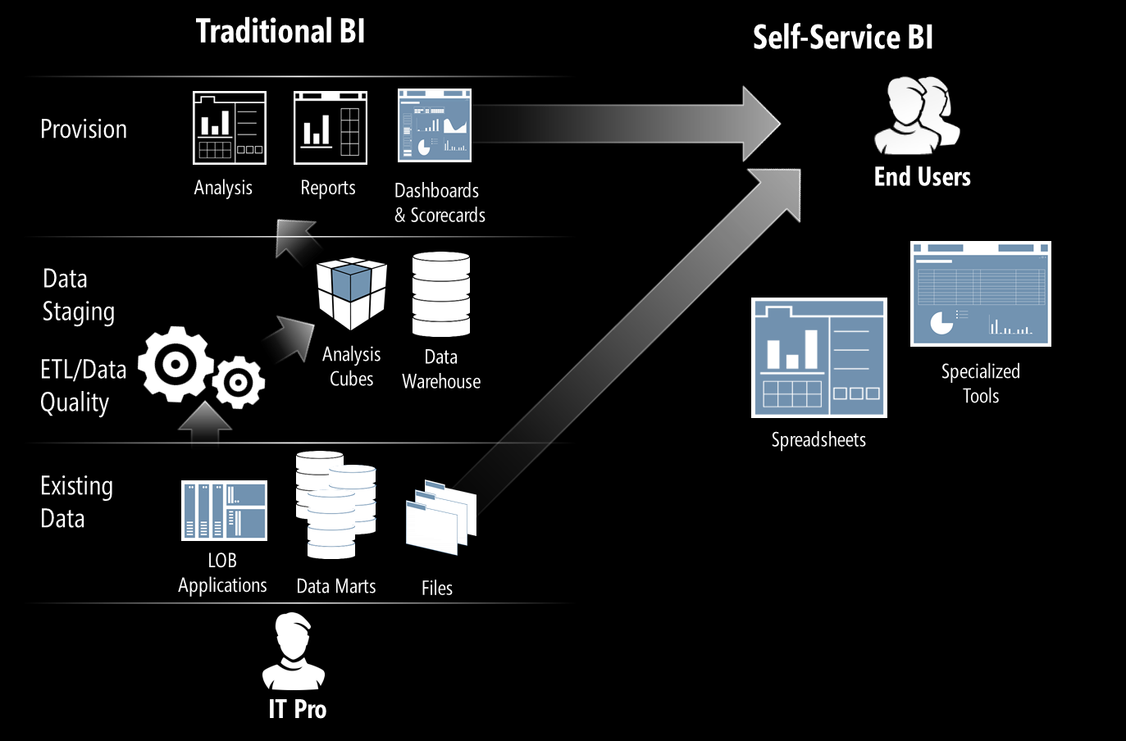
Evolution of BI
Traditional BI
Self-Service BI
Provision
Empower
Manage
Delivering the next generation of BI Agility with IT Oversight
Notes:
SS

Slide 8



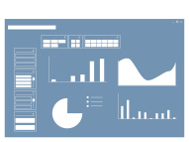












Microsoft Business Intelligence
Most Broadly adopted Productivity & Collaboration Tools
SharePoint
Dashboards & Scorecards
SharePoint
Collaboration
Excel
Workbooks
PowerPivot Applications
Analysis
Services
Reporting
Services
Most widely deployed EIM & BI Platform
Integration
Services
Master Data
Services
LOB
Apps
Odata
Feeds
Notes:
SS

Slide 9

Once upon a time …
there were various IT departments serving various business groups
Notes:
SS

Slide 10







Silos of Unorganized BI
Report, scorecards and dashboards were everywhere, end users has to go to many different shares to find their reports
Individual IT departments were creating most of the reports for business, delivery was slow
Sales & Marketing
Human Resources
Operations
Finance

Slide 11

No single place to explore enterprise data
No single catalog of all databases at Microsoft
No single place to manage and grant permissions to all consumers for all servers
Different consumers (business end users, power users, developers and web service users) had to go to different places and servers to access
Publishers wanted to publish data without moving it
What kind of data is out there?
Business users with Power Pivot
?
EDW Sources
Can I see the data before requesting access?
?
Developers
Other IT Sources
?
End users
Web Services/Applications
Can I access the data from Excel, SQL, SSRS, or…?
SQL Azure Sources
5/17/2011
Notes:
SS

Slide 12
Business Challenge was to…
Create EDW
Enable business power users to create their own reports?
    Create a self-service BI environment
    Enable data as a service from EDW
    Benefit from Elasticity of the cloud
Notes:
SS

Slide 13




Challenges Facing Enterprise IT
Provisioning, deploying and managing servers at scale
Enabling faster and more efficient development of applications with existing knowledge and toolsets
Infrastructure costs grow as a percentage of total IT spend
Notes:
DS

Slide 14

















We Are Getting More Choices
  On Premises
  Cloud Services
  Communication
  Collaboration
  Business Apps
  Storage
Active Directory
  Identity
AD/Live ID
  Platform
Notes:
DS

Slide 15




Cloud Impact
NEW ECONOMICS
REDUCED MANAGEMENT
INCREASED OPPORTUNITIES
Pay for what you use
Lower and predictable costs
Shift from capex and opex
Accelerate speed to value
No patching, maintenance
Faster deployment
Robust multi-layered security
Reliability and fault-tolerance
Latest software for users
Internet collaboration
Anywhere access
Instant self-provisioning
15
5/17/2011
Notes:
DS

Slide 16
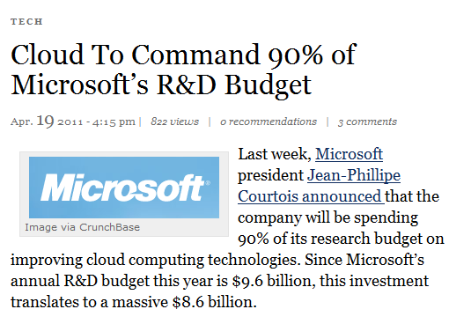
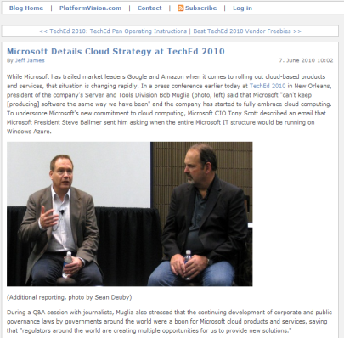
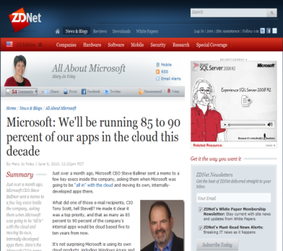
Committed to the Cloud
Notes:
DS

Slide 17



Microsoft IT’s Journey to the Cloud
An iterative process
Many proof-of-concept efforts
Application segmentation is key
Learn and adjust
at every stage
Implement
Segment & Select
Learn & Plan
Evaluate
Notes:
SS

Slide 18
Silos of Unorganized BI
Report, scorecards and dashboards were everywhere, end users has to go to many different shares to find their reports
Individual IT departments were creating most of the reports for business, delivery was slow
Sales & Marketing
Human Resources
Operations
Finance
Notes:
SS

Slide 19
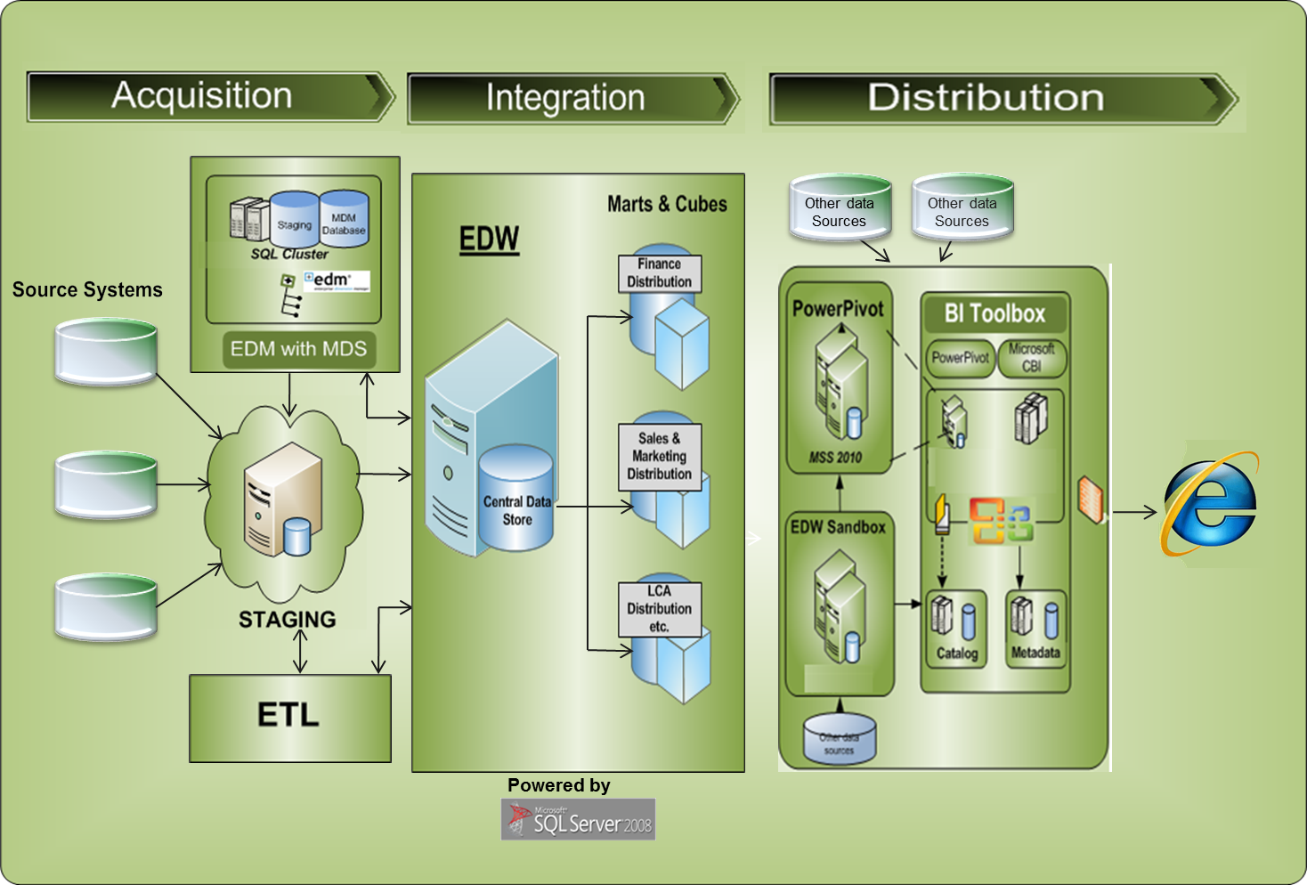
 | Microsoft IT EDW Architecture and BI Engineering Platforms

Slide 20


Consolidated Business Intelligence
      CBI was created with
          A single enterprise report catalog
          Hosted BI solution with Reporting Services, PPS etc.
          A SharePoint based BI portal
Sales & Marketing
CBI
Human Resources
Operations
Finance
Enterprise Report Catalog
Notes:
SS

Slide 21
SharePoint BI
demo
Notes:
SS

Slide 22
The EDW Journey
EDW 2.0 - Institutionalize
EDW 3.0 - Transformational
Focus on an enriched data experience
Transforming business
EDW 1.0 - Foundational
Primary Objectives:
Transforming business through data associations, analytics and insight
Broader cross segment reporting
End-to-end information experiences
Building technical capabilities
Primary Objectives:
Extend the EDW with certified, enriched data
Enhance the platform capabilities with business-enabling features
Improved self-service data acquisition, enrichment, publishing processes & data visualizations
Primary Objectives:
Create baseline technical capabilities: acquisition and distribution of source system data
Start at the ‘end’ first – e.g. CBI
Time
22

Slide 23
Initial State
Source Systems
Silo’d Data Sets
Duplicate, Conflicting & Inconsistent Marts, Cube, Reports…
LOB 1
Revenue
License
Finance
Organization
Product
Sales
LOB 2
Revenue
Oppty
Services
Organization
Product
Marketing
LOB 3
Expense
LCA
Product
Revenue
Operations
LOB 4
Incident
Product
Others
Organization
Notes:
DS

Slide 24


Still there were….
  Escalations
  Slow delivery
  Lack of self-service BI
  Redundant data
  Random Data Quality
  Rigid Reporting Tools & Datasets
24
Notes:
DS

Slide 25
Evolving state
Enterprise
Master Data
Managed Business Data:
Marts, Cubes, Reports
Source Systems
Finance
Revenue
Sales
Enriched
Sales
Organization
Product
Services
Marketing
Support
Marketing
Managed
Self Service Dynamic Visualization
Individual
License
Enrich Data
License
Revenue
Local Data
On Demand Data
Organization
Others
Marketing
Sales
Individual
Support

Slide 26
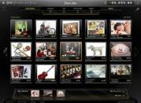
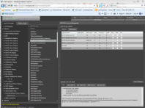

Microsoft IT’s approach to move to the Cloud
Move existing applications to Azure
  Develop segmentation methodology
  Find low-risk proof-of-concept applications
Make Azure the default for new application development
  Identify candidates
  Capture results
Move BIG/Critical applications
  Develop Tier 1 apps on the Azure Platform
  We have Cloud Power
Auction Tool
EDW Explorer
Social eXperience Platform
Volume Licensing
Performance @ Microsoft
Notes:
SS

Slide 27
No single place to explore enterprise data
No single catalog of all databases at Microsoft
No single place to manage and grant permissions to all consumers for all servers
Different consumers (business end users, power users, developers and web service users) had to go to different places and servers to access
Publishers wanted to publish data without moving it
What kind of data is out there?
Business users with Power Pivot
?
EDW Sources
Can I see the data before requesting access?
?
Developers
Other IT Sources
?
End users
Web Services/Applications
Can I access the data from Excel, SQL, SSRS, or…?
SQL Azure Sources
5/17/2011
Notes:
SS

Slide 28
Data as a Service - Enterprise Data Distribution Platform
  A single location for users to explore, publish & consume EDW and other external data
  UI for exploring, accessing & administrating data for consumption
  Diverse set of services and SQL API to consume data catering to multiple forms of consumption
  Data can be consumed by LOB and mobile applications, portals, PowerPivot Sandbox,
  database applications
EDW Sources
Data as a Service (DSL)
Consumer with Power Pivot
Other IT Sources
Powered by EDW
SQL Azure Sources
Notes:
SS

Slide 29
  LOB and mobile applications, portals, PowerPivot Sandbox, database applications were able to consume data
  Business metadata managed using data dictionary
  Reduced maintenance costs using logical mapping and abstraction from physical data model
  SQL Azure data sources provided elasticity of the cloud platform
Sales & Marketing
Human Resources
DSL
Operations
Finance
Data as a Service
Notes:
SS

Slide 30
Result…
  Terabytes of enterprise data is available through DSL
  Data can be consumed by LOB and mobile applications, portals, PowerPivot Sandbox, database applications
  Within 6 months of usage of this tool we observed:
    5.8 million requests for data
    96 LOB applications with 1600+ direct power users who do self service BI and enable it for thousands of end users
  Latest numbers: 65,000+ data requests per day → 1.9 million requests/ month
Data as a Service
Notes:
SS

Slide 31




















Windows Azure Platform
  GENERAL PURPOSE PROGRAMMING LANGUAGES
  Windows Azure Platform
Compute
Storage
Management
CDN
Connect
Middleware
Marketplace
Relational data
Management
Notes:
HP

Slide 32

DSL Use Cases
Users
EDW Explorer
Portals/ Apps
PowerPivot
Database Apps
LOB Apps
Re-useable control library
Silverlight
SharePoint
WPF
Web Services
SQL APIs (Get Data)
OData
Data Package Consolidator
EDW Components
(Databases on premise or SQL Azure)
Notes:
HP

Slide 33
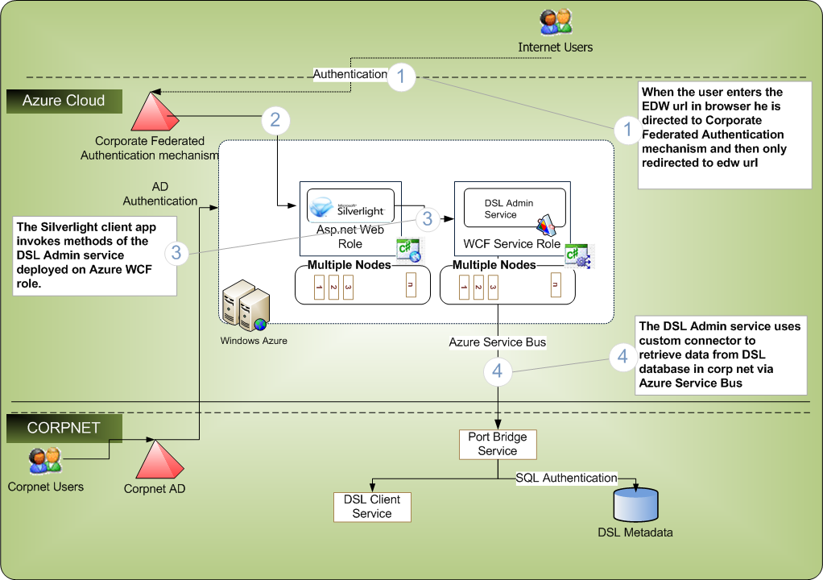
Data as a Service Cloud Architecture
Notes:
HP

Slide 34
Data as a Service
demo
Notes:
SS and HP

Slide 35
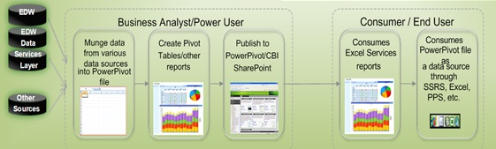
Microsoft IT SharePoint, Excel Services and
PowerPivot Environment
A self service environment for :
  Power users (customers) to access EDW data sources and/or non-sanctioned data sources
  Power users to be able to profile their data and prototype new applications using BI toolbox
  Power users to create and publish reports using Excel for the masses in an agile manner

Slide 36
Current BI Dynamic
I.W.
I.T.
Users “can’t quit Excel”
I need to get it done
“Underground BI” = Shadow apps = guerrilla apps
Excel is unmanageable
Not the right way
Reign in “Spreadmarts”
PowerPivot Proposition Include Excel as Part of the Solution
IWs do BI without knowing it, make Excel more useful
Incent sharing in a way that provides visibility to IT
Allow IT to add value without being a bottleneck
Analysis Services Roadmap Microsoft NDA-only

Slide 37
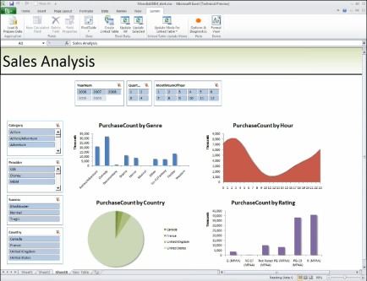
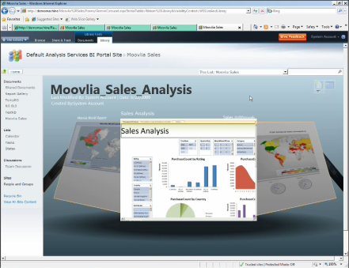






Introducing PowerPivot Technology
PowerPivot for Excel
PowerPivot for SharePoint
“PowerPivoting” Massive Data Volumes
With a few mouse clicks, a user can create and publish intuitive and interactive self-service analysis solutions.

Slide 38
PowerPivot
demo

Slide 39
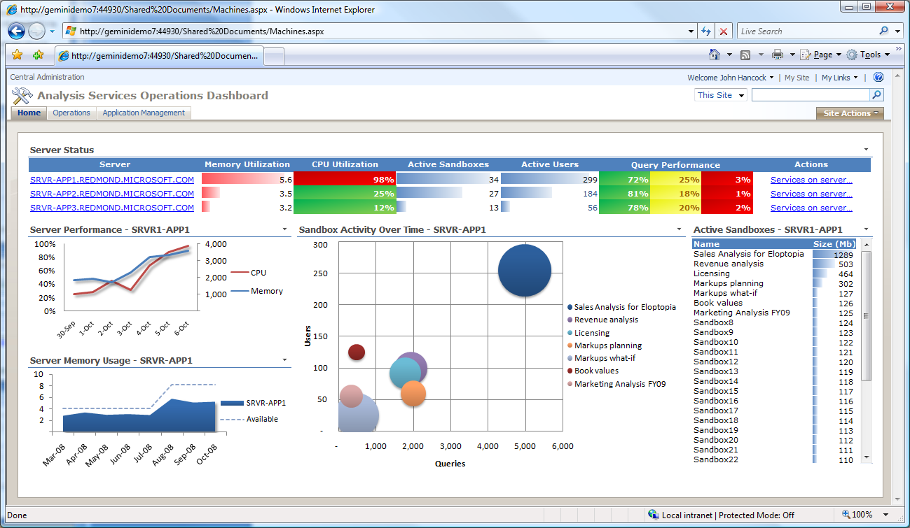
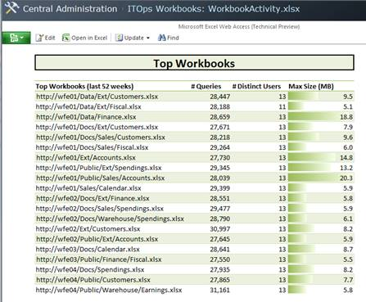
Out of the box BI Dashboards
Proactively monitor user-generated BI applications with PowerPivot dashboard
Track Server Status
  CPU and Memory Utilization
  System Capacity and Performance
  Workbook and User Activity over Time
Ensure Quality of Service
  Query Response Times
  Current Server State
  Largest and Most Popular Solutions
Monitor Activities and Performance
  Document Information and
  Data Sources
  Activity and Top Users
  Query Performance per Workbook
Notes:
SS

Slide 40








Familiar business problem scenario for a fictitious company you can relate with…
HR
  Lost productivity of end users
    Reports / scorecards are everywhere for different groups
    Users go to at least 8 different places for their BI
  Business rumor that IT takes too long to create BI solution
    Each IT implementation team has to figure out security, ramp up on BI expertise to host and secure
    Shadow applications built by business and vendors are agile
  Enable business power users to create their own reports
    Enable data as a service from EDW
    Benefit from Elasticity of the cloud
    Create a self-service BI environment
Finance
S&M
IT
Silos of unorganized BI assets
Notes:
DS

Slide 41
Top 10 considerations, questions and lessons learned while enabling data as a service and self service BI
10 | What to do first - EDW or BI reporting consolidation?
9 | How do you enable users to have a seamless experience while consuming data?
8 | How do you implement seamless security across layers ?
7 | How do you enable Data Governance and control data movement?
6 | Who should create BI and should we actually give control of the report catalog to business and enable self-service BI?
5 | Why Azure?
4 | How do I know who is consuming and how are they consuming data?
3 | How do you evangelize & achieve enterprise adoption?
2 | What front end tools do BI publishers use and how do you integrate various tools
1 | How do you achieve high customer satisfaction?
Notes:
DS

Slide 42

10
 | What to do first – Enterprise Data Warehouse or BI Reporting Consolidation?
Notes:
SS

Slide 43
9
 | How do you enable users to have a seamless experience while consuming data?
    Create a cloud based application to enable data as a service
    Expose EDW and other data sources through one url
    Abstract/shield users from backend data sources and Engineering work
    Make it easy for users to consume data
    Net effect → Seamless experience
Notes:
HP

Slide 44
 | How do we implement seamless security across layers?
8
    AD Authentication
    Constrained Delegation (Kerberos) for data level security
    SharePoint security for Excel Services / DCL storage and community pages
    Data security by user context
Notes:
SS

Slide 45
 | How do you enable Data Governance and control data movement?
7
Data Governance model is important
Publishers maintain and set rules for data movement
Prioritize user types (P1, P2, P3) e.g. P3 can wait for their reports / Data
Control over
    Full pull vs. incremental pulls
    number of rows
    Concurrent connections etc.
Notes:
HP

Slide 46
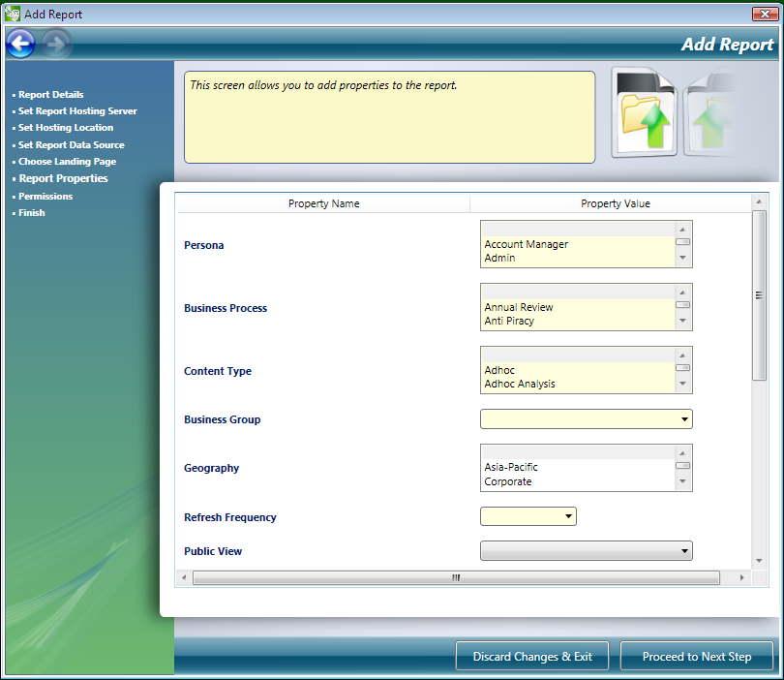
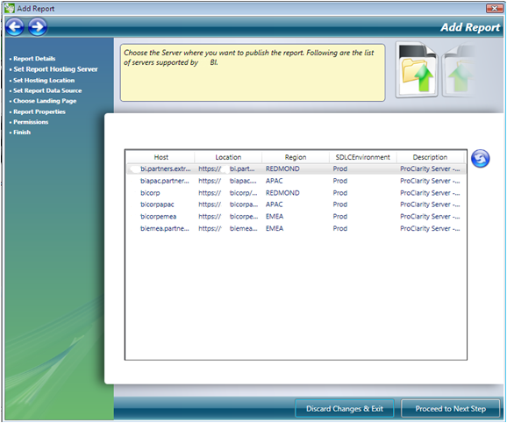
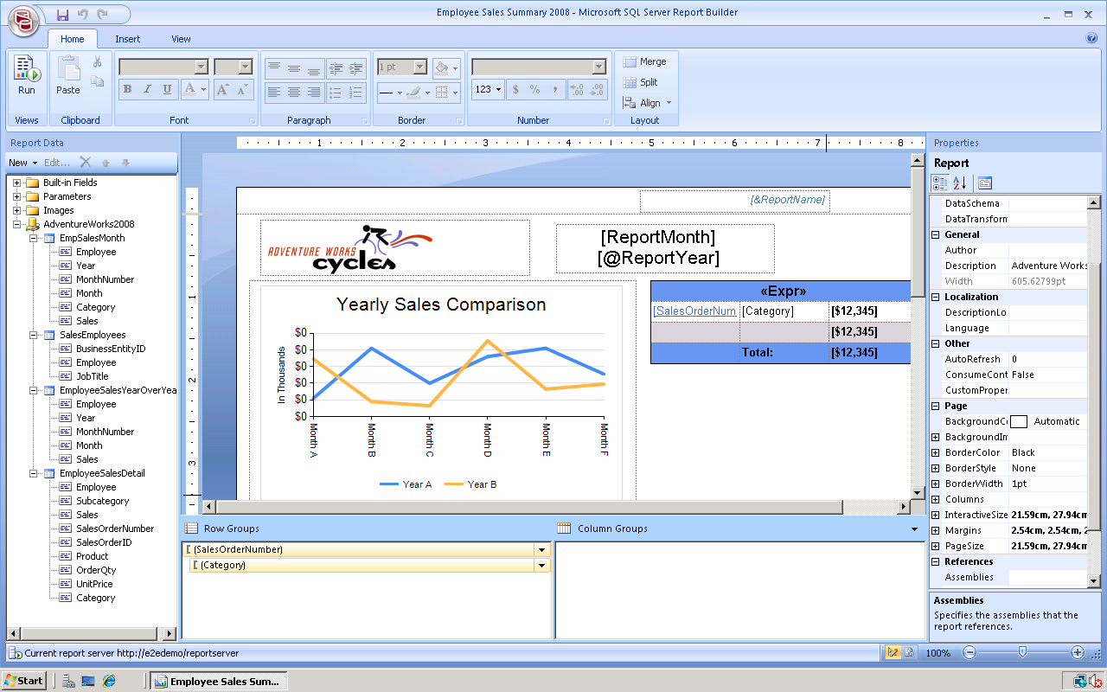
 |  | Who should create BI and should we actually give control of the report catalog to business and enable self-service BI?
6
Step 1
Power users or BI Devs Create Report
Step 2
Reports Published to Report Server
Step 3
Report Published to Report Catalog
Step 4
End users View in the Portal
CBI Catalog is URL based and hence even third party BI tool reports can be added
Notes:
SS

Slide 47
5
 | Why Azure?
Moving to Azure - reliable with
  Less maintenance
  Faster deployment
Reduced time to get started with Dev, Test, UAT and production environments
Elasticity and scalability
Pay for what you use
Anywhere access
Notes:
SS

Slide 48
 | How do I know who is consuming and how are they consuming data?
4
Enable usage statistics on top of data as a service type of solution
  Monitor number of users, DSL packages, number of requests etc.
  Publishers wants to know who consuming the data and what data is being consumed
Notes:
HP

Slide 49
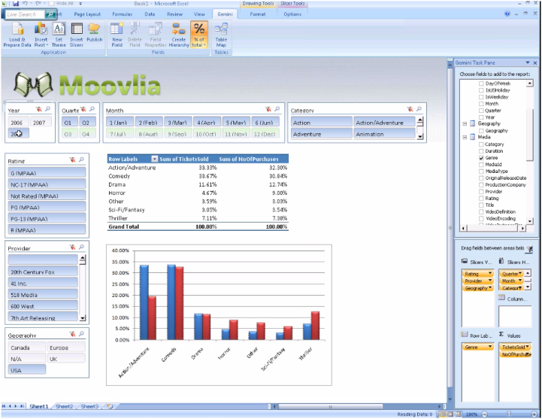
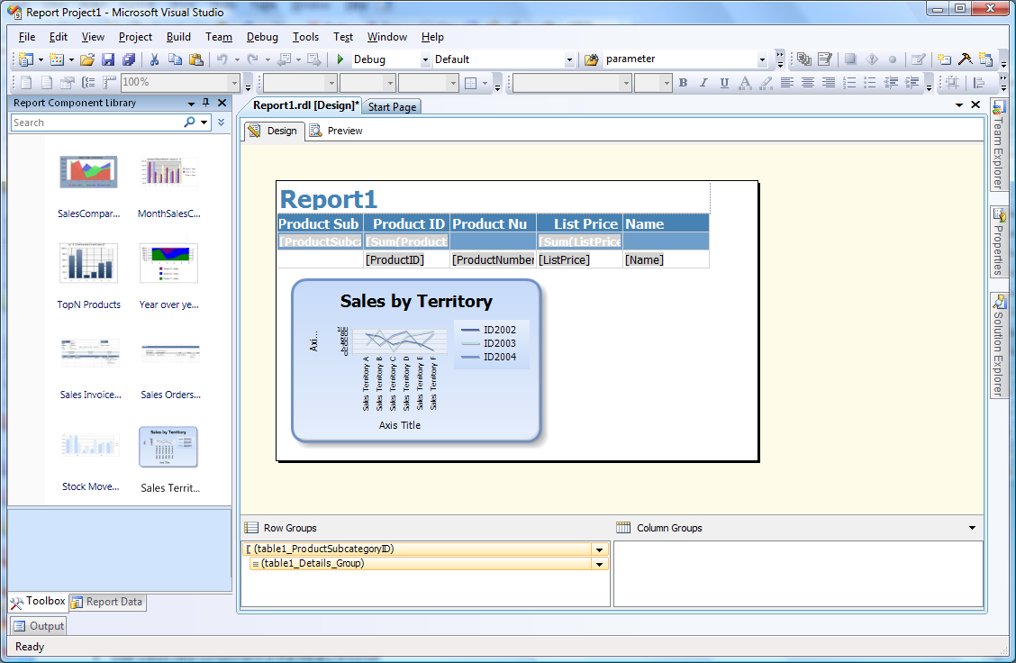
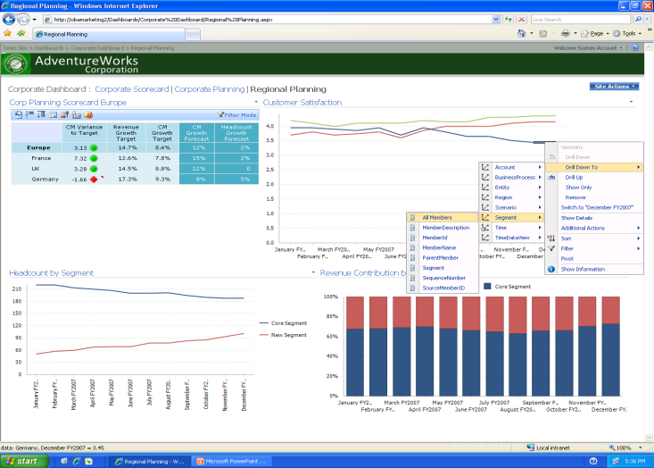


 | What front end tools do BI publishers use and how do you integrate various tools?
3
Analytics
Help business units target right BI front end tools for the right users
Reporting
Dashboards
Build reports with
Report Builder
Analyze data with Excel
Explore data in SharePoint
Notes:
SS

Slide 50
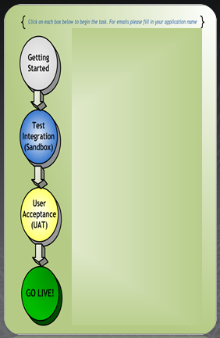
 | How do you evangelize & achieve enterprise adoption?
2
Evangelize and provide demonstrations
  Regular live meeting demos
  Video channel
  Trainings on BI stack over
  live-meeting
Onboarding process
  Onboarding site and documents
  Onboarding team with weekly calls
Prototyping
Proper production support team
Questionnaires using SharePoint forms
Clickable onboarding steps
Emails to right aliases
Deployment from one environment to the next
Notes:
SS

Slide 51
 | How do you achieve high customer satisfaction?
1
Customer empathy
    Learn from mistakes
    Implement feedback
    Customer satisfaction surveys
Maintain customer relationship with regular meetings
Improve, improve, improve
Notes:
SS

Slide 52
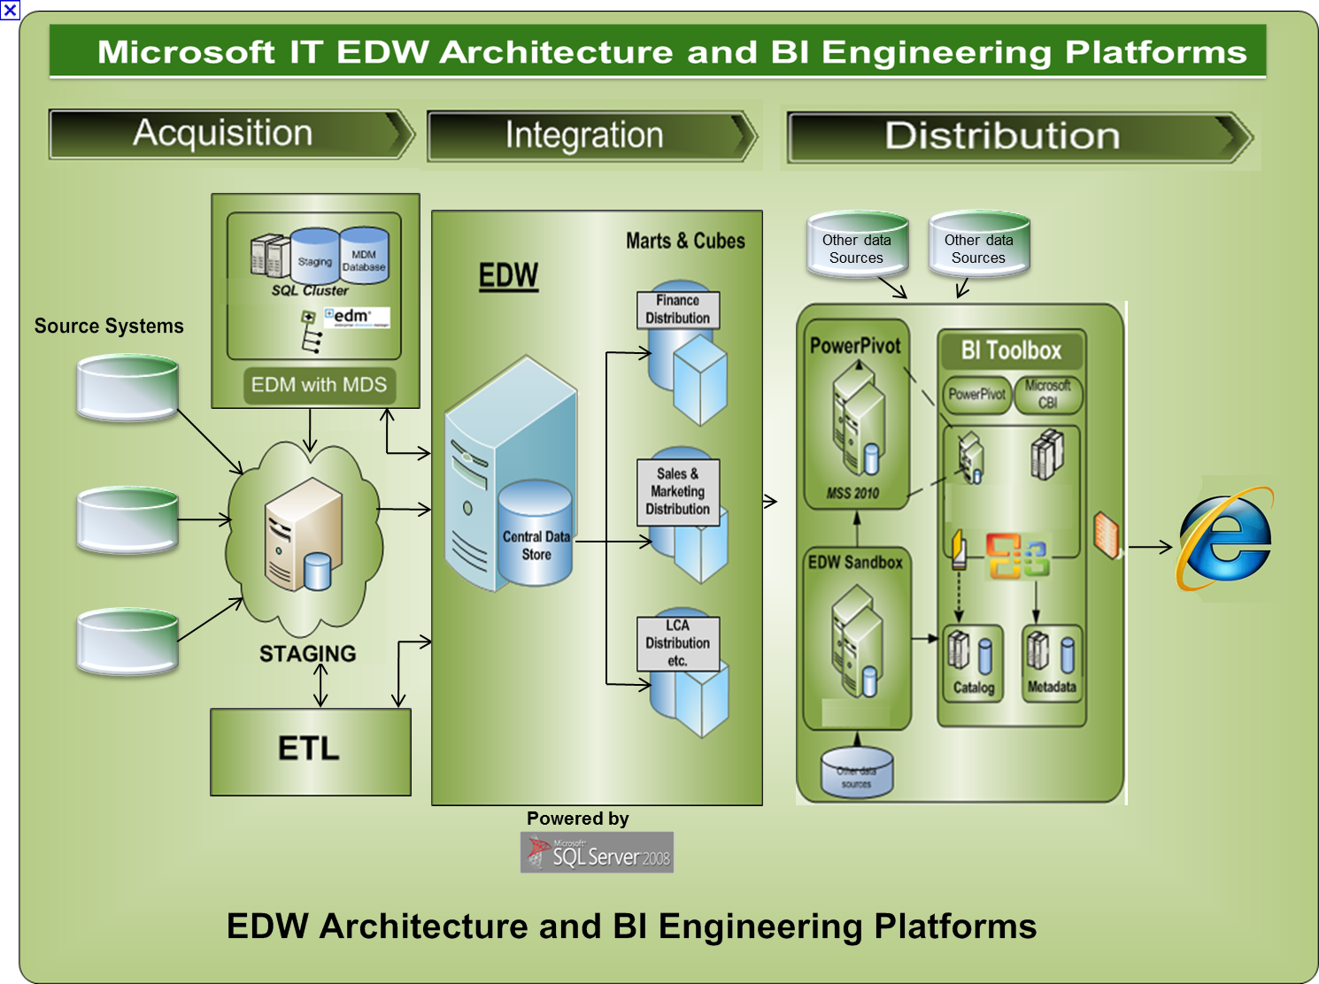
Moral of the story …
Empower business users by enabling self service BI and data as a service from IT…powered by your EDW, Azure applications and data from cloud
Notes:
SS

Slide 53

And the business and IT folks happily
collaborate together…
The journey continues and
YES there are things we can do better in future…
Notes:
SS

Slide 54
Resources and next steps
Microsoft BI:
    http://www.microsoft.com/bi
Windows Azure site: http://www.microsoft.com/windowsazure/
Enabling Self Service BI at Microsoft video:
    http://technet.microsoft.com/en-us/edge/enabling-self-service-bi-from-edw-using-sharepoint-2010-and-sql-server-2008-r2.aspx
Microsoft CBI IT Showcase video:
    http://www.facebook.com/video/video.php?v=125986687920&ref=mf
Microsoft CBI white paper and other content:
    http://technet.microsoft.com/en-us/library/bb735122.aspx
Microsoft IT Showcase Webcasts
    http://www.microsoft.com/howmicrosoftdoesitwebcasts

Slide 55
Links
PowerPivot and BI Links
  http://www.PowerPivot.com
  http://www.microsoft.com/bi
  http://blogs.msdn.com/excel/archive/2009/10/22/introducing-powerpivot.aspx
  http://msdn.microsoft.com/en-us/library/ee210692(SQL.105).aspx
Additional content on Microsoft IT deployments and best practices can be found on http://www.microsoft.com
  Microsoft TechNet http://www.microsoft.com/technet/itshowcase

Slide 56





Resources
Learning
  Connect. Share. Discuss.
  Microsoft Certification & Training Resources
http://northamerica.msteched.com
www.microsoft.com/learning
PowerPivot website
  Sessions On-Demand & Community
www.microsoft.com/teched
www.powerpivot.com
BI
  Resources for IT Professionals
http://microsoft.com/technet
www.microsoft.com/bi
  Resources for Developers
http://microsoft.com/msdn

Slide 57



What’s Next?
Follow, Tweet and Enter to
win an Xbox Kinect Bundle
GAME ON! Join us at the top
of every hour at the BI booth to
compete in the Crescent Puzzle
Challenge and Win Prizes
Sign up to be notified when
the next CTP is available
at: microsoft.com/sqlserver
Join the Conversation
@MicrosoftBI
/MicrosoftBI
Notes:
Follow @MicrosoftBI and tweet your thoughts on the session, visit the Business Intelligence kiosk to show your tweet and enter for your chance to win 1 of 2 Xbox Kinect Bundles!

Slide 58
Resources
  Connect. Share. Discuss.
http://northamerica.msteched.com
Learning
  Sessions On-Demand & Community
  Microsoft Certification & Training Resources
www.microsoft.com/teched
www.microsoft.com/learning
  Resources for IT Professionals
  Resources for Developers
http://microsoft.com/technet
http://microsoft.com/msdn

Slide 59











Complete an evaluation on CommNet and
enter to win!

Slide 60

Notes:
New for TechEd 2011, we will be working with Microsoft Tag (http://tag.microsoft.com/overview.aspx) to create unique Tags for every session at the event. Your session Tag will appear on both the room signage and at the end of your presentation. With your session Tag, attendees will be able to scan as they enter the room to retrieve session details, view speaker bios, and engage in discussions; or scan at the end of the presentation to evaluate your session and download materials. We’re excited to integrate Microsoft Tag across the My TechEd mobile experience this year.

Slide 61

© 2011 Microsoft Corporation. All rights reserved. Microsoft, Windows, Windows Vista and other product names are or may be registered trademarks and/or trademarks in the U.S. and/or other countries.
The information herein is for informational purposes only and represents the current view of Microsoft Corporation as of the date of this presentation. Because Microsoft must respond to changing market conditions, it should not be interpreted to be a commitment
on the part of Microsoft, and Microsoft cannot guarantee the accuracy of any information provided after the date of this presentation. MICROSOFT MAKES NO WARRANTIES, EXPRESS, IMPLIED OR STATUTORY, AS TO THE INFORMATION IN THIS PRESENTATION.

