Slide 1

What’s New in Microsoft SQL Server Code-Named “Denali” for SQL Server Integration Services
DBI317
Matt Masson
Integration Services Team
Microsoft

Slide 2
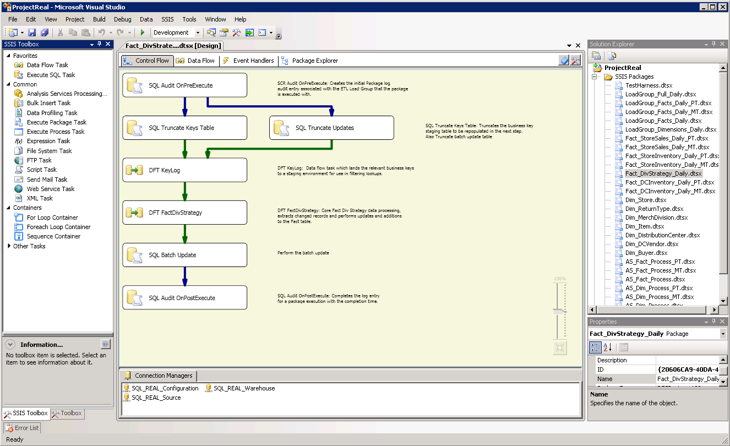
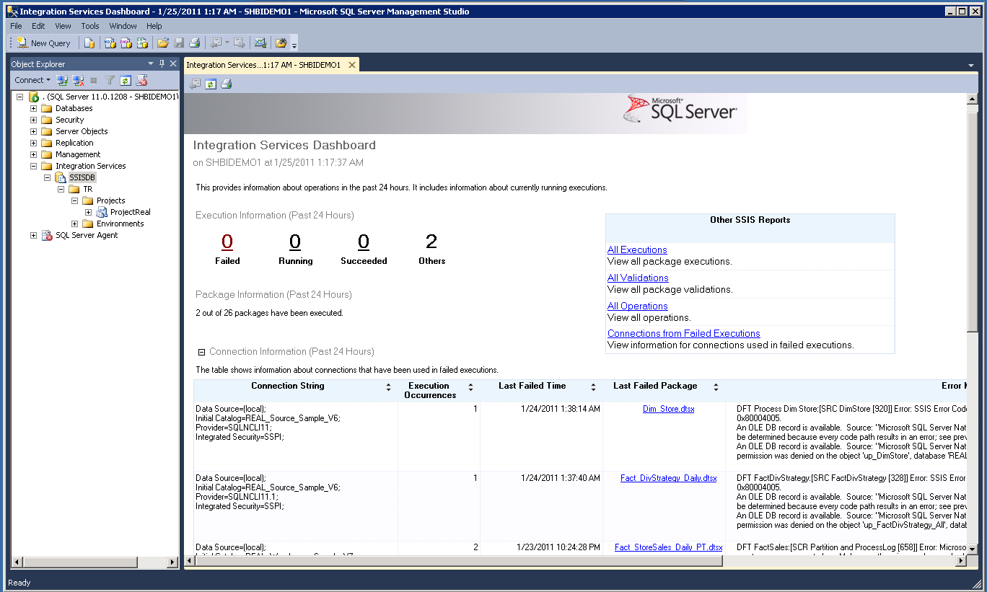
What’s New in SQL Server Denali - Integration Services
Improved Deployment, Configuration and Management
Enhanced Usability
UI Improvements
Helping new users ramp up
Increasing ETL developers productivity
Shared connection managers
Key Customer Requests
Undo
Flexible order of authoring
Easy to diff package format
Improved deployment, configuration and management of SSIS projects
SSIS Server
Support for parameters
Ability to use SSMS for troubleshooting of common SSIS issues

Slide 3
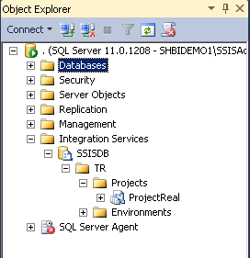
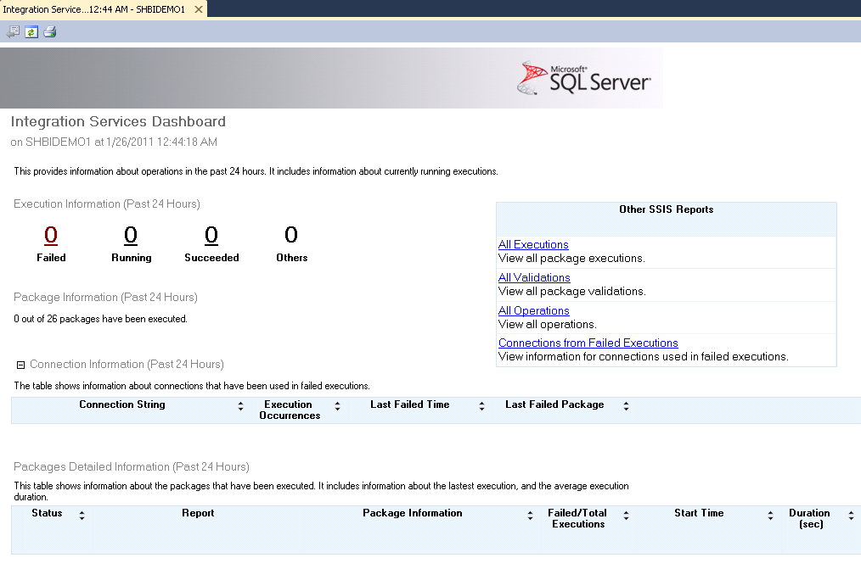
Scenarios
Converting Packages
Using the Server
Troubleshooting
Convert
Pre-Denali
Packages
Denali
Projects
Upgrading and converting pre-Denali packages
Taking advantage of Denali features
Managing projects that have been deployed to the server
Configuring the projects
Running the packages
Find out what happened in packages that have been run in the past 24 hours
Troubleshooting package failures, performance and data issues

Slide 4
Developer Experience
demo

Slide 5
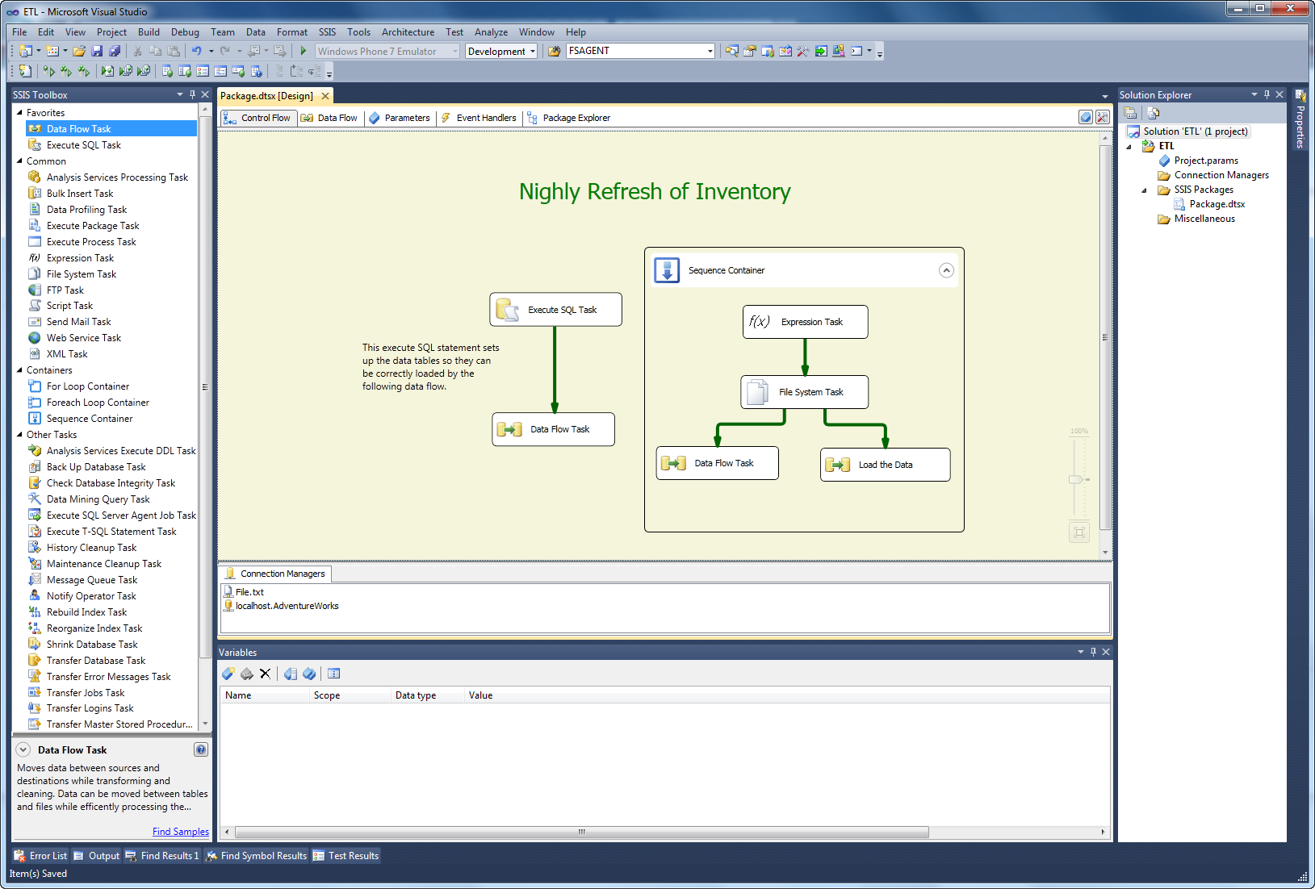
What Did I Just See?
Visual Studio 2010
.NET 4 support
Undo / redo
New toolbox and icons
Projects & parameters
Flexible order of authoring

Slide 6
Project Deployment Model
Making deployment easier…

Slide 7
What You Need to Know
Everything you have now continues to work in Denali
  Except
    Execute DTS 2000 Package Task
    ActiveX Script Task
Moving to the Project Deployment Model is optional
  Most ETL projects will benefit from it

Slide 8
Preparing for the Project Deployment Model
Projects
    Dependent packages? Execute Package tasks?
Parameters
  What configurations are used?
  Configurations shared between packages?
Shared Connection Managers
  Do my packages use common connections?
Execution on the server
    Is there any state stored externally?

Slide 9
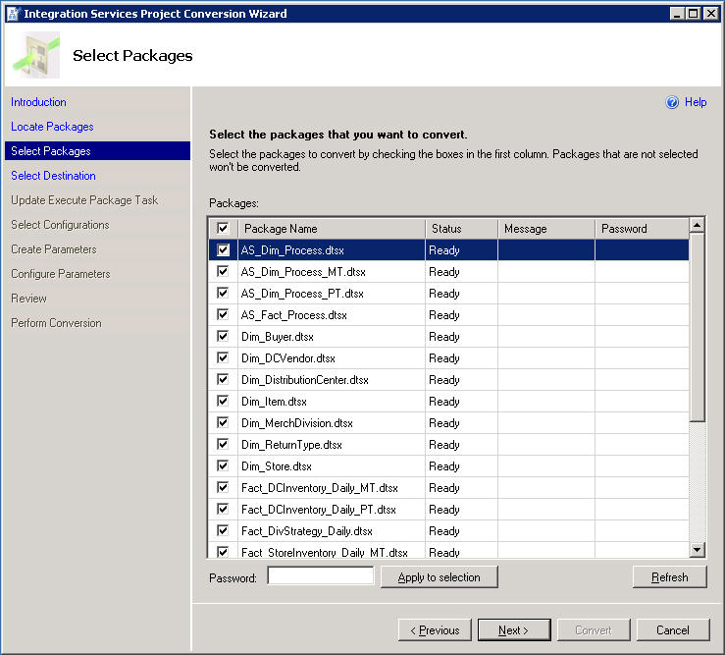
Migrating Pre-Denali Packages
Project Conversion Wizard
    Consider using project parameters for shared configuration values between packages
    No need to use connection managers for Execute Package Task references
Refine in BIDS
  Consider using shared connection managers
  Update Execute Package Tasks to resolve expression-based external references

Slide 10
Converting Packages
demo

Slide 11
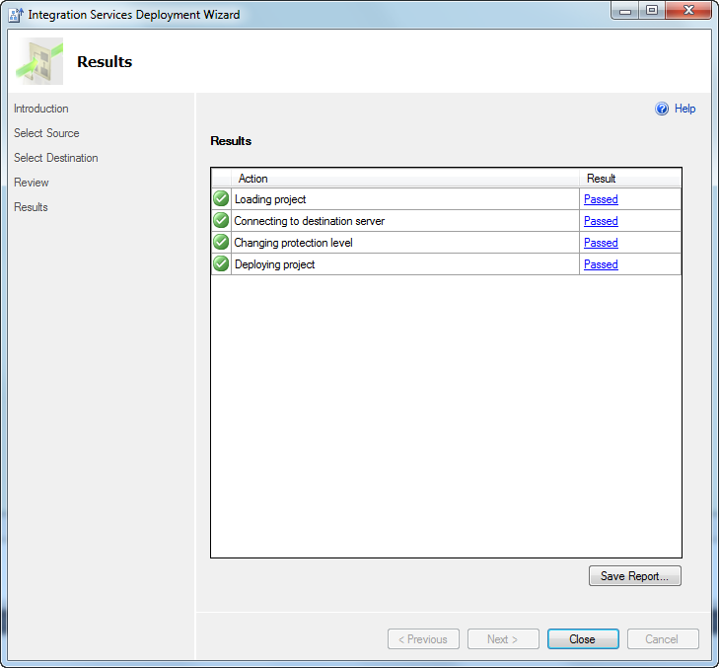
What Did I Just See?
Project Conversion Wizard
Execute Package Task
Shared Connection Managers
Deployment

Slide 12
Server Model
Making configuration and logging easier…

Slide 13



The Server Gives You…
Configuration
Security
Management
Set values for parameters
Central connection manager configuration
Advanced property override functionality
Transparent encryption of projects and parameter values
Row-level security to control access to packages
Interactive package execution and SQL Agent integration
Dashboard and built in reports for troubleshooting

Slide 14
Using the Server
demo

Slide 15
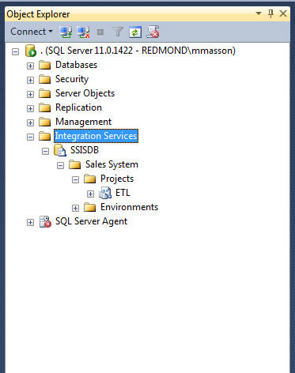
What Did I Just See?
Using SSMS to
  Manage SSIS projects
  Run a package
    Specifying parameter values
    Setting up property overrides
  Setup server environments
Scheduling packages deployed to SSIS catalog

Slide 16
The Denali Experience
What to do when things go wrong…

Slide 17
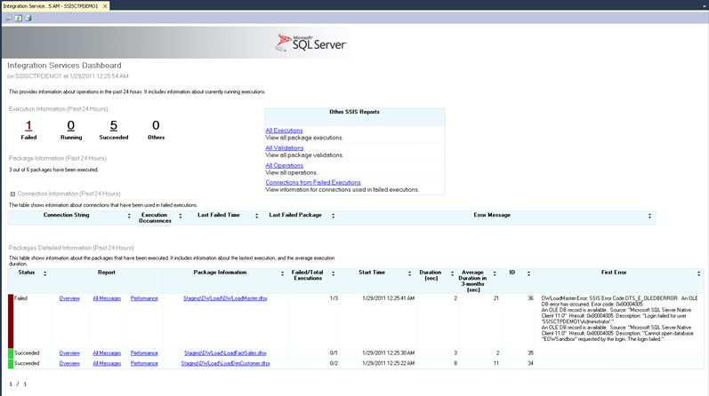
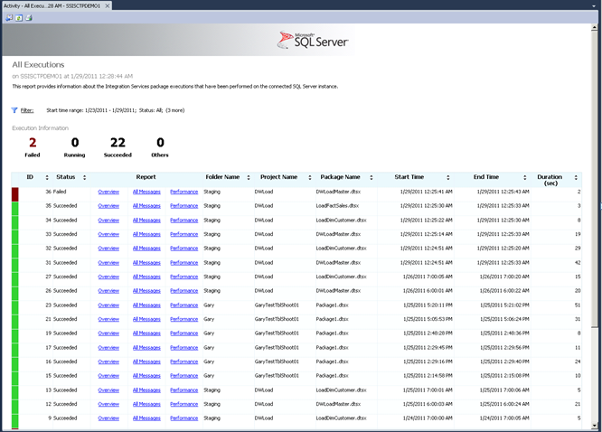
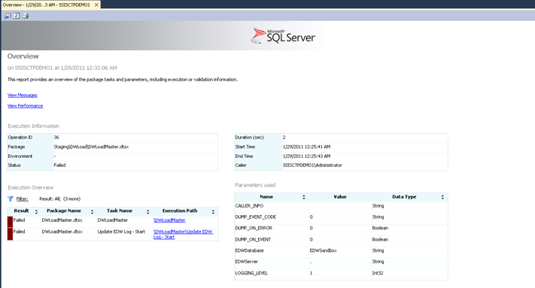
Information at Your Fingertips
Built-In SSIS Reports
Stored Procedures and Views
catalog.event_messages
catalog.event_message_context
catalog.executable_statistics

Slide 18
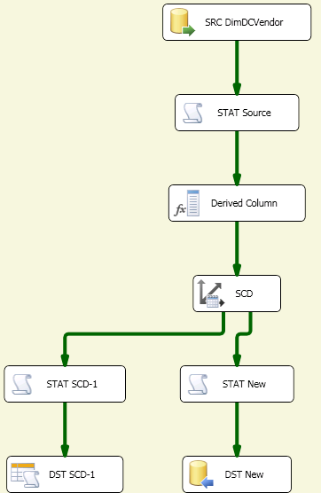
Performance Issues
“These packages were running well for the past 6 months, taking less than an hour to complete. Last night’s run took over 7 hours!”
“Where are the bottlenecks in my package?”
“Can I get instance-specific package execution counter information?”

Slide 19

Component Timing & Performance Counters
Ability to find out time spent in the
data flow components
Querying Performance Information for a
running execution
dm_execution_performance_counter
Validate
Pre Execute
ProcessInput
ProcessInput
Post Execute
Time
SELECT package_name, task_name, subcomponent_name,
SUM(DATEDIFF(ms,start_time,end_time)) as active_time,
DATEDIFF(ms,min(start_time),max(end_time)) as total_time
FROM catalog.execution_component_phases
WHERE execution_id = 1841
GROUP BY package_name, task_name,
subcomponent_name, execution_path
ORDER BY package_name, task_name,
subcomponent_name, execution_path
select *
from catalog.dm_execution_performance_counters (@execution_id)

Slide 20
Data Issues
“Some values in our data warehouse don’t look right. What went wrong?”
“No rows written for the last
nightly load. Are we dropping data?”
“The package works on my dev box... why is it failing in the production machine?

Slide 21
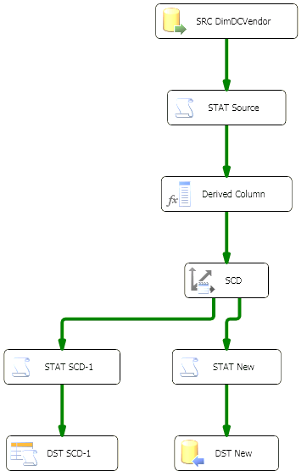
Data Tap & Row Counts
Ability to perform data tap
Ability to find out the number of rows transferred on the server
SELECT package_name, task_name,
source_component_name, destination_component_name,
rows_sent
FROM catalog.execution_data_statistics
WHERE execution_id =1836
ORDER BY source_component_name,
destination_component_name
Data Dump
Files
DataDumps

Slide 22
Troubleshooting Information
 | 10,000 foot view | 5000 foot view | Ground view
Now Query execution state while package is running | What is the current status of this package? How long has it been running? | How many rows have been transferred so far? Which phases has my component completed? | How many buffers are used by this execution? How many buffers have been spooled to disk? Can I debug this process?
Historical Control which information is captured at a server level | When this error occurred, what was the state of components, connection manager, and variables How long did this package take to run in the past? | How much memory was available the last time this package was run? How many rows does this package usually transfer? How much time is spent in each of the components in this data flow? | Memory Dump files (binary and textual)

Slide 23
Summary
Improved Deployment, Configuration and Management
Enhanced Usability
UI Improvements
Helping new users ramp up
Increasing ETL developers productivity
Shared connection managers
Key Customer Requests
Undo
Flexible order of authoring
Easy to diff package format
Improved deployment, configuration and management of SSIS projects
SSIS Server
Support for parameters
Ability to use SSMS for troubleshooting of common SSIS issues

Slide 24

Database Platform (DAT) Resources
Required Slide
Track PMs will supply the content for this slide, which will be inserted during the final scrub.
  Visit the updated website for SQL Server® Code Name “Denali” on www.microsoft.com/sqlserver and sign to be notified when the next CTP is available
  Follow the @SQLServer Twitter account to watch for updates
Try the new SQL Server Mission Critical BareMetal Hand’s on-Labs
Visit the SQL Server Product Demo Stations in the DBI Track section of the Expo/TLC Hall. Bring your questions, ideas and conversations!
Microsoft® SQL Server® Security & Management | Microsoft® SQL Server® Optimization and Scalability
Microsoft® SQL Server® Programmability | Microsoft® SQL Server® Data Warehousing
Microsoft® SQL Server® Mission Critical | Microsoft® SQL Server® Data Integration

Slide 25





Resources
  Connect. Share. Discuss.
http://northamerica.msteched.com
Learning
  Sessions On-Demand & Community
  Microsoft Certification & Training Resources
www.microsoft.com/teched
www.microsoft.com/learning
  Resources for IT Professionals
  Resources for Developers
http://microsoft.com/technet
http://microsoft.com/msdn

Slide 26












Complete an evaluation on CommNet and
enter to win!

Slide 27


Slide 28

© 2011 Microsoft Corporation. All rights reserved. Microsoft, Windows, Windows Vista and other product names are or may be registered trademarks and/or trademarks in the U.S. and/or other countries.
The information herein is for informational purposes only and represents the current view of Microsoft Corporation as of the date of this presentation. Because Microsoft must respond to changing market conditions, it should not be interpreted to be a commitment
on the part of Microsoft, and Microsoft cannot guarantee the accuracy of any information provided after the date of this presentation. MICROSOFT MAKES NO WARRANTIES, EXPRESS, IMPLIED OR STATUTORY, AS TO THE INFORMATION IN THIS PRESENTATION.

