Slide 1

Fast Track Data Warehouse V3.0
New Features and Best Practices
DBI308
Michael Bassett
Program Manager II
Microsoft
Jim Hautala
Solutions Engineer
HP
Anjan Das
Sr. Technical Product Manager
Microsoft

Slide 2
Agenda
Reference Configurations and Best Practices
What are SQL Server Fast Track Reference Configurations
General Fast Track Recommendations
Fast Track 3.0 new features and guidelines
FT 3.0 Changes
Performance Testing and Best Practices
New guidelines

Slide 3
Fast Track Data Warehouse
What is it?
The SQL Server Fast Track initiative provides a basic methodology and concrete examples for deployment of balanced hardware and database configuration for a data warehouse workload.

Slide 4
Fast Track Data Warehouse
Value Proposition
Predetermined balance across key system components.
  This minimizes the risk of over spending for CPU or storage resources that will never be realized at the application level.
Predictable out-of-the-box performance.
  Fast Track configurations are built to capacity that already matches the capabilities of SQL Server application for a selected server and workload
Workload-centric.
  Rather than being a one-size-fits-all approach to database configuration, the FTDW approach is aligned specifically with a data warehouse use case.

Slide 5
Fast Track Data Warehouse
Workload Evaluation
Scan-Intensive
  Disk scan performance is more important than disk seek time.
Nonvolatile
  Data is rarely changed once loaded. Changes must be managed to minimize fragmentation.
Index-Light
  Nonclustered indexes are good for discrete lookups but bad for large scan performance.
Partition-Aligned
  Simplify data lifecycle management and minimize fragmentation

Slide 6
Loading for Fast Track – Best Practices
Minimizing logical fragmentation is key to Fast Track scan performance
  Minimizes Disk head movement
  Maintains high average request size (Think ~400k not 8k)
    Implies lower operation (IOP) counts to achieve high scan rates than traditionally seen with SQL Server.
  Sustain high average scan rates
  (up to 200 MB/s per RAID10 LUN)

Slide 7
Loading for Fast Track – Best Practices
Key considerations for a Fast Track data load
  Data Architecture: Destination table, partitioning, and filegroup
  Source Data: Format & size
  System Resources: CPU & Memory

Slide 8
Load for Fast Track – Best Practices
New Methodologies for Fast Track 3.0 reduce load times
New Initial load method using Staging Tables in final DB
  BCP to Heap table in staging Database
  Insert/Select to Staging Table in Final DB (1 Stage table for each partition)
  Create CI if needed
  Use partition switch to make staging tables partitions in final production table
This method reduced load time by 50% as compared to initial load methods prescribed in Fast Track 2.0
Additional methods described in Fast Track 3.0 Reference Guide

Slide 9
Fast Track Migration Load to Partitioned CI
Step 3
“Transform”
Step 1
“Base Load”
Step 2
“Stage Insert”
Step 4
“Final Append”
Target Database
2 sets, 4 concurrent Create Cluster Index with Compression
INTO “Final Destination”
8 Concurrent Partition Switch
Filegroup
“Stage A”
Filegroup
“Stage B”
Filegroup “A” Partition 1,2
Filegroup “B” Partition 3,4
Filegroup “C” Partition 5,6
Filegroup “D” Partition 7,8
8 Source Data Files
8 Concurrent Inserts
8 Heap Stage Table
Constraint on CI Part Key
Part Switch
Part Switch
Part Switch
Part Switch
2 CI Stage Tables
2 CI Stage Tables
2 CI Stage Tables
2 CI Stage Tables
Base Heap StageTable
Destination Partitioned CI Table
8 Core Server
Partition 1 Destination CI
Partition 3 Destination CI
Partition 5 Destination CI
Partition 7 Destination CI
Create CI
Partition 2 Destination CI
Partition 4 Destination CI
Partition 6 Destination CI
Partition 8 Destination CI
8 Concurrent Bulk Insert

Slide 10
Migration Load
Michael Bassett
Program Manager II
SQL Systems Engineering
demo

Slide 11
Non-Volatile Incremental Load
Target Database
Step 1
Incremental
Load
1 Source Data File
Bulk Insert DOP <= 8
Primary
Partitioned CI
Table
Current Partition

Slide 12
Volatile Incremental Load
Step 1
DDL
Target Database
Step 2
Primary View
Primary View
Unions Holding & Primary Tables
Filegroup “Current”
Filegroup “Historical”
Step 3
Incremental
Load
Partitions
47,48
Partitions
1-46
Volatile Holding
Tables
Primary
Partitioned CI
Table
Partition 47 Destination CI
1 Source Data File
Bulk Insert
Partition 1..46 Destination CI
Partition 48 Destination CI
Step 4
Manage Partitions

Slide 13
Evaluating Page Fragmentation
Average Fragment Size in Pages – This metric is a reasonable measure of contiguous page allocations for a table.
Value should be >= 400 for optimal performance
select db_name(ps.database_id) as database_name
,object_name(ps.object_id) as table_name
,ps.index_id
,i.name
,cast (ps.avg_fragment_size_in_pages as int) as [Avg Fragment Size In Pages]
,ps.fragment_count as [Fragment Count]
,ps.page_count
,(ps.page_count * 8)/1024/1024 as [Size in GB]
from sys.dm_db_index_physical_stats (DB_ID() --NULL for all DBs else run in context of DB , OBJECT_ID(‘dbo.lineitem’), 1, NULL, ‘SAMPLED’) AS ps --DETAILED, SAMPLED, NULL = LIMITED
inner join sys.indexes AS i
on (ps.object_id = i.object_id AND ps.index_id = i.index_id)
where ps.database_id = db_id()
and ps.index_level = 0

Slide 14
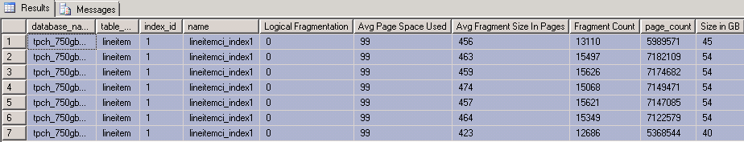
Evaluating Page Fragmentation
Average Fragment Size in Pages – This metric is a reasonable measure of contiguous page allocations for a table.
Value should be >= 400 for optimal performance

Slide 15
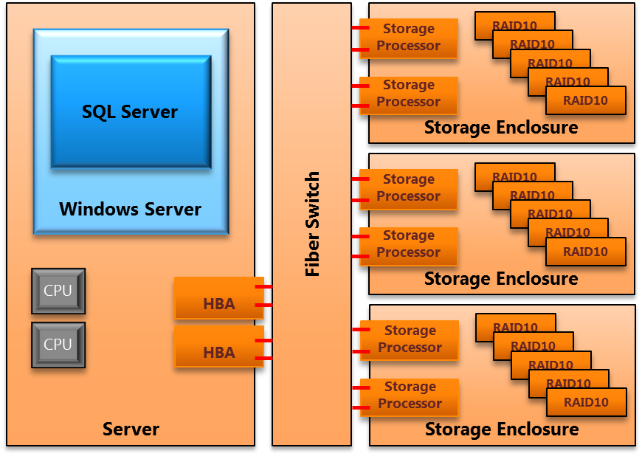
Sample Fast Track Configuration
CPU balanced to Disk

Slide 16
Maximum Consumption Rate (MCR)
Calculating MCR for a CPU
  Calculate the standardized MCR for the CPUs in the chosen server.
    You can also use published MCR ratings for FTDW configurations. In general CPUs of the same family have similar MCR.
  Use the MCR value to estimate storage and storage network requirements and create an initial system design.

Slide 17
Calculating MCR
Michael Bassett
Program Manager II
SQL Systems Engineering
demo

Slide 18
Sample Fast Track Configuration
CPU balanced to Disk

Slide 19
Baseline Hardware Validation
SQLIO.exe
Establish real rather than rated, performance metrics for the key hardware components of the Fast Track reference architecture.
Example:
  "C:\Program Files (x86)\SQLIO\sqlio.exe" –kR –fSequential -s30 –o60 -b512 .\iobw.txt –t2

Slide 20
SQLIO testing
Michael Bassett
Program Manager II
SQL Systems Engineering
demo

Slide 21
Fast Track Database Validation
Actual SQL Server performance
Establishing SQL Server performance characteristics, based on a FTDW workload, allows for comparison against the performance assumptions provided by the Baseline Hardware evaluations process.
  Real SQL Server testing
  Various levels of concurrency
  Various types of queries

Slide 22
Fast Track Database Throughput metrics
In general, database throughput metrics should reflect at least 80 percent of baseline rates for Fast Track validated reference architectures.
The performance metrics calculated in this process are the basis for published FTDW performance values.

Slide 23
Fast Track Data Warehouse V3.0
New Features and Best Practices
Jim Hautala
Solutions Engineer
HP
partner

Slide 24
SQL Server Fast Track Reference
Configurations
SQL Server® Fast Track Data Warehouse for HP servers, storage and networking products
HP and MSFT have developed 5 hardware reference architectures that use best practices and have been pre-tested to provide balanced performance to reduce costs, save time and reduce risk
Accelerates the sales cycle, significant cost savings, protects investments.
The configurations target small, medium and large data warehouses which will provide a path to “Enterprise Data Warehouse*”
Complete Bill of Materials for each configuration

Slide 25
Hardware Selection
Dependent on Workload
Per Core guidelines no longer apply
  Published Reference configurations for guidelines
  Hash Joins and Sorts may require extra memory
  Workloads that utilize cache reads
Calculate Consumption Rates
  Maximum CPU consumption Rate
  Benchmark Consumption Rate (your workload)
  Match BCR rates to published configurations MCR
Storage requirements
  Published Data Warehouse sizes

Slide 26
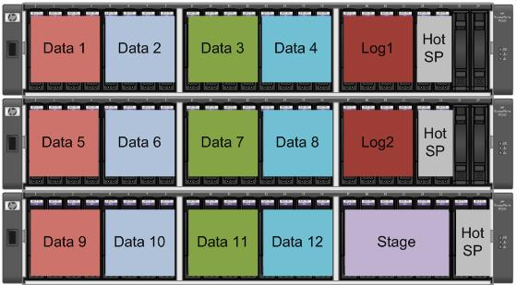
Fast Track LUN Configuration
RAID10 Data LUNs
RAID10 Log LUNs
6 Disk
Secondary Stage
Primary Data, TempDB, Primary Stage striped
on Data LUNs

Slide 27
Fast Track Data Striping
Fast Track evenly spreads SQL data files across physical 4-Disk RAID-10 disk arrays
FT Storage Enclosure
CREATE FILEGROUP DB1
Raid-10
Primary Data
Log
ARY01D1v01
ARY02D1v03
ARY03D1v05
ARY04D1v07
ARY05v09
DB1-1.ndf
DB1-3.ndf
DB1-5.ndf
DB1-7.ndf
DB1.ldf
Disk pairs (1&2 + 3&4)
ARY01D2v02
ARY02D2v04
ARY03D2v06
ARY04D2v08
DB1-2.ndf
DB1-4.ndf
DB1-6.ndf
DB1-8.ndf

Slide 28
Statistics and Compression
Use statistics to address performance
  AUTO UPDATE/CREATE
  Use composite statistics for loop and join performance
  Minimize manual statistics on larger data sets
Compression recommended
  Current FT configurations based on 3x compression
  Helps reduce I/O requirements
  Not recommended for random I/O workloads

Slide 29
Sequential Data Performance
Sequential scan performance starts with database creation and extent allocation
Recall that the –E startup option is used
  Allocate 64 extents at a time (4MB)
Pre-allocation of user databases is strongly recommended
Autogrow should be avoided if possible
  If used, always use 4MB increments

Slide 30
Performance Testing and Best Practices
Better Performance with Increased Memory
  Guidance changed from 4GB/Core. No longer tied to # of cores.
  Queue Depths Optimized at 48 or 64
RAID10 Arrays reduce Management Complexity
Power Settings in BIOS and Control Panel
MPIO Complexity is High – Use Explicit mappings or Failover Only Policy

Slide 31
Performance Testing and Best Practices (cont’d)
Resource Governor plays a bigger role
  Changes for large configurations such as the DL980
MAXDOP Settings
  MAXDOP 0 not Optimal

Slide 32


What is new in Fast Track
Data Warehouse 3.0?
New: Fast Track 3.0 enables Partners to build and test Reference Architectures while Microsoft validates
Customers and Partners get new and enhanced benefits from Fast Track 3.0:
Customers
Partners
Faster performance – new configurations offer high IO throughput of up
to 15GB/s
More control and flexibility to build and test their own configurations
Increased scale – new Reference Architectures offer up to 80 TB!
Opportunity to differentiate configurations
Greater Choice with new Hardware Partners

Slide 33
Technical Changes in
Fast Track 3.0 Data Warehouse
Changes | Description
FTDW 3.0 Architecture | Basic component architecture for FT 3.0 based systems.
New Memory Guidelines | Minimum and maximum tested memory configurations by server socket count.
Additional Startup Options | Notes for T-834 and setting for Lock Pages in Memory.
Storage Configuration | RAID1+0 now standard (RAID1 was used in FT 2.0).
Evaluating Fragmentation | Query provided for evaluating logical fragmentation.
Loading Data | Additional options for CI table loads.
MCR | Additional detail and explanation of FTDW MCR Rating.
New Reference Configurations | Reference Configurations updated to include hardware/guidance advances

Slide 34
HP Fast Track Architecture Changes
RAID10 Arrays vs RAID1
  Reduce Management Complexity
8GB Storage Arrays
New Load Procedures
  Bulk Insert To Staging Tables
  Insert/Select to Production/Staging Table
  Switch to Final DB Partition
Use highest clock speed for best performance
Use default settings on P2000 Arrays

Slide 35
DL980 G7
8 Socket, 64 core server
512GB RAM
Current maximum size exceeds practical limit of single Fast Track Database
Server tested using multiple fast track databases simultaneously
14GB/sec logical scan rate using less than 200 disk drives

Slide 36
Fast Track Testing
New methodology provides more stringent testing
HP works with Microsoft to perform testing
Test Harness uses simulated workloads from 5,10,20 and 40 concurrent queries
Formal signoff once HP and Microsoft have optimally tuned configuration

Slide 37
HP Fast Track Futures
Fast Track HA Solution
Direct Attached Storage
HP Bladesystem
Solid State Storage
Other BI Systems
  OLTP
  SSIS

Slide 38
In Summary
SQL Server Fast Track 3.0 Data Warehouse Reference Architectures provide performance at a low TCO
Reference configurations ensure your hardware choice is the right one
Reference Configurations are tested and validated with real world workloads
Sequential Scan workloads are a must; Random centric workloads do not work well with Fast Track

Slide 39

Database Platform (DAT) Resources
Required Slide
Track PMs will supply the content for this slide, which will be inserted during the final scrub.
  Visit the updated website for SQL Server® Code Name “Denali” on www.microsoft.com/sqlserver and sign to be notified when the next CTP is available
  Follow the @SQLServer Twitter account to watch for updates
Try the new SQL Server Mission Critical BareMetal Hand’s on-Labs
Visit the SQL Server Product Demo Stations in the DBI Track section of the Expo/TLC Hall. Bring your questions, ideas and conversations!
Microsoft® SQL Server® Security & Management | Microsoft® SQL Server® Optimization and Scalability
Microsoft® SQL Server® Programmability | Microsoft® SQL Server® Data Warehousing
Microsoft® SQL Server® Mission Critical | Microsoft® SQL Server® Data Integration

Slide 40





Resources
  Connect. Share. Discuss.
http://northamerica.msteched.com
Learning
  Sessions On-Demand & Community
  Microsoft Certification & Training Resources
www.microsoft.com/teched
www.microsoft.com/learning
  Resources for IT Professionals
  Resources for Developers
http://microsoft.com/technet
http://microsoft.com/msdn

Slide 41












Complete an evaluation on CommNet and
enter to win!

Slide 42


Slide 43

© 2011 Microsoft Corporation. All rights reserved. Microsoft, Windows, Windows Vista and other product names are or may be registered trademarks and/or trademarks in the U.S. and/or other countries.
The information herein is for informational purposes only and represents the current view of Microsoft Corporation as of the date of this presentation. Because Microsoft must respond to changing market conditions, it should not be interpreted to be a commitment
on the part of Microsoft, and Microsoft cannot guarantee the accuracy of any information provided after the date of this presentation. MICROSOFT MAKES NO WARRANTIES, EXPRESS, IMPLIED OR STATUTORY, AS TO THE INFORMATION IN THIS PRESENTATION.

