Slide 1



What’s New in Manageability for Microsoft SQL Server “Denali”
DBI304
Denny Cherry
Sr. Database Administrator
Phreesia

Slide 2
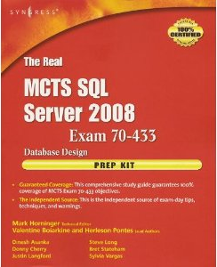
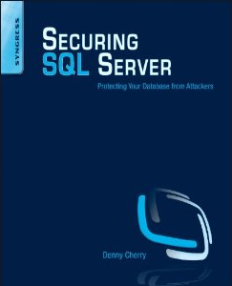

About Me
Author or Coauthor of 4 books
6+ SQL Mag articles
Dozens of other articles
Microsoft MVP since Oct 2008
Microsoft Certified Master
Founder of SQL Excursions
Sr. DBA for Phreesia
All Images past this slide sourced from Microsoft Office’s Clip Art Library.

Slide 3

Agenda
Management Studio Enhancements
Distributed Replay
Contained Databases
Sequences
User Defined Server Roles
Data Tier Applications

Slide 4
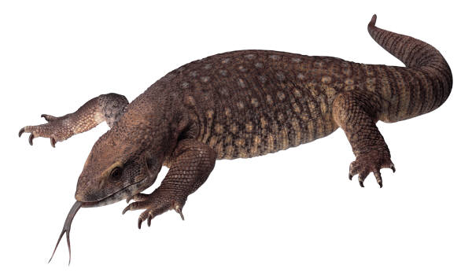
Management Studio Enhancements
New UI based on WPF
Faster load time
Better multi-monitor support
Better keyboard shortcut support
Notes:
Talk about the keyboard shortcuts being customizable via a config file to support either the .NET shortcuts or the legacy SSMS shortcuts.

Slide 5

Debugging Enhancements
Condition Breakpoint
  "IsTrue" style condition breakpoint should accept all T-SQL boolean Expression as input
  "HasChanged" style condition breakpoint should accept all T-SQL expression
T-SQL Expression Evaluation in
  Watch Window/Quick Watch
  Supports evaluation of all valid T-SQL
  Expression in Watch Window.
Datatip during debugging
Debugging Yukon (SP2) servers from SSMS is enabled

Slide 6
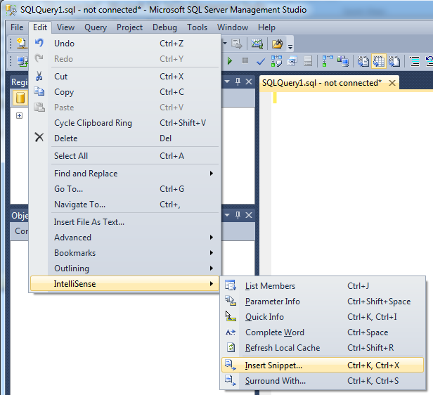
Code Snipits
Quick easy intellisence way to write code for objects
<CTRL>K + <CTRL>X to activate
Provides sample code for a wide variety of objects
  Tables
  Procedures
  Views
  Functions
  Logins / Users

Slide 7
Code Snipits Demo
Notes:
Fire up SSMS and show the code snipits using the <CTRL>K + <CTRL>X hot keys and “Edit > IntelliSense > Insert Snippet”

Slide 8
Activity Monitor
Gives quick overview of the instance
Allows real time viewing of
  Running Processes
  Resource Waits
  File IO Statistics
  Most recent, most expensive queries run against the instance
Fixed the “Column Width” bug
Notes:
The Column Width bug isn’t fixed until CTP 3.

Slide 9
Distributed Replay
Allows for simulating a missions critical workload
Can run captured data from multiple computers at once
Two modes for different situations
  Synchronization Mode
  Stress Mode
Notes:
Sync mode checks for application compatibility and/or performance testing
Stress mode is for stress testing, capacity planning and capacity forecasting
NOTE: Not installed as a normal SQL Component. Installed from the Tools screen of the installer. In CTP 1 this requires having Visual Studio and/or SSMS installed before running through the distributed replay installer. If not done in the correct order, rerun the distributed replay installer and do a repair to push everything back out.

Slide 10
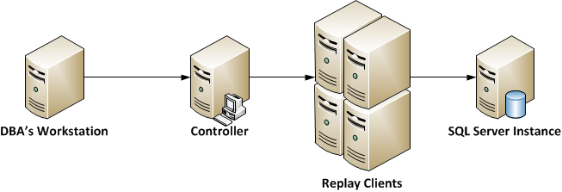
Distributed Replay Components
Target Server
Replay Clients
Replay Controller
Administration Tool
Notes:
Target Server – SQL Server instance that the replay is directed towards.
Replay Clients – One or more computers which run the “SQL Server Distributed Replay Client” service. Multiple clients are used to run large workloads at once.
Replay Controller – A computer running the “SQL Server Distributed Replay Controller” service which is used to control the Replay Clients.
Admin tool – dreplay.exe command line application which talks to the controller. This app is used to actually control the replay controller
The admin tool does not need to be run from the replay controller.
The controller and the client can be installed on the same computer, but only one instance of each service can be installed on a single computer.
When processing a trace, the trace needs to be on the controller not on the admin machine.
These services have to be started in the correct order. The Controller MUST be started first, then the client services can be started.

Slide 11
Distributed Replay Process
Capture data via SQL Server Profiler or Server Side Trace
Preprocess
  Takes trace data and creates an intermediate file
Event Replay
  Intermediate file is taken and part of the file is sent to each replay client
  Client writes data to a dispatch file
  After clients receive dispatch data, controller launches and synchronizes the replay
  Each client can record the replay activity to a local result trace file
Notes:
DReplayServer.xml – Controller configuration file
DReplayClient.xml – Client configuration file
Dreplay.exe.preprocess.config – Preprocess configuration file
Dreplay.exe.replay.config – Replay configuration file
Controller configuration file: Specify controller logging level in the file that is named DReplayServer.xml. This file is located on the controller. When the controller service starts, it loads the logging level from the configuration file.
Client configuration file: Specify client settings, such as logging level and the location of the result directory, in the file that is named DReplayClient.xml. This file is located on each client. When the client service starts, it loads settings from the configuration file, such as the controller name.
Preprocess configuration file: Specify settings for the preprocess stage, such as whether to include system session activities during the replay, and the maximum idle time setting. By default, the administration tool uses the preprocess configuration file named DReplay.exe.preprocess.config. If you modify the preprocess configuration file, we recommend that you modify a copy rather than the original. For more information, see How to: Prepare the Input Trace Data.
Replay configuration file: Specify settings for the event replay stage, such as the event sequencing mode and settings that affect the replay speed. By default, the administration tool uses the replay configuration file that is named DReplay.exe.replay.config. If you modify the replay configuration file, we recommend that you modify a copy rather than the original. For more information, see Replay Option (Distributed Replay Utility Administration Tool).

Slide 12
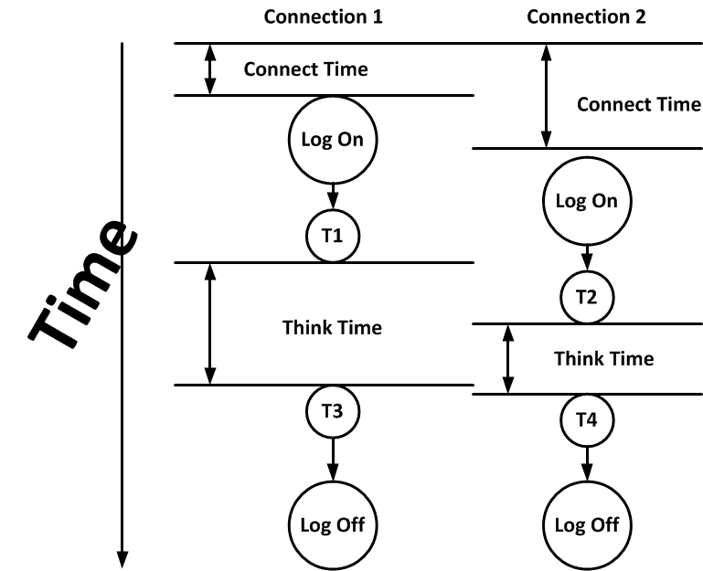
Distributed Replay Importing Settings
Connect Time
Think Time
MaxIdleTime
HealthmonInterval
QueryTimeout
Notes:
Connect Time and Think Time are in DReplay.exe.replay.config
Connect Time – Amount of time the trace should wait between the trace starting and the logon event starting
Think Time – Amount of time between the completion of the previous event and the start of the next event
MaxIdleTime is in the DReplay.exe.preprocess.config
Tells the replay how long the entire trace process can be idle for, before skipping to the next runnable command. For example if the trace contains a large window of no work being done such as over night for 4 hours, this setting prevents the need to have the system idle for 4 hours.
HealthmonInterval is in DReplay.exe.replay.config
This setting tells the replay process how often to resolve deadlocks that the replay process creates. The default is 60 seconds. This setting is ignored in Stress mode
QueryTimeout is in DReplay.exe.replay.config
This setting tells the replay process how long to wait for the database engine to return the first record. If the first row is returned within the timeout then the timeout is no longer in effect. If no row is received within the timeout then the query is terminated. The default timeout is 3600 seconds (60 minutes).

Slide 13
Distributed Replay Demo
Notes:
Uses:
Clientpc.mrdenny.lab
Replay-controller.mrdenny.lab
Replay-client.mrdenny.lab
Denali-1.mrdenny.lab
Replay controller is also a replay client
Navigate to “C:\Program Files (x86)\Microsoft SQL Server Distributed Replay Utility\DReplayAdmin\” on my laptop. Grab path and commands from RunReplay.txt under Sample Code\dreplay
In CTP 1 you have to have the SQL Server Management Studio installed on all the replay controller and replay client machines for this to work. SSMS needs to be installed before the distributed replay software is installed.
Preprocessing the captured trace takes 1-2 minutes. This trace file is 386 Megs.

Slide 14
Contained Databases
Three database containment options are available
  None
  Partially Contained
  Fully Contained – Coming in the future
Two Containment Models
  Application Model
  Management Model
Notes:
Management model is all instance level objects such as Endpoints, sys.server_principals, etc.
Application Model
System Catalog Views - Sys.procedures, sys.routes, sys.tables, etc.
The only DMV which is allowed is sys.dm_db_uncontained_entities
T/SQL Language – comments, SELECT, INSERT, UPDATE, TOP, etc.
DB specific system stored procedures – sp_create_plan_guide, sp_columns, sp_helptext, etc.
DBCC statements – checkdb, checktable, help, show_statistics, shrink, checkident, useroptions, etc.
Management Model
Server Wide Catalog Views – sys.certificates, sys.configurations, sys.database_files, sys.endpoints, sys.servers, sys.services, sys.sql_logins
Compatibility Views – sys.users, sys.types, sys.servers, etc.
CREATE/DROP/ALTER Statements – resource governor, keys, endpoints, server audits

Slide 15
Contained Database Models
Application Model
Management Model
Database System Catalog Views
Data Types
T/SQL Language
Object Creation
Rights on these objects
SET statements / ANSI statements
Built-In Functions
Database Specific System Stored Procedures
DBCC statements
Server Wide Catalog Views
Compatibility Views
Various CREATE/DROP/ALTER Statements
FILESTREAM
CDC functions
Trace Data
Profiler procedures
Linked Servers
Full Text Search
Notes:
Application Model
System Catalog Views - Sys.procedures, sys.routes, sys.tables, etc.
The only DMV which is allowed is sys.dm_db_uncontained_entities
T/SQL Language – comments, SELECT, INSERT, UPDATE, TOP, etc.
DB specific system stored procedures – sp_create_plan_guide, sp_columns, sp_helptext, etc.
DBCC statements – checkdb, checktable, help, show_statistics, shrink, checkident, useroptions, etc.
Management Model
Server Wide Catalog Views – sys.certificates, sys.configurations, sys.database_files, sys.endpoints, sys.servers, sys.services, sys.sql_logins
Compatibility Views – sys.users, sys.types, sys.servers, etc.
CREATE/DROP/ALTER Statements – resource governor, keys, endpoints, server audits

Slide 16

Temp Tables
Local temp tables are not allowed within fully contained databases
Local temp tables within partially contained databases will be reported in sys.dm_db_uncontained_entities
Temp tables can not use named constraints
Temp tables can not use UDTs, XML schema collections or UDFs

Slide 17
Security and the Contained Database
Adding a user to a contained database by db_owner or db_securityadmin allows user to log into the instance
Access to other databases would be allowed via guest user
Contained SQL Logins do not follow password policies
AUTO_CLOSE could lead to a DoS attack
Notes:
If the database is auto closed, every time a user authenticates the database must be started back up to see if the user is a contained user in that database and could contribute to a DoS attack against the server if the user login rate is high enough.

Slide 18
Partially Contained Databases
Allows some uncontained features
  Tables that use uncontained functions
  Check constraints that use uncontained functions
  Numbered Procedures (exec YourProcedure;2)
Query sys.dm_db_uncontained_entities for uncontainable objects

Slide 19
Uncontained Feature Usage
sys.dm_db_uncontained_entities DMV
Databases:Uncontained Entity Uses Perfmon Counter
sqlserver.database_uncontained_usage xEvent

Slide 20
Contained Database Demo
Notes:
Uses:
Denali-1
Denali-2
Show the contained database
Create a login within the database
Create a job within the database
Backup the database and restore to denali-2
Show the login and job on the new server.

Slide 21
Sequences
ANSI compliant number generator
Created using CREATE SEQUENCE
Much faster than using IDENTITY property
Used like the IDENTITY property by using NEXT VALUE as default value for column
Can be called separately to get the next available value from within T/SQL

Slide 22

Sequences
Sequences can restart automatically when using the CYCLE keyword
Developer can specify the number of values which are cached
MINVALUE specified the lower bound of the sequence
MAXVALUE specified the upper bound of the sequence.
IDENTITY loads 20 values into memory, and logs when each one is used
Notes:
If the cache option is enabled without specifying a cache size, the Database Engine will select a size. However, users should not rely upon the selection being consistent. Microsoft might change the method of calculating the cache size without notice.
With IDENTITY SQL Server caches 20 values into memory, but writes to the meta data each time a value is used. Sequence only writes to the meta data when a new block of values is allocated into memory. This change can cause gaps in the number list. Specifying NO CACHE will increase the odds that no numbers will be skipped.

Slide 23
Sequences
Sequence loads a user configurable value range when initialized, with no additional writes until new range is created
Sequences can skip numbers when instance is restarted
Sequences can be reseeded easily
One sequence can be used on multiple tables
Sequences can roll over and start over automatically

Slide 24
Creating a Sequence
CREATE SEQUENCE MySequence
AS TINYINT | SMALLINT | INT | BIGINT
START WITH 0
INCREMENT BY 1
MAXVALUE 2000000
CACHE 1000
Notes:
Numeric values are also supported as long as they have a scale of 0

Slide 25
Using a Sequence
SELECT NEXT VALUE FOR dbo.MySequence AS MyValue;
GO
DECLARE @value INT
SELECT @value = NEXT VALUE FOR dbo.MySequence;
SELECT @value
GO
SELECT NEXT VALUE FOR dbo.MySequence, *
FROM sys.all_objects
GO

Slide 26
Permissions on Sequences
GRANT UPDATE ON OBJECT::dbo.MySequence TO [user] ;

Slide 27
User Defined Server Roles
Allows for the creating of new server wide rolls
Helps with separation of duties for compliance
Allows for the creation of sub-sysadmin roles which have some sysadmin level rights
Great for Junior DBAs, Managers, Auditors, Developers, etc.
New triggers allow for monitoring when logins added to/from server roles

Slide 28
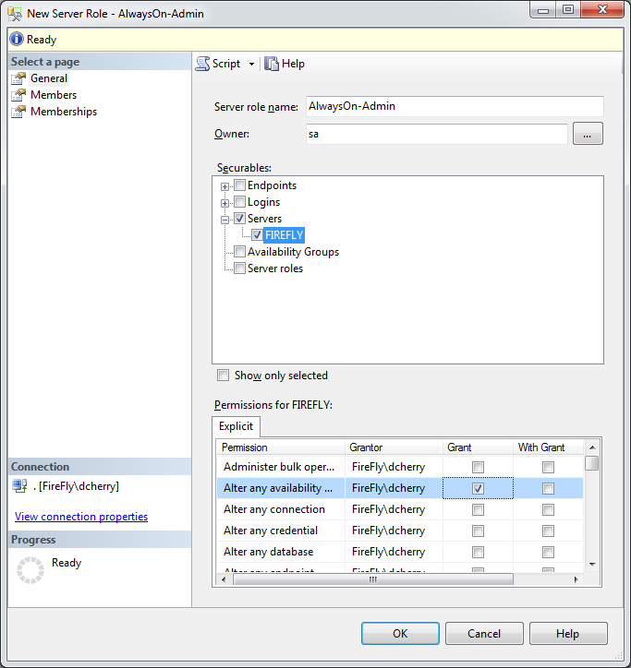
User Defined Server Roles

Slide 29
Creating a User Defined Server Role
CREATE SERVER ROLE [AlwaysOn-Admin] AUTHORIZATION [sa]
ALTER SERVER ROLE [AlwaysOn-Admin] ADD MEMBER [MyUser]
GRANT ALTER ANY AVAILABILITY GROUP TO [AlwaysOn-Admin]
GRANT ALTER ANY ENDPOINT TO [AlwaysOn-Admin]
GRANT CREATE AVAILABILITY GROUP TO [AlwaysOn-Admin]
GRANT CREATE ENDPOINT TO [AlwaysOn-Admin]
GO

Slide 30
Capturing Server Role Changes
CREATE TRIGGER role_change
ON ALL SERVER
FOR ADD_SERVER_ROLE_MEMBER, DROP_SERVER_ROLE_MEMBER
AS
  PRINT 'Server Role Membership Changed'
  SELECT EVENTDATA().value('(/EVENT_INSTANCE/TSQLCommand/CommandText)[1]','nvarchar(max)')
GO
Notes:
ALTER SERVER ROLE [setupadmin] DROP MEMBER [sa]
GO

Slide 31
User Defined Server Roles Demo
Notes:
Uses
Denali-1
ClientPC
Click through the UI showing all the various screens and flexability of the user defined server role

Slide 32
Data Tier Applications
In Place Upgrades
Fully supports SQL Azure Object Set (as of May 2011)
Application Import and Export Now Supporting Data
#sqlwinning
Notes:
No More databases being dropped for schema changes !!!!

Slide 33
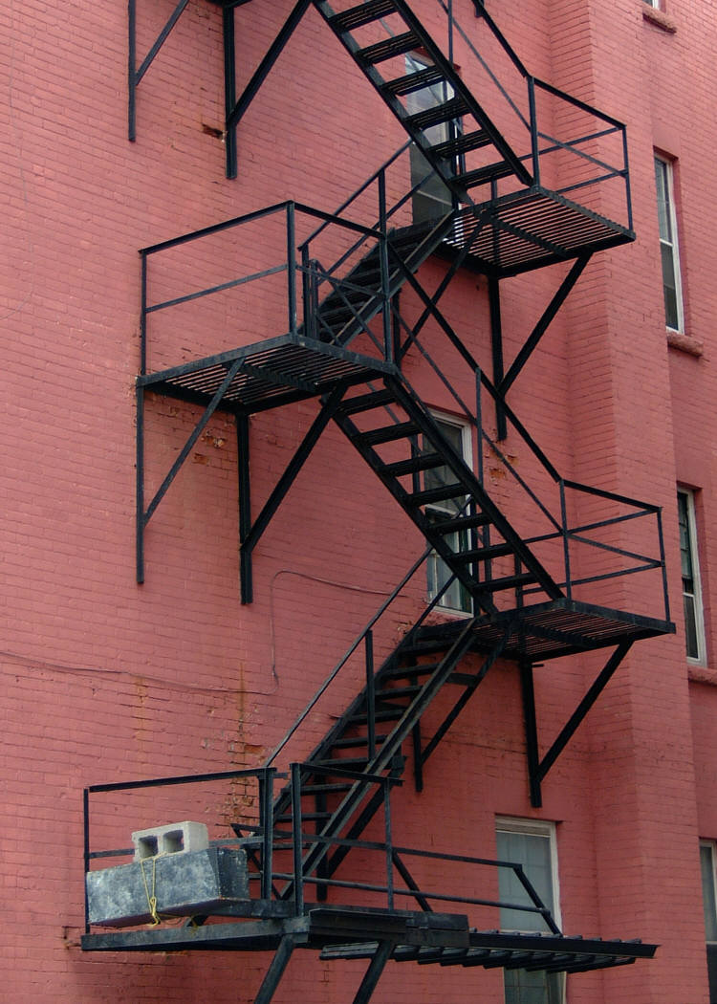
Deployment Enhancements
Core Server Support
  Install via command line switches
  Install via settings file
  Supports
    Windows Server 2008 SP2+ x64
    Windows Server 2008 R2
Notes:
This version is in case the core installer doesn’t support the UI. If it does hide this slide and show the next slide instead.
This decision probably won’t be made until the RTM installer is being built.

Slide 34

Clustered Deployment Enhancements
Cluster Installs are no longer supported in WoW
Geographically Dispersed Clusters support multi-subnet failover
Mount Points can be mounted on local disks instead of SAN LUNs
  Only one instance can use each local disk drive letter.
Notes:
For Geo clusters…
All servers must be in the same Windows domain
Mixed AND / OR dependencies are not supported.
More than one IP per subnet is not supported
Keep in mind DNS change latency when failover happens
The instance will not come online until the DNS change has been registered on the local DNS server

Slide 35

Related Content
Required Slide
Speakers, please list the Breakout Sessions, Interactive Discussions, Labs, Demo Stations and Certification Exam that relate to your session. Also indicate when they can find you staffing in the TLC.
Breakout Sessions (DBI206, DBI302, DBI306, DBI312)
Interactive Sessions (DBI373-INT, DBI374-INT)
Hands-on Labs (DBI376-HOL, DBI378-HOL, DBI380-HOL)
Product Demo Stations (Microsoft SQL Server Security & Management)
Related Certification Exam – MCITP: Database Administration, MCM “Denali”
Find Me Later At… The “Database Couch”, The SQL Manageably Booth

Slide 36





Resources
  Connect. Share. Discuss.
http://northamerica.msteched.com
Learning
  Sessions On-Demand & Community
  Microsoft Certification & Training Resources
www.microsoft.com/teched
www.microsoft.com/learning
  Resources for IT Professionals
  Resources for Developers
http://microsoft.com/technet
http://microsoft.com/msdn

Slide 37












Complete an evaluation on CommNet and
enter to win!

Slide 38

Notes:
New for TechEd 2011, we will be working with Microsoft Tag (http://tag.microsoft.com/overview.aspx) to create unique Tags for every session at the event. Your session Tag will appear on both the room signage and at the end of your presentation. With your session Tag, attendees will be able to scan as they enter the room to retrieve session details, view speaker bios, and engage in discussions; or scan at the end of the presentation to evaluate your session and download materials. We’re excited to integrate Microsoft Tag across the My TechEd mobile experience this year.

Slide 39
Notes:
Fire up SSMS

Slide 40
Notes:
Fire up SSMS

