Slide 2

Using Knowledge to Cleanse Data with Data Quality Services
DBI207
Elad Ziklik
Principal Group Program Manager
Microsoft Corporation

Slide 3

What is Data Quality ?
Data Quality represents the degree to which the data is suitable for business usages
Data Quality is built through People + Technology
+ Processes
Bad Bata → Bad Business
Notes:
We will talk about what is Data Quality.
The important thing is that there is no absolute term for DQ there is no bad data in terms. It depends on your usage of the data. Once you know the person who is using the data and once you know your data you can then define if this data is good for the usage purpose or bad and what you would like to do with it. Data Quality is not Black and white it is subjective to your usage of the data.
There are many dimensions to DQ.
The quality of data can be defined, measured and managed through various Data Quality Dimensions and metrics such as accuracy, consistency , completeness , duplicates, timeliness.

Slide 4

Common Data Quality Issues
Data Quality | Issue | Sample Data Problem
Standard | Are data elements consistently defined and understood ? | Gender code = M, F, U in one system and Gender code = 0, 1, 2 in another system
Complete | Is all necessary data present ? | 20% of customers’ last name is blank, 50% of zip-codes are 99999
Accurate | Does the data accurately represent reality or a verifiable source? | A Supplier is listed as ‘Active’ but went out of business six years ago
Valid | Do data values fall within acceptable ranges? | Salary values should be between 60,000-120,000
Unique | Data appears several times | Both John Ryan and Jack Ryan appear in the system – are they the same person?
Notes:
There are lots of DQ issues we are going to talk about some of the common issues and later on see how we handle them. The biggest issue that customer come to us with is data which is incorrect.
What does it mean incorrect –
Misspelled names
Misspelled address’s – addresses which do not exist, e-mail addresses
Another big problem we address in DQ issues is duplicates. Any company that deals with lots of companies has this problem. For example you won’t imagine how many entries for Boeing can be in a data source – Boing with address in saint Louis, Chicago, Europe etc. more than 100rds. If you have the same entity entered many time with different representations it can be a problem as now you won’t believe what your BI is telling you. For example what is your total sales ? Did you count them multiple times, did you under count them. And this is a huge problem.
You can spend lots of time and money on your BI tools but if your underline data is wrong than it’s a waste of time and money.

Slide 5
Requirements for Data Quality Solutions
Cleansing
Matching
Profiling
Monitoring
Monitoring
Tracking and monitoring
the state of Quality
activities and Quality
of Data
Cleansing
Amend, remove or enrich data that is incorrect or incomplete. This includes correction, standardization and enrichment.
Profiling
Analysis of the data source to provide insight into the quality of the data and help to identify data quality issues.
Matching
Identifying, linking or merging related entries within or across sets of data.
Notes:
What is a DQ product or a tool that is worthwhile ?
A good data quality tool will In the market a good data quality tool will have these 4 parts.
On the right are the basics:
Cleansing – Cleansing is correcting the incorrect – going through data and correcting all the names, addresses etc,
Matching – Matching is the capability to find the duplicate. We are talking about semantic duplicates not absolute duplicates as absolute are easy to find. We are talking about Microsoft Corp, Microsoft, Microsoft LTD, Microsoft misspelled different representations of the same company. We call it matching cause the technology is to match things. You can also find it as de-deuplication or Entity resolution.
These are the core things you buy DQ for. But without additional tools it is hard to use.
Profiling - You need profiling. If you have a list of 1000 customers then you run it through the tool and whatever it does it does. But if it is a list of 1,000,000 than you need to decide what to run, should I run it. Profiling decides if the data is good. Should I run DQ project on it does running DQ improve the data.
Monitoring – Monitoring is administration, this is a product for several people and we want to see who is doing what, what processes are running etc.
This is Data Quality and this is what we do now we are going to understand what DQS is we are going to talk about these topics and then see the functionality in a demo.

Slide 6
What is DQS ?
Data Quality Services (DQS) is a
Knowledge-Driven data quality solution, enabling IT Pros and data stewards to easily improve the quality of their data

Slide 7
Microsoft’s DQS Solution Concepts
Knowledge-Driven
Based on a Data Quality Knowledge Base (DQKB)
Data Domains capture the semantics of your data
Support use of user-generated knowledge and IP by 3rd party reference data providers
Acquires additional knowledge the more you use it
Compelling user experience designed for increased productivity
Open and Extendible
Easy to use
Semantics
Knowledge Discovery
Notes:
Lets start talking about what we are doing. MS DQS main concept is Knowledge driven. To correct data you need to understand what the data is about. When we talk about understanding we are talking about semantic understanding and not scheme. Schema is easy semantic is how do I know that Corp and Corporation are the same. This is something that only a person can help us understand someone who knows the data. And to cleanse the data you need to have knowledge about the data. Every prouct in DQS applies knowledge but ussually you do not understand where the knowledge is etc. In MS DQS you will see a seperation between knowledge and applying the knowledge and we will see in the demo that we first create the knowledge and in a speprate part apply this knowledge. This means the knowledge is plugable, u can updtae it, download receive ti…
Creating knowledge is a difficult process mostly manual intervention. We are goinn in V1 to enable people how to extract knwoledge from you data. If you show me a sample of your data and walk with me in a computer assiciated method than I can help you extract klnowledge easier. That’s what we mean by knowledge discovery.
Even with this capability building knowledge is difficult and if you can avoid it please do. That’s why we enabled you to plug knowledge into the system. For example if there is a 3rd party which has this knowledge for example US addressees than senseless to create this knowledge on your own.
You will saw a demo of the option how you can in 2 clicks find someone else to apply his data on your knowledge.
Easy to use – we hope for all of our products.

Slide 8
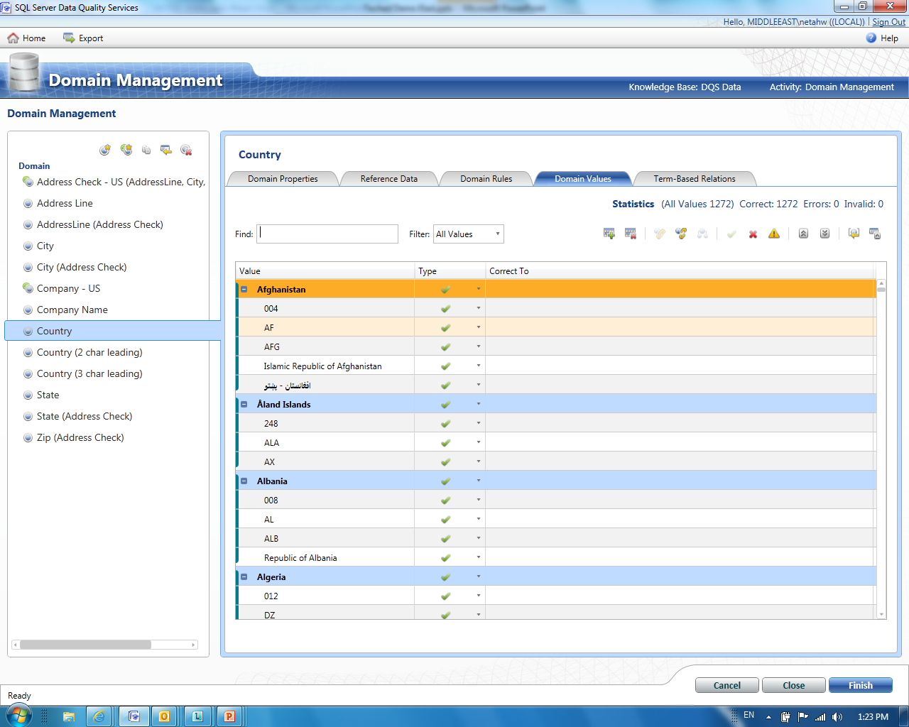
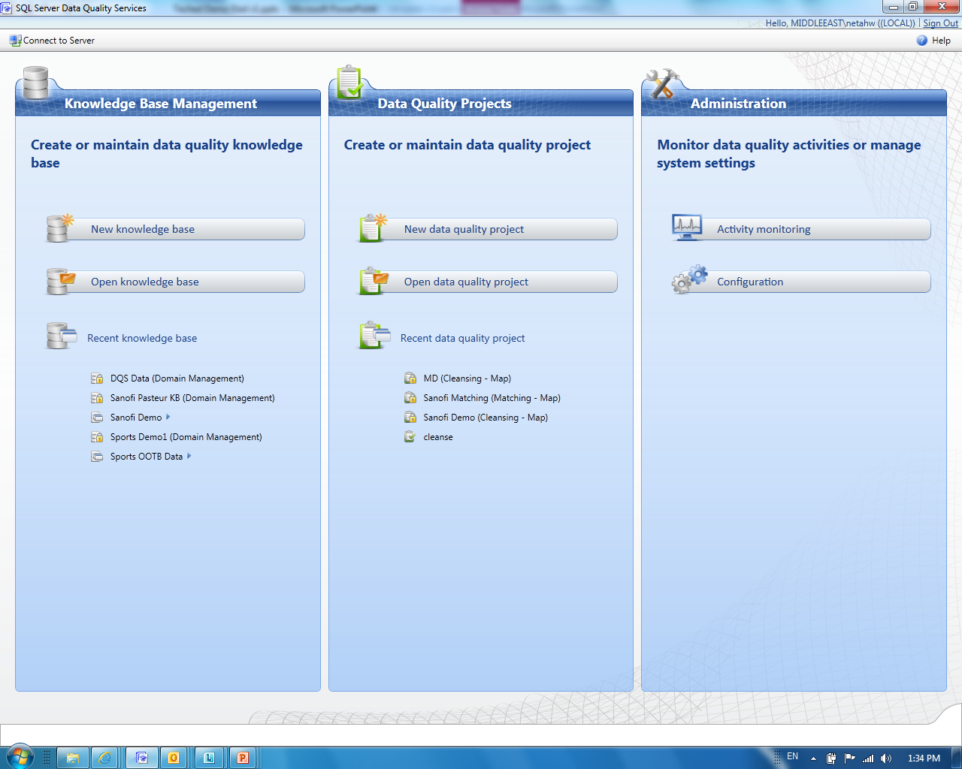
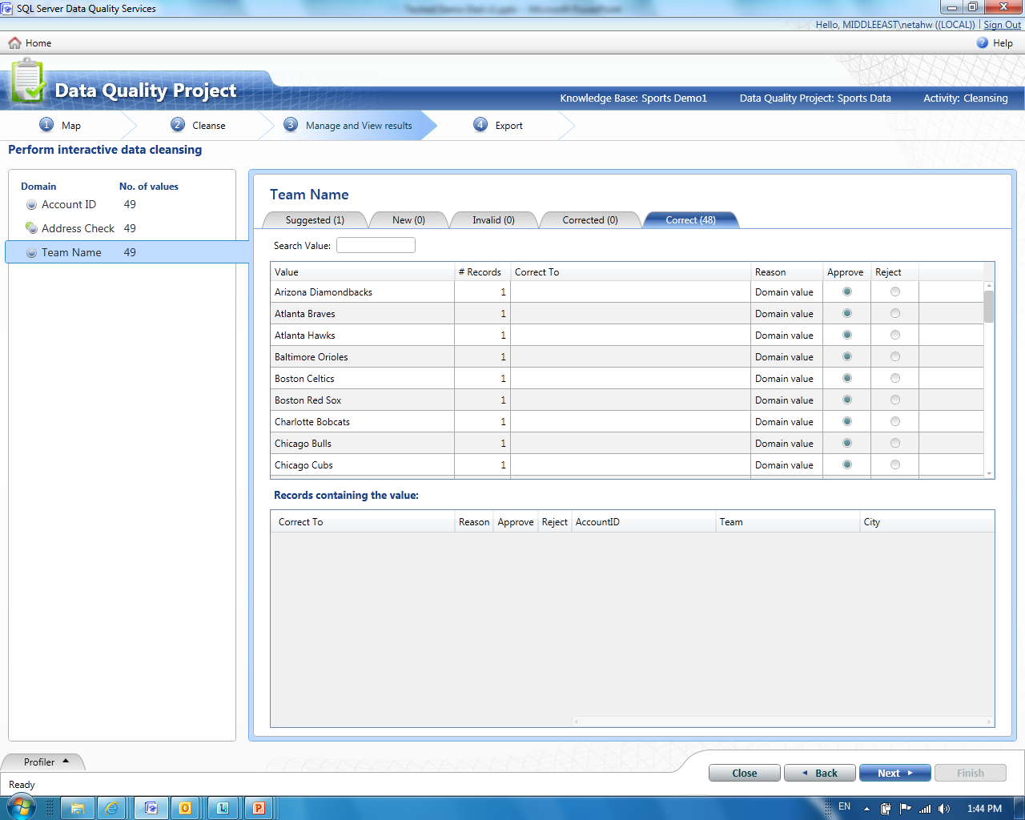

Make Data Quality Approachable To Everyone
  Improve your data quality with DQS
    Cleanse the data and keep it clean
    Build confidence in your enterprise data
    Share the responsibility for data quality
  Remove Barriers for Data Quality
    Designed for ease of use
    Empowering the business users
    See data quality results in
    minutes rather than months

Slide 9



DQS Process
Cloud Services
Knowledge
Management
Build
Reference
Data
Discover / Explore Data / Connect
Knowledge
Manage
Enterprise
Data
Knowledge
Base
Integrated
Profiling
Status
Progress
Notifications
Correct
& standardize
Match & De-dupe
Use
DQ Projects

Slide 10
DQS High Level Scenarios
Knowledge Management &
Reference Data
Creating and managing the Data Quality Knowledge Bases
Discover knowledge from your org’s data samples
Exploration and integration with 3rd party reference data
Cleansing & Matching
Correction, de-duplication and standardization of the data
Administration
Tools to monitor and control data quality processes
Notes:
Now we are closer to the actual product. The product has 3 main activities
Knowledge management – creating your knowledge base. How do I clean the data – learn, connect an external source etc.
Applying this knowledge- cleansing matching/de-duping
Administration – we will walk through some of the stuff but it is administration.
This is also the structure of the security model and users – you can have a user that is administrator, one that creates the knowledge and a user that actually cleanses the data and uses the data

Slide 11
DQS Demo 1 - Interactive Cleanse and Knowledge Management
demo

Slide 12
Data Quality Knowledge Base (DQKB)
Values
Composite Domains
Domains
Represent the data type
Knowledge Base
Domains
3rd party Reference Data
Rules & Relations
Matching Policy
Notes:
We talked about knowledge before we go to the demo lets talk a bit about what is a knowledge Base. Knowledge base is an atomic unit where we keep the types of data. When we mean type of data for example customer data with 10 attributes we create a KB for it. In the KB we have domain. Domain is an atomic unit about a particular data for example – addresses, names, cities gender etc.
There are 2 types of domains – basic domain is an attribute of the data for example company name and it will contain all this knowledge. It can contain a list of core values, a list of errors, a list of synonms it might contain validation rules – this hsould not be more then, less then regex etc. It might contain a statement that tells the engine that this data should be cleansed by an 3rd aprty. All this is in a domain.
Sometime you need more than one domain for example address if you data contains Address line, city, state zip than of course you can correct each one sepratly but you will have better results if you correct them together as an etity. As knowing the zip code might help in correcting the address line or state. To create this enmtity you can create a composite domain which include several domains and then define the relationship between them. We will soon see how we use it.
All this is what is in the KB.

Slide 13

DQS Architecture Overview
DQ Clients
Azure Market Place
Categorized Reference Data Services
Categorized Reference Data
MS DQ
Domains Store
DQS UI
Knowledge Discovery and Management
DQ Server
Reference Data API
(Browse, Get, Update…)
3rd Party
Interactive DQ Projects
RD Services API
(Browse, Set, Validate…)
Reference Data Services
DQ Engine
Data Exploration
Cleansing
Knowledge Discovery
Data Profiling & Exploration
Reference Data
Matching
Reference Data Sets
SSIS DQ Component
DQ Projects Store
Common Knowledge Store
Knowledge Base Store
DQ Active Projects
MS Data Domains
Local Data Domains
Published KBs
Future Clients –Excel, SharePoint…
Notes:
We are going to see a bit where we are. The product is DQS we have a server, client and several things around it.
We have several clients:
Our client which you just saw
Another client is SSIS and there is an SSIS component that we ship in Denali, in it you do the mapping and select which KB to use. The KB should already exist and then there are some additional setting you need to define for example what to do with suggestions.
3. Another client is MDS which is integration with MDS, very small baby step of
integration. We will be more integrated but not yet.
Another part is the Market place – Knowledge base – you can use external reference data Via DataMarket or in CTP3 direct integration in addition you can create a KB and upload it to the store or download a KB from the store. The external RDS is another demo we would like to do.

Slide 14
DQS Data Sources
DataMarket
Easily cleanse and enrich data with Reference Data Services from DataMarket
3rd Party Reference Data Providers
Open integration with external 3rd party reference data providers
DQS Data Store
Website that contains DQS knowledge available for downloading
Organization Data
Create domains from your own data sources
Out of the Box Knowledge
A set of data domains that come out of the box with DQS
Notes:
Now we are closer to the actual product. The product has 3 main activities
Knowledge management – creating your knowledge base. How do I clean the data – learn, connect an external source etc.
Applying this knowledge- cleansing matching/de-duping
Administration – we will walk through some of the stuff but it is administration.
This is also the structure of the security model and users – you can have a user that is administrator, one that creates the knowledge and a user that actually cleanses the data and uses the data

Slide 15
DQS Demo 2 - Cleansing using Reference Data Services and
Composite Domains
demo

Slide 16
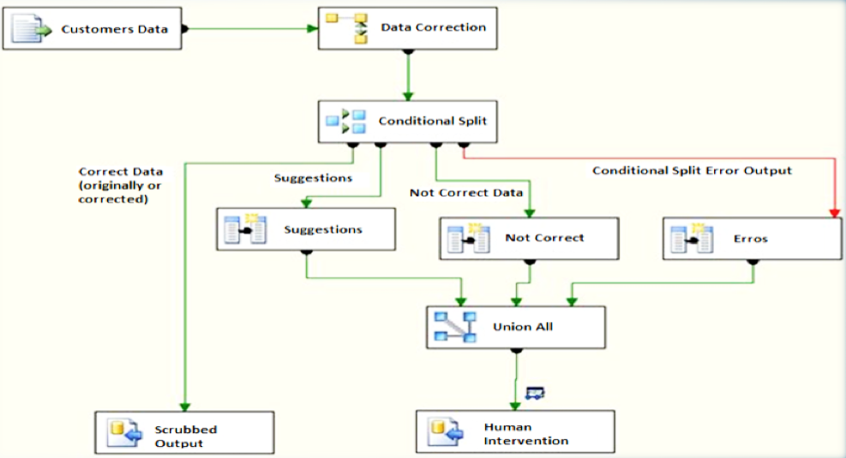
Batch Cleansing - Using SSIS
SSIS Data Flow
Reference Data Services
DQS Server
New Records
Knowledge Base
SSIS Package
Corrections & Suggestions
Values/Rules
Source + Mapping
Data correction
Component
Destination
Reference Data Definition
Correct Records
Invalid Records
Microsoft Confidential—Preliminary Information Subject to Change

Slide 17
DQS Demo 3 - Matching
Elad Ziklik
Principal Group Program Manager
Data Quality Services
demo

Slide 18


Matching
Microsoft Corporation, Bill gates,
1 Microsoft way, Redmond, WA, 98052
Microsoft, Gates, One Microsoft way, Redmond WA
Microsoft Corp, William Henry Gates, 1 Microsfot way, Redmond, WA
Microsfot, W. H. Gates, Redmond, WA
Why Match?
  Identify duplicates within the data source
  Create consolidated view of data
DQS Matching
  Build a matching policy
  Matching training
  Create a matching project
  Choose survivors
DQ Client – Match Results

Slide 19



DQS – Value Proposition Summary
Knowledge-driven
Easy To Use
Open & Extendible
Focus on cloud-based Reference Data
User-generated knowledge
Integration with SSIS
Rich Knowledge Base
Continuous improvement
and knowledge acquisition
Build once, reuse for
multiple DQ improvements
Focus on productivity and
user experience
Designed for business users
Out-of-the-box knowledge

Slide 20



What’s Next?
Follow, Tweet and Enter to
win an Xbox Kinect Bundle
GAME ON! Join us at the top
of every hour at the BI booth to
compete in the Crescent Puzzle
Challenge and Win Prizes
Sign up to be notified when
the next CTP is available
at: microsoft.com/sqlserver
Join the Conversation
@MicrosoftBI
/MicrosoftBI
Notes:
Follow @MicrosoftBI and tweet your thoughts on the session, visit the Business Intelligence kiosk to show your tweet and enter for your chance to win 1 of 2 Xbox Kinect Bundles!

Slide 21





Resources
  Connect. Share. Discuss.
http://northamerica.msteched.com
Learning
  Sessions On-Demand & Community
  Microsoft Certification & Training Resources
www.microsoft.com/teched
www.microsoft.com/learning
  Resources for IT Professionals
  Resources for Developers
http://microsoft.com/technet
http://microsoft.com/msdn

Slide 22











Complete an evaluation on CommNet and
enter to win!

Slide 23

Notes:
New for TechEd 2011, we will be working with Microsoft Tag (http://tag.microsoft.com/overview.aspx) to create unique Tags for every session at the event. Your session Tag will appear on both the room signage and at the end of your presentation. With your session Tag, attendees will be able to scan as they enter the room to retrieve session details, view speaker bios, and engage in discussions; or scan at the end of the presentation to evaluate your session and download materials. We’re excited to integrate Microsoft Tag across the My TechEd mobile experience this year.

Slide 24

© 2011 Microsoft Corporation. All rights reserved. Microsoft, Windows, Windows Vista and other product names are or may be registered trademarks and/or trademarks in the U.S. and/or other countries.
The information herein is for informational purposes only and represents the current view of Microsoft Corporation as of the date of this presentation. Because Microsoft must respond to changing market conditions, it should not be interpreted to be a commitment
on the part of Microsoft, and Microsoft cannot guarantee the accuracy of any information provided after the date of this presentation. MICROSOFT MAKES NO WARRANTIES, EXPRESS, IMPLIED OR STATUTORY, AS TO THE INFORMATION IN THIS PRESENTATION.

