Slide 1

Managing Master Data with MDS and Microsoft Excel
DBI204
John McAllister
Principal Program Manager
Microsoft

Slide 2
Session Objectives
Up-to-speed on Master Data Services (MDS)
Demonstrate MDS with Excel
Help you fix data in your organization

Slide 3
Is there a problem?
Incorrect reports
Informal systems
No process

Slide 4
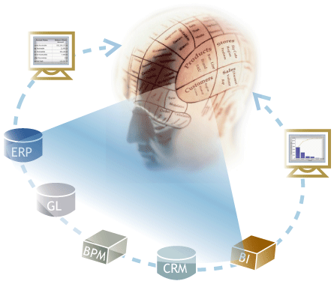
Where does data come from?
Systems
Processes
External Sources
People?

Slide 5

Definitions
Master Data Management (MDM)
Worth managing
Objects, not transactions
Granularity varies by role
Shareable
Master Data Services (MDS)

Slide 6
MDS - Typical Solutions & Scenarios
Multiple sources cause confusion
  Map data with MDS
Inconsistent identifiers break reports and processes
  Manage reference lists with MDS
Dimensions need constant maintenance
  Business users manage dimensions with MDS

Slide 7
SQL Server Master Data Services
Store
Integrate & Share
Enable Processes
Identity, Attributes, Hierarchies
WCF API
Stewardship UI
Excel UI
Secure by role
Tables & Views
Data Quality
Validation & Versions
Manage Transactions – Annotate & Review
Notifications & Workflows
Web UI to model, administer, manage security, write rules, manage integration.

Slide 8
MDS Architecture
WEB-UI
Excel Add-In
Workflow/
Notifications
IIS Service
External Systems
WCF
MDS Service
BizTalk/
.NET
MDS Database
Subscribing
Systems
Subscription Views
Staging Tables
DQS (Cleansing & Matching)
SSIS
SSIS

Slide 9
SQL Server Master Data Services
Application and managed database stores master data
WCF APIs for all operations (programmability)
Web UI to manage the model (schema) and data
Validation rules and versioning
Table & View bulk integration
Email notifications & SharePoint workflows

Slide 10
Denali Adds
Improved Web UI
Excel Add-in
  Easier data updates and management
  Simplified data model creation
  Integration with Data Quality (DQS)
New staging interface (Entity Based Staging)
Improved quality (usability, robustness, security, scale, performance)

Slide 11
What does Excel have to do with Data Management?

Slide 12
Three Excel Usage Patterns
Powerful Data Steward
  Creates and Edits large amounts of data
  Needs a flexible UI, derives values with complex formulas
  Comfortable working in Excel and likes to stay there
The MDS Practitioner
  Doesn’t need Excel, but welcomes the ability to quickly create a model and load data
The MDM Neophyte and Data Steward
  Able to build a simple model quickly

Slide 13
Demo Background
Data Steward Experience
  Working in Excel to Manage Data
Modeler Experience
  Working in Excel and MDS to build a model and load data

Slide 14
Demo – Premise and Data
Managing a list of 1000 locations
Data is consumed in Excel and shared in spreadsheets
A few experts really know the locations

Slide 15
The MDS Excel Add-in
John McAllister
Principal Program Manager
demo

Slide 16
Recap
The new Excel Add-in in SQL Server Denali will make it even easier to enable teams in your organization to manage their important data assets
Download The Next CTP to learn more

Slide 17
Q & A

Slide 18

© 2011 Microsoft Corporation. All rights reserved. Microsoft, Windows, Windows Vista and other product names are or may be registered trademarks and/or trademarks in the U.S. and/or other countries.
The information herein is for informational purposes only and represents the current view of Microsoft Corporation as of the date of this presentation. Because Microsoft must respond to changing market conditions, it should not be interpreted to be a commitment
on the part of Microsoft, and Microsoft cannot guarantee the accuracy of any information provided after the date of this presentation. MICROSOFT MAKES NO WARRANTIES, EXPRESS, IMPLIED OR STATUTORY, AS TO THE INFORMATION IN THIS PRESENTATION.

Slide 19
Appendix
The following slides are the “standard” MDS Denali deck and contain more detail than the TechEd presentation

Slide 20
MDS in Denali

Slide 21
What is Master Data?
  Data that is worth managing for its consumer
  About the objects that are the focus of organizational activity
  (Customers, Products, Cost Centers, Locations, Assets, Tasks …)
  Exists in different forms at each level of the organization (team, department, division, enterprise Or marketing, finance, operations )
    The requirements of a product model can vary between org levels
    Different object types are more specific to certain org levels
  Characteristics
    Relatively slowly changing
    Shared (multiple contributors and consumers)
    Objects of the transactions rather than transactional data
MDS enable users to manage Lists of Objects. This capability is powerful in a wide variety of scenarios across all the organization levels.

Slide 22
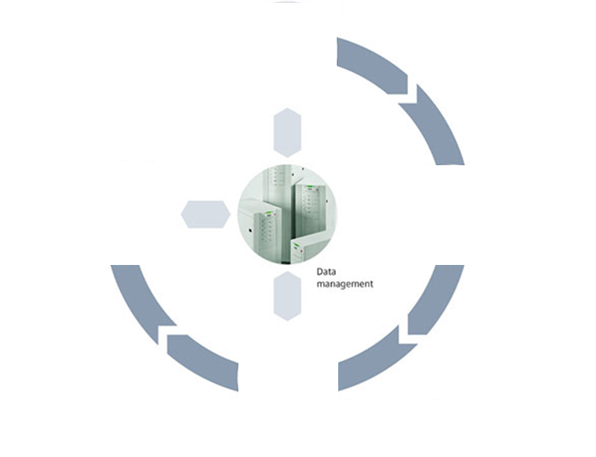
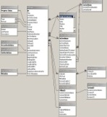


Challenges
Data is inaccurate
Data is incomplete
Schema is not aligned
Inaccurate analysis, reports, conclusions
High operation costs
Find and
Adapt Data
Notify
Store and Improve
Quality
Manage/ Control
the Data
Updating the data and relations between objects require lengthy IT involvement
Difficulty in managing access and security hinders collaboration (encourages silos)
In lack of business validation changes are prone to errors
Difficulty to track business changes
Apps / Users need to be aware of data or metadata changes

Slide 23
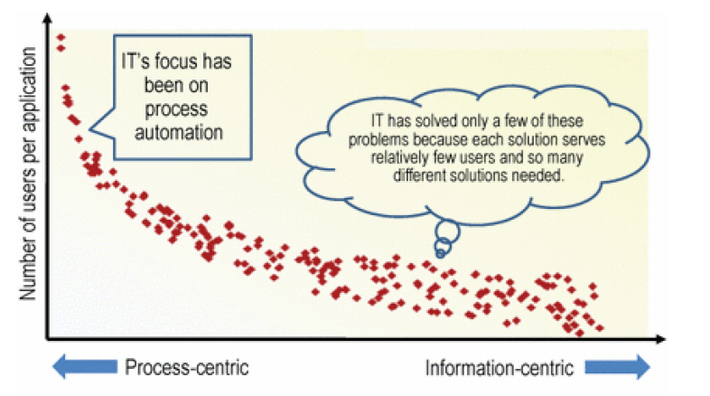
End Effect of Challenges
  IT struggles to support a few high-profile enterprise data management needs, while
  A large base of data experts/ analysts in org are underserved (as a result work offline in tools like Excel)
Gartner Oct. 2010
  Strong push for
  Self-Service of Data Management by Data Experts / Analysts

Slide 24

Scenarios
A company has adopted 6 “best of breed” systems from different vendors. They need to be able to propagate the correct customer information to each system in a consistent way.
MDS provides a platform providing central schema, integration points and validation for SI/ISV/Internal IT to develop a custom solution
A company receives frequent sales data from multiple retailers with incompatible identifiers. The producer needs to map all these identifiers to a single identity.
With MDS, business users can now make these changes directly in data without modifying ETL processes.
Data Management Applications
Data Warehouse / Data Marts Mgmt
Operational Data
Management
Provides storage and management of the data and metadata used as the application knowledge
Object mappings
Reference Data / managed lists
Metadata management / data dictionary
Enable business users to manage the dimensions and hierarchies of the Data Warehouse / Data mart in a controlled way
Integration between operational system
A clothing manufacturer has a catalog containing 100s of properties about their products (material, shape, color, size…). Data fed into the catalog is incomplete and is at varying levels of granularity and classification.
MDS enable them to create and maintain a central repository for the catalog, where people can securely contribute and modify content and structure without IT assistance or code changes..
The IT department has built a data warehouse and reporting platform, but business users complain about the correctness of the dimensions and lack of agility in making updates
MDS empowers the business users to manage dimensions directly while IT can govern the changes.
An IT department has databases with 100’s of tables and 1000’s of distinct columns.
Keeping track of the purpose and usage of each system over time is a nightmare.
MDS provides them an easy human interface to enable adding information about the usage, source systems, and meaning of each column.
Enable Partners
MDS focus

Slide 25

MDS Value and Approach
Value
MDS enforces processes and validation rules that ensure data is correct eliminating otherwise required manual processes
MDS enables direct editing and managing the data enabling rapid insight and the ability to change or augment rules / analytics
MDS decreases the risk and costs of upgrades, migrations, and consolidations by identifying, mastering, and extending critical business entities
MDS enables business users to build their own simple solutions directly from Excel which reduces IT cost
Approach
Start by addressing islands of problems within the org – bottoms up approach (analogy Data Marts vs Data Warehouses)
Empower IWs through Self-Service: Enable end users to create and modify the data in a controlled and secure way
Ease Admins tasks
    Simple deployment
    Easy to define and manage data models

Slide 26
MDS Value and Approach
Value
MDS enforces processes and validation rules that ensure data is correct eliminating otherwise required manual processes
MDS enables direct editing and managing the data enabling rapid insight and the ability to change or augment rules / analytics
MDS decreases the risk and costs of upgrades, migrations, and consolidations by identifying, mastering, and extending critical business entities
MDS enables business users to build their own simple solutions directly from
Excel which reduces IT cost
Approach
Start by addressing islands of problems within the org – bottoms up approach (analogy Data Marts vs Data Warehouses)
Empower IWs through Self-Service: Enable end users to create and modify the data in a controlled and secure way
Ease Admins tasks
    Simple deployment
    Easy to define and manage data models

Slide 27
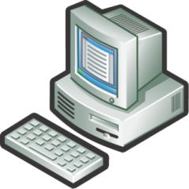







MDS Capabilities
Validation
Authoring business rules to ensure data correctness
Modeling
Entities, Attributes, Hierarchies
MDS
Excel Add-In
Web UI
Data Cleansing and Matching
Role-based Security and Transaction Annotation
Master Data Stewardship
Versioning
Integrate & Share
Loading batched data through Staging Tables
Registering to changes through APIs
Consuming data through Views
Workflow / Notifications
DWH
Excel
External
(CRM, …)

Slide 28
MDS Architecture

Slide 29
SQL 11 Focus
Focus on Foundational Platform
V1 product
Empowering IW through Excel Add-in and improved Web UI
- Ease of updating / managing the data
- Simplify the data model creation
- Sharing with others
Integration with Data Quality (DQS)
Enhanced performance
- New staging interface (Entity Based Staging)
- Highly scalable
Improved quality (usability, robustness, security)
SQL 11
SQL 2008R2

Slide 30



What’s Next?
Follow, Tweet and Enter to
win an Xbox Kinect Bundle
GAME ON! Join us at the top
of every hour at the BI booth to
compete in the Crescent Puzzle
Challenge and Win Prizes
Sign up to be notified when
the next CTP is available
at: microsoft.com/sqlserver
Join the Conversation
@MicrosoftBI
/MicrosoftBI

Slide 31





Resources
  Connect. Share. Discuss.
http://northamerica.msteched.com
Learning
  Sessions On-Demand & Community
  Microsoft Certification & Training Resources
www.microsoft.com/teched
www.microsoft.com/learning
  Resources for IT Professionals
  Resources for Developers
http://microsoft.com/technet
http://microsoft.com/msdn

Slide 32











Complete an evaluation on CommNet and
enter to win!

Slide 33


Slide 34
© 2011 Microsoft Corporation. All rights reserved. Microsoft, Windows, Windows Vista and other product names are or may be registered trademarks and/or trademarks in the U.S. and/or other countries.
The information herein is for informational purposes only and represents the current view of Microsoft Corporation as of the date of this presentation. Because Microsoft must respond to changing market conditions, it should not be interpreted to be a commitment
on the part of Microsoft, and Microsoft cannot guarantee the accuracy of any information provided after the date of this presentation. MICROSOFT MAKES NO WARRANTIES, EXPRESS, IMPLIED OR STATUTORY, AS TO THE INFORMATION IN THIS PRESENTATION.

