Slide 1

Ten Must-Have Tools for Windows Azure
COS210
Brian H. Prince
Developer Evangelist
Microsoft

Slide 2

Brian H. Prince
Architect Evangelist
Microsoft blog. www.brianHprince.com twitter.
@brianHprince email.
Brian.Prince@microsoft.com

Slide 3
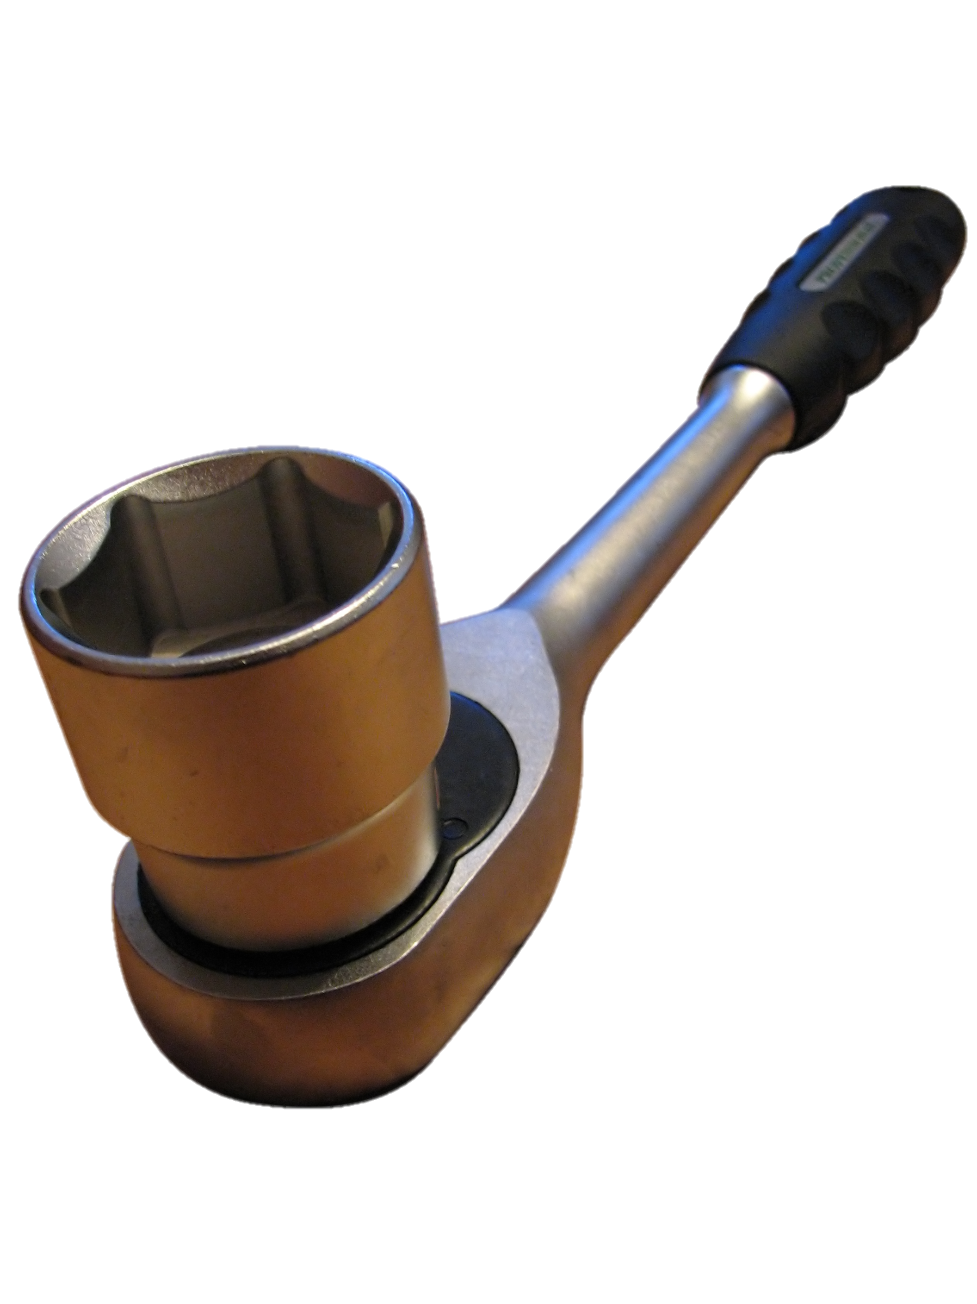
We all need tools

Slide 4

Only write the code that only you can write

Slide 5

Goal
Look for tools that have a material impact. Some are commercial, some are open source.
10 is a lie.
Will look only at tools outside of Microsoft.
Source credit: marfis75 on flickr - http://www.flickr.com/photos/marfis75/3244951558/

Slide 6
Tool Categories
Management
Debugging
Deployment

Slide 7
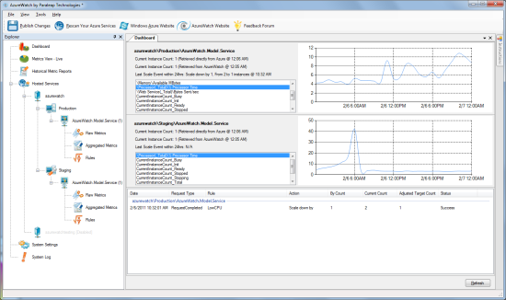
0. AzureWatch
Configure to watch your instances
Autoscale your app
Rule based
Email Alerts
Runs in your environment, or in the cloud
$ 1.375 cents/instance/hour
http://azurewatch.net/

Slide 8
Configuring AzureWatch
demo

Slide 9

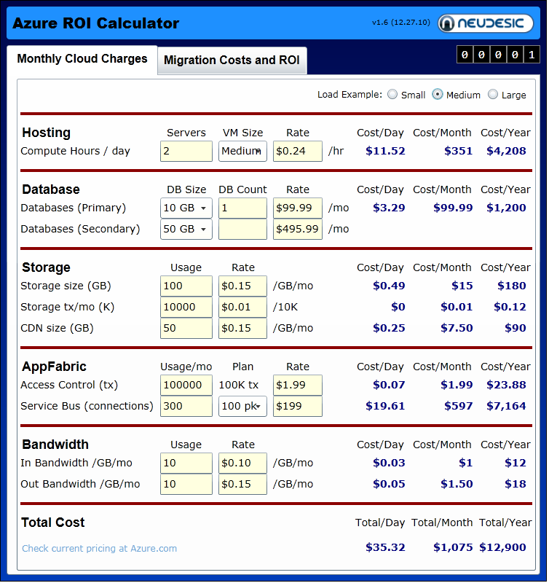
Return on
Investment
How much will it save us?
How much will the cloud cost?
Alternate: Official ROI Tool - WindowsAzure.com
$ Free
http://azureroi.cloudapp.net/

Slide 10
Using the ROI Tool
demo

Slide 11

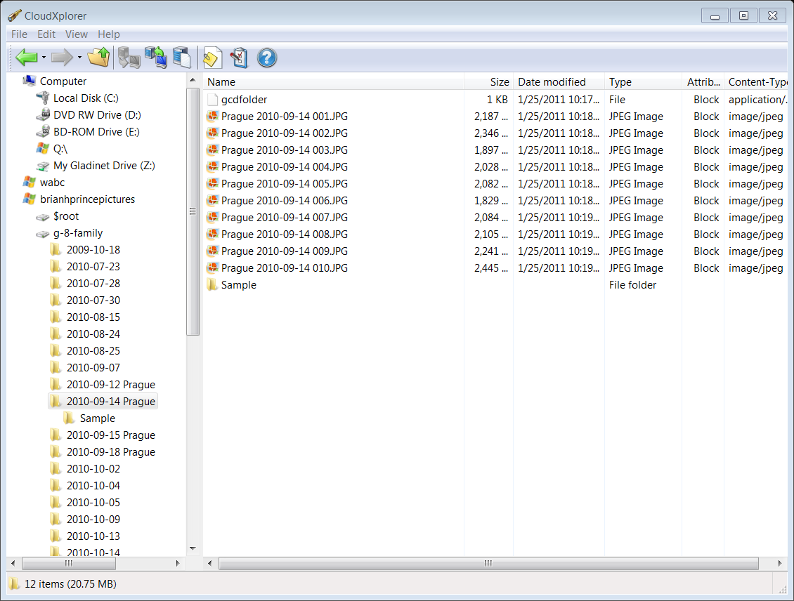
ClumsyLeaf : CloudXplorer
Client for Windows Azure Storage
Manages multiple storage accounts
Updated often
Copy, move, delete, rename file
Supports $root
Auto resume uploads
Create Shared Access Signatures
Alternate: Cloud Storage Studio
www.cerebrata.com
$free
http://www.clumsyleaf.com/

Slide 12
Looking at your storage account
demo

Slide 13

2. Cerebrata : PowerShell cmdlets
Sophisticated scripts to accelerate your development
Great for management and deployment automation
PowerShell can be called from .NET easily
New-HostedService / Remove / Update
Restart-Role / Restore-Role
Scripts to backup\restore SQL Azure Databases
Backup / restore Blob containers
Manage affinity groups
Manage and configure diagnostics
Alternate: Windows Azure Cmdlets archive.msdn.microsoft.com/azurecmdlets
$69.99
http://www.cerebrata.com/

Slide 14

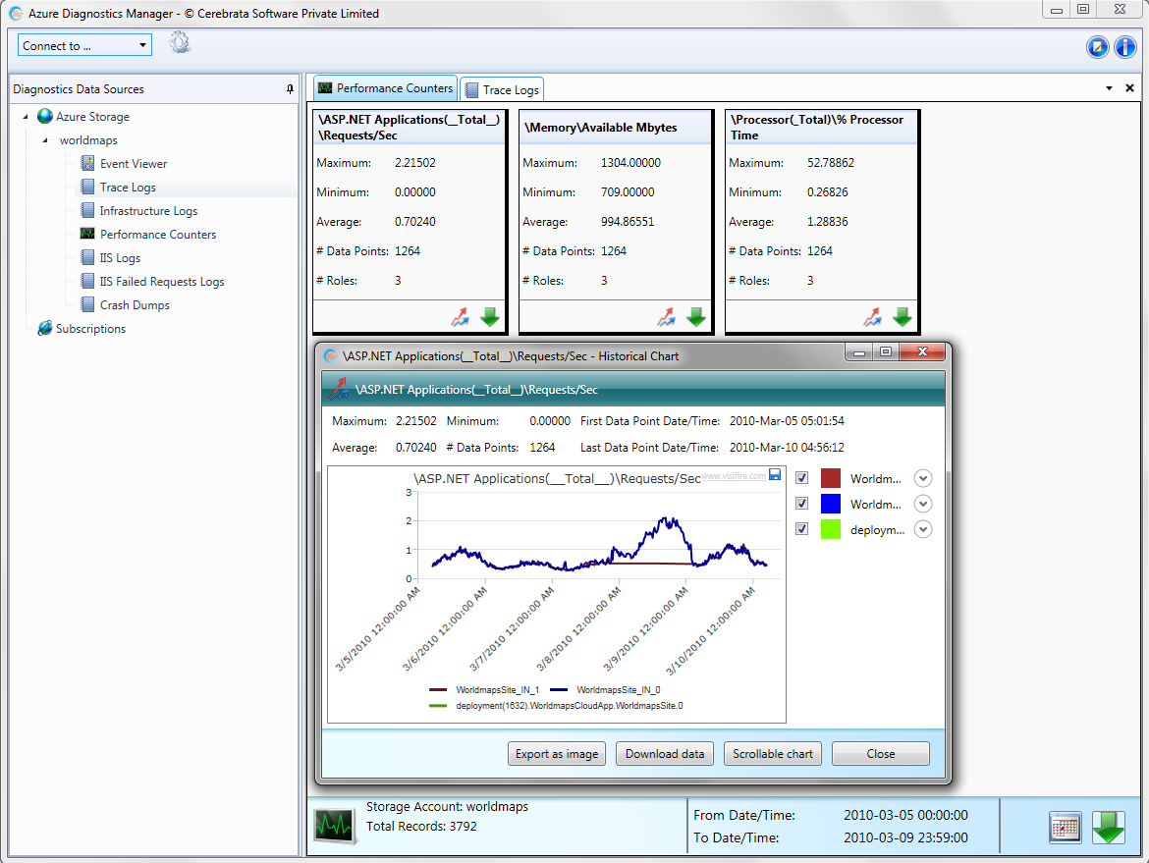
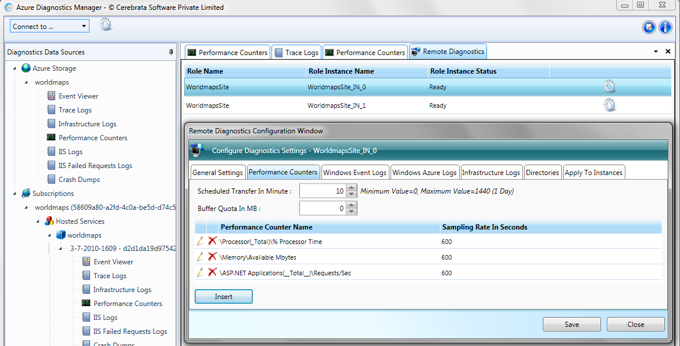
3. Cerebrata : Diag tool
Makes it easy to configure and monitor diagnostics without code
Alternate: Windows Azure MMC Snapin
archive.msdn.microsoft.com/windowsazuremmc
$69.99
http://www.cerebrata.com/

Slide 15
How to easily work with Diagnostics
demo

Slide 16

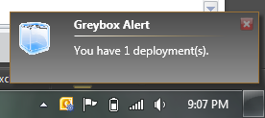
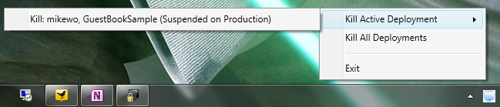
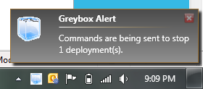
4. Greybox
- Easily monitor the status of your Windows Azure Subscriptions
- Make sure you don’t leave a demo up and running
-Avoid burning your free hours
- Monitors
compute usage only
$ Free
http://greybox.codeplex.com
Source credit: Lance McCord on flickr - http://www.flickr.com/photos/mccord/529136871/

Slide 17
Cost Limiting with GrayBox
demo

Slide 18

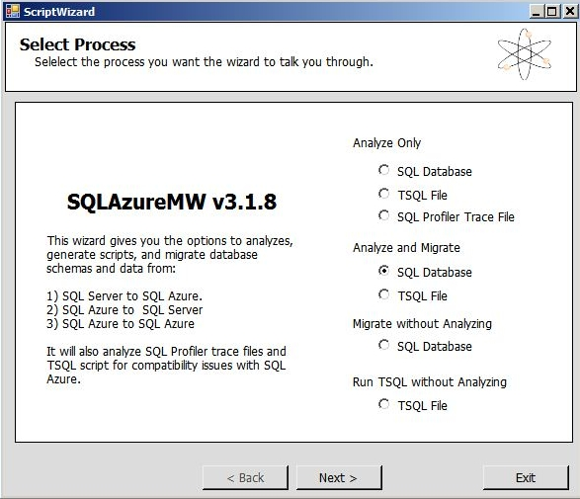
5. SQL Azure
Migration Wizard
Analyze DB
Fix Schema
Create DB
Upload Data
$ Free
http://sqlazuremw.codeplex.com
Source credit: Purple Phoenix on flickr - http://www.flickr.com/photos/purplephoenix/4538022903/

Slide 19

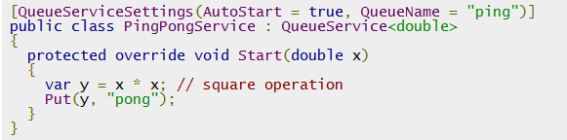
6. Lokad Cloud - .NET O/C Mapper
Object to Cloud Mapper with many tools in the box
  Provides strongly typed interface to BLOB storage
  Easy chunky entity storage in Table storage
  QueueService makes Queues easier to work with
  Simplified auto-scaling
  Task scheduler
  Any many more…
$ Free
http://lokadcloud.codeplex.com/

Slide 20

7. Multitenant Web Role
Easily host multiple web applications in a web role without the deployment problems.
Scales really well.
When an instance is restarted, it re-loads from BLOB storage.
ttp://azuretoolkit.codeplex.com/releases/view/62330

Slide 21





How does it work?
BLOB
Storage
Role Instance
IIS
Local storage

Slide 22
Deploy a web site in minutes
demo

Slide 23

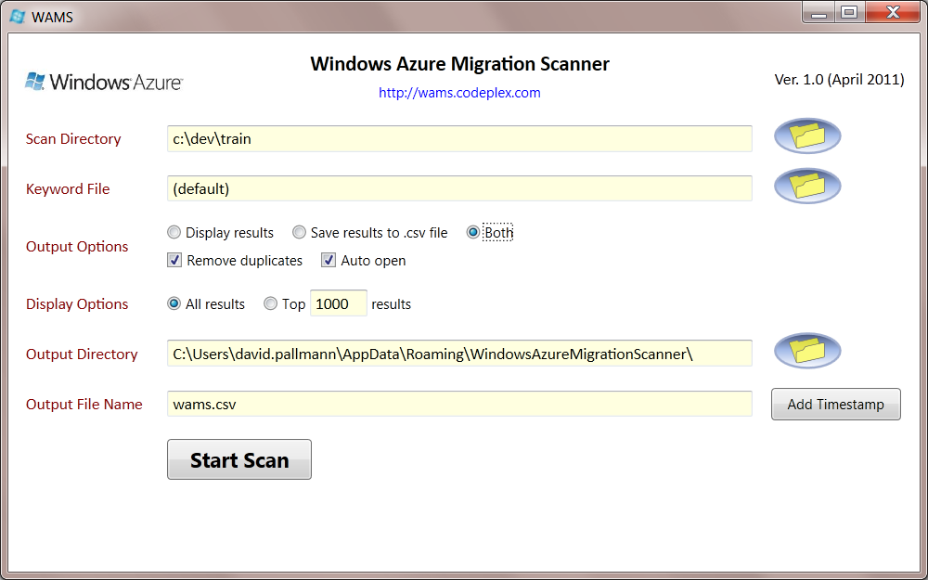
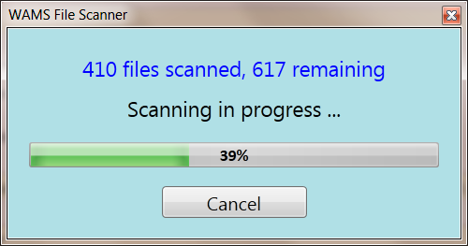
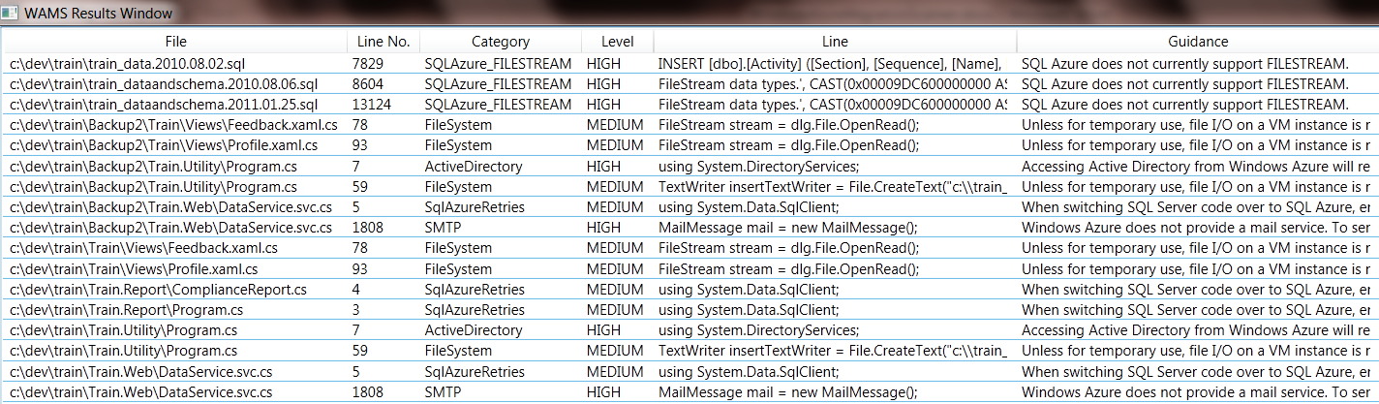
8. Windows Azure Migration Scanner
FXcop for Windows Azure
Scans an app to determine cloud migration fitness
Rules Based

Slide 24
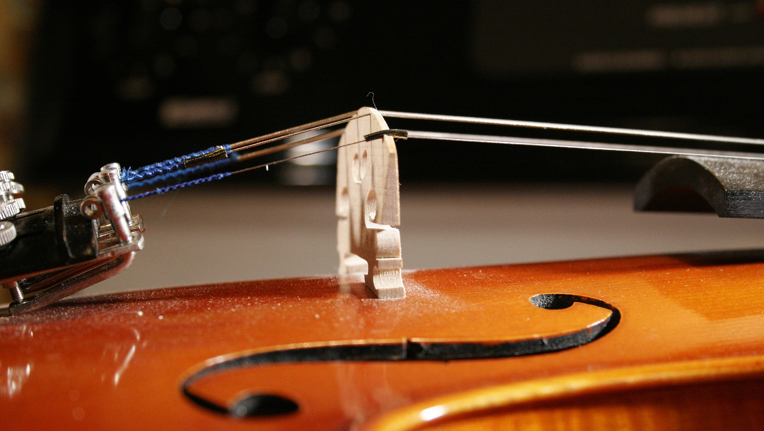
9. Fiddler
http://www.fiddler2.com
Local HTTP Proxy
No need to change how your code works
Tacks all HTTP traffic so you can inspect it

Slide 25
Peeping in on HTTP with Fiddler
demo

Slide 26





Resources
  Connect. Share. Discuss.
http://northamerica.msteched.com
Learning
  Sessions On-Demand & Community
  Microsoft Certification & Training Resources
www.microsoft.com/teched
www.microsoft.com/learning
  Resources for IT Professionals
  Resources for Developers
http://microsoft.com/technet
http://microsoft.com/msdn

Slide 27












Required Slide
Complete an evaluation on CommNet and
enter to win!

Slide 28

© 2011 Microsoft Corporation. All rights reserved. Microsoft, Windows, Windows Vista and other product names are or may be registered trademarks and/or trademarks in the U.S. and/or other countries.
The information herein is for informational purposes only and represents the current view of Microsoft Corporation as of the date of this presentation. Because Microsoft must respond to changing market conditions, it should not be interpreted to be a commitment
on the part of Microsoft, and Microsoft cannot guarantee the accuracy of any information provided after the date of this presentation. MICROSOFT MAKES NO WARRANTIES, EXPRESS, IMPLIED OR STATUTORY, AS TO THE INFORMATION IN THIS PRESENTATION.

