Slide 2
What’s new for Silverlight & XNA developers in Windows Phone Mango
SESSION CODE: WPH304
Chris Walsh
@ChrisWalshie
blog.walshie.me

Slide 3
Which is right for me?
Browser, Maps control
Graphics, pick a technology
XNA
GPU Accelerated
Very low level
Silverlight
XAML markup
Controls & User Friendly

Slide 4
What you have now
Silverlight
XNA
Controls
Retained Mode
Declarative XAML
GPU Accelerated
Immediate Mode

Slide 5
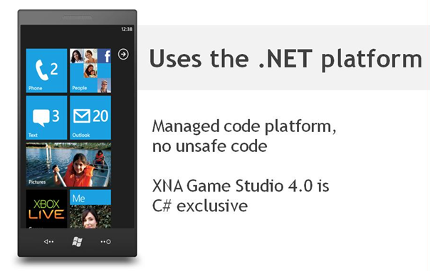
What is XNA?

Slide 6
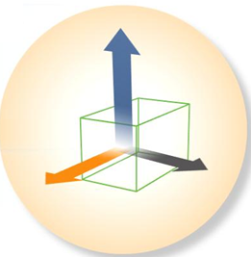
What is XNA?
Create your game without having to worry about orientation or resolution
Automatic scaling
Hardware accelerated
It’s “free”

Slide 7
The Game Loop
private void OnUpdate(object sender, GameTimerEventArgs e)
{
}
private void OnDraw(object sender, GameTimerEventArgs e)
{
SharedGraphicsDeviceManager.Current.GraphicsDevice.Clear(Color.CornflowerBlue);
}

Slide 8
The Game Loop
Two game options
Fixed-Step Loops (default)
Variable Step Loops

Slide 9
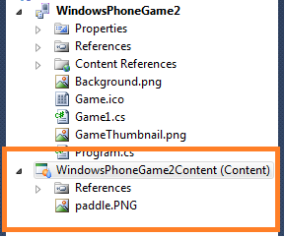
Content Pipeline

Slide 10
Content Pipeline demo

Slide 11
XNA Shared Graphics
XNA Rendering takes over
Graphics operations valid when shared rendering enabled
SetSharingMode(bool IsEnabled)
Silverlight model
Application class
PhoneAppPage with default navigation
XNA 3D graphics within your APP!!!

Slide 12
XNA Shared Graphics
GPU resource management
Silverlight releases resources when using XNA
Maximize free memory by minimizing repeat loading of content
XNA API’s allow manual resource management
XNA SharedGraphicsDeviceManager
Uses Direct3D device sharing with Silverlight

Slide 13
XNA Shared Graphics Demo

Slide 14
But what about the “Game” type
New GameTimer type for events
XNA.Framework.Game
Game “Heartbeat” methods
Application lifetime events (from Silverlight)
Content Manager

Slide 15
What’s changed?
public sealed class GameTimer : IDisposable
{
public GameTimer();
public event EventHandler<GameTimerEventArgs> Draw;
public event EventHandler<EventArgs> FrameAction;
public event EventHandler<GameTimerEventArgs> Update;
public int FrameActionOrder { get; set; }
public TimeSpan UpdateInterval { get; set; }
public int UpdateOrder { get; set; }
public int DrawOrder { get; set; }
public static void ResetElapsedTime();
public static void SuppressFrame();
public void Start();
public void Stop();
public void Dispose();
}
// A snapshot of the game timing state.
// The values provided are solely based
// on game time and not real time.
public sealed class GameTimerEventArgs : EventArgs
{
//…
public TimeSpan ElapsedTime { get; internal set;
public bool IsRunningSlowly { get; internal set;
public TimeSpan TotalTime { get; internal set; }
}

Slide 16
Can I use them together?

Slide 17
UIElementRenderer
Silverlight App Page still active when using XNA Shared Rendering
UIElementRenderer renders a UIElement to a Texture2D
Use it how you want
Texture models
Billboards
UI, controls & input

Slide 18
UIElementRenderer uses
Per-frame targets
Draw entire page along with 3D rendering
Game score / Status Bar
Menu’s
Single-use targets
International text, where you want it
Effects & Transitions from Silverlight to XNA
Background image creation

Slide 19
Sockets!

Slide 20
Windows phone “mango” RTM’ed 27.07.2011!!!!
Get started now – http://create.msdn.com

Slide 21
Enrol in Microsoft Virtual Academy Today
Why Enroll, other than it being free?
The MVA helps improve your IT skill set and advance your career with a free, easy to access training portal that allows you to learn at your own pace, focusing on Microsoft technologies.
What Do I get for enrolment?
Free training to make you become the Cloud-Hero in my Organization
Help mastering your Training Path and get the recognition
Connect with other IT Pros and discuss The Cloud
Where do I Enrol?
www.microsoftvirtualacademy.com
Then tell us what you think. TellTheDean@microsoft.com

Slide 22
Resources
www.msteched.com/Australia
Sessions On-Demand & Community
www.microsoft.com/australia/learning
Microsoft Certification & Training Resources
http:// technet.microsoft.com/en-au
Resources for IT Professionals
http://msdn.microsoft.com/en-au
Resources for Developers

Slide 23
© 2010 Microsoft Corporation. All rights reserved. Microsoft, Windows, Windows Vista and other product names are or may be registered trademarks and/or trademarks in the U.S. and/or other countries.
The information herein is for informational purposes only and represents the current view of Microsoft Corporation as of the date of this presentation. Because Microsoft must respond to changing market conditions, it should not be interpreted to be a commitment on the part of Microsoft, and Microsoft cannot guarantee the accuracy of any information provided after the date of this presentation. MICROSOFT MAKES NO WARRANTIES, EXPRESS, IMPLIED OR STATUTORY, AS TO THE INFORMATION IN THIS PRESENTATION.

