Slide 2
New Windows phone “mango” application platform services
SESSION CODE: WPH304
Chris Walsh
@ChrisWalshie
blog.walshie.me

Slide 4
“iRevolutionary”

Slide 6
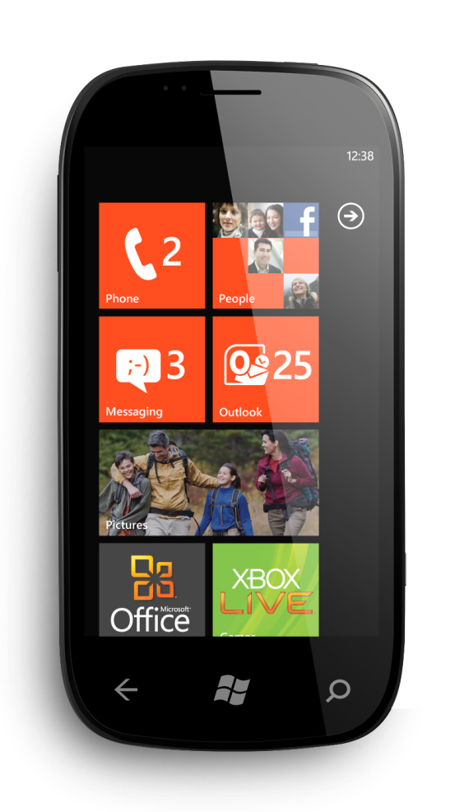

Slide 7
Agenda
Motion APIs & Camera
New Launchers & Choosers
Structured Data
Developer Tools Enhancements
New API’s
General Silverlight Goodness

Slide 8
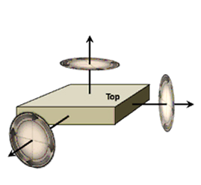
What Sensors are available
Gyro
Accelerometer
Compass

Slide 9
Sensors Demo

Slide 10
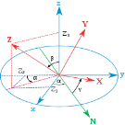
Motion Sensor
$$\left[\begin{matrix}\cos{γ.cos} α & −\cos{β}.\sin{α}+\sin{β}.\sin{γ.\cos{α}} & \sin{β}.\sin{α}+ \cos{β}.\sin{γ.\cos{α}} \\ \cos{γ.sin} α & \cos{β}.\cos{α}+\sin{β}.\sin{γ.\sin{α}} & −sin{β}.\cos{α}+ \cos{β}.\sin{γ.\sin{α}} \\ −\sin{γ} & \sin{β}.\cos{γ} & \cos{β}.\sin{γ}\end{matrix}\right]$$
Motion Sensor
Use this sensor whenever available

Slide 11
Sensor Availability
Physical hardware required for most debugging scenarios
Not all phones have all sensors
Gyro & Compass optional
Motion Sensor accuracy based on sensors present

Slide 12
Accessing the Camera
Silverlight 4 WebCam API
Taken from SL4 desktop API + added functionality
PhotoCamera Class
New Managed API

Slide 13
Camera Demo

Slide 14
Camera API Scenarios
Silverlight 4 WebCam
Reuse SL4 WebCam Knowledge
Easily Target Desktop and Phone
Record Video and Audio into a File
PhotoCamera
Take High Quality Photos
Handling Hardware Button
Handling Flash mode and Focus

Slide 15
Camera Specifics
Use Y or YUV format for proessing
Video output is MP4
ALWAYS check for device flash support.

Slide 16
Structured Data LINQ to SQL
Architecture
Code First
Create Context
Submit Transaction
Schema Upgradeable

Slide 17
Structured Data LINQ to User
Chooser Tasks
EmailAddressChooserTask
PhoneNumberChooserTask
AddressChooserTask
Microsoft.Phone.UserData (read only)
Contacts
Appoinments

Slide 18
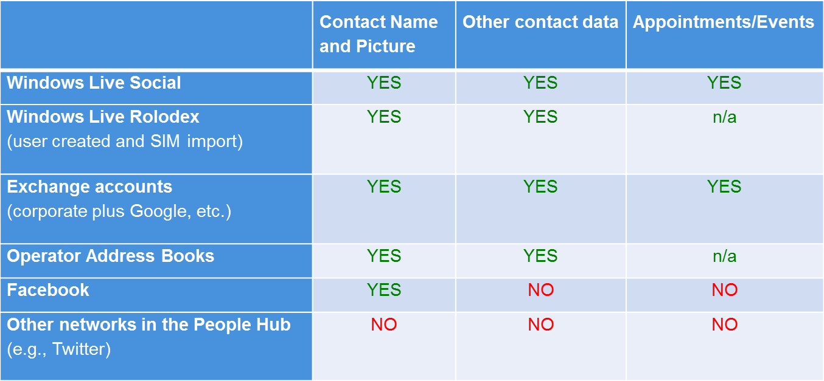
Shared Data Access

Slide 19
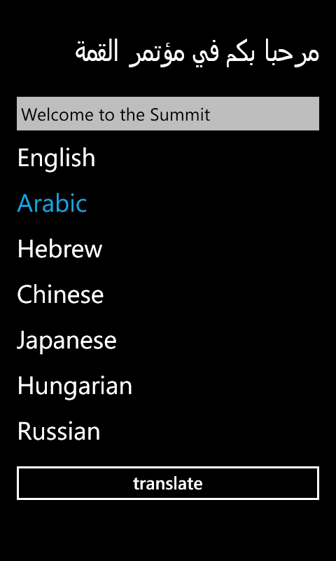
Silverlight Goodness text
Expanding with
international text
Supporting ALL languages
on the phone

Slide 20
Silverlight Goodness API
We’re now Silverlight 4
ImplictStyles
Binding enhancements
ICommand
Enhanced Text Stack Rendering
TextBox events
Touch
Tap, DoubleTap & Hold gestures

Slide 21
New Controls
Demo

Slide 22
Developer Tool Enhancements
Demo

Slide 23
Windows phone “mango” RTM’ed 27/07/2011!!!!
Get started now – http://create.msdn.com

Slide 24
Enrol in Microsoft Virtual Academy Today
Why Enroll, other than it being free?
The MVA helps improve your IT skill set and advance your career with a free, easy to access training portal that allows you to learn at your own pace, focusing on Microsoft technologies.
What Do I get for enrolment?
Free training to make you become the Cloud-Hero in my Organization
Help mastering your Training Path and get the recognition
Connect with other IT Pros and discuss The Cloud
Where do I Enrol?
www.microsoftvirtualacademy.com
Then tell us what you think. TellTheDean@microsoft.com

Slide 25
© 2010 Microsoft Corporation. All rights reserved. Microsoft, Windows, Windows Vista and other product names are or may be registered trademarks and/or trademarks in the U.S. and/or other countries.
The information herein is for informational purposes only and represents the current view of Microsoft Corporation as of the date of this presentation. Because Microsoft must respond to changing market conditions, it should not be interpreted to be a commitment on the part of Microsoft, and Microsoft cannot guarantee the accuracy of any information provided after the date of this presentation. MICROSOFT MAKES NO WARRANTIES, EXPRESS, IMPLIED OR STATUTORY, AS TO THE INFORMATION IN THIS PRESENTATION.

